Slide 1




Mathematical Models and Numerical Methods of Computational Neuroscience
計算神経科学の数学モデルと数値手法
Alan Fung
Neural Coding and Brain Computing Unit, OIST

Slide 2

Agenda
Brief introduction of Differential Equations
Neuronal Models
Numerical Method to Simulate Neuronal Models
How the Network can be trained

Slide 3

Ordinary Differential Equations
A fundamental tool in theoretical Science (Not only in Physics or Computational Neuroscience)
The differential equation gives the dependence of derivatives

Slide 4
Interpretation of Differential Equations
The first differential equation I have ever seen is the definition of velocity:
By definition,

Slide 5
Interpretation of Differential Equations
By knowing the slopes, one may trace the whole curve!
tells us the next point

Slide 6
Examples of Models and Theories
Simple Harmonic Oscillator
Heat Equation
Acceleration
Returning Force
Rate of Heat
Influx of Heat
(by Divergence Theorem)

Slide 7
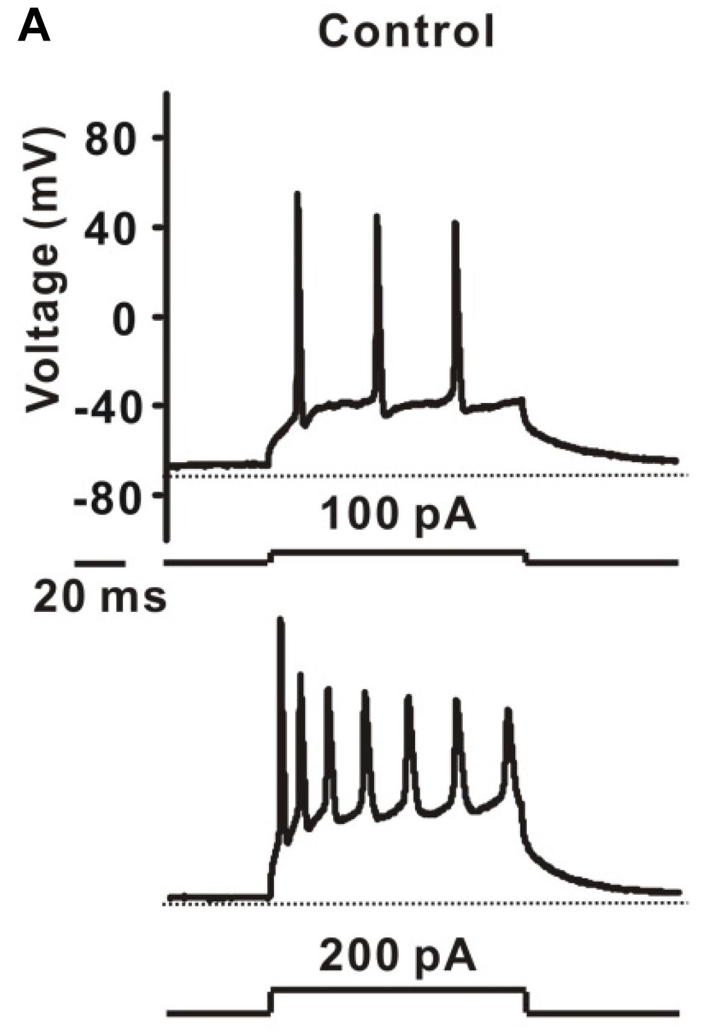

To Model a Neuron ...
Neurons can be excited by current injection
If the membrane potential is larger than some thresholds, an action potential will be triggered
A. D. Reyes, Nature (2019)
Z. Lin et al, Front. Pharmacol. (2019)

Slide 8
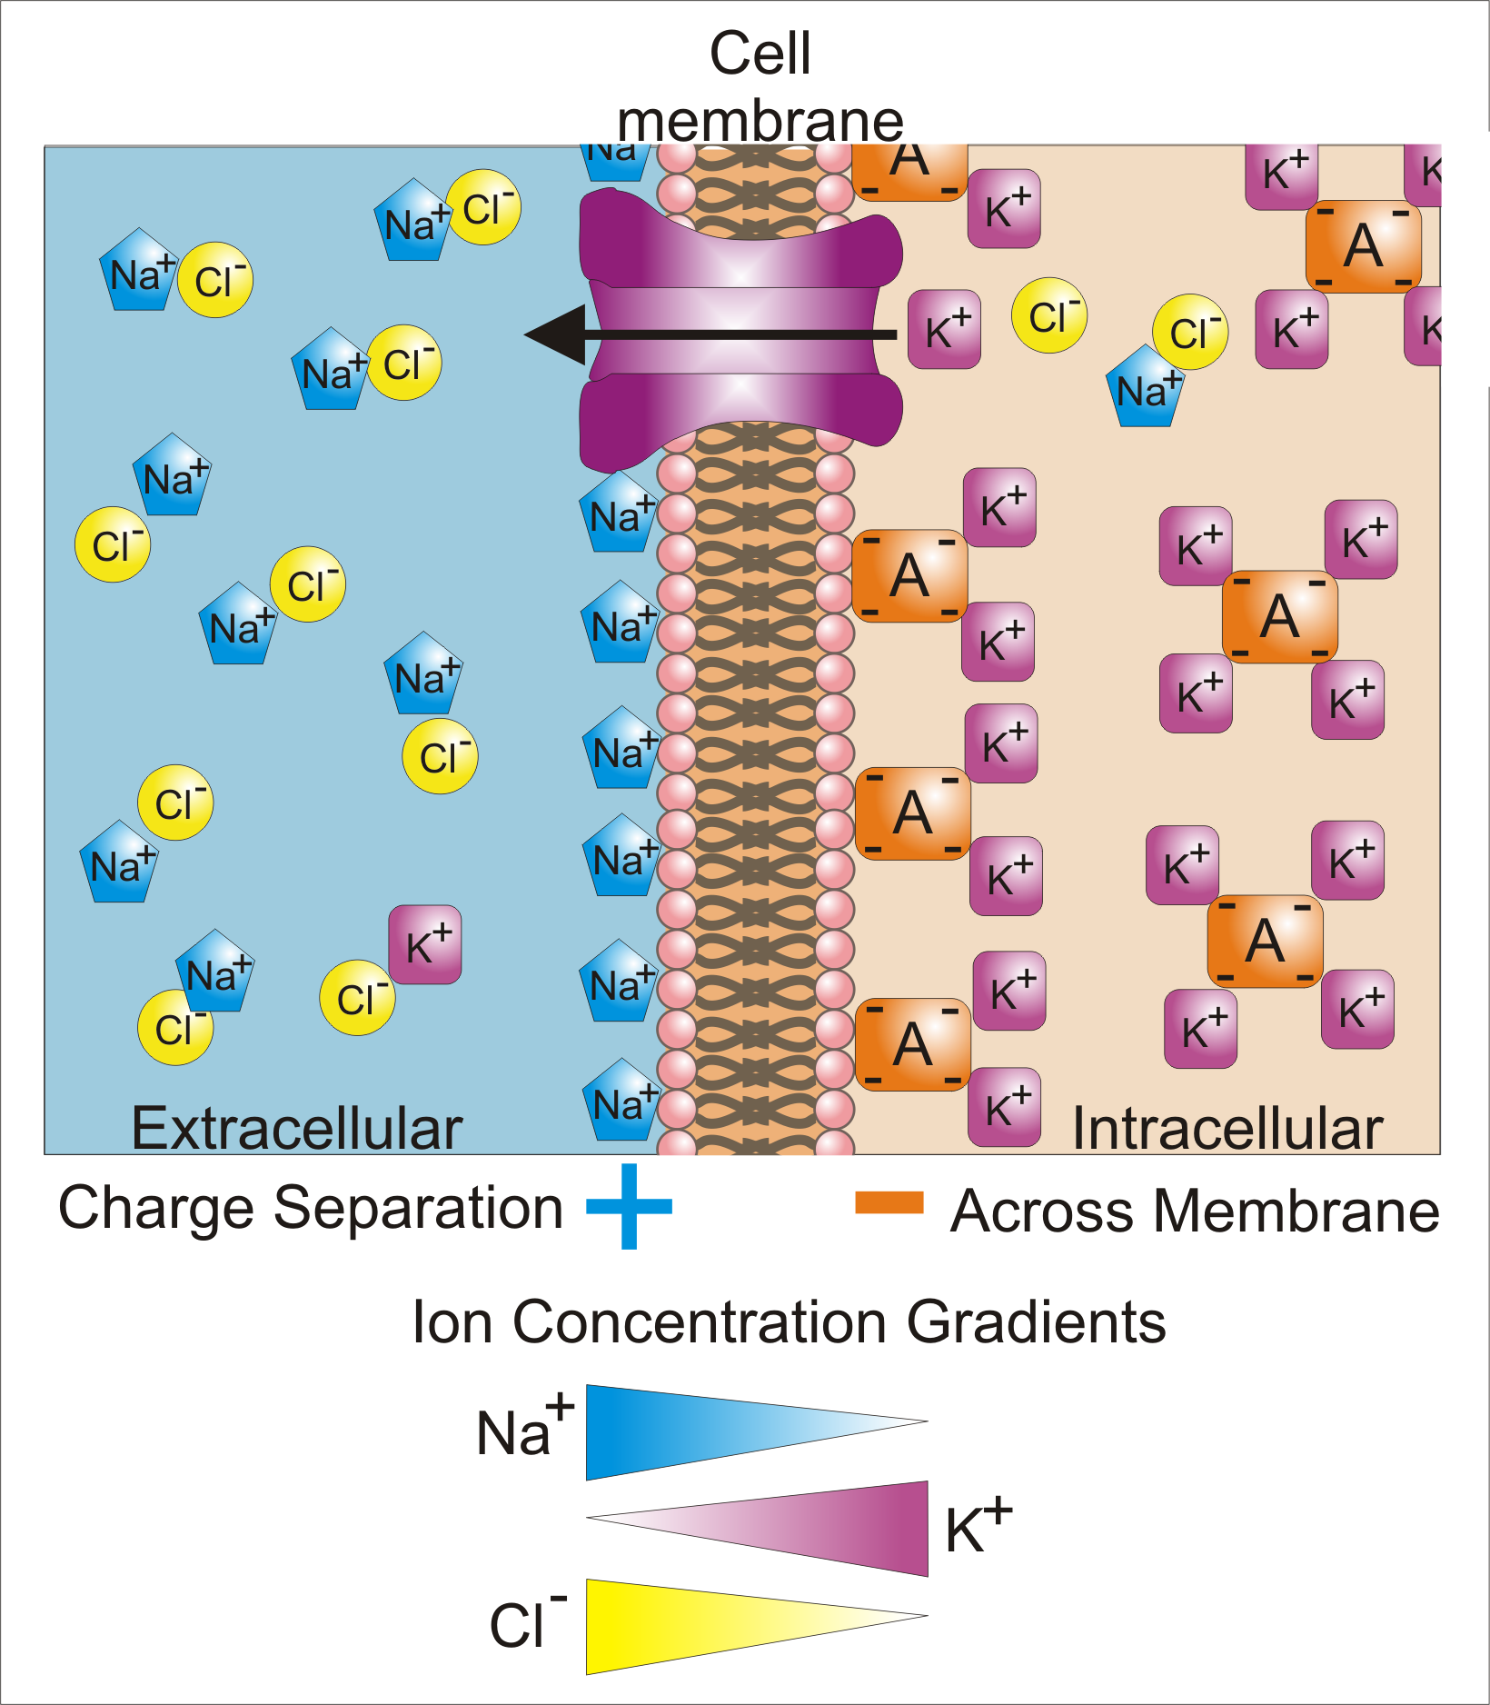
Membrane Potential
The voltage mentioned in the previous slide is the membrane potential
Membrane potential means the potential difference across the neuron membrane
By Synaptidude, CC BY 3.0, https://commons.wikimedia.org/w/index.php?curid=21460910

Slide 9
Membrane Potential
The membrane potential can be controlled by concentrations of ions
Living cells actively maintain the potential difference by their ion bumps
The typical resting potential difference is -65 mV
By Synaptidude, CC BY 3.0, https://commons.wikimedia.org/w/index.php?curid=21460910

Slide 10
Membrane Potential
Current Injection
By injecting current, the membrane potential can be changed
As the membrane potential large than the threshold, the neuron gives a spike
By Synaptidude, CC BY 3.0, https://commons.wikimedia.org/w/index.php?curid=21460910

Slide 11
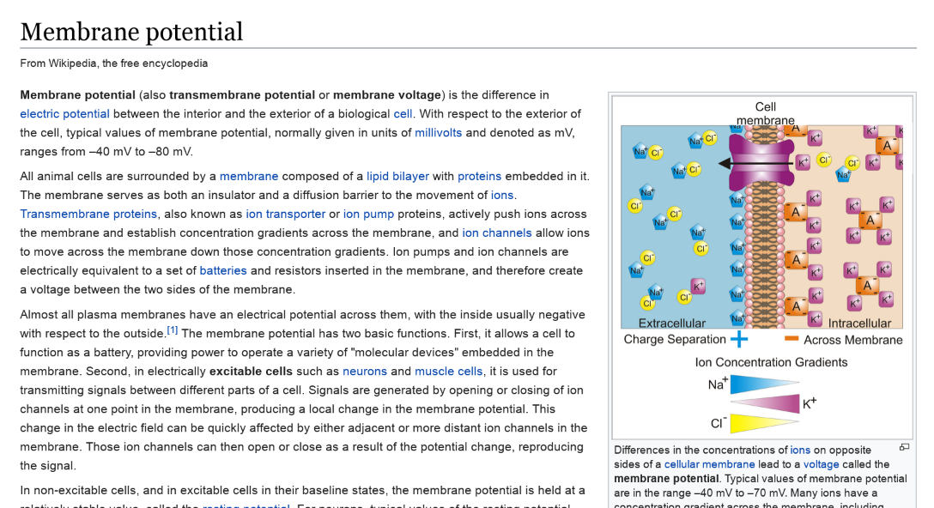
For More Knowledge about Membrane Potential

Slide 12
Membrane Works Like ...
By injecting current, the potential across membrane changes
As the potential across the threshold, the neuron fires
It works like a capacitor with a leaky current

Slide 13
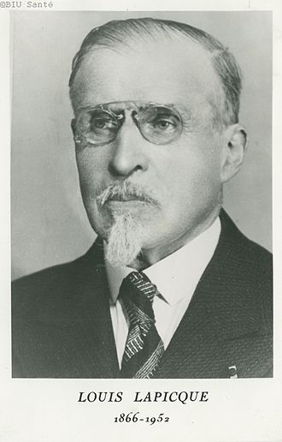
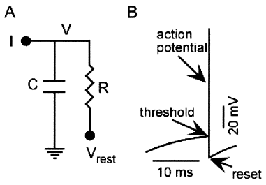
Leaky Integrate-and-Fire (LIF) Model
In 1907, Lapicque proposed a simple model for neurons
L. F. Abbott, Brain Research Bulletin (1999)

Slide 14
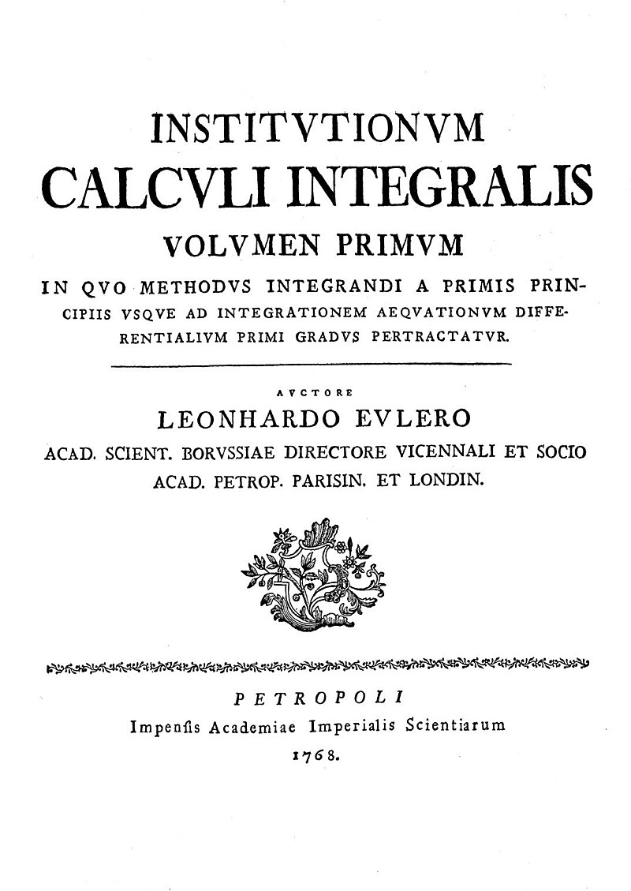
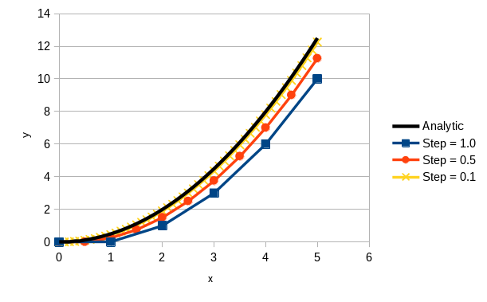
Euler Method
Demonstrated by Euler in 1768
Easy to understand, but the error could be big

Slide 15
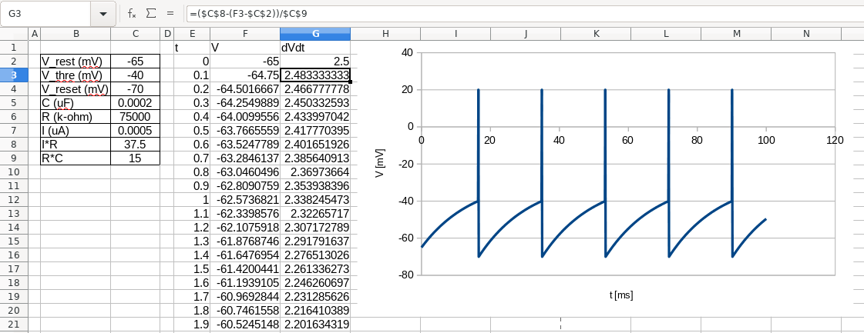
First Simulation (Numerically Solve the Differential Equation)
By calculating derivatives at t₀, one can estimate the voltage at t₀+Δt

Slide 16
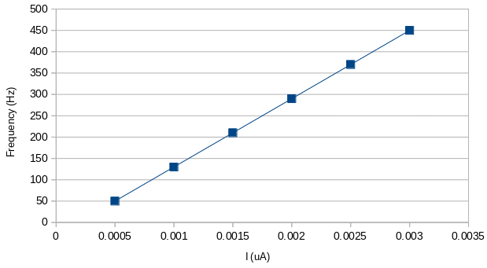
How Spiking Frequency Depends on Input Current
The LIF neuron fired more frequently as the input current increases
Gaston will tell you how to do it in Nest

Slide 17
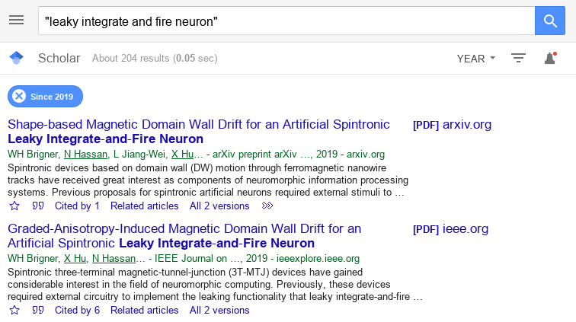

Studies Involving LIF Model
Last 10 Months, 204 papers
Last 4.83 Years, 1040 papers
There are ~200 paper talking about “leaky integrate and fire neuron” every year

Slide 18


Other Neuronal Models
Hodgkin–Huxley model
  Proposed by Hodgkin and Huxley in 1952
    They received the 1963 Nobel Prize in Physiology or Medicine for this work
  The input current charges up the membrane capacitor
  But there are other types of current influenced by the change in membrane potential

Slide 19
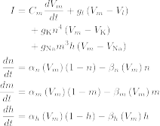
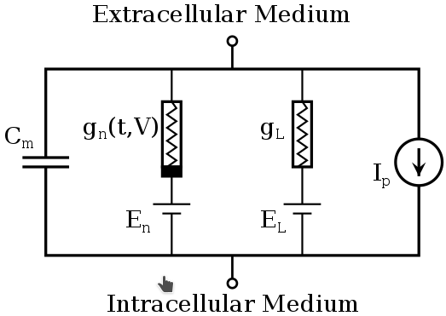
Hodgkin–Huxley model
There are other equations omitted here
This model considers also ion currents involving potassium ion and calcium ion induced by the potential difference
Wikipeida

Slide 20
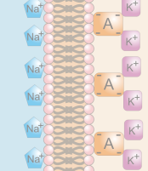
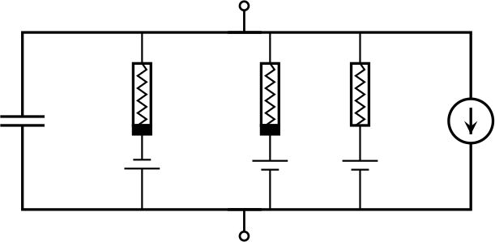

Additional Ion Currents in the HH Model
Intracellular Medium
The same leaky current used in Leaky-integrate-and-fire model
Sodium ion has a reversal potential depolarizing the membrane
The conductivity is also voltage-gated
Potassium ion has a reversal potential hyper-polarizing the membrane
The conductivity is voltage-gated
Extracellular Medium

Slide 21
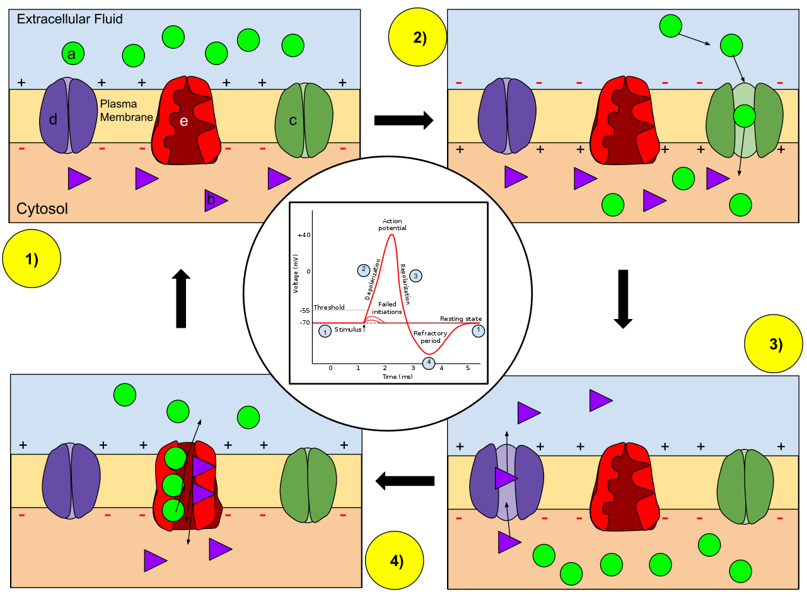
Action Potential
Resting State.
As the membrane potential increase, Calcium ion channel opens;
The membrane gets further depolarized
As the membrane become “too large”, Calcium ion channel closes;
The membrane gets further hyperpolarized
Active ion pumps reset the concentrations of different ions
By CThompson02, CC BY-SA 4.0

Slide 22
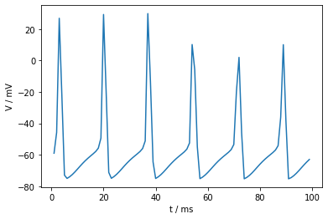
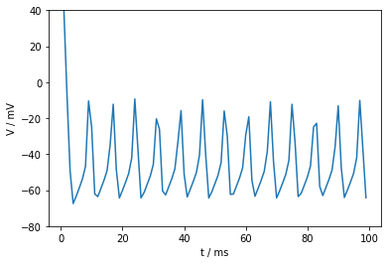
Simulating HH Neuron
HH Neurons show more biological behavior
But more complicated
  Very difficult to implement in Excel
  But you can do it easily in Nest
Computationally Expensive

Slide 23

Improve the Numerical Method
Euler method has a relatively large error, are there alternatives?
There are extensions of the Euler method
The simplest one is the mid-point method

Slide 24
Performance of Mid-point Method
Can the Euler method with a smaller step beats mid-point method?
The mid-point method is surprisingly good

Slide 25
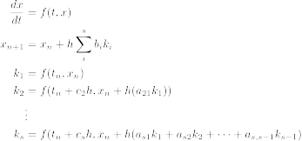
Runge–Kutta methods
Runge–Kutta methods are a family of methods having the following form:
No Worry. Use the
Implementations
Shipped with Libraries

Slide 26
Remarks of RK Methods
Higher-order integration takes care of higher-order curves
Some algorithms enable error control
Implementation is tedious
  Use libraries to avoid mistake
RK methods are not perfect
  In some scenario, implicit methods should be used
  (see Wikipedia)

Slide 27
Summary 1
Differential Equation
  An important tool for Quantitative Science
Numerical Method
  Euler Method
  Runge-Kutta Methods
Neuronal Model
  Leaky-Integrate-and-Fire Model
  Hodgkin-Huxley model

Slide 28
Long-term Synaptic Plasticity
In the previous talk, Fukai-sensei has introduced the spike-timing-dependent plasticity


?
X

Slide 29
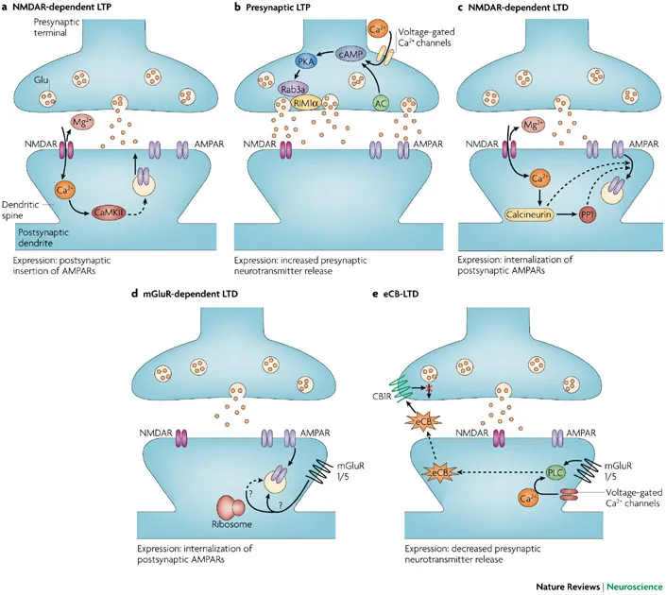
Highly Simplified Biology
There are various mechanisms able to modify to efficacy of chemical synapses
Although there are different processes, for simplicity, we pay our attention on spiking timing rather than biological details
Kauer & Malenka Nature Rev. (2007)

Slide 30
Spike-Timing-Dependent
Plasticity (Classical)
pre-
post-
post-
pre-
The change in w depends on the spike timings
The change shown here is just a classical view

Slide 31
Online implementation of STDP models
In order to perform STDP with differential equations, an online implementation of STDP is proposed
To be explained in the following

Slide 32


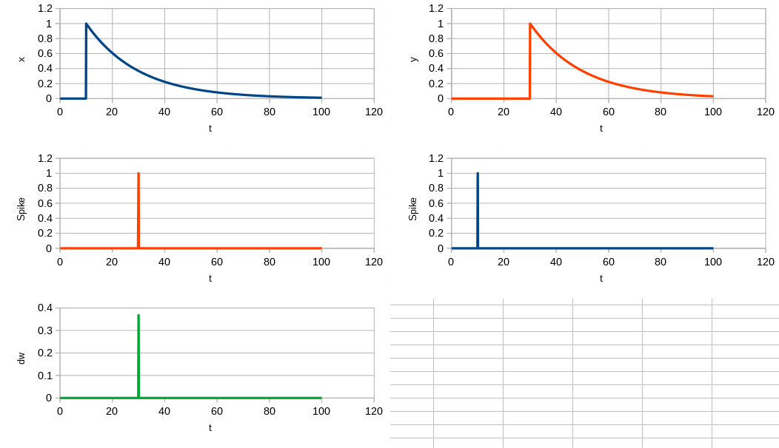

Simulation!
Both pre-synaptic spike and post-synaptic spike generate a decay curve in x and y
Pre-synaptic
Post-synaptic
If x / y is compared with delta functions of corresponding to post-synaptic / pre-synaptic spike ...
The change in w is then determined

Slide 33
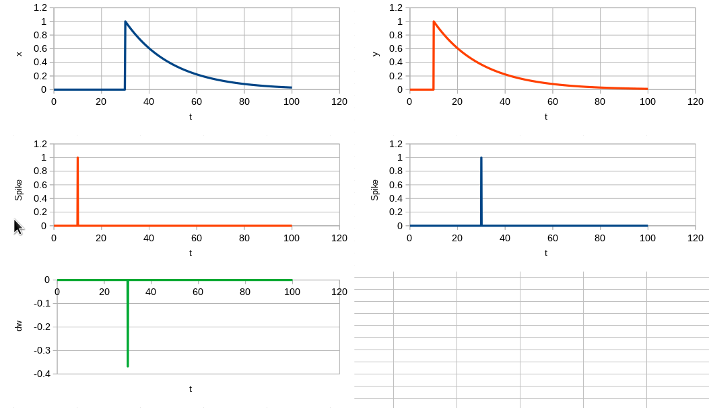
If the Spike Order is Reversed, ...

Slide 34
Then, ...
With an appropriate firing sequence, the network can be trained.



Slide 35

Summary 2
Networks of neurons can perform more complicated computations
The output of the computation can be trained
  The output is determined by connections between neurons
In real neuronal networks, one important process changing connections between neurons is STDP
STDP can be implemented using a group of differential equations

Slide 36
Take-Home Message
Some neuronal behaviors can be mathematically modeled
Networks of neurons has the potential to do different computations
Those networks can be trained

Slide 37
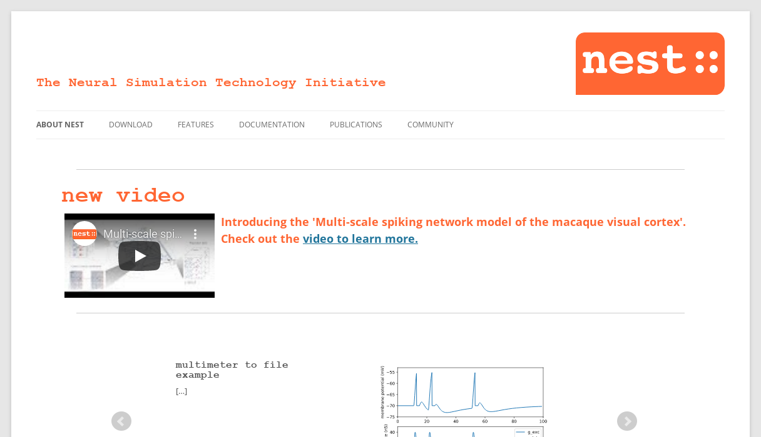
Caution
Don’t really do scientific simulations in spreadsheet
In the following, other lab members will tell you about the usage of nest simulator for neuronal computation

Slide 38
Thank you

