Slide 1
Mathematical Models and Numerical Methods of Computational Neuroscience
計算神経科学の数学モデルと数値手法
Alan Fung
Neural Coding and Brain Computing Unit, OIST
Skill Pills+

Slide 2

Agenda
Brief introduction of Differential Equations
Neuronal Models
Numerical Method to Simulate Neuronal Models
How Network of Neurons Performs Computation
How the Network can be trained

Slide 3

Ordinary Differential Equations
Fundamental tool in theoretical Science (Not only in Physics or Computational Neuroscience)
The differential equation gives the dependence of derivatives

Slide 4
Interpretation of Differential Equations
The first differential equation I have ever seen is the definition of velocity:
By definition,

Slide 5
Interpretation of Differential Equations
By knowing the slopes, one may trace the whole curve!
tells us the next point

Slide 6

Examples of Models and Theories
Simple Harmonic Oscillator
Heat Equation
Acceleration
Returning Force
Rate of Heat
Influx of Heat
(by Divergence Theorem)

Slide 7
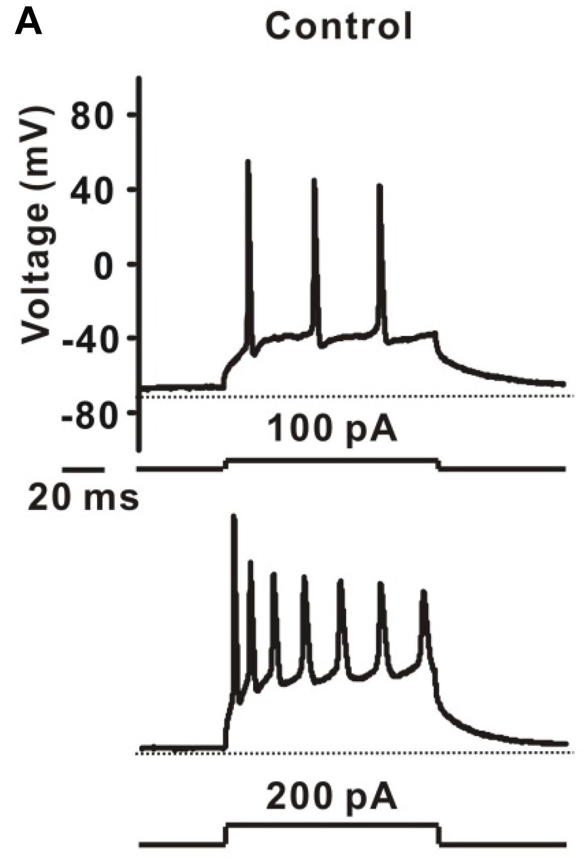

To Model a Neuron ...
Neurons can be excited by current injection
If the membrane potential is larger than some thresholds, an action potential will be triggered
A. D. Reyes, Nature (2019)
Z. Lin et al, Front. Pharmacol. (2019)

Slide 8
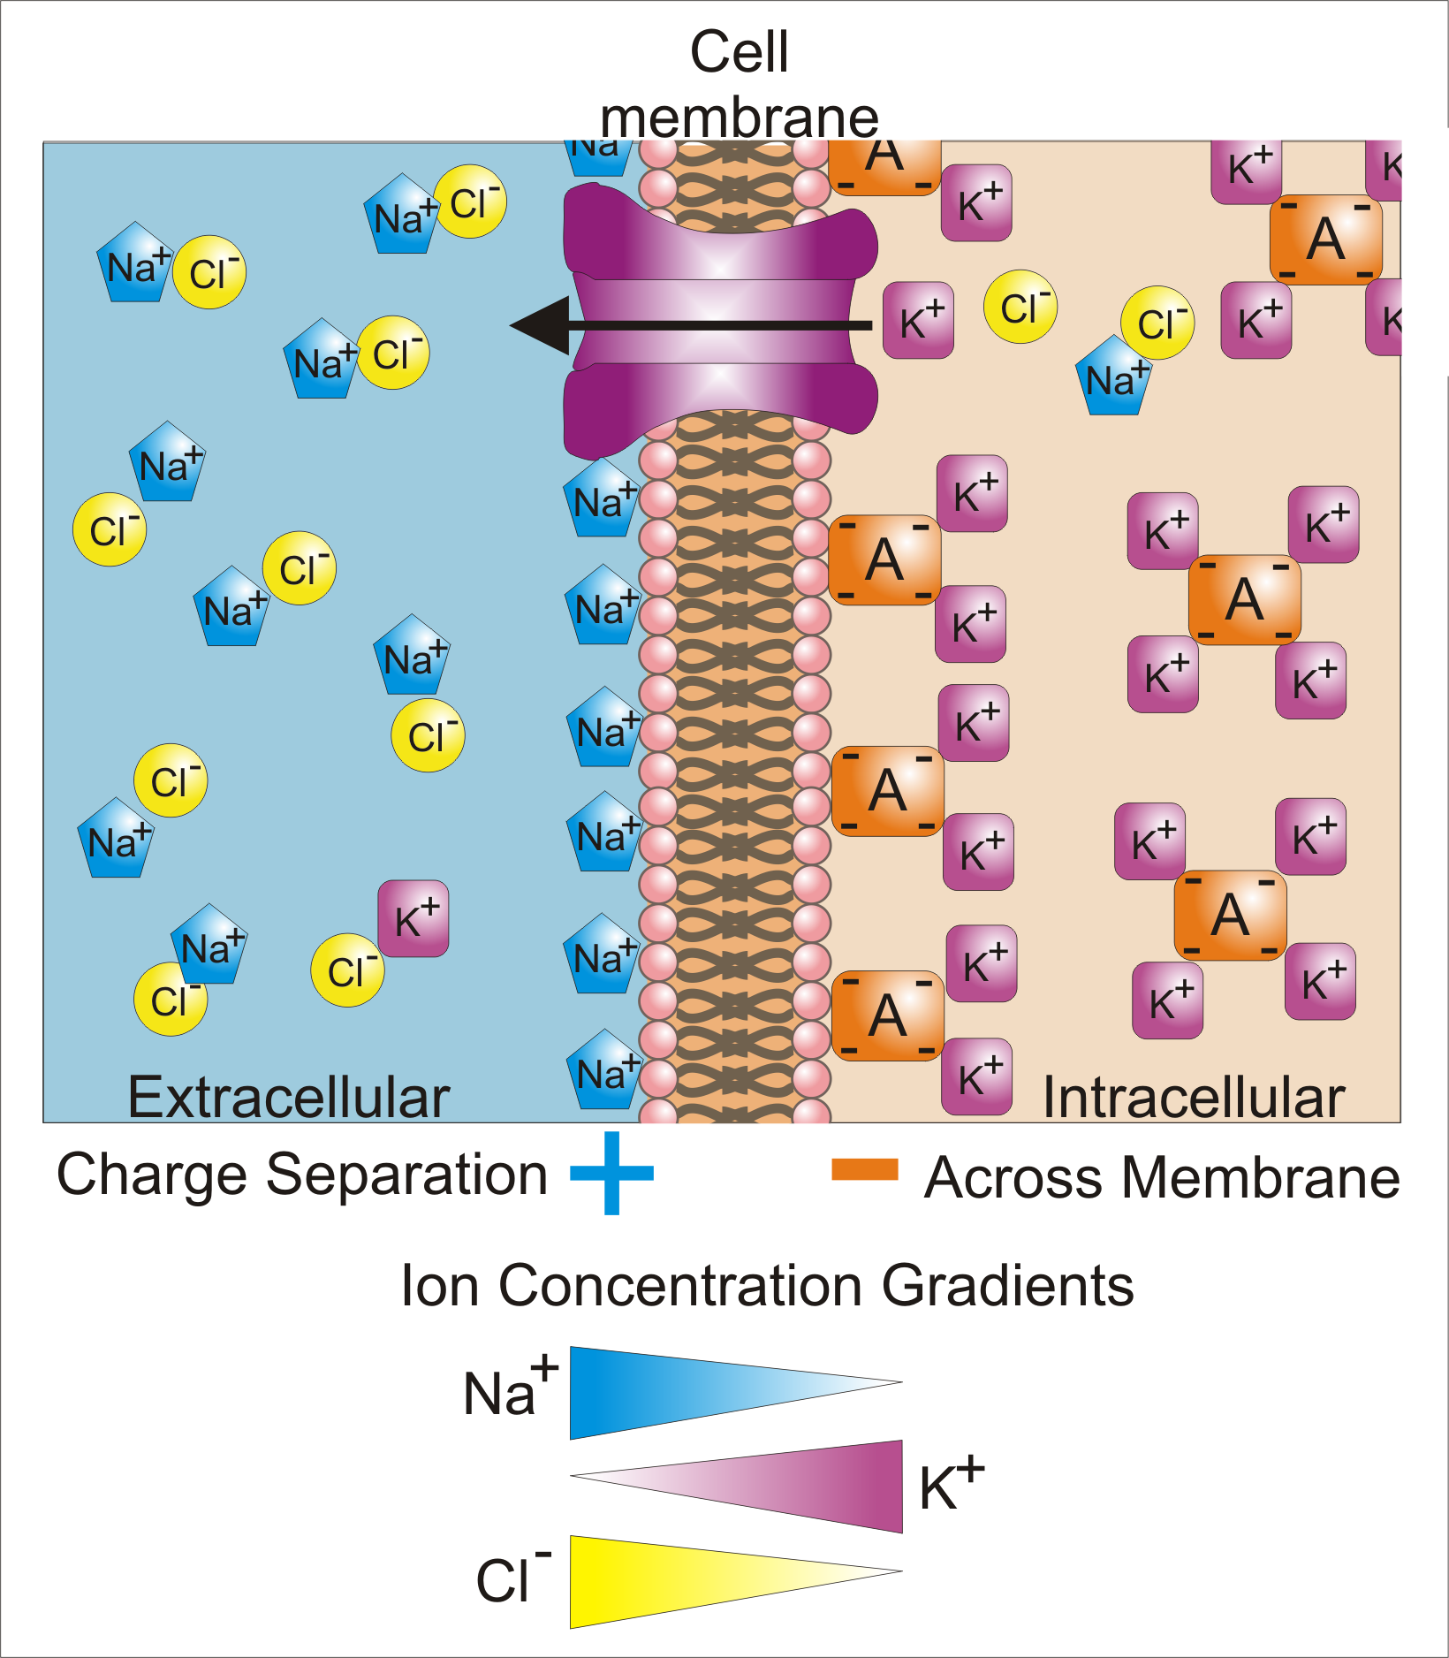
Membrane Potential
The voltage mentioned in the previous slide is the membrane potential
Membrane potential means the potential difference across the neuron membrane
By Synaptidude, CC BY 3.0, https://commons.wikimedia.org/w/index.php?curid=21460910

Slide 9
Membrane Potential
The membrane potential can be controlled by concentrations of ions
Living cells are actively maintain the potential difference by their ion bumps
The typical resting potential difference is -65 mV
By Synaptidude, CC BY 3.0, https://commons.wikimedia.org/w/index.php?curid=21460910

Slide 10
Membrane Potential
Current Injection
By injecting current, the membrane potential can be changed
As the membrane potential large than the threshold, the neuron gives a spike
By Synaptidude, CC BY 3.0, https://commons.wikimedia.org/w/index.php?curid=21460910

Slide 11
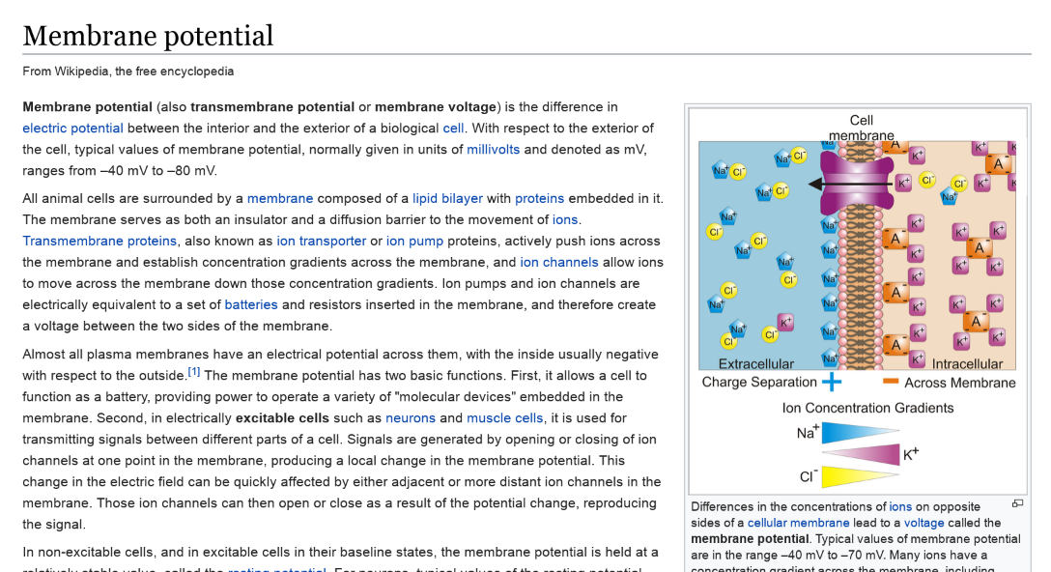
For More Knowledge about Membrane Potential

Slide 12
Membrane Works Like ...
By injecting current, the potential across membrane changes
As the potential across the threshold, the neuron fires
It works like a capacitor with a small break-down voltage

Slide 13
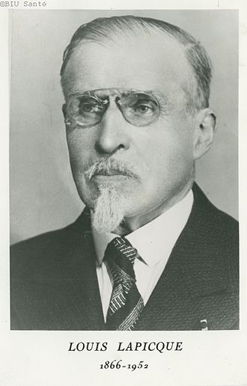

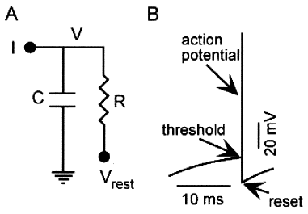
Leaky Integrate-and-Fire (LIF) Model
In 1907, Lapicque proposed a simple model for neurons
L. F. Abbott, Brain Research Bulletin (1999)

Slide 14
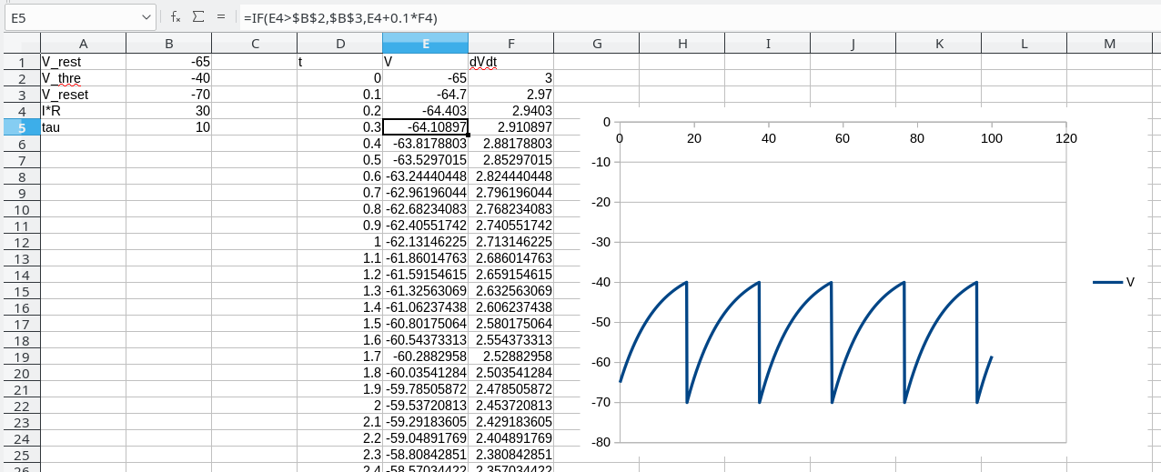

First Simulation (Numerically Solve the Differential Equation)
By calculating derivatives at t₀, one can estimate the voltage at t₀+Δt
Spikes

Slide 15
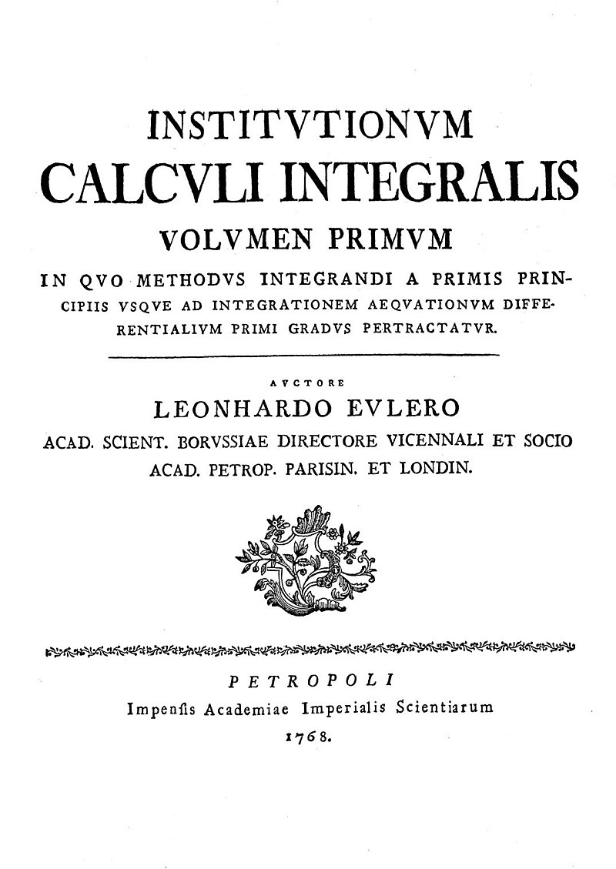
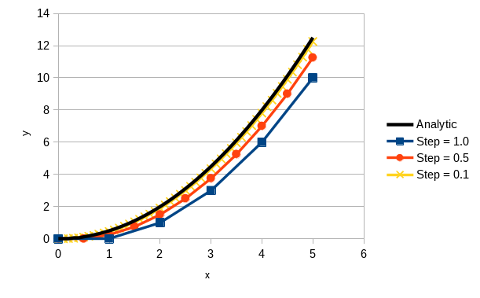
Euler Method
Demonstrated by Euler in 1768
Easy to understand, but the error could be big

Slide 16

The Simulation Features ...
Good
  Simple
  More input current, more spikes
  Capture some neuronal features
Bad
  The stepping process will not be accurate
  The trace of membrane potential does not look like that in experiments

Slide 17
Result Revisit
VS.
Z. Lin et al, Front. Pharmacol. (2019)

Slide 18
LIF Model is Still Valuable
LIF neurons can be excited, and the spiking rate is proportional to the input current
Useful enough for investigations on neural computing
Cheap computational cost

Slide 19


Studies Involving LIF Model
Last 10 Months, 204 papers
Last 4.83 Years, 1040 papers
There are ~200 paper talking about “leaky integrate and fire neuron” every year

Slide 20


Other Neuronal Models
Hodgkin–Huxley model
  Proposed by Hodgkin and Huxley in 1952
    They received the 1963 Nobel Prize in Physiology or Medicine for this work
  The input current charges up the membrane capacitor
  But there are other current influenced by the change in membrane potential

Slide 21
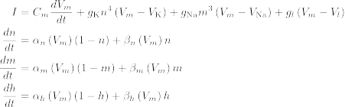
Hodgkin–Huxley model
There are other equations omitted here
This model consider also ion currents involving potassium ion and calcium ion induced by the potential difference

Slide 22
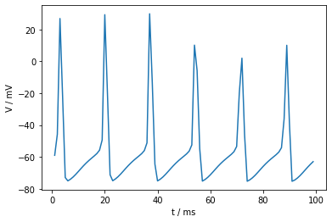
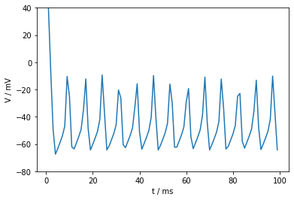
Simulating HH Neuron
HH Neurons show a more biological behavior
But more complicated
  Very difficult to implement in Excel
  But you can do it easily in Nest
Computationally Expensive

Slide 23

Improve Numerical Method
Euler method has a relatively large error, is there alternatives ?
There are extensions of Euler method
The simplest one is the mid-point method

Slide 24
Performance of Mid-point Method
Can Euler method with a smaller step beats mid-point method?
Mid-point method is surprisingly good

Slide 25
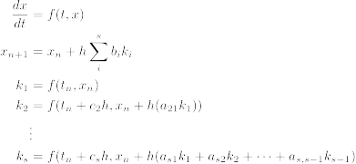
Runge–Kutta methods
Runge–Kutta methods is a family of method has the following form:
No Worry. Use the
Implementations
Shipped with Libraries

Slide 26
Remarks of RK Methods
Higher order integration takes care higher order curves
Some algorithms enable error control
Implementation is tedious
  Use library to avoid mistake
RK methods are not perfect
  In some scenario, implicit method should be used
  (see Wikipedia)

Slide 27
Summary 1
Differential Equation
  An important tool for Quantitative Science
Numerical Method
  Euler Method
  Runge-Kutta Methods
Neuronal Model
  Leaky-Integrate-and-Fire Model
  Hodgkin-Huxley model

Slide 28
Neuronal Computing
Single neuron can not do much
  More or less a sensor for input current
Network of neurons can do more complicated computations
  Connection between neuron are the key

Slide 29


Network of Neurons
Pre-Synaptic
Cell Body
(Soma)
Flow
Synapse
Flow
Axon
Flow
Dendrite
Post-Synaptic
Neurons integrate inputs from other neurons
  Gathering information to “decide” firing or not firing
  Connection between neurons is the key

Slide 30
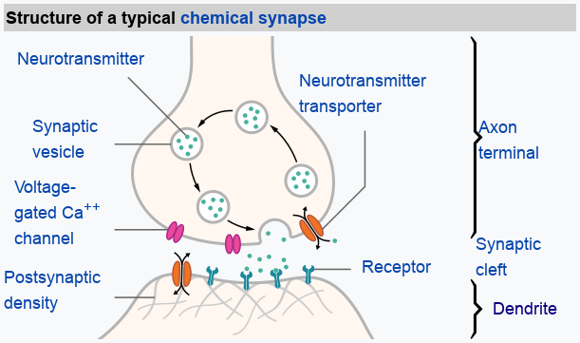

How Synapse Work?
(A Highly Simplified Version)
(Abstract) synaptic strength
Spike from a pre-synaptic neuron
By Thomas Splettstoesser (www.scistyle.com) - Own work, CC BY-SA 4.0

Slide 31
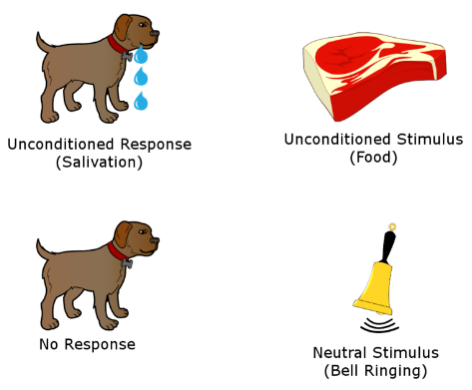
Naive Analogy
The Pavlov's experiment
What if there is a small circuit in the dog’s brain
Meat

By Salehi.s - Own work, CC BY-SA 4.0
Saliva
Bell
❒

Slide 32
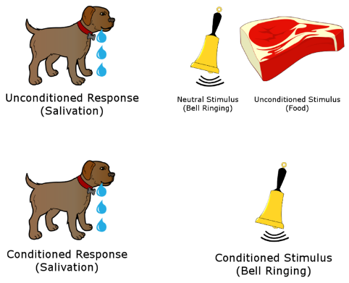
The Pavlov's Experiment
But the bell condition can be trained

Slide 33
Neuronal Connections are Plastic
Meat

Saliva
Bell
❒

In the naive example, the neuronal circuit should be updated
In Neuroscience, this kind of update is called Long-term Plasticity
One important process of plasticity is Spike-Timing-Dependent Plasticity (STDP)

Slide 34
Spike-Timing-Dependent Plasticity
The change in w depends on the spike timings
The change shown here is just a classical view

Slide 35
Online implementation of STDP models
In order to perform STDP with differential equations
To be explained in the following

Slide 36


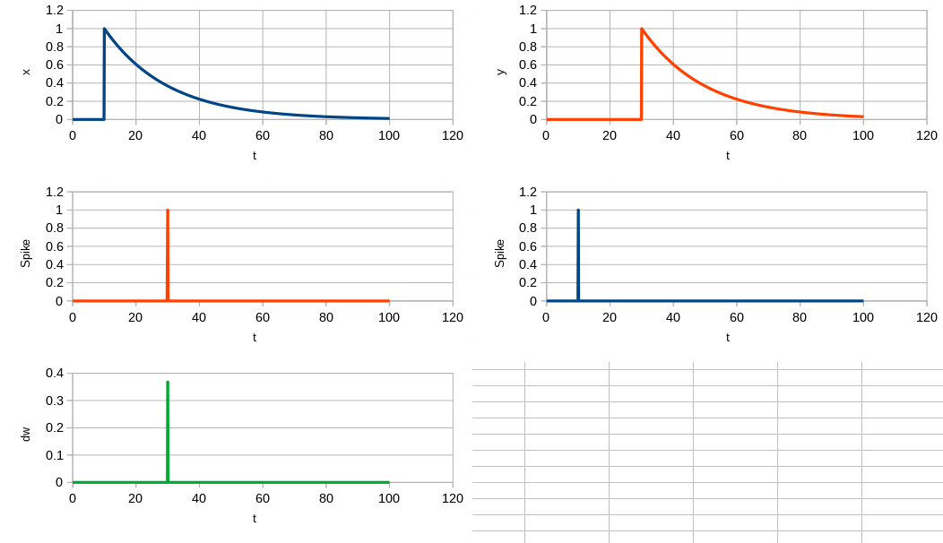
Simulation!
Both pre-synaptic spike and post-synaptic spike generate a decay curve in x and y
Pre-synaptic
Post-synaptic
If x / y is compared with delta functions of corresponding to post-synaptic / pre-synaptic spike ...
The change in w is then determined

Slide 37
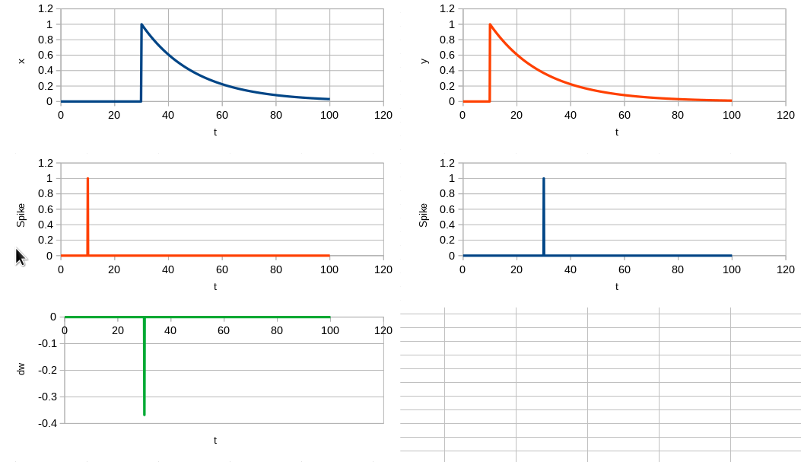
If the Spike Order is Reversed, ...

Slide 38
Then, ...
With appropriate firing sequence, the network can be trained,
Meat

Saliva
Bell


Slide 39
Summary 2
Network of neurons can perform more complicated computation
Output of the computation can be trained
  Output is determined by connections between neurons
In real neuronal network, one important process changing connections between neurons is STDP
STDP can be implemented using a group of differential equations

Slide 40
Take-Home Message
Some neuronal behaviors can be mathematically modeled
Network of neurons has a potential to do different computations
Those network can be trained

Slide 41
Caution
Don’t really do scientific simulation in spreadsheet

Slide 42
Thank you

