Slide 1
Labcyte 525 demo test results
Charles Plessy, RIKEN, June 14th, 2018

Slide 2
Parameter space exploration of a biochemical reaction
Using the the nanoliter-scale liquid handling platform “Labcyte Echo” platform, we assembled more than 3,000 reverse-transcription (RT) reactions in eight 384-well plates. We then assessed the RT efficiency by sequencing them with the nanoCAGE method. The RT reactions were made in quadriplicates and differed in the combination of the following reaction parameters:
  Template switching oligonucleotide (TSO): 9 different concentrations ranging from 0.6 to 160 µM.
  Reverse-transcription primer (RTP): 6 different concentration ranging from 1 to 24 µM.
  RNA quantity: 6 different starting amounts from 1 pg to 100 ng.
  Enzyme type (SuperScript III or IV)
This makes 2,592 reactions, to which we added 480 negative controls.

Slide 3
Rationale
In some projects, we need to know the range of reagent concentrations in which the reaction works, because, because of experimental constraints limiting them. (For instance highest concentrations may be too viscous to handle, or lowest concentrations may be hard to produce because of adsorption losses, etc.)
Some of our past benchmarks are hard to replicate accurately across long periods of time (multiple years), when material, operators, reagent batches and laboratory location have fully turned over. A standardised automation platform may my the key for long-term replication.
With a systematic approach, we hope to comprehensively characterise a biochemical system to the point that iterative approaches over years are not necessary anymore. (Without the high resolution reached in this work, developments are made by small incremental changes scattered over years – also known as “protocol drift”).

Slide 4
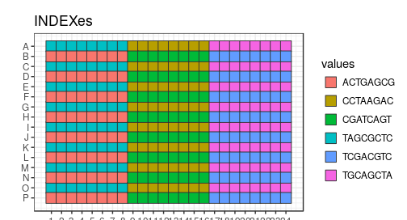
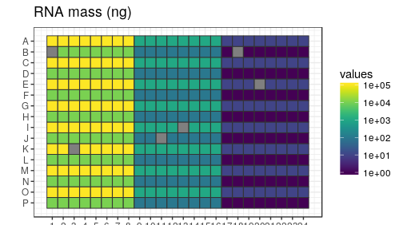
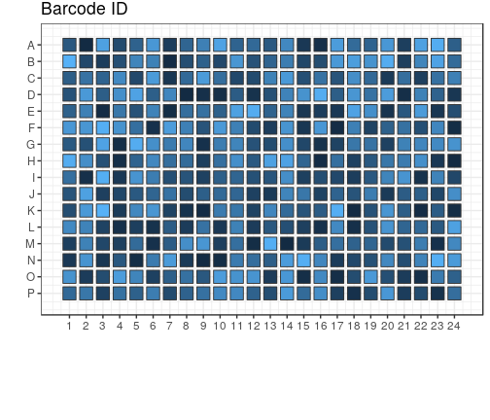
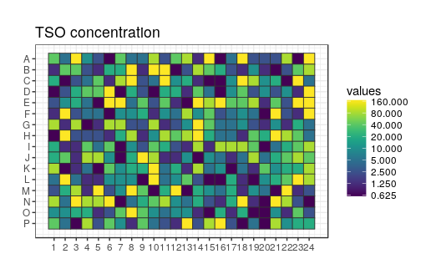
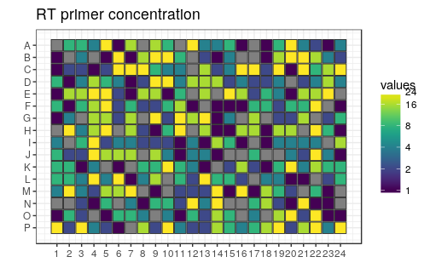
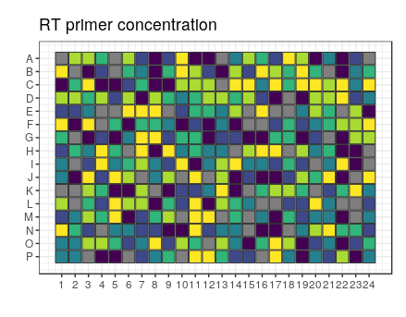
Computer-assisted experiment design: example reagent maps from the 384-well plates that we prepared
Above: different randomisation on different replicates
Computer-generated randomisation plays an important role in our study: to eliminate positional biases, the well coordinates of reactions with the same reagent parameters are randomly chosen. Moreover, the barcode identifiers (for multiplexing next-generation sequencing) are also randomised. Lastly, the position of the negative controls (for instance the grey squares in the “RNA mass” panel) are randomised, thus generating a plate fingerprint that prevents accidental sample swaps. Here, the RNA mass parameter was not randomised because different masses needed different numbers of PCR cycles in the nanoCAGE reactions. For practical purposes (multichannel pipetting and limited number of barcodes), each plate was divided in 6 interleaved “sextants”, but development of 384 different barcodes would entirely be possible.

Slide 5
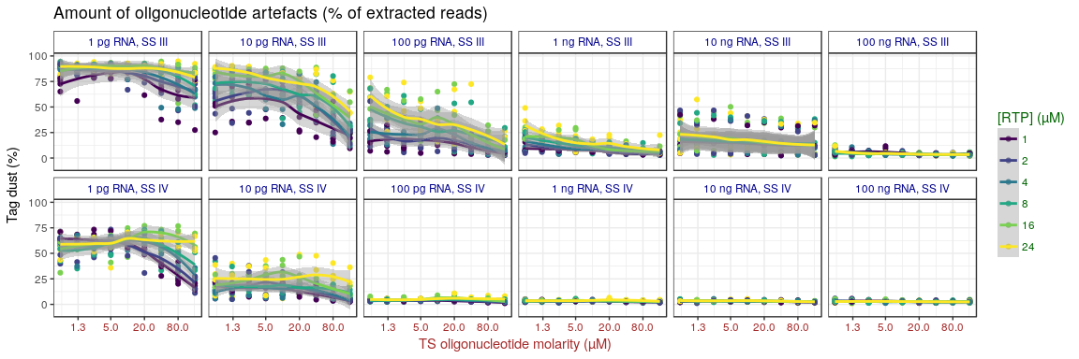
How to read the plots
Vertical columns in the plot grid:
RNA amounts
Color-coded: 6 different
RTP concentrations
Rows:
Different
enzymes
Vertical axis: metric of interest
(varies for each figure)
Horizontal axis: TSO concentrations
(log scale, same for all plots)

Slide 6
Too much but also too few oligonucleotides cause high amounts of artefacts

Slide 7
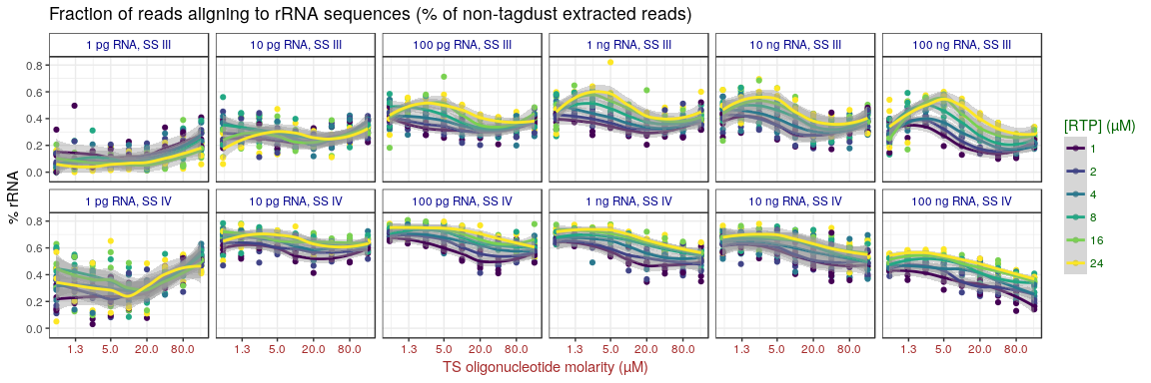
Identification of non-linear patterns
(when looking at the amount of ribosomal RNA detected – lower is better)
At lower resolution (less points on a narrower dynamic range), we could have concluded that there is a monotonic response followed by a plateau.

Slide 8
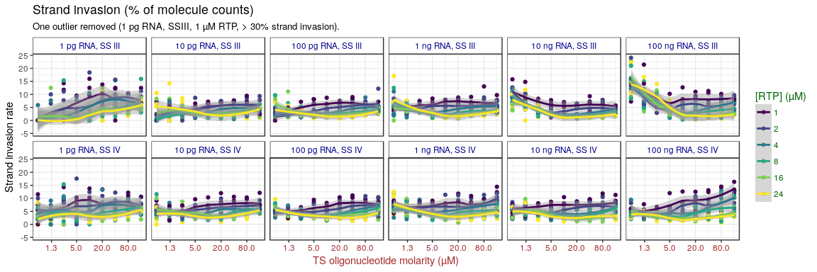
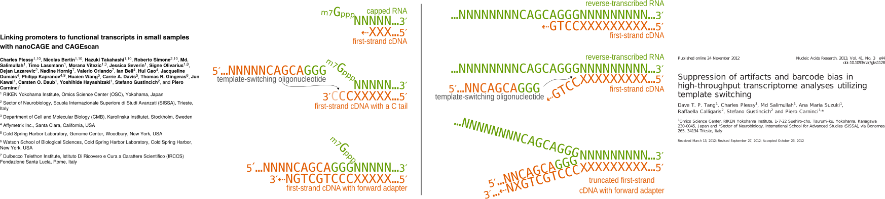
Counter-intuitive findings: more TSO artefacts at low TSO concentrations !
With such experiments, we gain a mechanistic insight.

Slide 9
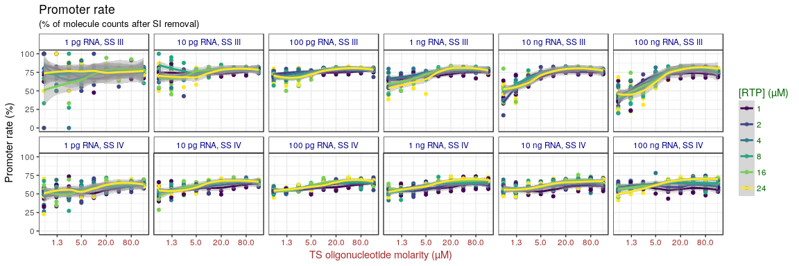
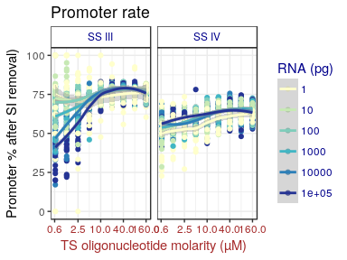
High TS oligos is almost always good
(thus, we should not fear that beads-based method would introduce too much of them)
← alternative representation

Slide 10
Conclusions and perspectives
Further directions
  Put in perspective with software parameter optimisation and AI.
  Try other graphical representations ? (3D plots, ratios of parameters, ...)
  Explore more parameters (dNTP and divalent concentrations)
  Further automate (3D printed sample collector, library preparation on Labcyte platform, etc.)
Conclusions regarding reverse-transcription
  In general, high [TSO] and low [RTP] is better.
  But [RTP] should be matched to [TSO].
  Optima are different at single-cell scale (10 pg) and bulk scale (100 ng).
Perspectives
  Optimise other reactions (ligations, template-switching of miRNAs, downstream PCR steps, ...)
  Further automation of experiment design.

Slide 11
Acknowledgements
RIKEN:
  Sachi Kato
  Stéphane Poulain
  Aki Minoda
  Piero Carninci
Labcyte
  Iris Chen
  Hiro Ishida
Kiko-tech
  Hisakazu Komina

