Slide 1
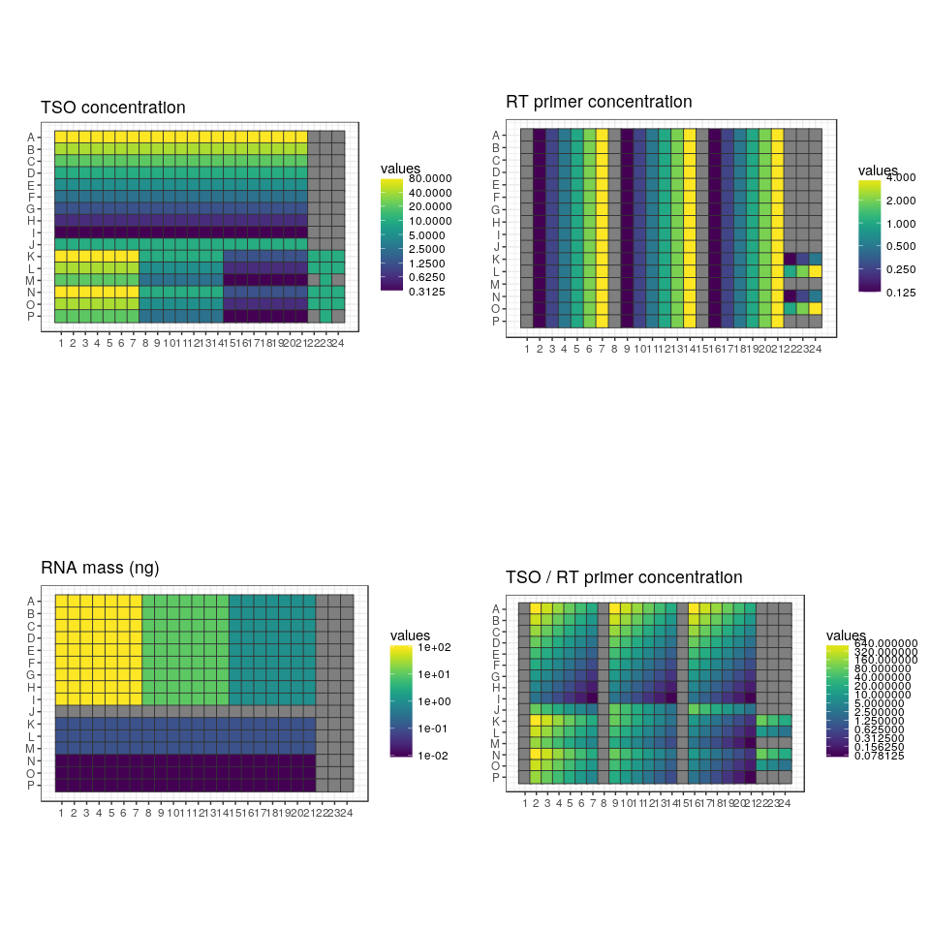
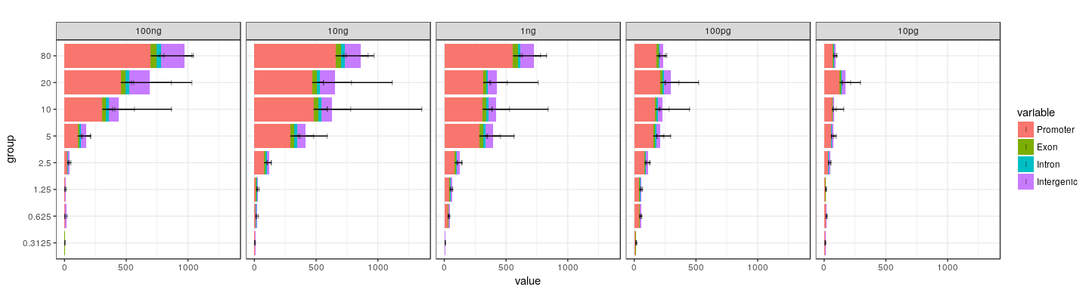
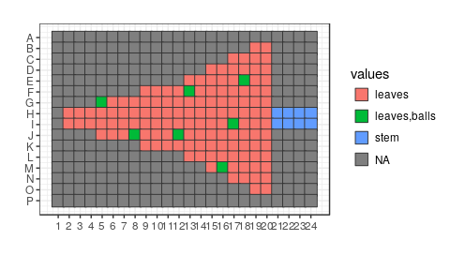

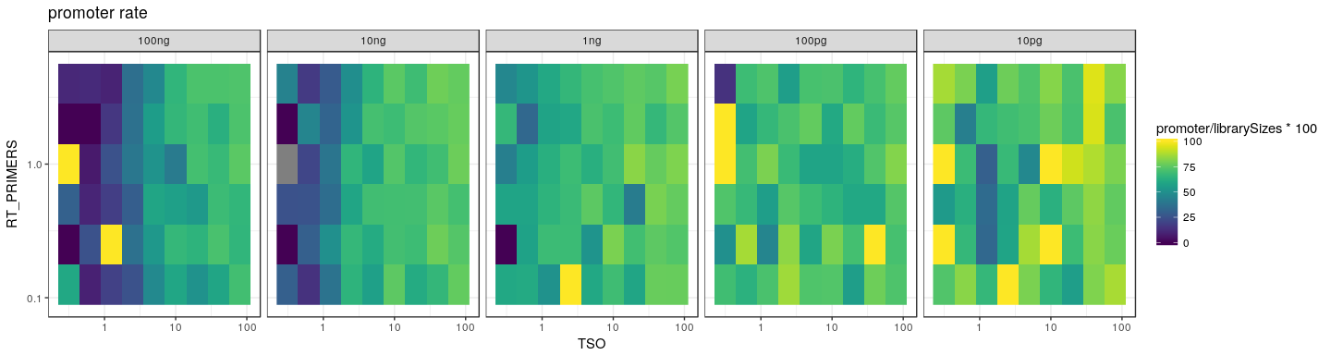
Optimization of a transcriptome technology with the Labcyte Echo 525
Background: “nanoCAGE” is a technology to measure gene activity in small samples yielding sub-microgram amounts of RNA (bulk samples), or single cells (containing ~10 picograms), by quantitative reading of RNA start sequences. Its first step, reverse-transcription (RT), is a bottleneck. This reaction uses two oligonucleotides (“TSO” oligonucleotides and RT primers). We are searching for optimal concentrations of reagents.
Design: we prepared triplicated 384-well plates with a different RT reaction in each well, testing all possible combinations of 9 concentrations of TSO, 6 concentrations of RT primers, and 5 quantities of RNA. The volume of each reaction was downscaled to 500 nL. The original reaction assemblage contains only 75 nL of distilled water (all the remaining water is brought in by the buffer, NTPs, etc.). Thus, we could vary the concentration of one reagent (TSO) by transferring 1, 2 or 4 drops of 25 nL. All the other variations of concentrations were done by preparing source wells with the appropriate stock concentration for 25 nL transfers. The reactions were “barcoded” with the TSOs, and the reactions made with the same quantity of RNA were amplified together. All the reactions were multiplexed and sequenced following the nanoCAGE protocol.
Results: 1) we miniaturized the reverse transcription in 500 nL for the first time in our laboratory. 2) we tested reagent concentrations in a broader range than ever (special thanks to Iris Chen for the calibration of transfers of the TSO at high (viscous) concentrations). 3) we generated at low cost a multi-dimensional dataset of thousands of different reactions. 4) we found that single-cell-scale reactions need a reduction of the reagent amounts. 5) we developed a software for automatically translating tables of reagent concentrations into transfer files (source / destination coordinates, volume). 6) we have presented the Echo 525 machine to colleagues working at RIKEN and Tokyo University.
Perspectives: we are repeating the experiment at a larger scale, and plan to test other parameters. It would be interesting to optimize other reactions of the nanoCAGE method (such as the cDNA PCR amplification).
Design of the destination plate
Peak TSO optimum varies with RNA concentration
Custom software developed to translate plate designs into transfer files.
[TSO] (µM)
Better detection of gene promoters at high TSO or low RNA
plan actual
C. Plessy, S. Poulain, S. Kato (RIKEN); Iris Chen (Labcyte)

