Slide 1
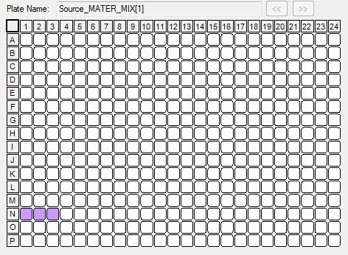
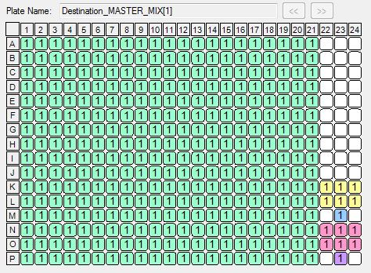
MASTER_MIX
350 nL in each well
Source
Destination
[65 μL in each well]

Slide 2
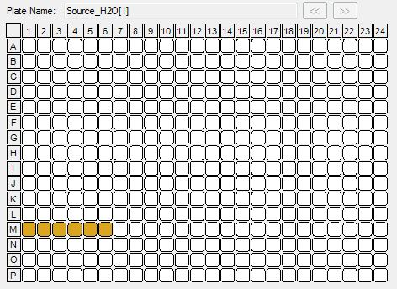
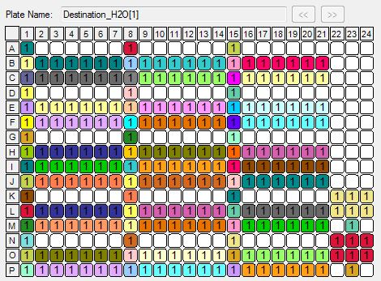
H₂O
25, 50, 75 or 125 nL in different wells
Source
Destination
[65 μL in each well]
25 nL (J2-J7, J9-J14, J18-J21, K22-K24, L22-L24, N22-N24, O22-O24, A1, A8, A15, D1, D8, D15, G1, G8, G15, K1, K8, K15, N1, N8, N15)
50 nL (B2-B7, B9-B14, B18-B21, E2-E7, E9-E14, E18-E21, H2-H7, H9-H14, H18-H21, L2-L7, L9-L14, L18-L21, O2-O7, O9-O14, O18-O21, M23, P23, J1, J8, J15)
75 nL (C2-C7, C9-C14, C18-C21, F2-F7, F9-F14, F18-F21, I2-I7, I9-I14, I18-I21, M2-M7, M9-M14, M18-M21, P2-P7, P9-P14, P18-P21, B1, B8, B15, E1, E8, E15, H1, H8, H15, L1, L8, L15, O1, O8, O15)
100 nL (C1, C8, C15, F1, F8, F15, I1, I8, I15, M1, M8, M15, P1, P8, P15)

Slide 3
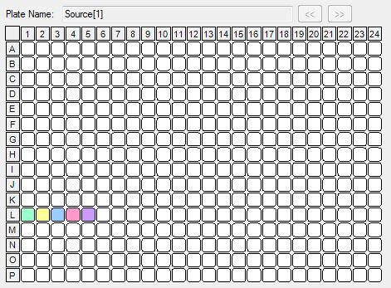
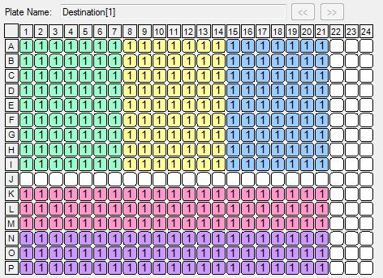
RNA
25 nL in each well
J1-J21, K22-24, L22-L24, M23, N22-N24, O22-O24, P23 = RNA- CONTROLS
Source
Destination
4 μg/μL [L1] – 400 ng/μL [L2] – 40 ng/μL [L3] – 4 ng/μL [L4] – 400 pg/μL [L5] [20 μL in each well]
100 ng [A1-I7] – 10 ng [A8-I14] – 1 ng [A16-I21] – 100 pg [K1-M21] – 10 pg [N1-P21]

Slide 4
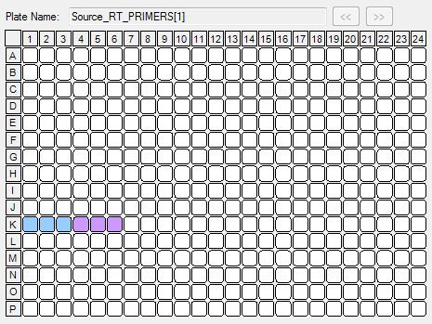
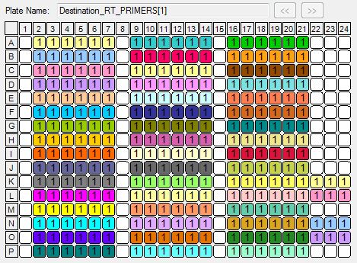
RT_PRIMERS
25 nL in each well
Source
Destination
2,5 μM [K1] – 5 μM [K2] – 10 μM [K3] – 20 μM [K4] – 40 μM [K5] – 80 μM [K6] [20 μL in each well]
0,125 μM [col.2,9,16,K22,N22] – 0,25 μM [col.3,10,17,K23,N23] – 0,5 μM [col.4,11,18,K24, N24] – 1 μM [col.5,12,19,L22, O22] – 2 μM [col. 6,13,20,L23,O23] – 4 μM [col. 7,14,21,L24, O24]

Slide 5
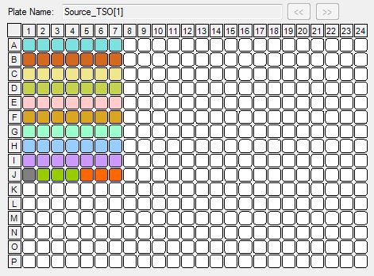
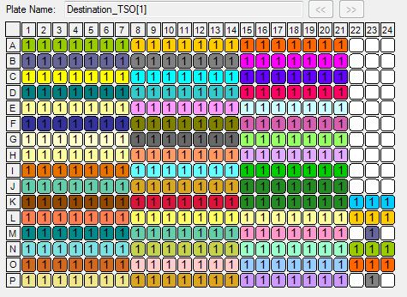
TSO (barcodes 1-70)
25, 50, or 100 nL (1, 2 or 4 drops)
A1-A7, D1-D7, G1-G7, J1-J21 ➔ 4 drops
K22-K24, L22-L24, M23 ➔ 4 drops
N22-N24, O22-O24, P23 ➔ 4 drops
B1-B7, E1-E7, H1-H7 ➔ 2 drops
C1-C7, F1-F7, I1-I7 ➔ 1 drop
Source
Destination
400 μM (rows A,B,C)
50 μM (rows D,E,F)
6,25 μM (rows G,H,I)
[20 μL in each well]
80 μM (A1-A21, K1-K7, N1-N7) – 40 μM (B1-B21, L-1-L7, O1-O7) – 20 μM (C1-C21, M1-M7, P1-P7) – 10 μM (D1-D21, K8-K14, N8-N14, J1-J21, K22-K24, L22-L24, M23, N22-N24, O22-O24, P23) – 5 μM (E1-E21, L8-L14, O8-O14 ) – 2,5 μM (F1-F21, M8-M14, P8-P14) – 1, 25 μM (G1-G21, K15-K21, N15-N21) – 0,625 μM (H1-H21, L15-L21, O15-O21) – 0,3125 μM (I1-I21, M15-M21, P1-P21)

Slide 6
MASTER_MIX PREPARATION
Reagent | Volume for 1 reaction (nL) | Stock conc. | Final conc. | Master_Mix for 384 reactions (201,25 μL)
Sorbitol/Trehalose | 40 | 0,66 M/3,3 M | 0,0528M/0,264M | 23
SuperScript III Reaction Buffer | 100 | 5x | 1x | 57,5
DTT | 50 | 0,1 M | 0,01 M | 28,75
dNTPs | 31,25 | 10 mM | 0,625 mM | 17,97
Betain | 75 | 5 M | 0,75 M | 43,13
SuperScript III | 50 | 200 U/μL | 20 U/uL | 28,75
H₂O | 3,75 | - | - | 2,16
TOTAL | 350 |  |  | 201,25
(65 – 15) / 350 = 142 destination wells filled per source well
➔ 3x 65 μL wells required to effectively fill 384 wells

Slide 7
1 2 3 4 5 6 7
1 2 3 4 5 6 7
1 2 3 4 5 6 7
8 9 10 11 12 13 14
8 9 10 11 12 13 14
8 9 10 11 12 13 14
15 16 17 18 19 20 21
15 16 17 18 19 20 21
15 16 17 18 19 20 21
22 23 24 25 26 27 28
22 23 24 25 26 27 28
22 23 24 25 26 27 28
29 30 31 32 33 34 35
29 30 31 32 33 34 35
29 30 31 32 33 34 35
36 37 38 39 40 41 42
36 37 38 39 40 41 42
36 37 38 39 40 41 42
43 44 45 46 47 48 49
43 44 45 46 47 48 49
43 44 45 46 47 48 49
50 51 52 53 54 55 56
50 51 52 53 54 55 56
50 51 52 53 54 55 56
57 58 59 60 61 62 63
57 58 59 60 61 62 63
57 58 59 60 61 62 63
64 65 66 67 68 69 70
64 65 66 67 68 69 70
64 65 66 67 68 69 70
1 2 3 4 5 6 7
22 23 24 25 26 27 28
43 44 45 46 47 48 49
65 66 67
8 9 10 11 12 13 14
29 30 31 32 33 34 35
50 51 52 53 54 55 56
68 69 70
15 16 17 18 19 20 21
36 37 38 39 40 41 42
57 58 59 60 61 62 63
64
1 2 3 4 5 6 7
22 23 24 25 26 27 28
43 44 45 46 47 48 49
65 66 67
8 9 10 11 12 13 14
29 30 31 32 33 34 35
50 51 52 53 54 55 56
68 69 70
15 16 17 18 19 20 21
36 37 38 39 40 41 42
57 58 59 60 61 62 63
64

