Slide 1
UBECONN AS / EXECUTIVE PROJECT REVIEW
ubeconn
From fibre signals to cable intelligence
Distributed acoustic sensing for cable monitoring • Project status and proposed next steps
SEE THE SIGNAL.
UNDERSTAND THE EVENT.
A traceable path from DAS recordings to
mapped evidence, expert review and
validated alerts.
BUILD > VERIFY > LEARN > OPERATE
LOFOTEN / 4 IMPORTED ROUTES
Current position: a working local investigation platform with a clear path to field validation.
PROJECT SNAPSHOT / 16 SEP 2026
UBE / 01
Notes:
Audience: technically informed executives and project stakeholders. This presentation describes the repository and recorded project evidence as of 16 September 2026. It is not a claim of a production rollout or certified event detection. Future phases are proposed, with no approved budget or delivery dates implied.
Sources: PROJECT SNAPSHOT / 16 SEP 2026

Slide 2
01 / EXECUTIVE POSITION
ubeconn
The foundation is built. Field validation is the next gate.
Progress spans capture, asset context, investigation and exploratory analytics.
BUILT
DEMONSTRATED
NEXT
Evidence workspace
Discovery workflow
Validated detection
Map assets, inspect raw
windows, replay recordings and
record classification reviews.
A bounded archive pilot extracts
features and ranks candidate
windows for expert review.
Verify timing and geography;
collect independent labels;
evaluate by incident and season.
579
575
115,847
4
imported masts
inferred connections
legacy RMS event records
target event classes
A strong software foundation; classification accuracy and operational benefit remain to be measured.
SOURCES / docs/map-app.md · docs/masts.md · docs/event-ml.md · recorded DB snapshot
UBE / 02
Notes:
Counts are the recorded 16 September 2026 snapshot, not a fresh server query. Existing 115,847 legacy events are unclassified threshold records. The 575 connections are inferred. New investigation tables and review writes are local; server class and asset migrations were previously applied.
Sources: SOURCES / docs/map-app.md · docs/masts.md · docs/event-ml.md · recorded DB snapshot

Slide 3
02 / PRODUCT INTENT
ubeconn
Turn distributed measurements into actionable evidence
The intended operator outcome: find where to investigate, why it matters and what supports the decision.
TARGET CLASS 01
TARGET CLASS 02
TARGET CLASS 03
TARGET CLASS 04
Normal
Operations
Ice
Loading
Wind
Galloping
External
Interference
Establish the range of
normal behaviour,
including wind.
Test whether signal
changes can
distinguish ice-related
conditions.
Validate sustained
motion patterns
against field
observations.
Review strikes,
vegetation contact and
other disturbances.
MEASURE
>
LOCATE
>
REVIEW
>
PRIORITISE ACTION
Proposed value: earlier investigation and better maintenance prioritisation, measured during the pilot.
SOURCES / AGENTS.md · docs/event-ml.md; operational outcomes are project goals
UBE / 03
Notes:
DAS means distributed acoustic sensing. A channel is a spatial sample along the monitored fibre. The target classes are not the RMS/variance metric identifiers in the database. Vegetation strikes are a candidate subtype of External Interference, not an implemented dedicated classifier. Ice mass, load and displacement cannot be inferred without calibration and ground truth.
Sources: SOURCES / AGENTS.md · docs/event-ml.md; operational outcomes are project goals

Slide 4
03 / SYSTEM ARCHITECTURE
ubeconn
One evidence chain connects signals, assets and review
HDF5 stores the signal; PostgreSQL stores context; the API serves bounded analysis to the browser.
INPUT
PROCESSING
SERVICE
OPERATOR
DAS archive
Bounded
analysis
FastAPI
Cable
Observatory
>
>
>
Interrogator
Completed HDF5
files
Explicit channel IDs
Signal windows
Asset geometry
Events and review
API
Python / h5py
Fixed-frame metrics
Replay + file
snapshots
React / MapLibre
Plotly signal review
Classification history
POSTGRESQL / assets · events · weather · recording references · review history
The local investigation workflow is implemented; verified live capture and production rollout are separate gates.
SOURCES / docs/map-app.md · src/Mapui/{api,signals,metrics,live}.py
UBE / 04
Notes:
React/TypeScript, MapLibre and Plotly form the frontend. FastAPI serves PostgreSQL metadata and bounded HDF5 slices. Capture accepts completed-file notifications and publishes atomic file-backed snapshots. Replay is implemented and explicitly labeled. Live operation requires independently verified acquisition time and channel mapping; notification support is not evidence of field validation. No complete raw signal array is posted as an in-memory global.
Sources: SOURCES / docs/map-app.md · src/Mapui/{api,signals,metrics,live}.py

Slide 5
04 / GEOGRAPHIC FOUNDATION
ubeconn
579 masts anchor the asset view across four routes
Workbook provenance and channel references are retained for every imported mast.
ROUTE / MASTS / CONNECTIONS
R06
188 / 187
Fygle–Solbjørn
R12
94 / 93
Svolvær–Kleppstad
R13
101 / 100
Kvitfossen–Svolvær
R14
196 / 195
Kleppstad–Fygle via Valberg
MAST COORDINATES / INFERRED CONNECTIONS / NO BASEMAP
Assets are mapped; physical connectivity, water crossings and distant endpoint matches still need review.
SOURCES / results/masts/masts.csv · results/masts/spans.csv · docs/masts.md
UBE / 05
Notes:
Diagram generated directly from imported mast coordinates, ordered by route_position; links are illustrative inferred connections, not the actual fibre path. Route names come from the mast workbook inventory, not conflicting event-limit gids. R13 lacks M38. R06 M184–M188 lie 17.5–498.5 m from the endpoint channel; R14 M1 is about 30.1 m away. All other imported masts are within 10 m. Seven water-crossing candidates are unconfirmed and all installation types remain unknown.
Sources: SOURCES / results/masts/masts.csv · results/masts/spans.csv · docs/masts.md

Slide 6
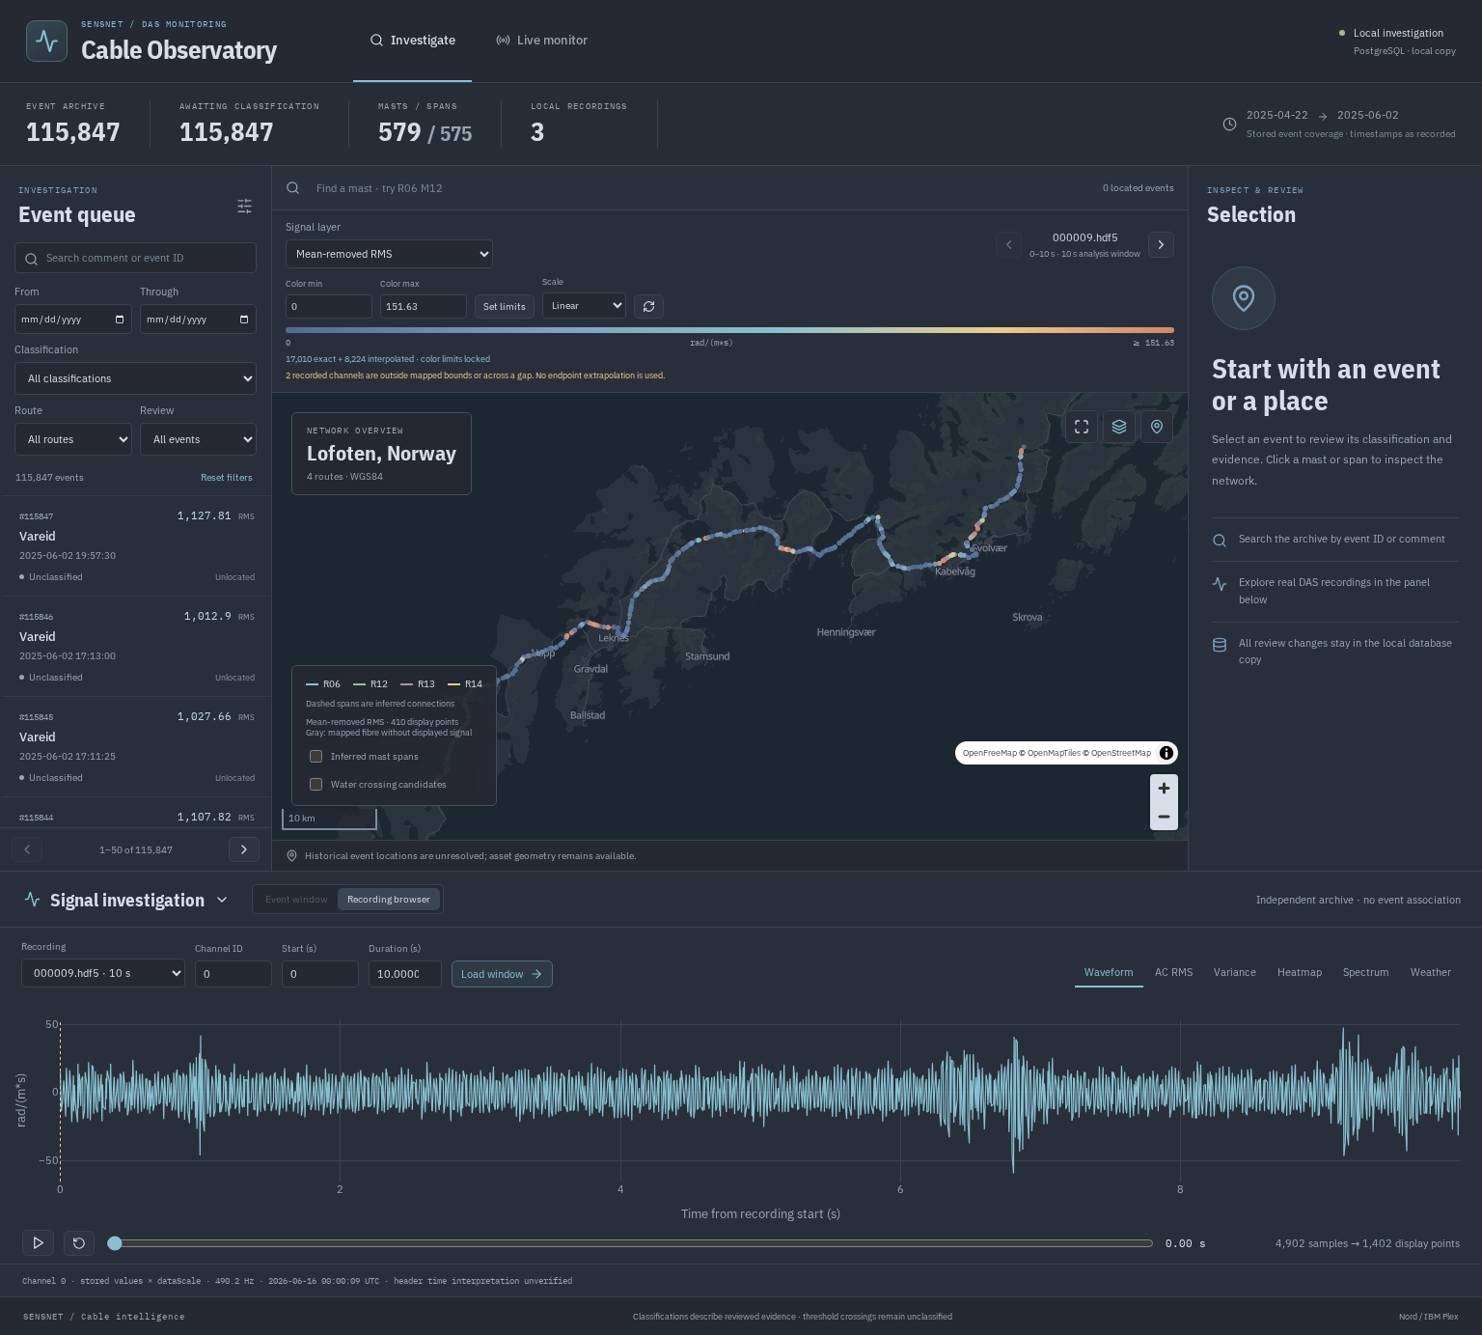
05 / WORKING APPLICATION
ubeconn
Investigate an event, a place or a recording
An integrated local workspace connects the event queue, network map and signal evidence.
LOCATE
Search routes, masts and recorded events
INSPECT
Waveform, heatmap, spectrum and trends
REVIEW
Store a class, evidence note and history
ACTUAL LOCAL BUILD / ORIGINAL UI COLOURS
SOURCE / .local/screenshots/overview.png · docs/map-app.md
UBE / 06
Notes:
Unmodified screenshot of the current local application. Its Nord styling and legacy Sensnet label are retained as implementation evidence; the presentation introduces Ubeconn branding separately. The recording shown is an independent archive example, not a verified window for historical events. Map attribution is retained within the screenshot. Basemap: OpenFreeMap / OpenMapTiles / OpenStreetMap. Local review identities are self-reported; authentication is a deployment task.
Sources: SOURCE / .local/screenshots/overview.png · docs/map-app.md

Slide 7
06 / SIGNAL INTEGRITY
ubeconn
Signal amplitude and event meaning stay distinct
Map layers are reproducible window measurements. Classification requires independent evidence.
MAP METRIC
MAP METRIC
MAP METRIC
MAP METRIC
AC RMS
Band RMS
Absolute peak
Variance
Vibration level after
removing the mean
Energy within a
selected frequency
band
Largest mean-removed
signal excursion
Signal variability in
squared units
TRACEABILITY
File + sample window + channel ID + scale + processing version
17,010
8,224
2
exact coordinate matches
bounded coordinate interpolations
channels remain unlocated
Never interpret map colour as event class or severity; no missing fibre ranges are reconstructed.
SOURCES / docs/map-app.md · docs/channel-mapping.md · src/Mapui/metrics.py
UBE / 07
Notes:
The local app applies header dataScale and preserves explicit header channel IDs. Fixed ten-second frames make map metrics independent of display zoom. AC RMS and absolute peak remove the window mean; band RMS integrates Welch power, with exploratory default 1–10 Hz; variance uses squared units. Display reduction retains actual extrema. Current example recordings resolve 17,010 exact positions and 8,224 bounded coordinate interpolations. Two channels outside the stored mapping remain unlocated. No signal values are interpolated or channel IDs shifted.
Sources: SOURCES / docs/map-app.md · docs/channel-mapping.md · src/Mapui/metrics.py

Slide 8
07 / EVIDENCE READINESS
ubeconn
The largest archive is still an unlabeled candidate set
Time, location and labels must be verified together before historical events become training evidence.
Legacy alarms
APR–JUN 2025
115,847 RMS records
Class and reliable event location
unresolved
Channel metadata
APR 2026
25,235 positions
Historical mapping equivalence
unverified
Example recordings
JUN 2026*
3 full local files
Independent of the historical alarm
archive
Expert ground truth
NEXT PHASE
Incident / inspection
evidence
Required to validate the four target
classes
* Header date is plausible but not independently verified.
Alarm volume is useful for review prioritisation; it does not establish labeled incidents or model accuracy.
SOURCES / AGENTS.md · docs/map-app.md · docs/event-ml.md · .local/verification.json
UBE / 08
Notes:
115,847 records span 22 April–2 June 2025 and are all RMS metric events with NULL class in the inspected snapshot. Their comments do not match current threshold names, so the legacy location join cannot resolve them. Current channel metadata is dated 16 April 2026. Example archive headers suggest 16 June 2026 but original acquisition-time interpretation remains unverified. A 2026 recording cannot be attached to a 2025 event merely for visual completeness. NULL means unclassified, never normal.
Sources: SOURCES / AGENTS.md · docs/map-app.md · docs/event-ml.md · .local/verification.json

Slide 9
08 / WEATHER CONTEXT
ubeconn
Weather adds context once time and location are trustworthy
YR collection is in place at two configured locations; humidity is a planned extension.
COLLECTED TODAY
PROPOSED EXTENSION
Temperature · wind speed · direction
Humidity + source-validity
timestamps
Kråkern Bru and Leknes
YR forecast context
Missing and stale values remain visible
Explicit variable and unit definitions
Collector and storage support
Documented station-to-route relevance
ALIGNMENT RULE
Verified acquisition time > appropriate location > latest valid prior weather
Weather supports interpretation; humidity or freezing conditions alone do not prove ice loading.
SOURCES / src/weather/weather_capture.py · docs/map-app.md · docs/event-discovery.md
UBE / 09
Notes:
Stored variables are air temperature, wind speed and wind direction at Kråkern Bru and Leknes. These are collected YR forecast values, not necessarily direct measurements. The current collector uses database-default collection timestamps rather than verified forecast-validity times. The local UI only uses past rows relative to the stored event time and displays missing/stale context; this does not independently verify the original acquisition alignment. Add humidity with explicit lookup semantics, units, collector support and missing-value handling. Do not assume numeric type 4 means humidity.
Sources: SOURCES / src/weather/weather_capture.py · docs/map-app.md · docs/event-discovery.md

Slide 10
09 / DISCOVERY PILOT
ubeconn
Archive discovery has been exercised on real recordings
A reproducible pilot produces a compact review queue without loading the full archive into memory.
90
15 min
240
6
archive files
approximate coverage
window / block feature rows
exploratory clusters
CLUSTER POPULATION / FEATURE ROWS
45
RECORDED EXECUTION
0
1
12
37.8 s initial / 0.29 s resume
2
23
3
131
~160 MiB peak resident memory
Identical feature output after resume
One pilot run; no accuracy estimate
4
7
5
22
This proves the discovery workflow on a small archive; seasonal coverage and verified labels are still needed.
SOURCES / results/das-discovery-pilot-20260916/{summary,pilot-validation}.json
UBE / 10
Notes:
Pilot inputs: 90 approximately ten-second files, 25,236 channels, roughly 15 minutes of archive data. Fifteen 60-second temporal windows × 16 spatial blocks × 32 channels per block produce 240 feature rows. Six exploratory clusters have populations 45, 12, 23, 131, 7, 22 for IDs 0–5. Initial run 37.849 seconds, resume 0.288 seconds; max RSS 164300 KiB = approximately 160.4 MiB. Resumed feature output had identical SHA-256. These are one recorded run, not general performance guarantees. No weather join was enabled; timestamps and locations were unverified. Scores are review priorities, not class probabilities.
Sources: SOURCES / results/das-discovery-pilot-20260916/{summary,pilot-validation}.json

Slide 11
10 / DETECTION DEVELOPMENT
ubeconn
The ML baseline is built; field accuracy is still unproven
The implementation supports four classes, grouped validation and quantified prediction windows.
01
02
03
04
Discover
Verify
Train
Evaluate
Rank unusual and
representative
windows.
Attach inspection,
camera or incident
evidence.
Use one agreed signal
representation.
Hold out independent
incidents and seasons.
RELEASE EVIDENCE
Per-class precision / recall · false-alert burden · confidence calibration
Site and season generalisation · detection latency · traceable predictions
Model deployment follows field evidence; threshold alarms and anomaly clusters cannot substitute for labels.
SOURCE / docs/event-ml.md · src/Capture/event_ml.py
UBE / 11
Notes:
No trained supervised model or measured field accuracy is supplied. The offline baseline uses stored input values, while discovery and map analysis apply dataScale; preprocessing must be reconciled before model reuse. At least three independent groups per class are a code-level validation minimum, not sufficient field evidence. Group related windows by session or incident to avoid leakage. Hold out sites, seasons and incidents. Current output probabilities are uncalibrated, and the default 0.7 review threshold is not an approved operating point. The single-label model cannot describe simultaneous ice and galloping.
Sources: SOURCE / docs/event-ml.md · src/Capture/event_ml.py

Slide 12
11 / READINESS ASSESSMENT
ubeconn
Software checks do not establish field performance
Recorded local checks support the investigation workflow; operational acceptance remains ahead.
CAPABILITY
EVIDENCE AVAILABLE
REMAINING GATE
Asset foundation
579 masts / 575 inferred links
Confirm physical inventory
Investigation app
Browser workflow + review persistence
Authenticated multi-user
deployment
Signal and replay
Bounded reads / 3 files replayed
Verified live timing and mapping
Discovery
240 feature rows / repeatable resume
Broader seasonal data
Four-class baseline
Training + grouped evaluation code
Labels and held-out field results
RECORDED LOCAL CHECKS: 58 PYTHON TESTS + FRONTEND BUILD + BROWSER REVIEW CHECKS
The next milestone is a controlled field pilot with measurable acceptance criteria.
SOURCES / docs/map-app.md · docs/event-ml.md · docs/masts.md · recorded pilot results
UBE / 12
Notes:
The documentation records 58 Python tests passed, a successful production frontend build, desktop/mobile browser checks with no page errors, save/reload/history checks, and three recordings published as archive replay on 16 September 2026. These checks were not rerun for this presentation and do not establish a live field deployment. Asset migrations 001–003 were previously applied to the server. Investigation migration 004 is in the local clone only; production deployment is not included.
Sources: SOURCES / docs/map-app.md · docs/event-ml.md · docs/masts.md · recorded pilot results

Slide 13
12 / PROPOSED ROADMAP
ubeconn
Advance through evidence gates, then expand deployment
Sequence proposed for planning; durations, owners and budget require project agreement.
GATE 1
GATE 2
GATE 3
GATE 4
Trust the data
Build ground
truth
Prove detection
Pilot operations
Verify acquisition time,
channel mapping and
preprocessing.
Evaluate held-out
incidents; calibrate
thresholds and
confidence.
Run shadow alerts,
measure workload and
harden deployment.
Collect field labels,
normal baselines and
richer weather context.
Exit: traceable reference
windows
Exit: reviewed, grouped
dataset
Exit: agreed
performance achieved
Exit: operator
acceptance
Protect the evidence chain first; expand sites, seasons and automation only after acceptance gates pass.
PROPOSAL / grounded in the documented project limitations and deployment prerequisites
UBE / 13
Notes:
This is a proposed execution sequence, not an approved schedule. Workstreams can overlap when dependencies are satisfied. Ice-related validation depends on observing representative conditions, so calendar promises would be premature. Agree accountable owners and gate criteria before execution. Phase 1 includes resolving legacy mapping conflicts and an explicit preprocessing contract; phase 2 adds humidity and source-validity timestamps; phase 3 validates on independent incidents; phase 4 begins in shadow mode with human review.
Sources: PROPOSAL / grounded in the documented project limitations and deployment prerequisites

Slide 14
13 / PROPOSED ACCEPTANCE SCORECARD
ubeconn
Measure detection quality and operational usefulness
Agree numerical targets before the pilot; the project does not yet have validated operating thresholds.
MEASURE
PILOT EVIDENCE
PROPOSED OWNER
Data integrity
Verified timestamps, channel coverage, missing-data
rate
Acquisition + data owner
Event quality
Per-class precision / recall; false alerts per route-day
Analytics + domain reviewer
Location and latency
Error against verified location; acquisition-to-alert delay
Field + platform owner
Operational value
Review time, actionable findings, missed confirmed
incidents
Operations owner
Robustness
Performance across sites, seasons and configuration
changes
Project acceptance team
Pilot success means trusted evidence and a manageable alert burden under representative field conditions.
PROPOSAL / validation plan; no performance results or target commitments implied
UBE / 14
Notes:
Report performance by class and condition with sample counts and uncertainty. Evaluate at incident level, not only window level. False alerts should be reported per monitored route-day or another agreed coverage unit. Acquisition-to-alert latency must distinguish acquisition time from publication and processing time. Location error requires verified physical events. Measure missing data and unavailable coverage. Pair technical results with review burden, useful findings and independently verified outcomes; avoided costs remain unproven.
Sources: PROPOSAL / validation plan; no performance results or target commitments implied

Slide 15
14 / PRODUCTION PATH
ubeconn
Prepare the platform for controlled operations
A production pilot adds identity, reliability and incident handling around the existing evidence workflow.
IDENTITY + GOVERNANCE
RELIABILITY
INCIDENT WORKFLOW
Accountable decisions
Observable operation
Useful alerts
Authenticated reviewers
Restricted database access
Reviewed schema migration
Versioned models and
thresholds
Capture health and stale-data
status
Storage and retention planning
Backup / restore verification
Live / replay separation
Merge related candidate
windows
Preserve evidence references
Human review and closure
Agreed escalation integrations
SHADOW MODE FIRST
Observe decisions and workload before automated operational
escalation.
Deploy a support tool with traceable evidence; increase automation as field confidence grows.
SOURCES / docs/map-app.md deployment boundary · docs/event-ml.md next steps; extensions proposed
UBE / 15
Notes:
Current local deployment uses loopback, a local database copy, same-origin write checks and self-reported reviewer names. Production requires authenticated identities, suitable authorization, a restricted database role, reviewed migration 004 and deliberate service enablement. Supervisor templates default autostart=false. Proposed reliability work includes retention planning, backup/restore tests, health monitoring and integration-specific alert delivery. Incident aggregation should preserve source file/sample/channel evidence, distinguish a candidate from a sustained incident and support review/closure.
Sources: SOURCES / docs/map-app.md deployment boundary · docs/event-ml.md next steps; extensions proposed

Slide 16
15 / EXECUTIVE DECISIONS
ubeconn
Fund the next evidence milestone
The proposed next increment is a controlled validation pilot with named owners and a reviewed dataset.
DECISION 1
DECISION 2
DECISION 3
Choose the pilot
scope
Assign the evidence
owners
Agree the
acceptance gate
Representative routes, field
access and independently
observable conditions.
Acquisition and mapping, expert
labeling, analytics and operator
review.
Detection quality, alert workload,
traceability and deployment
readiness.
NEXT DELIVERABLE
Verified dataset + held-out evaluation + pilot go /
no-go
Ubeconn’s next step: convert a working technical foundation into defensible operational evidence.
PROPOSAL / scope, resources, target values and schedule to be agreed by Ubeconn AS
UBE / 16
Notes:
No investment amount, commercial claim, customer commitment or staffing assignment is implied. Proposed decisions: select representative pilot routes and field access; assign data, domain-review and operations accountability; approve acceptance measures and production prerequisites. The concrete deliverable is a verified evidence pack plus held-out results and an operational acceptance decision. Data capture should include quiet normal operation, windy normal operation and independently verified target incidents. Seasonal or rare conditions may require a longer observation period.
Sources: PROPOSAL / scope, resources, target values and schedule to be agreed by Ubeconn AS

Slide 17
APPENDIX A / EVIDENCE REGISTER
ubeconn
Sources and scope behind the presentation
Project-local evidence only. No external market, cost-saving or detection-accuracy claims are made.
Platform and deployment
docs/map-app.md; src/Mapui/{api,signals,metrics,live}.py
Asset inventory and mapping
docs/masts.md; docs/channel-mapping.md; results/masts/*.csv
Database snapshot
AGENTS.md; .local/verification.json (16 September 2026)
Discovery pilot
docs/event-discovery.md; results/das-discovery-pilot-20260916/
Supervised baseline
docs/event-ml.md; src/Capture/event_ml.py
Application image
Original .local/screenshots/overview.png; map attribution retained
READING THE STATUS
Implemented / field validated
Inferred / confirmed Proposed / committed
All numerical project claims refer to the documented snapshot or recorded pilot run.
COMPILED / 16 SEP 2026 · repository working tree and recorded project evidence
UBE / 17
Notes:
Source precedence: current implementation documentation and artifacts supersede older architecture descriptions in AGENTS.md. Specifically the capture pipeline now uses file-backed snapshots and the main application is FastAPI + React rather than the retired Dash contract. Snapshot counts are historical observations, not refreshed server queries. No database, application or production configuration was changed to create this presentation. Roadmap and acceptance slides are proposals.
Sources: COMPILED / 16 SEP 2026 · repository working tree and recorded project evidence

Slide 18
APPENDIX B / UBECONN VISUAL IDENTITY
ubeconn
A simple identity, grounded in ube purple
House-report hierarchy and IBM Plex typography, adapted to Ubeconn’s colour profile.
ubeconn
Deep plum
Ube
Lavender
Soft white
#1D1429
#9D6BD0
#CFADF0
#F6F0FC
PLAIN WHITE WORDMARK
IBM Plex Sans Condensed
IBM Plex Sans / Body IBM Plex Mono / Labels
Dark backgrounds, generous spacing, restrained colour and clear evidence labels.
BRAND ASSETS / white vector wordmark + transparent PNG + IBM Plex fonts (OFL)
UBE / 18
Notes:
The logo is intentionally a plain lowercase white wordmark. The colours are a proposed Ubeconn palette inspired by ube flesh, not a standardized botanical colour reference. Background: deep plum #1D1429. Panel #2B1E3A. Primary ube #9D6BD0. Accent lavender #CFADF0. Text #F6F0FC. Plain logo #FFFFFF. IBM Plex Sans is body text, IBM Plex Sans Condensed bold is for headings, IBM Plex Mono is for labels. Fonts are supplied under the included SIL Open Font License. PowerPoint text remains editable; the PDF is a font-stable companion.
Sources: BRAND ASSETS / white vector wordmark + transparent PNG + IBM Plex fonts (OFL)

