Slide 1

UBECONN AS / MANAGEMENT UPDATE
Moving forward with event classification
Using machine learning to classify real cable events, with verified examples and expert review.
OUR FOCUS
Classify real
cable events
Bring recordings, weather and expert
knowledge together.
Use confirmed examples to teach the
model and test its suggestions.
A clearer view of cable behaviour.
Better context. Structured review.
A foundation for learning.
The platform is ready for structured investigation. Verified examples are the next priority.
PROJECT UPDATE / 16 SEPTEMBER 2026
UBE / 01
Notes:
Prepared for executive management. This is a new, less technical presentation, not an update to the previous deck. It uses the supplied purple logo unchanged and a brighter ube palette. Company name remains Ubeconn AS in text; the supplied artwork is not respelled. Current evidence supports a local investigation platform, a completed discovery pilot and supervised training software. It does not establish a field-validated classifier. Weather migration 005 is deployed on the server and local installation and supersedes the older two-location/no-humidity snapshot.
Sources: PROJECT UPDATE / 16 SEPTEMBER 2026

Slide 2
01 / PLATFORM FOUNDATION
The building blocks for event classification are in place
The next phase brings these capabilities together around real recordings and confirmed examples.
CAPABILITY
WHAT IT ENABLES
Unified workspace
Explore recordings and retain expert conclusions
Mapped assets
Investigate cable behaviour across four routes
17 weather locations
Add temperature, wind and humidity context
Discovery workflow
Find useful examples for expert review
Machine learning
Random Forest classification trained on verified examples
Our focus is to turn real recordings and expert knowledge into dependable event classifications.
EVIDENCE / project documentation; detailed sources and status in speaker notes
UBE / 02
Notes:
Sources: docs/map-app.md; docs/masts.md; docs/weather.md; docs/event-ml.md. User clarification: existing event entries were randomly generated demonstration data, not a historical incident archive or candidate training set. They are intended for future deletion; this presentation task does not delete database records. The local application supports investigation and review. The asset import contains 579 masts across four routes and 575 inferred links. Weather collection is deployed. Training code exists; a field-validated classifier still requires confirmed examples and testing.
Sources: EVIDENCE / project documentation; detailed sources and status in speaker notes

Slide 3
02 / THE OPERATOR EXPERIENCE
A clear workflow for reviewing real recordings
The local workspace supports investigation, expert review and a lasting record of the evidence.
01 / EXPLORE
02 / UNDERSTAND
03 / RECORD
Choose a real
recording
Bring the evidence
together
Save the reviewed
category
Find the relevant asset and
inspect the recorded cable
behaviour.
Compare signal patterns with
weather, inspections and
confirmed observations.
Keep the conclusion, reviewer
and supporting evidence for
learning and follow-up.
RECORDING + CONTEXT + EXPERT REVIEW
Every training example should connect a real recording to an evidence-backed label.
WORKFLOW / based on the implemented local investigation application
UBE / 03
Notes:
Source: docs/map-app.md. The application supports asset search, signal inspection, archive replay and classification reviews with evidence notes and history. The prior screenshot was removed because it displayed randomly generated demonstration events. No demonstration event counts are presented as operational evidence. Classifying real recordings requires explicit verified time and location references. This workflow diagram describes capabilities, not a claim of production rollout.
Sources: WORKFLOW / based on the implemented local investigation application

Slide 4
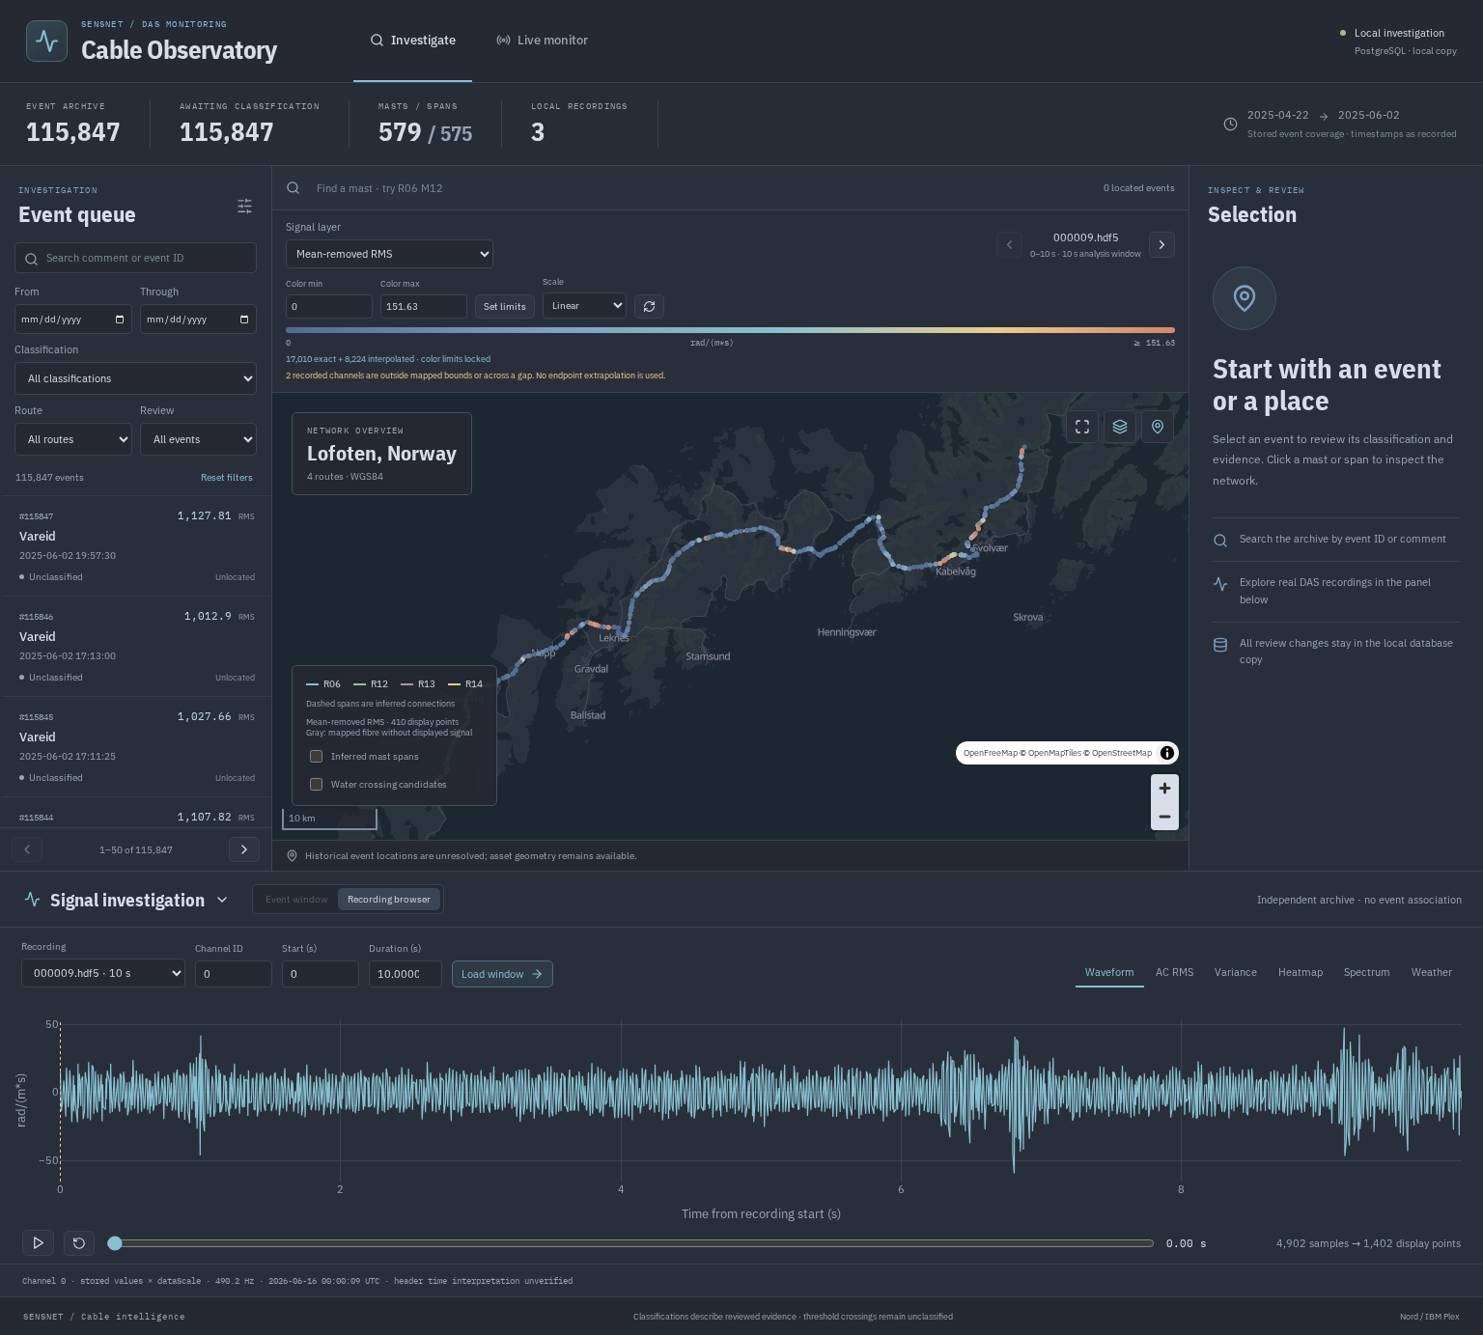
03 / THE NEW USER INTERFACE
The new UI brings map, signals and review together
A single workspace helps reviewers move from cable behaviour to a documented conclusion.
1. Explore the network
Search masts and routes. Use the map to choose where to
investigate.
2. Inspect the recording
Review signal patterns and play back the recording to see
changes over time.
3. Record the conclusion
Select an event to save its category, reviewer and supporting
evidence.
UI DEMONSTRATION
Visible event entries are illustrative, not real incidents.
SCREENSHOT / local application; demonstration entries shown for interface illustration only
UBE / 04
Notes:
Sources: docs/map-app.md and assets/application-overview.png. Screenshot is an unchanged capture of the local application. Event entries and counts visible in the screen are randomly generated demonstration data, as clarified by the user; they are not real incidents, a training set or performance evidence. The slide illustrates interface capabilities only. The map displays assets and signal layers; the recording browser supports waveform, heatmap, spectrum and playback. The review panel supports a category, reviewer, evidence note and review history when an event is selected. No event is selected in this overview screenshot. The displayed recording is an independent archive example. Screenshot retains the original app branding and colours, and basemap attribution: OpenFreeMap / OpenMapTiles / OpenStreetMap. The supplied Ubeconn logo and pale ube slide palette remain unchanged.
Sources: SCREENSHOT / local application; demonstration entries shown for interface illustration only

Slide 5
04 / WEATHER UPGRADE — DEPLOYED
Weather context now follows more of the network
Forecast coverage has expanded, and relative humidity is now being collected.
BEFORE
NOW
2
17
locations across the route
network
forecast locations
COLLECTED
COLLECTED
COLLECTED
NEW
Temperature
Wind speed
Wind direction
Humidity
New records also retain when the forecast applies and when it was issued.
Richer weather context supports event interpretation; forecasts do not confirm the cause of an event.
EVIDENCE / docs/weather.md · migration 005 applied on server and local installation
UBE / 05
Notes:
Migration 005_distributed_weather.sql and the collector were deployed on 16 September 2026. Two original locations remain; fifteen new points use mast coordinates across R06, R12, R13 and R14 at approximately five kilometre spacing. There are now 17 locations × four weather variables. Both installations recorded successful initial captures of 68 rows. Server capture runs hourly at minute 13; local capture is on demand. These are MET/YR modeled forecasts, not direct measurements. Source validity, issue and retrieval timestamps are stored on new rows. Integration with ML requires verified recording times, appropriate location selection and weather available at the time of the event.
Sources: EVIDENCE / docs/weather.md · migration 005 applied on server and local installation

Slide 6
05 / MACHINE LEARNING, IN PLAIN LANGUAGE
We use Random Forest machine learning for classification
Supervised learning: confirmed examples teach the model to recognise the four event categories.
THE CLUES
MACHINE LEARNING TECHNIQUE
THE RESULT
Cable behaviour +
weather
Random Forest
A suggested category
for review
300 decision trees learn from
confirmed examples. Their
combined votes suggest the
event category.
How strong is the vibration?
Is it rhythmic or irregular?
What were the conditions?
The output includes a class and
scores. Uncertain cases are
flagged for attention.
INTENDED OUTPUTS
Normal operations
Ice loading
Wind galloping
External interference
The software can learn and make predictions; its reliability must be demonstrated on independent events.
MODEL STATUS / supervised training software implemented; field accuracy not yet established
UBE / 06
Notes:
Source: src/Capture/event_ml.py and docs/event-ml.md. The supervised baseline is a Random Forest with 300 decision trees and balanced class weights. Training uses signal summaries covering vibration strength, peaks, rhythmic behaviour, variability across channels and changes over the window, plus optional temperature, wind speed/direction and humidity. Missing weather is explicit. The model learns rules from reviewed examples; a new window receives a predicted class, four uncalibrated scores and a low-score review flag. No supervised trained model or measured field accuracy is supplied. The scores must not be presented as a validated confidence percentage. Weather must be aligned before being used. The baseline outputs a single category for each window, not an incident duration or severity.
Sources: MODEL STATUS / supervised training software implemented; field accuracy not yet established

Slide 7
06 / THE LEARNING PROCESS
Two machine-learning steps support event classification
Unsupervised learning finds patterns; supervised learning links those patterns to confirmed event types.
01 / PILOT COMPLETED
02 / NEXT PRIORITY
03 / SOFTWARE READY
04 / BEFORE ROLLOUT
Find patterns
Confirm the
cause
Teach the
model
Test new
events
K-means groups
similar signals.
Isolation Forest
highlights unusual
ones.
People use inspections
or incident evidence to
assign reliable labels.
Random Forest learns
the four event
categories from
expert-labeled
examples.
Check its suggestions
on events it has never
seen during training.
PILOT EVIDENCE
Discovery exercised on about 15 minutes of real recordings.
Finding an unusual pattern is a way to select examples for review; it does not establish an event class.
EVIDENCE / docs/event-discovery.md · recorded discovery pilot · docs/event-ml.md
UBE / 07
Notes:
The offline discovery workflow uses clustering (KMeans) and anomaly ranking (Isolation Forest), without verified class labels. The recorded pilot covered roughly 15 minutes across 90 archive files, producing 240 window/block feature rows and six exploratory clusters. These clusters are not the four event classes. No weather join was used in that pilot. Human reviewers must use independent evidence, including inspections, cameras or confirmed incident records, to assign labels. A separate supervised Random Forest can then train on those examples. Related windows from one session/incident must stay in the same evaluation group, with additional unseen sites/seasons/incidents reserved for final assessment. Neither the pilot nor its six clusters demonstrates event-classification accuracy.
Sources: EVIDENCE / docs/event-discovery.md · recorded discovery pilot · docs/event-ml.md

Slide 8
07 / THE FOUR CATEGORIES
The goal is to distinguish four types of operation
Each category needs confirmed examples, including cases that are easy to confuse.
01
Normal operations
02
Ice loading
Recognise normal cable behaviour,
including windy conditions.
Test for changes associated with
independently confirmed ice.
03
Wind galloping
04
External interference
Recognise sustained cable movement
confirmed in the field.
Investigate disturbances such as strikes or
vegetation contact.
A quiet signal is not automatically normal, and cold or humid weather is not proof of ice.
TARGET CATEGORIES / classification design; detection performance still to be validated
UBE / 08
Notes:
Source: docs/event-ml.md; project objectives in AGENTS.md. Exact database class names are Normal Operations, Ice Loading, Wind Galloping and External Interference. Vegetation contact or strikes are examples for the External Interference category, not an independently validated vegetation classifier. Normal examples must include quiet and windy operation. Ice detection may need additional evidence, sensors or features; existing vibration features alone may not distinguish it reliably. The current model chooses one class per window and cannot express simultaneous ice and galloping. Class names do not establish severity, ice mass or loading force.
Sources: TARGET CATEGORIES / classification design; detection performance still to be validated

Slide 9
08 / BUILD THE TRAINING DATASET
Collect confirmed examples of real cable behaviour
Build a dedicated training dataset from verified recordings and independent field evidence.
01
Match the evidence
Real data
Confirm when and where a recording belongs.
02
Verify the cause
Verified labels
Use inspections, cameras or reliable incident reports.
A dedicated dataset for
training and testing the
classifier.
03
Include normal operation
Teach the model what ordinary conditions look like.
The most valuable next asset is a small, trustworthy set of examples that can grow over time.
NEXT PHASE / real recordings, expert labels and independent evaluation
UBE / 09
Notes:
Sources: user clarification; docs/event-ml.md; docs/map-app.md. Existing event records are randomly generated demonstration data and are excluded from the classification dataset. The user intends to delete them later; no database deletion is performed in this task. Collect verified real recordings for all four target classes, including varied normal operation. Retain recording/time/location references and independent evidence for every label. Keep related windows from the same incident grouped when evaluating the model. No amount of synthetic demonstration events establishes field performance.
Sources: NEXT PHASE / real recordings, expert labels and independent evaluation

Slide 10
09 / NEXT STEPS
Start with verified examples, then classify with oversight
A short sequence takes the project from the current platform to useful event suggestions.
STEP 1
STEP 2
STEP 3
STEP 4
Select and align
Confirm the
labels
Train and test
Use with review
Choose pilot
recordings and verify
time, place and
weather.
Measure correct
classifications, missed
events and false alerts.
Pilot model
suggestions while
people check the
results.
Have experts review
examples of all four
categories.
FIRST MILESTONE: an expert-reviewed dataset with evidence for every label.
Management focus: agree the pilot scope and assign a field-review owner to build the first labeled dataset.
PROPOSED NEXT STEPS / scope, owners and acceptance targets to be agreed
UBE / 10
Notes:
Proposed sequence grounded in docs/event-ml.md, docs/map-app.md and docs/weather.md. 1: select a manageable pilot scope and verify recording time, channel/location mapping, preprocessing and weather availability. 2: field experts label representative examples for all four classes, keeping independent incidents grouped and retaining evidence. 3: train the Random Forest and assess on independent events, measuring per-class precision/recall, false alerts, missed events and practical reviewer workload; confidence scores and thresholds need validation. 4: run class suggestions in a controlled pilot with human review before automating operational escalation. Model output is not yet integrated as a proven production classifier. No budget, schedule, numerical performance or customer commitment is implied. Initial management action: name a field-review owner and agree the pilot scope.
Sources: PROPOSED NEXT STEPS / scope, owners and acceptance targets to be agreed

