Slide 1
Lecture 3
Review of Internet Protocols Transport Layer

Slide 2
Protocols: HW/SW Interface
Internetworking: allows computers on independent and incompatible networks to communicate reliably and efficiently;
Enabling technologies: SW standards that allow reliable communications without reliable networks
Hierarchy of SW layers, giving each layer responsibility for portion of overall communications task, called protocol families or protocol suites
Transmission Control Protocol/Internet Protocol (TCP/IP)
This protocol family is the basis of the Internet
IP makes best effort to deliver; TCP guarantees delivery
TCP/IP used even when communicating locally: NFS uses IP even though communicating across homogeneous LAN
Notes:
WS companies used TCP/IP even over LAN
Because early Ethernet controllers were cheap, but not reliable

Slide 3
Services provided by layers
Each layer in protocol stack provides a “service”
Uses service from lower layers
Benefits of layering
Isolates complexity
Clearly defined interfaces
Protocols implement functionality within layer

Slide 4
Layered Network Architecture (OSI)
Network
B
A
DATA
7
Application
AH
DATA
Application
7
6
Pre.
PH
DATA
Pre.
6
5
Session
SH
DATA
Session
5
4
Transport
TH
DATA
Transport
4
3
Network
NH
DATA
Network
3
2
Data Link
DH
DATA
Data Link
2
1
Physical
PH
DATA
Physical
1

Slide 5
TCP/IP Model
OSI
TCP/IP
7
Application
Application
6
Pre.
5
Session
4
Transport
TCP
3
Network
IP
2
Data Link
Host-to-Net
1
Physical
ISO OSI (Open Systems Interconnection) not fully implemented
Presentation and Session layers not present in TCP/IP

Slide 6
Protocols
Protocols define communication between entities
Format and order of messages
Actions taken on transmission and/or receipt of message or other event
Protocols use headers (and trailers) for control information
Naming depends on layer

Slide 7
Process-to-process communication
We have a network. How to get between programs?

Slide 8
Process Communication
How do the end systems communicate?

Slide 9
Interface-to-interface connectivity
We now have links. How to get across the network?

Slide 10
Datagrams
Datagrams are forwarded independently

Slide 11
TCP/IP packet
Application sends message
TCP breaks into 64KB segments, adds 20B header
IP adds 20B header, sends to network
If Ethernet, broken into 1500B packets with headers, trailers
Header, trailers have length field, destination, window number, version, ...
Ethernet
IP Header
TCP Header
IP Data
TCP data
(≤ 64KB)

Slide 12
Communicating with the Server: The O/S Wall
Problems:
O/S overhead to move a packet between network and application level => Protocol Stack (TCP/IP)
O/S interrupt
Data copying from kernel space to user space and vice versa
Oh, the PCI Bottleneck!
User
CPU
Kernel
PCI Bus
NIC
NIC

Slide 13
The Send/Receive Operation
The application writes the transmit data to the TCP/IP sockets interface for transmission in payload sizes ranging from 4 KB to 64 KB.
The data is copied from the User space to the Kernel space
The OS segments the data into maximum transmission unit (MTU)–size packets, and then adds TCP/IP header information to each packet.
The OS copies the data onto the network interface card (NIC) send queue.
The NIC performs the direct memory access (DMA) transfer of each data packet from the TCP buffer space to the NIC, and interrupts CPU activities to indicate completion of the transfer.

Slide 14
Transmitting data across the memory bus using a standard NIC
http://www.dell.com/downloads/global/power/1q04-her.pdf

Slide 15
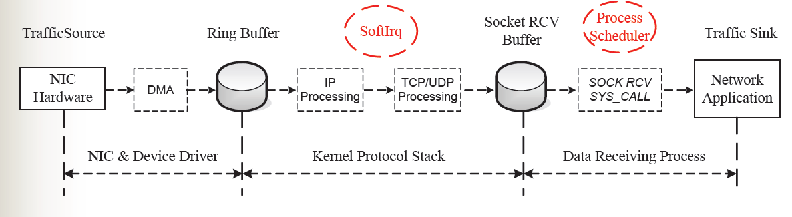
TCP/IP Processing Path (RX)

Slide 16
Network I/O Processing
1000
TCP requirements Rule of thumb:
1GHz for 1Gbps
100
100
Network bandwidth outpaces Moore’s Law
40
10
10
GHz and Gbps
1
0.1
Moore’s Law
.01
1990
1995
2000
2003
2005
2006/7
2010
Time

Slide 17
I/O Acceleration Techniques
Architectural Improvement
TCP Offload: Offload TCP/IP Checksum and Segmentation to Interface hardware or programmable device (Ex. TOEs)
O/S Bypass: User-level software techniques to bypass protocol stack – Zero Copy Protocol
(Needs programmable device in the NIC for direct user level memory access – Virtual to Physical Memory Mapping. Ex. VIA)
All the high bandwidth NICs today employ some kind of TCP Offload and O/S Bypass techniques

Slide 18
Multiplexing/de-multiplexing
Multiple processes operate on one computer
Interface address alone is not sufficient to distinguish
Need to (de)multiplex traffic from different processes
5-tuple used for unique identification of connection
IP source address
IP destination address
Transport layer source port
Transport layer destination port
Transport layer protocol

Slide 19
TCP/IP packet
MAC
IP
TCP
APP. DATA
MAC
Source Port
Destination Port
Sequence Number
Acknowledgement Number
Header Length and Options
Window Size
Checksum
Urgent Pointer
Options (0 or more 32-bit words)

Slide 20
TCP/IP packet
MAC
IP
TCP
APP. DATA
MAC
Ver.
IHL
Service Type
Total Length
Identification
Options and Fragment Offset
Time to Live
Protocol
Header Checksum
Source Address
Destination Address
Options (0 or more 32-bit words)

Slide 21
TCP/IP packet
MAC
IP
TCP
APP. DATA
MAC
Preamble
D. Add.
S. Add.
Leng.
CRC

Slide 22
TCP Header: 5-tuple example
5-tuple is reversed for return communication
Destination port is associated with application layer protocol (e.g., 80 for HTTP)
Operating system picks source port randomly

Slide 23
TCP header
Port numbers
Sequence number
Position of data
ACK number
Next expected data
Checksum
Flags for connection setup and teardown

Slide 24
What functionality does TCP provide?
Reliability
Recovery from errors in the network layer
Flow control
Limit transmission rate to not overwhelm receiver
Congestion control
Limit transmission rate to not overwhelm network

Slide 25
Reliable data transfer
How can reliability be achieved?
Consider different assumptions for network layer
Case 1: completely reliable network layer
Send segment
Case 2: bit errors in network layer
Add error detection and ACK/NAK
Add sequence number to handle garbled ACK/NAK
Case 3: bit errors and packet loss in network layer
Timer to trigger retransmission
“Stop-and-wait” protocol

Slide 26
Reliable data transfer
Stop-and-wait has low performance
How can we increase throughput?
Sliding window
Allow multiple segments “in-flight”

Slide 27
Sliding window example

Slide 28
UDP: bare bones protocol
Ports, length, checksum
Checksum is optional

Slide 29
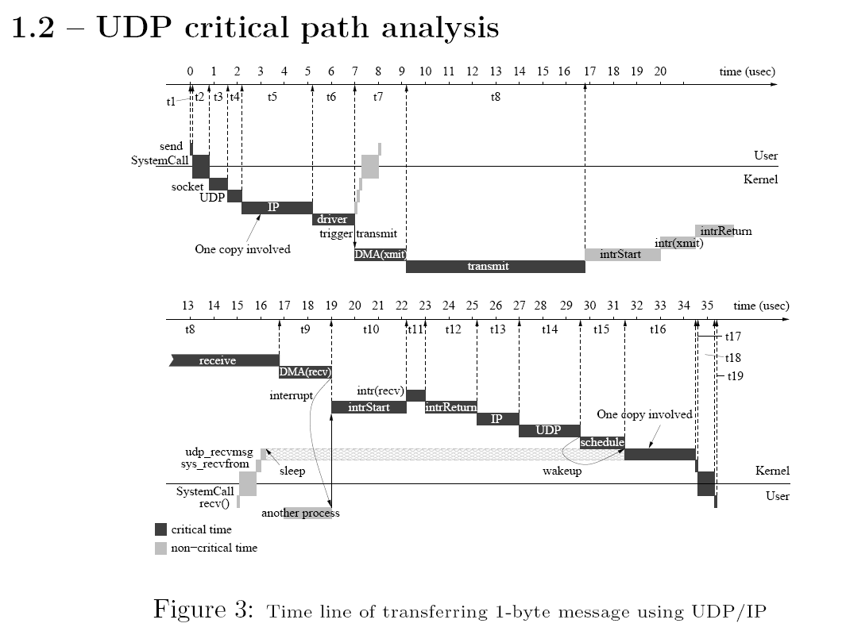

Slide 30
Internet Protocol
IP header
Source and destination address
Datagram length
Upper layer protocol
Identifies TCP, UDP, etc.
Time to live
Protection against accidental loops
Header checksum
Protection against bit errors
Fragmentation possible
Link layer limited to some datagram size (min. MTU is 576 bytes)

Slide 31
Other IP aspects
Routing
Determines forwarding
ICMP
Error handling
Link layer
Address resolution (ARP)
Dynamic IP addresses (DHCP)
Application layer
Domain names (DNS)
Transport layer
Network address translation (NAT)
New IP version: IPv6

Slide 32
Network systems
Data is switched between network stacks

Slide 33
Classification of network systems
Network system differ by level of protocol processing

Slide 34
Example network system: NIC
Network interface card / adapter connects to link
Block diagram:

Slide 35
Example network system: switch
Switch connects multiple links
Block diagram:

Slide 36
Example network system: switch
System may differ by system architecture
Example: share memory vs. distributed memory

Slide 37
Application requirements
Different applications have different requirements:

Slide 38
Throughput preservation
Throughput performance
Ensure network system can handle link rates at all points
Delay/jitter
Ensure network system processes traffic quickly
Packet loss
Ensure sufficient buffer space and fast processing
Most network system design focus on bandwidth

Slide 39
Packet rate vs. data rate
Data rate states total number of bits per second
Each packet requires specific processing
Packet rate sometimes more meaningful
What is the packet rate for a 10Gbps link?
Distinguish small packets and large packets

Slide 40
System design for throughput
What are the differences between these systems?
How do they affect throughput preservation?

