Slide 1
Lecture 4
Network Processors: A Solution to the Next Generation Networking Problems

Slide 2

Outline
Background and Motivation
Network Processor Architecture
Next Generation Network applications
Our Research – NePSim, DVFS/Clock Gating, Web Switch Design and Evaluation (IEEE Micro2004, DAC 2005, Hot I 2005, ANCS 2005)

Slide 3
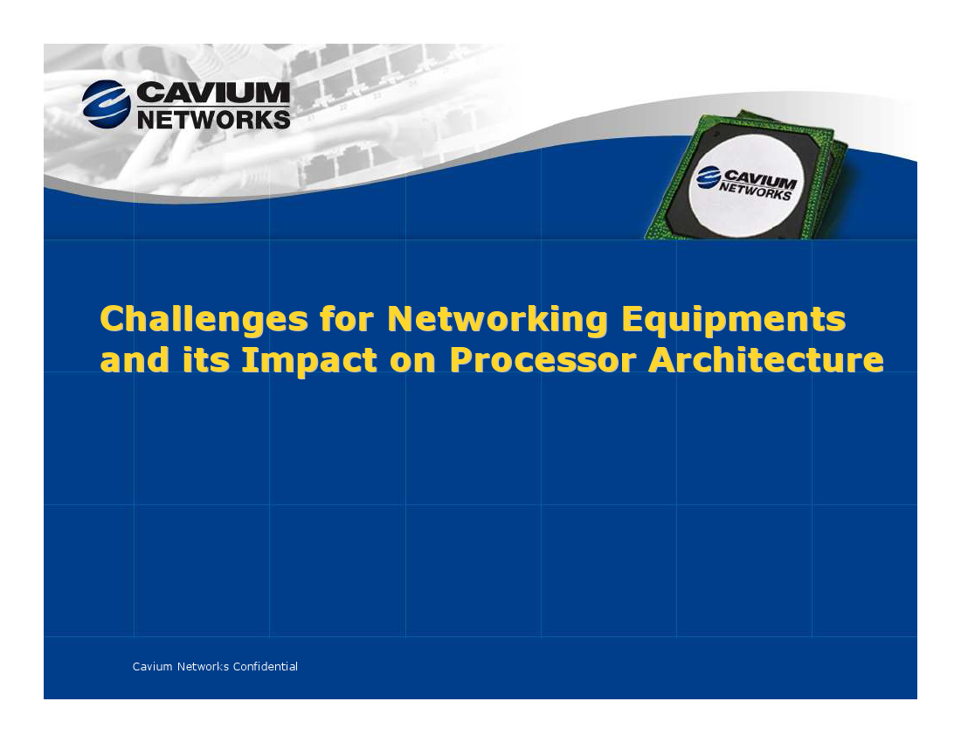

Slide 4
Processing Tasks
Policy Applications
Control
Plane
Network Management
Signaling
Topology Management
Queuing / Scheduling
Data Transformation
Data
Plane
Classification
Data Parsing
Media Access Control
Physical Layer

Slide 5
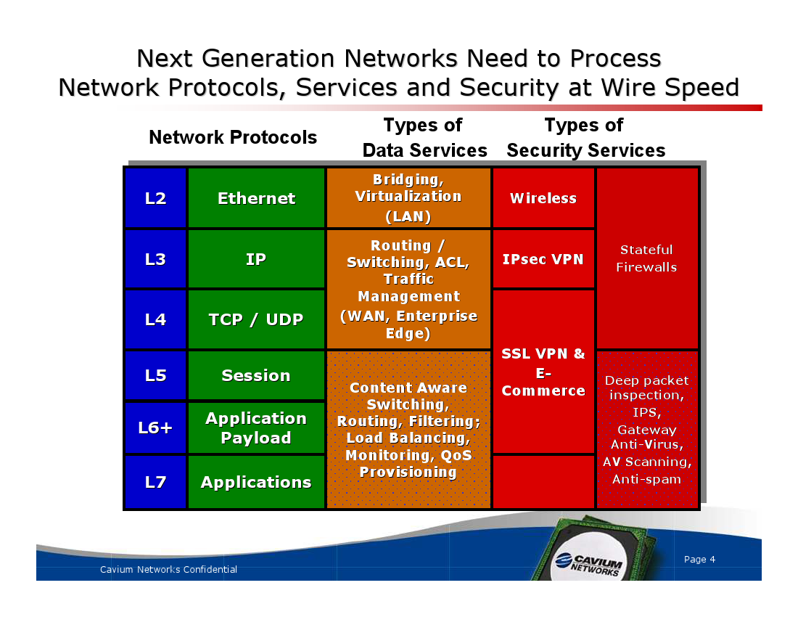

Slide 6
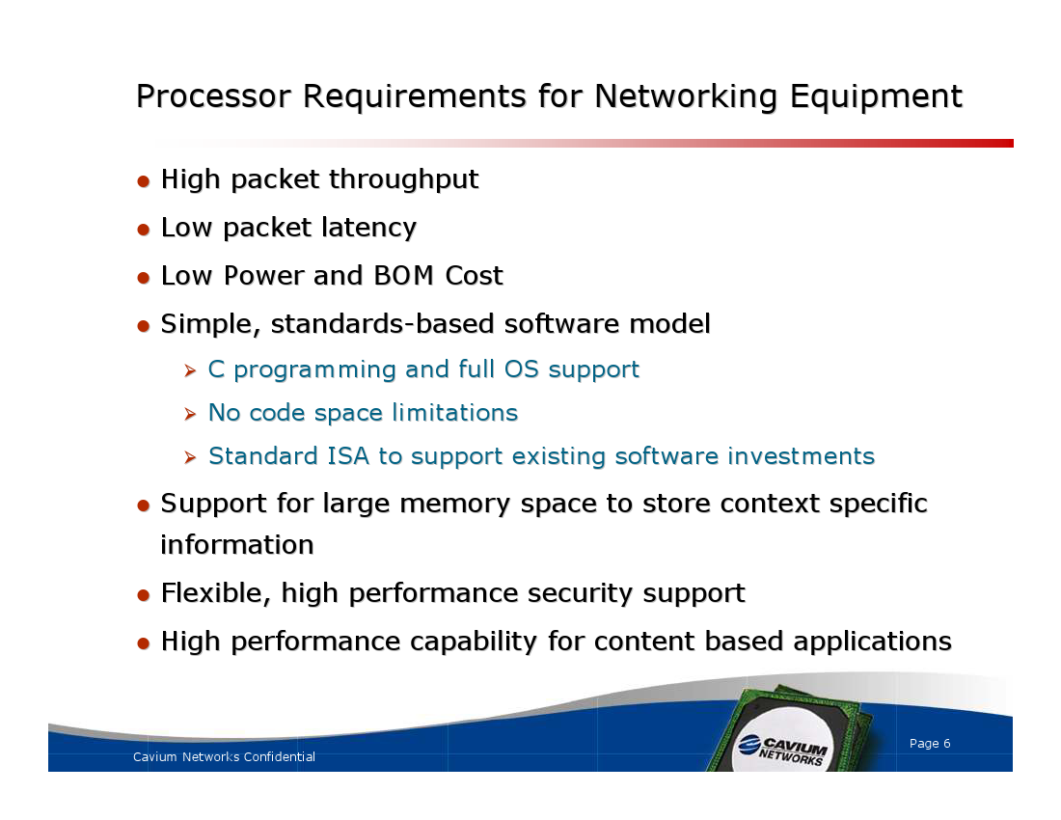

Slide 7
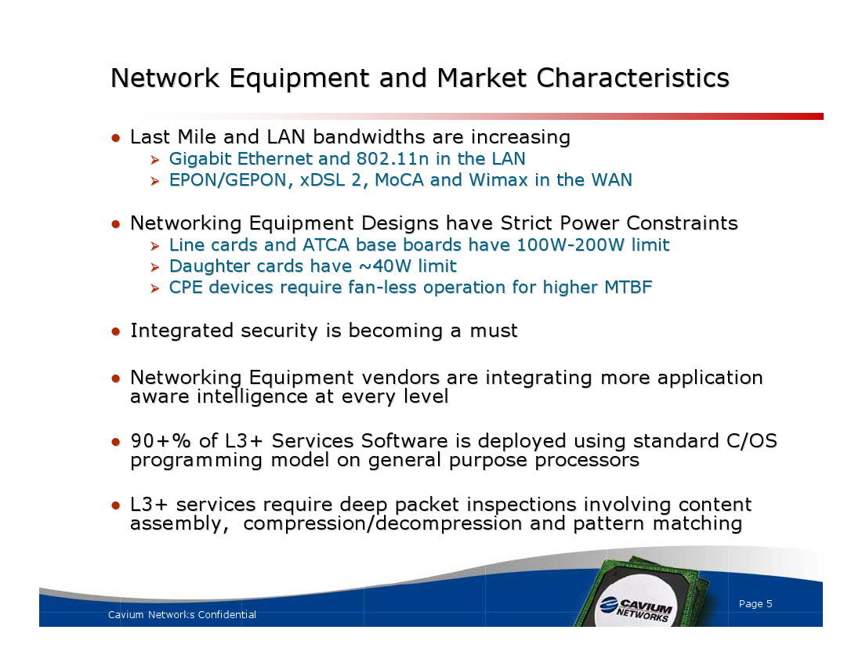

Slide 8
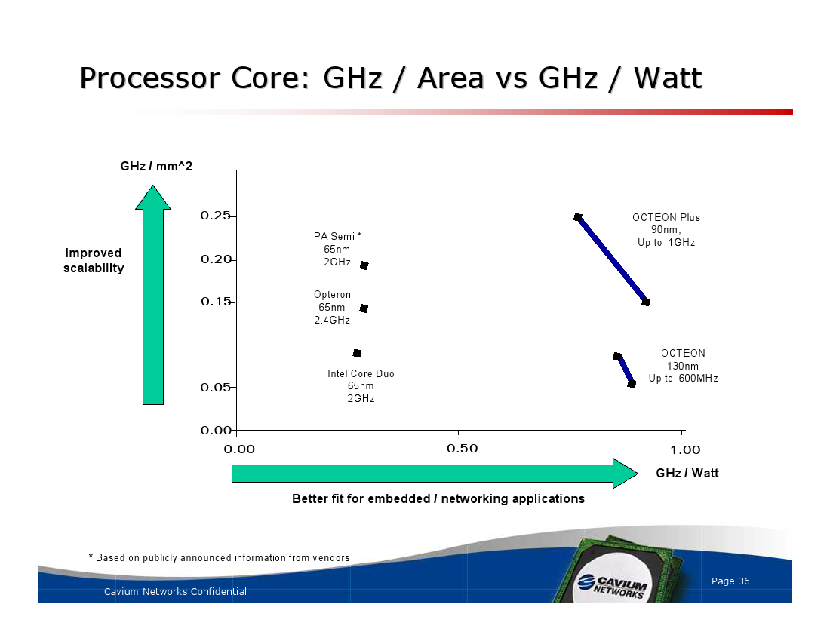

Slide 9
Introduction to Network Processors
Traditional processors in networks
  General-purpose CPU
    Not fast enough to handle new link speeds
  ASIC
    Good performance, but lack flexibility. New applications or protocols make the old processor obsolete
Solution: Network Processors (NPs)
  Processors ‘optimized’ for networking applications
    Very powerful processors with additional special-purpose logic
      Accelerators for a set of tasks
      Special memory controllers for moving packet data
  Software programmable

Slide 10
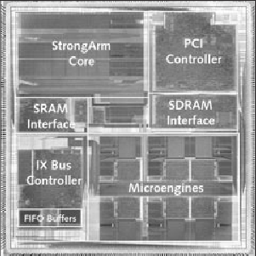
Packet Processing in the Future Internet
Network Processors
ASIC
Future Internet
More packets
&
Complex packet
processing
High processing power
Support wire speed
Programmable
Scalable
Optimized for network applications
…
General-
Purpose Processors
Notes:
It is not hard to predict some of the characteristics of the next generation Internet.
We will see increasing huge amount of packets flowing along the internet infrastructure, partly due to the large number of computers connected, partly due to the versatile network applications. Traditional routing still exists. Packet classification is a necessity for differentiated service. We need secure online transactions so secure processing such secure socket layer (SSL) is deployed everywhere. Voice-over-IP gets more popular. It is safe to image more and more new applications and protocols appear quickly.
There are currently two approaches to meet the large demand of packet processing in the next generation of Internet.
One is using Application Specific Integrated Circuit (ASIC). The advantage of dedicated hardware is the performance. However, you have paying for the cost of long-time development and verification process. And most importantly, ASIC is not flexible. For example you bought an ASIC product that implements MD5. Just recently the MD5 algorithm is proven not safe any more. So you have to abandon the product and buy a new one. That is a big waste of money.
As opposite to ASICs, The other approach is to use GPP, such as MIPS or ARM chips because you can easily change the software programs. However, they are not capable for process packets at Gigabit or 10Gb rate, simply because they are designed for general purpose tasks, not specifically for packet processing at high rate.
As a result, a new breed of processors, - NP- have been designed to combine the high performance of ASICs and programmability of GPP.

Slide 11








Applications of Network Processors
DSL modem
Edge router
Core router
Wireless router
VoIP terminal
VPN gateway
Printer server

Slide 12
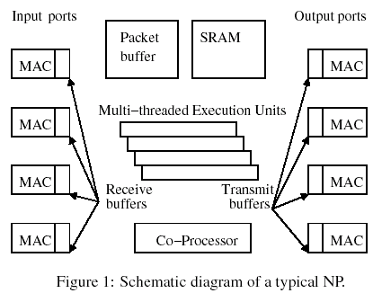


Background on NP
Architecture
  Control processor (CP): embedded general purpose processor, maintain control information
  Data processors (DPs): tuned specifically for packet processing
  Communicate through shared SRAM and DRAM
NP operation
  Packet arrives in receive buffer
  Packet Processing
  Transfer the packet onto wire after processing
DP
CP

Slide 13
Core Processing Techniques
Packet-Level Parallel Processing
  Distribute packets to independent processing units
Packet-Level Pipelining
  Build an array – each processor executes a specific task
Multi-threading
  Packets are relatively independent – so switch to another one in the face of a memory access delay
Smart memory management and DMA units
  Allocate storage and transfer packet headers and payloads without oversight
Special purpose hardware accelerators
  Tree lookup, CRC, CAM

Slide 14

Intel IXP 2400
SRAM
SRAM
controller
ME
ME
Scratch
Hash
CSR
ME
ME
XScale
SDRAM
IX bus
interface
PCI
ME
ME
SDRAM
controller
ME
ME
XScale core
8 Microengines(MEs)
Each ME
  run up to 8 threads
  4K instruction store
  Local memory
Scratchpad memory, SRAM & DRAM controllers

Slide 15
72
DDRAM
MEv2
1
MEv2
2
Rbuf
64 @ 128B
S
P
I
3
or
C
S
I
X
32b
MEv2
4
MEv2
3
PCI
(64b)
66 MHz
Intel®
XScale™
Core
32K IC
32K DC
G
A
S
K
E
T
Tbuf
64 @ 128B
32b
64b
MEv2
5
MEv2
6
Hash
64/48/128
Scratch
16KB
QDR
SRAM
1
QDR
SRAM
2
MEv2
8
MEv2
7
CSRs
-Fast_wr -UART
-Timers -GPIO
-BootROM/Slow Port
E/D Q
E/D Q
18
18
18
18
IXP2400

Slide 16
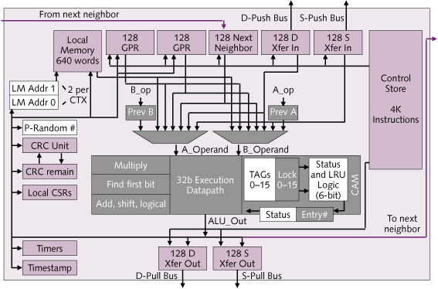
Intel IXP2400 Datapath
XScale core replaces StrongARM
1.4 GHz target in 0.13-micron
Nearest neighbor routes added between microengines
Hardware to accelerate CRC operations and Random number generation
16 entry CAM

Slide 17
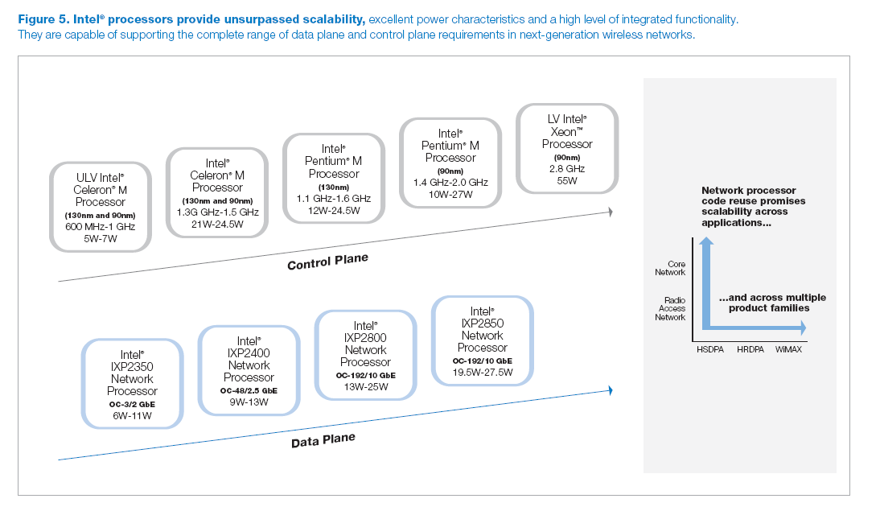

Slide 18
Other Commercial Network Processors
IBM Power NP,
Cisco Twister,
Motorola C-Port
AMCC nP7510
EZchip NP2
Agere PayloadPlus
Hifn 5NP4G
Notes:
This table lists the representative products of these NP providers. You can see most of them now support OC 192 which is 10Gb.
The majority of the network processors have features like multi-core, multi-threading, optimized ISA, on-chip h/w accelerators.

Slide 19
Commercial Network Processors
Vendor | Product | Line speed | Features
AMCC | nP7510 | OC-192/ 10 Gbps | Multi-core, customized ISA, multi-tasking
Intel | IXP2850 | OC-192/ 10 Gbps | Multi-core, h/w multi-threaded, coprocessor, h/w accelerators
Hifn | 5NP4G | OC-48/ 2.5 Gbps | Multi-threaded multiprocessor complex, h/w accelerators
EZchip | NP-2 | OC-192/ 10 Gbps | Classification engines, traffic managers
Agere | PayloadPlus | OC-192/ 10 Gbps | Multi-threaded, on-chip traffic management
Notes:
This table lists the representative products of these NP providers. You can see most of them now support OC 192 which is 10Gb.
The majority of the network processors have features like multi-core, multi-threading, optimized ISA, on-chip h/w accelerators.

Slide 20
Octeon Processor Acrchitecture

Slide 21
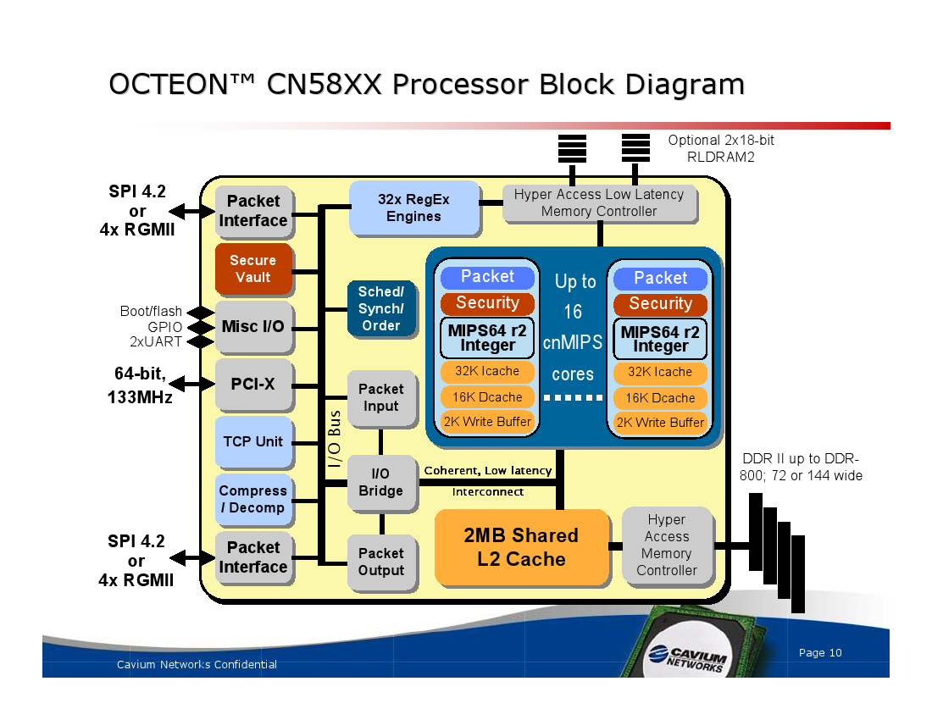

Slide 22
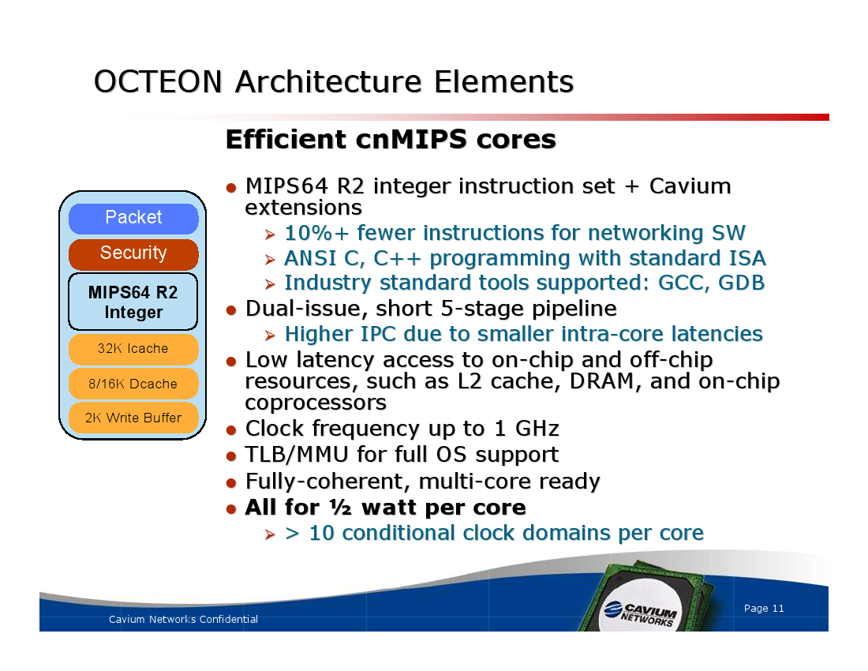

Slide 23
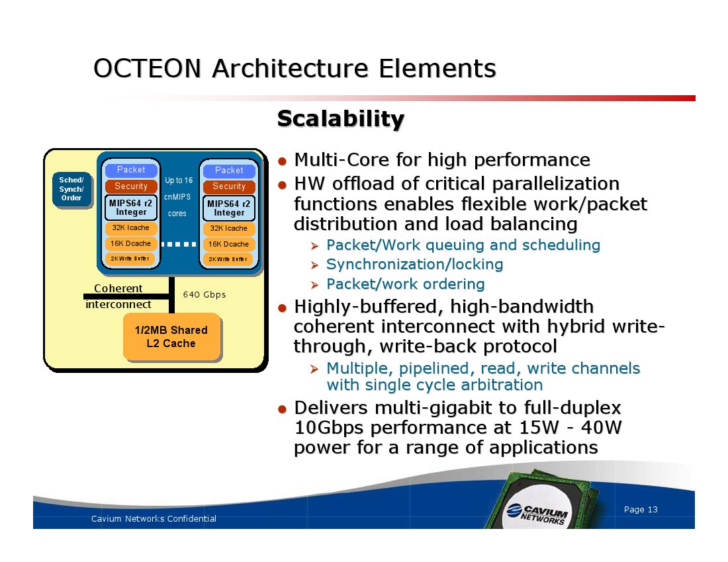

Slide 24
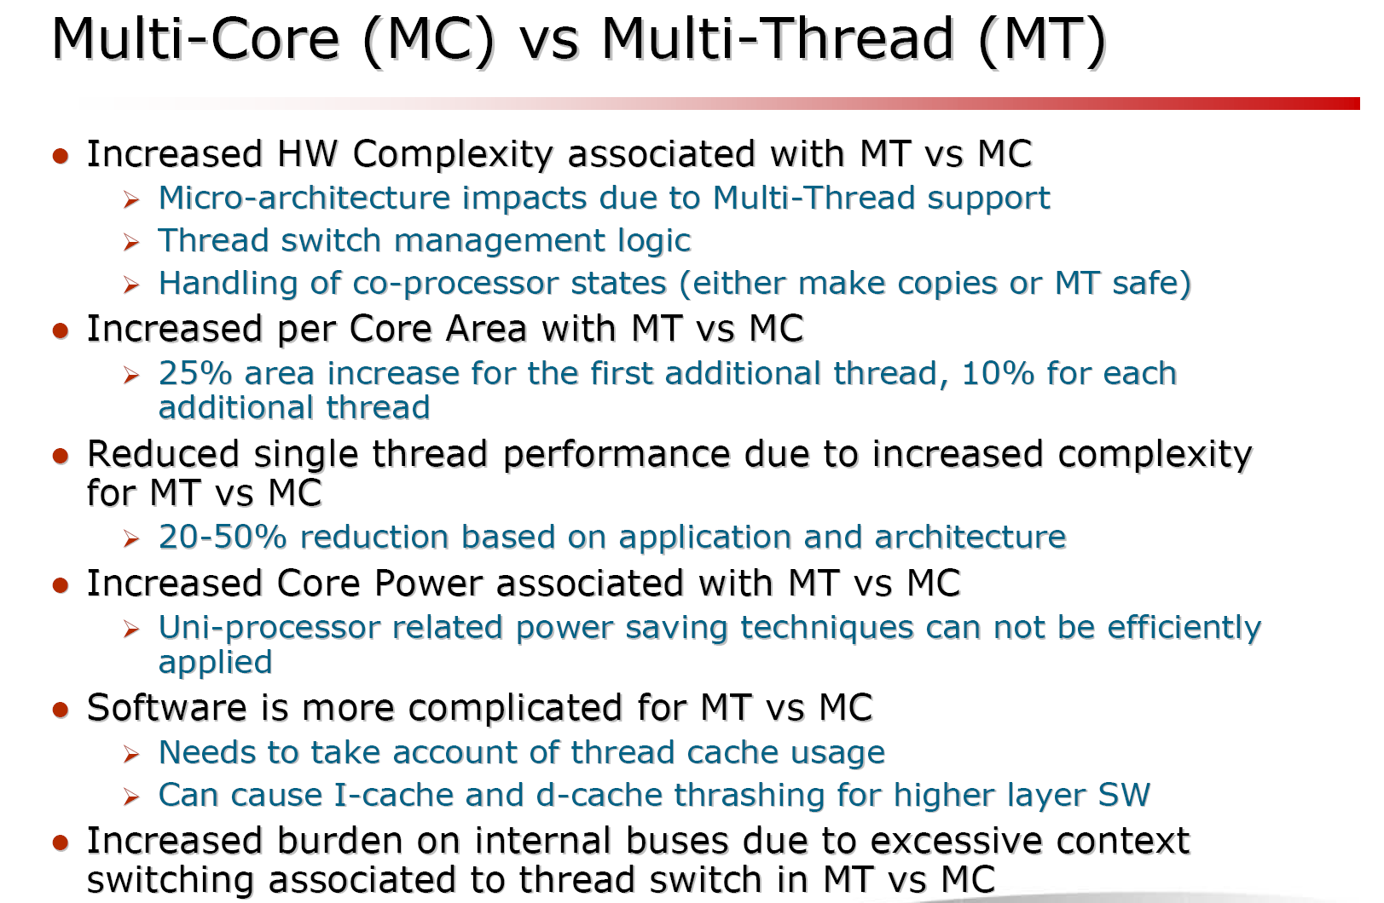

Slide 25
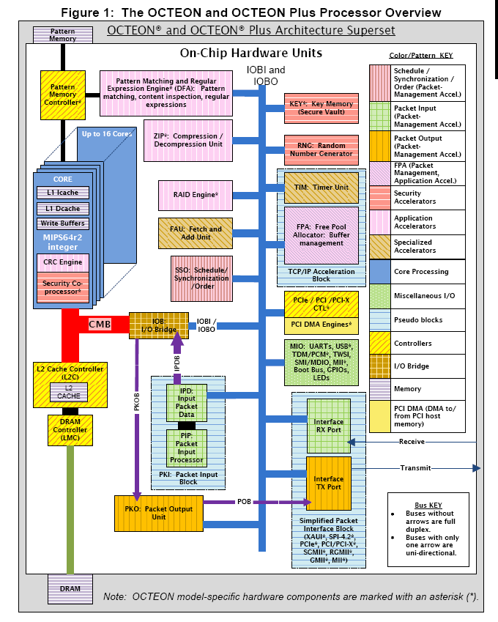

Slide 26
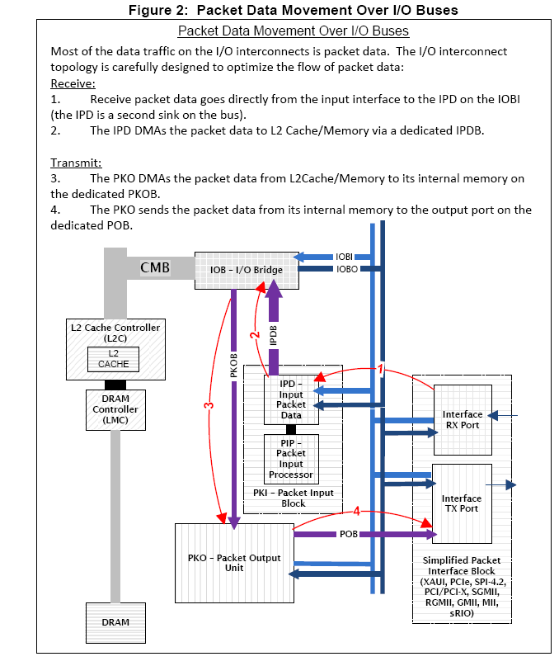

Slide 27

Our Research
Design and Evaluation and Low Power Design of Network Processors
Notes:
Good morning everyone, It is my great pleasure to be here presenting my research. The topic of my presentation today is low power design of network processors.
This research is supported by National Science Foundation and Intel Corp.

Slide 28

Outline
NePSim – A Network Processor Simulator
Power Saving with Dynamic Voltage Scaling
Adapting Processing Power Using Clock Gating
Notes:
Here is the outline of my talk. I will first talk about the research background and motivation.
Next I will introduce you our network processor simulator –NePSim
Then I will present some performance evaluation results using NePSim
After that, I will present two power saving techniques for network processors.
One is DVS
The other one is adapting processing power using clock gating.
I will conclude my talk with ongoing research and future directions.

Slide 29

Objectives and Challenges of NePSim
Objectives
  Open-source
  Cycle-level accuracy
  Flexibility
  Integrated power model
  Fast simulation speed
Challenges
  Domain specific instruction set
  Porting network benchmarks
  Difficulty in debugging multithreaded programs
  Verification of the functionality and timing
  Yan Luo, Jun Yang, Laxmi Bhuyan, Li Zhao, NePSim, IEEE Micro Special Issue on NP, Sept/Oct 2004, Intel IXP Summit Sept 2004, 250+ downloads, 1600+ page visits, users from Univ. of Arizona, Georgia Tech, Northwestern Univ., Tsinghua Univ.
Notes:
We want a open-source simulator that models a real NP. We chose to model Intel IXP1200, partly because of the support from Intel, partly because of its popularity in the current NP market and research community.
We want to have cycle-level accuracy.
We want the flexibility for users to add new instructions and functional units.
To conduct power related research, we need to integrate power model to enable power dissipation simulation and optimizations
We want the extensibility of the simulator for future NP architectures.
We want it fast so that we can obtain simulation results within reasonable time.

Slide 30
NePSim Software Architecture
Microengine (six)
SRAM
Microengine
Stats
Memory (SRAM/SDRAM)
SDRAM
Network Device
Debugger
Network Device
Debugger
Verification
NePSim
Statistic
Verification
Notes:
This figure shows the software architecture of NePSim. Each block is a software module in NePSim.

Slide 31

Benchmarks
ipfwdr
  IPv4 forwarding(header validation, IP lookup)
  Medium SRAM access
nat
  Network address translation
  Medium SRAM access
url
  Examines payload for URL pattern
  Heavy SDRAM access
md4
  Compute a 128-bit message “signature”
  Heavy computation and SDRAM access
Notes:
To conduct performance evaluation, we ported four representative network applications as benchmarks.
There is no compiler that compiles standard C program into binary executable for IXP1200. So porting these benchmarks means rewriting the program in microengine C language, which need significant effort
Reminder: SRAM stores control data structures such as routing table. SDRAM stores packet payload.
Ipfwdr is conventional packet forwarding task for IPv4 protocol. It conducts header validation and trie-based routing table lookup.
The lookup procedure has medium SRAM accesses.
url examines the packet payload for predefined patterns. It has large number of SDRAM accesses. It is often used in content aware routing.
Nat translates addresses between different networks, it incurs a number of SRAM accesses to the hash table.
Md4 is a hashing function that computes the 128-bit message digest. It involves heavy computation and large number of SDRAM accesses.

Slide 32
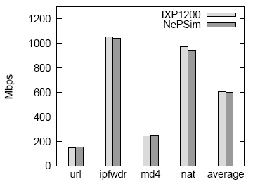
Validation of NePSim
Throughput
Notes:
We used logic of constraint language to verify the correctness and accuracy of NePSim simulator.
We verified the throughput and processing latency against IXP1200. We found that the throughput and average latency are within 1% and 6% respectively. So in our NP architecture research we use NePSim as the primary tool.
Our paper on NePSim appears in IEEE Micro Special Issue on NP in October 2004.

Slide 33
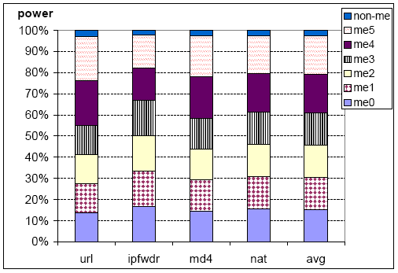
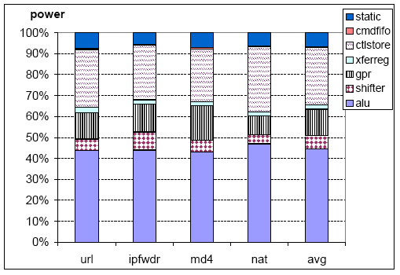
Power Consumption Breakdown
ME0..ME5
Control Store
GPR
ALU
Notes:
We conduct power estimation and found that:
Microengines consume the majority of the power.
ALU consumes significant power (about 45%) as multiple threads share an ALU
Control store uses 28% of the power because it stores instructions for threads, and it is access almost every cycle.
In addition, GPR consumes 13%, shifter 7%.
The ALU power is high. It might be because we derive it from Wattch model. Wattch’s ALU is more complex than ME. And Wattch derives the number from a old reference.

Slide 34
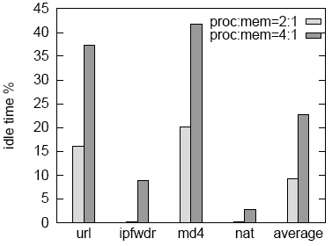
Slow Memory Causes Idle Time
4:1
2:1
Idle time gives the opportunities to save NP’s power
Notes:
This figure shows that there are more and more idle time as the speed gap of processor and memory increases.
WHY not using cache?
Not much locality in the arriving packet.
Program are stored in fast on-chip storage.

Slide 35
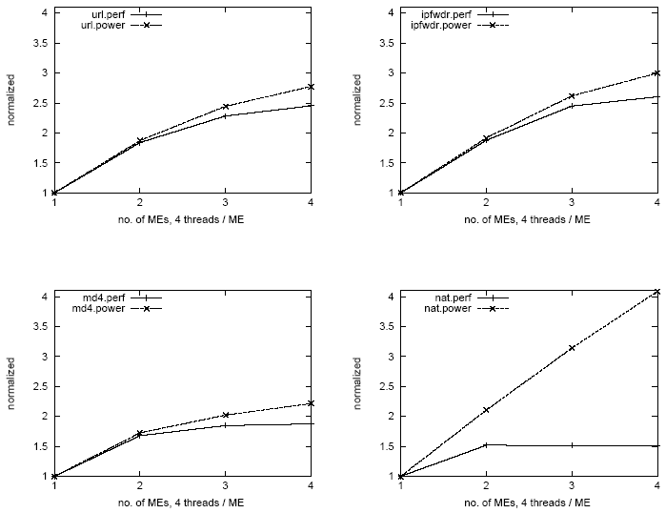
Performance-Power Trend
Power
Power
Performance
Performance
url
ipfwdr
Power
Power
Performance
Performance
md4
nat
Power consumption increases faster than performance

Slide 36
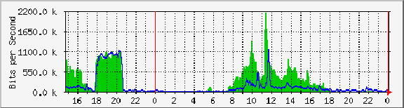
Real-time Traffic Varies Greatly
Slowdown the PEs by reducing voltage and frequency (DVFS)
Shutdown unnecessary PEs, re-activate PEs when needed (Clock gating)
Notes:
In reality, the network traffic varies greatly from time to time.
This figure plots how the traffic volume of a edge router fluctuated in a day.
System: CISCO 3660 Supporting BRCC Weyers Cave Campus
Maintainer: John York
Description: ATM0
ifType: Sonet
ifName: ATM0/0
Max Speed: 45.0 MBytes/s
Ip: 65.162.88.22

Slide 37
Dynamic Voltage and Frequency Scaling
(DVFS)
Power = C • α • V² • f
Voltage Frequency
Reduce PE voltage and frequency when PE has idle time
Notes:
So we actively slow down the execution of threads because we don’t have to run that fast. We reduce PE speed (frequency) when memory is bottleneck.
Frequency and Voltage go hand-in-hand. When frequency is low, voltage is low.
The good news is that power is proportional to F and the square of V. So what we are trading the speed for is the power consumption.

Slide 38
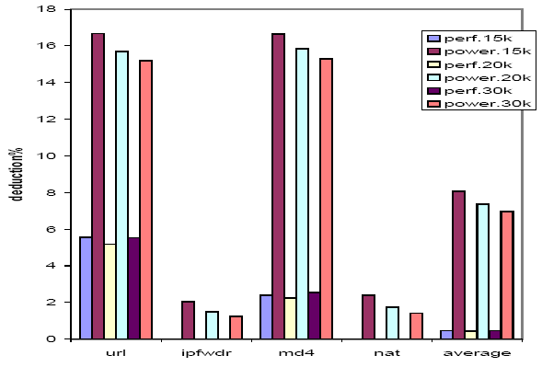
Power Reduction with DVFS
Power Reduction
Perf. Reduction
url ipfwdr md4 nat avg
Yan Luo, Jun Yang, Laxmi Bhuyan, Li Zhao, NePSim: A Network Processor
Simulator with Power Evaluation Framework, IEEE Micro Special Issue
on Network Processors, Sept/Oct 2004
Notes:
Initial (V,F)=(1.3V, 600MHz)
DVS period: every 15K, 20K or 30K cycles make a DVS decision to reduce or increase FV.
Up to 17% power savings with less than 6% performance loss
On average 8% power saving with <1% performance degradation
Packet header processing, payload processing.
More memory access, more idle time, more power saving opportunities.

Slide 39
Clock Gating/De-activating PEs
Network Interface
PE
Thread Queue
PE
Receive buffer
scheduler
H/w accelerator
Network Processor
Co-processor
  Length of thread queue
Bus
  Fullness of internal buffers
Yan Luo, Jia Yu, Jun Yang, Laxmi Bhuyan, Low Power Network Processor Design Using Clock Gating, IEEE/ACM Design Automation Conference (DAC), Anaheim, California, June 13-17, 2005

Slide 40
PE Shutdown Control Logic
If (thread_queue_length > T)
increment counter;
+
counter
>
threshold
+ alpha
MUX
- alpha
If (counter exceeds threshold)
{ turn-off-a-PE;
decrement threshold }
Length > T
true
Buffer full
T
-PE
+PE
If (buffer is full)
{ turn-on-a-PE;
increment threshold }
Thread queue
Internal Buffer
Notes:
First introduce T( the number of threads in a PE). Then the counter
Compare counter with threshold.
Why dynamic threshold ?
As different benchmarks have different processing time on packet. So the average queue length are different.

Slide 41
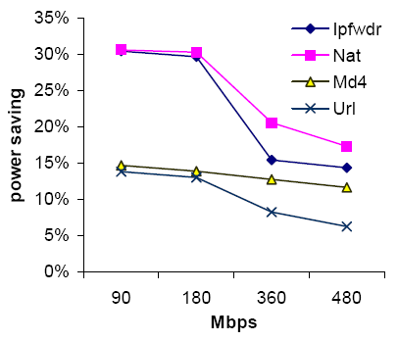
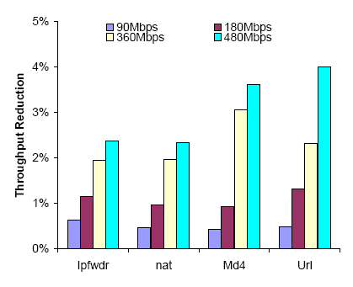
Performance Evaluation (I):
Power and Throughput

Slide 42
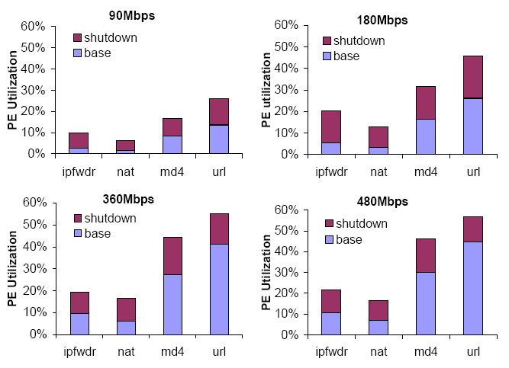
Performance Evaluation (II):
PE Utilization
Yan Luo, Jia Yu, Jun Yang, Laxmi Bhuyan, Low Power Network Processor Design Using Clock Gating,
IEEE/ACM Design Automation Conference (DAC), Ahaheim, California, June 13-17, 2005

Slide 43
Main Contributions
Constructed an execution driven multiprocessor router simulation framework, proposed a set of benchmark applications and evaluated performance
Built NePSim, the first open-source network processor simulator, ported network benchmarks and conducted performance and power evaluation
Applied dynamic voltage scaling to reduce power consumption
Used clock gating to adapt number of active PEs according to real-time traffic

Slide 44
NP Related Work
NP Performance
  An analytic framework [Franklin’02]
  Coarse-grain functional level approximation [Xu’03]
  Improving performance of memories [Hasan’03]
Power model
  Cacti [Jouppi’94]
  Wattch [Brooks’00]
  Orion [Wang’02]
Simulation Tools
  SDK(closed-source, no power model, low speed)
  SimpleScalar (disparity with real NP, inaccuracy)
Notes:
Performance
An analytic framework [Franklin, NP2002]
Coarse-grain functional level approximation [Xu,IEEE Network 2003].
StepNP [Paulin, IEEE Trans.DTC 2002]
Improving performance of memories [Hasan, ISCA2003]
Power model
Cacti for caches, CAMs and SRAM-cell based array structures.
Wattch \cite{Brooks,ISCA2000}
HotSpot for estimating chip temperature, \cite{Skadron, ISCA 2003}
Orion for interconnection networks [wang, Micro 2002],

Slide 45


Web Switch or Layer 5 Switch
www.yahoo.com
Internet
Image Server
IP
TCP
APP. DATA
Application Server
GET /cgi-bin/form HTTP/1.1
Host: www.yahoo.com…
Switch
HTML Server
Layer 4 switch
  Content blind
  Storage overhead
  Difficult to administer
Content-aware (Layer 5/7) switch
  Partition the server’s database over different nodes
  Increase the performance due to improved hit rate
  Server can be specialized for certain types of request

Slide 46
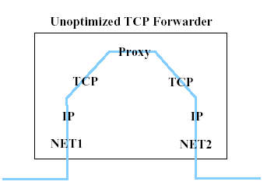
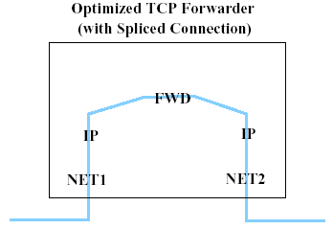

Layer-7 Two-way Mechanisms
TCP gateway Application level proxy on the web switch mediates the communication between the client and the server
TCP splicing Reduce the overhead in TCP gateway by forwarding directly by OS
user
kernel
user
kernel

Slide 47
TCP Splicing
SYNC
Time
SYND,ACKC+1
Establish connection with the client
  Three-way handshake
Choose the server
Establish connection with the server
Splice two connections
Map the sequence for subsequent packets
ACKD+1,DataC+1
SYNC
SYNS,ACKC+1
ACKS+1,DataC+1
D ->S
ACKC+len+1,DataD+1
D<- S
ACKC+len+1,DataS+1
ACKD+len+1
D ->S
ACKS+len+1
Client
Switch
Server

Slide 48
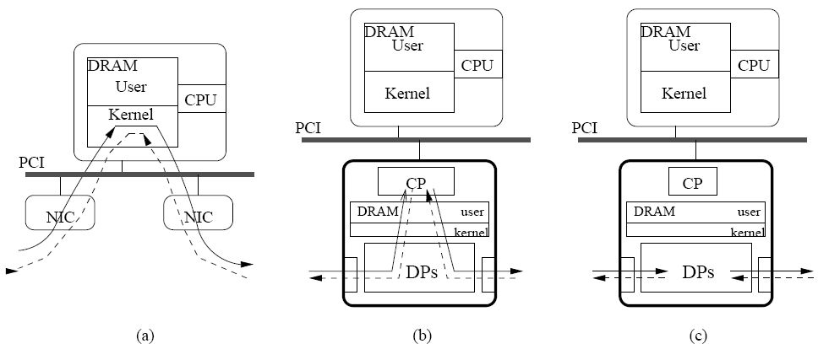
Design Options
Option (a): Linux-based switch
  Overhead of moving data across PCI bus
  Interrupt or polling still needed
Option (b): Put a control processor (CP) in the interface to setup connections, and execute complicated applications. Data Procesors (DPs) process packets for forwarding, classification and simple processing
  But, the CP may have its own protocol stack – Ex. embedded Linux!
Option (c): DPs handle connection setup, splicing & forwarding – But large Code Size is a huge problem due to limited instruction memory size of the DPs!

Slide 49
Experimental Setup
Radisys ENP2611 containing an IXP2400
  XScale & ME: 600MHz
  8MB SRAM and 128MB DRAM
  Three 1Gbps Ethernet ports: 1 for Client port and 2 for Server ports
Server: Apache web server on an Intel 3.0GHz Xeon processor
Client: Httperf on a 2.5GHz Intel P4 processor
Linux-based switch
  Loadable kernel module
  2.5GHz P4, two 1Gbps Ethernet NICs

Slide 50
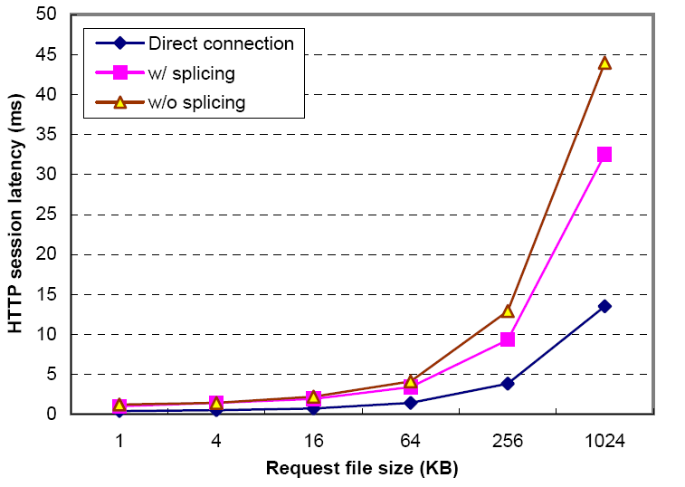
Latency on a Linux-based switch
Latency is reduced by TCP splicing

Slide 51
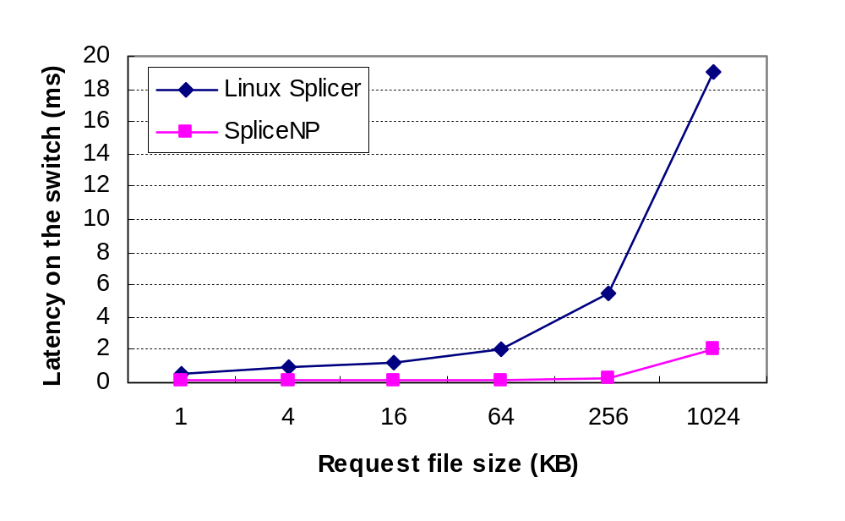
Latency

Slide 52
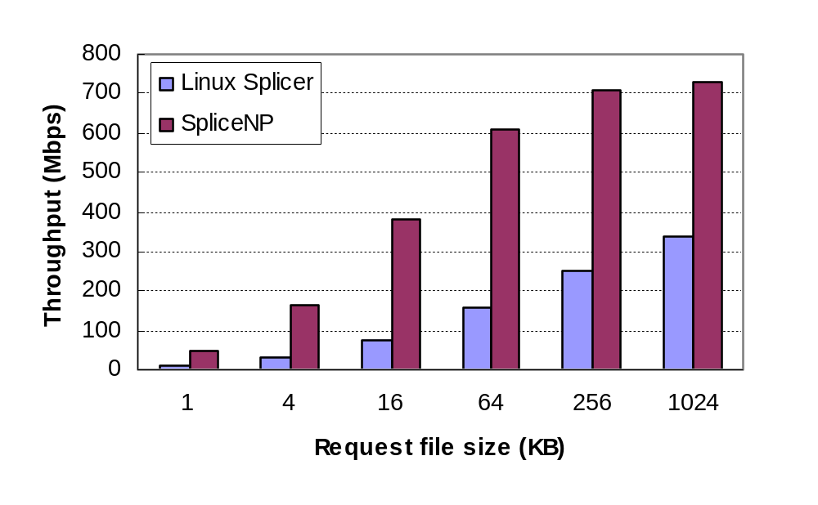
Throughput

Slide 53
Conclusions
Implemented TCP splicing on an IXP 2400 network processor
Analyzed various tradeoffs in implementation and compared its performance with a Linux-based TCP splicer
Measurement results show that NP-based switch can improve the performance significantly
  Process latency reduced by 83% for 1KB data
  Throughput improved by 5.7x

