Slide 1
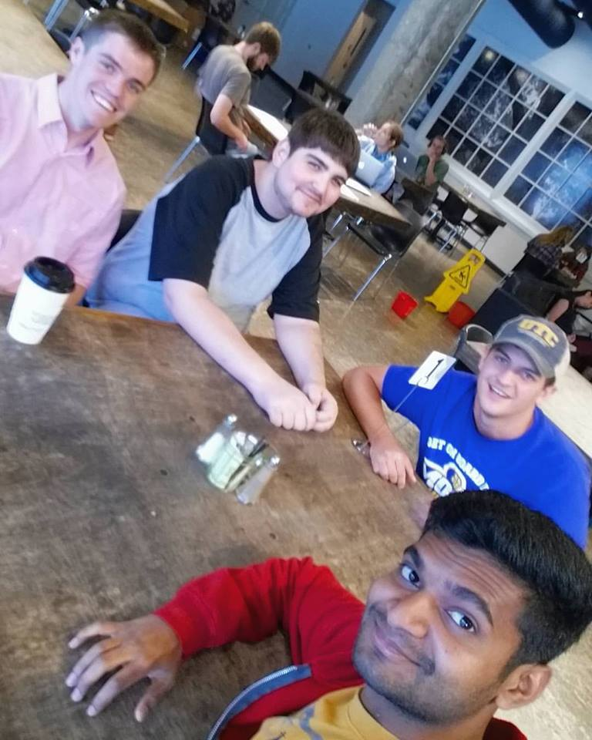
The Brogrammers
Shopkins Collector
Create-A-Thon Competition
University of Tennessee at Chattanooga

Slide 2
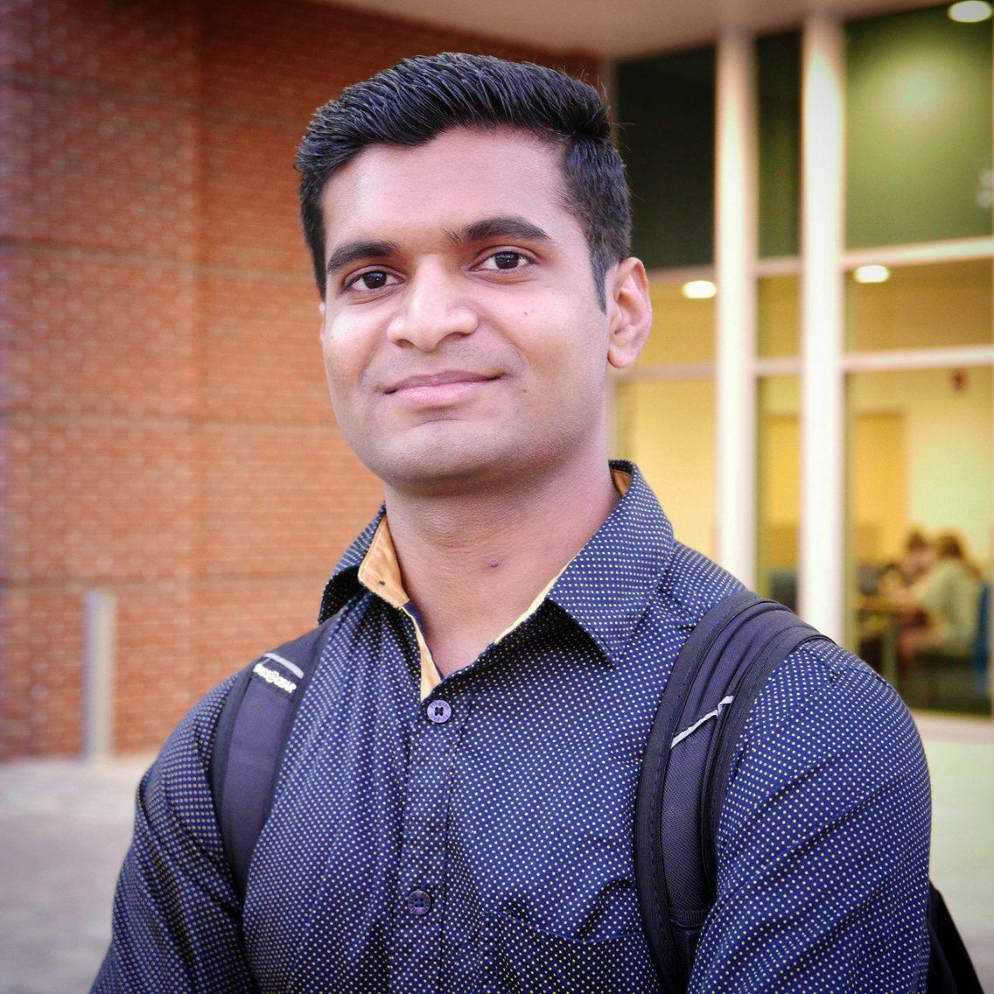
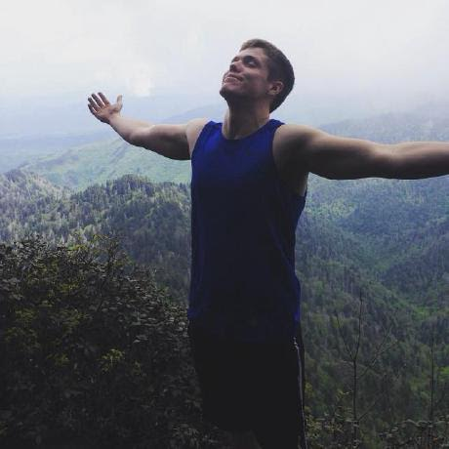
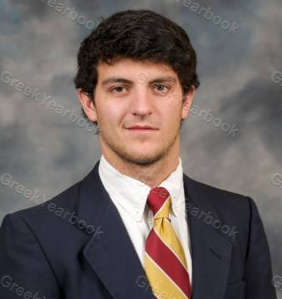
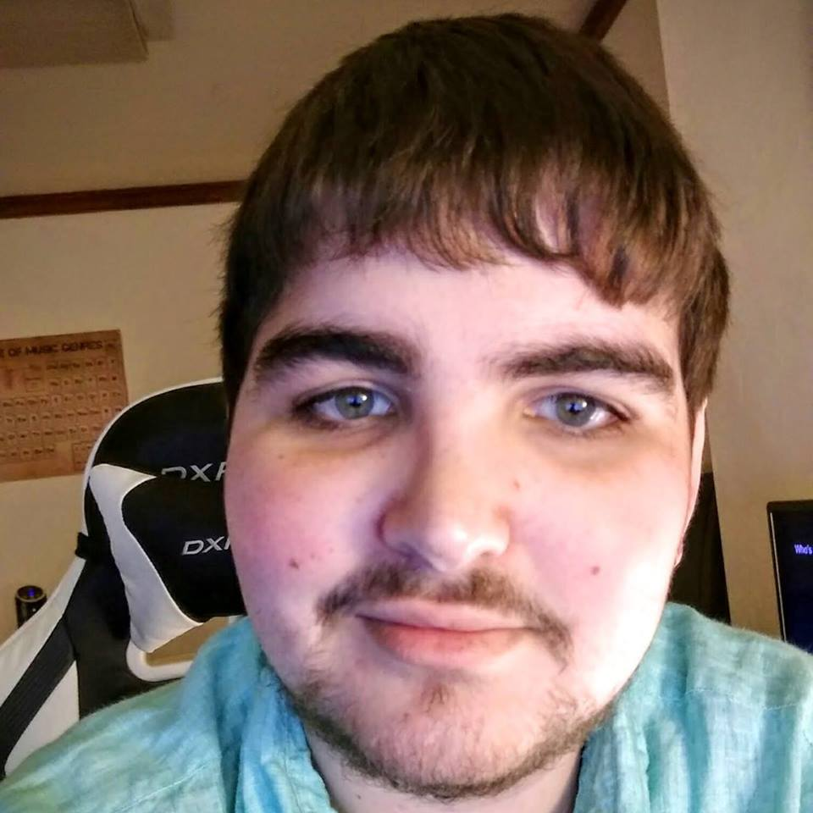
Alaykumar Patel
Meet the Team
Evan Grayson
Position: Co-Designer
Major: Computer Engineering
Position: Back-End
Major: Computer Science
Steven Hullander
Jose Stovall
Position: Project Manager & QA
Major: Computer Science
Position: Co-Designer
Major: Computer Science

Slide 3
The Challenge
Design, build, and demonstrate a mobile application that allows users of all ages to organize their collection – in this case, Shopkins.

Slide 4
The Problem and UI/UX Approach
Analysis: Analyzed the task at hand, researched product, decided on web based application
Design: chose a gender and age neutral UI, and created a UX that is easy and fun for all of our users
Implementation: used a collection of programming languages (HTML, CSS, Javascript, and GO) for a seamless web based experience

Slide 5
Test Plan and Results
We have tested our site and all of its features and UI elements on a wide variety of devices, including:
Android
HTC One A9 – 100% success
Samsung Galaxy Note 4 – 100% success
iOS
iPhone 5C – 99.9% success (blocked scripts in game)
iPhone 6s Plus – 99.9% success (blocked scripts in game)
IPad Mini 4 – 99.9% success (blocked scripts in game)
Windows
Desktop (Native Resolution: 3440 x 1440) – 100% success (allow scripts)
Laptop (Native Resolution: 1920 x 1080) – 100% success (allow scripts)

Slide 6
Monetization
Ad Banners
Data Farming
“Coin” system for Matchkins game
Premium Accounts to remove Ad Banners

