Slide 1
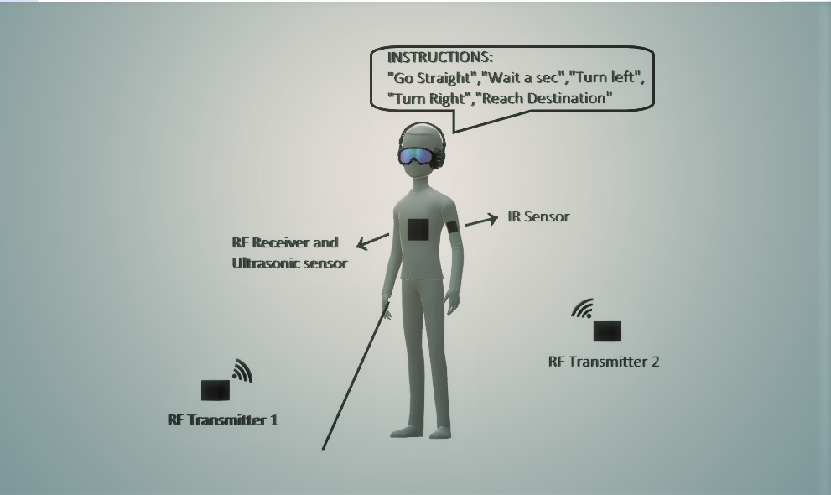
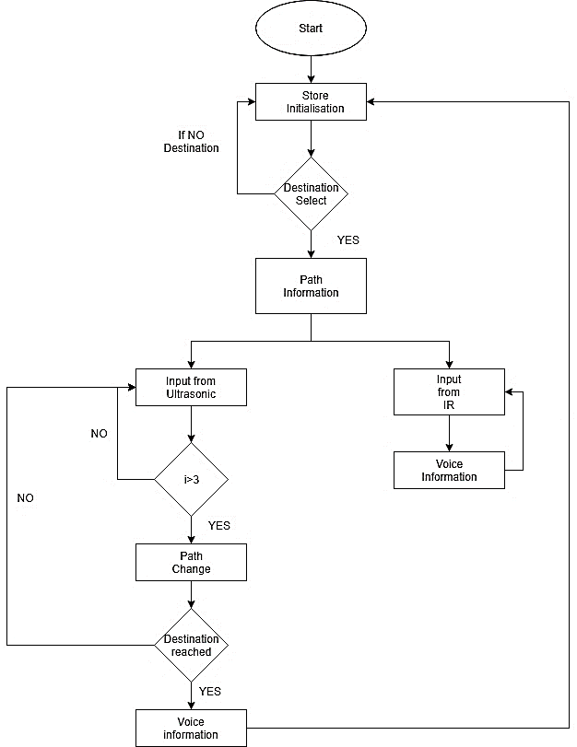
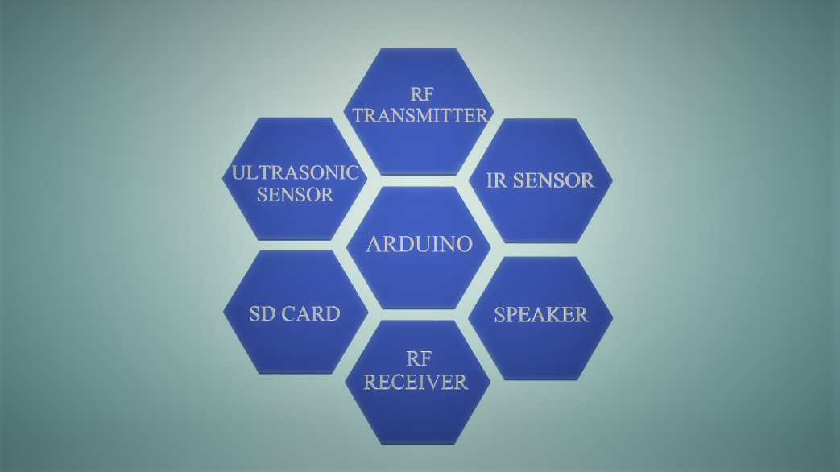
PATH PLANNING AND OBSTACLE DETECTION FOR BLIND PERSON
FLOW CHART
PROBLEM STATEMENT
About 1% of the human population is visually impaired, and amongst them about 10% is fully blind. One of the consequences of being visually impaired is the limitations in mobility. Accordingly, they need to use a wide range of tools and techniques to help them in their mobility. For global navigation, many tools already exist like handheld GPS systems are now available to guide them in outdoor situations. These tools are not helpful for local navigation: local path planning and collision avoidance. So an innovative and affordable system is needed to be implemented in order to avoid blind people colliding against fixed and moving obstacles and to guide them in indoor environments.
PROJECT IDEOLOGY
The goal of this Project is to develop a wearable tool that assists the blind to accomplish his local navigation tasks. The tool must provide information about the direct surroundings of the blind to enable him to move around without collisions. This project develops navigational assistance technology for the blind person to move from one place to other inside building/office/ campus environments using RF technology. The project simultaneously provides a means of sensing a predetermined area around the person, using ultrasonic and IR sensors to detect moving and fixed obstacles by emitting waves. The reflected waves from the barrier objects are the inputs to the Arduino, which immediately alerts the person. Audio guidance of the destination specified which is already stored in SD card module is heard through the headphones.
SOFTWARE WORK
Arduino.cc for programming
PCB wizard for designing single and double sided printed circuit boards
Proteus 8 professional design suite for schematic capture, simulation, and PCB layout design.
Library Packages of major components like Arduino, ultrasonic and IR sensors, Voice packages, RF transceivers which are not inbuilt are added separately.
DESIGN
CONCLUSION AND RECOMMENDATION
Visually impaired people have difficulty in perceive and understand the physical reality in environment that they are not familiar with. Therefore, this project proposes a solution to assist blind people in their navigation by developing a method of path planning. The method will give the route to be taken by user from his/her starting position to the destination.
For future work, the proposed work can be extended with many more algorithms and parameters that are needed to be calculated in real time motion of the blind person to improve the system.
Circuit Photo
Team members
Nuqxhnx xjerihfyiung xjfoitygn38 4octjgu3h xfy34hcg4y..

