Slide 1

KNOWLEDGE TRANSFER
LLM Inference & Sampling
PROMPT
Reverse-KT
LOGITS
KV-cache Sampling Lab
TOKEN
Sampling • attention • KV cache • FastAPI • k8s • monitoring
CACHE
CPU-first demo | Multi-Node | Local models | Observable behavior
Project: https://github.com/ojas-kulkarni-emergys/sampling-kv-cache-lab

Slide 2
01 / LEARNING JOURNEY
Learning Tracks Covered
The KT connects course concepts to a concrete, inspectable serving system.
Hugging Face LLM course
Kubernetes Crash Course
DeepLearning.AI MLOps
Transformers, generation, logits, decoding and cache behavior.
Pods, Deployments, Services, persistent storage and operational commands.
Packaging, serving, metrics, monitoring and deployment thinking.
APPLIED IN THE LAB
A local text-generation UI, a separate inference API, a Kubernetes deployment, and measurable generation/cache behavior.
Learning resources are linked in the final handover slide.
Project: https://github.com/ojas-kulkarni-emergys/sampling-kv-cache-lab
02

Slide 3
02 / WHY THIS MATTERS
KT objectives
What the implementation demonstrates
LLM behavior
Inference engineering
MLOps & operations
Control token selection and inspect how generation changes with decoding settings.
Separate the user interface from model execution behind a versionable API.
Containerize components, deploy repeatably, expose metrics and inspect logs.
Understand the path from logits to token selection.
Compare two decoding configurations under the same prompt and seed.
Inspect measured K/V cache tensors and optional attention matrices.
Operate the UI and inference service as separate Kubernetes workloads.
Project: https://github.com/ojas-kulkarni-emergys/sampling-kv-cache-lab
03

Slide 4
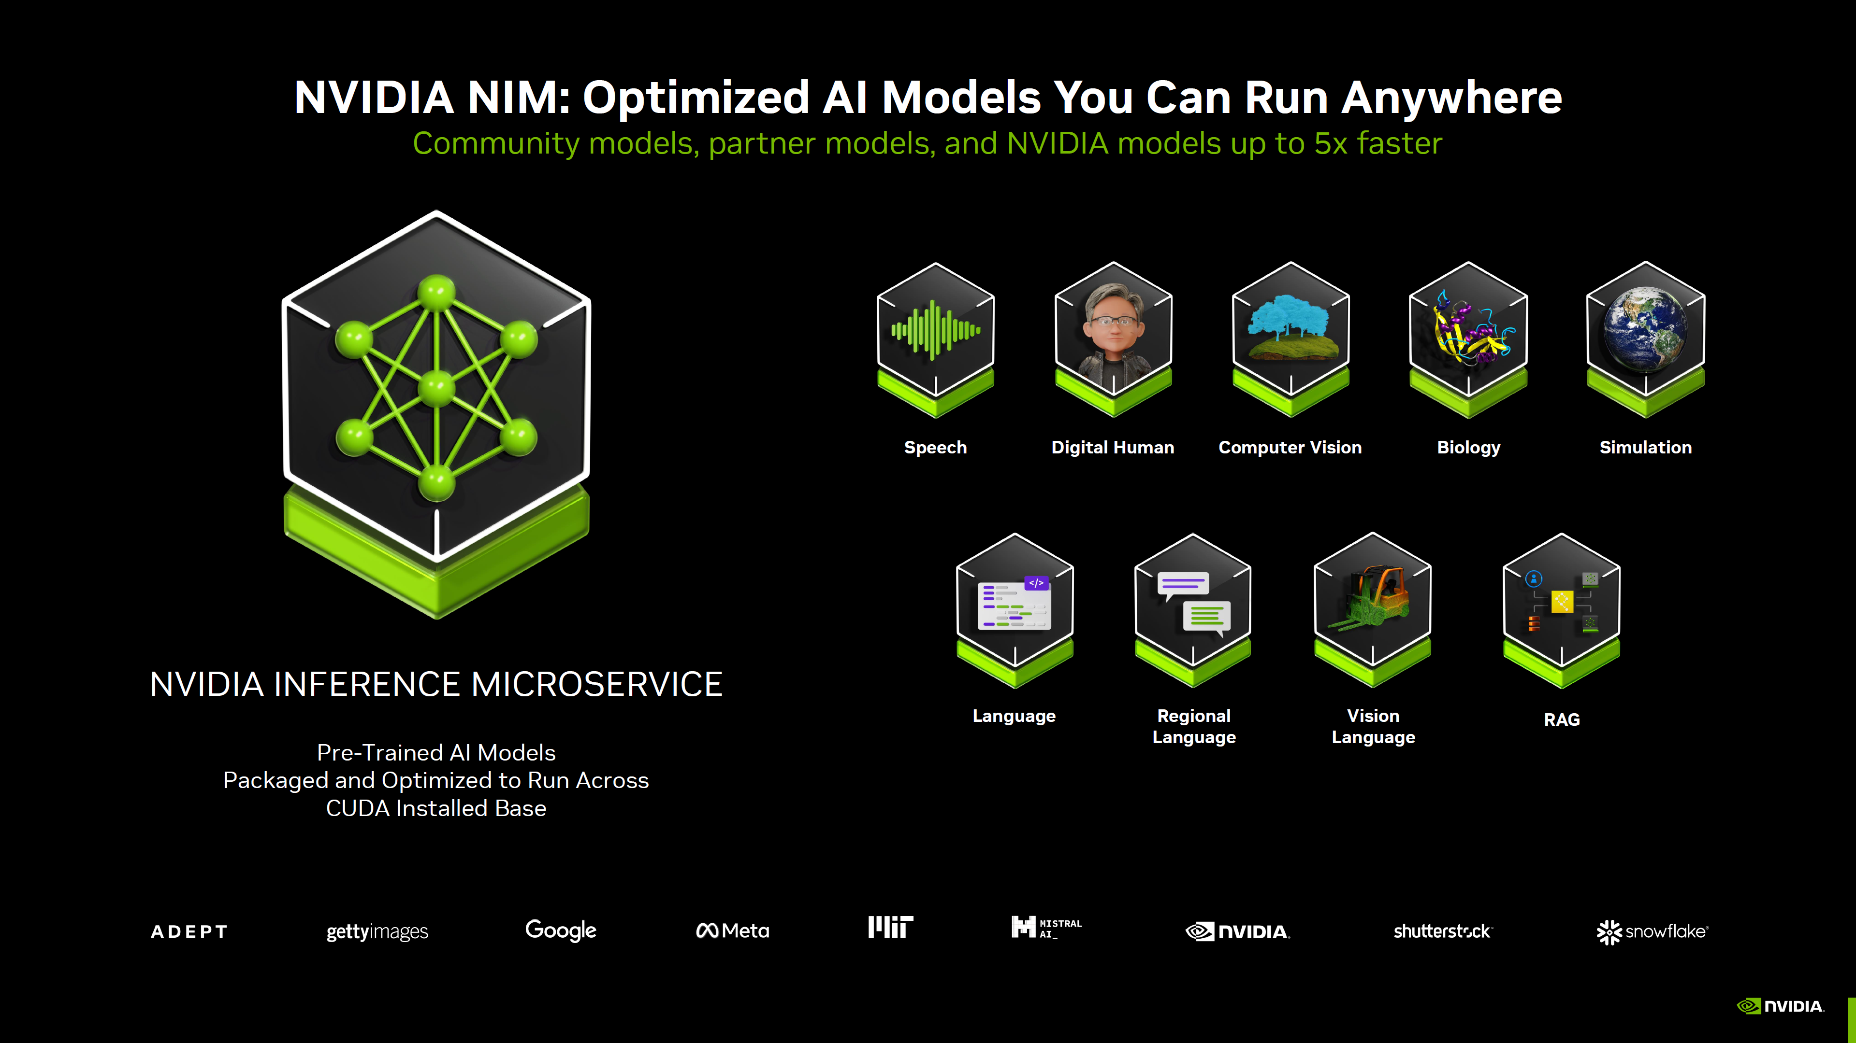
02 / WHY THIS MATTERS
Transferrable KPIs
A small lab makes model-serving trade-offs visible before scaling to production.
Serving boundary: Teams-facing experience can call a backend API instead of embedding model execution in the UI.
Reliability: health checks, request validation, bounded generation and clear error paths.
Operational visibility: latency, request counts, generated-token counts and cache payload metrics.
Scale deliberately: measure CPU/RAM and concurrency before increasing replicas or enabling autoscaling.
Scaling Deployments: llm-d with router & gateway
IaC: Using terraform to setup infrastructure locally
Project: https://github.com/ojas-kulkarni-emergys/sampling-kv-cache-lab
04

Slide 5
03 / ARCHITECTURE
Service Access
The UI and inference API can be run locally in-process or separated using INFERENCE_URL.
Browser
Local m/c
Gradio UI
FastAPI inference
Ngrok:tunnel (port 80)
Nginx tunnel: Gradio NodePort
A/B controls + plots
/compare :8000
PVC / model cache
Prometheus metrics
Local Transformers model / vllm (via llm-d)
survives Pod restart
Grafana dashboard
CPU • one model cached
Kubernetes namespace: sampling-lab • Service routes UI → inference(local/llm-d) • PVC stores downloaded model files
Project: https://github.com/ojas-kulkarni-emergys/sampling-kv-cache-lab
05

Slide 6
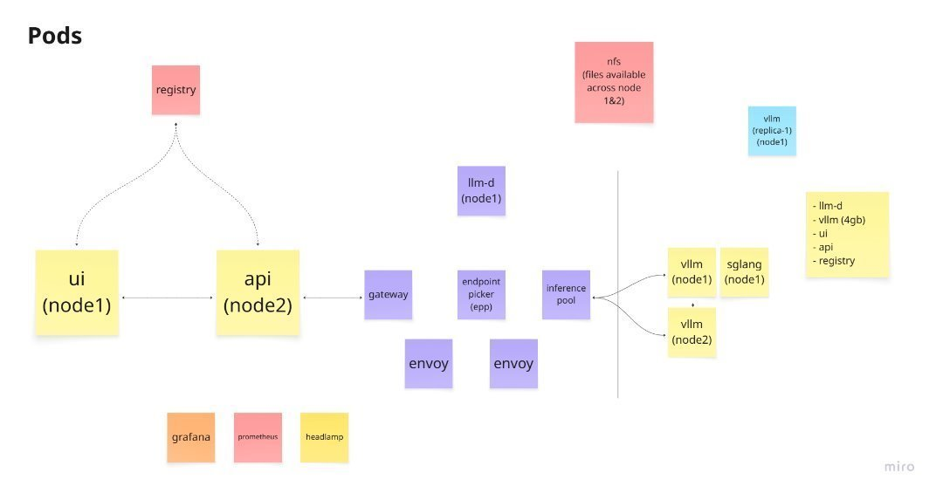

03 / ARCHITECTURE
System architecture
Kubernetes k8s Pods​
Project: https://github.com/ojas-kulkarni-emergys/k8s-setup
06

Slide 7
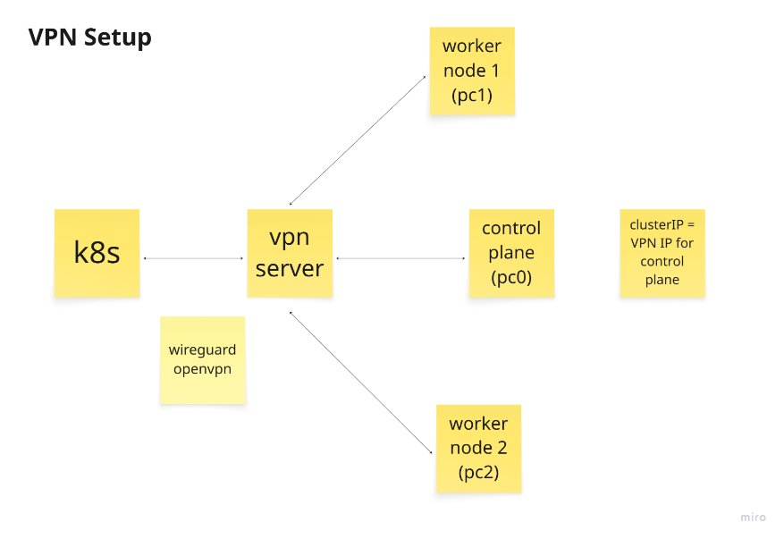
03 / ARCHITECTURE
VPN Setup
The VPN setup uses a hosted server for the current setup, but on-prem hosting can be done with wireguard or openvpn
Terraform Scripts:
To automate the setting up of the control plane/worker nodes
To automate the helm installation of the setup
To automate the setup of VPN
Project: https://github.com/ojas-kulkarni-emergys/k8s-setup
07

Slide 8
04 / MODEL CONCEPTS
Attention: each token builds context from earlier tokens
For causal language models, a position attends to allowed earlier positions, not future tokens.
Query (Q)
Key (K)
Value (V)
What information is this token looking for?
What does each context position offer for matching?
What information is weighted and mixed into the result?
Attention(Q,K,V) = softmax(QKᵀ / √dₖ + causal mask) V
The demo can show a layer-0 attention heatmap: query-token position × key-token position.
Why it matters: attention explains contextual token representations; its matrices can be expensive to retain, so capture is optional in this CPU-first lab.
Project: https://github.com/ojas-kulkarni-emergys/sampling-kv-cache-lab
08

Slide 9
05 / GENERATION
From logits to the next token
A/B comparison keeps the prompt fixed while changing the decoding policy.
1
LOGITS
2
ADJUST
3
FILTER
4
SELECT
5
APPEND
Model scores vocabulary
Penalties / temperature
Top-k, top-p, min-p, typical
Sample token or expand beams
Update context + cache
Greedy
Sampling
Beam search
Pick the highest-probability token; repeatable for the same model/context.
Temperature and filters change which candidates can be selected.
Track multiple candidate sequences; beam width applies to this mode.
Seed • maximum new tokens • stop string • repetition/frequency penalties are also exposed in the UI.
Project: https://github.com/ojas-kulkarni-emergys/sampling-kv-cache-lab
09

Slide 10
06 / INFERENCE EFFICIENCY
KV cache avoids recomputing prior token projections
The lab reports real past_key_values payloads, not a synthetic cache estimate.
Prefill
Decode
Inspect
Process the prompt and build K/V tensors for its token positions.
Process each newly selected token and extend cached positions.
See cache length, tensor shape, bytes and a K heatmap.
Same prompt + same processed length → same cache payload size
Different selected tokens can change later K/V values. Sampling does not change context-window capacity or bytes per cached token.
Boundary: this is a dynamic full-attention cache, not a PagedAttention or quantized-cache benchmark. Reported bytes exclude weights, allocator overhead and attention buffers.
Project: https://github.com/ojas-kulkarni-emergys/sampling-kv-cache-lab
10

Slide 11
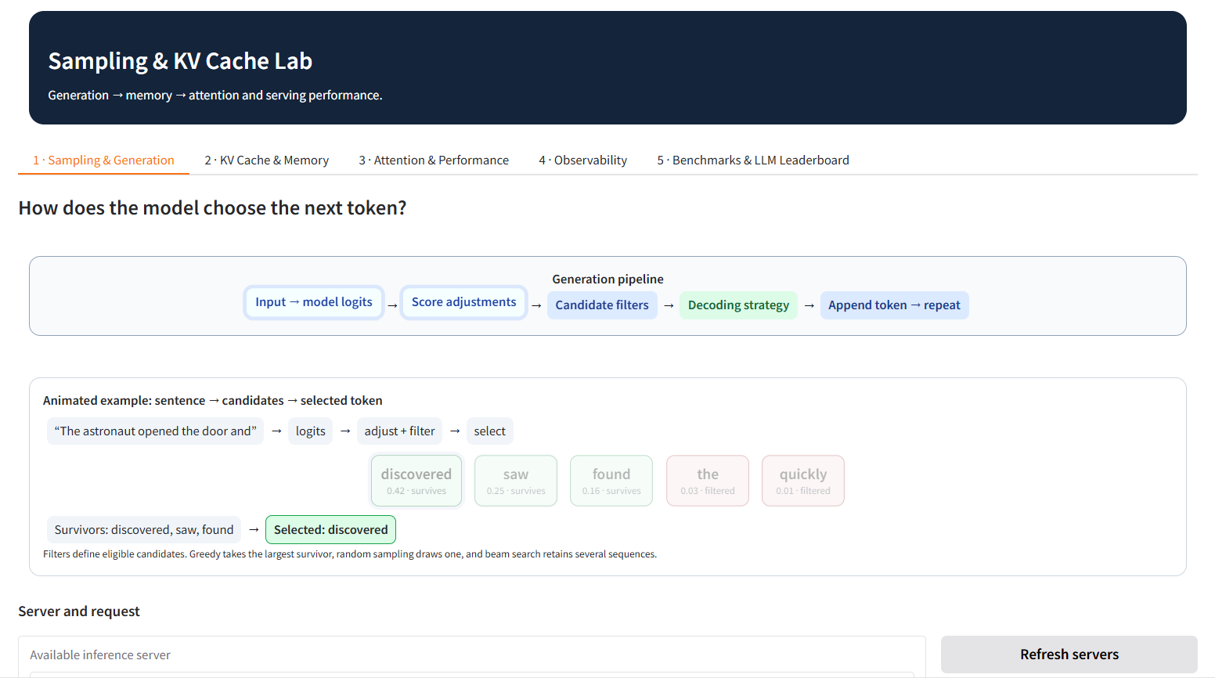
07 / UI Demo
Gradio:
URL: Demo
Project: https://github.com/ojas-kulkarni-emergys/sampling-kv-cache-lab
11

Slide 12
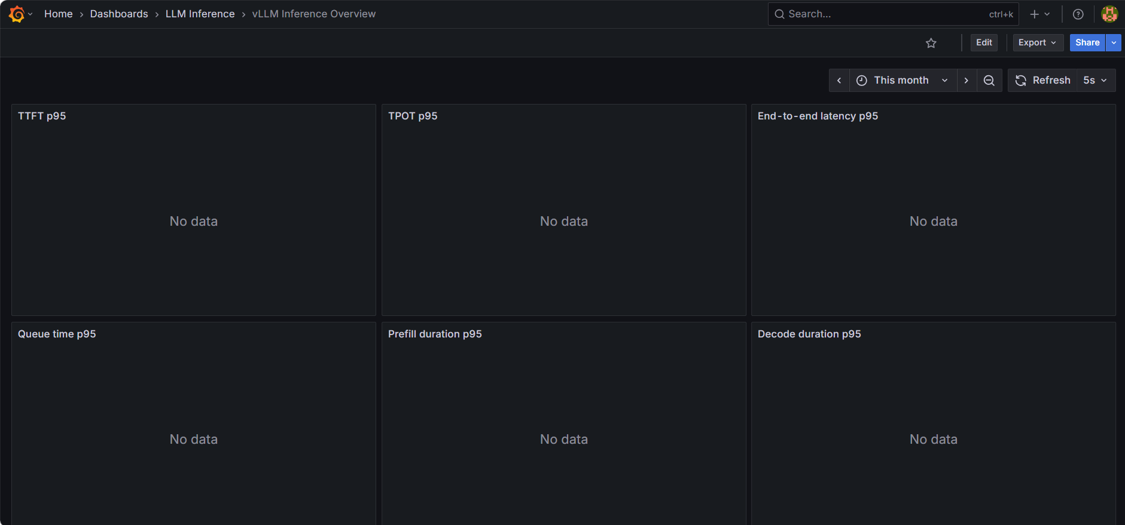
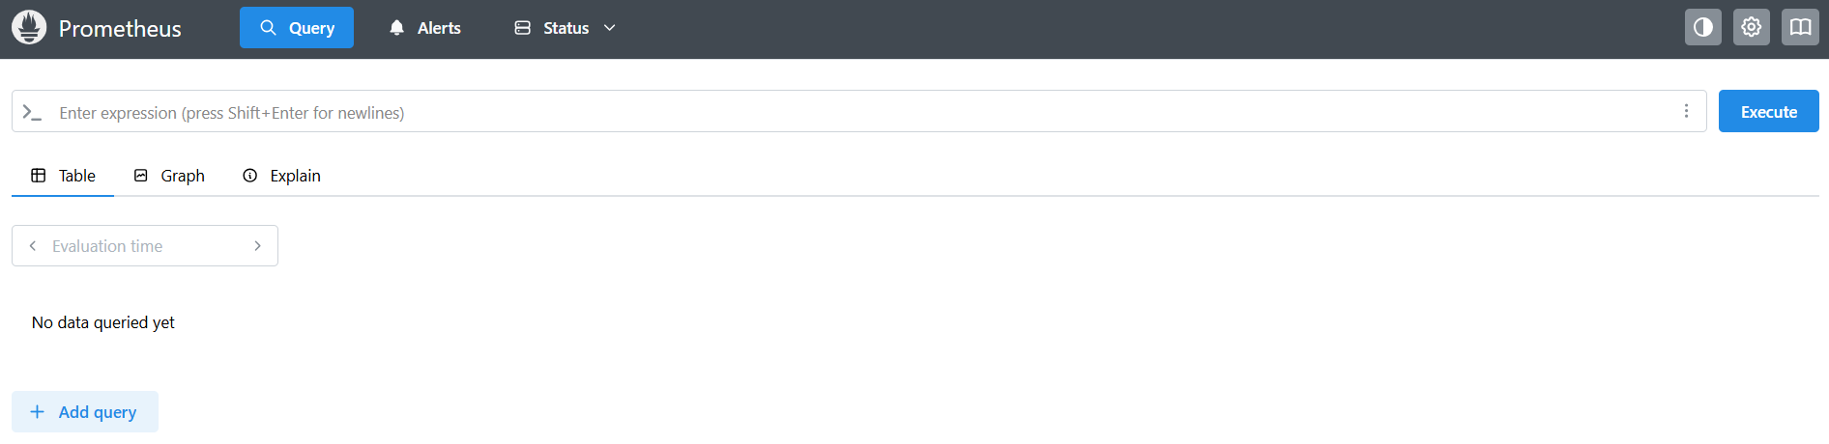
08 / Observability
Model & API Observability
Grafana: vLLM Overview
Prometheus: PromQuery
Note:
Grafana queries Prometheus to get the metrics
Preconfigured Dashboards are displayed on Grafana Dashboard
Preconfigured Queries are run through PromQL
Metrics to track:
TTFT
TPOT (p95)
Tokens/sec
KV-cache utilization
Prefill Time (p95)
Latency
Throughput
Project: https://github.com/ojas-kulkarni-emergys/k8s-setup
12

Slide 13
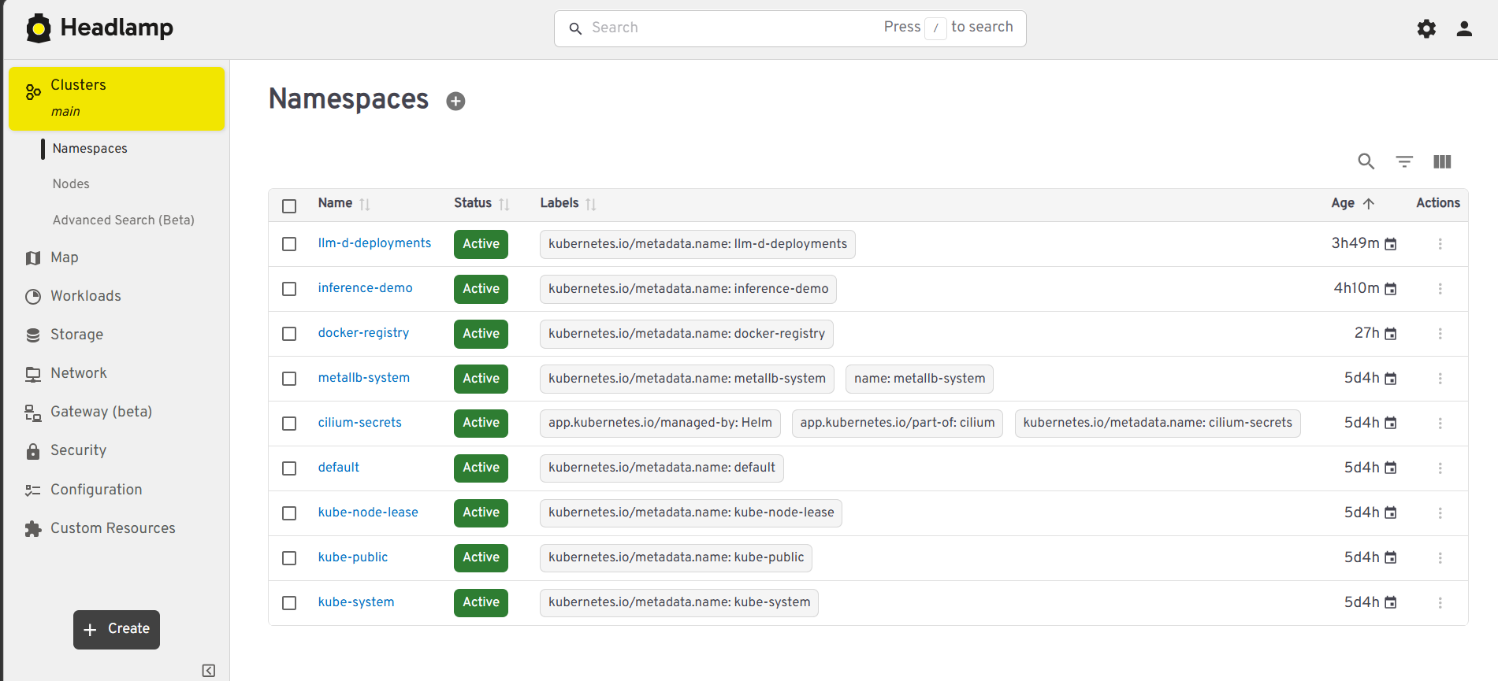
08 / Observability
Cluster Observability
Headlamp: Dashboard
Project: https://github.com/ojas-kulkarni-emergys/k8s-setup
13

Slide 14


09 / Overview
Demo Urls:
Additional Links:
Gradio URL: Demo
Grafana: vLLM Overview
Prometheus: PromQuery
Headlamp: Dashboard
llm-d/llm-d: State of the art inference performance with modern
accelerators on Kubernetes
Machines - Tailscale
System Architecture | Miro Board
Github Repo:
Project: https://github.com/ojas-kulkarni-emergys/k8s-setup
Project: https://github.com/ojas-kulkarni-emergys/sampling-kv-cache-lab
LLM Inference & Sampling
14

Slide 15
Thank you
LLM Inference & Sampling
13

