Slide 1
CS 4803/8803 P2a Submission
Ojas Mediratta
omediratta3@gatech.edu
903678112
Provide your answer on the appropriate slide. Do not delete or add new slides.

Slide 2
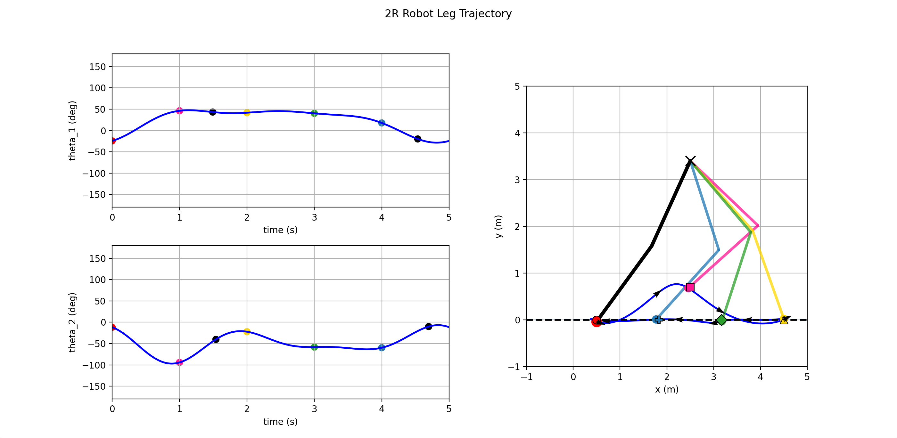
Paste the screenshot of the entire interactive figure showing your best performing trajectory. [6 pts]

Slide 3
Fill in the table indicating the numeric coordinates of your chosen joint angle points. We will use these to verify the screenshot of your trajectory. If necessary, you can use additional rows and resize the table. If different numbers of points are chosen for the joint angles, leave unused cells blank. [1 pts]
Point # | t₁ (s) | ϑ₁ (°) | t₂ (s) | ϑ₂ (°)
2 | 0.00 | -24.38 | 0.00 | -11.69
2 | 1.00 | 46.25 | 1.00 | -94.34
3 | 1.49 | 43.25 | 1.54 | -40.24
4 | 2.00 | 41.74 | 2.00 | -22.21
5 | 3.00 | 40.24 | 3.00 | -58.27
6 | 4.00 | 17.70 | 4.00 | -59.78
7 | 4.53 | -19.87 | 4.70 | -10.19

Slide 4
What was your strategy to obtain your best trajectory? What worked and what didn’t? Did you notice any trends when changing the location of your chosen points or increasing the number of chosen points? [3 pts]
I walked around a bit in my own home to try and get a better intuition of what the walking motion looks like. After playing around with the plotter, I figured out a trajectory shape that made sense to what I observed from my own gait. I started by adjusting theta 1 to get the pose of the legs at t0-t5 to match the general area where I wanted them to be, then adjusted theta 2 to bend the knees for the swing part of the walk. Adding points helped me keep the path from dipping below y = 0.

