Slide 1
CS 4803/8803 P1 Reflection
Ojas Mediratta
omediratta3@gatech.edu
903678112
Provide your answer on the appropriate slide. Do not delete or add new slides.

Slide 2
Why does the power series expansion for the exponential map converge faster than the “compound interest” approximation? [5 pts]
The compound interest approximation is applying an approximation with a first-order integrator locally, which has an error that accumulates each time it’s applied. The power series expansion is better since it’s essentially fitting the curve’s shape directly (where the compound interest is basically approximating the curve with short straight segments), and the error is controlled by the (k+1)! Term.

Slide 3
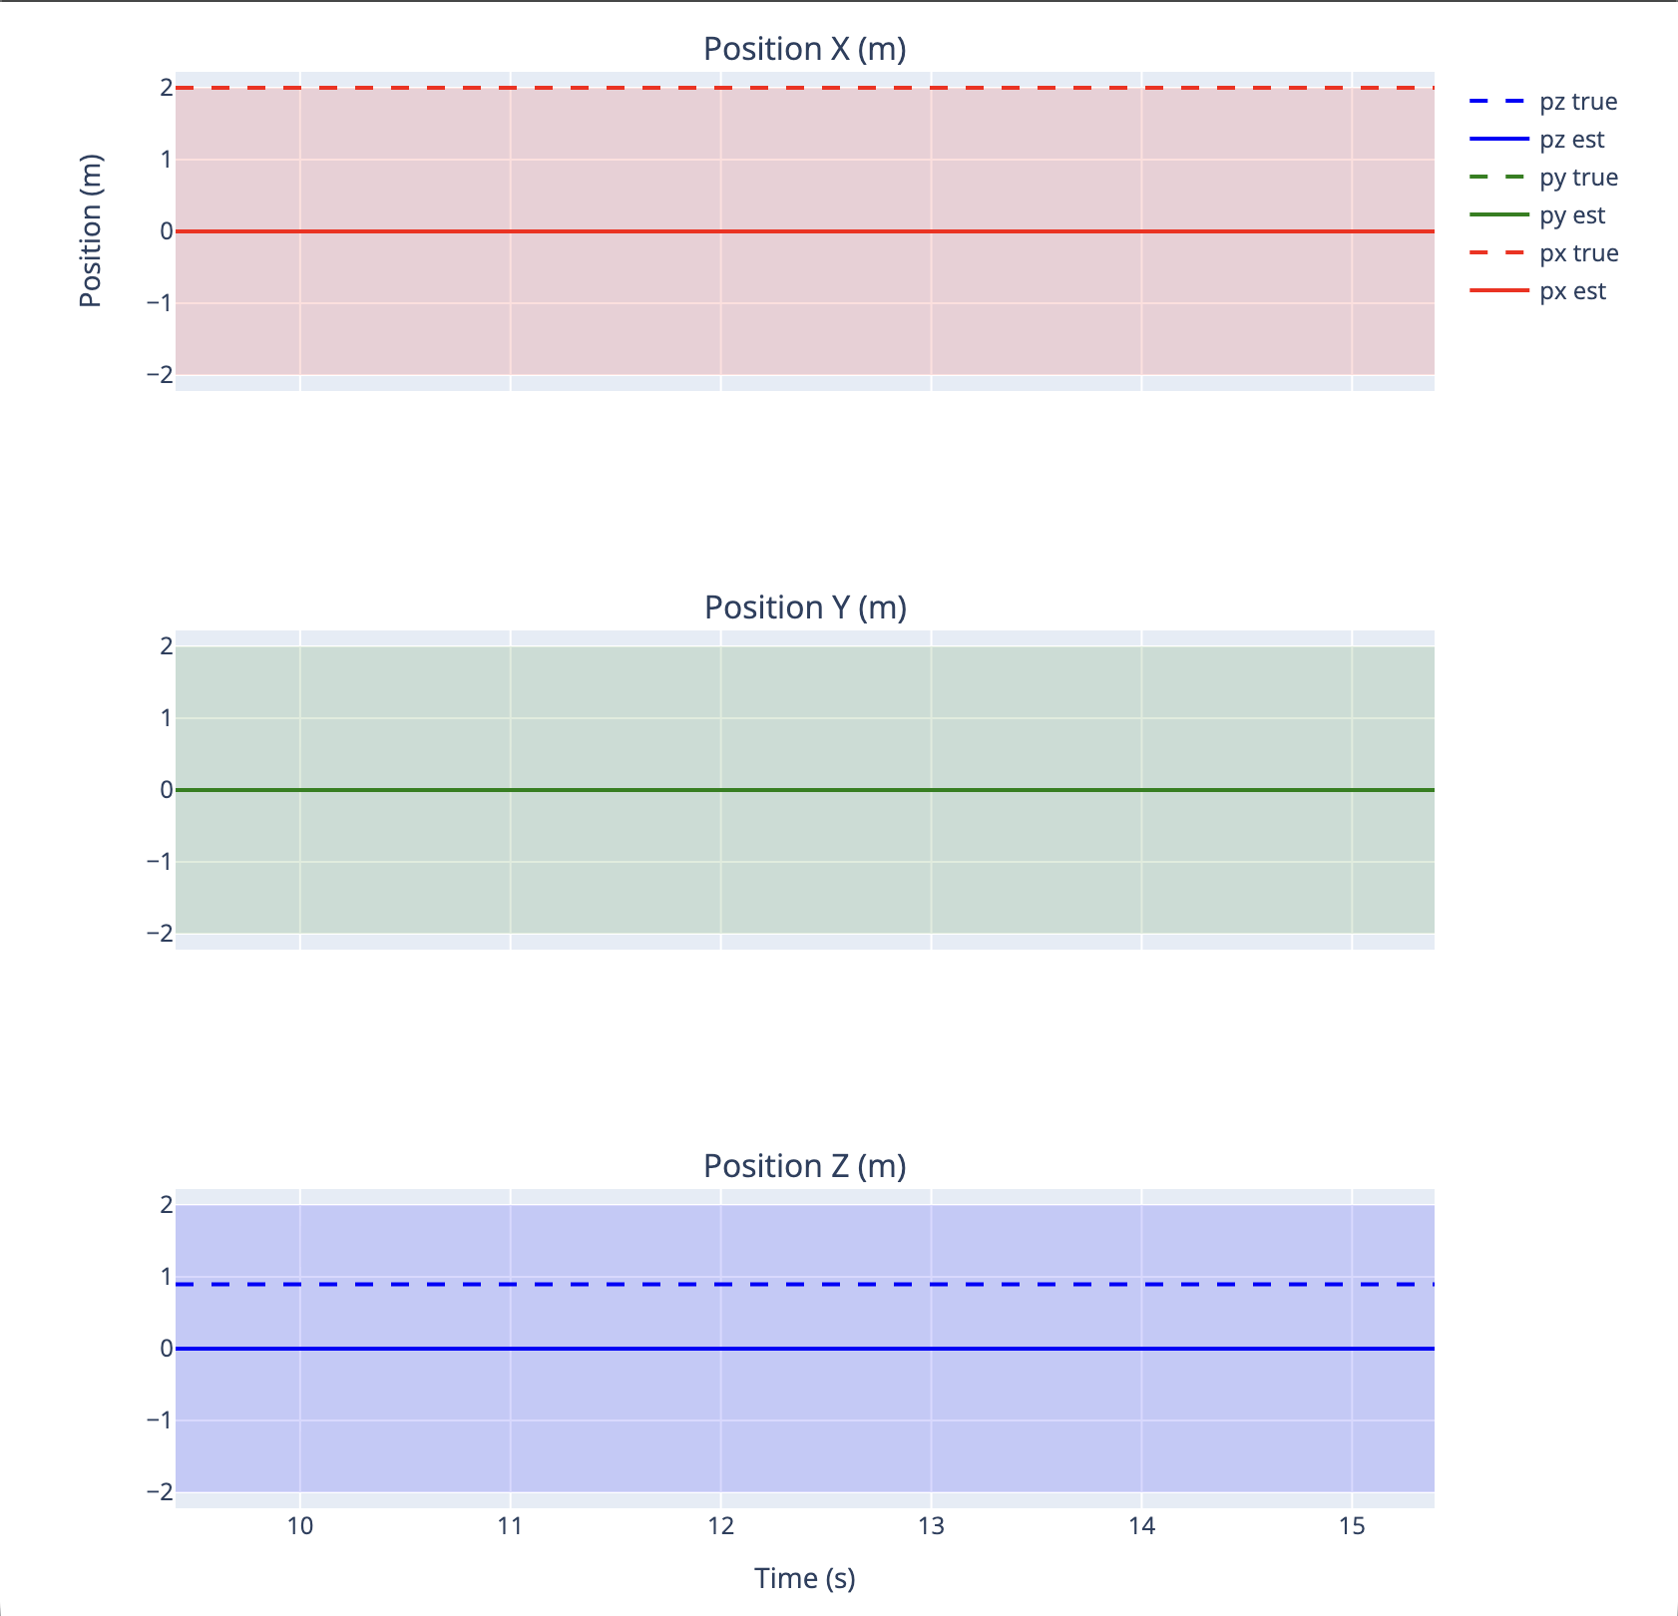
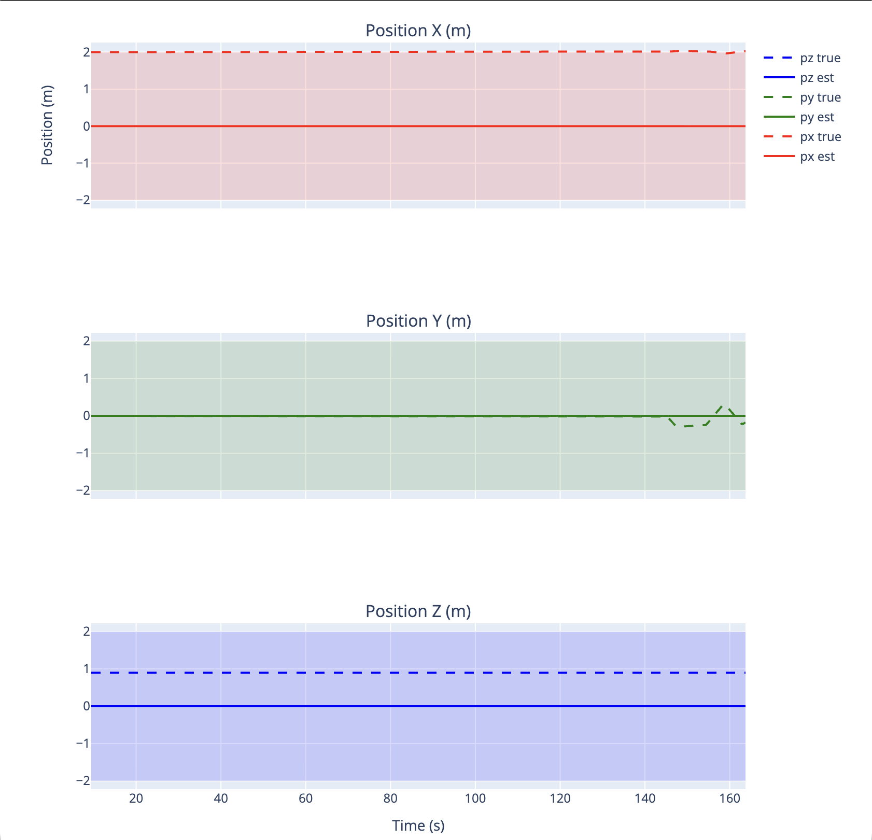
Choose a keyboard-based action. Explain why the robot moves the way it does and refer to a screenshot of the position graph taken using the “P” key. [5 pts]
The keyboard based action I selected was using the up and down arrow keys. These keys apply a force of 1.0 N in the robot's body frame X direction (forward/backward). Since the robot's body X axis is aligned with the world Y axis, the forward thrust causes the robot to move in the Y direction in world coordinates, shown in the graph.
Before
After

Slide 4
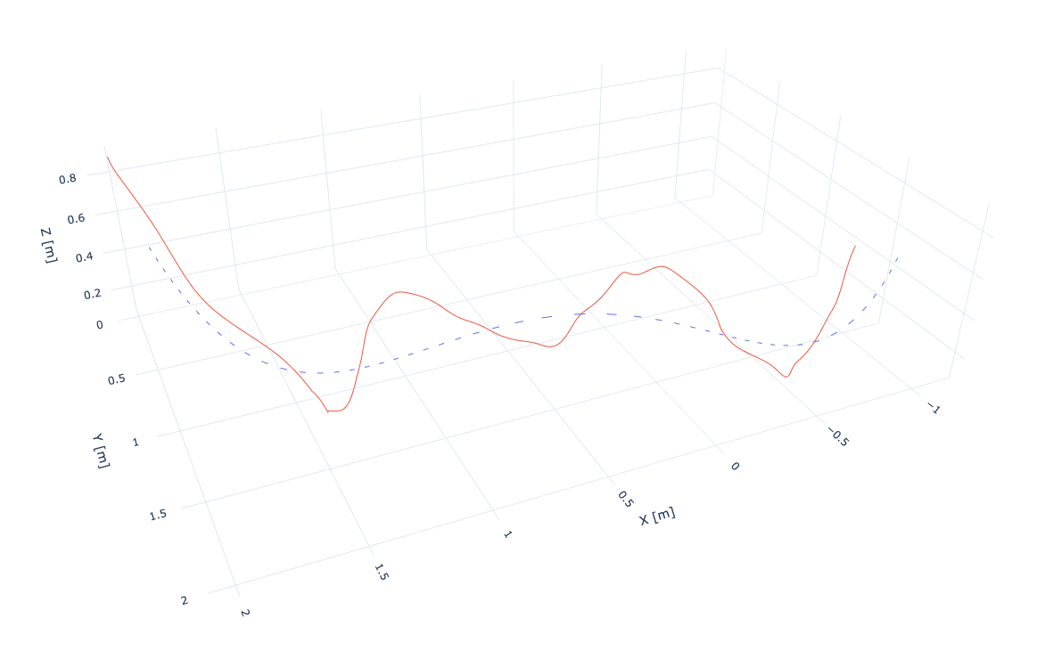
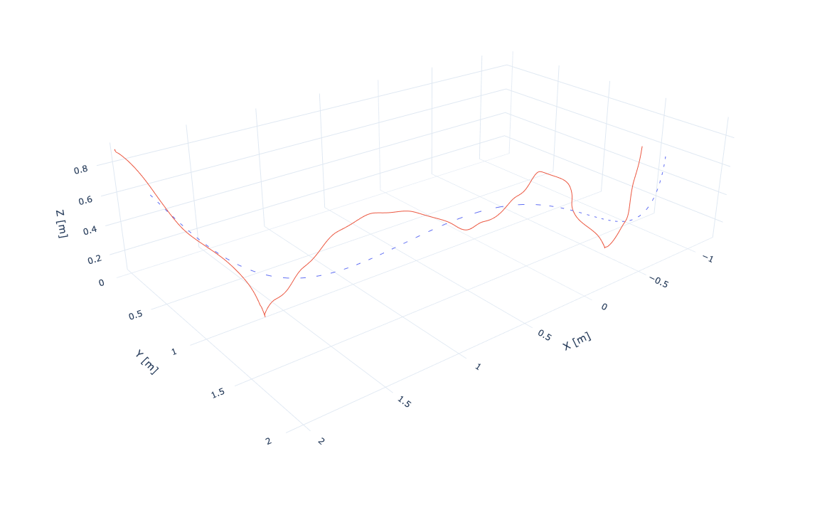
Discuss the effect of changing the IMU noise parameters. How does your change impact the trajectory tracking performance? Provide a screenshot of the trajectory plot using key “T”. [5 pts]
I increased the IMU noise parameters from SIGMA_ACC = 0.004 and SIGMA_GYRO = 00.5 to SIGMA_ACC = 0.04 and SIGMA_GYRO = 0.5 (10x the original values). Interestingly, this change seemed to slightly improve trajectory tracking performance in the simulation, though the change isn’t as apparent in the plot. By increasing these values, the EKF trusts the IMU predictions less and weights the range and depth measurements more heavily during updates. This results in more accurate state estimates when the external sensors are more reliable than the IMU, which means tighter trajectory following with less deviation from the desired path.
With SIGMA_ACC = 0.004 and SIGMA_GYRO = 0.05
With SIGMA_ACC = 0.04 and SIGMA_GYRO = 0.5

Slide 5
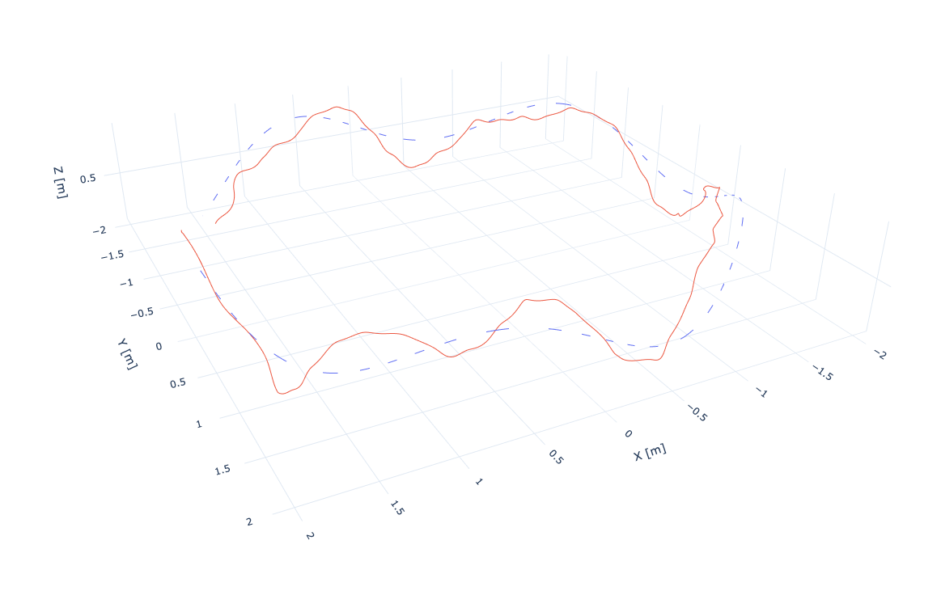
Explain in terms of the EKF the trajectory tracking performance of the robot using the default IMU noise parameters. Provide a screenshot of the trajectory plot using key “T”. [5 pts]
With the default IMU noise parameters (SIGMA_ACC = 0.004, SIGMA_GYRO = 0.05), the EKF trusts the IMU predictions heavily due to the low process noise covariances. During prediction, the filter propagates state using IMU measurements. The update step corrects this using the depth and range measurements. This produces pretty smooth trajectory following but with noticeable drift/deviation from the desired path. The tracking controller directly uses these EKF estimates, so any estimation drift translates to tracking error.

Slide 6
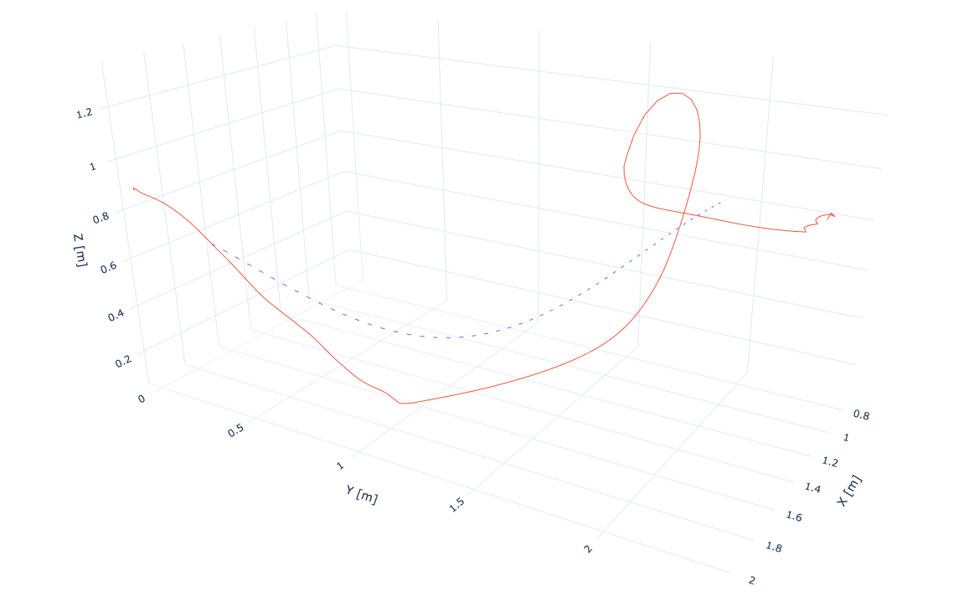
On line 81 of the ROV_Controller.py file, change the variable “X_true” to “X_est”. How does this impact the trajectory tracking performance? Provide a screenshot of the trajectory plot using key “T”. [5 pts]
The trajectory tracking performance got completely messed up. Changing it causes the trajectory controller to use the EKF's estimated state instead of ground truth. This data is noisy and the error accumulates. The plot shows the robot going entirely off course (my robot crashed into the side of the world). Having the Kalman Filter implemented properly for closed loop control is very important.

Slide 7
What did you learn in this module that most surprised you? [0 pts]
I was surprised by the complexity of implementing an EKF in practice. Beyond the basic predict-update cycle, constructing measurement Jacobians H for each sensor type took me a really long time and making sure everything worked. I thought the math would be more straightforward.

