Slide 1
CS 4803/8803 P4c Reflection
Ojas Mediratta
omediratta3@gatech.edu
903678112
Provide your answer on the appropriate slide. Add new slides if necessary but ensure you assign them to the appropriate question on Gradescope.

Slide 2
Explain the role of IMU preintegration in this pipeline. What information is being accumulated between LiDAR keyframes, and why is it useful instead of adding one factor per raw IMU sample? [5 pts]
IMU preintegration basically bundles up lots of fast IMU readings into one motion estimate between LiDAR keyframes. It keeps track of the change in orientation, velocity, and position implied by the IMU samples, plus the time gaps between them.
That helps because instead of adding a separate factor for every IMU sample, the graph only gets one compact factor per keyframe pair. So the optimization stays much smaller and faster, but we still keep most of the IMU information.

Slide 3
Explain the purpose of the bias-evolution factor. Why is it not enough to add only an IMU factor between consecutive states? What modeling assumption is the bias factor capturing? [5 pts]
It keeps the IMU bias from changing too wildly between keyframes. It’s basically saying the bias should stay close to the previous bias, with some noise that grows with time.
An IMU factor by itself only connects the motion states. It doesn’t explicitly model bias drift, so the optimizer can’t account for slow changes in the accelerometer and gyro offsets. The bias factor captures the assumption that bias changes gradually.

Slide 4
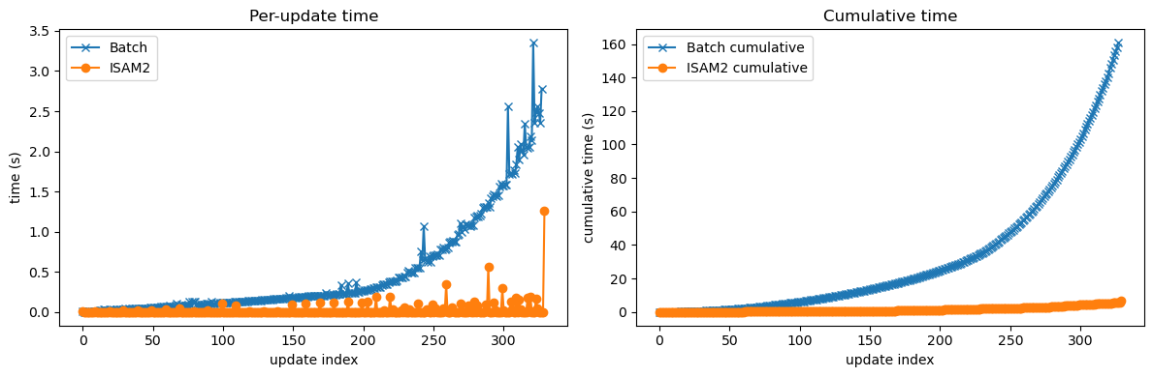
Paste a screenshot of your Batch vs. ISAM2 update-time comparison. Explain how update time changes as the number of keyframes grows and connect it to the difference between the two methods. [5 pts]
Batch re-solves the whole graph every time a new keyframe is added, so each update gets more expensive as the graph grows. ISAM2 does incremental updates, so it only adjusts the parts of the graph that changed, which keeps per-update cost close to constant.

Slide 5
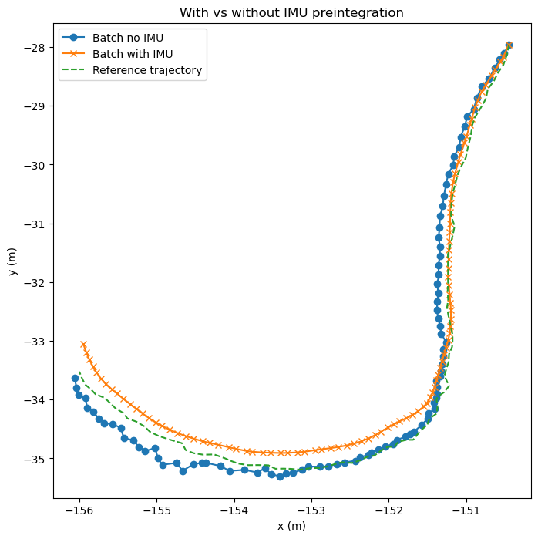
Paste a screenshot of your comparison of IMU preintegration usage and enter your ATE RMSEs. Explain why IMU preintegration can sometimes degrade performance. Discuss a few plausible causes *. [5 pts]
In my run the ATE RMSE was 0.181 without IMU and 0.299 with IMU preintegration, so preintegration actually made it worse in this case. That can happen for a few practical reasons: even a small timestamp mismatch between LiDAR and IMU can hurt fusion, the IMU noise/bias settings might not be tuned well, initialization (especially bias/orientation) might be off, or the IMU-LiDAR extrinsic/frame alignment could be slightly wrong. Also, since IMU is high-rate, small bias errors get integrated many times and can accumulate drift, which can pull the estimate away from the LiDAR-only solution.
* Examples of such causes could include sensor time offset, incorrect noise or bias settings, bad initialization, frame or extrinsic mismatch, or integration of biased high-rate measurements.

Slide 6
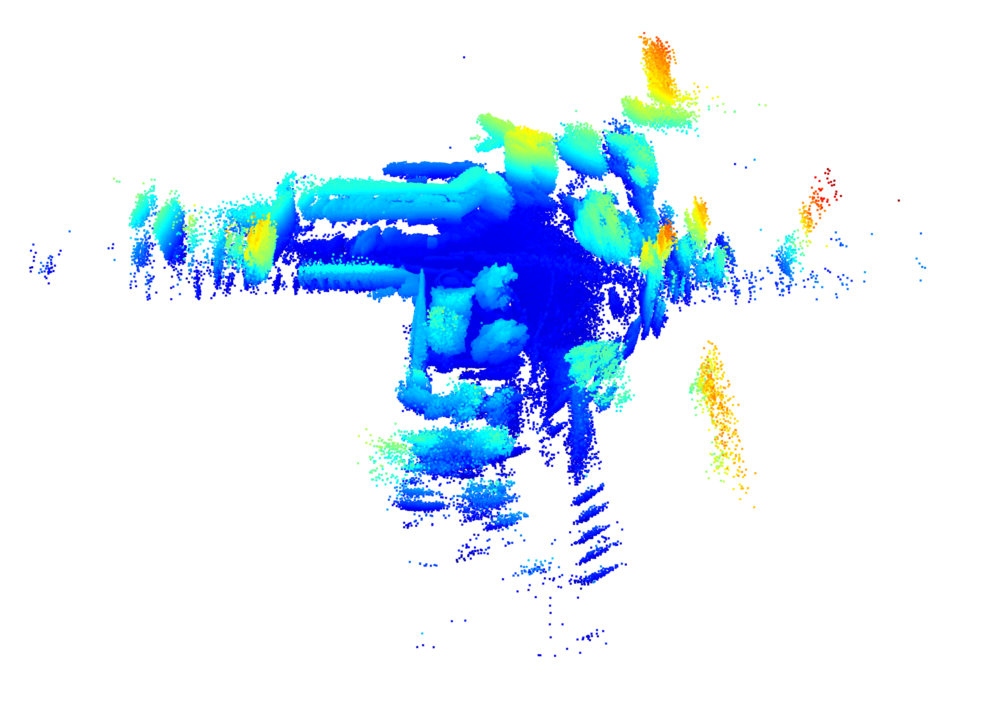
Paste a screenshot of your point-cloud map (batch or ISAM2; do not copy the image from notebook!). Comment on what parts look consistent and any artifacts or distortions. Why might our pipeline have distortions in the map?* [5 pts]
The main map structure looks mostly consistent, but there are outlying points and some blur/ghosting, especially around edges. Those artifacts likely come from drift. This is best described as a hybrid: mostly LiDAR-inertial odometry with some SLAM behavior, not fully globally consistent SLAM.
ISAM2 point-cloud
*Reflect on the limits of calling this pipeline “SLAM.” Is it more precise to call it LiDAR-inertial odometry, SLAM, or a hybrid? Consider the presence or absence of loop closure, global consistency, and mapping behavior.

Slide 7
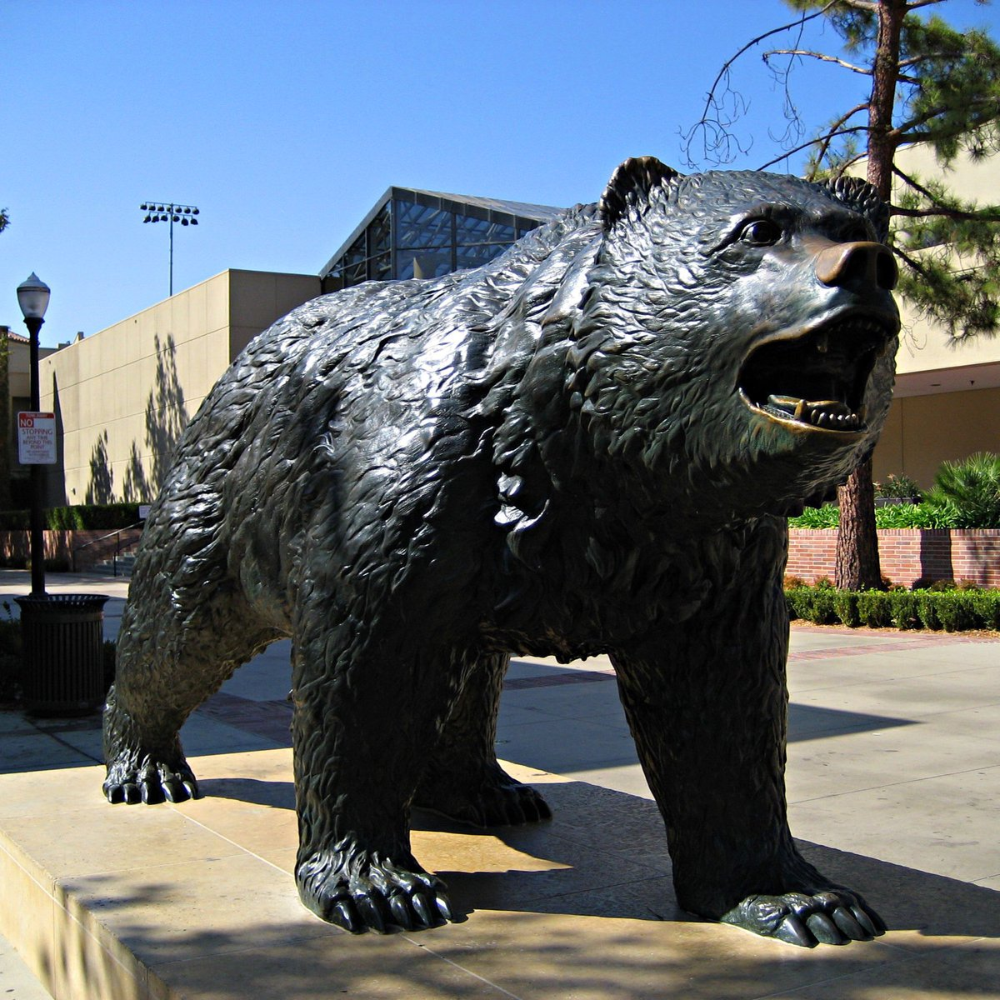
In your final stitched global point-cloud map, find the UCLA Bruin Bear and take a screenshot! [Bonus +1 pt]
Paste screenshot here
Reference

