Slide 1
CS 4803/8803 P2c Reflection
Ojas Mediratta
omediratta3@gatech.edu
903678112
Provide your answer on the appropriate slide. Add new slides if necessary, but ensure you assign them to the appropriate question on Gradescope.

Slide 2
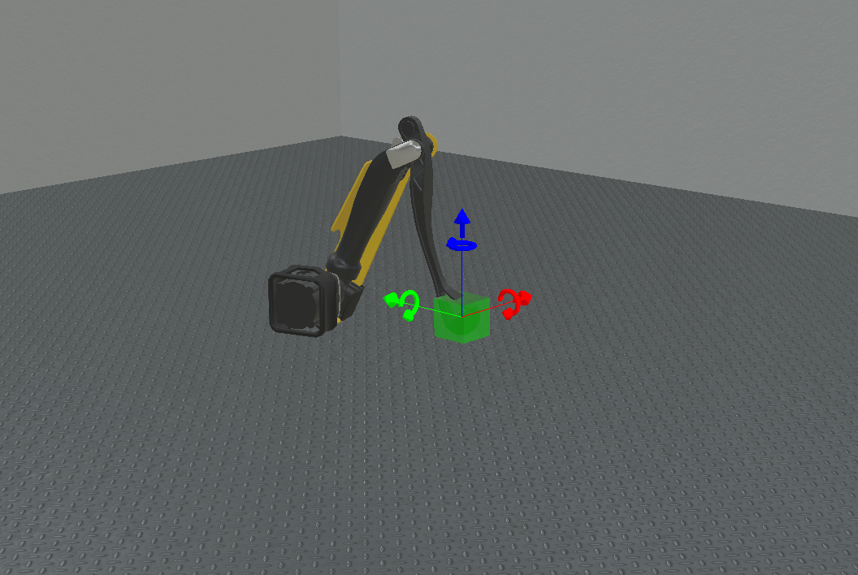
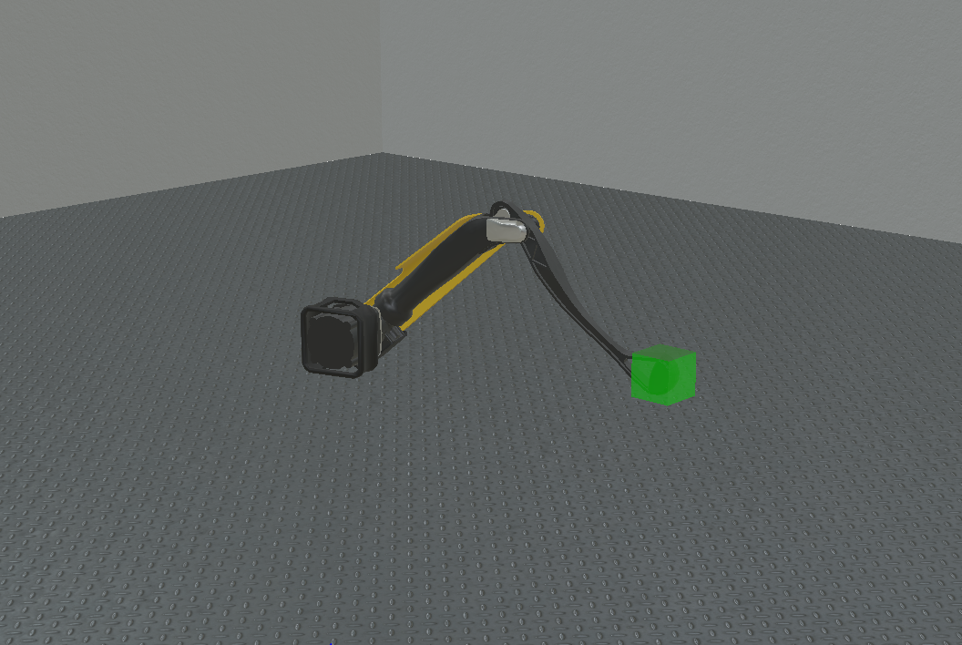
Take a screenshot of the IK working. Does it converge fast? [5 pts]
It converges quite quickly in response to the moving of the box. Depending on where the box is moved, it can take just slightly longer for the end effector to stop moving, but still a quick convergence.

Slide 3
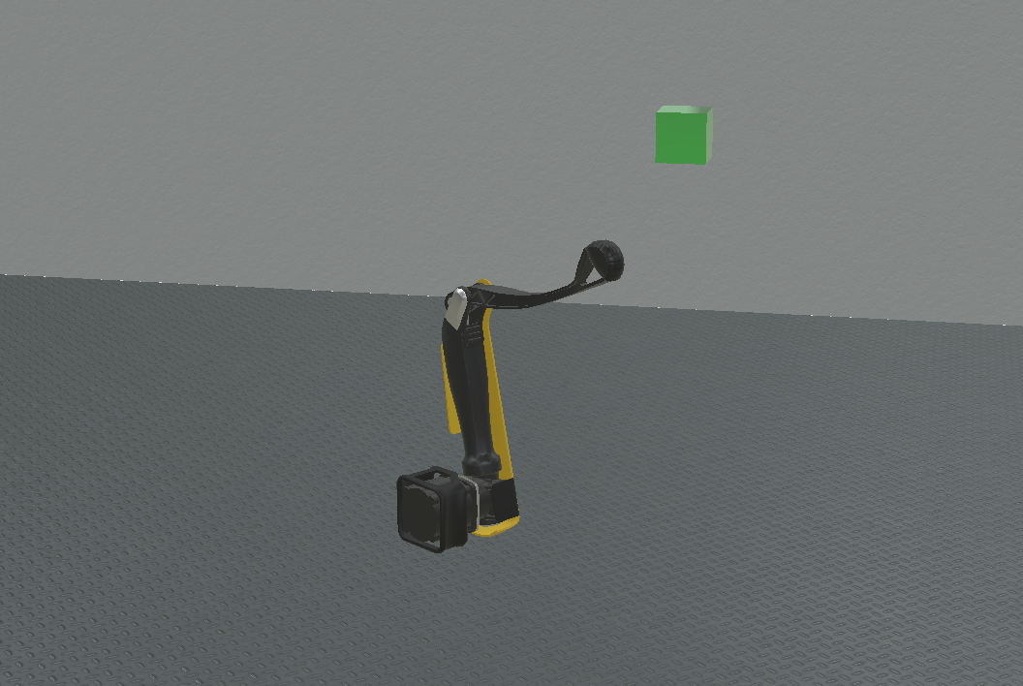
Take a screenshot of the leg when the goal is moved outside the workspace. What do you notice? [5 pts]
The leg will extend itself as far as possible in the direction of the goal along the degree of freedom for which the goal is out of bounds. If the goal is moved along a degree of freedom or axis in which the leg still has mobility, it will still pursue the goal along those axes, even if the goal is out of bounds.

Slide 4
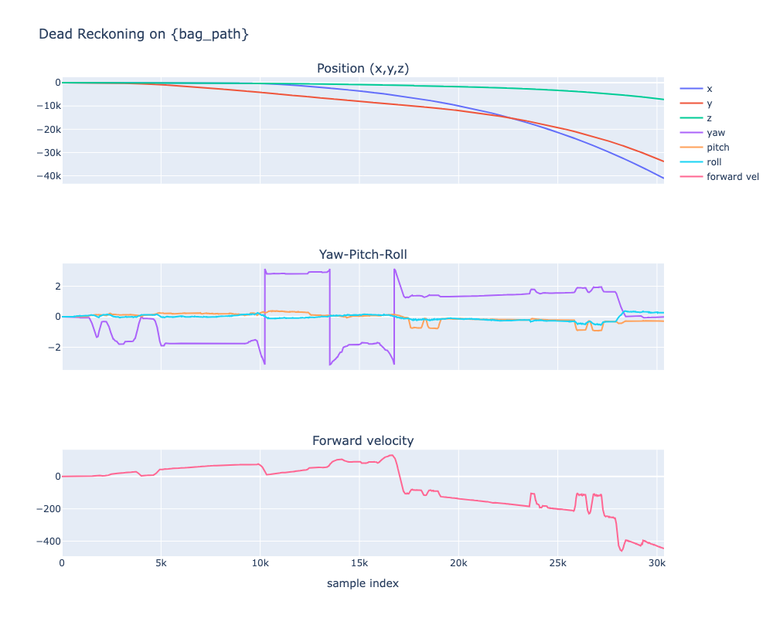
Paste screenshots of the main plots from the dead reckoning notebook. Add a short discussion about the behavior (drift, velocity, etc.). [5 pts]
The dead-reckoning plots show clear cumulative drift: position in x and y diverges strongly over time (with z also drifting), yaw is unstable and drifts/jumps while pitch and roll stay relatively small, and forward velocity trends from near zero to large negative values with spikes; together this is the expected behavior of pure IMU integration without external corrections, where bias/noise and heading error accumulate and propagate into velocity and then large position error.

Slide 5
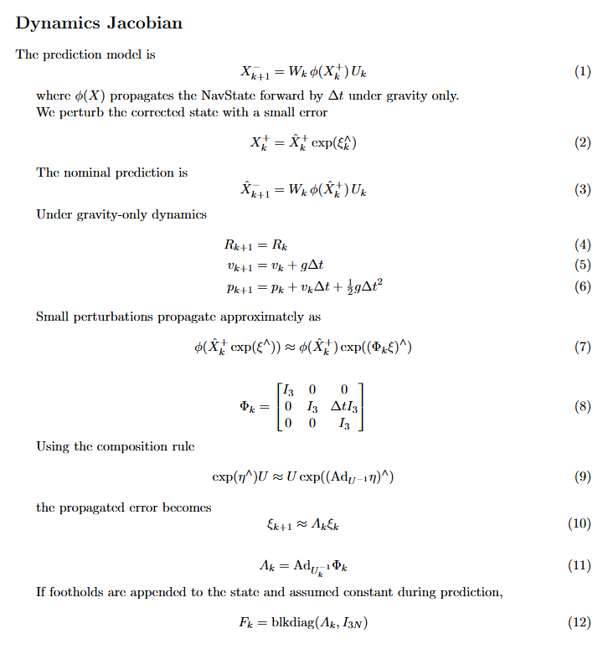
Paste a screenshot of your proof of the dynamics Jacobian. [5 pts]

Slide 6
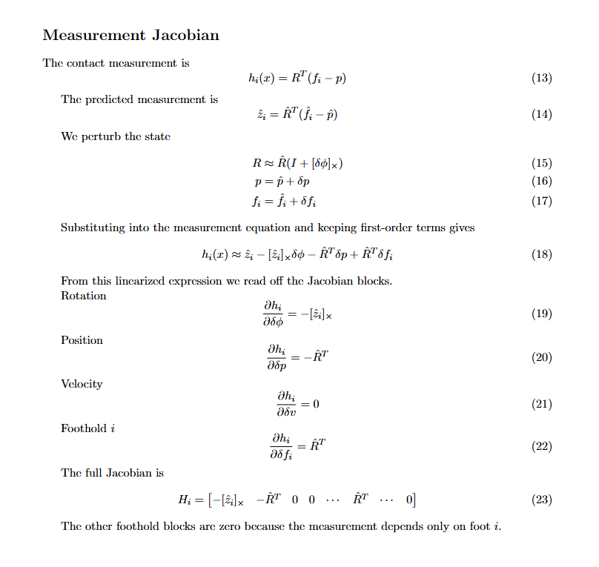
Paste a screenshot of your proof of the measurements Jacobian. [5 pts]

Slide 7
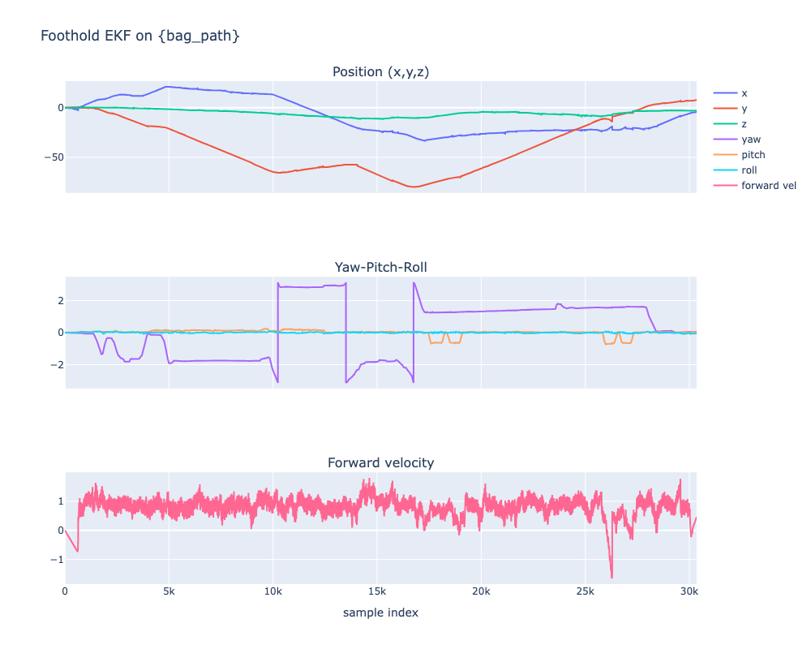
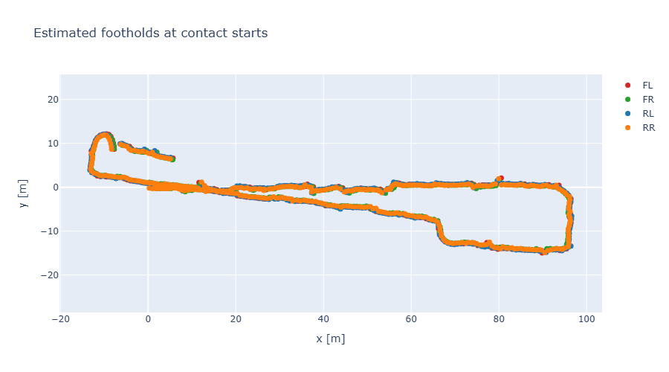
Paste screenshots of the main plots from the foothold filter notebook. Compare the behavior with dead reckoning. [5 pts]
Compared with dead reckoning, the foothold EKF is much more stable: position stays bounded (tens of meters), forward velocity remains near a reasonable range (about 0 to 1 m/s), and the trajectory/foothold map is consistent instead of diverging. Pitch and roll improve too, while yaw still drifts and occasionally jumps because contact updates weakly constrain heading. Overall, foothold measurements greatly reduce translational drift and velocity bias, with yaw as the main remaining error.

Slide 8
Discuss the trend of yaw over time. Why can yaw still drift or be weakly observable in this setup? [5 pts]
Yaw drifts over time with occasional jumps/wraps instead of staying fixed. It remains weakly observable because foothold/contact updates mainly constrain translation and relative geometry, not absolute heading about gravity; without a global heading sensor (like magnetometer/vision), gyro bias and slip can accumulate into yaw error.

Slide 9
Propose how you would improve the system with additional sensors. Which sensors would you add? Which failure modes do they improve? How will you incorporate them into the filter? [5 pts]
I would add a magnetometer (fixes yaw drift via heading update), vision/LiDAR odometry (reduces long-term position drift via pose/relative-motion updates), and GPS outdoors (anchors global position). I would also use foot force/slip detection to reject bad contact updates and adapt measurement noise. In the EKF, each is added as a measurement model z = h(x) + v with its own Jacobian H and covariance R; slip/contact quality mainly gates updates or inflates R rather than directly estimating a new state.

Slide 10
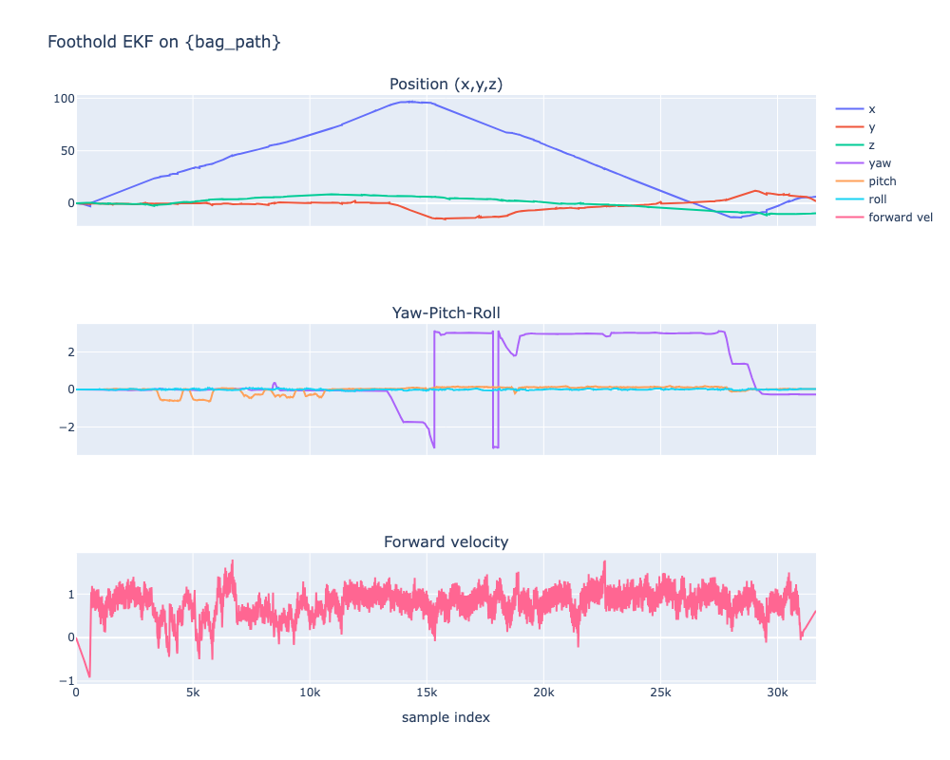
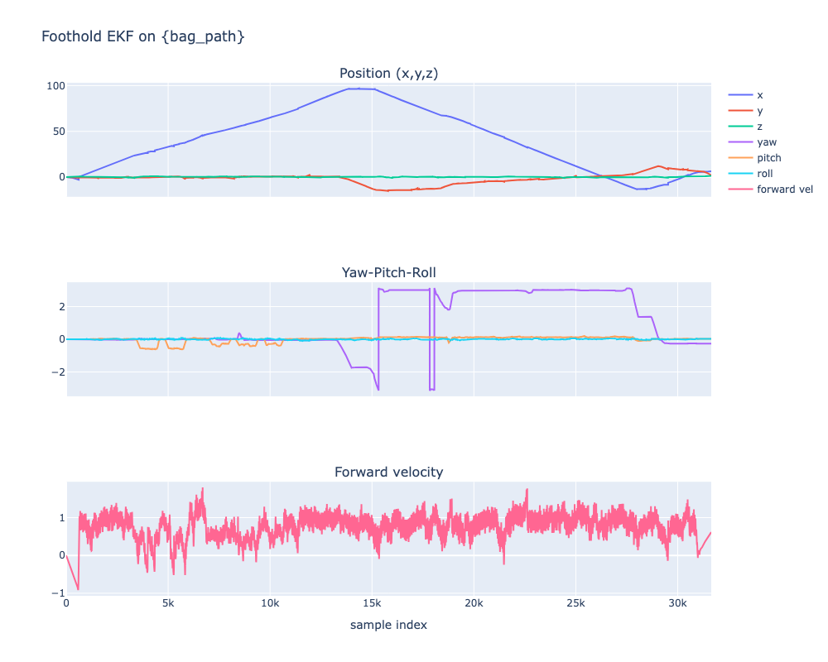
Paste screenshots from both runs on the stair dataset. Discuss your observations on what changes. [5 pts]
On stair.bag, enabling APPLY_HEIGHT_PRIOR makes the estimate smoother and more vertically stable (z/pitch/roll fluctuate less), while disabling it gives noisier vertical behavior and more drift. The overall horizontal trend is similar in both runs, and yaw still drifts/jumps in both, so the prior mainly helps height/contact consistency rather than heading. The improvement is very minor.
With APPLY_HEIGHT_PRIOR = False
With APPLY_HEIGHT_PRIOR = True

