Slide 1
Quantum Gates and Circuits
By: Suhas Bharadwaj
Dept. of Electronics and Communication Engineering
8th Semester, PES University

Slide 2
Quantum Bits
Known as qubits for short.
Can be either 0 or 1, just like a classical bit.
Unlike classical bits, qubits aren’t represented by voltages.
They instead rely on physical properties of quantum particles.
E.g. Spin of an electron, polarization of a photon, etc.

Slide 3
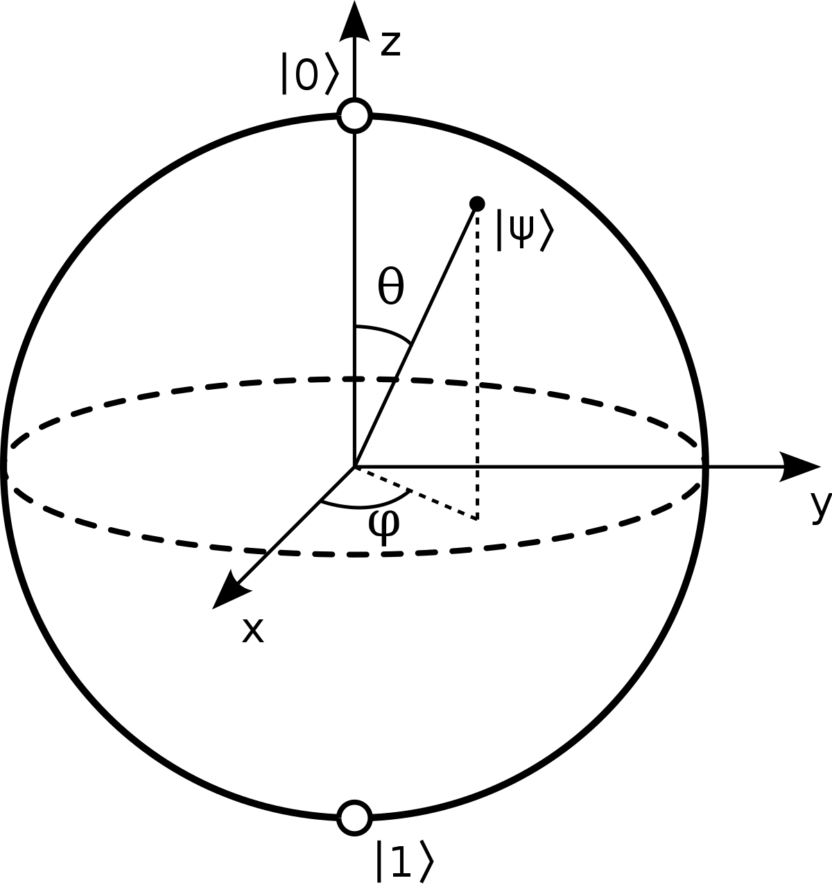

Representation of Qubits
Qubits are mathematically represented as vectors, and are written as $\left.|0\right\rangle$ and $\left.|1\right\rangle$. (The $\left.|\right\rangle$ come from Dirac’s notation.)
A qubit is represented geometrically using a Bloch sphere (shown below), which has two degrees of freedom: the polar and azimuthal angles.

Slide 4
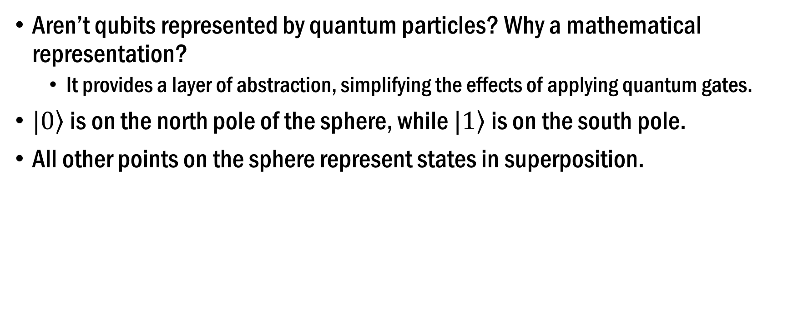
Representation of Qubits (Continued)
Aren’t qubits represented by quantum particles? Why a mathematical representation?
It provides a layer of abstraction, simplifying the effects of applying quantum gates.
$\left.|0\right\rangle$ is on the north pole of the sphere, while $\left.|1\right\rangle$ is on the south pole.
All other points on the sphere represent states in superposition.

Slide 5
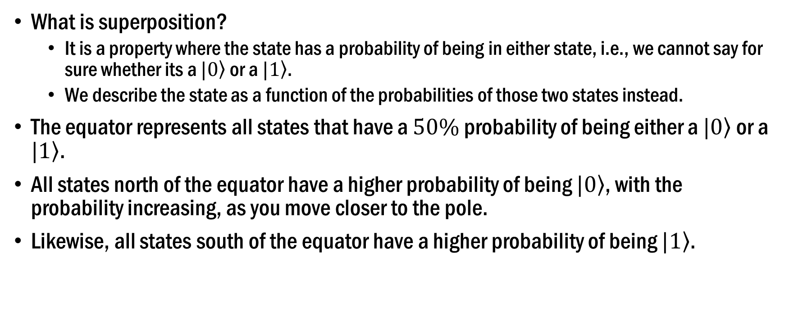
Representation of Qubits (Continued)
What is superposition?
It is a property where the state has a probability of being in either state, i.e., we cannot say for sure whether its a $\left.|0\right\rangle$ or a $\left.|1\right\rangle$.
We describe the state as a function of the probabilities of those two states instead.
The equator represents all states that have a $50\%$ probability of being either a $\left.|0\right\rangle$ or a $\left.|1\right\rangle$.
All states north of the equator have a higher probability of being $\left.|0\right\rangle$, with the probability increasing, as you move closer to the pole.
Likewise, all states south of the equator have a higher probability of being $\left.|1\right\rangle$.

Slide 6
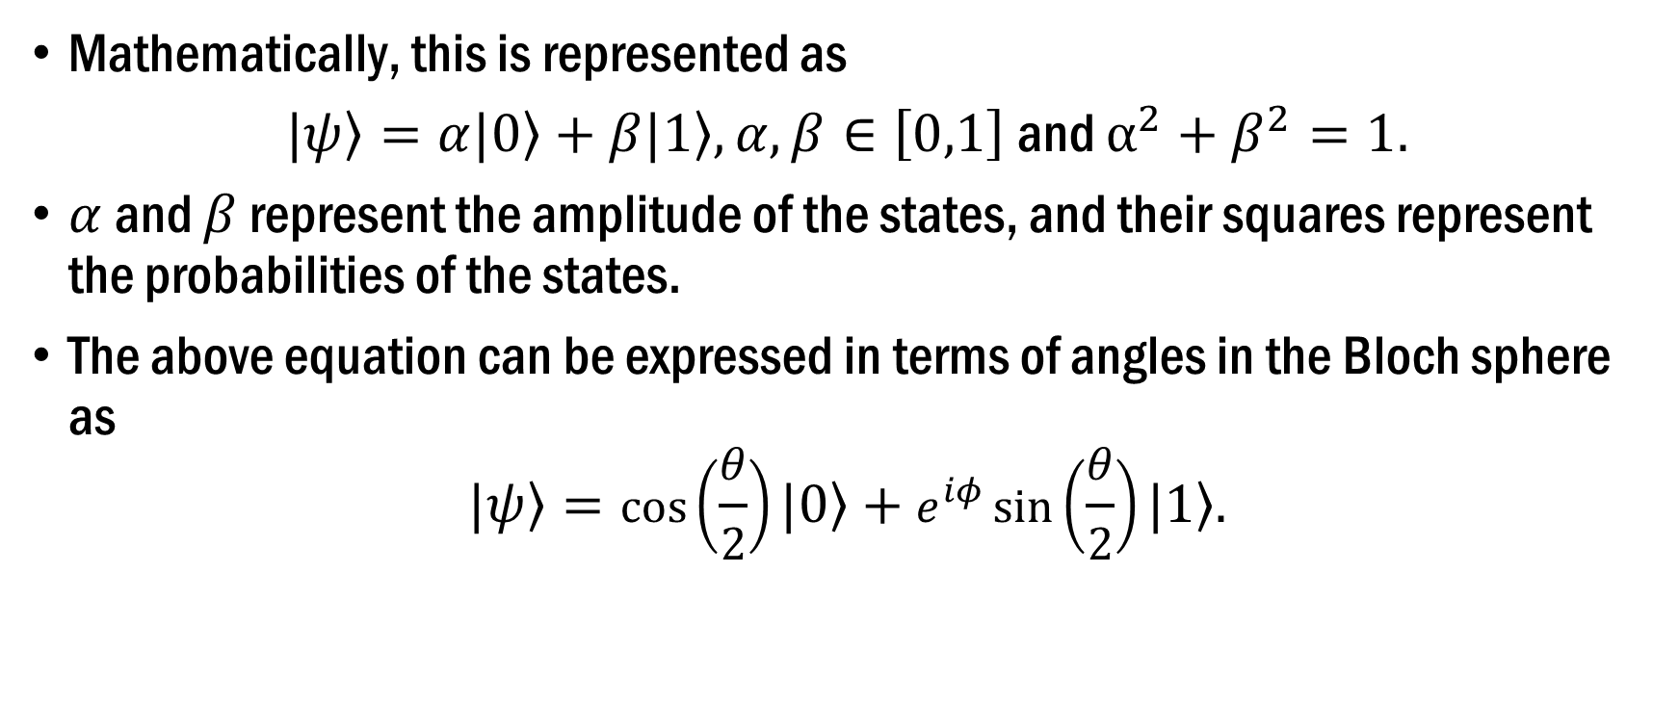
Representation of Qubits (Continued)
Mathematically, this is represented as
$\left.|ψ\right\rangle =α\left.|0\right\rangle +β\left.|1\right\rangle , α, β∈\left[0,1\right]$ and $α^{2}+β^{2}=1.$
$α$ and $β$ represent the amplitude of the states, and their squares represent the probabilities of the states.
The above equation can be expressed in terms of angles in the Bloch sphere as
$$\left.|ψ\right\rangle =\cos\left(\frac{θ}{2}\right)\left.|0\right\rangle +e^{iφ}\sin\left(\frac{θ}{2}\right)\left.|1\right\rangle .$$

Slide 7
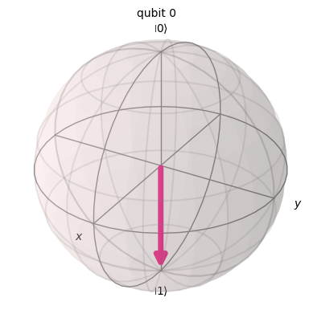
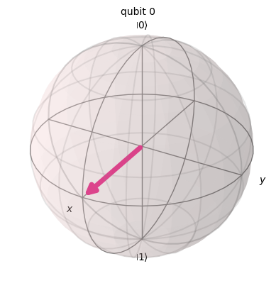
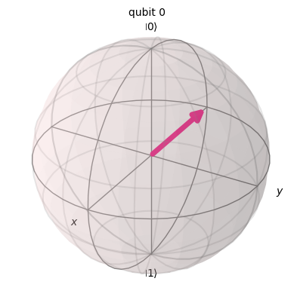
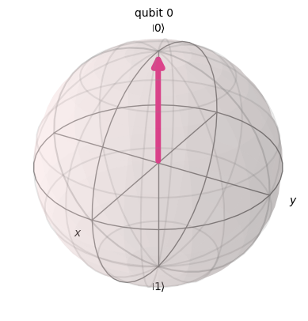
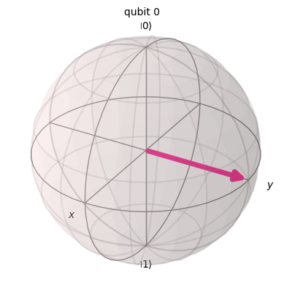
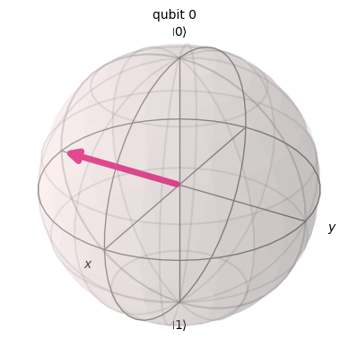
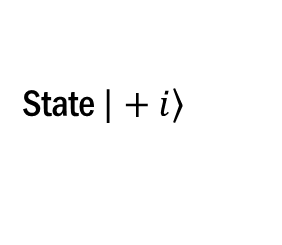
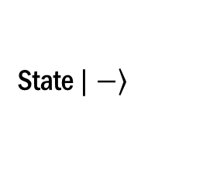
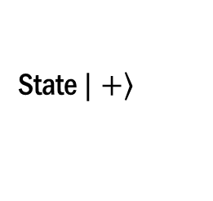
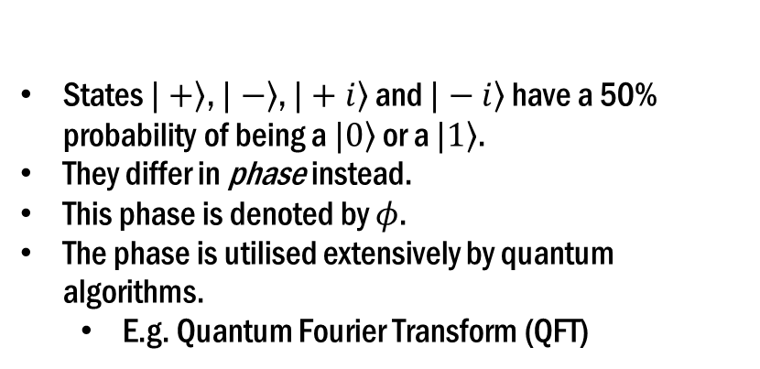
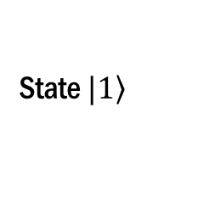
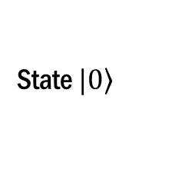
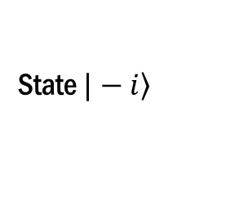
Representation of Qubits (Continued)
State $\left.|0\right\rangle$
State $\left.|1\right\rangle$
State $\left.|+\right\rangle$
State $\left.|−\right\rangle$
States $\left.|+\right\rangle$, $\left.|−\right\rangle$, $\left.|+i\right\rangle$ and $\left.|−i\right\rangle$ have a 50% probability of being a $\left.|0\right\rangle$ or a $\left.|1\right\rangle$.
They differ in phase instead.
This phase is denoted by $φ$.
The phase is utilised extensively by quantum algorithms.
E.g. Quantum Fourier Transform (QFT)
State $\left.|+i\right\rangle$
State $\left.|−i\right\rangle$

Slide 8
Quantum Gates
A review of classical gates:
NOT gates cause a bit-flip.
OR gates produce a HIGH output when at least one input is HIGH.
AND gates produce a HIGH output only when all inputs are HIGH.
NAND and NOR gates form the set of universal gates, using which all other logical operations can be realised.
They usually take multiple inputs and provide one output.
The numbers of inputs and outputs are equal in a quantum gate.

Slide 9

Quantum Gates (Continued)
Applying a Quantum gate causes a rotation of the vector in the Bloch sphere.
Rotation about the $x$ axis causes the probability of states to change.
Rotation about $z$ axis causes a change in phase.
Rotation about $y$ axis causes a change in both probabilities and phase.

Slide 10
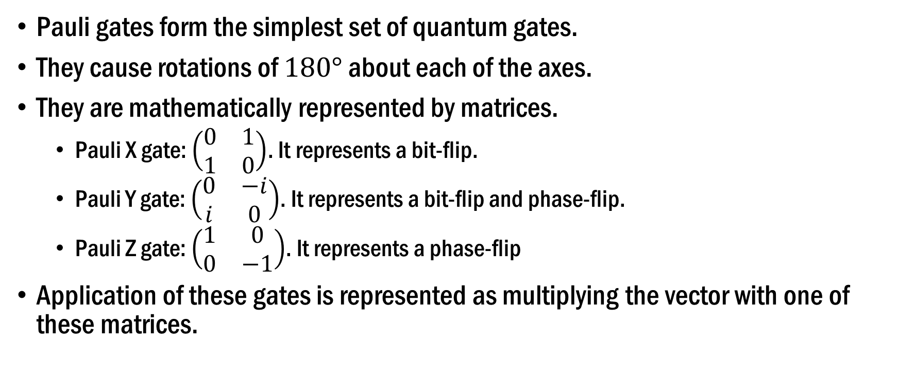
Quantum Gates (Continued)
Pauli gates form the simplest set of quantum gates.
They cause rotations of $180°$ about each of the axes.
They are mathematically represented by matrices.
Pauli X gate: $\left(\begin{matrix}0 & 1 \\ 1 & 0\end{matrix}\right)$. It represents a bit-flip.
Pauli Y gate: $\left(\begin{matrix}0 & −i \\ i & 0\end{matrix}\right)$. It represents a bit-flip and phase-flip.
Pauli Z gate: $\left(\begin{matrix}1 & 0 \\ 0 & −1\end{matrix}\right)$. It represents a phase-flip
Application of these gates is represented as multiplying the vector with one of these matrices.

Slide 11
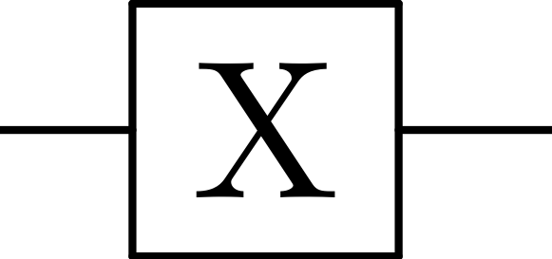
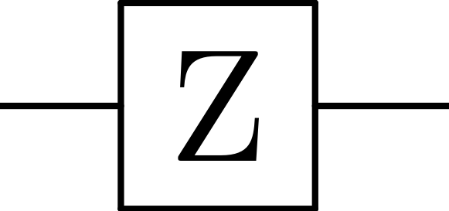
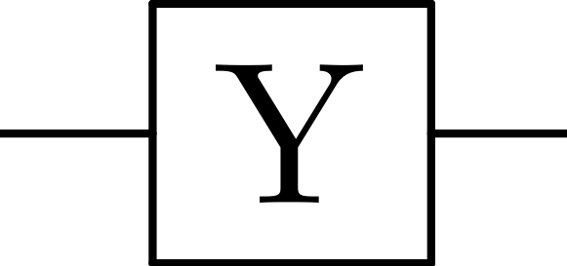
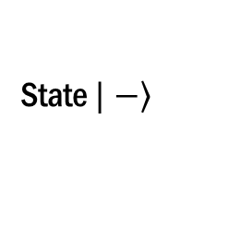
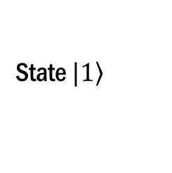
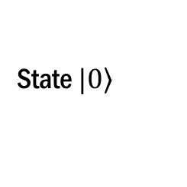
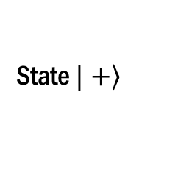
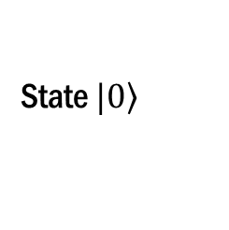
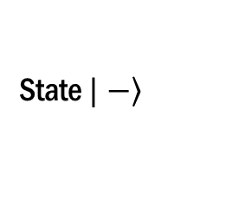
Quantum Gates (Continued)
Visualizations of application of Pauli gates:
State $\left.|0\right\rangle$
State $\left.|1\right\rangle$
State $\left.|+\right\rangle$
State $\left.|−\right\rangle$
State $\left.|0\right\rangle$
State $\left.|−\right\rangle$

Slide 12
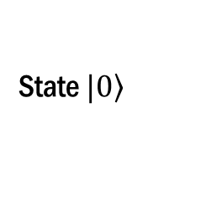

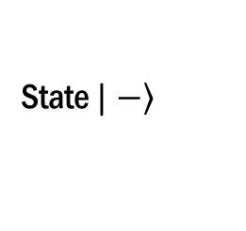
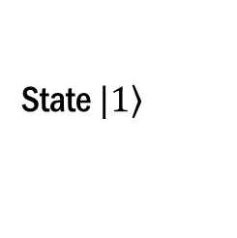
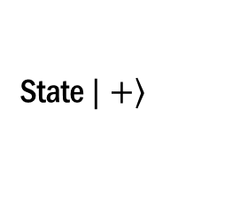
Quantum Gates (Continued)
A very popular single-qubit gate is the Hadamard gate.
It puts $\left.|0\right\rangle$ and $\left.|1\right\rangle$ into states of equal superposition, i.e., the vectors are rotated from the poles onto the equator.
H gate matrix: $\frac{1}{\sqrt{2}}\left(\begin{matrix}1 & 1 \\ 1 & −1\end{matrix}\right)$.
State $\left.|0\right\rangle$
State $\left.|+\right\rangle$
State $\left.|1\right\rangle$
State $\left.|−\right\rangle$

Slide 13
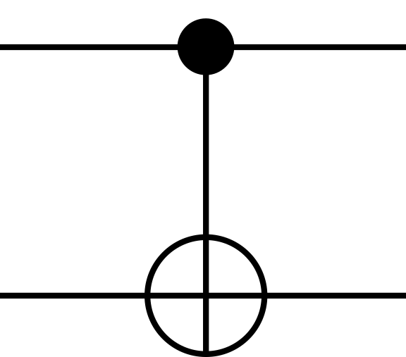

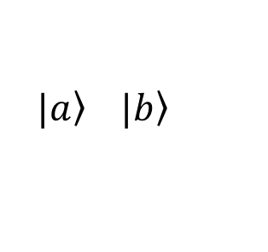
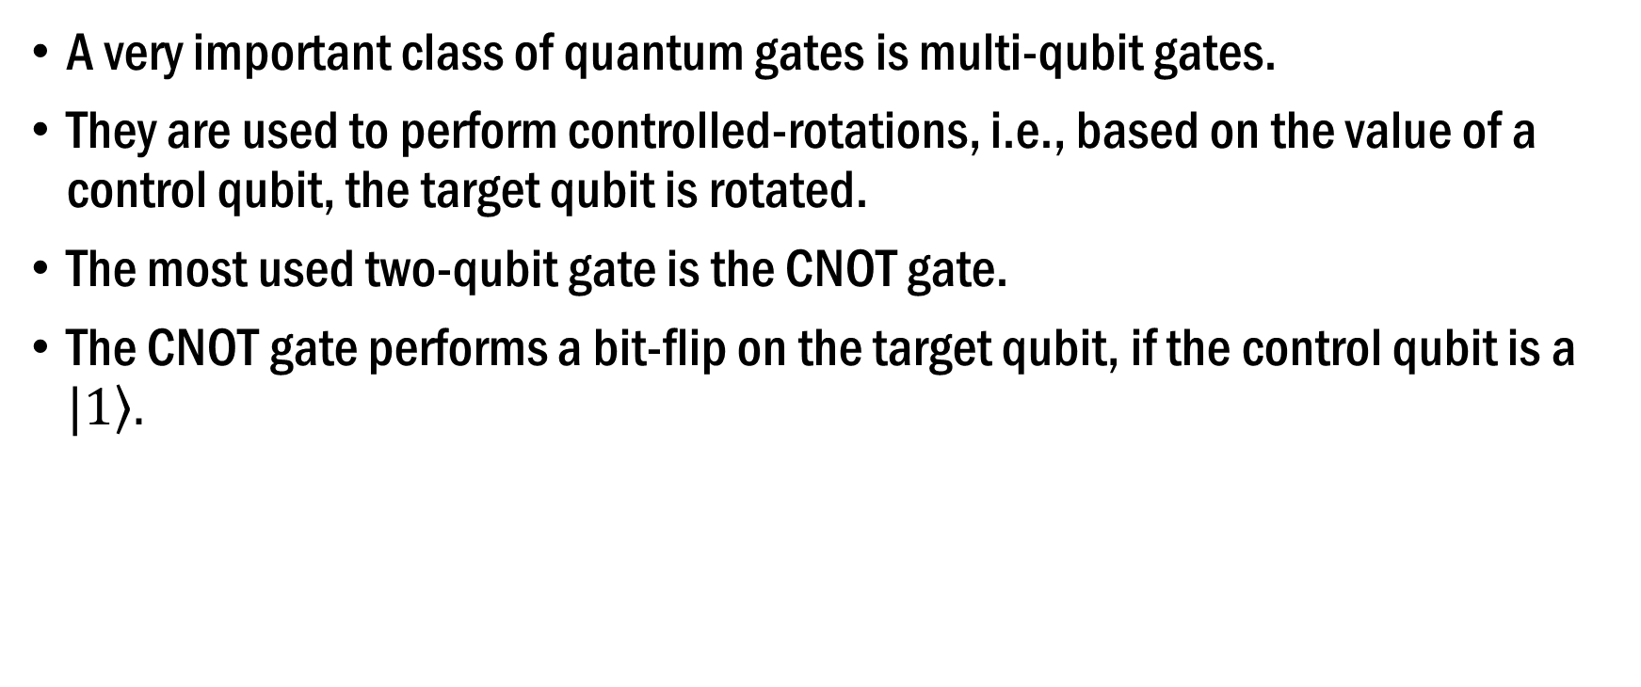
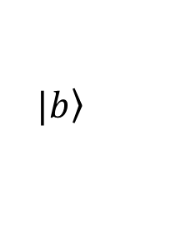
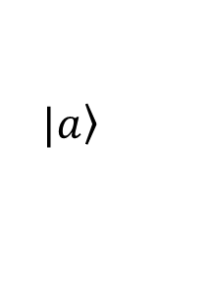
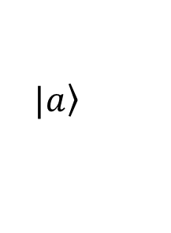
Quantum Gates (Continued)
A very important class of quantum gates is multi-qubit gates.
They are used to perform controlled-rotations, i.e., based on the value of a control qubit, the target qubit is rotated.
The most used two-qubit gate is the CNOT gate.
The CNOT gate performs a bit-flip on the target qubit, if the control qubit is a $\left.|1\right\rangle .$
$$\left.|a\right\rangle$$
$$\left.|a\right\rangle$$
$$\left.|b\right\rangle$$
$$\left.|a\right\rangle \left. |b\right\rangle$$

Slide 14
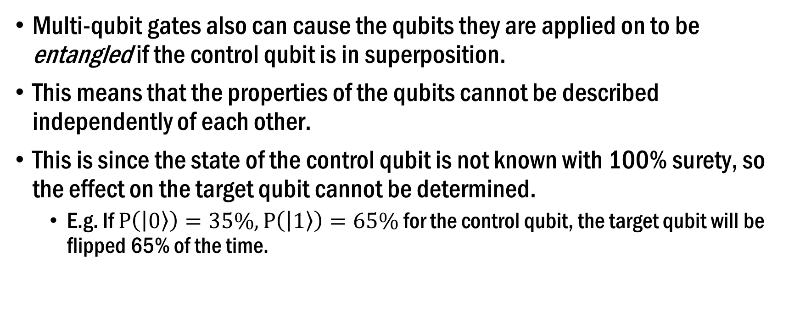
Quantum Gates (Continued)
Multi-qubit gates also can cause the qubits they are applied on to be entangled if the control qubit is in superposition.
This means that the properties of the qubits cannot be described independently of each other.
This is since the state of the control qubit is not known with 100% surety, so the effect on the target qubit cannot be determined.
E.g. If $P\left(\left|0\right\rangle \right)=35\%, P\left(\left|1\right\rangle \right)=65\%$ for the control qubit, the target qubit will be flipped 65% of the time.

Slide 15
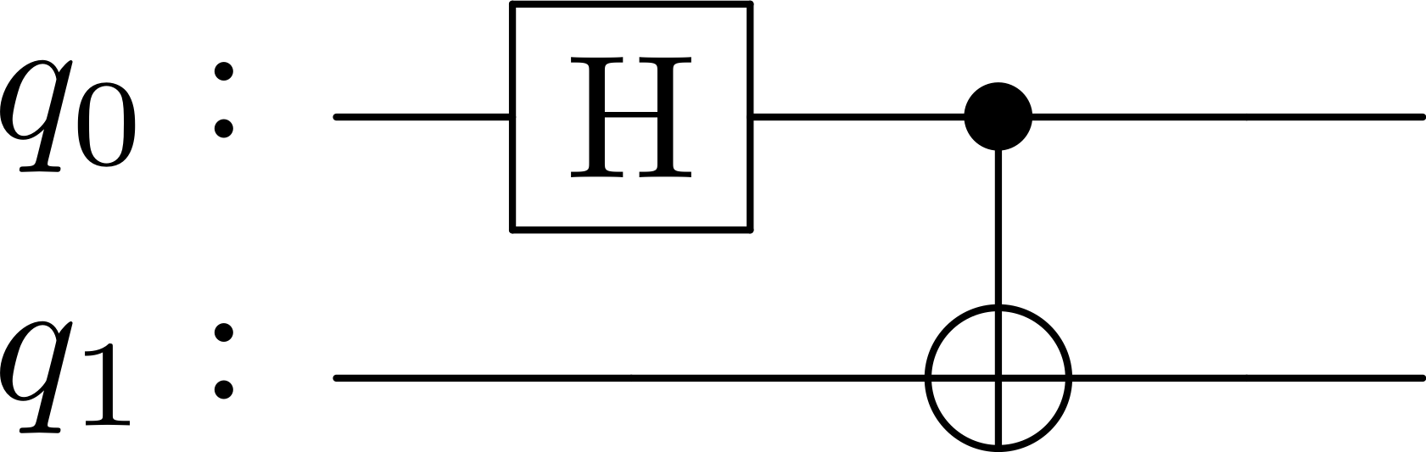
Quantum Circuits
Various qubits can be used together to perform more complex operations.
Superposition allows for parallelized computation, since the effect on all states can be computed at once.
Further, all the gates are reversible in nature. This means that there is no information loss, and the computation is energy efficient.
E.g. Circuit for creating a bell pair:

Slide 16
Measurements
After performing the desired operations, the qubits are measured, resulting in classical bits.
Qubits in superposition yield different values every time they are measured because of their probabilities.
So the circuit is run several times, and the measurement after each run is stored. The number of times the circuit is run is referred to as the number of shots.
A high number of shots allows us to see the probabilities by experiment.

Slide 17
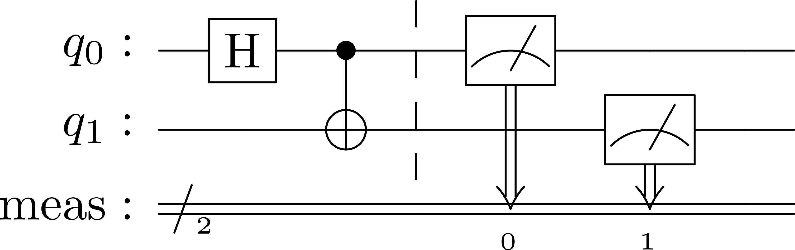
Measurements (Continued)
Measuring a qubit also alters it. So, once a qubit is measured, it can’t be directly reused for more operations.
Measuring a qubit can also cause some crosstalk with any neighbouring qubits.
Measurements also introduce latency.
Bell state circuit with measurements:
The measured values are stored in a classical register called ‘meas’ here.

Slide 18
Superconducting Qubits
Working Principle

Slide 19
Superconductors
Normal conductors have a positive temperature coefficient, meaning that as temperature increases, resistance increases.
So, as a metal is cooled down, the resistance gradually decreases, as the electrons in the metal collide fewer times.
Physicists before 1911 thought that at some low enough temperature, the current will at some point stop flowing because the electrons will be lacking much of the thermal energy and will be bound to their atoms instead.
But in 1911, Heike K Onnes cooled down Mercury to less than 4K using liquid Helium. Instead of seeing a very high resistance, he observed that it was zero.

Slide 20
Superconductors (Continued)
To emphasize, he did not see the resistance was some value close to zero. He observed it to be zero exactly.
The reason this occurs is as follows:
As an electron moves through the lattice, it distorts the lattice around it slightly, as the ions are positively charged.
This sets up a local distortion and vibration in the lattice which makes the region slightly positive in charge.
A second electron can now be attracted to the distorted region, despite the natural repulsion between two electrons, forming a pair with the first electron known as a Cooper Pair.

Slide 21
Superconductors (Continued)
The electrons Cooper pair become entangled, and the energy required to separate the two electrons increases.
Under normal circumstances, the thermal energy is greater than the binding energy, preventing them from forming a single entangled state.
At sufficiently low temperatures, these paired electrons can move through the crystal lattice without resistance because they behave effectively as Bosons rather than Fermions.
Bosons (particles with integer spin) can condense into the same quantum state, unlike fermions (which have half-integer spin and must occupy different states due to the Pauli exclusion principle).

Slide 22
Superconductors (Continued)
Two important properties of superconductors:
Phase coherence
All Cooper pairs are described by a wavefunction with the same phase.
Meissner Effect
Superconductors expel magnetic fields completely.
This is because a surface current is induced by the magnetic field which opposes it.
This prevents any magnetic field from penetrating through the superconductor.

Slide 23
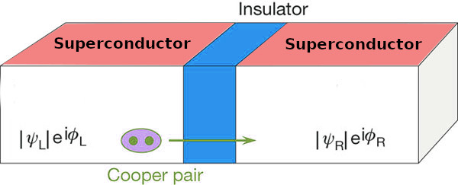
Josephson Junctions
Josephson junctions comprise of a superconductor – insulator – superconductor (S-I-S) interface.
The insulator is very thin, allowing Cooper pairs to tunnel through it.
The two superconductors on either side are described by wavefunctions with different phases.
This phase difference plays an important role – it sets up a current through the j unction, even though a voltage isn’t applied.
Image source: https://911electronic.com/physics-of-josephson-junctions-critical-current-qubit-array-and-graphene/

Slide 24
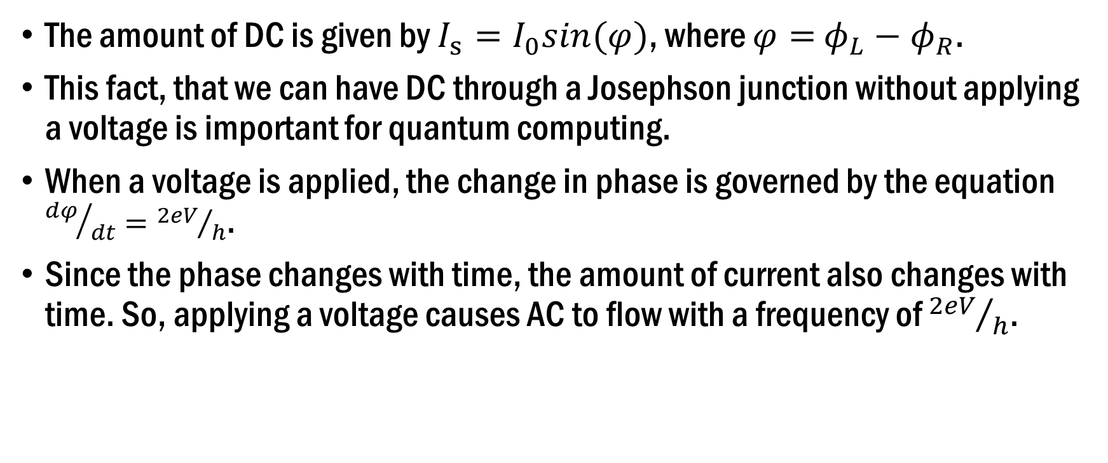
Josephson Junctions (Continued)
The amount of DC is given by $I_{s}=I_{0}sin(φ)$, where $φ=$ $φ_{L}−φ_{R}$.
This fact, that we can have DC through a Josephson junction without applying a voltage is important for quantum computing.
When a voltage is applied, the change in phase is governed by the equation ${dφ}/{dt}={2eV}/h$.
Since the phase changes with time, the amount of current also changes with time. So, applying a voltage causes AC to flow with a frequency of ${2eV}/h$.

Slide 25
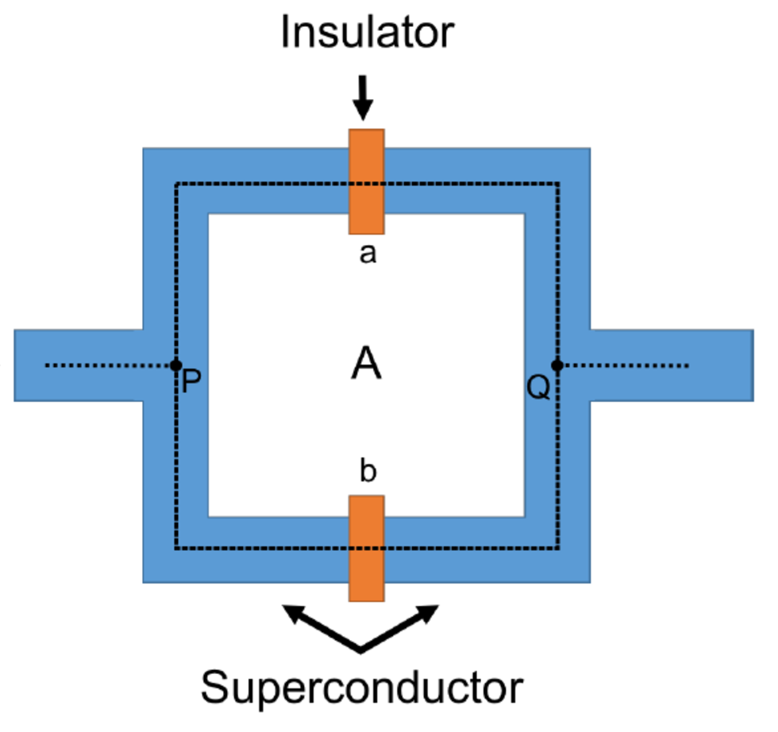
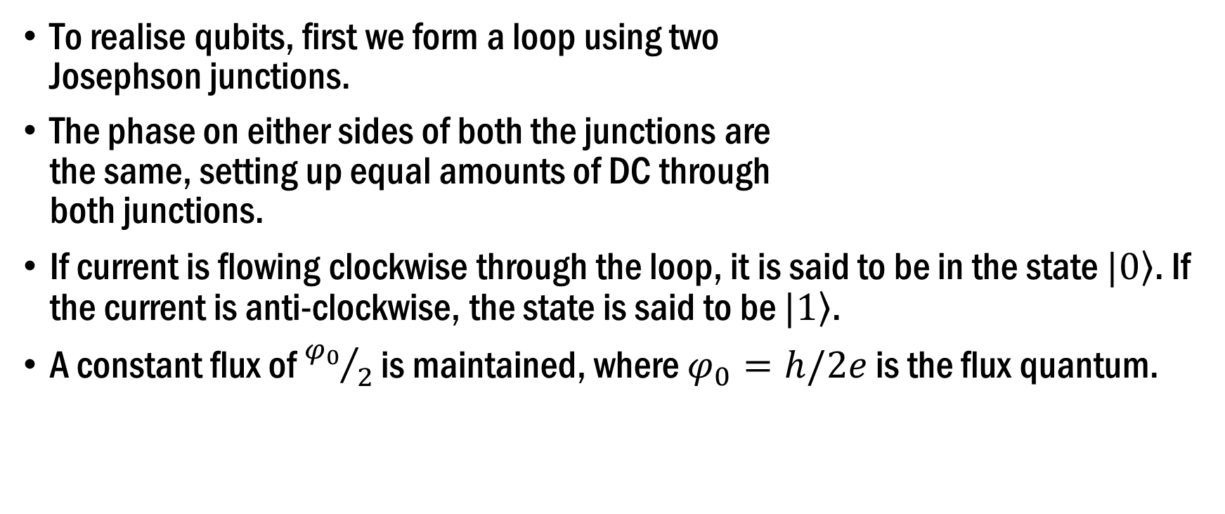
Superconducting Qubits
To realise qubits, first we form a loop using two Josephson junctions.
The phase on either sides of both the junctions are the same, setting up equal amounts of DC through both junctions.
If current is flowing clockwise through the loop, it is said to be in the state $\left.|0\right\rangle$. If the current is anti-clockwise, the state is said to be $\left.|1\right\rangle$.
A constant flux of ${φ_{0}}/2$ is maintained, where $φ_{0}=h/2e$ is the flux quantum.

Slide 26
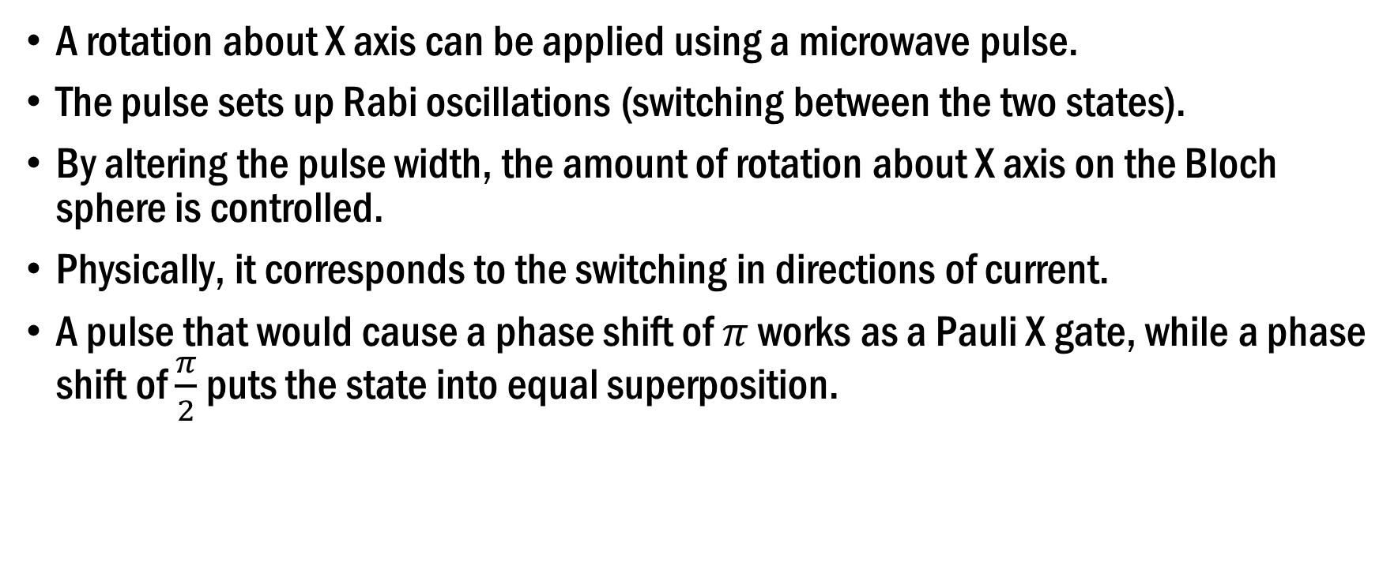
Gates and Superconducting Qubits
A rotation about X axis can be applied using a microwave pulse.
The pulse sets up Rabi oscillations (switching between the two states).
By altering the pulse width, the amount of rotation about X axis on the Bloch sphere is controlled.
Physically, it corresponds to the switching in directions of current.
A pulse that would cause a phase shift of $π$ works as a Pauli X gate, while a phase shift of $\frac{π}{2}$ puts the state into equal superposition.

Slide 27
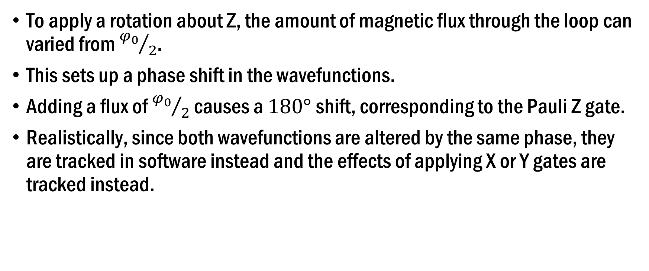
Gates and Superconducting Qubits (Contd.)
To apply a rotation about Z, the amount of magnetic flux through the loop can varied from ${φ_{0}}/2$.
This sets up a phase shift in the wavefunctions.
Adding a flux of ${φ_{0}}/2$ causes a $180°$ shift, corresponding to the Pauli Z gate.
Realistically, since both wavefunctions are altered by the same phase, they are tracked in software instead and the effects of applying X or Y gates are tracked instead.

Slide 28
Effects of Noise
Qubits are highly susceptible to noise which can be due to variations in the magnetic fields, thermal variations, fabrication limitations, crosstalk between two qubits, and so on.
These qubits are operated at very low temperatures to ensure that there are as few physical processes as possible that can interfere with the qubits.
As a metric, we use the coherence time to understand how long a qubit is usable.
Coherence time is defined as the duration for which the system can maintain its state without losing information.

Slide 29
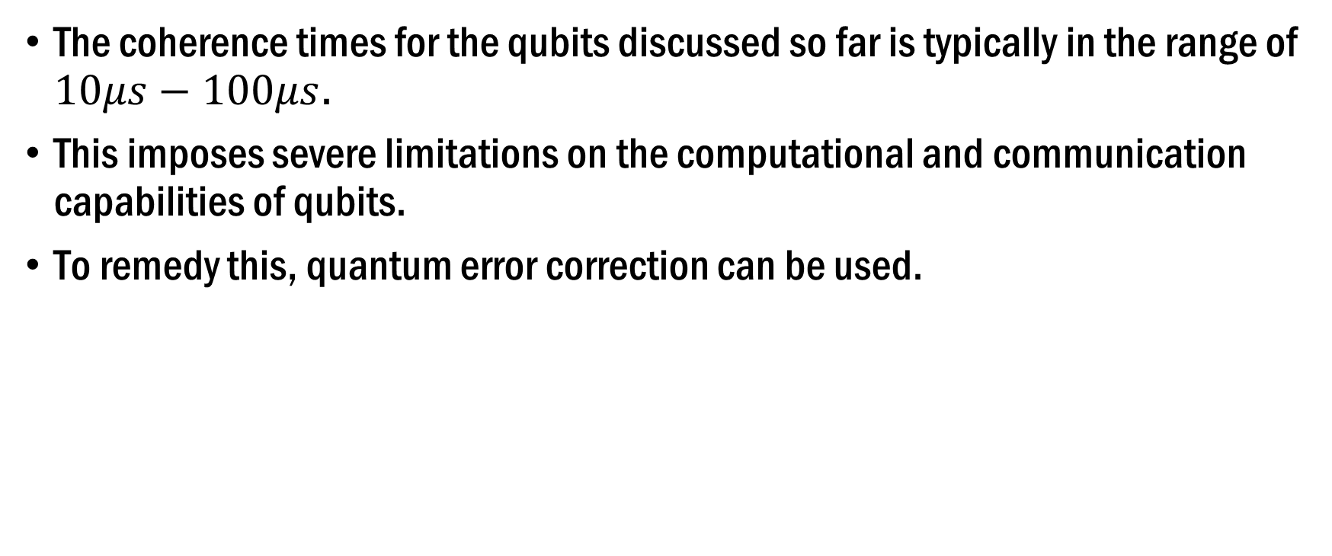
Effects of Noise (Continued)
The coherence times for the qubits discussed so far is typically in the range of $10μs−100μs$.
This imposes severe limitations on the computational and communication capabilities of qubits.
To remedy this, quantum error correction can be used.

Slide 30
Quantum Error Correction
A brief introduction

Slide 31
Quantum Error Correction
Like classical error correction, quantum error correction is performed by introducing redundancy.
In Classical Error Correction Codes (CECCs), parity bits are added which indicate the position of the error.
In Quantum Error Correction Codes (QECCs), parity qubits cannot simply be added because they will be entangled with the data carrying qubits.
The reason this is problematic is that measuring the parity qubit will also affect the other qubit that it is entangled with.

Slide 32
Quantum Error Correction (Continued)
The simplest QECC is where, the data is repeated across at least 3 qubits.
The three qubits are together referred to as one logical qubit.
That way, if one of the qubits suffers an error, it can be compared with the other two and be corrected.
This only works for one error. If two errors occur, this scheme fails.
But how are the qubits compared? They can’t be measured due to their entangled nature.

Slide 33
Quantum Error Correction (Continued)
“We have learned that it is possible to ﬁght entanglement with entanglement”
- John Preskill.
The three qubits are instead entangled with two more auxiliary qubits (aka ancilla qubits).
Now these ancilla qubits can be measured without altering the states of the original three qubits.
Measuring the ancillas yields information about the position of the error, which can then be corrected. This is known as obtaining the syndrome.

Slide 34


Quantum Error Correction (Continued)
The bit flip correction circuit:
There is an error on ${qubit}_{1}$, which is reflected in the ancillas after the CNOT gates and detected finally after they are measured.

Slide 35
Quantum Error Correction (Continued)
This process of projecting the error onto ancillas and measuring them is the primary mechanism in use in all error correction codes to this day.
A phase-flip code can also be made by simply adding Hadamard gates after encoding the logical qubit, and performing the same process.
In 1995, Shor presented his 9-qubit code, which encodes a bit-flip code into the phase-flip code, protecting against both types of errors that can occur.

Slide 36
A Very Brief Recap
Qubits can be mathematically represented by vectors.
Applying quantum gates causes the rotation of those vectors.
Physically, qubits can be realised using Josephson junctions in a loop.
Gates can be applied onto the qubits using microwave pulses and changing the magnetic fields.
To combat low coherence times, quantum error correction can be used.

Slide 37
Thank You

Slide 38
Q&A

