Slide 1
Dominosa
Group members:
L . Nikhil Raj - CB.SC.U4CSE24026
Ojas Joshi - CB.SC.U4CSE24034
S . Varun Teja - CB.SC.U4CSE24045
Karthikraja - CB.SC.U4CSE24021

Slide 2
The Game
The core concept:
  A grid of numbers. A hidden set of dominoes
  The goal: Revise engineer the layout (find the hidden binds)
  Classic version: Solitaire
  Competitive strategy
  GamePlay loop:
    Observe: analyze the grid
    Deduce: find the most optimal move at that instant using Greedy logic
    Conquer

Slide 3
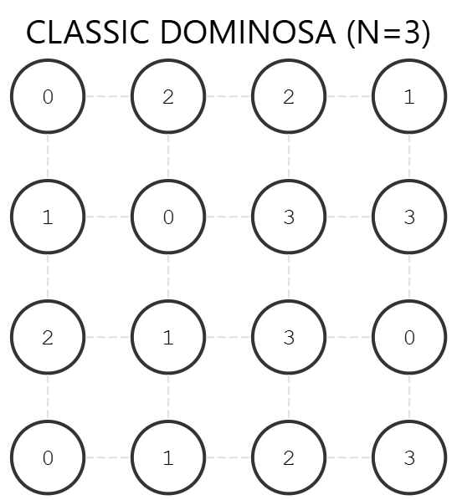

Slide 4
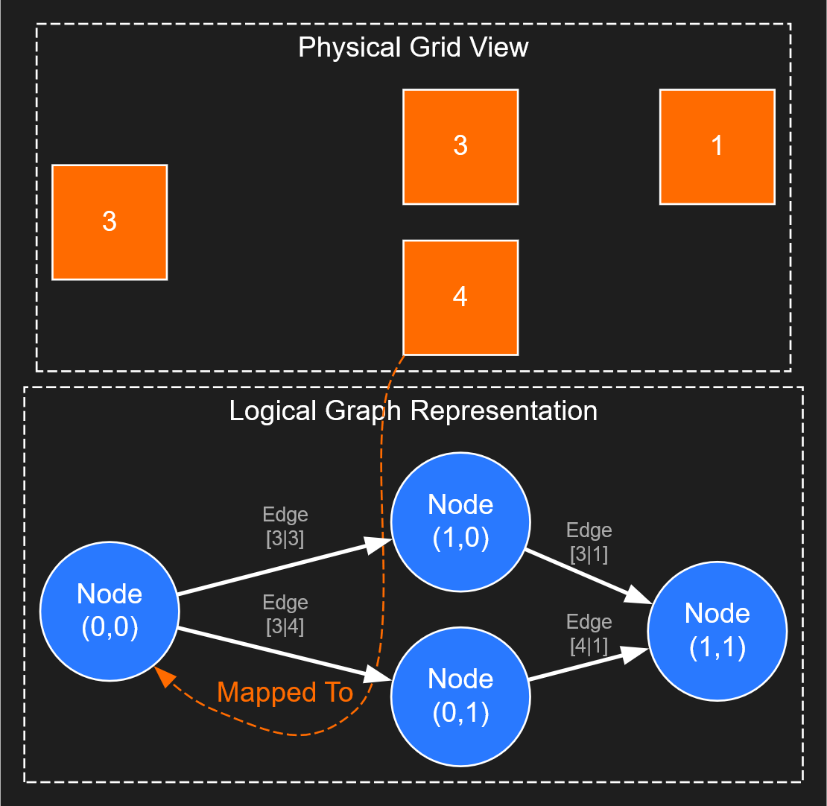

Slide 5
Game Philosophy :
The core idea:
Dominosa is a deterministic logic puzzle — not a guessing game.
Design principles:
• Every puzzle has exactly one valid solution
• Player's progress using logical deduction
• Trial-and-error is discouraged by constraints
• Mistakes are prevented using logical rules
Goal:
Train structured reasoning through constraint- based problem solving.

Slide 6
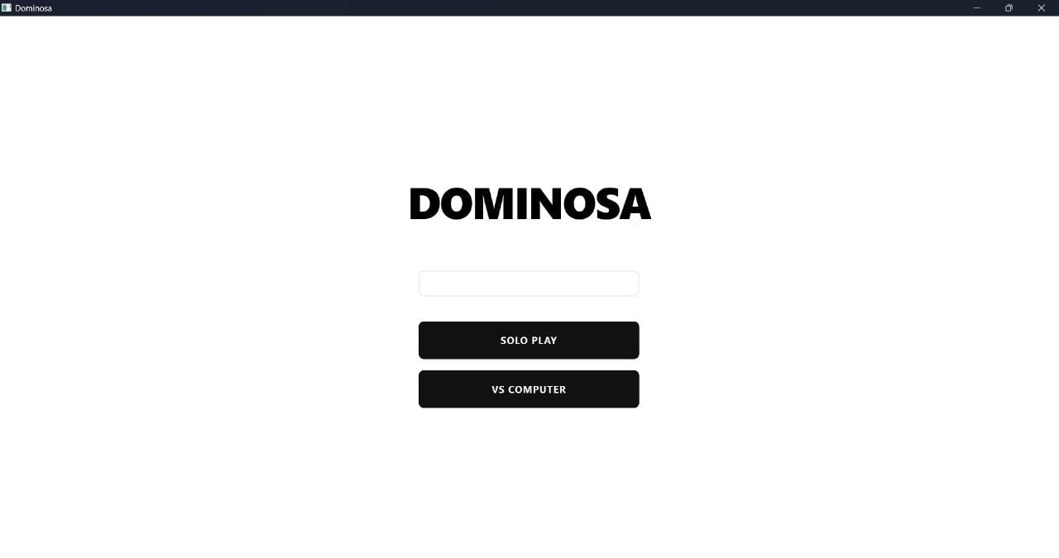
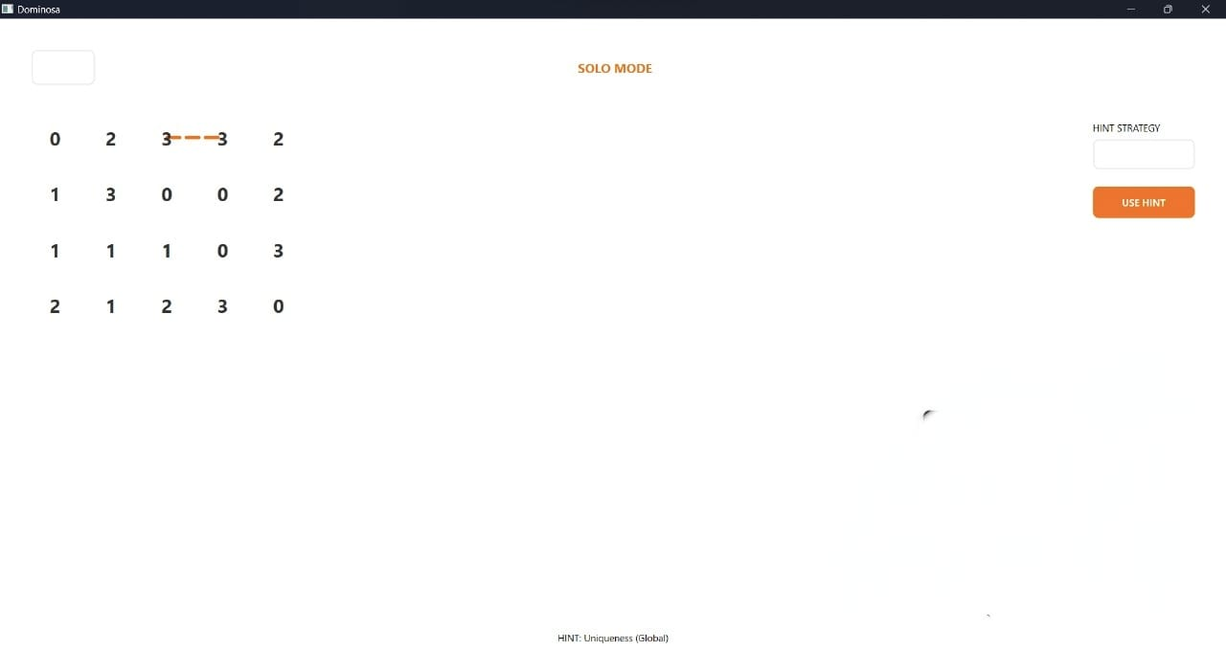
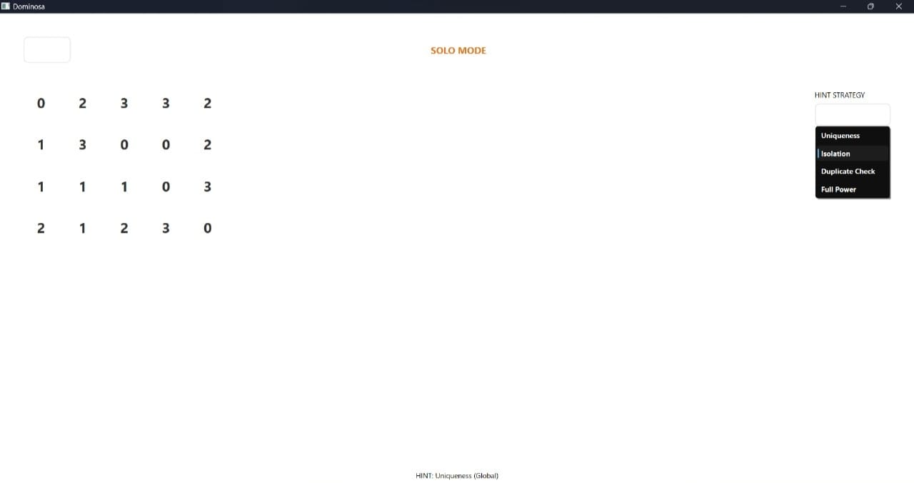
User Interface Walkthrough
Home Screen:
• Grid size selection
• Mode selection (Solo / CPU)
Game Screen:
• Centered logical grid
• Highlighted selections for feedback
• Sidebar for strategy control
Hint System:
• Uniqueness — global constraint
• Isolation — local constraint
• Duplicate Check — negative constraint

Slide 7
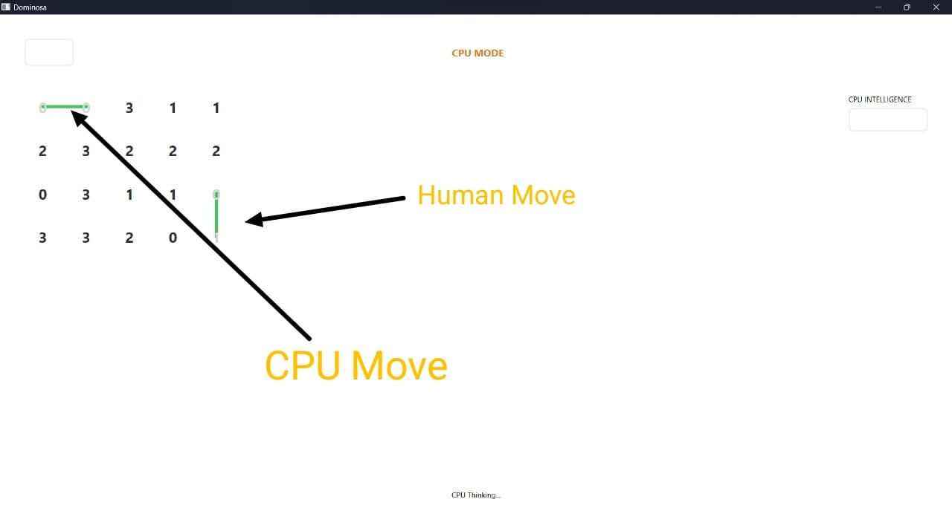
Human vs CPU Philosophy
CPU design:
• Uses same strategies as hint system
• Demonstrates optimal logical play
• Acts as learning mirror for player
Purpose:
CPU mode teaches how to think, not how to guess. It will make move with us will not gives hints to make a move

Slide 8
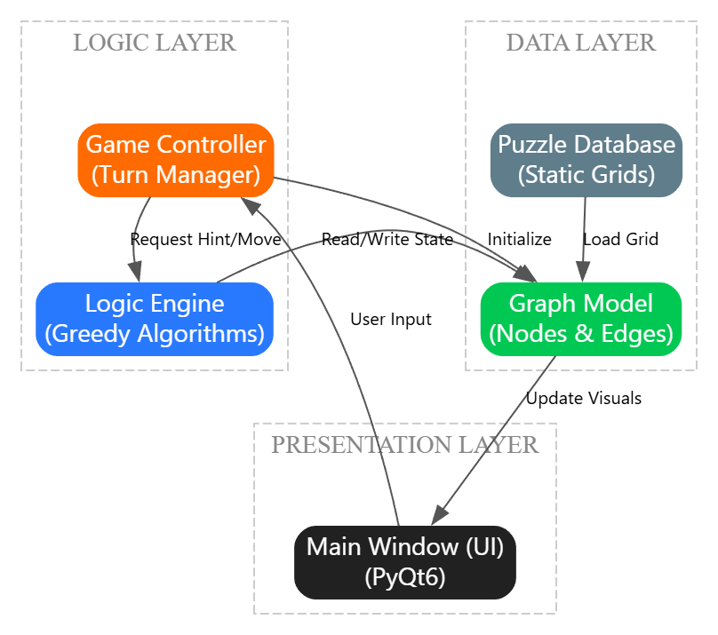
Architecture
Design Pattern: modified Model View Controller
Workflow :
  1. Input : user clicks a cell (view/UI)
  Processing: the Controller checks if it’s a valid move
  Logic : the solver analyzes the Graph Model to find the best move
  4. Update : the Board State changes and the UI repaints the grid

Slide 9
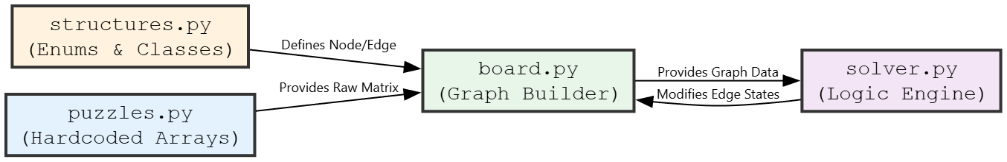
Game Engine Components

Slide 10
Logic Engine
Greedy Algorithm
  Definition : locally the most optimal decision is taken at each iteration
  Application: only Deterministic moves are executed
Greedy Strategies
Duplicate Check : Constraint propagation (Negative Logic)
Uniqueness : Global Search (Frequency Counting)
Isolation : Local Search (Graph Degree)
CPU Logic : Priority queue of the above

Slide 11
Strategy 1: Uniqueness
The logic (global search)
The solver ignores the grid shape and looks at the Bone Pile
It iterates through ever possible domino
It scans the board for all possible locations of that specific pair
The rule
  If possible_loacations == 1, move is forced
  We claim the edge

Slide 12
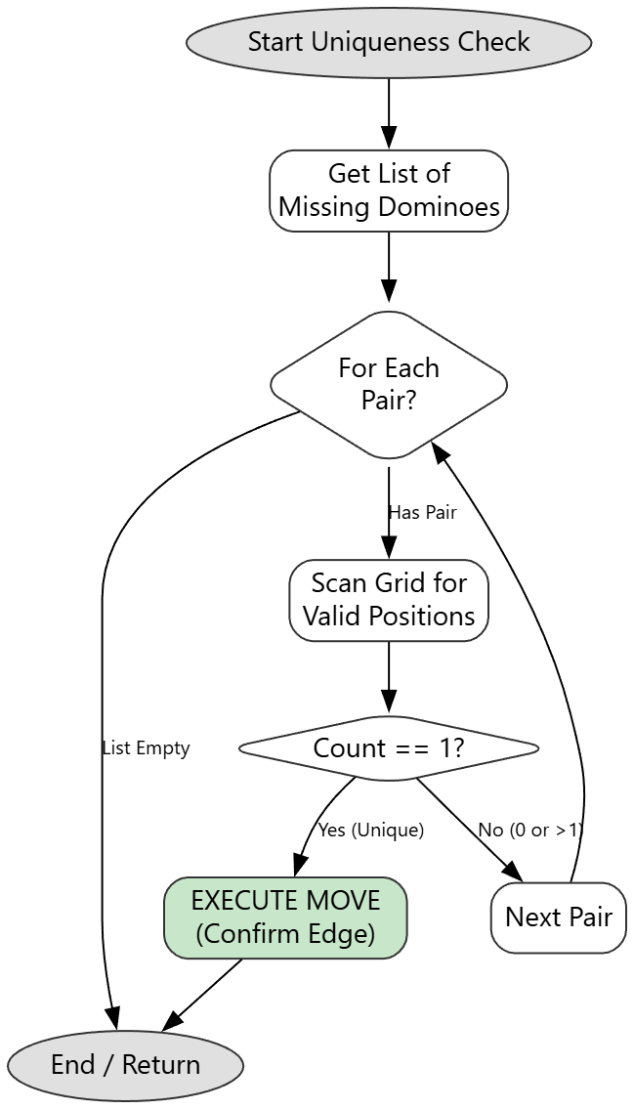

Slide 13
Strategy 2: Isolation (local constraint)
The logic (local search)
This strategy ignores the global list of dominoes and focuses on the Graph topology
It visits every node on the board
It calculates the node degree to find how many nodes it can still connect to
The rule
If valid_neighboard == 1 , the cell is trapped
It must connect to that single remaining neighbor immediately

Slide 14
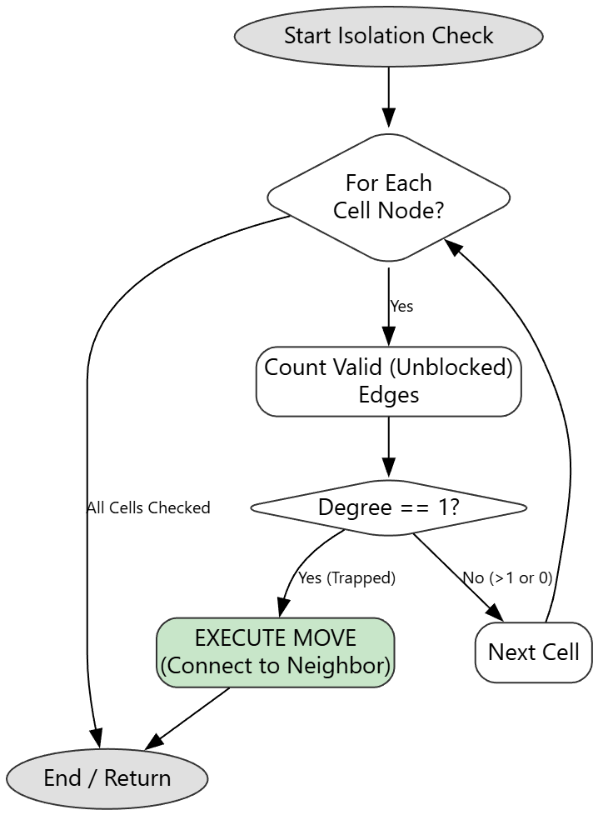

Slide 15
Strategy 3: Duplicate check (negative logic)
The logic (constraint propagation)
This strategy doesn’t look for where you can put a domino, it looks for where a domino cannot go
It identifies all the Confirmed pairs on the board
The rule
It scans all remining empty connections
If an empty connection matches a Confirmed pair, it marks that edge as blocked
Reason: each pair in dominos only exists once

Slide 16
Strategy 4: CPU logic (priority system)
The logic
It is a Prioritized logic engine
It combines all strategies into a single decision tree
The rule
Defense First: run Duplicate check to block impossible moves
Global Constraint : check uniqueness to claim unique dominoes
Local Constraints: check isolation to save trapped cells
Action : execute the first valid move found in this order

Slide 17
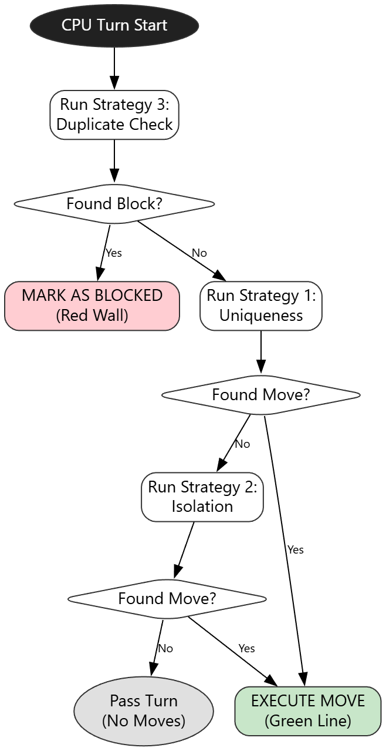

Slide 18
User Interface Overview
Design Philosophy: minimalist Glass aesthetic
( clean while background, high-contrast text & subtle orange accents for focus)
Key Features :
Menu System : Dynamic start screen allowing selection of grid sizes
Interactive Grid : Responsive click handled with visual feedback
Sidebar :
Solo mode: Displays ‘hint strategy’ selector
CPU mode: Displays ‘cpu startergy’ selector

Slide 19
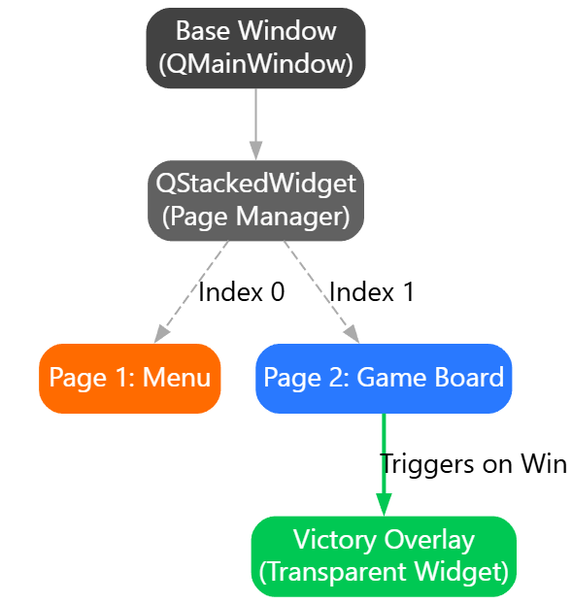

Slide 20
Thank You

