Slide 1
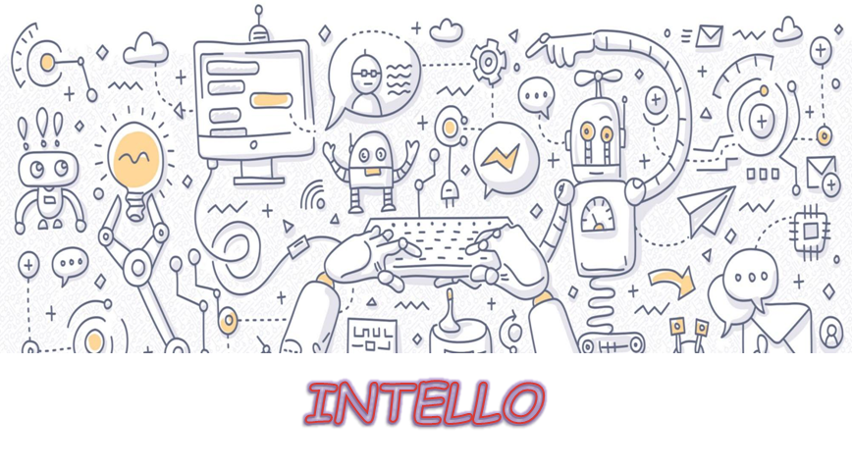

Slide 2

AIM
To build an application that can answer queries about the Admission procedure of an Educational institute. In other words, a CHATBOT!

Slide 3
BACKGROUND KNOWLEDGE
What is a Chatbot?
Types of models used for chatbots
Retrieval-based model
Generative model
Types of platforms for chatbots
Goal-oriented or transactional
Conversational platforms
ALICE Bot
Basics of AIML

Slide 4
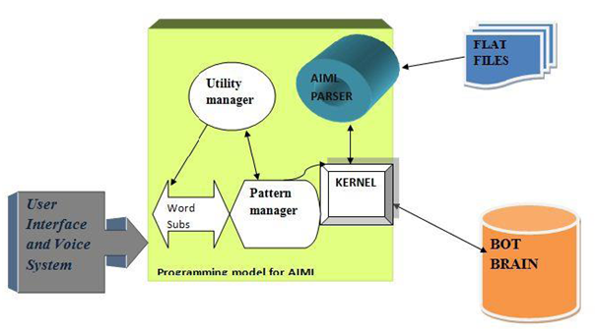
Existing tools to develop chatbots
Api.ai
Wit.ai
Motion.ai
Architecture of a chatbot

Slide 5


INTRODUCTION TO THE PROJECT
The chatbot will:
help find answers to common questions easier!
replace the FAQ section!
reduce the load of the office staff!

Slide 6
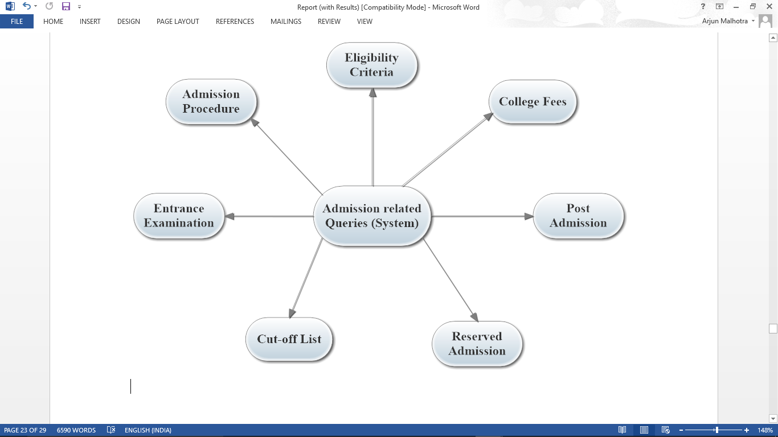
So, what kind of questions do I answer?
What do I look like?
You’ll see me soon!

Slide 7
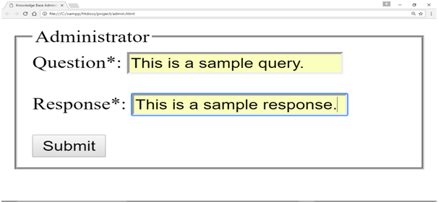
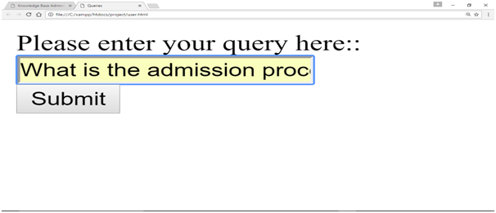
SYSTEM FEATURES
As of now, we are operating Intello through the default IDLE (Integrated Development Interface for Python) interface.
Interface for Administrator Interface for User

Slide 8
Functional Requirements: A knowledge base to store patterns. The system should be able to understand the context of the queries. The admin must have access to manipulate the DB.
Non-Functional Requirements: Performance - should run on a variety of operating systems that support the Python, AIML and PHP. It usually takes close to 1 second for the kernel to get loaded the first time it is started. Corresponding loads take less than 0.5 seconds on average. Safety - shall not store or process any information about its users. Security - passwords should be stored using secure methods. Questions of unknown categories should be stored in a separate ‘machine learning’ file which will be used periodically to add a higher level of functionality.

Slide 9
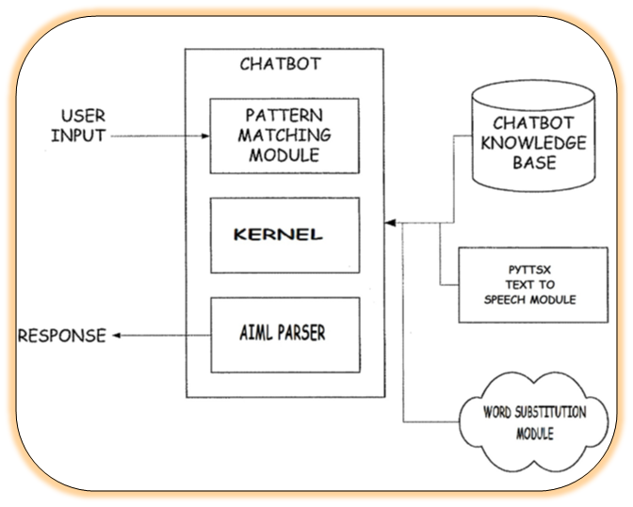
IMPLEMENTATION

Slide 10
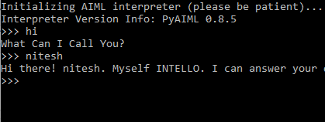
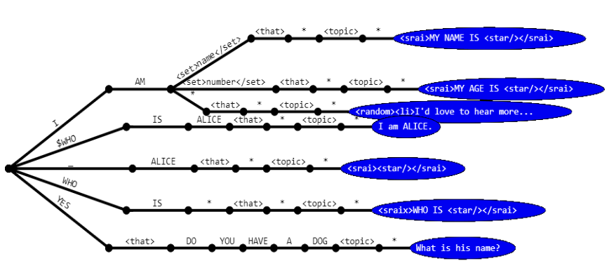
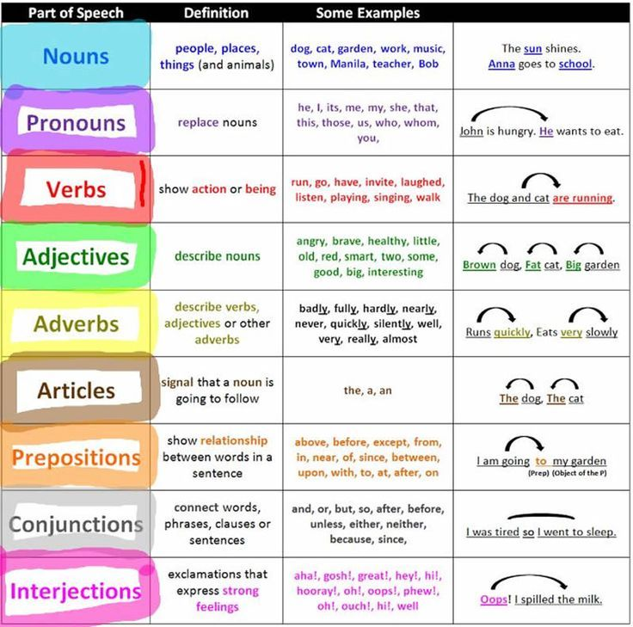


Slide 11
RESULTS AND ANALYSIS

Slide 12
CONCLUSION AND FUTURE SCOPE

Slide 13
THANK YOU

