Slide 1
Software
Engineering
School Management
Group Members Roll no.
Ojasvi Aggarwal 7448
Ashish Bansal 7452

Slide 2
Purpose of the project
The project entitled SCHOOL MANAGEMENT SYSTEM has been designed and developed in such a way that any school may use it.
The aim of the software is to automate various functions that
are being performed in most of the schools in general like assignment submission, internal marks updating etc.
This software brings all school management processes, from assignment submission to generation of scorecards of the students and their record graphs.

Slide 3
Functional Requirements
The idea is to develop a web application for a school management. The web application will be designed in a way to satisfy the desired needs of teachers, students and parents. This will be developed to maintain the records of the students (score records, teachers feedback) etc.
The general layout of the website is as below and is further described.
Student information
Login
Class wise record and Information
Exam Information
Upcoming school events, fests and competitions
Participation and certificates
Books referred by institution
Parent’s notice
Class wise feedback forms

Slide 4
System specification—S/W and H/W requirements
SOFTWARE INTERFACE
Operating System : Every operating system, every browser
Front end : HTML, CSS, Java Script
Back-end : SQL database, PHP
HARDWARE INTERFACE
Processor: X86 Compatible processor with 1.7 GH Clock speed.
RAM : 512 MB or more
Hard disk : 20 GB or more
Monitor : VGA/SVGA
Keyboard : 104 Keys Mouse : 2 buttons/ 3 buttons

Slide 5
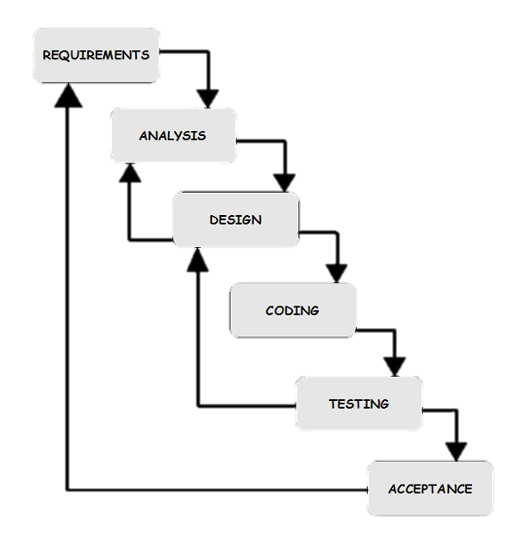
Process Model
Process model
This software uses WATERFALL MODEL which is also known as linear sequential model.
Purpose of Use
The customer is completely aware of his requirement.
There will be no need to update the SRS again and again since all requirements are known at once.
Due to lesser user intervention, the software will be made in time.
We wont have to move back from current phase to the previous phase.
Waterfall Model

Slide 6
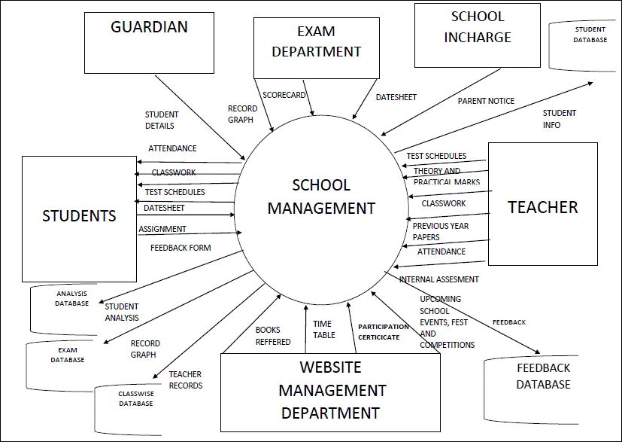
Data Flow Diagram
Context Level DFD

Slide 7
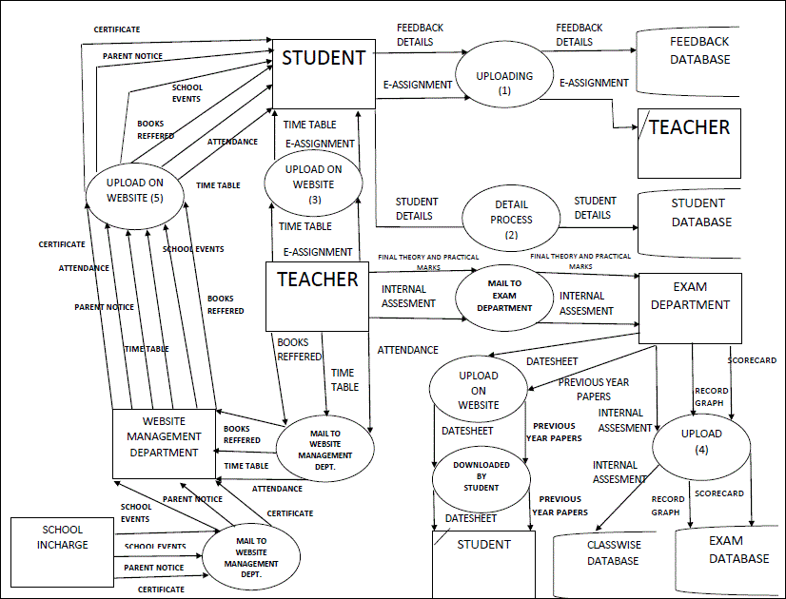
Level 1 DFD

Slide 8
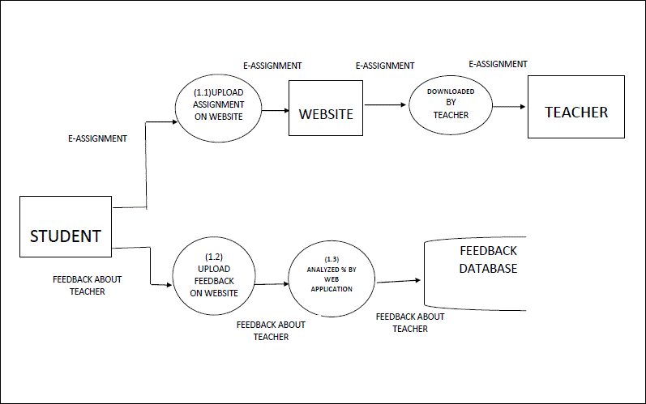
Level 2 DFD

Slide 9
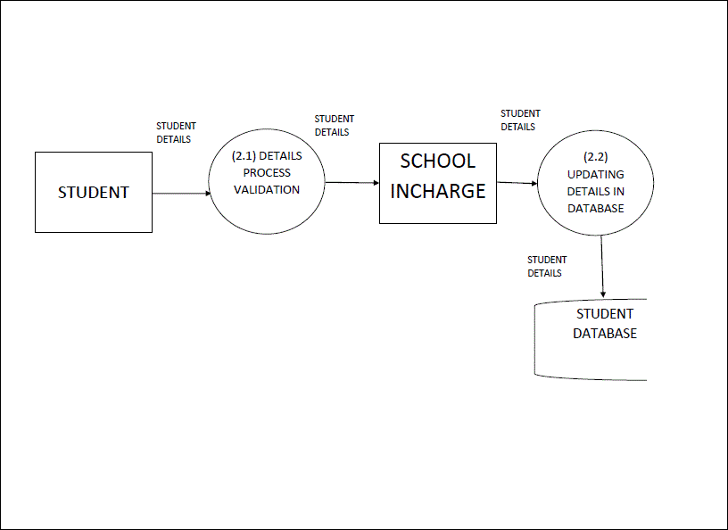
Level 3 DFD

Slide 10
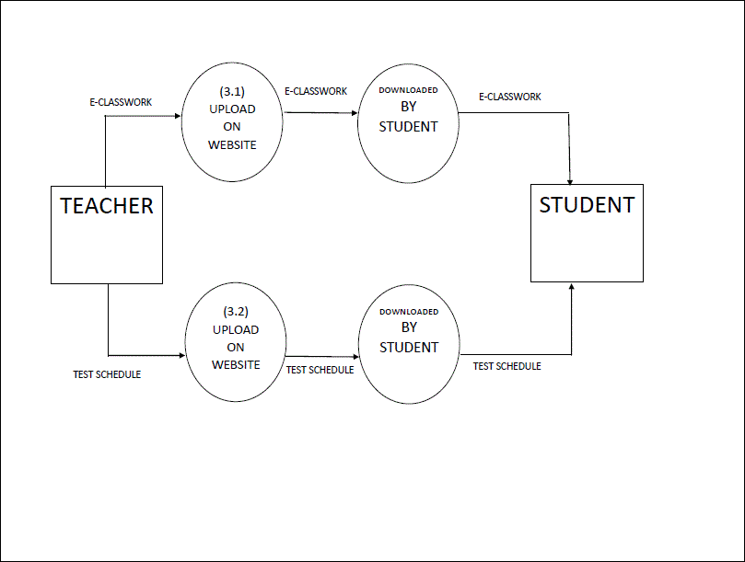
Level 4 DFD

Slide 11
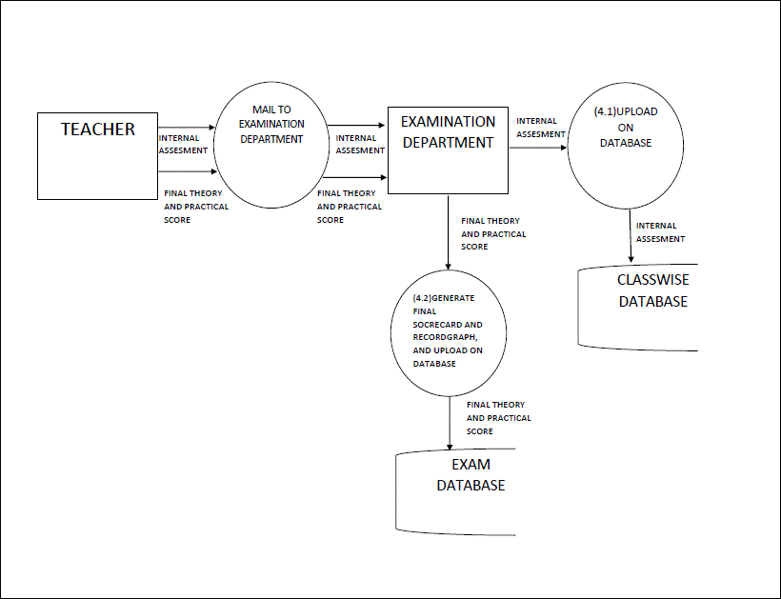
Level 5 DFD

Slide 12
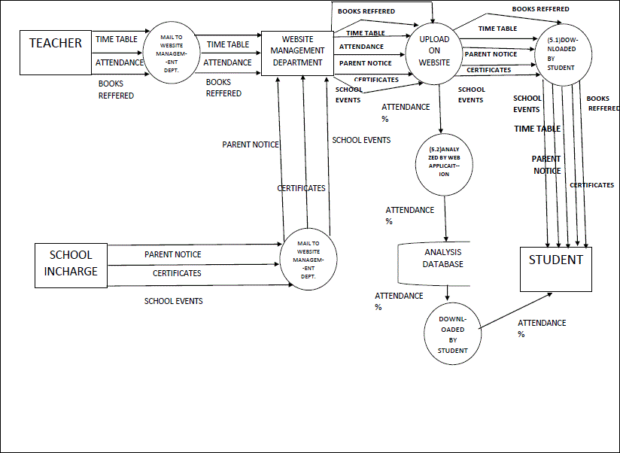
Level 6 DFD

Slide 13
Data Dictionary
Student Basic Info Database:
Name + Father’s Name + Address + Contact + Admission Number + Admission Year + Mode of Transport
Exam Database:
Name + Admission Number + Final Scorecard + Final Record graph
Feedback Database:
Teacher ID + Feedback (%) Class wise Database: Name + Class + Roll Number + Admission Number +
Assignment Submission + Internal Assessment + Teacher ID
Analysis Database:
Name + Admission Number + Fees + Attendance + Participation Record
Student Details (in DFD Level 1):
Name + Father’s Name + Address + Contact + Admission Number + Admission Year + Mode of Transport
Attendance Percentage (Process 5.2):
(Attended classes by student * 100)/ (Total classes held)
Feedback Percentage (Process 1.3):
(∑Marks given to teacher by student)/ (No. of students)*100

Slide 14
Function Point
Computing FP
Number of external inputs (EIs) – 14
Number of external outputs (EOs) – 14
Number of external inquiries (EQs) – 1
Number of internal logical files (ILFs) – 5
Number of external interface files (EIFs) -0

Slide 15
UFP = 136
Fi: - Complexity
1. Does the system require reliable backup and recovery? 4
2. Are specialized data communications required to transfer information to or from the application? 3
3. Are there distributed processing functions? 2
4. Is performance critical? 2
5. Will the system run in an existing, heavily utilized operational environment? 3
6. Does the system require online data entry? 5
7. Does the online data entry require the input transaction to be built over multiple screens or operations? 3
8. Are the ILFs updated online? 4
9. Are the inputs, outputs, files, or inquiries complex? 2 10. Is the internal processing complex? 3
11. Is the code designed to be reusable? 4 12. Are conversion and installation included in the design? 2
13. Is the system designed for multiple installations in different organizations? 5
14. Is the application designed to facilitate change and ease of use by the user? 5

Slide 16
∑fi = 47
CAF = 0.65 + 0.01*47
CAF = 1.12
FP = UFP *[0.65 + 0.01 * (∑Fi)]
FP = 136 * 1.12 = 152. 32
Effort and Size
From the data about FP computed by us and computed FP from previous projects of the same type, we can estimate the size of the project and effort (in terms of person hours) can be estimated

Slide 17
RISK TABLE

Slide 20
TIMELINE CHART

Slide 22
DESIGN ENGINEERING
STUDENT LOGIN
STUDENT INFORMATION
CLASSWISE RECORD AND INFORMATION
TIME TABLE
UPCOMING SCHOOL EVENT AND FEST AND COMPETITION
BOOKS REFFERED BY INSTITUTION
EXAM INFORMATION
CLASSWISE FEEDBACK FORM
ASSIGNMENT AND SUBMISSION RECORD
CLASSWORK
TEST SCHEDULE
PARENT NOTICE
CLASSWISE DATESHEET
SCORECARD
SCHOOL MANAGEMENT
TEACHER LOGIN
EXAM DEPT. LOGIN
WEBSITE MANAGEMENT DEPT. LOGIN
LOGIN
CLASSWISE RECORD AND INFORMATION
ASSIGNMENT AND SUBMISSION RECORD
CLASSWORK
TEST SCHEDULE
ATTENDENCE
PREVIOUS YEAR PAPER
RECORDGRAPH
EXAM INFORMATION
CLASSWISE DATESHEET
SCORECARD
RECORDGRAPH
TIME TABLE
UPCOMING SCHOOL EVENT AND FEST AND COMPETITION
PARTICIPATION AND CERTIFICATE
PARTICIPATION AND CERTIFICATE
BOOKS REFFERED
PARENT NOTICE
CLASSWISE FEEDBACK FORM
ARCHITECTURAL DESIGN

Slide 23
DATA / DATABASE DESIGN
Student Basic Info Database:

Slide 24
Class wise Database
Analysis Database

Slide 25
Exam Database
Feedback Database

Slide 26
TEST PROCEDURE SPECIFICATION- BASIS PATH TESTING
Cyclomatic complexity
The value computed for cyclomatic complexity defines the number of independent paths in the basis set of a program and provide us with an upper bound for the number of test that must be conducted to ensure that all statements have been executed at least once.

Slide 27
PSEUODOCODE
Total <- Total number of classes held
Attend <- Classes attended by student
If(total == 0)
Print(”Error:- divide by zero “);
Else
Percentage = (attended/ total)*100;
Upload Percentage
Exit

Slide 28
FLOWGRAPH
Cyclomatic complexity
No. of vertices = 8
No. of edges = 8
Cyclomatic complexity = edges – nodes + 2
= 8 – 8 + 2
= 2
Total no. of independent paths = 2
Independent paths:
Path 1: 1 -> 2 -> 3 -> 4 -> 8
Path 2: 1 -> 2 -> 3 -> 5 -> 6 -> 7 -> 8

Slide 29
TEST CASE SPECIFICATION

