Slide 1
BOOLEANS

Slide 2
Problem Statement :
To create new formats of text, photo and video news for consumption on smartphone. As India has crossed 90% consumption of news on mobile phone, the formats of news presentation on mobile phones needs to be more and more creative in order to service the user better. There are various layouts which are coming, for example - card layouts, data layouts, video feeds and others. News companies needs to identify newer formats in terms of UI and UX, to service the consumer in a better manner.

Slide 3
Ideation
An app which will cover most trending fake news's.
We will also making a fake news detector in which when a user gets a news and copies it at his/her clipboard, we can access his/her clipboard and notify them whether the news is fake or not.

Slide 4
Why one should use our app?
As the app contains the most trending fake news , it would help people to know the real truth behind the rumour.
Moreover till now we are not having a trusted and effective app which lists all the fake news , thus user have to wander around various sites to make a conclusion. Wherever this app will provide the user each and every information on a single platform.

Slide 5
The most important and unique feature of the app is that the user will easily get to know about the probability of any text received from any source , simply by just copying it.

Slide 6
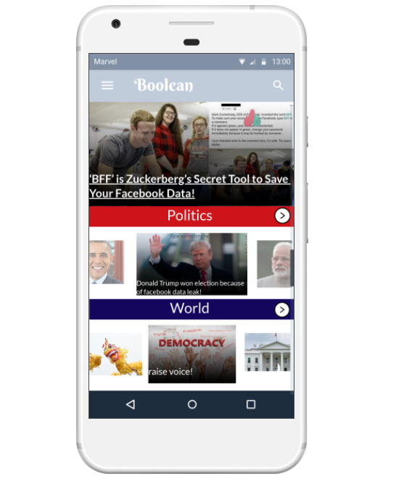
Prototype
Home page

Slide 7
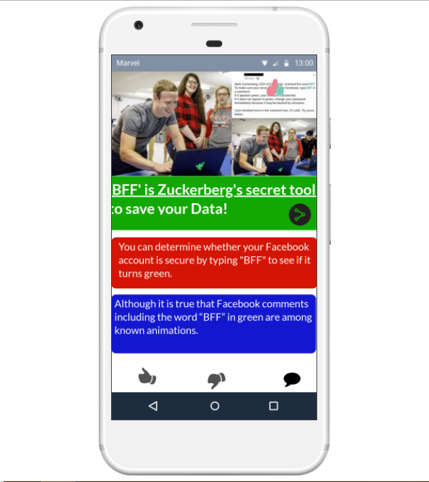
prototype
News content

Slide 8
scalability
In machine learning by importing classifiers , it will match the keyword dictionary precisely , which will increase the accuracy of the detection of the fake news.
User doesn’t have to go through our app for trending fake news. We will share these as messages through whatsapp by Whatsapp for Business .

Slide 9
BY- LAZYBOOLEANS To- IncubateIND

