Slide 1
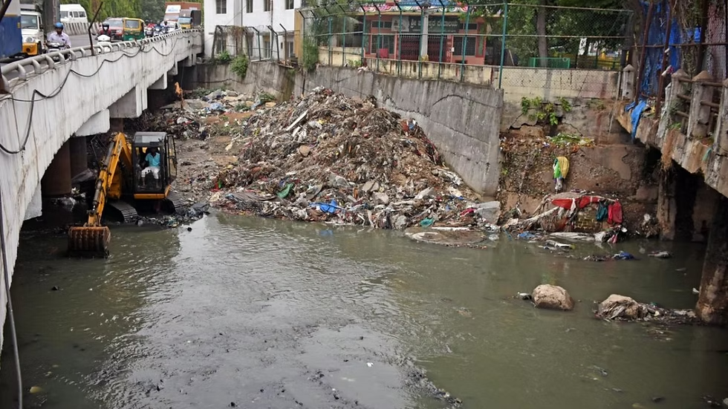
SMARTDRAIN
Predictive Urban Drainage Monitoring & Early Warning System
"Monitor Drainage. Predict Risk. Prioritize Action."
Team Members:
Ojas Kumar Kashyap (25BCE0721)
Iraban Bhattacharya (25BCE2169)
Asutosh Aum (25BEC0275)
Dhruv Patel (25BEC0308)

Slide 2
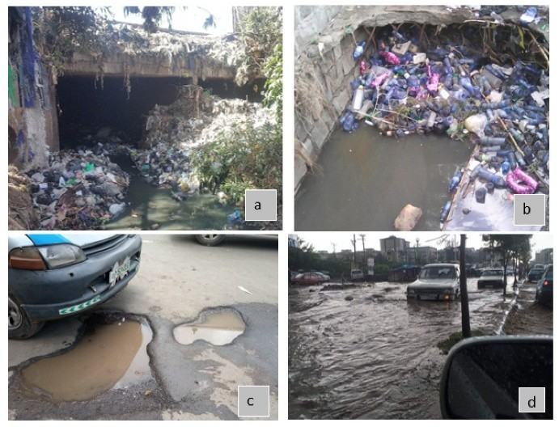

Urban Drainage: A Reactive Problem
Urban flooding arises from heavy rainfall compounded by blocked or partially blocked storm-water drains — plastic waste, leaves, silt and debris reducing conveyance. Municipal responses are largely complaint-driven and manual.
Typical Sequence
Key Limitations
Drain blockage → Water accumulation → Public complaint → Manual inspection → Cleaning
No continuous drain condition monitoring
Blockages remain unseen until visible flooding
Water-level alone does not reveal cause
Limited municipal inspection capacity
Maintenance is reactive, causing higher cost
Emphasis: "Can we identify high-risk drains BEFORE severe overflow occurs?"

Slide 3
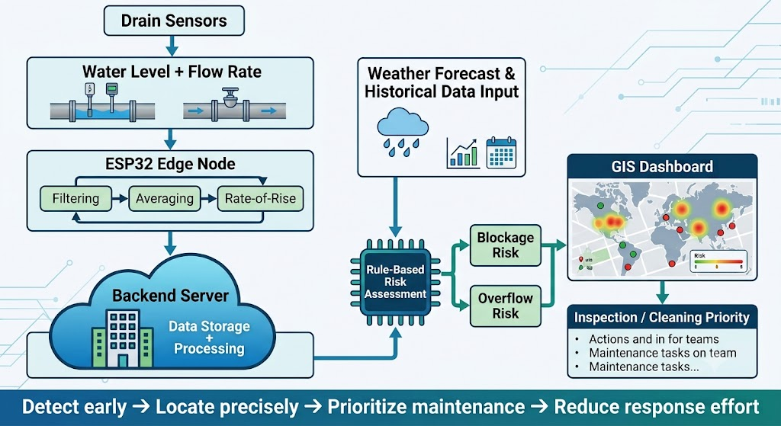
Proposed Solution
A distributed IoT-based drainage monitoring system that detects abnormal drainage behaviour at critical points and prioritizes intervention before localized blockage develops into large-area water accumulation.

Slide 4
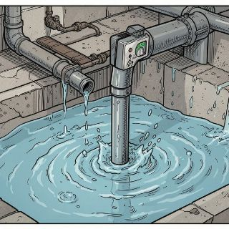
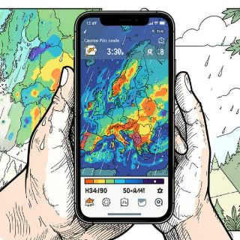
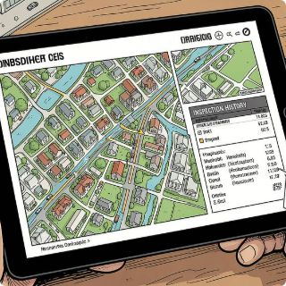
SmartDrain — From Reactive Maintenance to Predictive Action
SmartDrain is an IoT + Weather Intelligence + GIS-based predictive maintenance system that uses multi-parameter, rule-based risk assessment to surface high-priority drains for inspection.
Real-time Water-Level & Flow
Weather Forecast
Historical Drainage Records
Location-specific short-term precipitation forecasts (1–3 hour windows) are integrated server-side.
Sensors capture level, flow-rate and rate-of-rise at the drain throat.
Last cleaning dates, past blockage incidents and drain attributes inform risk calibration.
Core flow: SENSE → ANALYZE → ASSESS RISK → VISUALIZE → ACT
Example UI (SAMPLE): Drain D-04 Blockage Risk: 87% · Overflow Risk: 76% · Status: HIGH PRIORITY

Slide 5

Objectives
Continuous Monitoring
Real-Time Hydrology
Weather Integration
Track critical drainage points 24/7.
Measure water level, flow and rate-of-rise.
Ingest location-specific precipitation forecasts.
Rule-Based Assessment
GIS Visualization
Prioritised Action
Multi-parameter rules identify abnormal behaviour.
Map-based city-wide risk view and drill-down details.
Rank drains for inspection and preventive cleaning.
Low-Cost Prototype
Affordable hardware & scalable architecture for pilots.
Shift from reactive drainage cleaning to data-driven preventive maintenance.

Slide 6
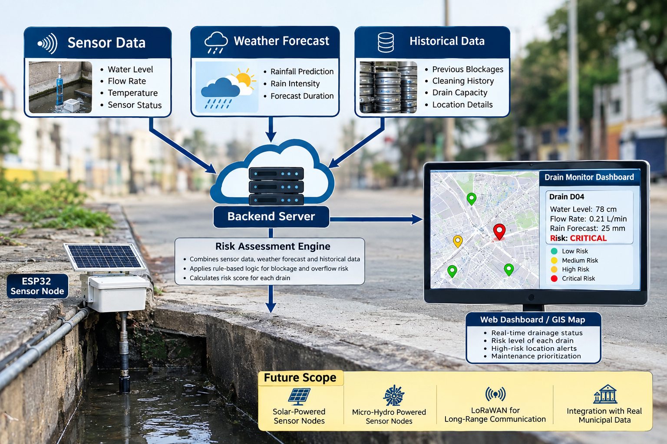

How Drainage Risk is Calculated
Real-Time Sensor Data
Weather Data
Historical Data
Location-specific precipitation forecast (Next 1 hour, Next 3 hours) — intensity and duration.
Past blockage incidents, last-clean date, drain diameter & slope, upstream connectivity.
Water level (absolute)
Flow rate (L/min)
Rate of water-level rise (cm/min)
Sensor health metrics
The engine assigns weighted contributions from each parameter and outputs a normalized risk score. Prototype bands (subject to calibration): 0–30 LOW · 30–60 MEDIUM · 60–80 HIGH · 80–100 CRITICAL.
Risk Score (conceptual): combination of Water-Level Factor, Flow Anomaly Factor, Level-Rise Factor, Forecast Rainfall Factor, Historical Risk Factor. Weights are experimentally adjustable.

Slide 7
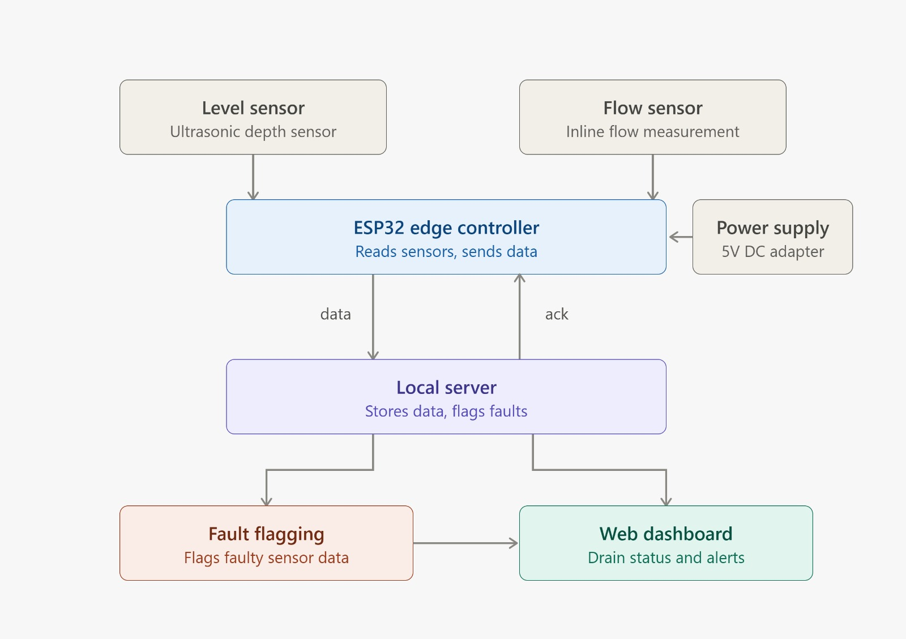
Flowchart

Slide 8
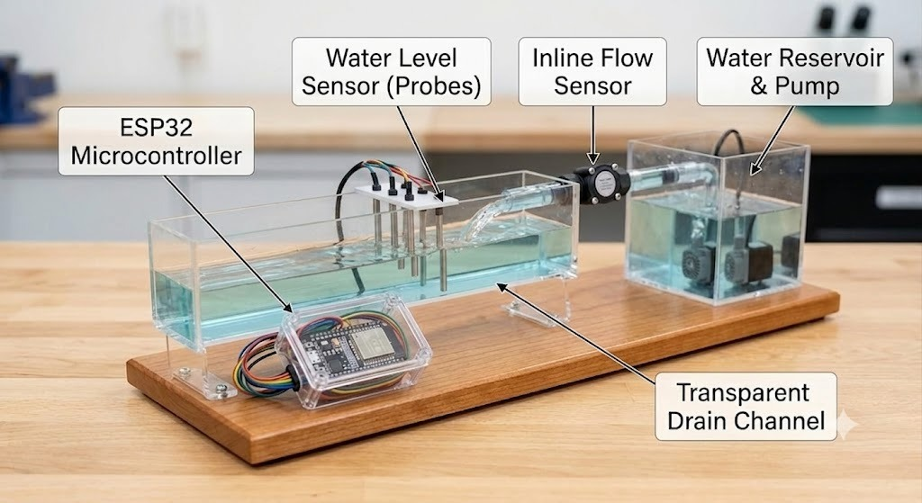

Slide 9
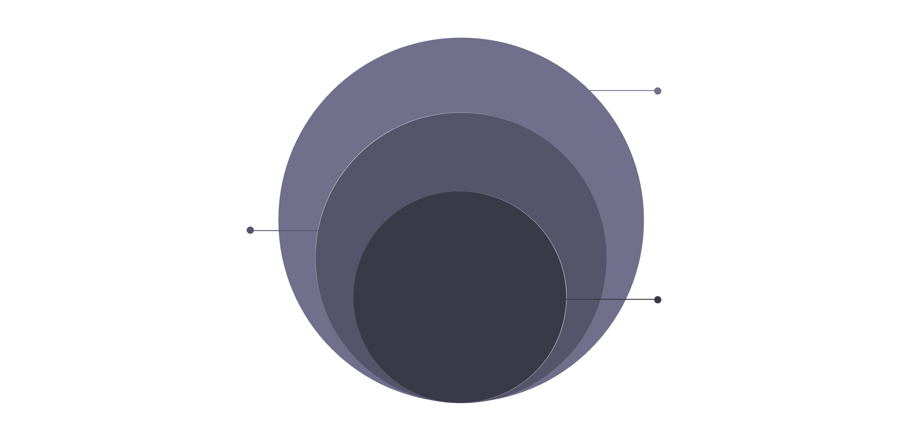
System Architecture — Edge to Cloud
Server & Application
API, DB, weather, risk engine, GIS alerts
Edge Layer
ESP32: sampling, filter, averaging
Physical Layer
Drain sensors: level and flow
Visual containers: PHYSICAL LAYER · EDGE LAYER · COMMUNICATION · SERVER LAYER · APPLICATION LAYER. ESP32 performs lightweight preprocessing; backend handles storage, weather integration, multi-parameter scoring, GIS services and dashboard delivery.
ESP32 Edge Responsibilities
Server Responsibilities
Sensor sampling at configurable intervals
Noise filtering (median / moving average)
Averaging and rate-of-rise calculation
Sensor health & battery telemetry
Package JSON payload; resend if ACK not received
Time-series storage (per Drain_ID)
Weather API polling and caching
Rule-based scoring engine
GIS tile & marker management
Alert / notification generation

Slide 10
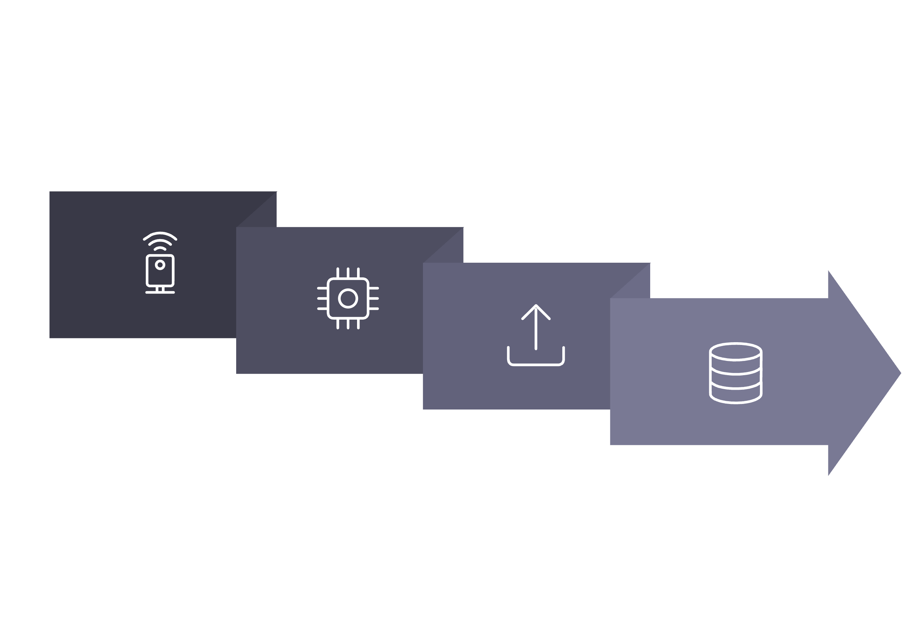
End-to-End Working Workflow
Edge
Store
Sense
Map Status Mapping
Transmit
GREEN → LOW · YELLOW → MEDIUM · ORANGE → HIGH · RED → CRITICAL
Example JSON payload (SAMPLE): { "Drain_ID":"D02", "Water_Level_cm":56.2, "Rise_Rate_cpm":4.1, "Flow_Lpm":0.42, "TS":"2026-08-21T09:12:00Z" }
Recommended Actions
Monitor — Continue telemetry
Inspect — Schedule team visit
Prioritise Cleaning — Dispatch crew
Immediate Intervention — Emergency response

Slide 11
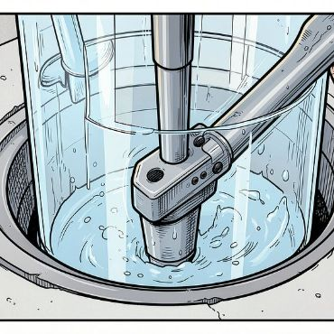

Low-Cost Working Prototype
Scaled demonstrator: linked transparent drain chambers with fitted water‑level sensors, a flow sensor in-line, ESP32 edge node, collection tank and recirculation pump. Removable blockage segment simulates debris.
Hardware Components
Demonstration Scenarios
ESP32 microcontroller
Ultrasonic / pressure water-level sensor
Inline flow sensor
Pump and recirculation plumbing
Prototype enclosure and mounts
NORMAL FLOW → GREEN
PARTIAL BLOCKAGE → YELLOW / ORANGE
SEVERE BLOCKAGE + HIGH FORECAST → RED

Slide 12
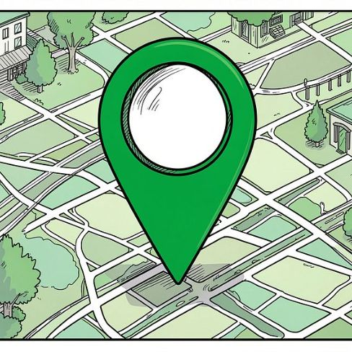
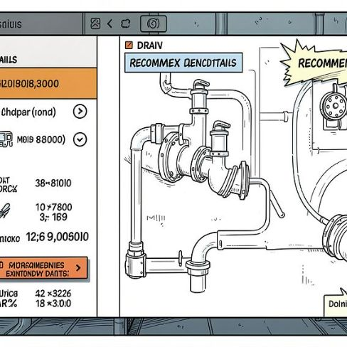
From Drain Sensors to a City-Wide Risk Map
Interactive GIS dashboard: point markers per drain, cluster summarisation, filter by risk band, time-slider for trend playback, and drill-down panel showing sample drain metrics.
Marker View
Drill-Down Details (SAMPLE)
🟢 D01 · 🟢 D02 · 🟡 D03 · 🔴 D04 (SAMPLE)
DRAIN D04 — Water Level: 78 cm · Flow Rate: 0.21 L/min · Level Rise: 4.5 cm/min · Forecast: 25 mm · Blockage Risk: 87% · Overflow Risk: 76% · Status: CRITICAL
Numbers above are SAMPLE / DEMONSTRATION values for UI preview only.

Slide 13
Literature review
Patent Number | Existing Patent Focus | SmartDrain's Differentiation / Potential Novelty
GB2589849B - Sewer blockage detection | Sewer blockage detection using water-depth, flow behaviour, sensor comparison and historical flow patterns. | Combines water level + flow anomaly + rate-of-rise + rainfall forecast + historical drain condition into a unified predictive risk score.
EP3204562B1 - Assembly of a sewer and a sewer blockage detection system | Sewer blockage detection using pressure/back-pressure measurement and threshold-based alarm generation. | Uses non-invasive water-level and flow sensing with predictive risk analysis instead of pressure-based blockage detection.
US20240044123A1 - System for increasing and displaying effectiveness and efficiency of stormwater infrastructure | Monitoring stormwater infrastructure using liquid-level/flow information and electronic control of stormwater discharge. | Focuses on blockage & overflow risk prediction and GIS-based maintenance prioritization rather than primarily controlling stormwater discharge.
US20210340749A1 - related earlier publication of the same US stormwater patent family | Earlier publication in the same US stormwater patent family. | Adds multi-parameter predictive risk assessment, rainfall integration and drain-level maintenance prioritization.

Slide 14
Literature review
Patent Number | Patent Focus | SmartDrain's Potential Differentiation
US11721191B1 | Smart-city flood early warning using precipitation + drainage capacity + historical ponding + road-network information and predictive modelling. | SmartDrain works at the individual-drain level, combining actual sensor behaviour with forecast rainfall to prioritize drainage maintenance. (Google Patents)
US12230116B2 | IoT smart-city flood warning using precipitation, GIS/environmental information, drainage capacity and road ponding. | SmartDrain specifically creates drain-level blockage and overflow risk, rather than primarily predicting road flooding. (Google Patents)
CN109814462B | Big-data urban drainage monitoring using road water level, drainage-well level, rainfall duration/intensity and historical disaster data, with graded flood warnings. | SmartDrain adds flow rate, rate-of-rise, blockage-specific risk and GIS-based maintenance prioritization. (Google Patents)
TW202223208A / TWI770695B | AI detection of sewer blockage and leakage using flow capacity, flow velocity, water level, rainfall and upstream/downstream data. | SmartDrain should emphasize its maintenance-priority framework, separate blockage/overflow scores and GIS operational workflow, rather than claiming basic AI blockage detection. (Google Patents)

Slide 15
Feasibility, Impact & Future Scope
Approximate Prototype Budget (INR)
Expected Impact & Benefits
ESP32
₹500
Earlier identification of abnormal drainage behaviour
Prioritised maintenance reduces municipal response time
Reduced dependence on complaint-driven inspection
Low-cost nodes allow dense network coverage for pilots
GIS-based view supports operational planning and trend analysis
Water-level sensors
₹500
Flow sensors
₹400
Pump + Tubing
₹500
Plastic boxes / structure
₹500
Power supply & wiring
₹500
Miscellaneous
₹500
Estimated prototype
₹3,000–₹4,000
Future Scope
LoRaWAN / mesh for long-range, low-power communication
Solar-powered sensor nodes for energy autonomy
Flow-powered autonomous nodes at high-discharge drains
Integration with official rainfall stations and municipal GIS
Automated maintenance-ticket generation and crew routing
Pilot to city-scale phased rollout after experimental calibration
SMARTDRAIN — Monitor Drainage. Predict Risk. Prioritize Action.

