Slide 1
TaleToon: Transforming Cultural Significance into Narrative Visualizations through Comics using Multi modal Deep learning techniques
Final Year Project
Zeroth Review
Team No: 23
TEAM MEMBERS:
Dharani S – 2022103034
Swastika S R – 2022103569
Shunmathi R – 2022103570
Raseena Thasneem A – 2022103576
NAME OF GUIDE:
Dr. M.S. Karthika Devi,
Assistant Professor (Sr. Gr.),
DCSE, Anna University.

Slide 2
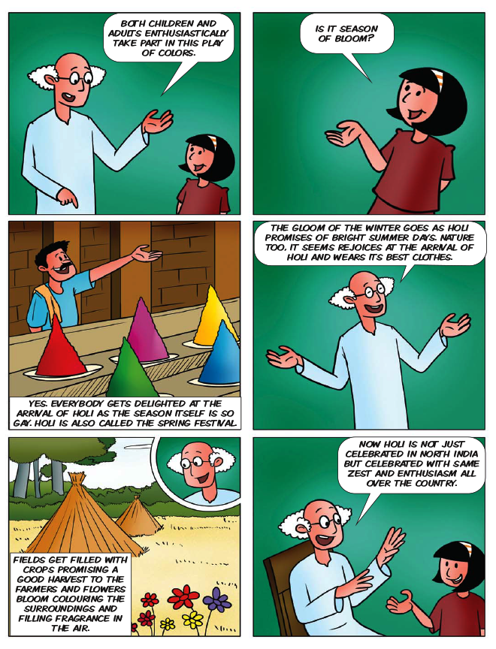
INTRODUCTION
The educational system of today has undergone significant transformations by integrating technology and creativity to enhance learning.
Despite these advances, the transmission of cultural values often remains confined to traditional methods that fail to truly engage learners.
Children need to be guided through humanistic and value oriented principles that nurture their moral, emotional, and cultural growth.
Storytelling has always been an effective tool in education, allowing learners to connect emotionally, internalize lessons, and develop empathy through engaging narratives.
Among various mediums, comics serve as a powerful fusion of art and text, transforming complex cultural traditions into captivating visual stories that educate while entertaining.

Slide 3

OBJECTIVES
Overall Objective:
The objective of our proposed system, TaleToon, is to design an AI-driven storytelling framework that converts culturally significant information, specifically Indian festivals, into engaging comic-style narratives for younger audiences.
Specific Objectives:
To retrieve culturally relevant information from curated datasets, ensuring authenticity, contextual accuracy, and cultural representation.
To summarize and refine factual content into structured narrative scenes with emotions, dialogues, and cultural symbolism.
To generate visual comic panels from narrative text by implementing advanced text-to-image generation models and techniques, maintaining visual consistency and cultural elements.
To design comic layouts and integrate dialogues for coherent storytelling flow and visually suitable presentation.
To promote cultural learning through interactive, visually appealing storytelling that engages and educates learners of all ages.

Slide 4
LITERATURE SURVEY
TITLE | APPROACHES USED | ISSUES
Consistent Story-to-Comic Generation via Character Clustering Source: ACM SIGGRAPH, 2024 | Consistency-preserving pipeline Multi-stage diffusion DINO-based clustering Visual coherence automation | Lacks cultural adaptability Limited textual grounding Dataset not domain-specific
Content-Aware Video2Comics with Manga-Style Layout Source: IEEE Transactions on Multimedia, Vol. 17, No. 12, Dec 2015 | Keyframe/speaker extraction Identifies narrative moments Content-Aware Optimization (MCMC-based) Applies manga filters | Frame selection accuracy relies on reliable speaker detection Balloon placement can overlap or misalign with visual elements. Computationally expensive

Slide 5
LITERATURE SURVEY
TITLE | APPROACHES USED | ISSUES
A Study on Automatic Generation of Comic Strips from a Scenario Source: Springer HIMI, 2017 | Extracts scenario data Maps onto templates Uses heuristic rules Dialogue/visual placement | Requires manual adjustment Limited scalability and diversity of panel designs. Lacks adaptive learning
From IVAs to Comics: Generating Comic Strips from Emergent Stories with Autonomous Characters Source: Springer IVA, 2007 | Converts IVA logs Maps action/emotion Rule-based layout Arranges sequential panels | Scene segmentation and emotion tagging often produce inconsistent results. Limited visual consistency between panels Requires predefined mappings

Slide 6
LITERATURE SURVEY
TITLE | APPROACHES USED | ISSUES
CodeToon: Story Ideation, Auto Comic Generation, and Structure Mapping for Code-Driven Storytelling Source: ACM UIST, 2022 | Uses structure mapping Integrated story to visual pipeline Hybrid rule/generative Automates comic/dialogue | Rule-based mapping limits flexibility Maintaining visual coherence is challenging Requires human supervision
ComicGAN / Comic-focused Text→Image GAN Works Source: Pre-print (arXiv): [arxiv.org/abs/2109.09120] | GAN-based pipelines Text-to-comic images and feasibility Stylization cues and panel aware rendering | Underdeveloped Comic evaluation metrics Maintaining visual consistency across panels is challenging. Outputs often lack fine-grained cultural context

Slide 7
LITERATURE SURVEY
TITLE | APPROACHES USED | ISSUES
Automatic Comic Generation from Videos / Multi-Page Comic Generation Source: ACM / IEEE Works (e.g., ACM Transactions on Multimedia, 2021) | Extracts video story beats Converts to multi-page comics End-to-end pipelines Scene segmentation and visual summarization | Perform poorly on cultural-context interpretation Limited scalability for textual datasets or culturally diverse stories

Slide 8
PROPOSED SYSTEM
Retrieve relevant cultural passages using Sentence-BERT (SBERT) for semantic input analysis and source content preservation.
Generate narrative summaries and dialogues using Llama-3 (for summarization) and Flan-T5 (for dialogue and emotion refinement).
Extract characters, objects, and actions (the scene blueprint) using BERT-based Semantic Role Labeling (SRL) for structured scene parsing.
Synthesize comic-style visuals (ensuring consistency/authenticity) using Stable Diffusion and VQGAN+CLIP generative models.
Arrange visuals and text boxes (for optimal reading flow) using LayoutGAN or a Transformer-based layout generator for multi-panel design.

Slide 9
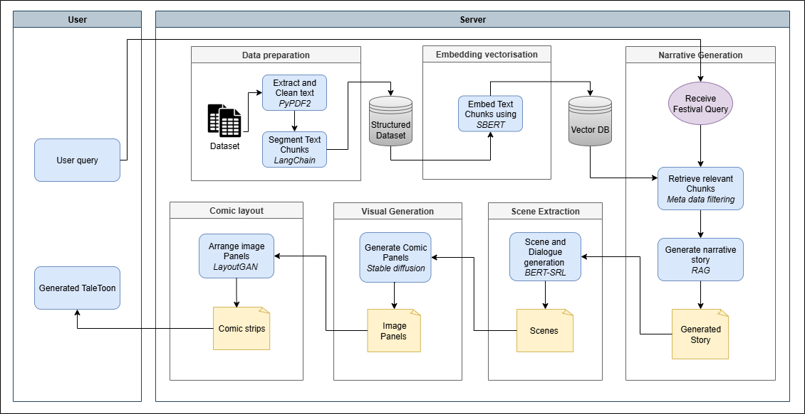
ARCHITECTURE DIAGRAM
TaleToon Framework

Slide 10
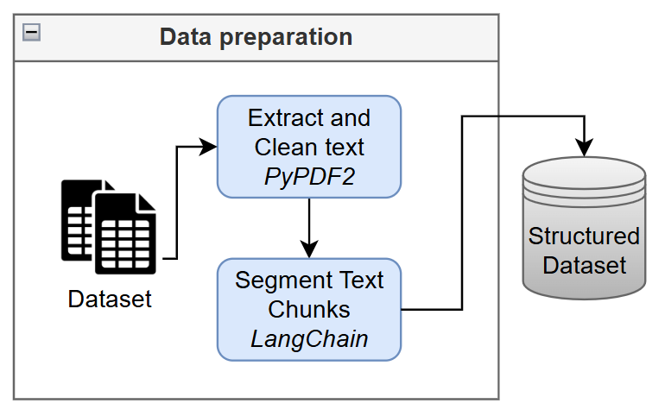
DETAILS OF MODULES
Data Preparation (Preprocessing)
INPUT: PDF Book (Raw Text Corpus of cultural/festival data)
ALGORITHM:
Text Extraction & Segmentation:
Extract raw text from the PDF using PyPDF2.
Clean text (remove headers, footers, special characters).
Segment the cleaned text into fixed-size or paragraph-based chunks suitable for embedding.
OUTPUT: Structured Dataset (Cleaned and chunked text files).

Slide 11
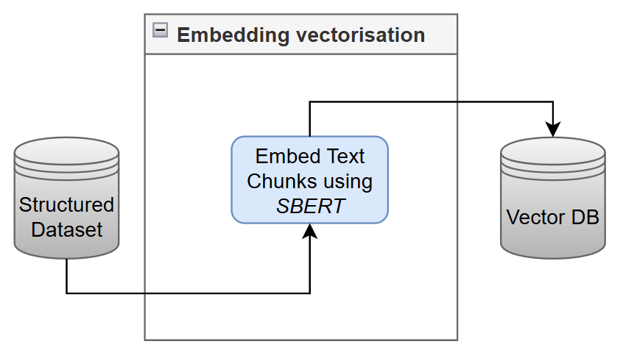
DETAILS OF MODULES
Embedding Vectorization
INPUT: Structured Dataset (Text chunks from Data Preparation)
ALGORITHM:
SBERT Encoding:
Initialize the pre-trained Sentence-BERT (SBERT) model.
Pass each text chunk through SBERT to generate a high-dimensional vector embedding.
Store the chunk and its corresponding vector in the database
OUTPUT: Vector DB (Database containing paired text chunks and their high-dimensional vector embeddings).

Slide 12
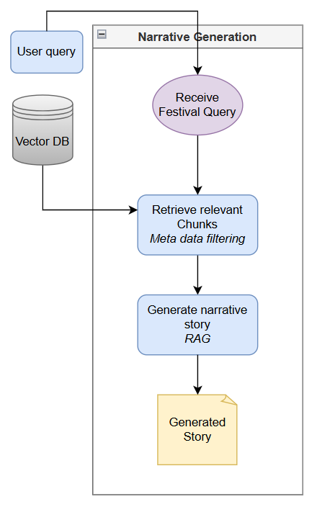
DETAILS OF MODULES
Narrative Story Generation (RAG Core)
INPUT: Festival Query (User-entered text/topic, e.g., "Story of Diwali"); Vector DB.
ALGORITHM:
Retrieval & Generation (RAG):
Retrieval: Embed the user query using SBERT. Query the Vector DB using cosine similarity to find the top-K most relevant cultural text chunks.
Prompting (Llama-3): Construct a prompt for Llama-3 containing the original query and the retrieved chunks. Instruct Llama-3 to summarize the facts into a coherent narrative.
OUTPUT: Generated Story (Coherent, factual, multi-paragraph narrative).

Slide 13
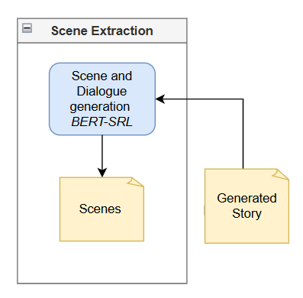
DETAILS OF MODULES
Scene and Dialogue Generation (Narrative Refinement)
INPUT: Generated Story (Factual narrative text).
ALGORITHM:
SRL & Refinement (Flan-T5/BERT):
Scene Segmentation: Divide the narrative into discrete, comic-ready scenes (e.g., based on shifts in time, setting, or action).
Entity Extraction (BERT-SRL): For each scene, apply BERT-based Semantic Role Labeling (SRL) to identify the Subject (Character), Verb (Action), and Object/Setting.
Dialogue/Emotion Refinement (Flan-T5): Use Flan-T5 to refine the action and entities into specific visual descriptions and generate expressive dialogues/captions (Textual Prompts).
OUTPUT: Scenes (Structured JSON/XML objects for each comic panel, containing the image prompt, character list, background, and dialogue).

Slide 14
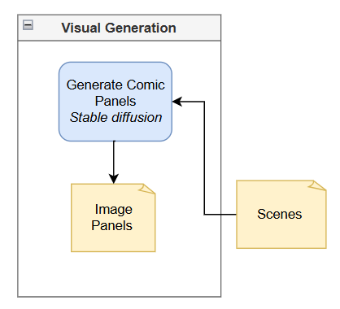
DETAILS OF MODULES
Text to Image Generation (Visual Synthesis)
INPUT: Scenes (Structured data with image prompts, entity details, and cultural style cues).
ALGORITHM:
Conditional Diffusion (Stable Diffusion):
Feed the textual prompts and structural cues from the Scenes into a Stable Diffusion model.
Generate the visual output.
OUTPUT: Images (Individual comic panel visuals, ensuring consistent characters and cultural backgrounds).

Slide 15
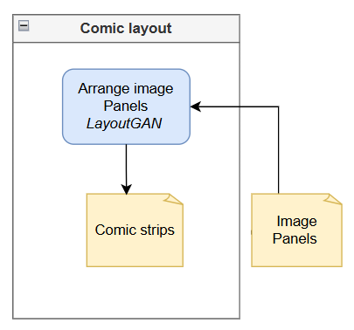
DETAILS OF MODULES
Comic Layout
INPUT: Images (Synthesized panel visuals); Scenes (Structured data containing dialogues/captions).
ALGORITHM:
Layout Generation (LayoutGAN):
Determine the number of panels per row/page based on scene count and complexity.
Apply a Layout Generation Model (e.g., LayoutGAN) to arrange the image panels, respecting reading order and panel boundaries.
Stitch all elements into a single cohesive comic page image.
OUTPUT: Comic Panels / Final Assembled Comic (Web-ready digital comic output).

Slide 16
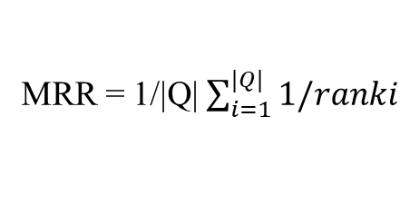
PERFORMACE METRICS
1. Retrieval Performance (Measuring Input Relevance)
Mean Reciprocal Rank (MRR):
To verify that the most contextually relevant cultural passages are retrieved closer to the top of the search results for a user’s query.
MRR = 1/|Q| $\sum_{i=1}^{|Q|}{1/ranki}$
where Q is the set of queries and 𝑟𝑎𝑛𝑘_{𝑖} ​ is the position of the first relevant document for query
Calculates the average of the reciprocal ranks (1/rank) of the first relevant document across all queries.
2. Narrative Consistency (Measuring Fact Integrity)
Fact Consistency Score (FCS):
To assess how well the summarization and narrative modules (Llama-3/Flan-T5) preserve the cultural facts and event sequences from the original dataset.
FCS = Number of consistent factual entities/Total factual entities in reference text
Ratio of the Number of consistent factual entities to the Total factual entities in reference text.

Slide 17
PERFORMACE METRICS
3. Visual Quality and Alignment (Multimodal)
CLIP Score :
To evaluate the semantic consistency between the narrative text (prompts) and the generated visual scenes, ensuring accurate scene-to-image mapping.
CLIP Score = f_{t}∙f_{i}/||f_{t}||∙||f_{i}||
where 𝑓_{𝑡} and 𝑓_{𝑖} ​ denote the text and image feature vectors respectively.
Calculates the cosine similarity between the text and image feature vectors generated by the CLIP model

Slide 18
DATASET DESCRIPTION
DATASET NAME | DESCRIPTION | USAGE
"Festivals of India" (By Dr. Venugopal Menon) – Book Link | Detailed essay explaining the origin, legends, symbolism, and regional significance of major Hindu, Sikh, Jain, Buddhist, Muslim, and Christian festivals in India. | Used as the high-quality source for Text Retrieval and Summarization (RAG source) to maintain historical and cultural accuracy in comic generation.
"Fairs and Festivals of India“ (By Wiley India) - Supplementary Course Material Link | Covers major Indian festivals and fairs, including brief descriptions, customs, and symbolic practices. Also includes state-wise festival lists. | Used for Event Categorization, Cultural Detail Verification, and Narrative Refinement (Flan-T5 prompting) to guide accurate visual storytelling.

Slide 19
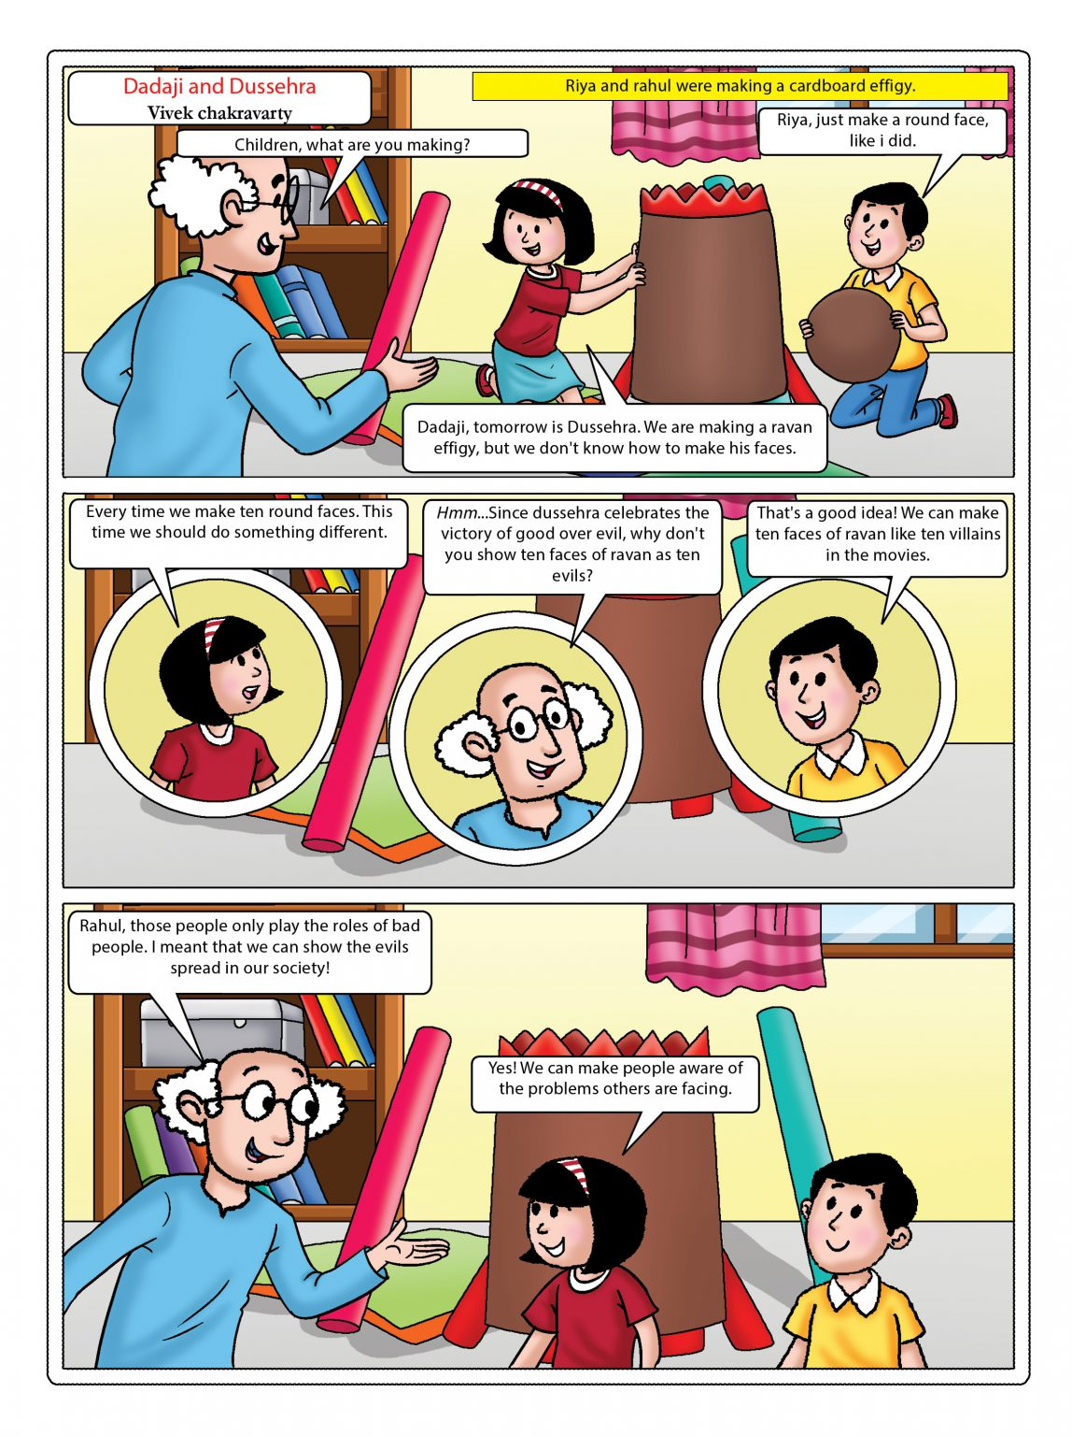
DELIVERABLES TO BE DEMONSTRATED
1. End-to-End Visual Story Generation:
Demonstrate the entire pipeline by converting a single cultural query (e.g., "Story of Ganesh Chaturthi") into a complete, multi-panel comic page that is culturally coherent and ready for reading.
2. Measurable Quality and Consistency:
Show quantitative proof of the system's success across its pipeline, specifically demonstrating high scores in Mean Reciprocal Rank (MRR) for factual retrieval.
3. Semantic-Visual Alignment:
Verify the accuracy of the multimodal translation by showing a high CLIP Score, proving that the BERT-SRL extracted narrative details (characters, actions, settings) are correctly reflected in the generated images.

Slide 20
DELIVERABLES TO BE DEMONSTRATED
Intermediate Deliverables
1. Narrative Story Generation (RAG)
The system outputs a series of raw, relevant text paragraphs/chunks (e.g., historical facts, ritual steps, deity names) from the Source
2. Scene & Dialogue Generation (BERT-SRL)
The output is Structured Text (a "blueprint" or script): e.g., Scene 1: [Character: Krishna), [Action: Lifts Mountain], [Dialogue: "Worship Govardhan"], [Setting: Storm/Rain].
3. Text to Image Generation (Stable Diffusion)
The system generates individual, high-quality, comic-style image panels (e.g., Lord Krishna lifting the hill, but in a clean, Indian comic art style).
4. Comic Layout (LayoutGAN)
The final output is a Multi-Panel Comic Strip with all elements integrated: Panels arranged in reading order, characters cropped/placed, and dialogues/balloons correctly positioned.

Slide 21
REFERENCES
1. J. Zheng et al., "CogCartoon: Towards Practical Story Visualization," International Journal of Computer Vision, 2024, doi: 10.1007/s11263-024-02267-5.
2. K. Raza, N. Ahmad, and D. Singh, "Chapter Title In Press," in Generative AI: Current Trends and Applications, K. Raza, N. Ahmad, and D. Singh, Eds. Singapore: Springer, 2024, Ch. 25, doi: 10.1007/978-981-96-8197-6_25.
3. K. Stephen et al., "Compute to Tell the Tale: Goal-Driven Narrative Generation," in Proceedings of the 30th ACM International Conference on Multimedia (MM '22), New York, NY, USA: ACM, 2022, pp. 783–793, doi: 10.1145/3503161.3549202.
4. M. Tao, B.-K. Bao, H. Tang, Y. Wang, and C. Xu, "StoryImager: A Unified and Efficient Framework for Coherent Story Visualization and Completion," in European Conference on Computer Vision (ECCV) 2024, 2024, doi: 10.1007/978-3-031-72992-8_27.
5. P. G. S. B. Bhati et al., "FABULA: Intelligence Report Generation Using Retrieval-Augmented Narrative Construction," in 2023 IEEE/ACM International Conference on Advances in Social Networks Analysis and Mining (ASONAM), 2023, doi: 10.1145/3625007.3627505.

Slide 22
REFERENCES
6. S. Abdollahi, W. Nejdl, and S. Gottschalk, "Retrieval-Augmented Generation of Event Collections from Web Archives and the Live Web," International Journal on Digital Libraries, 2025, doi: 10.1007/s00799-025-00419-7.
7. S. K. Alhabeeb and A. A. Al-Shargabi, "Text-to-Image Synthesis With Generative Models: Methods, Datasets, Performance Metrics, Challenges, and Future Direction," IEEE Access, vol. 12, pp. 24412–24427, 2024, doi: 10.1109/ACCESS.2024.3365043.
8. X. Yang et al., "Automatic Comic Generation with Stylistic Multi-page Layouts and Emotion-driven Text Balloon Generation," ACM Transactions on Multimedia Computing, Communications, and Applications, vol. 17, no. 2, pp. 1–28, 2021, doi: 10.1145/3440053.
9. Y. Lu et al., "Interactive Story Visualization via Multimodal Large Language Models," in European Conference on Computer Vision (ECCV) 2024, 2024, doi: 10.1007/978-3-031-73033-7_6.
10. Z. Zhou et al., "Multi-Granular Semantic Consistent Story Generation," in Proceedings of the 31st ACM International Conference on Multimedia (MM '23), New York, NY, USA: ACM, 2023, pp. 1492–1502, doi: 10.1145/3613904.3642803.

