Slide 1
Wall Climbing Robot

Slide 2
Introduction
Wall climbing is a robot which can climb on any surface which can be all elevations like acute obtuse and at right angle also
The body is made up of aluminum links for light weight, 2 bldc motors to produce the required torque and 2 DC motos for locomotion

Slide 3
Principle
The basic principle is that the 2 bldc motors create enough thrust to hold the robot against the wall which may be at any angle

Slide 4
Components
Aluminum links 12mm X 12mm X 1.5mm
M4 and M5 Bolts and nuts
4 stainless steel clamps
2 BLDC motors
2 DC motors
Aurdino
Motor driver for BLDC and DC motors
Battery (Lipo)

Slide 5
Working Methodology
The important part while the designing the robot was the material selection of Chassis
Many materials like all kinds of fiber like carbon fiber were considered but aluminum was the selected because its was mechanically sufficient and also cost effective
Designing it as compact as possible with symmetry on both axis
Electronic connections and uploading the code
Testing and using the results for its improvement

Slide 6
Equations and Calculations

Slide 7
CAD Model

Slide 8
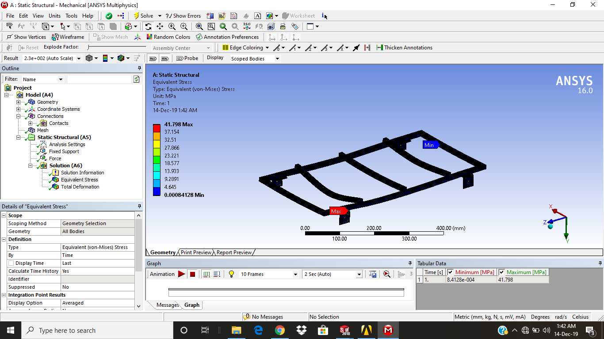
Analysis of the Chassis

Slide 9
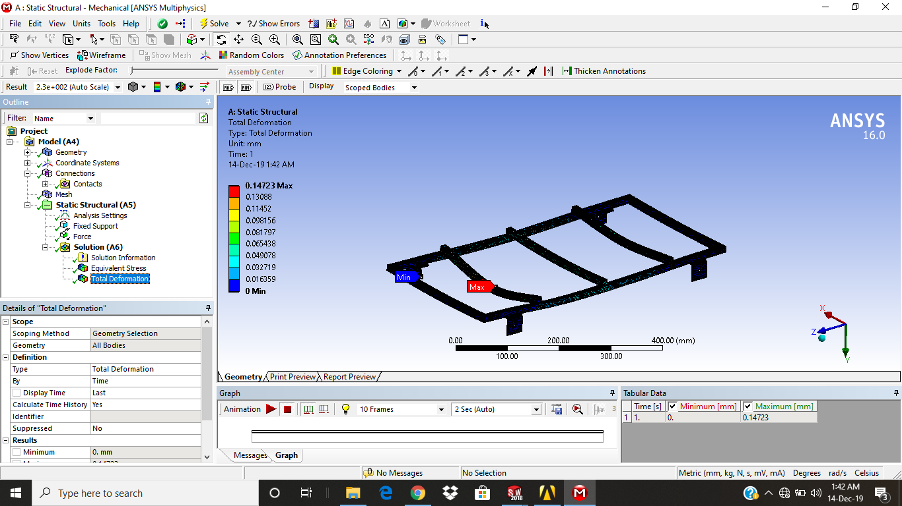
Analysis of the Chassis

Slide 10
Testing videos

Slide 12
Drawbacks
The BLDC motors are fixed so the thrust cannot be applied at angles whenever required.
The prototype is not as mechanically and electrically efficient as drone
Compared to the required weights its heavy
Depends on the friction between surface and wheel

Slide 13
Future scope
The BLDC motor having 3 DOF i.e. all freedom of rotation.
No need of locomotion motors when BLDC motors can be used to provide the required forward and angular push.
Making chassis light weight by using different and less expensive material
Remote controllable

