Slide 1
Subsea Oil Pipeline Insulation Performance under High Thermal Stress
Mini Project 6 · Heat and Mass Transfer Lab (BMEE402P)
School of Mechanical Engineering (SMEC), VIT Vellore
Project Guide: Yagna S Mukkamala
Ishaan Pitambare (24BME0029)
Ojas Raverkar (24BME0046)
Arnav Deogaonkar (24BMV0087)

Slide 2
Problem Definition and Novelty
1
2
3
Why it matters
What we studied
Novelty
Crude oil carries paraffin waxes. As the oil cools, wax solubility falls and crystals deposit on the pipe wall, progressively blocking flow (waxing).
Thermal resistance and conductivity of insulation layers under rising thermal load, then 10 km of multilayer subsea pipe, to keep oil above 45 °C.
Textbooks treat k as constant. We tested whether real layer resistance holds, degrades or rises with load, for flow assurance and insulation design.

Slide 3
Data Acquisition: Interface Temperatures (°C)
Insulation | Oil inlet | Inner wall | Steel / insulation | Insulation / jacket | Jacket / concrete | Concrete / fouling | Outer surface | Seawater
Aerogel | 110 | 109.37 | 109.34 | 6.053 | 5.475 | 4.14 | 4.088 | 4
 | 50 | 49.727 | 49.715 | 4.933 | 4.598 | 4.061 | 4.038 | 4
Solid PP | 110 | 105.75 | 105.57 | 18.512 | 13.312 | 4.956 | 4.521 | 4
 | 50 | 48.155 | 48.077 | 10.297 | 8.0408 | 4.415 | 4.226 | 4
Syntactic PP | 110 | 106.66 | 106.52 | 15.393 | 11.31 | 4.751 | 4.409 | 4
 | 50 | 48.552 | 48.49 | 8.944 | 7.172 | 4.326 | 4.177 | 4
Advanced Syntactic Foam | 110 | 107.25 | 107.14 | 13.377 | 10 | 4.618 | 4.337 | 4
 | 50 | 48.808 | 48.757 | 8.069 | 6.611 | 4.2683 | 4.1463 | 4
Rigid PU Foam | 110 | 109.25 | 109.22 | 6.45 | 5.646 | 4.169 | 4.092 | 4
 | 50 | 49.674 | 49.66 | 5.113 | 4.714 | 4.073 | 4.04 | 4
Wood | 110 | 106.66 | 106.52 | 15.353 | 11.31 | 4.751 | 4.409 | 4
 | 50 | 48.592 | 48.495 | 8.944 | 7.172 | 4.326 | 4.177 | 4
Hylam | 110 | 104.91 | 104.72 | 21.364 | 15.142 | 5.154 | 4.6241 | 4
 | 50 | 47.793 | 47.707 | 11.535 | 8.835 | 4.496 | 4.27 | 4

Slide 4
Pipeline Model and Inputs
Layer | Thickness | k (W/m·K) | Purpose
Steel pipe (ID 400 mm) | 20 mm | 45 | Carries the oil and withstands internal pressure
Thermal insulation | 50 mm | 0.025 to 0.25 | Main barrier: limits heat loss to keep oil above 45 °C
Polymer jacket | 5 mm | 0.30 | Necessary to keep seawater out of the insulation (wet insulation conducts far more heat) and to guard against abrasion and impact
Concrete coating | 50 mm | 1.7 | Necessary to add submerged weight so the pipe stays on the seabed against currents, and to protect against impact
Biofouling | 1 mm | 0.6 | Marine growth on the outer surface, modelled as a thin film
10 km
106.8 kg/s
2200 J/kg·K
100 / 500
4 °C
45 °C
110 / 50 °C
pipe length
oil mass flow
oil specific heat
h oil / sea, W/m²·K
seawater
wax threshold
oil inlet

Slide 5
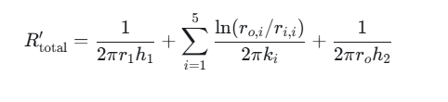


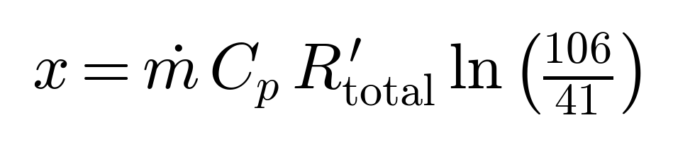
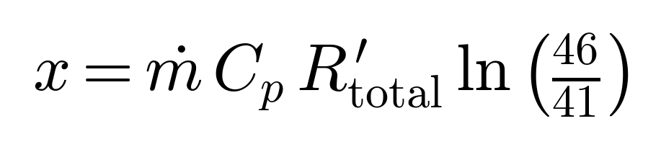
Formulae Used
Total resistance per metre, R′ (K·m/W)
Oil temperature along the pipe
Heat loss per metre at distance x
Waxing distance, 110 °C inlet (oil reaches 45 °C)
Waxing distance, 50 °C inlet (oil reaches 45 °C)
r: radius, k: conductivity, h: film coefficient, ṁ: mass flow, C_p: specific heat, T∞ = 4 °C. 106/41 = (110 − 4)/(45 − 4) and 46/41 = (50 − 4)/(45 − 4).

Slide 6
Results: Heat Loss and Temperature, 110 °C Inlet
Insulation | k (W/m·K) | R′ (K·m/W) | Heat loss (W/m) | T at 10 km (°C) | Wax dist. (km)
Aerogel | 0.025 | 1.339 | 79.5 | 106.68 | 299.0
Rigid PU Foam | 0.03 | 1.122 | 94.5 | 106.05 | 250.5
Adv. Syntactic Foam | 0.12 | 0.307 | 345.2 | 96.28 | 68.6
Syntactic PP | 0.15 | 0.253 | 419.4 | 93.58 | 56.4
Wood | 0.15 | 0.253 | 419.4 | 93.58 | 56.4
Solid PP | 0.2 | 0.198 | 534.2 | 89.54 | 44.3
Hylam | 0.25 | 0.166 | 639.2 | 86.01 | 37.0
Every insulation keeps the oil above 45 °C, but Aerogel and Rigid PU Foam lose by far the least heat (79.5 and 94.5 W/m).
Green: oil stays at or above 45 °C (no waxing). Red: oil falls below 45 °C (waxing risk).

Slide 7
Results: Heat Loss and Temperature, 50 °C Inlet
Insulation | k (W/m·K) | R′ (K·m/W) | Heat loss (W/m) | T at 10 km (°C) | Wax dist. (km)
Aerogel | 0.025 | 1.339 | 34.3 | 48.56 | 36.2
Rigid PU Foam | 0.03 | 1.122 | 41.0 | 48.29 | 30.3
Adv. Syntactic Foam | 0.12 | 0.307 | 149.8 | 44.05 | 8.3
Syntactic PP | 0.15 | 0.253 | 182.0 | 42.87 | 6.8
Wood | 0.15 | 0.253 | 182.0 | 42.87 | 6.8
Solid PP | 0.2 | 0.198 | 231.8 | 41.12 | 5.4
Hylam | 0.25 | 0.166 | 277.8 | 39.59 | 4.5
Only Aerogel (48.6 °C) and Rigid PU Foam (48.3 °C) keep the oil above 45 °C; every other option falls into the waxing region.
Green: oil stays at or above 45 °C (no waxing). Red: oil falls below 45 °C (waxing risk).

Slide 8
Visualization: Oil Temperature after 10 km
At 110 °C all options pass; at 50 °C only Aerogel and Rigid PU Foam stay above the 45 °C threshold.

Slide 9
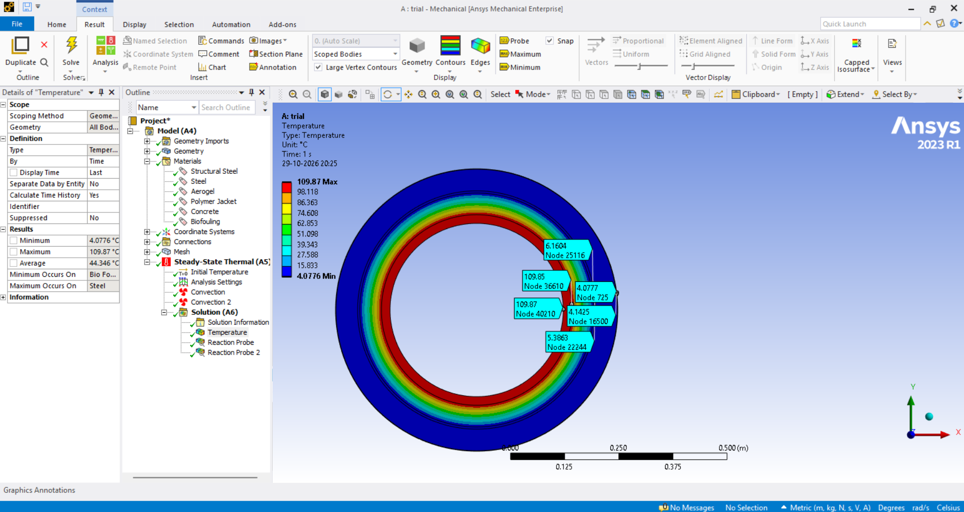
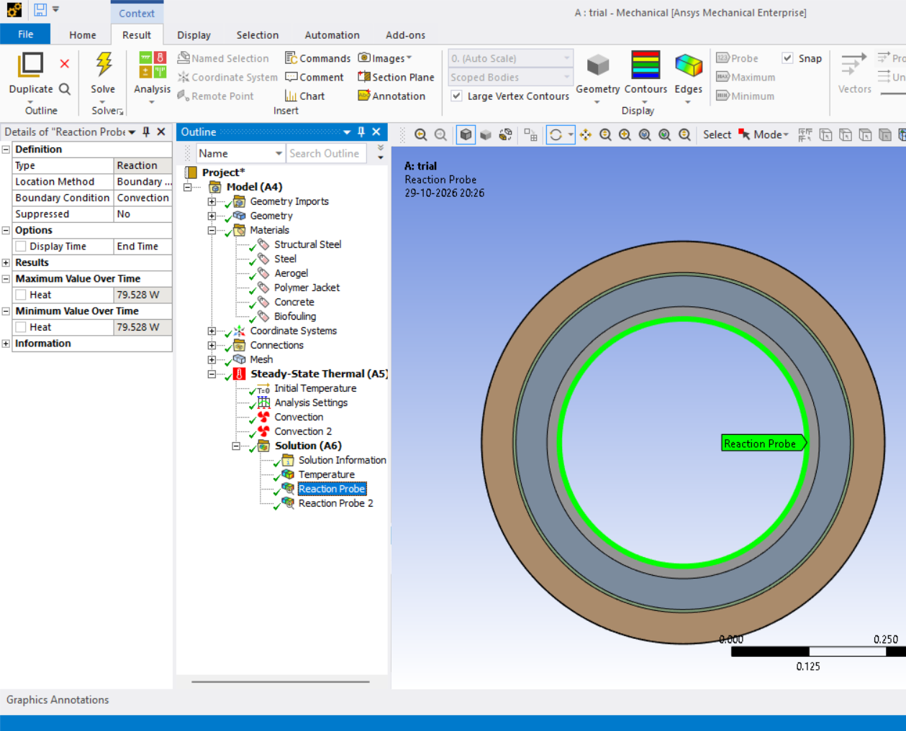
Visualization: ANSYS Thermal Simulation
Simulation for Aerogel
ANSYS 2023 R1 steady-state thermal model with oil-side and seawater-side convection. The radial temperature drop is concentrated across the insulation layer.

Slide 10
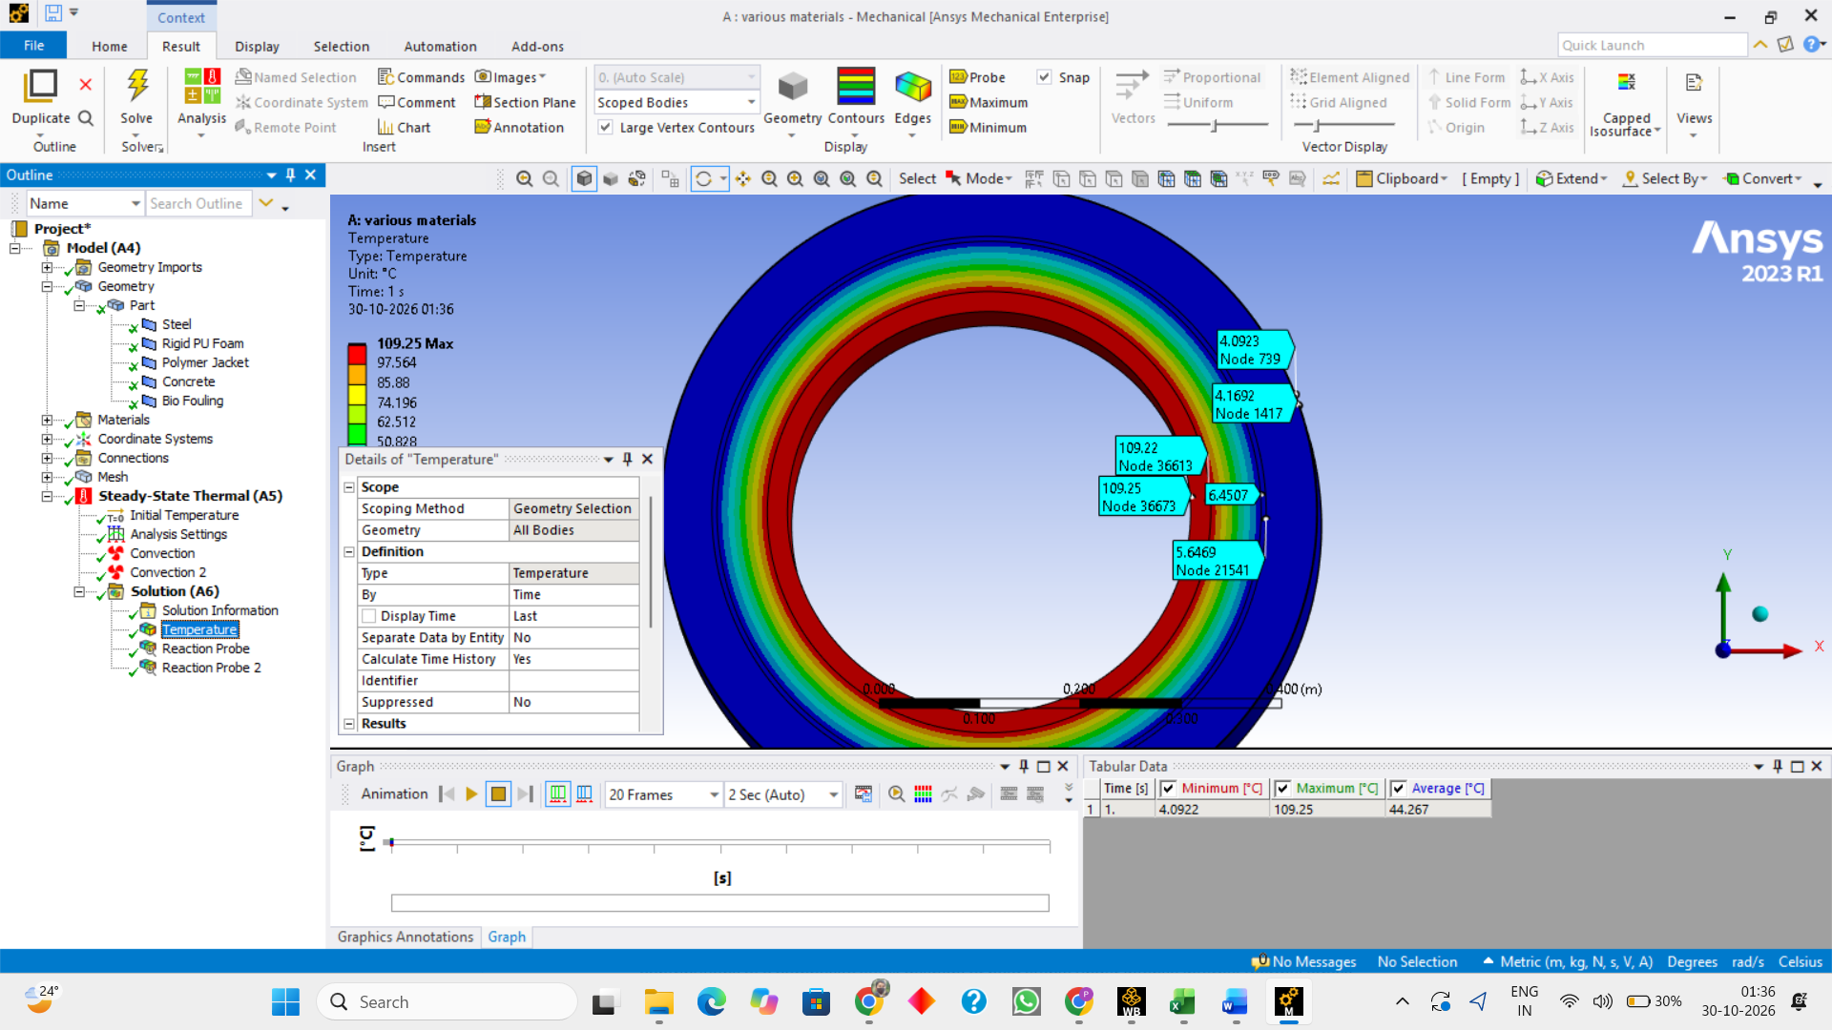
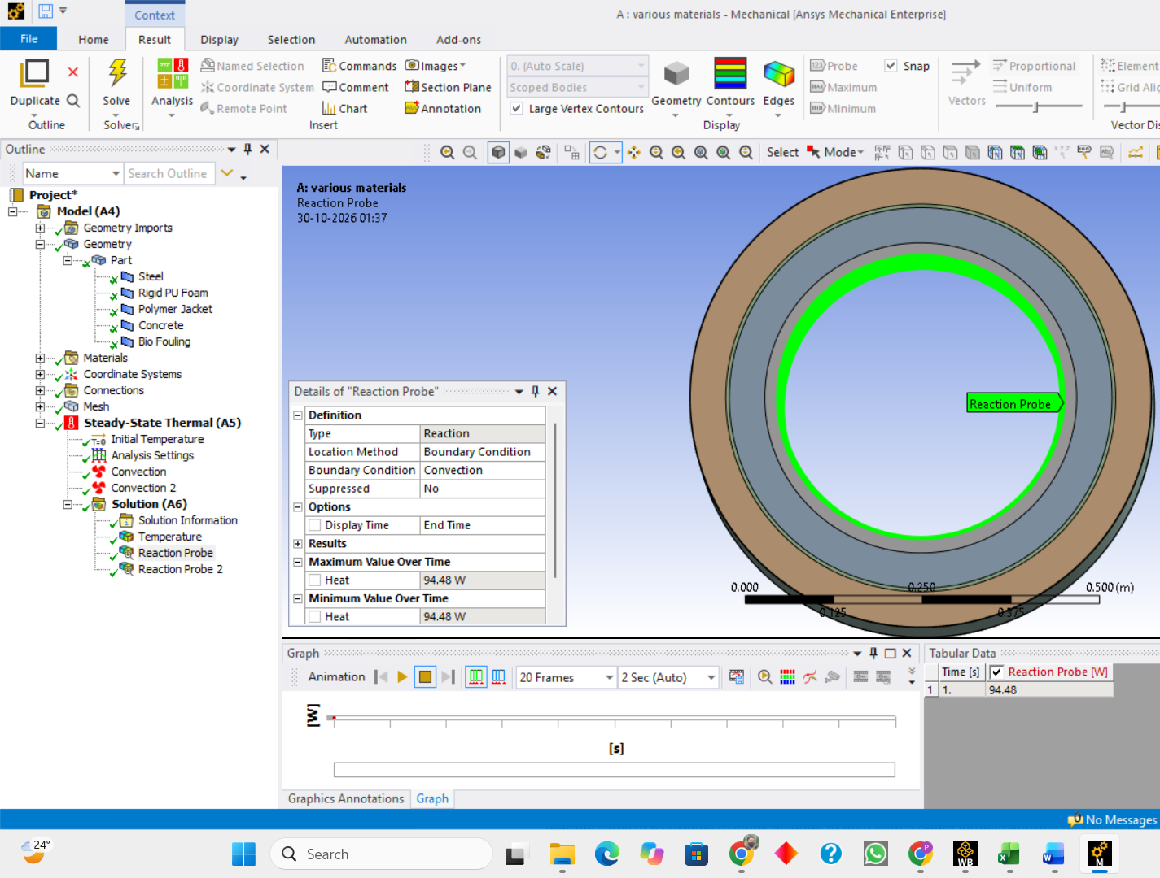
Visualization: ANSYS Thermal Simulation
Simulation for Rigid PU Foam
ANSYS 2023 R1 steady-state thermal model with oil-side and seawater-side convection. The radial temperature drop is concentrated across the insulation layer.

Slide 11
Critical Radius of Insulation
Insulation | k (W/m·K) | r_cr (mm)
Aerogel | 0.025 | 0.05
Rigid PU Foam | 0.03 | 0.06
Adv. Syntactic Foam | 0.12 | 0.24
Syntactic PP | 0.15 | 0.30
Wood | 0.15 | 0.30
Solid PP | 0.2 | 0.40
Hylam | 0.25 | 0.50
For a cylinder with outer convection
r_{cr} = k / h_{o}
If the outer radius r_o is above r_cr, adding insulation always reduces heat loss, because conduction resistance dominates.
Insulation outer radius = 270 mm, far above every r_cr (under 0.5 mm)
Evaluated with seawater-side h_o = 500 W/m²·K

Slide 12
Industrial Decision
Decision: specify Aerogel or Rigid PU Foam. They cut heat loss 4 to 8 times and are the only options that keep 50 °C oil above 45 °C after 10 km.
Problems Faced
Aerogel
Rigid PU Foam
All other options
Lowest heat loss (79.5 W/m at 110 °C). Use in pipe-in-pipe or hydrophobic packs, since it loses performance when wet.
Near-aerogel performance (94.5 W/m). It crushes under deep-sea pressure: use in shallow water with a jacket, or syntactic PU in deep water.
Syntactic PP and foam, solid PP, wood and Hylam pass at 110 °C but fall to 39.6 to 44.0 °C at 50 °C. They need thicker layers or hotter oil.

Slide 13
Solution
If PU foam is crushed
If aerogel gets wet
Switch to syntactic PU (glass microspheres) in deep water
Add a pressure-rated outer jacket or pipe-in-pipe
Use denser foam and prove it by pressure testing
Use hydrophobic aerogel in sealed, vacuum-packed layers
Keep it in a dry, gas-filled pipe-in-pipe annulus
Seal field joints and allow a wet-conductivity margin
What “thermal stress” means
It is the strain from running hot caused due to uneven expansion across the wall and softening at high temperature.
At 110 °C PU Foam is workable with very little margin as it is rated to about 100 to 130 °C.
Aerogel packs are rated to about 200 °C providing ample margin.

