Slide 1
WEB APPLICATION PROGRAMMING

Slide 2
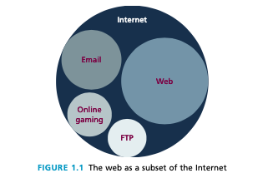
What is the web?

Slide 3

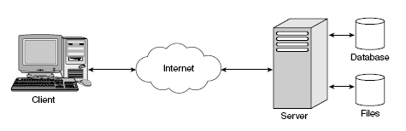
A SIMPLE Web Architecture

Slide 4

WHAT IS A BROWSER?

Slide 5
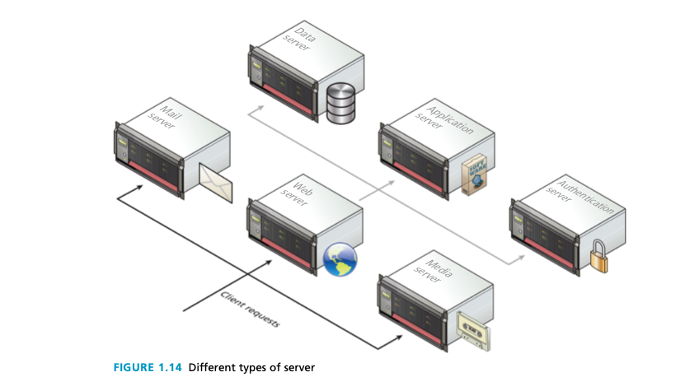
Types of servers

Slide 6
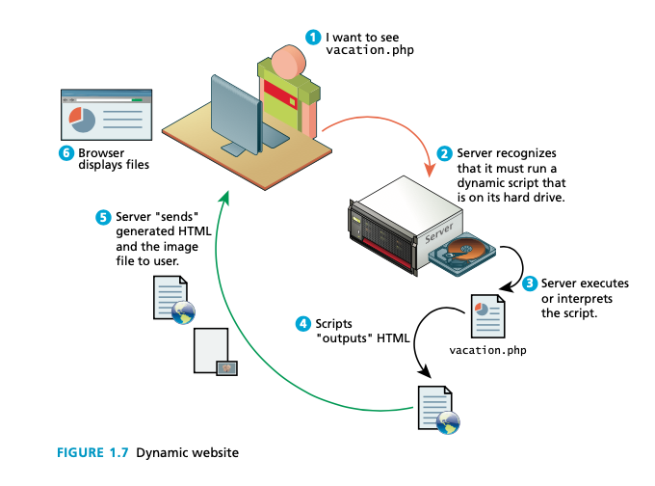
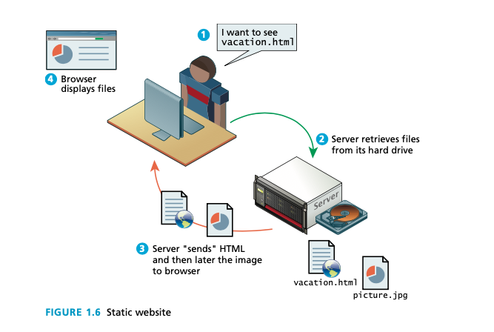
static vs dynamic

Slide 7
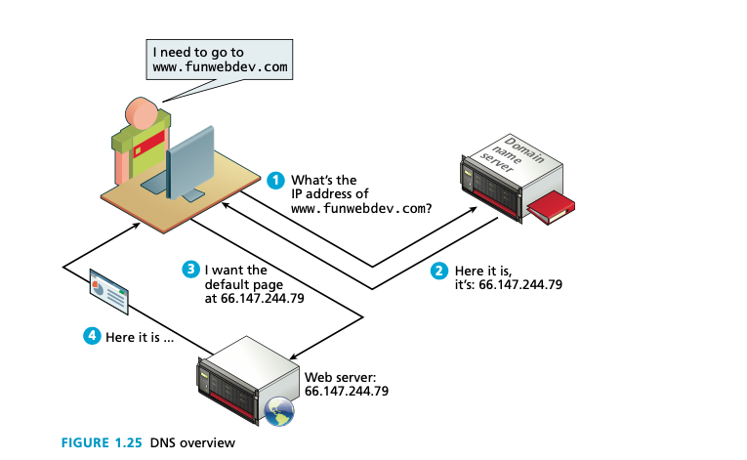
DNS

Slide 8
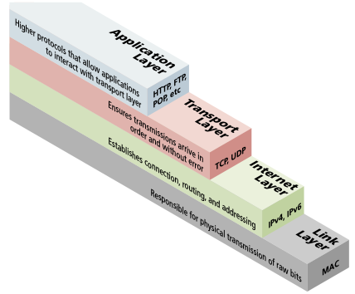
protocols

Slide 9
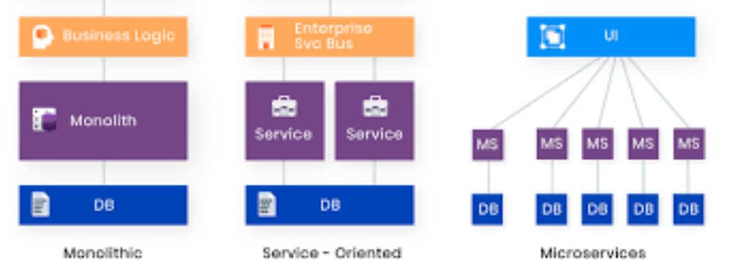
soa

Slide 10
How to create better architectures
Redundancy
Caching
Indexing
Proxies
Load Balancing

Slide 11
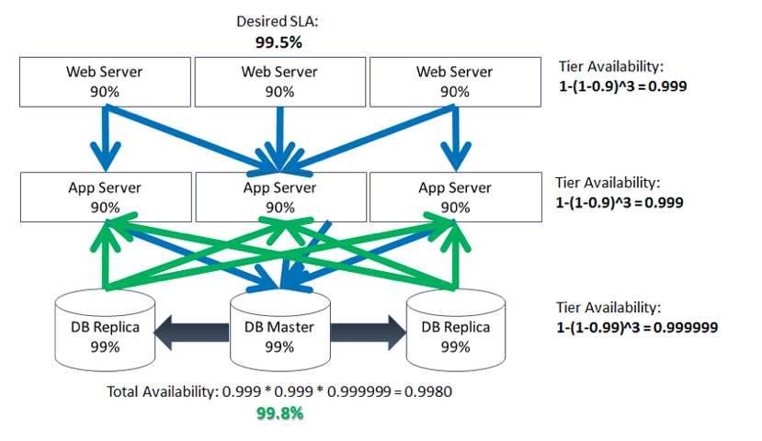
Redundancy

Slide 12
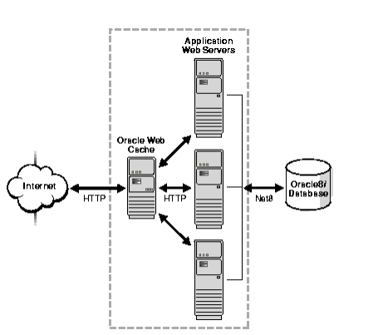
Caching

Slide 13
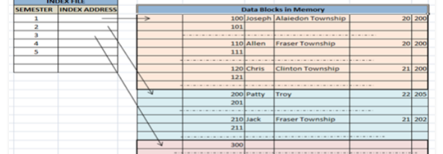
Indexing

Slide 14
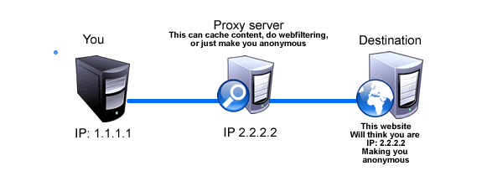
Proxies

Slide 15
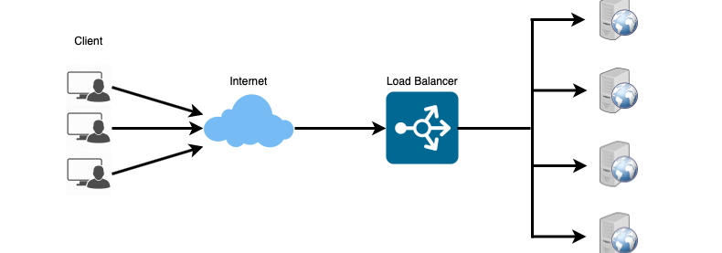
Load balancing

Slide 16
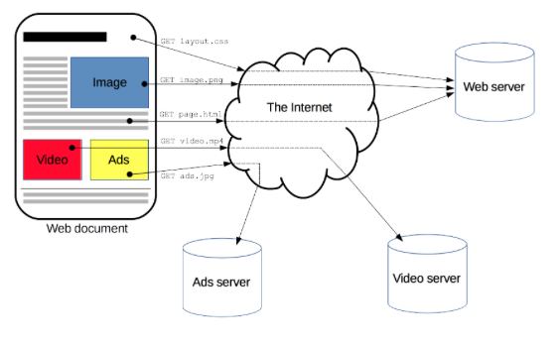
Protocols /methods

Slide 17
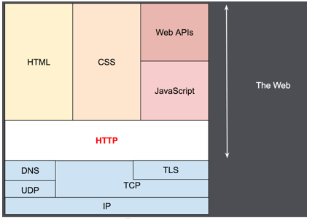

Slide 18
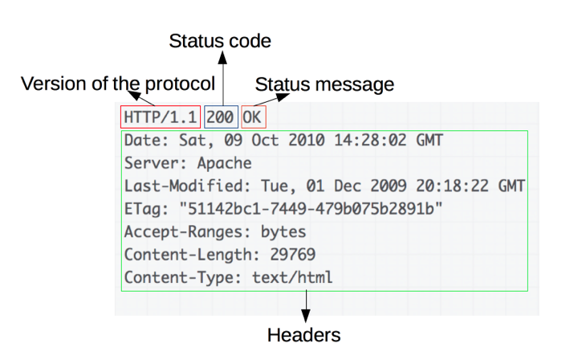
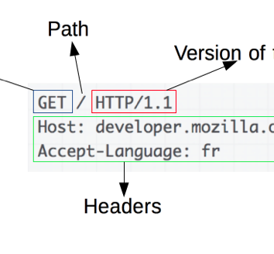
Response and request

Slide 19
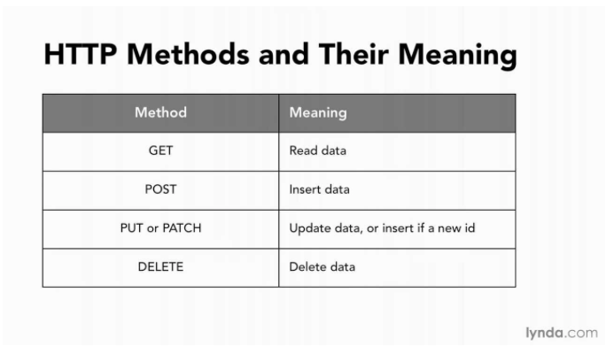

Slide 20
Html
HTML is defined as a markup language.
A markup language is simply a way of annotating a document in such a way as to make the annotations distinct from the text being annotated
Markup languages such as HTML, Tex, XML, and XHTML allow users to control how text and visual elements will be laid out and displayed.
WHY DO WE NEED A STANDARD ?

Slide 21
XHTML
XHTML 1.0 - a version of HTML that used stricter XML (extensible markup language) syntax rules .

Slide 22
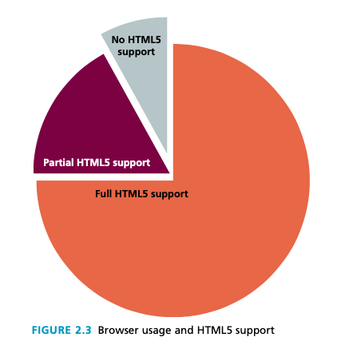
HTML5
There are three main aims to HTML5:
1. Specify unambiguously how browsers should deal with invalid markup.
2. Provide an open, nonproprietary programming framework (via JavaScript) for creating rich web applications.
3. Be backwards compatible with the existing web.

Slide 23
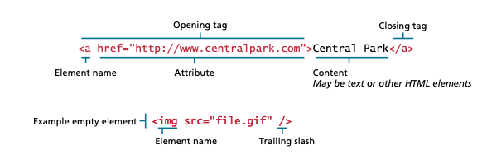
HTML ELEMENTS AND ATTRIBUTES

Slide 24
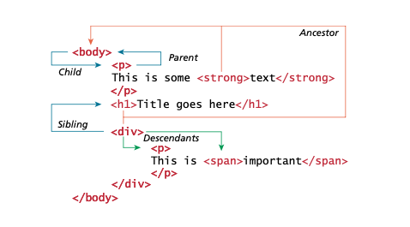
HTML NESTING

Slide 25
BASIC HTML DOCUMENT
<!DOCTYPE html> <html>
<title>first one</title>
<body> <h1>My First Heading</h1>
<p>My first paragraph.</p> </body>
</html>

Slide 26
Basic elements
A text header, denoted using the <h1>, <h2>, <h3>, <h4>, <h5>, <h6> tags.
A paragraph, denoted using the <p> tag.
A horizontal ruler, denoted using the <hr> tag.
A link, denoted using the <a> (anchor) tag.
A list, denoted using the <ul> (unordered list), <ol> (ordered list) and <li> (list element) tags.
An image, denoted using the <img> tag
A divider, denoted using the <div> tag
A text span, denoted using the <span> tag
https://www.w3schools.com/tags/

Slide 27
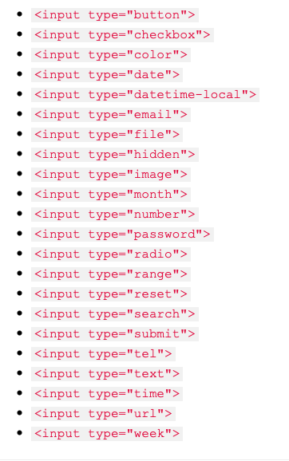
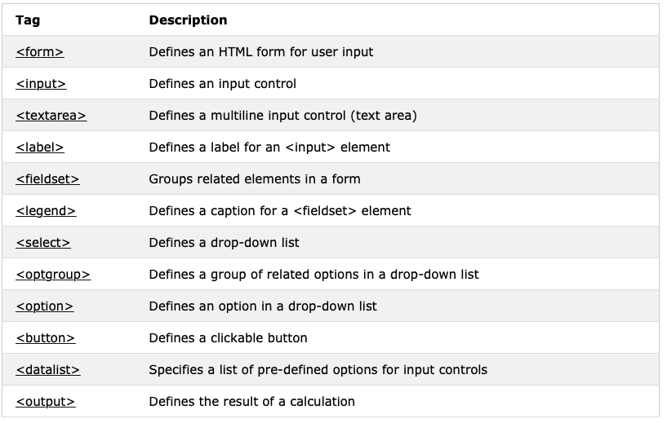
Html 5 forms

Slide 28
css
CSS is a W3C standard for describing the appearance of HTML elements. Another common way to describe CSS’s function is to say that CSS is used to define the presentation of HTML documents.

Slide 29
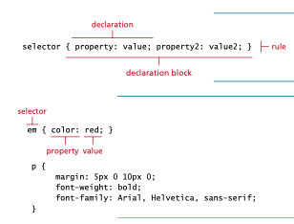
CSS SYNTAX

Slide 30
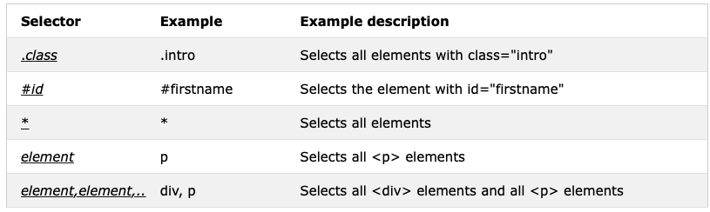
Css selectors

Slide 31
How to add css
External CSS
Internal CSS
Inline CSS

Slide 32
JAVASCRIPT
The idea of client-side scripting is an important one in web development. It refers to the client machine (i.e., the browser) running code locally rather than relying on the server to execute code and return the result.
There are many advantages of client-side scripting:
Processing can be offloaded from the server to client machines, thereby reducing the load on the server.
The browser can respond more rapidly to user events than a request to a remote server ever could, which improves the user experience.

Slide 33
EMBEDDED JAVASCRIPT
<script type="text/javascript">
/* a javascript comment */ alert ("hello world!");
</script>

Slide 34
JS BASICS (OBJECT ORIENTED )
VARIABLES (STRING ,NUMERICAL ,BOOLEAN)
OPERATORS
CONDITIONS
LOOPS
FUNCTIONS
ARRAYS

Slide 35
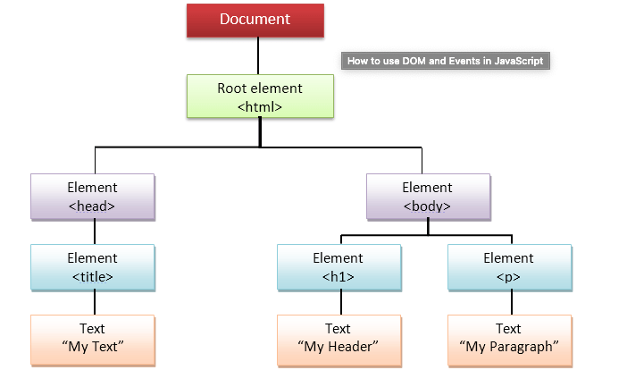
THE DOM
var latest = document.getElementById("latestComment"); var oldMessage = latest.innerHTML;
https://www.w3schools.com/js/js_htmldom_document.asp

Slide 36
jquery
jQuery is a JavaScript Library.
jQuery greatly simplifies JavaScript programming.
jQuery is easy to learn.

Slide 37
ajax
AJAX is a developer's dream, because you can:
Read data from a web server - after the page has loaded
Update a web page without reloading the page
Send data to a web server - in the background

Slide 38
php
It is just like any other programming language.
It binds really well with html,css and js.
There is a downfall of php as there are better programming languages.

Slide 39
Xml/json
It’s a form of encapsulating and wrapping data.
It is also used to transfer data between clients and servers.

Slide 40
What are the keywords to search for ? (to make better projects)
Client side: Angular 4,react,vuejs,ajax,jquery,bootstrap,html5,crud.
Client side storage: local/session storage, caching.
Serverside : Django,Springboot,JSP,servlets,php,asp.net.,nodejs
Databases: Mongodb,firebase,sql,mysql.
Additional functionalities:Oauth,sso,sessions,cookies,svg.Bootstrap

Slide 41
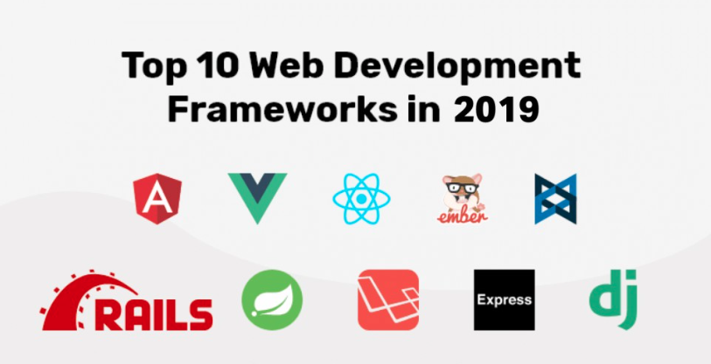
Frameworks

