Slide 1

SUMMER INTERNSHIP PROJECT REPORT ON:
COMPUTER NETWORKING
Submitted in partial fulfillment of the requirements for the award of the degree of
BACHELOR OF TECHNOLOGY
IN
COMPUTER SCIENCE ENGINEERING
SUBMITTED BY :
OJASSVI PRADHAN
04113302716
CSE-7A

Slide 2

NATIONAL THERMAL POWER COORPORATION LIMITED.
(NTPC)
SUMMER TRAINING REPORT
NATIONAL THERMAL POWER COORPORATION LIMITED (NTPC)
LODHI ROAD, NEW DELHI -110003

Slide 3
CONTENTS
DECLARATION
ACKNOWLEDGEMENT
COMMUNICATION
NETWORKING

Slide 4
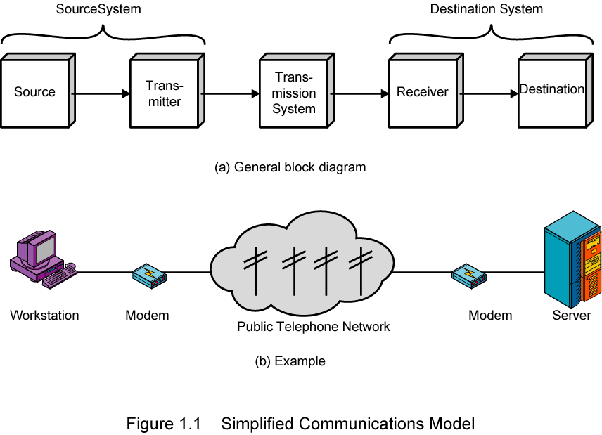
COMMUNICATION

Slide 5
COMMUNICATION MEDIA:
Computer networks can be classified according to the hardware and associated
software technology that is used to interconnect the individual devices in the network,
such as electrical cable (HomePNA, power line communication, G.hn), optical fiber, and radio waves
(wireless LAN). In the OSI model, these are located at levels 1 and 2.
WIRED TECHNOLOGIES:
Twisted pair wire is the most widely used medium for telecommunication.
Twisted-pair cabling consist of copper wires that are twisted into pairs.
Coaxial cable is widely used for cable television systems, office buildings, and other work-sites for
local area networks.
Optical fiber cable consists of one or more filaments of glass fiber wrapped in protective layers that
carries data by means of pulses of light.
WIRELESS TECHNOLOGIES:
Terrestrial microwave , communications satellite, cellular and PCS system, Wireless LANs,
Infrared communication.
COMMUNICATION PROTOCOL:
A communications protocol defines the formats and rules for exchanging information via a network and
typically comprises a complete protocol suite which describes the protocols used at various usage levels.

Slide 6
ETHERNET:
Ethernet is a family of connectionless protocols used in LANs, described by a set of standards together called IEEE 802 published by the Institute of Electrical and Electronics Engineers.
INTERNET PROTOCOL SUITE:
The Internet Protocol Suite is used not only in the eponymous Internet, but today nearly ubiquitously in any computer network. While at the Internet Protocol (IP) level it operates connectionless, it also offers a connection-oriented service layered
on top of IP, the Transmission Control Protocol (TCP). Together, TCP/IP offers a semi-hierarchical addressing scheme (IP address plus port number).
NEED OF COMMUNICATION NETWORKING:
Today computer is available in many offices and homes and therefore there is a need to share data and programs among various computers with the advancement of data communication facilities. The communication between computers has increased and it thus it has extended the power of computer beyond the computer room.

Slide 7
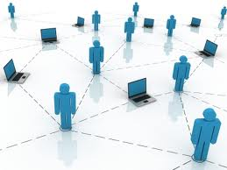
NETWORKING
In the world of computers, networking is the practice of linking two or more computing devices together for the purpose of sharing data. Networks are built with a mix of computer hardware and computer software.

Slide 8
TYPES OF NETWORK
LAN - Local Area Network
LAN connects networking devices with in short spam of area, i.e. small offices, home, internet cafes etc. LAN uses TCP/IP network protocol for communication between computers.
WAN - Wide Area Network
As “word” Wide implies, WAN, wide area network cover large distance for communication between computers. The Internet it self is the biggest example of Wide area network, WAN, which is covering the entire earth. WAN is distributed collection of geographically LANs.
Wireless - Local Area Network
A LAN, local area network based on wireless network technology mostly referred as Wi-Fi. Unlike LAN, in WLAN no wires are used, but radio signals are the medium for communication.

Slide 9
MAN - Metropolitan Area Network
This kind of network is not mostly used but it has its own importance for some government bodies and organizations on larger scale. MAN, metropolitan area network falls in middle of LAN and WAN.
CAN - Campus Area Network
Networking spanning with multiple LANs but smaller than a Metropolitan area network, MAN. This kind of network mostly used in relatively large universities or local business offices and buildings.
NETWORK DEVICES
ROUTER
A router is a device that forwards data packets between telecommunications networks, creating an overlay internet work. A router is connected to two or more data lines from different networks

Slide 10
ETHERNET HUB:
An Ethernet hub, active hub, network hub, repeater hub or hub is a device for connecting multiple twisted pair or fiber optic Ethernet devices together and making them act as a single network segment. Hubs work at the physical layer (layer 1) of the OSI model.
NETWORK SWITCH:
A network switch or switching hub is a computer networking device that connects network segments.
The term commonly refers to a multi-port network bridge that processes and routes data at the data link layer (layer 2) of the OSI model.
NETWORK BRIDGE:
Bridging is a forwarding technique used in packet-switched computer networks. Unlike routing, bridging makes no assumptions about where in a network a particular address is located. Instead, it depends on flooding and examination of source addresses in received packet headers to locate unknown devices.

Slide 11
REPEATER
A repeater is an electronic device that receives a signal and retransmits it at a higher level and/or higher power, or onto the other side of an obstruction, so that the signal can cover longer distances.
NETWORK TOPOLOGIES
Network topology is the layout pattern of interconnections of the various elements (links, nodes, etc.) of a computer^{[1][2]} or biological network.^{[3]} Network
topologies may be physical or logical. Physical topology refers to the physical design of a network including the devices, location and cable installation. Logical topology refers to how data is actually transferred in a network as opposed to its physical design. In general, physical topology relates to a core network whereas logical topology relates to basic network.
Point-to-point
The simplest topology is a permanent link between two endpoints. Switched point-to-point topologies are the basic model of conventional telephony.

Slide 12
BUS:
In local area networks where bus topology is used, each node is connected to a single cable. Each computer or server is connected to the single bus cable. A signal from the source travels in both directions to all machines connected on the bus cable until it finds the intended recipient.
STAR:
In local area networks with a star topology, each network host is connected to a central hub with a point-to-point connection. All traffic that traverses the network passes through the central hub. The hub acts as a signal repeater.
RING:
A network topology that is set up in a circular fashion in which data travels around the ring in one direction and each device on the right acts as a repeater to keep the signal strong as it travels.
MESH:
The value of fully meshed networks is proportional to the exponent of the number of subscribers, assuming that communicating groups of any two endpoints, up to and including all the endpoints, is approximated by Reed's Law.

Slide 13
TREE:
The type of network topology in which a central 'root' node (the top level of the hierarchy) is connected to one or more other nodes that are one level lower in the hierarchy (i.e., the second level) with a point-to-point link between each of the second level nodes and the top level central 'root' node.
HYBRID:
Hybrid networks use a combination of any two or more topologies in such a way that the resulting network does not exhibit one of the standard topologies (e.g., bus, star, ring, etc.). For example, a tree network connected to a tree network is still a tree network typology.
OSI REFRENCE MODEL:
The Open Systems Interconnection model (OSI model) was a product of the Open Systems Interconnection effort at the International Organization for Standardization. It is a way of sub-dividing a communications system into smaller parts called layers.

Slide 14
Layer 1: Physical Layer
The Physical Layer defines electrical and physical specifications for devices. In particular, it defines the relationship between a device and a transmission, such as a copper or optical cable.
Layer 2: Data Link Layer
The Data Link Layer provides the functional and procedural means to transfer data between network entities and to detect and possibly correct errors that may occur in the Physical Layer.
Layer 3: Network Layer
The Network Layer provides the functional and procedural means of transferring variable length data sequences from a source host on one network to a destination host on a different network, while maintaining the quality of service requested by the Transport Layer.
Layer 4: Transport Layer
The Transport Layer provides transparent transfer of data between end users, providing reliable data transfer services to the upper layers. The Transport Layer controls the reliability of a given link through flow control.
Layer 5: Session Layer
The Session Layer controls the dialogues (connections) between computers. It establishes, manages and terminates the connections between the local and remote application .

Slide 15
Layer 6: Presentation Layer
The Presentation Layer establishes context between Application Layer entities, in which the higher-layer entities may use different syntax and semantics if the presentation service provides a mapping between them.
Layer 7: Application Layer
The Application Layer is the OSI layer closest to the end user, which means that both the OSI application layer and the user interact directly with the software application. This layer interacts with software applications that implement a communicating component. Such application programs fall outside the scope of the OSI model.
TCP/IP REFRENCE MODEL
TCP/IP LAYERS
The layers near the top are logically closer to the user application, while those near the bottom are logically closer to the physical transmission of the data. Viewing layers as providing or consuming a service is a method of abstraction to isolate upper layer protocols from the nitty-gritty detail of transmitting bits over, for example, Ethernet and collision detection, while the lower layers avoid having to know the details of each and every application and its protocol.

Slide 16
Link Layer
The Link Layer (or Network Access Layer) is the networking scope of the local network connection to which a host is attached. This regime is called the link in Internet literature.
Internet Layer
The Internet Layer solves the problem of sending packets across one or more networks. Internetworking requires sending data from the source network to the destination network. This process is called routing.
Transport Layer
The Transport Layer's responsibilities include end-to-end message transfer capabilities independent of the underlying network, along with error control, segmentation, flow control, congestion control, and application addressing (port numbers).
Application Layer
The Application Layer refers to the higher-level protocols used by most applications for network communication. Examples of application layer protocols
include the File Transfer Protocol (FTP) and the Simple Mail Transfer Protocol (SMTP).

Slide 17
IP ADDRESS
An IP Address is a 32 bit unique number used to identify a host on a TCP/IP network. IP address is represented as 4 octets, each consisting of 8 bits. each octate is converted to a decimal format and a period(.) separates the decimal no. to make them readable for humans.
From bits:00000000=0
11111111=255
So, the decimal in IP ranges in 0 to 255.
IP address are expressed in dotted-decimal format, with four numbers separated by periods, such as 192.168.1.9(IP address).

Slide 18
An IP address has following 2 parts:
1: 1st part of an IP address is used as a network address.
2: 2nd part of an IP address is used as a host address.
An IP address is a 32 bit add, has 4 octates division.
8bit.8bit.8bit.8bit
Sub divided into classes: A, B, C, D, E (class D and class E are in higher observation under laboratory)

Slide 19


