Slide 1
Distributed Key-Value Store using Consistent Hashing and Quorum-Based Replication
19CSE313 Distributed Systems
Team_No: 01
Project Advisor: Ms. Meena Belwal
S.No | Registration Number | Name of the Student | Section
1 | BL.EN.U4CSE22281 | Ojas | CSE C
2 | BL.EN.U4CSE22248 | R Hitesh | CSE C
3 | BL.EN.U4CSE22255 | Shreevatsan S S | CSE C
4 | BL.EN.U4CSE22206 | Aniket Kumar | CSE C

Slide 2
Problem Definition
To design and implement a fault-tolerant, scalable distributed key-value store using consistent hashing and quorum-based replication for high availability.
Key Points:
Traditional centralized databases face bottlenecks and single points of failure.
Need for a system that supports scalable data distribution across multiple nodes.
Should ensure availability, fault-tolerance, and eventual consistency even during node failures.
Inspired by systems like Amazon Dynamo, suitable for cloud-scale applications.

Slide 3
Literature Survey
S.No | Author Name(s) | Full Title of the Paper with Year | Inference from the Paper (methodology, technology) | Open Problem (for your proposed work)
1 | Giuseppe DeCandia et al. | Dynamo: Amazon’s Highly Available Key-Value Store (2007) | Introduced consistent hashing, vector clocks, and quorum-based replication for high availability | Does not address dynamic quorum or modern security features
2 | Lakshman & Malik | Cassandra: A Decentralized Structured Storage System (2009) | Combines Dynamo’s replication with Bigtable’s data model for scalability | Complex to configure and lacks built-in support for lightweight transactions
3 | Basho Technologies | Riak: A Scalable, Decentralized Data Store (2010) | Focused on fault-tolerance and availability using Dynamo principles with simpler ops | No native support for complex queries or strong consistency
4 | Brewer, E.A. | CAP Twelve Years Later: How the “Rules” Have Changed (2012) | Analysis of trade-offs between consistency, availability, and partition tolerance | No practical framework for balancing CAP in dynamic systems

Slide 4
Software / Tools Requirements
Front End Software
Postman (for API testing)
Curl / CLI client (for basic key-value store operations)
Back End Software
Java 17
Spring Boot (for service orchestration)
Akka (for actor-based communication, if used)
Git / GitHub (for version control)
Gradle (for dependency Management)
Hardware Requirements
Minimum:
4 GB RAM
Dual-core processor
500 MB disk space
Recommended:
8 GB RAM
Quad-core processor
SSD for faster disk I/O

Slide 5
Architecture / Design
High-Level Architecture
Client sends requests (GET, PUT, DELETE) to any node.
The Coordinator Node is chosen based on consistent hashing of the key.
The coordinator manages:
Replica Placement to N nodes (including itself and successors).
Quorum Enforcement using parameters RRR and WWW.
Replica Nodes store and respond with data using versioning (Vector Clocks).
Core Components
Consistent Hash Ring: Distributes keys evenly across nodes.
Replication Manager: Ensures each key is stored on NNN nodes.
Quorum Manager: Manages reads/writes based on R+W>NR + W > NR+W>N.
Storage Engine: File-based CSV or MongoDB for local persistence.
Failure Handler: Manages hinted handoffs, node recovery, and repair.
Versioning System: Vector clocks for detecting concurrent writes.

Slide 6
Implementation
Programming Language & Frameworks
Java — Core language for backend logic
Spring Boot (optional for future HTTP API) — For exposing REST endpoints
Core Modules
Consistent Hashing Module
Assigns keys to nodes based on the hash ring
Replication Manager
Manages NNN-way replication for each key
Quorum Protocol Handler
Ensures successful read/write if quorum R, WR, WR, W is met
Vector Clock System
Handles versioning and conflict resolution
Storage Layer
CSV-based local file storage (can be extended to MongoDB)
Communication Model
Actor-based or Threaded TCP communication (custom protocol)
Nodes exchange metadata and data using JSON messages
Deployment
Nodes run as independent processes on localhost (with different ports)
Simulated failures via manual shutdowns during testing

Slide 7
Testing
Test Environment
Localhost setup with 3 to 5 node processes running independently
Manual node failures and restarts were simulated
Test Cases Executed
Basic Operations:
PUT, GET, and DELETE requests for multiple keys
Validated correct storage and retrieval with replication
Quorum Validation:
Verified that reads/writes succeed when quorum (R,W)(R, W)(R,W) conditions are met
Failure Simulation:
Node crash immediately after write
Verified data availability via surviving replicas
Data Versioning:
Tested conflict resolution using vector clocks for concurrent updates
Rejoin and Recovery:
Restarted crashed node and confirmed it syncs using vector clocks and background sync

Slide 8
Result and Analysis
Observations from Experimentation
Write Availability:
100% success rate for write operations before node failure (with quorum W=2W = 2W=2)
Read Consistency:
Post-failure reads successfully returned the latest data from available replicas
Data Durability:
No data loss even after an intentional node crash due to effective replication
Recovery Handling:
Recovered node performed background synchronization without blocking the system
Performance Metrics
Metric | Observed Value
Write Success Rate | 100% (Before Failure)
Read Success Rate | 100% (After Failure)
Replica Synchronization Time | ~3–5 seconds (local)
Conflict Resolution | Handled using vector clocks

Slide 9
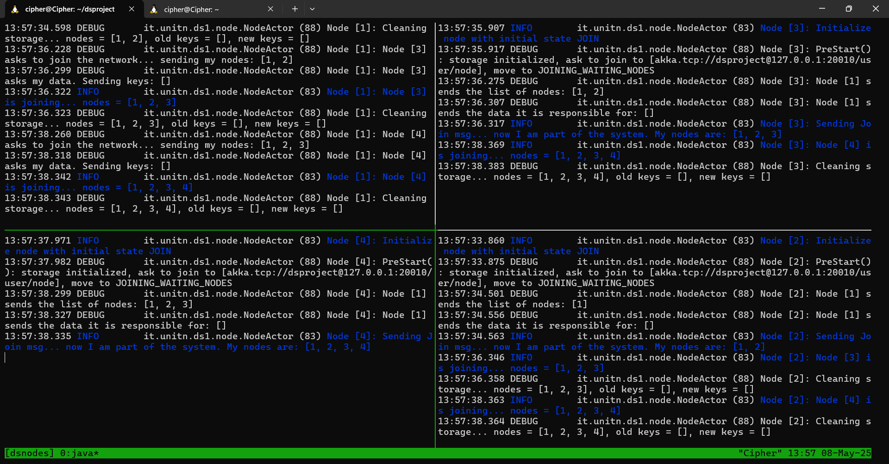
Demonstration

Slide 10
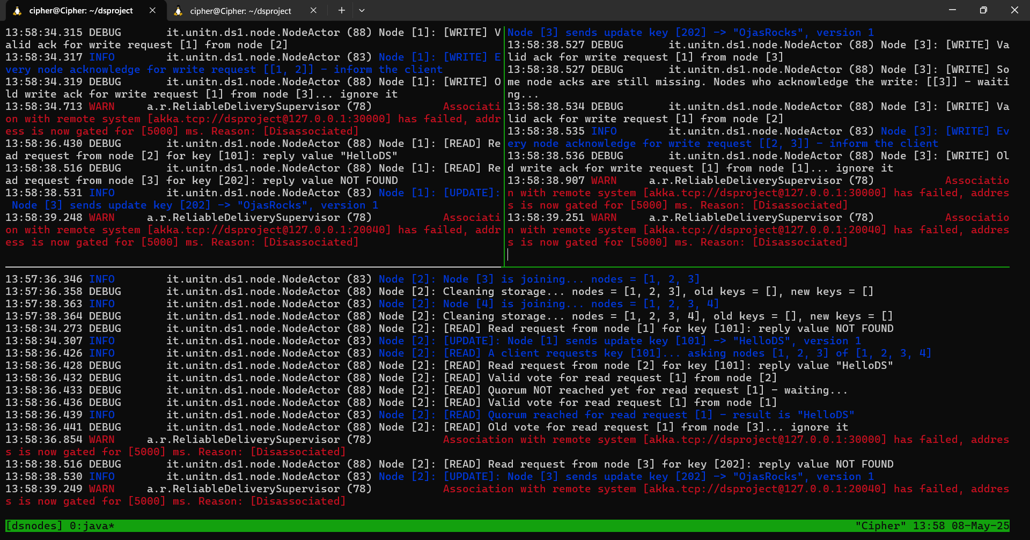
Demonstration

Slide 11
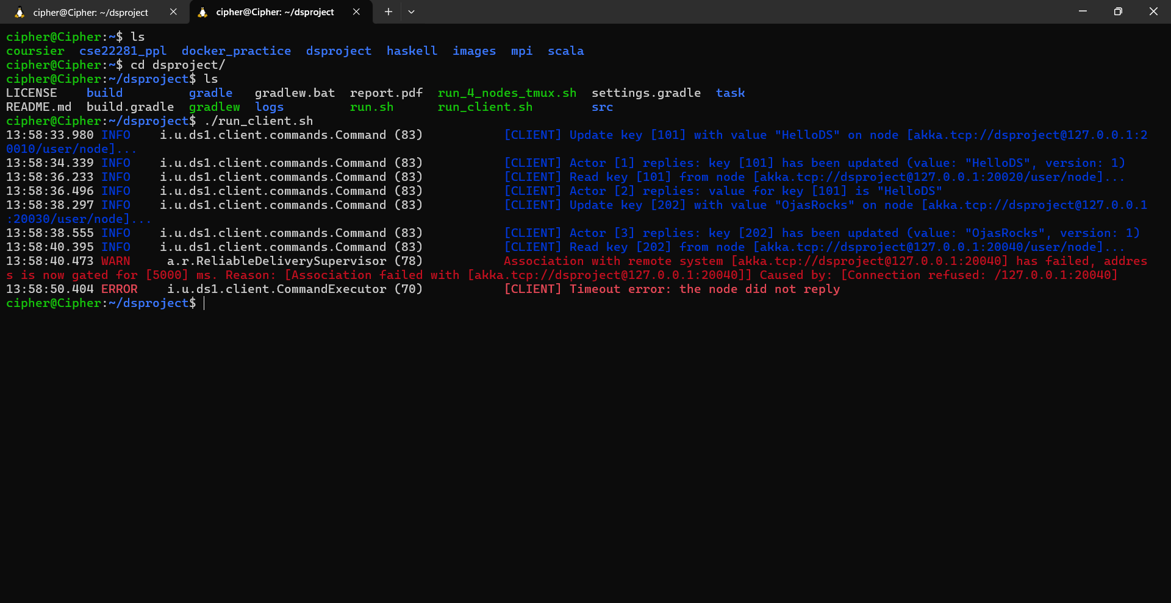
Demonstration

Slide 12
Script Files
#!/bin/bash
JAR_PATH="build/libs/node.jar"
LOG_DIR="logs"
SESSION="dsnodes"
mkdir -p $LOG_DIR
tmux kill-session -t $SESSION 2>/dev/null
tmux new-session -d -s $SESSION "export PORT=20010 NODE_ID=1; java -jar $JAR_PATH bootstrap > $LOG_DIR/node_1.log 2>&1"
sleep 2
tmux split-window -v "export PORT=20020 NODE_ID=2; java -jar $JAR_PATH join 127.0.0.1 20010 > $LOG_DIR/node_2.log 2>&1"
sleep 2
tmux select-pane -t 0
tmux split-window -h "export PORT=20030 NODE_ID=3; java -jar $JAR_PATH join 127.0.0.1 20010 > $LOG_DIR/node_3.log 2>&1"
sleep 2
tmux select-pane -t 1
tmux split-window -h "export PORT=20040 NODE_ID=4; java -jar $JAR_PATH join 127.0.0.1 20010 > $LOG_DIR/node_4.log 2>&1"
sleep 2
tmux select-layout tiled
tmux attach-session -t $SESSION

Slide 13
Conclusion and Future Enhancements
Conclusion
Successfully implemented a fault-tolerant Distributed Key-Value Store inspired by Dynamo.
Used consistent hashing, quorum-based replication, and vector clocks to ensure high availability and eventual consistency.
Simulated node joins, failures, and recoveries, validating robustness under dynamic conditions.
System performed reliably in a local setup, maintaining correct operation without data loss or downtime.
Future Work
Implement Gossip-based Membership: For fully decentralized and dynamic node discovery.
Build RESTful API Layer: Use Spring Boot to offer HTTP-based client interactions.
Add Dynamic Quorum Tuning: Adjust RRR and WWW values based on real-time network and load conditions.
Enhance Security: Secure inter-node communication and add user authentication.
Deploy on Cloud: Scale the system across multiple cloud VMs to simulate real-world distributed deployments.

Slide 14
References
B. Aslantas, E. N. Pektas, and S. Baydere, “Distributed Key Value Store for IoT Edge Devices,” 2024 9th International Conference on Computer Science and Engineering (UBMK), Antalya, Turkiye, 2024.
Y. Dawei, Y. Hengxiang, H. Meihui, and M. Jun, “Research on the Application of Distributed Key-Value Storage Technology in Computer Database Platform,” 2022 IEEE 2nd International Conference on Power, Electronics and Computer Applications (ICPECA), Shenyang, China, 2022.
C. Niu, W. Zhang, S. Byna, and Y. Chen, “Kv2vec: A Distributed Representation Method for Key-value Pairs from Metadata Attributes,” 2022 IEEE High Performance Extreme Computing Conference (HPEC), Waltham, MA, USA, 2022.
M. Cai, J. Shen, Y. Yuan, Z. Qu, and B. Ye, “Scaling Persistent In-Memory Key-Value Stores Over Modern Tiered, Heterogeneous Memory Hierarchies,” IEEE Transactions on Computers, vol. 74, no. 2, pp. 495-509, Feb. 2025.
Z. Wang et al., “NStore: A High-Performance NUMA-Aware Key-Value Store for Hybrid Memory,” IEEE Transactions on Computers, vol. 74, no. 3, pp. 929-943, March 2025.

Slide 15
References
M. Wang and Q. Sun, “Application of Consistent Hash Based on Virtual Node in Traffic Big Data,” 2022 7th International Conference on Intelligent Computing and Signal Processing (ICSP), Xi’an, China, 2022.
N. Zaouia, K. Djouzi, and M. Daoui, “Collisions-Resistant Hash Function Based on a Logistics Map,” 2023 IEEE International Conference on Enabling Technologies: Infrastructure for Collaborative Enterprises (WETICE), Paris, France, 2023.
J. Yi, X. Liu, Y.-m. Cheung, X. Xu, W. Fan, and Y. He, “Efficient Online Label Consistent Hashing for Large-Scale Cross-Modal Retrieval,” 2021 IEEE International Conference on Multimedia and Expo (ICME), Shenzhen, China.
Z. Wang and T. Luo, “An Improved Consistent Hashing-Based Data Indexing Method for Distributed Photovoltaic Stations on Highways,” 2024 IEEE 22nd International Conference on Industrial Informatics (INDIN), Beijing, China, 2024.
M. Coluzzi, A. Brocco, P. Contu, and T. Leidi, “A survey and comparison of consistent hashing algorithms,” 2023 IEEE International Symposium on Performance Analysis of Systems and Software (ISPASS), Raleigh, NC, USA, 2023.

Slide 16
THANK YOU

