Slide 1

WWT Unravel
Recommendation Algorithm for Wings R Us
Team Udaan (IIM Bangalore)
Ojasvi Pandya, Omkar Yadav, Ronak Gupta

Slide 2
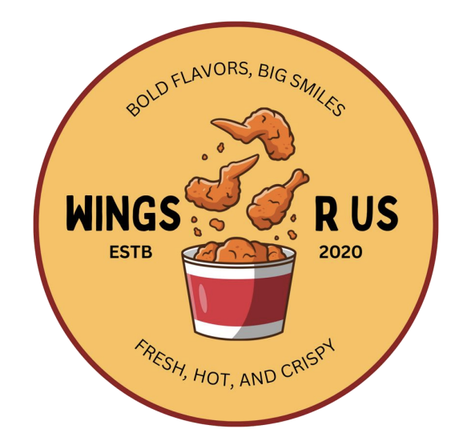
GitHub Repository: https://github.com/ojasvi-pandya/WWT-Unravel-Udaan-IIMB.git
Business Problem
Today Wings R Us is leaving money and loyalty on the table at the single most valuable moment in their digital funnel, the checkout page
1
2
3
Missed revenue at the “prime upsell” moment
Untapped insights in existing data
Poor customer experience
WHY THIS MATTERS FOR WINGS R US
Checkout is the highest-intent point, the customer is ready to pay, so adding a drink, side, or extra flavour is frictionless.
1.4M+ historical orders with rich signals about order combos. Today, this is just “stored history”, not an active revenue-generating asset.
First-time users often get generic prompts that don’t match their taste, loyal customers may see the same static add-ons repeatedly
INCREASE AOV
When recommendations feel authentic and are bundled smartly, the total bill can grow by almost 47%¹
4
5
Competitive disadvantage in digital experience
Operational inconsistency & missed learnings
REDUCE CHURN RATE
Major QSR players (McDonald’s, KFC, Domino’s) already use real-time, data-driven checkout personalization.
Without a unified, data-driven system, marketing teams can’t learn what works, iterate, or run low-risk pilots that prove ROI before scaling
An average QSR loses 30-40% of its customers every year², emphasizing the value of 1:1 personalization
Sources: Restaurant Upselling Techniques, QSR Personalisation Strategies

Slide 3
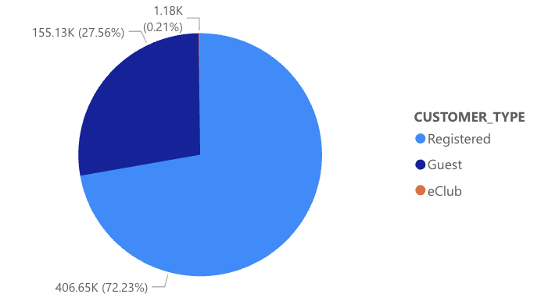
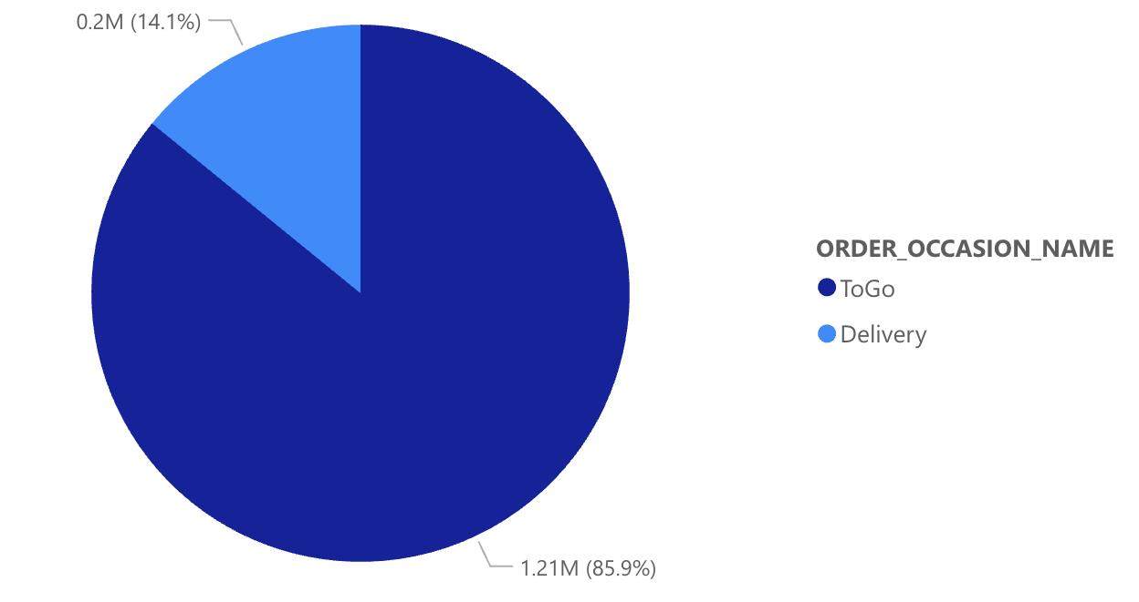
Exploratory Data Analysis
This split indicates that a one-size-fits-all recommendation model would be ineffective. It also highlights the opportunity to drive conversion from guest to registered users.
This data strongly suggests that "ToGo" and "Delivery" orders likely serve different customer needs (e.g., a quick individual lunch vs. a planned family dinner).
Items Most Frequently Purchased Together
Registered Customers on Delivery Occasions | 20 pc Crispy Strips + Ranch Dip – Large + Large Buffalo Fries
Registered Customers on To Go Occasions
Guest Customers on Delivery Occasions
Guest Customers on To Go Occasions

Slide 4
Data Preparation
DATA CLEANING
FEATURE ENGINEERING
Monetary Features | Total Order Value | Total monetary value for each individual order. Enables us to identify high-value vs. low-value transactions and the items associated with them
 | Average Order Value | Average amount a customer typically spends per order. Helps segment customers into "high-spenders" and "low-spenders," unlocking the insight that 'Registered' users may have a consistently higher AOV than 'Guests,' proving the value of your loyalty program
 | Customer Total Spend | Indicates customer's lifetime value. Allows us to identify your "VIP" customers, the small percentage who drive a large portion of your revenue and are most deserving of special offers
Behavioural & Contextual Features | Customer Frequency | Measures loyalty by counting the total number of orders placed by each customer. Data-driven way to identify "loyal fan" and a "first-time user"
 | Order Size | Counts the number of distinct items in each order to give an insight into basket size. Helps us understand if customers are buying full family meals or just a single item for themselves
 | Customer Recency | Measures how recently a customer has made a purchase. critical for identifying "at-risk" customers who haven't ordered in a while and could be targeted with a re-engagement campaign.
 | Time-based Features | Day of the week and the hour of the day for an order can reveal distinct patterns like weekday lunch rushes, after-school snack periods, or weekend family dinner, allowing for time-sensitive recommendations.
Initial Data Parsing
Parsed complex JSON order data into a flat format. Items with a price of zero were filtered out to remove erroneous or non-transactional entries
Data Consolidation
Merged three distinct datasets (orders, stores, customers) into a single, unified master file
Data Type Correction & Text Standardisation
Corrected data types & standardized all text to lowercase for analytical consistency
Handling Missing Values
Systematically filled null values in key categorical fields to prevent data loss and ensure data integrity
Duplicate Verification
Performed a full data scan to verify and confirm the absence of any duplicate order records

Slide 5





Building the Recommendation Engine
Market Basket Analysis
Data Structuring for Analysis
Generation of Association Rules
Personalised Segmentation
Validation and Optimisation
Utilized the
APRIORI ALGORITHM on over 1.4 million orders to discover foundational co-purchase patterns
Converted each customer order into a transaction list, preparing the data for pattern analysis
Generated hundreds of high-confidence rules ranked by LIFT and CONFIDENCE to find the most significant item pairings
Built specialized models segmented by CUSTOMER TYPE (Registered, Guest) & ORDER TYPE (Delivery, ToGo)
Validated each model using the RECALL@3 metric and optimized parameters to achieve a top score of ~23%
Technique Selection
Objective Definition
Item Consolidation
Transaction Creation
Data Filtering
One-Hot Encoding
Frequent Itemset Mining
Rule Ranking
Primary Segmentation
Nested Segmentation
Model Specialization
Train-Test Split
Performance Simulation
Metric-Driven Optimisation
Key Actions
Our Modelling Philosophy: We move beyond a one-size-fits-all model. By combining Market Basket Analysis with advanced segmentation and continuous validation, we ensure every recommendation is relevant to the unique customer journey.

Slide 6
Modelling Approach
Methodology
We generated association rules based on a minimum threshold of support and confidence values. Then, we prioritized the rules based on the higher lift values that was calculated. Min support = 0.001, Min confidence = 0.4
Recommendations | Segmentation |  |  | Recall@3
 | Customer Type | Order Day | Order Occasion
Model 1 | Yes | No | No | Registered: 0.1994 Guest: 0.2081 General Fallback: 0.1910
Model 2 | Yes | Yes | No | Registered Weekday: 0.2098 Registered Weekend: 0.1892 Guest Weekday: 0.2232 Guest Weekend: 0.1917 General Fallback: 0.1910
Model 3 | Yes | No | Yes | Registered To Go: 0.1829 Registered Delivery: 0.2047 Guest To Go: 0.2021 Guest Delivery: 0.0853 General Fallback: 0.1910
Customer Type (Registered vs Guest)
Order Day (Weekday vs Weekend)
Order Occasion Name (To Go vs Delivery)

Slide 7



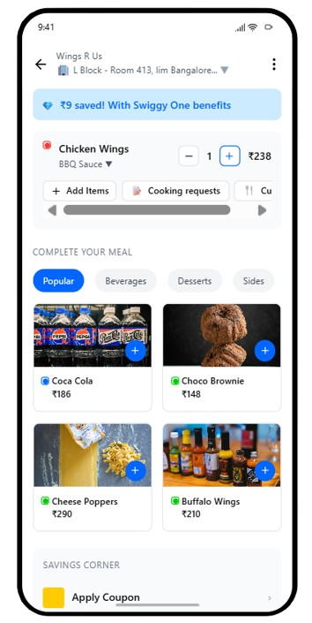
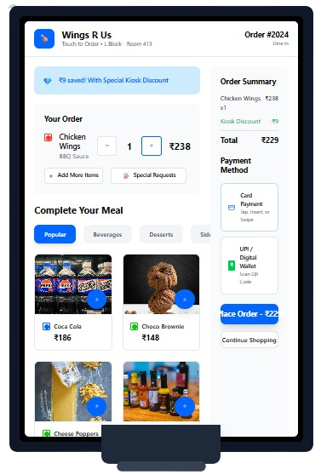
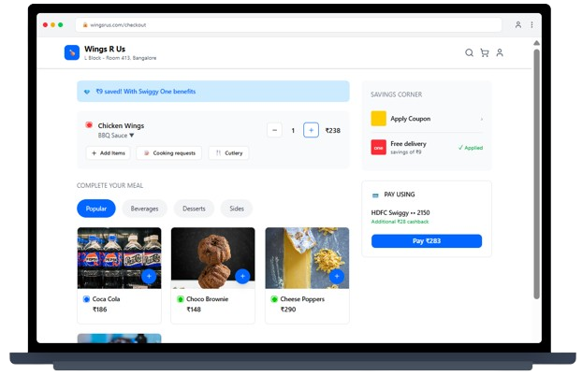
Implementation Strategy & Roadmap
Week 1-2
We will run an A/B test on 50% of your 'Registered' mobile app users in a single, high-volume city, i.e., Houston in our data. This test group will see the recommendations, while 50% control group will not.
Week 2-4
Customer Concerns
4-Week Pilot Program
We will measure and compare between the two groups.
Concerns | Mitigation
The choices feel repetitive or boring. | Dynamic recommendation rotation, smart suggestion suppression
The suggestions are irrelevant to my order. | Regular model retraining, context-aware cart filtering, tailored suggestions via segmentation
This feels intrusive or pushy. | Focus on UI/UX, non-intrusive design, limit recommendations
Recommendation Click-Through Rate (CTR)
Recommendation Conversion Rate
Average Order Value (AOV)
Consistent Cross-Platform Experience
Approach: A Centralized Recommendation API
We will develop a single, central 'brain' (API) that houses all the approved association rules and recommendation logic.
Execution
The mobile app, website, and in-store kiosks will all make a request to this central API, sending the current cart's contents, the customer type, and the order occasion (e.g., Delivery/ToGo).
MOBILE APP
IN-STORE KIOSK
WEBSITE

Slide 8




Critical success factors (CSFs) and Enablers of a robust recommendation process
Alignment with business strategic objectives
High-quality, rich data inputs
Performance & user experience
Cross-platform consistency & latency
Operational scalability & maintainability
ENABLERS:
Centralized recommendation API
Robust data & information management
Clear processes & guidance

Slide 9

THANK YOU

