Slide 1
AGENTIC AI & VECTORLESS RAG — VISUAL

Slide 2
AGENTIC AI & VECTORLESS RAG
Agentic AI & Vectorless RAG
Visual Overview
Voila AI

Slide 3

NEURAL NETWORK ARCHITECTURE

Slide 4
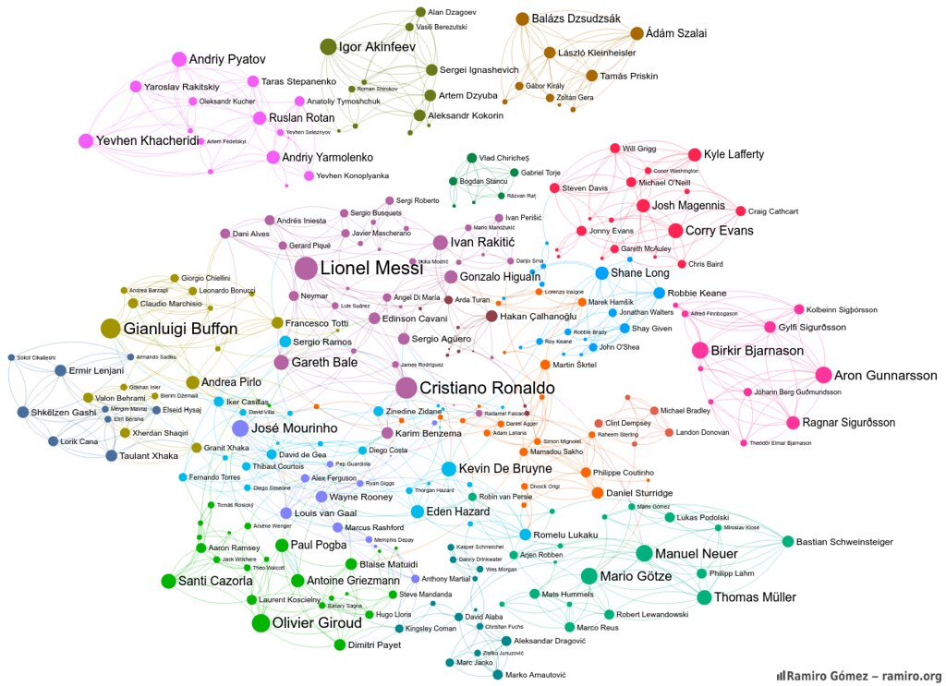
KNOWLEDGE GRAPH

Slide 5
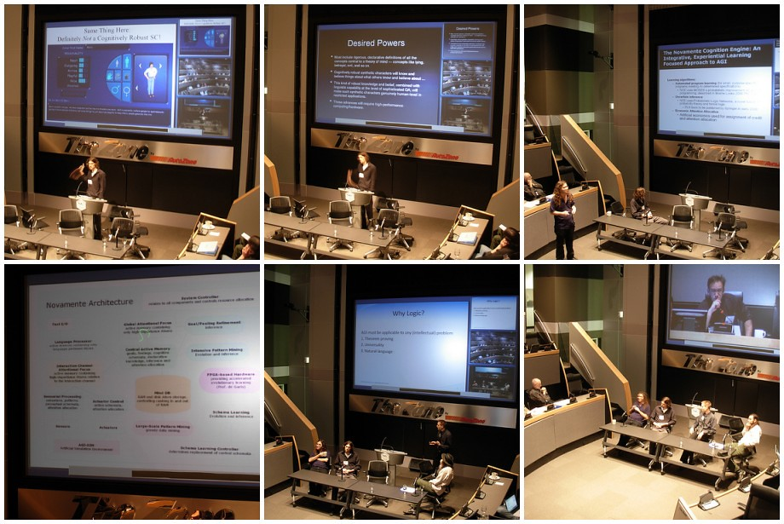
AI AGENT SYSTEM

Slide 6
SUMMARY
Agentic AI enables multi-step reasoning
Vectorless RAG eliminates embedding bottlenecks
Production-ready with existing infrastructure

