Slide 1
Three ways to find an answer in a 10-K
This project compares semantic, statistical and structural retrieval over SEC annual filings, holding everything after retrieval identical.
Ojaswi Athghara · 201959096
COMP702 MSc Project · Supervisor: Blaine Keetch · Second assessment
STATEMENT OF ETHICAL COMPLIANCE: A0
Data Category A. Every source document is a United States SEC 10-K filing taken from EDGAR, a public regulatory archive. The data carries no personal or confidential information and needs no licence or consent.
Participant Category 0. The project uses no human participants. Two language models generate and verify the benchmark; I carry out the two manual steps myself on the project's own outputs.
I have read the ethical guidance and I follow it throughout this project.
1
Notes:
State the title, the ethics category A0, and that the project uses public filings and no human participants. Move on quickly.

Slide 2
MOTIVATION
A 10-K hides its answers in three different shapes
Retrieval systems are usually tested on prose. An annual report mixes prose with dense tables and cross-referenced notes.
Narrative prose
Financial tables
Cross-referenced footnotes
Management states the answer in a sentence. Meaning-based search handles this well.
The answer sits in one cell of a numeric grid. Summarising the table destroys it.
The answer spans a note and the table it qualifies, so the reader must join them.
13
5
18,297
140
FILINGS
COMPANIES
ATOMIC NODES
BENCHMARK QUESTIONS
2
Notes:
Say the numbers out loud: 13 filings, 5 companies, 18,297 nodes.

Slide 3
RESEARCH QUESTION
Does document structure decide which retrieval paradigm wins?
The question stays open. No number in this deck answers it.
01
Build three pipelines that differ only in how they index
Semantic vectors, BM25 term statistics, and a summary tree over each filing.
02
Generate a benchmark with verified evidence
Two language models from different families propose and check every question.
03
Measure retrieval, answer quality and cost separately
A paradigm can win on accuracy and lose on speed, so each metric stands on its own.
3
Notes:
Three aims. Emphasise that retrieval is the only variable that changes.

Slide 4
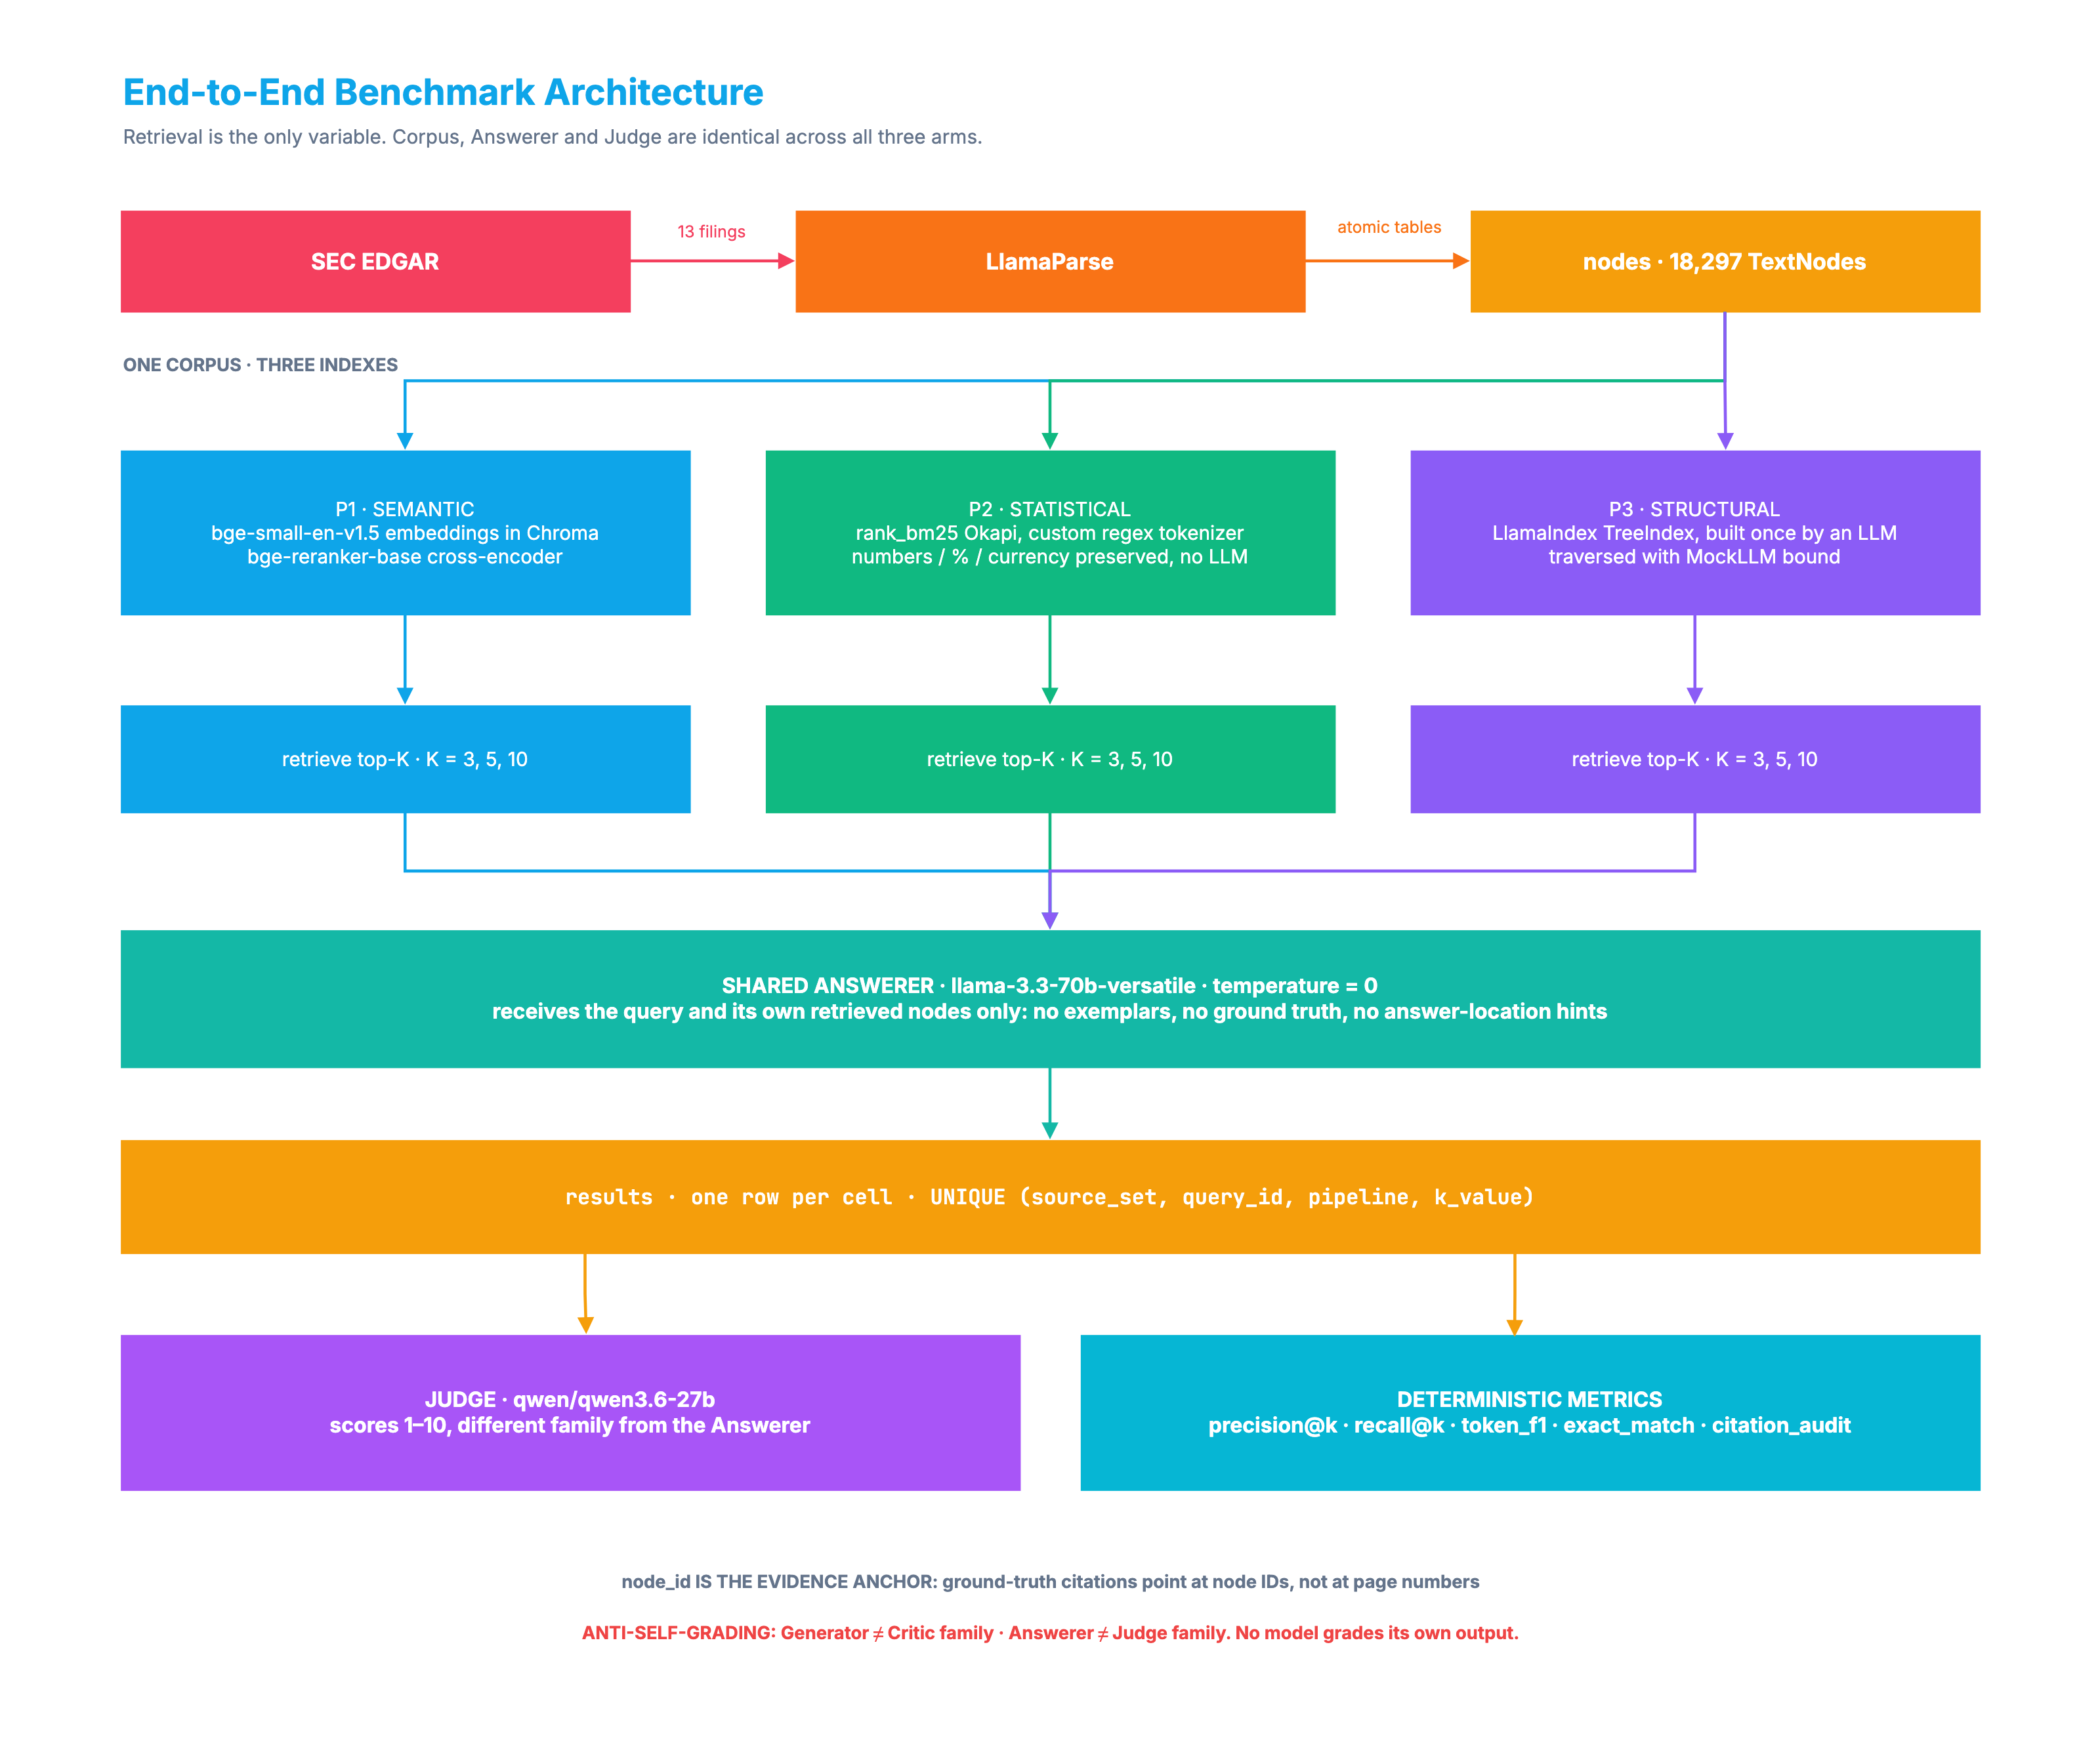
DESIGN
How a filing becomes searchable
4
Notes:
A filing becomes nodes, and every node carries an id. Three indexes are built over those same nodes. Walk it left to right once. Close on the line that matters: same input, three ways of organising it, so one variable changes.

Slide 5
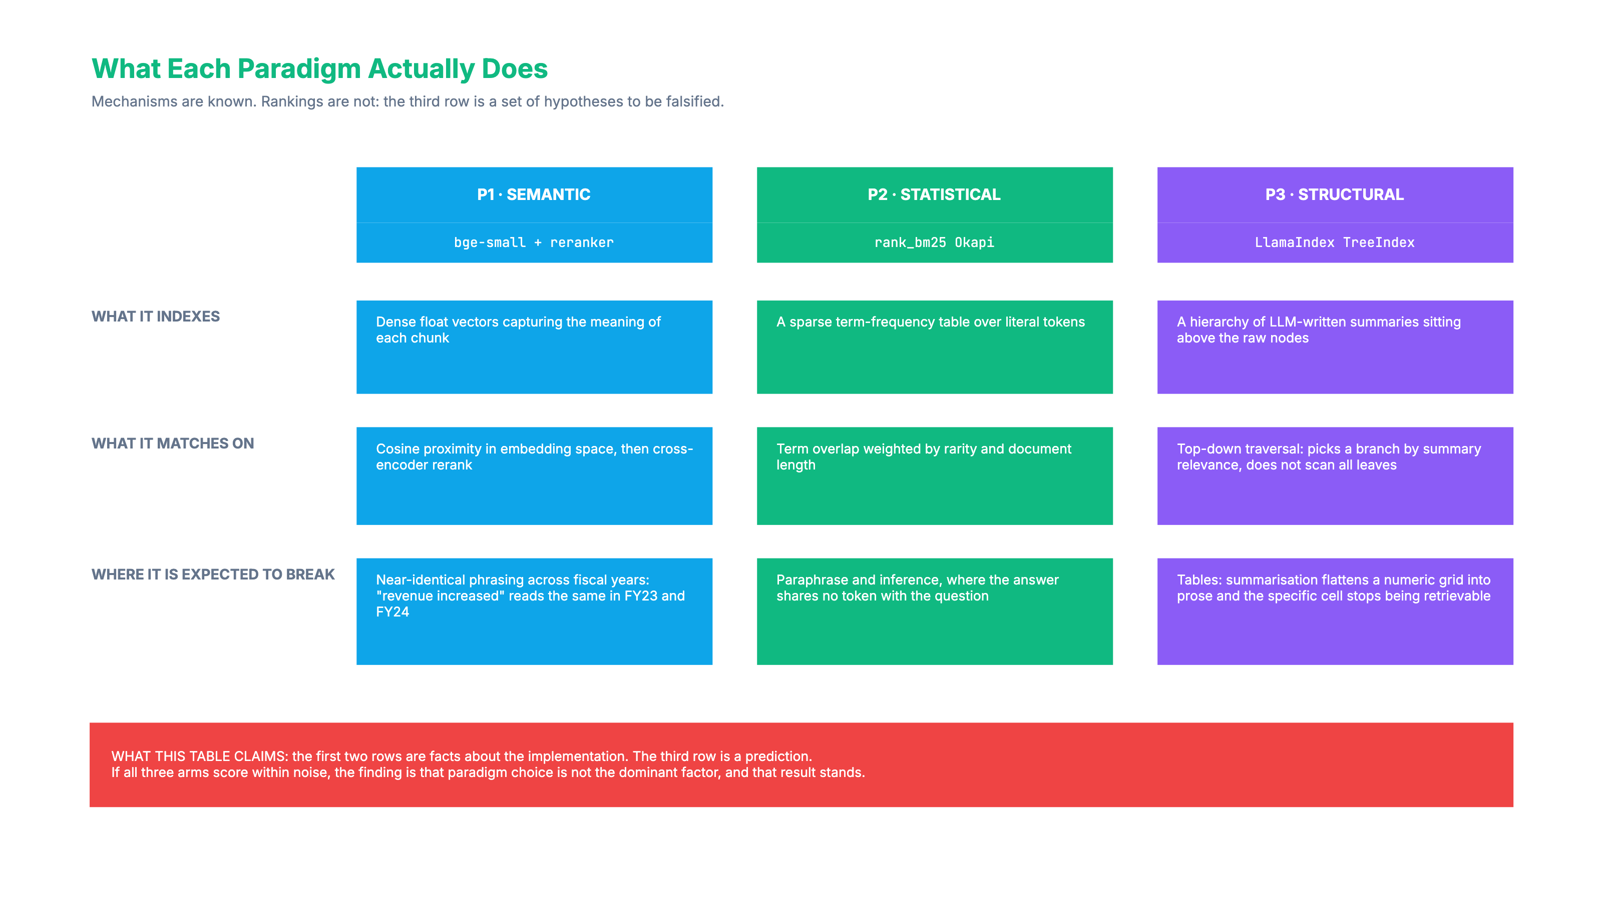
THE VARIABLE UNDER TEST
Each paradigm indexes a different property
5
Notes:
The first two rows state how each pipeline works. The third row is a prediction. Point at it and say plainly that it is a hypothesis, not a result.

Slide 6
FOUNDATIONS
What the project pins down before running anything
Scope, tests and reading, each settled with a number or a citation.
The corpus carries a stated size
13 filings across 5 companies give 18,297 addressable nodes, counted rather than estimated.
Tests cover every stage of the pipeline
339 tests cover ingestion, all three retrieval arms, dataset generation and the judge.
The review includes financial question answering
FinQA (Chen et al., 2021) studies question answering over financial filings. The dissertation widens this section.
The rest of this video shows the software running.
6
Notes:
Land the three numbers: 13 filings, 339 tests, one financial-domain citation. Keep it to about twenty seconds.

Slide 7
STATUS
Six phases stand complete. The benchmark has not run.
Verified against the repository, the test suite and the database on 20 August 2026.
339
13
140
0
20
TESTS PASSING
FILINGS INGESTED
QUESTIONS GENERATED
BENCHMARK ROWS
LABELS OUTSTANDING
Built and tested
Blocking the benchmark
Ingestion and parsing, all three retrieval pipelines, adversarial dataset generation, and the judge with its metrics.
Twenty golden questions still need hand-labelling, and the judge still needs to clear human scoring, before the 900-run benchmark can start.
The results table holds zero rows because the executor has never run. Every other number here comes from the live database.
7
Notes:
Be honest here. Zero results is the true state, and saying it plainly beats a vague claim.

Slide 8
Now, the software in use
What retrieval means
the question, and the paragraph ids that answer it
Source code
the BM25 tokeniser, and why a standard one will not do
A live comparison
four questions through all three pipelines at K = 3
The database
live row counts behind every number in this deck
The test suite
339 tests
8
Notes:
Swipe to the second desktop here. Do not narrate the switch. Five rows, five things on screen, in this order.

Slide 9
DEMO, MEASURED
Same question, three different sets of evidence
MSFT_2023, four questions, one per difficulty quadrant, K = 3. Retrieval only, run locally, zero API calls.
PIPELINE
P@3
R@3
LATENCY
WHAT THE RUN SHOWED
P1 semantic
0.42
0.69
5.34s
Found the evidence every time. The rerank is what costs the five seconds.
P2 statistical
0.50
0.75
0.02s
Ahead here. Three of the four answers sit in tables, BM25's home ground.
P3 structural
0.00
0.00
4.24s
Returned real nodes, from the wrong section. It commits to a branch at the root.
Never all three agreed
P3's zero is its architecture
0.33 was the maximum possible
Seven or eight distinct nodes came back across nine slots, on every question.
It chose the lease tables in Item 8 over the properties table in Item 2. A tree walk cannot reverse.
One correct node at K = 3 caps precision at a third. The denominator is K itself.
Four questions on one filing show the mechanism working. The benchmark proper is 900 runs and it has not started.
9
Notes:
This is the run they just watched. Read one row, not three. The P3 line is the one worth pausing on: it retrieved real nodes from a neighbouring section, which is the failure mode its architecture predicts.

Slide 10
CONCLUSIONS
What the work supports so far
None of these come from the benchmark. They come from building the system.
The three paradigms disagree about the evidence
On the same question they return different nodes, which is the effect the benchmark measures.
Cost separates them as sharply as accuracy might
BM25 retrieves with no model at all, while the vector arm pays for a cross-encoder on every query.
Free-tier limits shaped the architecture
The free quota runs out part-way through a run, which forced three providers and a resumable key.
10
Notes:
Three claims, none of them about which pipeline wins.

Slide 11
NEXT
What happens next
1
Label the 20 golden questions
manual, nothing blocks it
2
Clear the judge against human scoring
60 outputs, held-out questions
3
Build the remaining vector and BM25 indexes
local, no API cost
4
Run the 900-cell benchmark
free tier, resumable after any crash
5
Report per quadrant
where each paradigm wins, not one overall winner
A result showing no difference between the paradigms would falsify the hypothesis, and that finding still counts.
11
Notes:
Close on the falsification point. It shows the question is genuinely open.

