Slide 1
Indigenous Simulation Model for Design Validation of Traction Power Supply Network
GUI Development Progress Report
Under Prof. B. Das
Ojaswi Chopra – 21117086
Bhargav Pratim Nath – 21115038
Date: 17th Dec, 2024

Slide 2
Project Overview
Objective
Develop an efficient GUI for the simulation model to validate traction power supply networks, load flow and their corresponding outputs.
Indigenous solution for power network design validation.
Tech Stack
Backend: Octave (Simulation Model)
Key Features
Seamless backend and GUI integration.
Deployable as a standalone application using PyInstaller.
Frontend: Python (Streamlit Framework)
Integration: Oct2Py for Python-Octave communication.

Slide 3
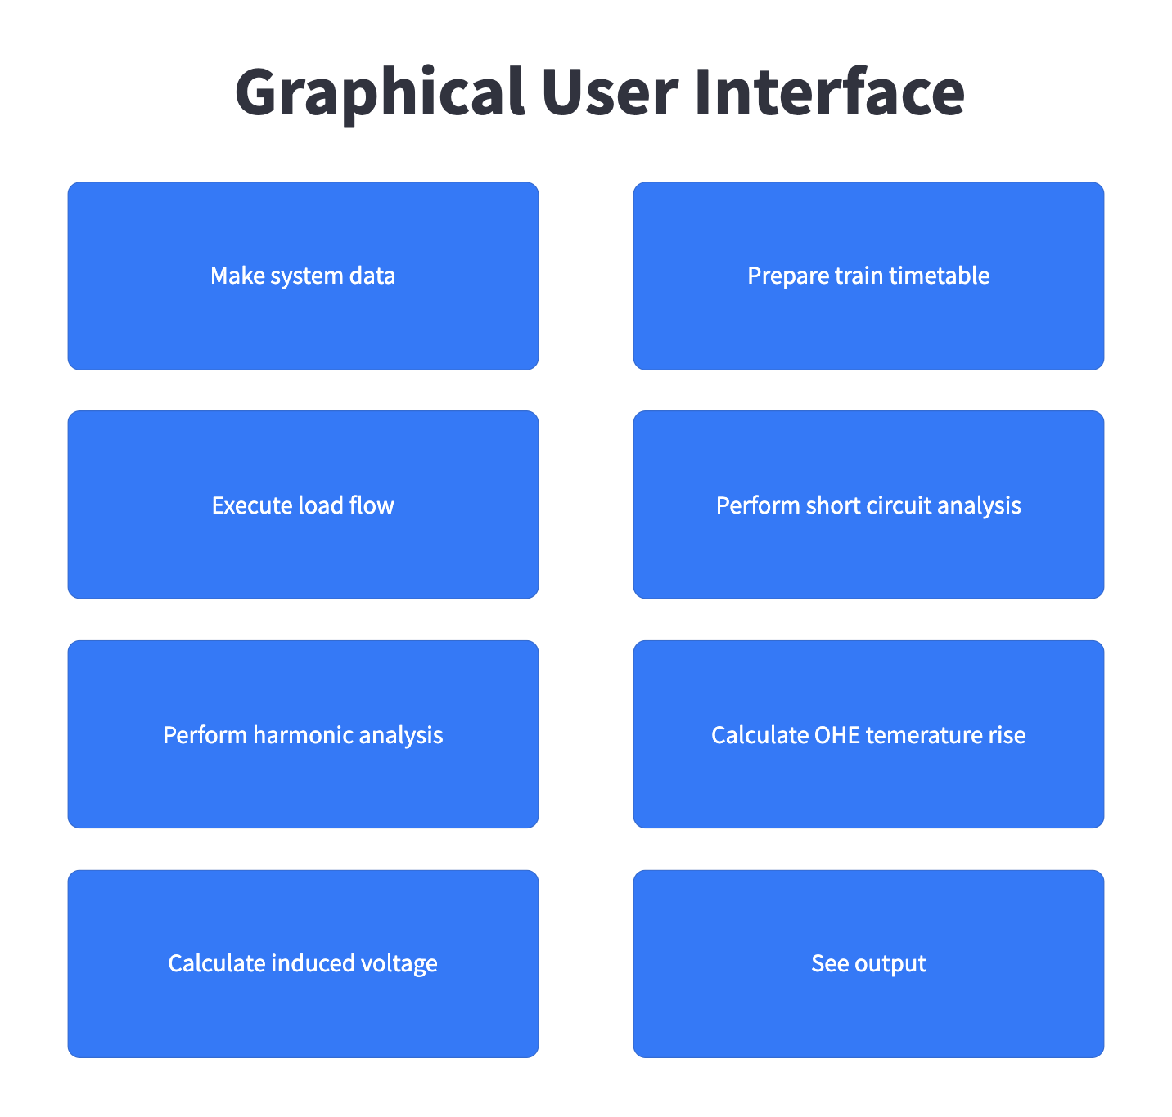
Progress So Far
Modules Developed: 4 out of 8.
Current Focus: Completing the remaining modules and enhancing user interactivity.
Modules implemented so far are:
MAKE SYSTEM DATA
EXECUTE LOAD FLOW
PERFORM SHORT CIRCUIT ANALYSIS
SEE OUTPUT
Fig 1. Landing Page

Slide 4
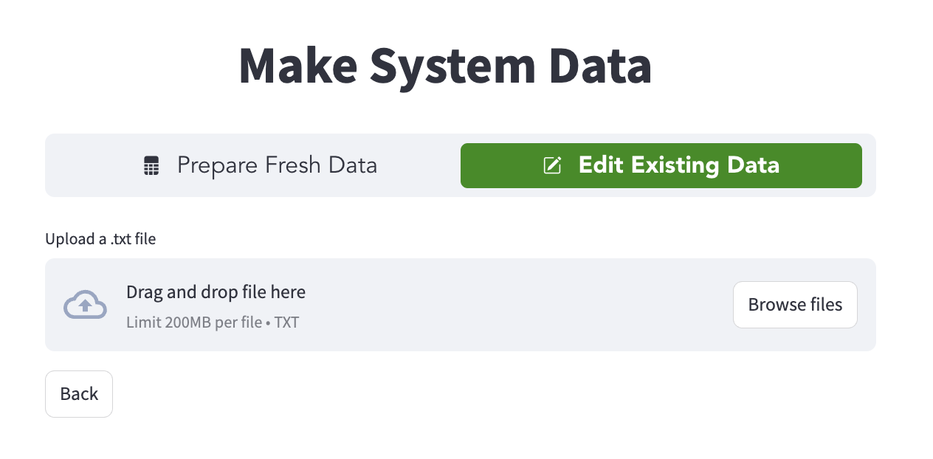
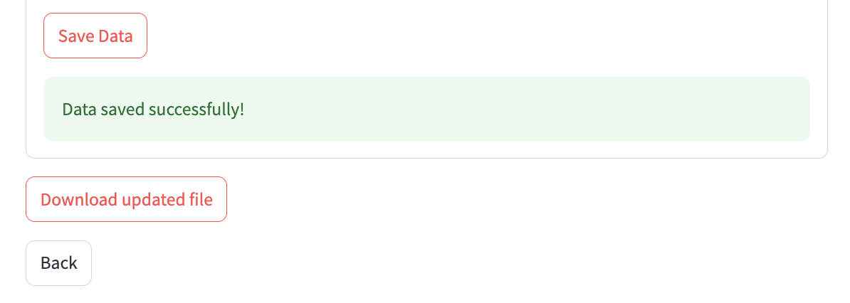
Module 1: Make System Data
1. Purpose
Allow users to edit existing system data files or prepare fresh data.
User can save the data and then download it in local memory to use later for other modules.
Fig 2. Make System Data Interface
2. Features
Supports .txt system files uploads to be edited.
It validates the file content to prevent erroneous inputs.
Has default values for inputs while inputting fresh data.
Fig 3. Downloading the Updated File

Slide 5
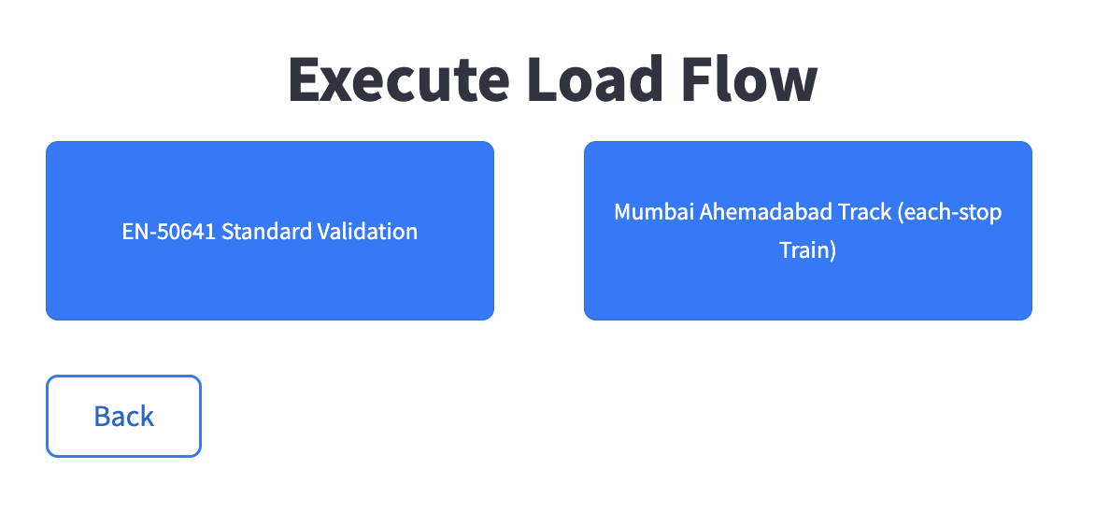
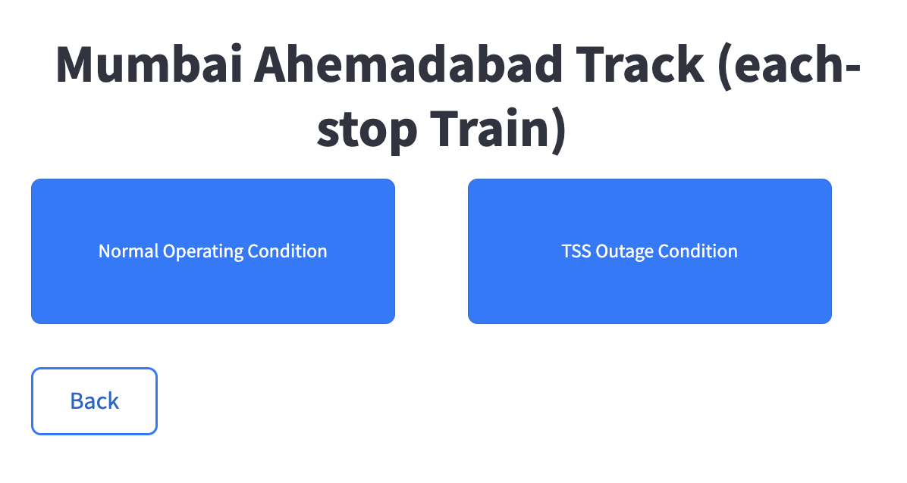
Module 2: Execute Load Flow
1. Purpose
Allows users to initiate Load Flow via GUI.
Automatically saves the variables needed to see output of load flow using GUI.
2. Features
Allows users to upload train timetable and system data file along with other inputs for Load Flow.
Sends user emails once load flow is completed.
Shows a progress bar while Load flow is executing.
Fig 4. Executing Load Flow Interface

Slide 6
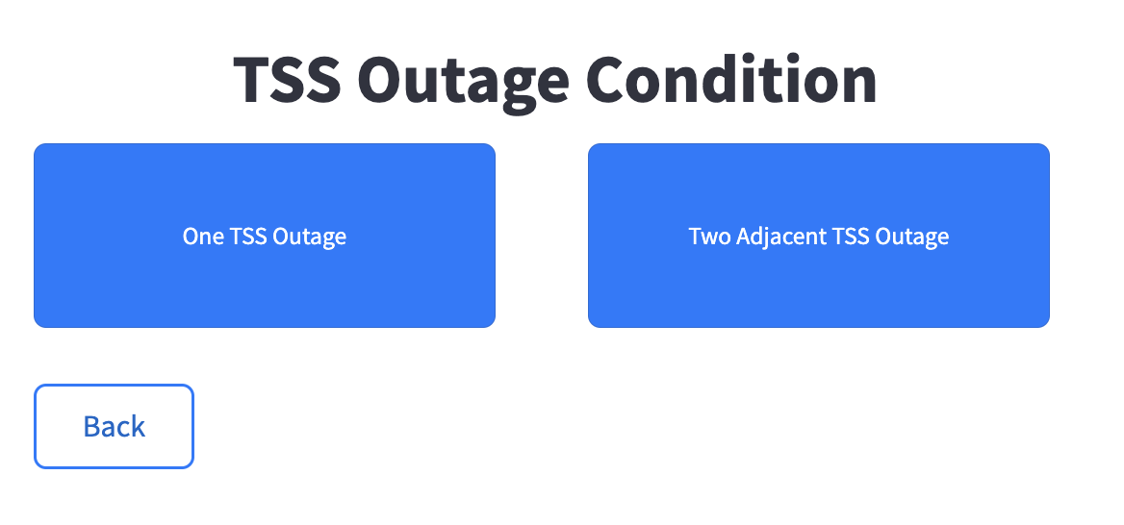
Module 2: Execute Load Flow
Fig 5. Executing Load Flow Interface

Slide 7
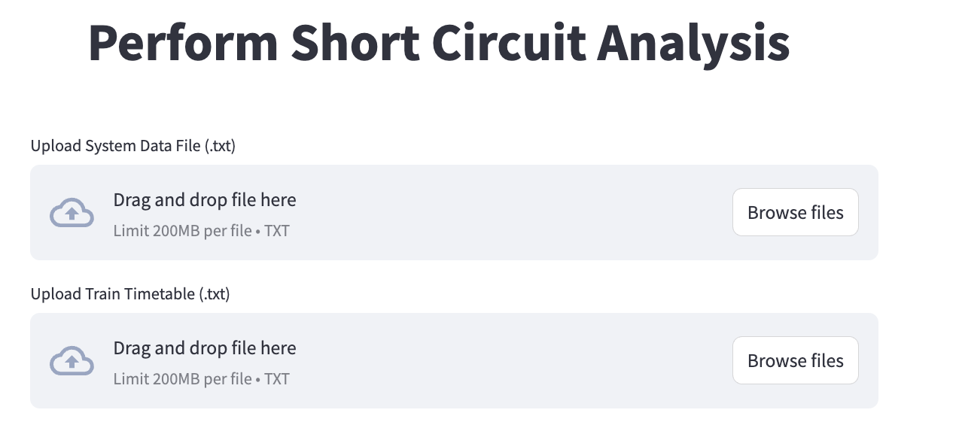
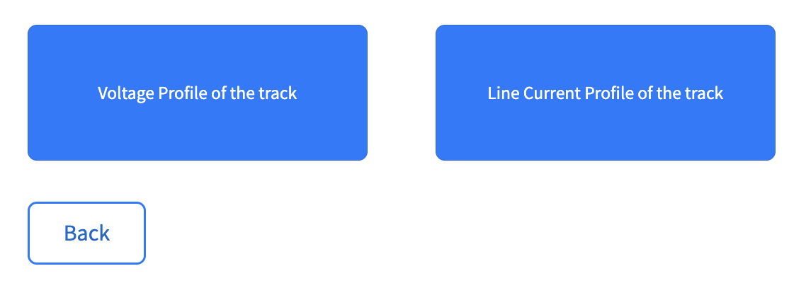
Module 3: Perform Short Circuit Analysis
1. Purpose
Allows users to Perform Short Circuit Analysis.
After execution, its outputs can be seen from See Output Submodule.
2. Features
Fig 6. Short Circuit Analysis Interface
Allows users to upload train timetable and system data file along with other inputs for Short Circuit Analysis.
The output submodules are, Voltage profile of track and Line Current profile of the track.
Fig 7. Output of Short Circuit

Slide 8
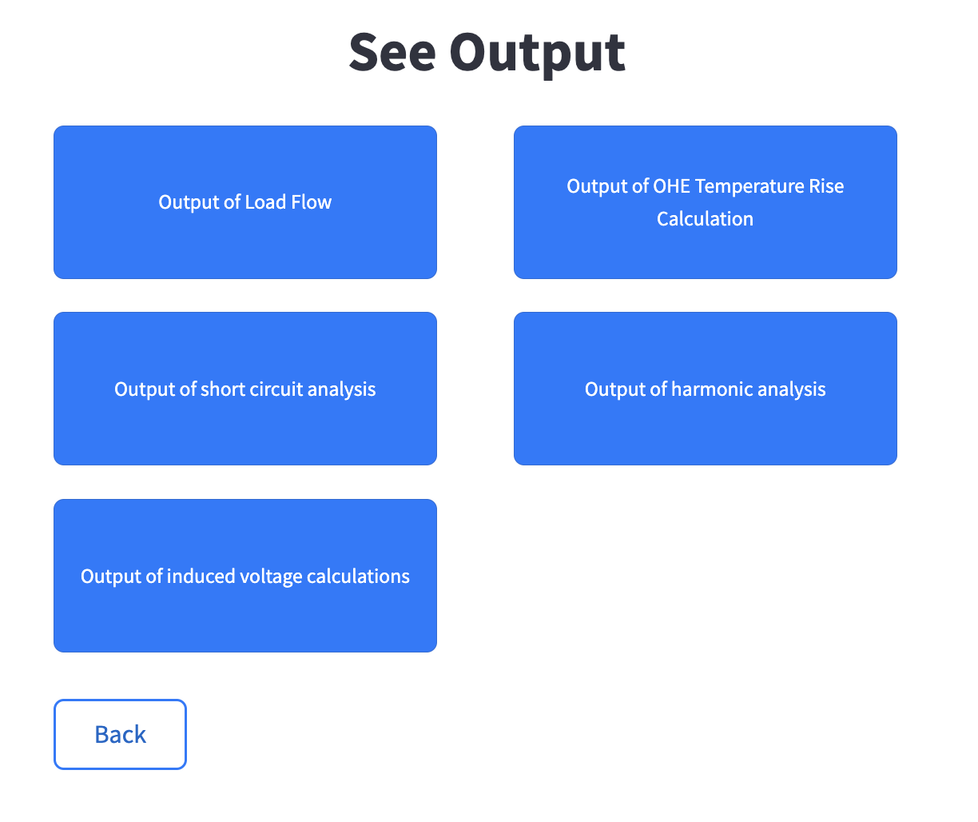
Module 4: See Output
1. Purpose
Allows users to see output of all the modules.
Once graphs and tables are displayed, users can download those and save in their local memory.
2. Features
Allows users to give relevant inputs for each graph.
It has 5 main submodules for Load Flow, OHE Temperature Rise, SCA, Harmonic Analysis and Induced Voltage Calculation.
Fig 8. Output Interface

Slide 9
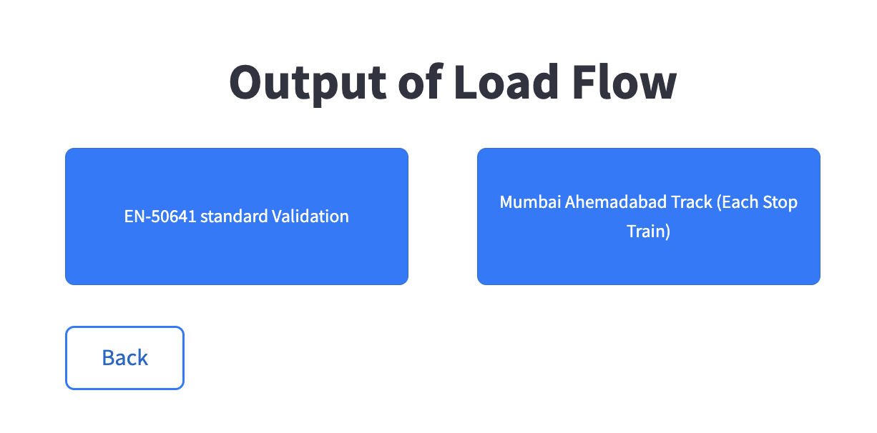
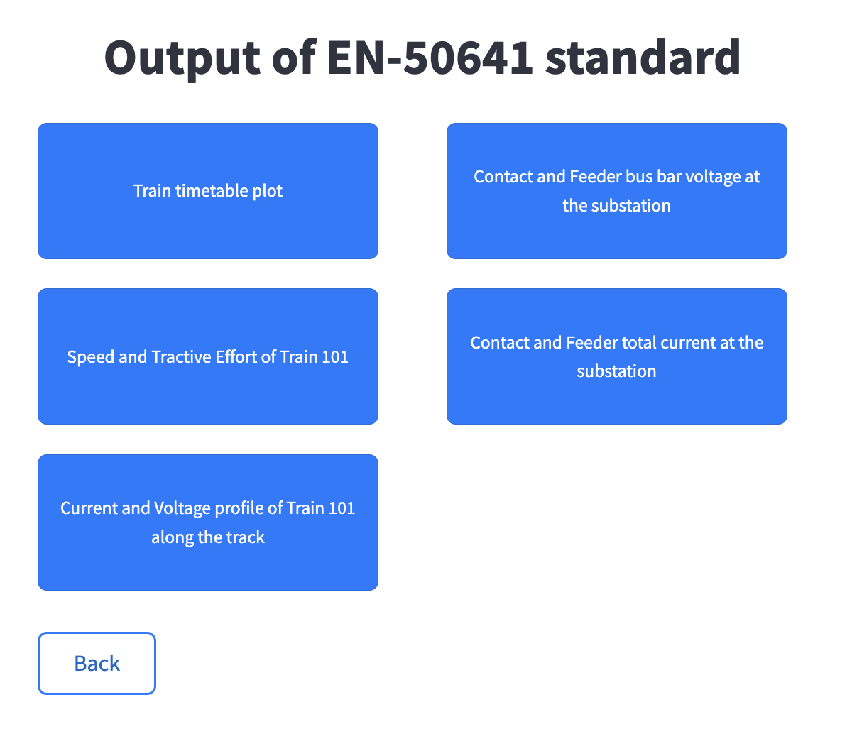
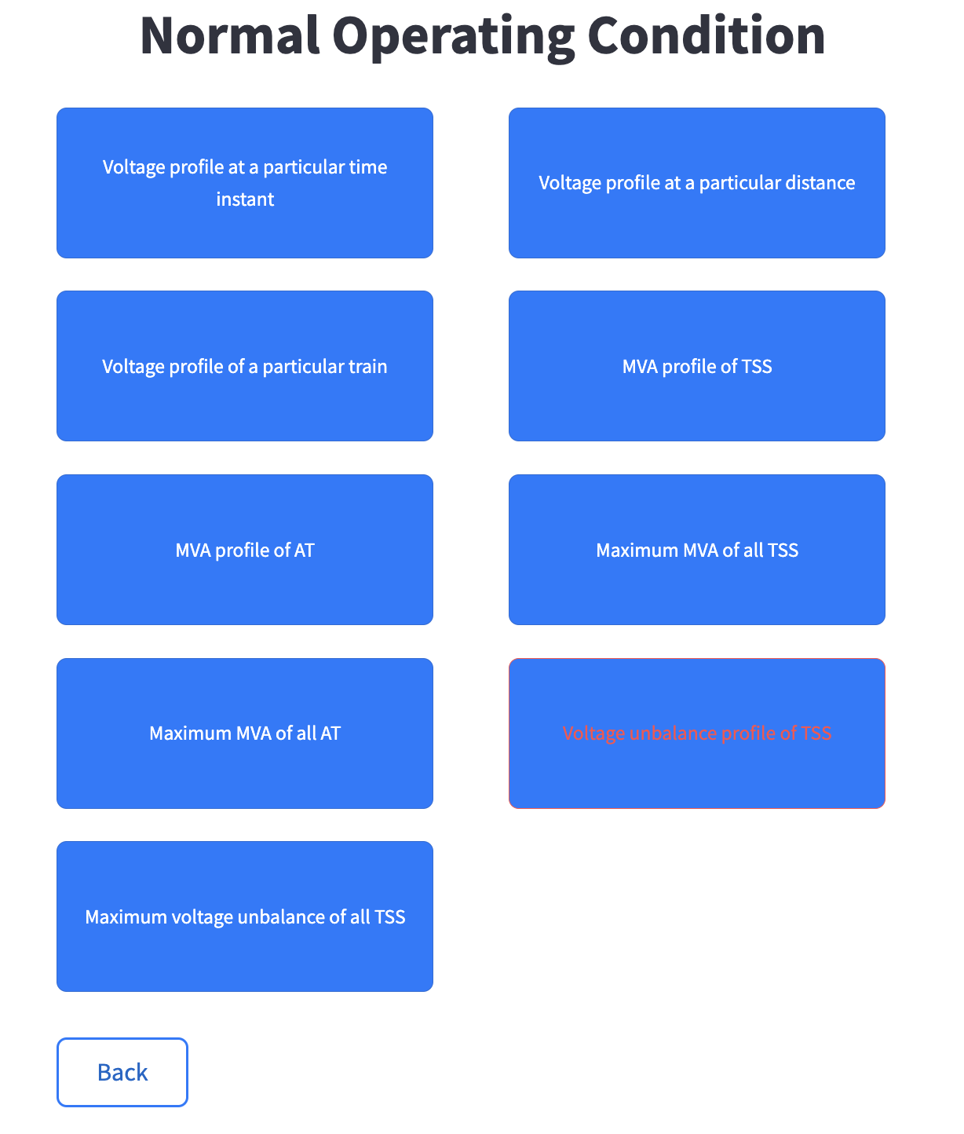
Module 4: See Output
Fig 8. Output Interface

Slide 10
Next Steps
1. Complete the remaining 4 modules:
Prepare Train Timetable
Perform Harmonic Analysis
Calculate OHE Temperature Rise
Calculate Induced Voltage
2. Deliver a fully-functional GUI application.
3. Robust error-handling mechanisms to ensure smooth operation for users with minimal technical knowledge.
4. Prepare user manuals and technical documentation to assist end-users and future developers in understanding and using the system effectively.

Slide 11
Thank You!

