Slide 1




Appointments that wait for you,
not the other way around
NAME OF PROJECT:
PRESENTED BY:
FlexiDoc
Stevie McLane

Slide 2
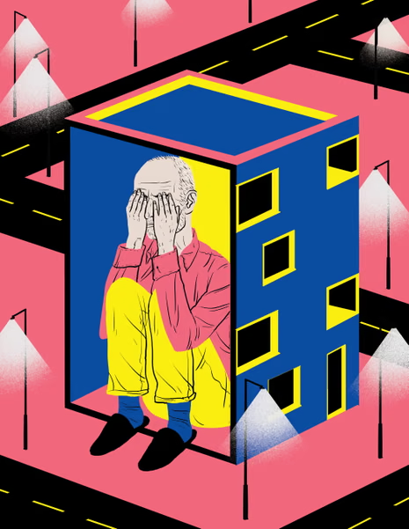
Usergroup
Known Struggles
I have chosen people diagnosed with agoraphobia as my user group. Agoraphobia can best be defined as “an anxiety disorder characterized by an intense fear of situations where escape might be difficult or help unavailable, often leading to severe avoidance of public spaces, crowds, or being alone.”
Approximately 1.3% to 2% of adults experience agoraphobia at some point in their lives. To some, that might not sound like much, but 5.5 million people would beg to differ.
  Leaving Home
  Crowds and Lines
  Enclosed Public Spaces
  Open Public Spaces
  Loss of Control

Slide 3
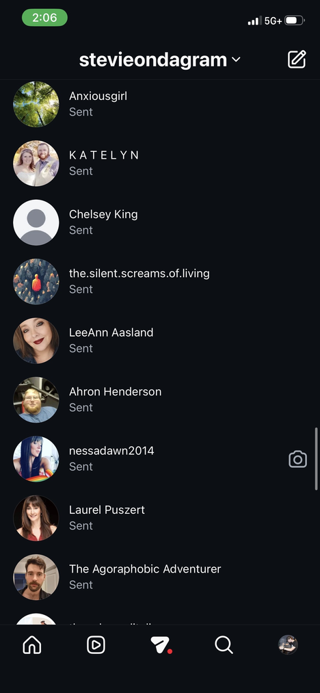
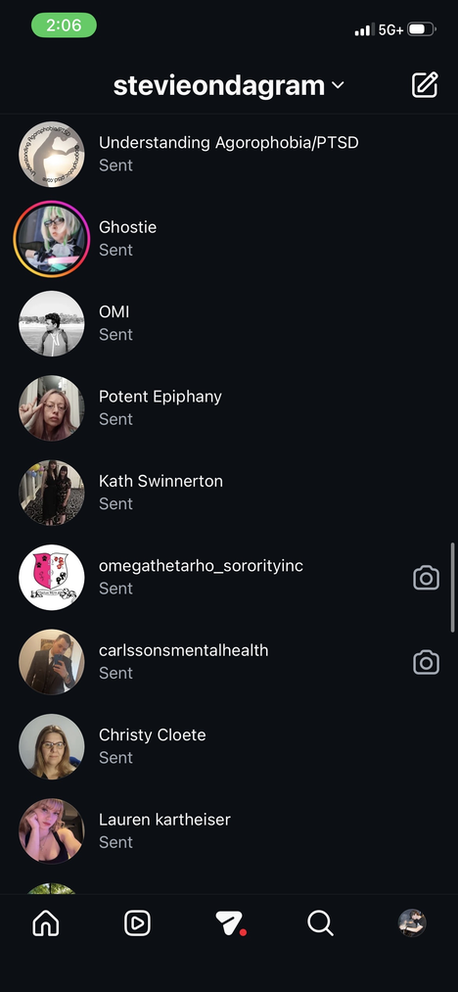

Research
I contacted members of an Agoraphobia support group through Instagram, and asked them the following open-ended research questions:
  What situations or environments outside your home feel most difficult or stressful for you, and why?
  Can you walk me through a recent experience where you needed to go out or interact with something (like an app, service, or place) and it didn’t go well?
  What would make it easier or more comfortable for you to do those same activities in the future?

Slide 4
Pain Points
The interviews that I conducted with diagnosed agoraphobes helped to shed light on three primary general pain points.
Companionship Fostering Safety
Users only feel safe when in the presence of a trusted figure (parent, guardian, partner, ect.) or medical professional.
Variation in Percieved Safety Levels
The amount of anxiety the user has for leaving the house varies from day to day. One day they can go to the store, the next is the end of the world
Frequent Schedule Modifications
When attending scheduled events - particularly doctor’s appointments - users often find themselves feeling content in their anxiety levels up until the moment right before the appointment. This leads to constant rescheduling and even canceling of important events.

Slide 5
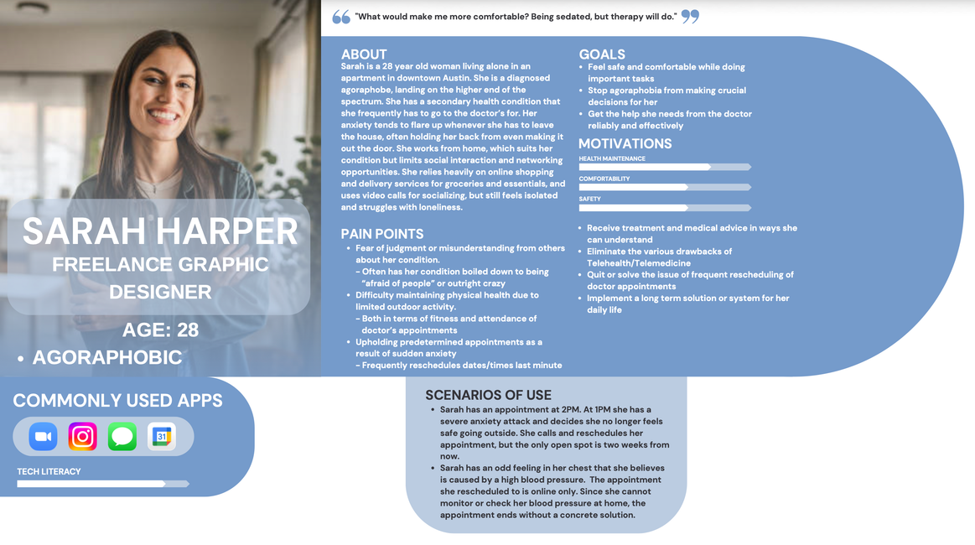
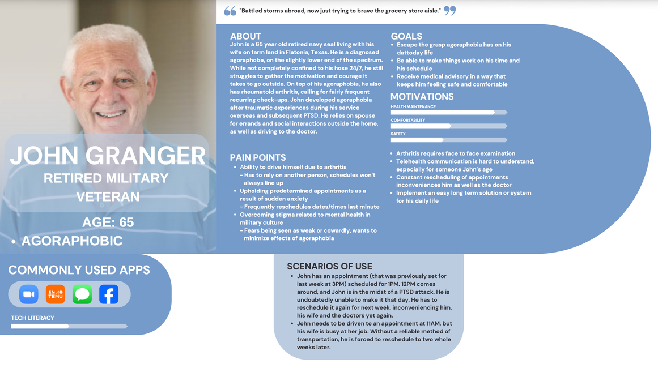
Personas
For my personas, I chose to identify two contrasting ends of my user group. The wider a net I cast, the more effective my solution can be.

Slide 6
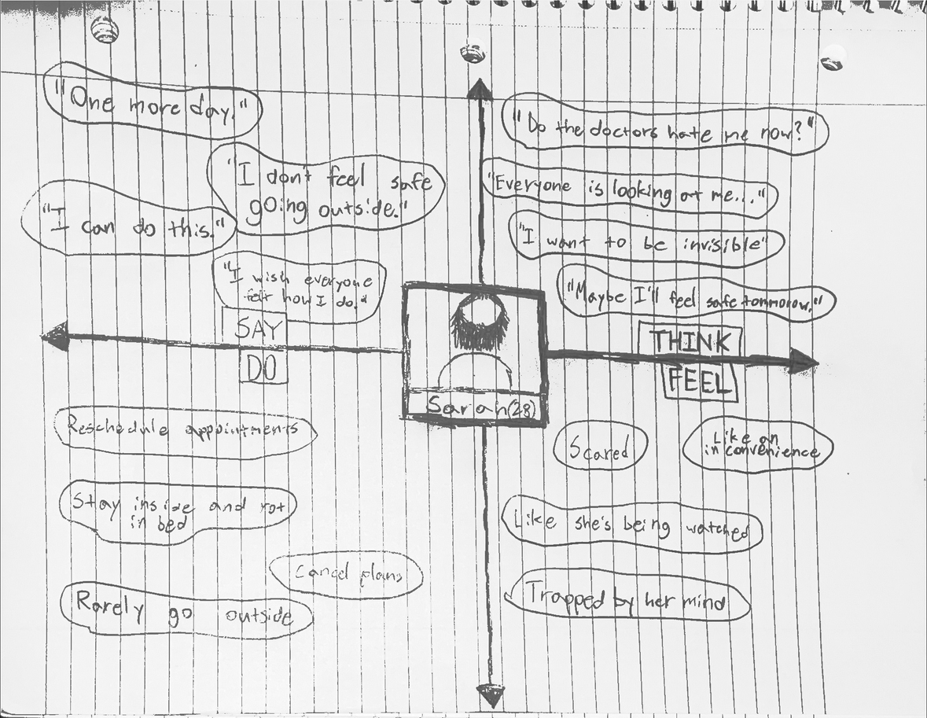
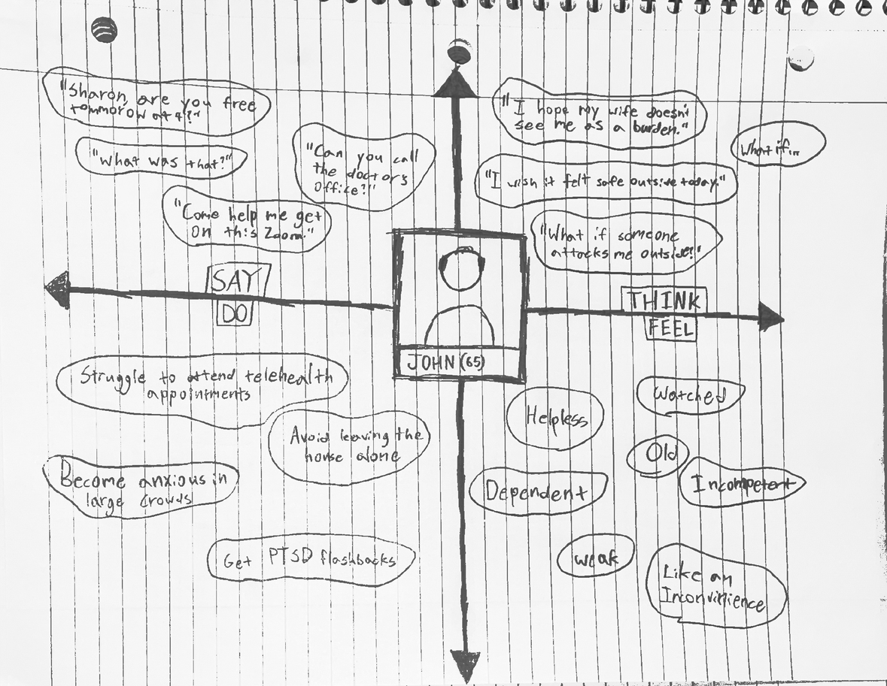
Emapthy Maps
From my personas, I created user empaty maps to beter understand my users and put myself in their shoes.

Slide 7
My Solution
  While other solutions and remedies are already in place, I’ve chosen to create an application that acts as a digital planner, with features tailored to agoraphobes
  Users can book an amount of time set by their office of choice (Four days, Five days, One week, ect)
  When booking, users can choose between an ofice visit, telehealth appointment, or even an in-house appointment
  By paying a reduced rate of the office’s cancelation fee, users can “bump” their appointment one day into the future (more than likely at a different time of day)
  This helps to make the user’s schedule more flexible and bring the safety to them.

Slide 8
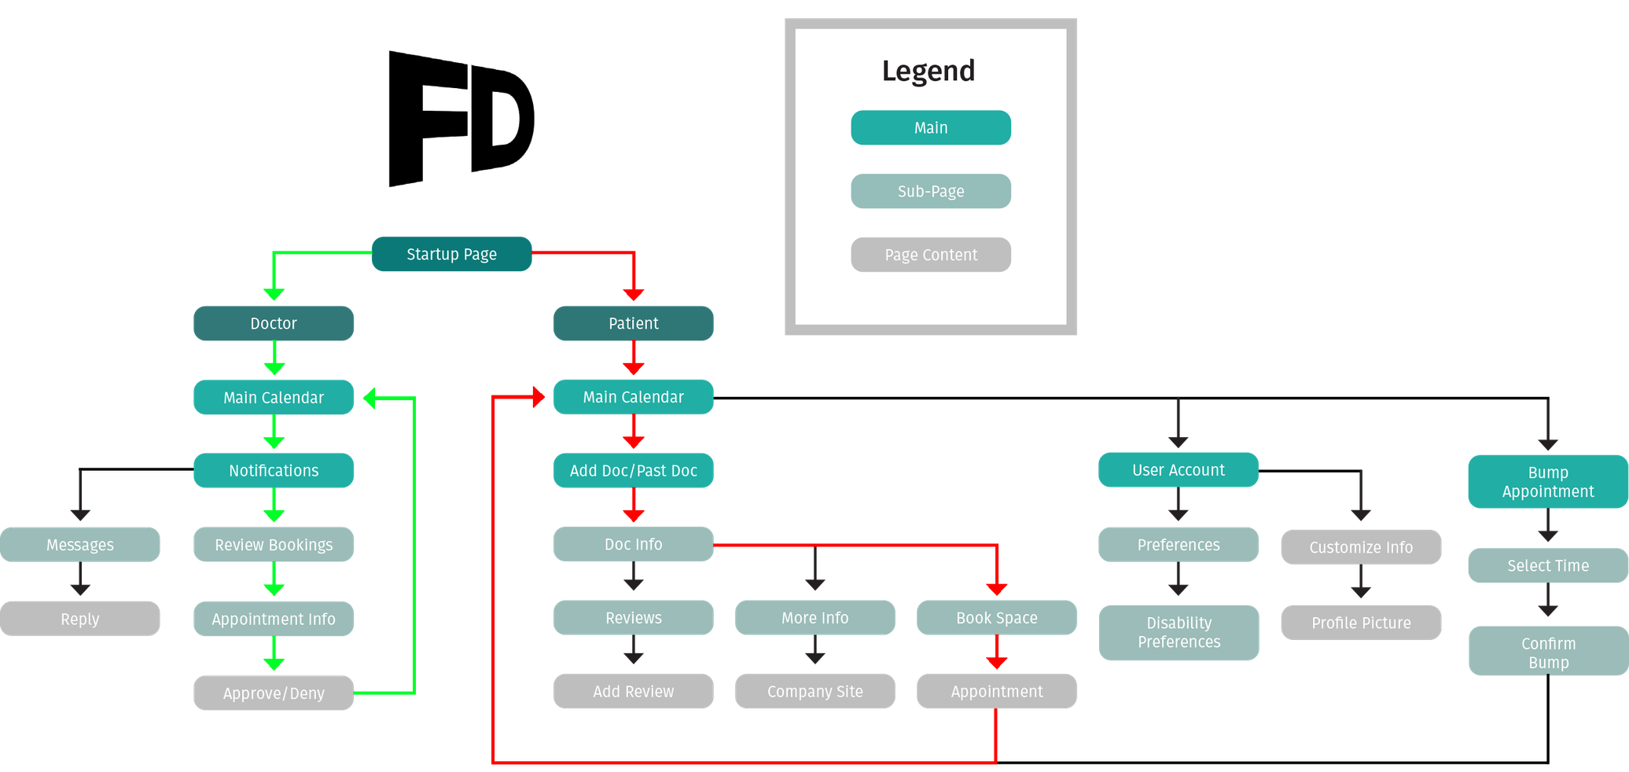
Site Map
This site map aims to plan out and organize both the patient end and the doctor end of my solution. Userflows have been highlighted in red and green.

Slide 9
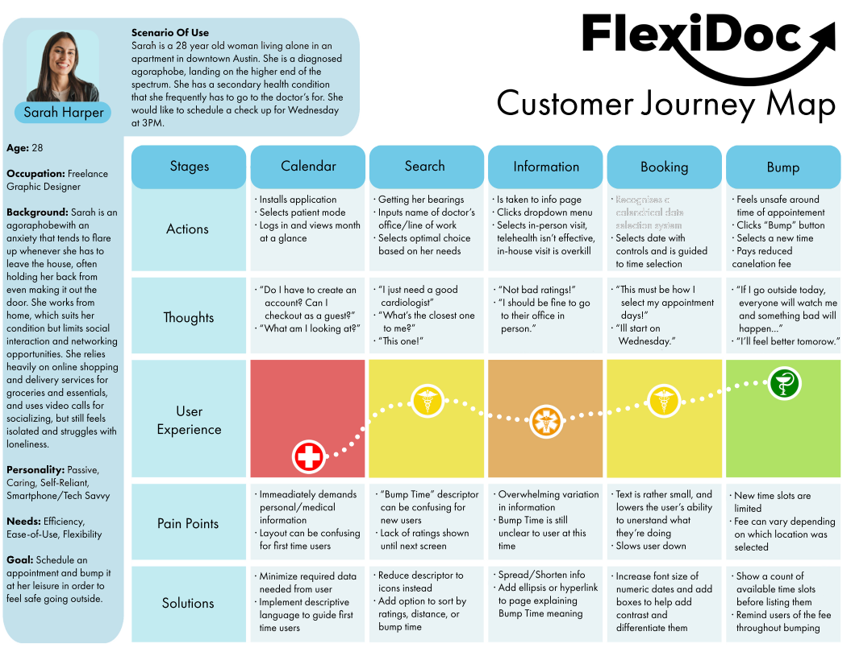
Customer
Journey Map
I created a detailed diagrammatic description of the user’s journey through my system.

Slide 10
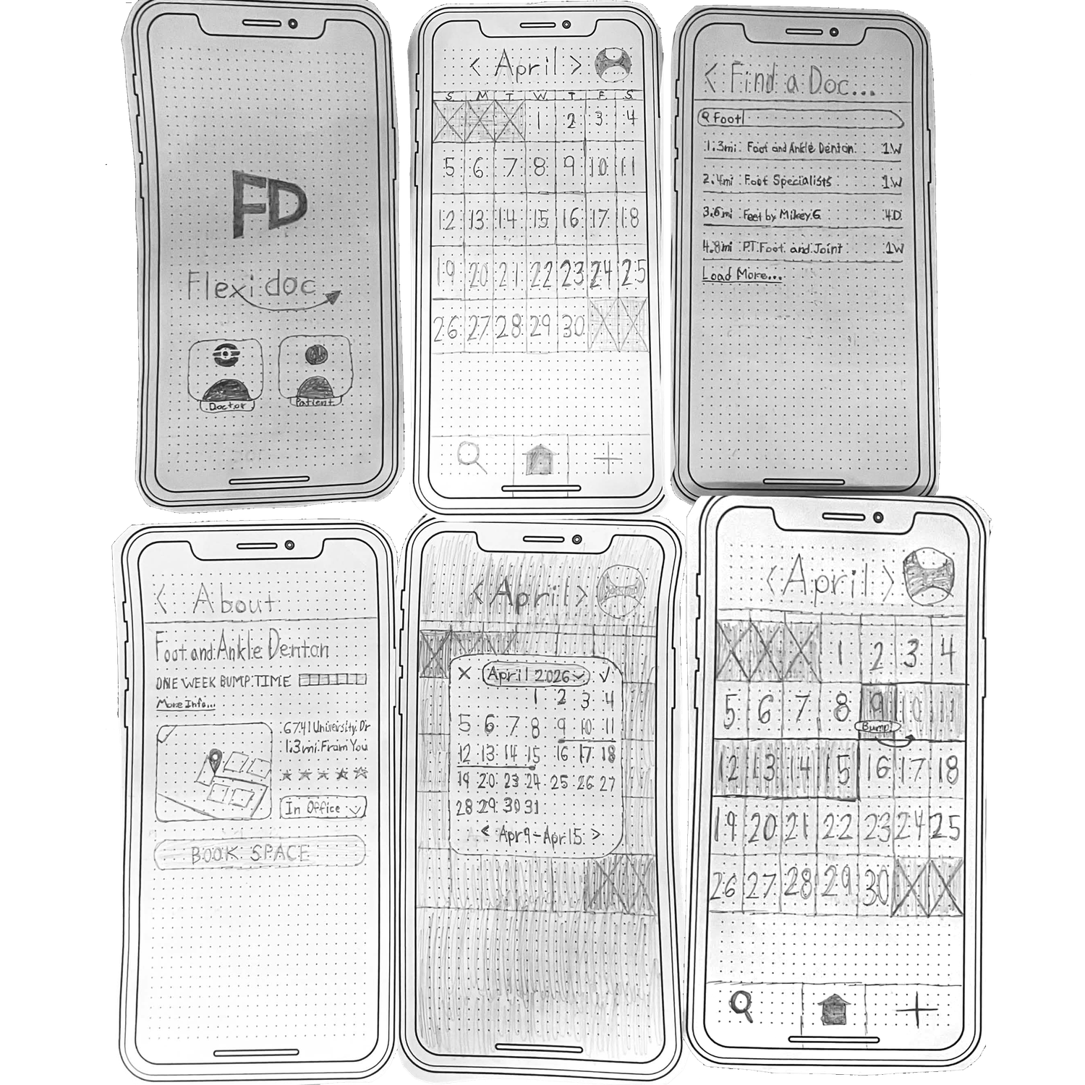
Prototype
  Rough outline / Wireframe approach
  Helps illustrate intended layout
  Demonstrates user flow through the “patient” end of the application
  Aids in identifying flaws and drawbacks of the system(s) being conceptualized
Drawbacks:
  Lack any mention of time of day
  Search, Home, and Add bar is inneffiecint and needs to be reworked
  More descriptive language would suit first time users much better

Slide 11
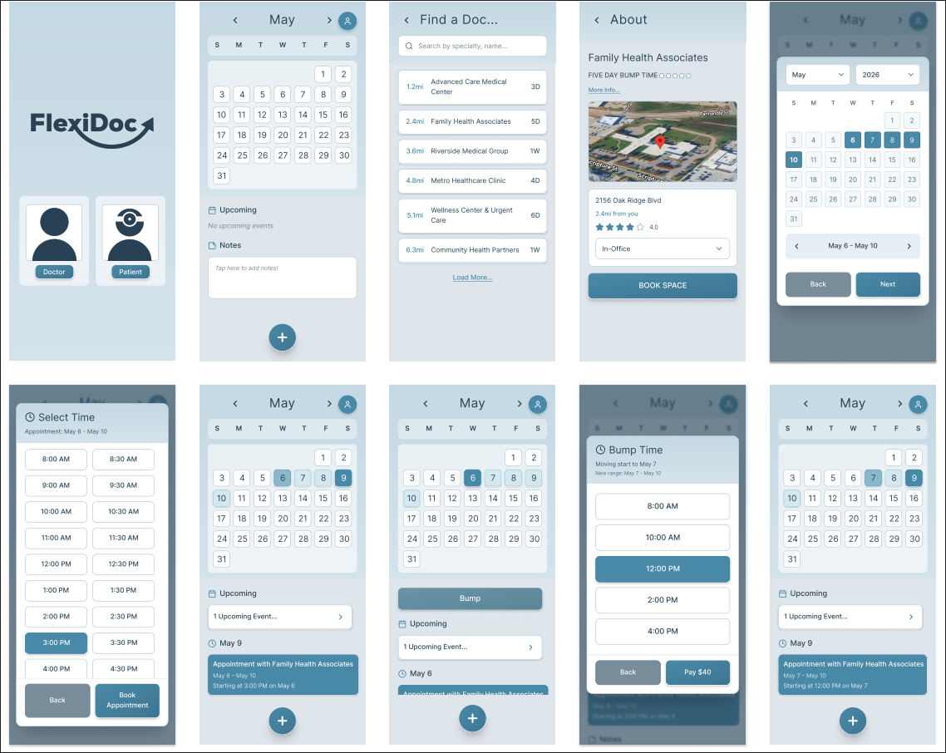
Final
Renders

