Slide 1
Smart Maker
Circuits for Examples

Slide 2
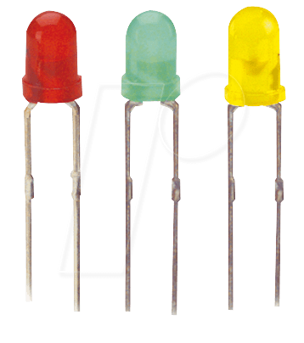
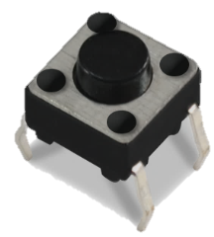
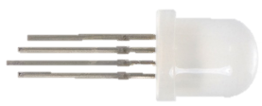
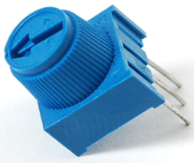
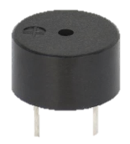

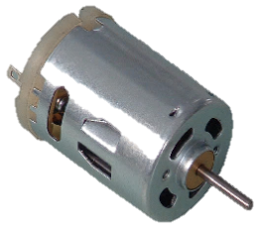
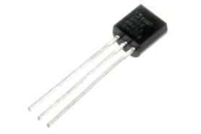



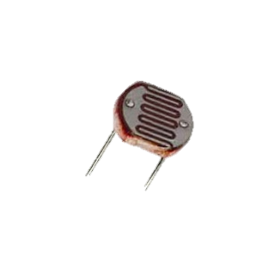
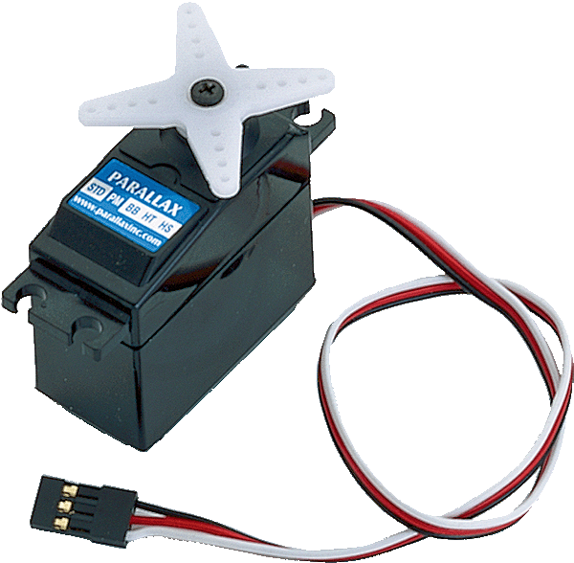
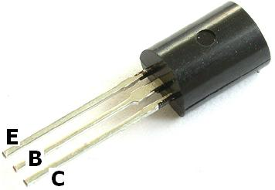
Part List
330Ω
10kΩ
Resistor
Push Button
Potentiometer
Buzzer
LED
Color LED
Diode
(1N4148)
TMP36
DC Motor
Photo
Resistor
Transistor
(P2N2222AG)
Soft
Potentiometer
Flex Sensor
Servo Motor

Slide 3
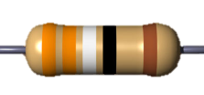
LED Circuit
D2
330Ω
+
-
GND

Slide 4
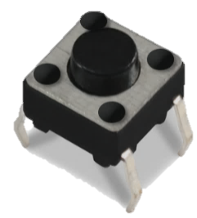
Push Button Circuit
External Pull-down type
Press HIGH
VCC (5V)
D2
10kΩ
GND

Slide 5
Push Button Circuit
External Pull-up type
Press LOW
VCC (5V)
10kΩ
D2
GND

Slide 6
Push Button Circuit
Internal Pull-up type
Press LOW
D2
GND

Slide 7

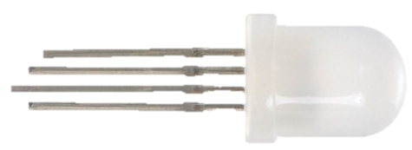
Color LED Circuit
D9~
330Ω
GND
D10~
330Ω
D11~
330Ω

Slide 8

Potentiometer Circuit
VCC (5V)
A0
GND

Slide 9
Soft Potentiometer Circuit
Pull-up type
Default VCC input
VCC (5V)
10kΩ
A0
GND

Slide 10
Soft Potentiometer Circuit
Pull-down type
Default GND input
VCC (5V)
A0
10kΩ
GND

Slide 11
Photo Resistor Circuit
VCC (5V)
A0
10kΩ
GND

Slide 12
Flex Sensor Circuit
VCC (5V)
A0
10kΩ
GND

Slide 13

Temperature Circuit
VCC (5V)
A0
TMP36
GND

Slide 14
Servo Motor Circuit
D2
VCC (5V)
GND

Slide 15

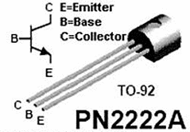
DC Motor Circuit
No Direction Control
Only Speed Control
VCC (5V)
DIODE
(1N4148)
D3~
330Ω
C
B
E
GND

Slide 16
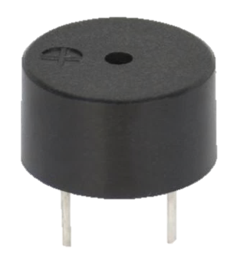
Buzzer Circuit
D2
330Ω
GND

Slide 17
Add-on Hardware
Circuits for Appendix

Slide 18
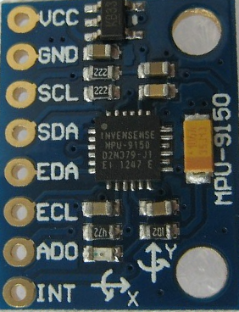
MPU9150
VCC (5V)
GND
A5 (SCL)
A4 (SDA)

Slide 19



Library
VCC (5V)
GND
D1
A0
100k
+
-
330Ω
10kΩ

