Slide 1

Data Analytics
Lecture CS1AC16
Dr Varun Ojha
University of Reading
23/02/2022

Slide 2
About the Module
Lectures:
Week 7, Week 8, Week 9
Practical session:
Week 10 and Week 11
Assessments
One Blackboard Class-Test in the last week of term
Exam question in CS1AC16 paper (two in Data Analytics section)

Slide 3
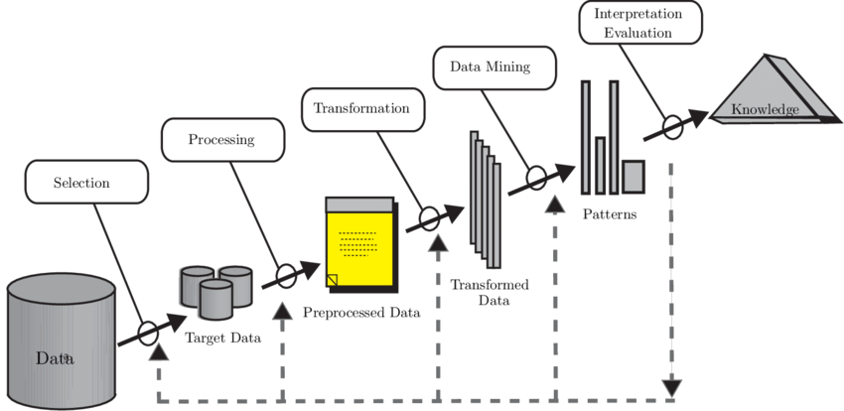
Module Outline

Slide 4


Why data analytics?
We need to interpret this large volume of data to extract knowledge
Data mining help us do that
The world produces tremendous volume of data
VOLUME of DATA
Notes:
200,000 emails sent per second
2.6 billion Google searches per day
5.8 billion YouTube views per day
360 million Tweets per day

Slide 5
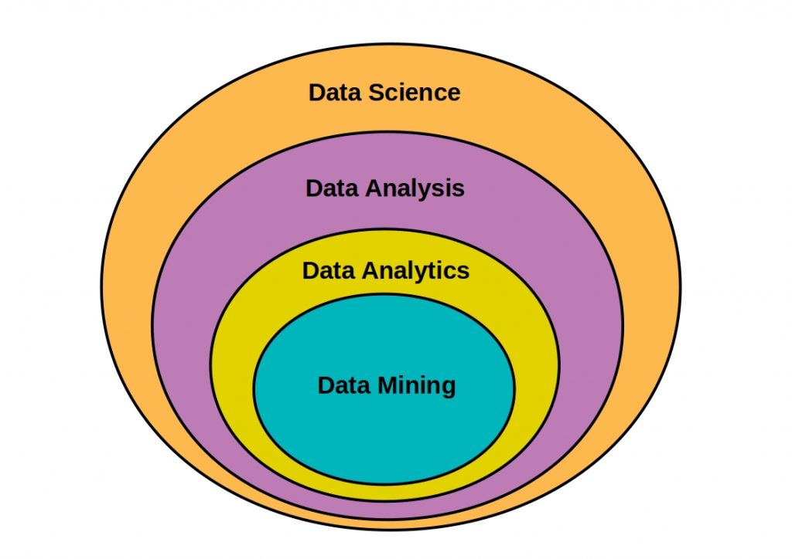
What is Data Analytics?
Data analysis is a process of inspecting, cleansing, transforming, and modelling data into useful information.
Data mining is a process used by companies to turn raw data into useful information.
Data science is an inter-disciplinary field that uses scientific methods, processes, algorithms to extract knowledge from data.
Image source: https://starship-knowledge.com/data-science-vs-data-analysis
Notes:
Data analysis is a process of inspecting, cleansing, transforming, and modelling data with the goal of discovering useful information, informing conclusions, and supporting decision-making.
Data mining is a process used by companies to turn raw data into useful information. By using software to look for patterns in large batches of data, businesses can learn more about their customers to develop more effective marketing strategies, increase sales and decrease costs.
Data science is an inter-disciplinary field that uses scientific methods, processes, algorithms and systems to extract knowledge and insights from many structural and unstructured data.

Slide 6
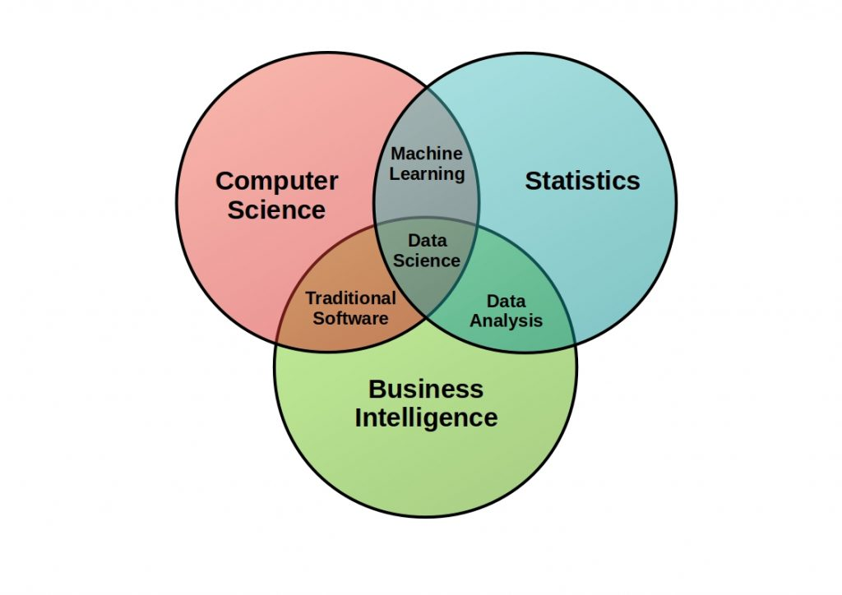
Hugh Conway (2010)

Slide 7
Applications of Data Analytics
Scientific Computing
Healthcare – Medical Imaging (A single MRI scan is 21 MB)
Biological Experiments - The human genome project (2.2 GB)
Cosmology – Imaging a Black hole (5 petabytes)
Physics Experiments – The Large Hadron Collider ( 330 petabytes of data)
Commercial Applications
Banking – Credit card use, fraud detection, product recommendation
Retail – Product recommendation, logistics
Social Networks – Ad targeting, product recommendation

Slide 8
Module Outline

Slide 9
What is Data?
Noun, a plural of datum (as appear in dictionary)
(used with a plural verb) individual facts, statistics, or items of information:
These data represent the results of our analyses.
Data are entered by terminal for immediate processing by the computer
(used with a singular verb) a body of facts; information:
Additional data is available from the president of the firm.

Slide 10
How to Store Data?
Tabular form. D
Tabular data is made up of a table with rows and columns
Each row consists of entities, objects or instances
Each student in RISIS database
Each column describes attributes or features
Age, course, grade
Each feature will have a value
19, computer science, 70

Slide 11
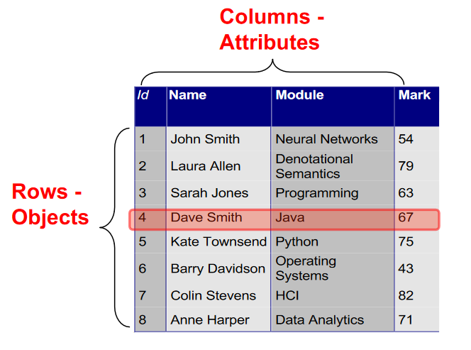
Instances (or objects)
In tabular data, one row will correspond to a single object or instance, or sample.

Slide 12
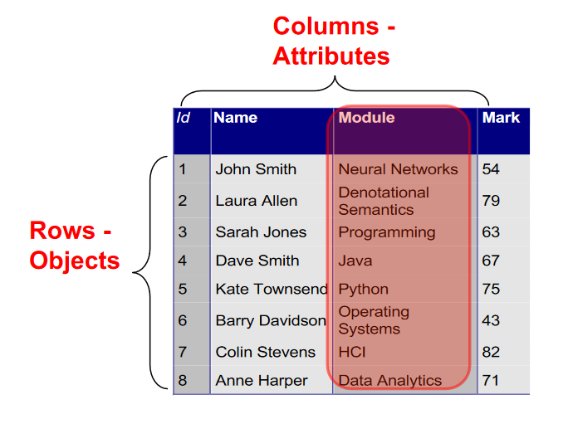
Features (or Attributes)
A column corresponds to an attribute, also called a feature or a variable, or an attribute.

Slide 13
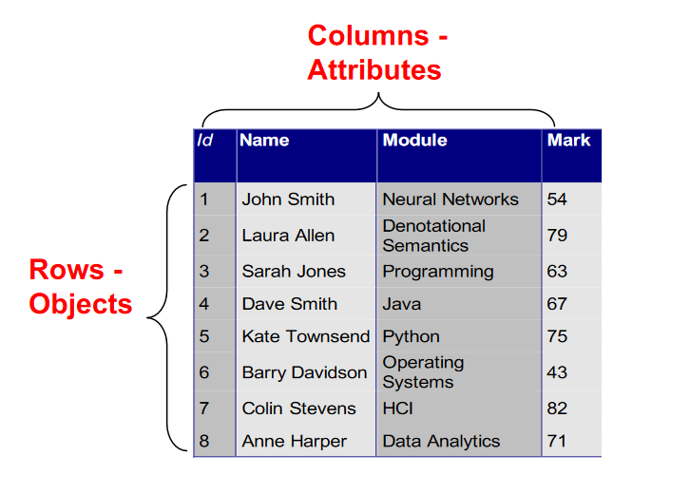
Features (or Attributes)
Attributes are therefore properties of objects that we would like to record.
For this RISIS example the features are id, name, course and grade of each student

Slide 14
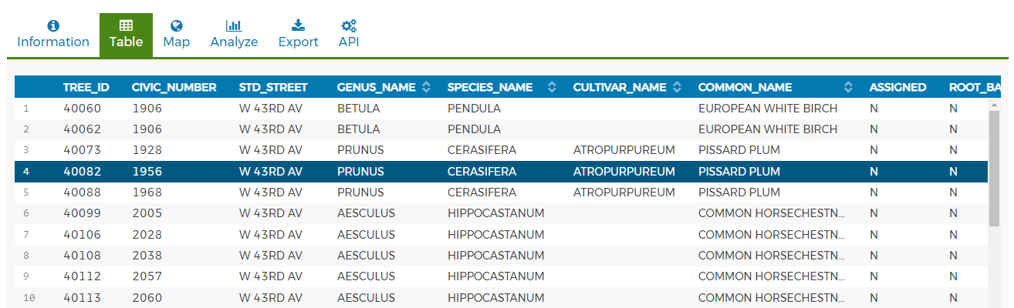
Example of a Real World Data
The Vancouver street trees dataset
https://opendata.vancouver.ca/explore/dataset/street-trees

Slide 15
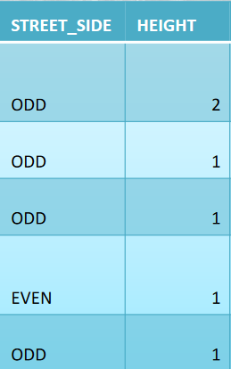
Types of Values
Values of features can be either discrete or continuous
Discrete data can only take certain values
Counts, set of words, postcodes
Example: the number of students in a class
Continuous data can take any value (within a range)
Can be termed as an infinite set of floating point values
Examples: Heights, weights, temperatures
Continuous
Discrete

Slide 16
Types of Values
In addition to being discrete or continuous, the characteristic of a variable can be described as:
Nominal Data
Categories (no ordering)
Qualitative data
Ordinal Data
Ordered Categories
Interval Data
Differences between measurements but no true zero
Quantitative data
Ratio Data
Differences between measurements, true zero exists

Slide 17
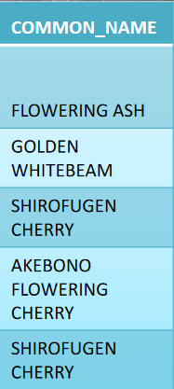
Nominal Data
A nominal scale describes a variable with categories that do not have a natural order or ranking.
Can either be equal or not equal:
Polly Vacher building = Polly Vacher building
Mauritius != Faroe Islands
Can be transformed/renamed so long as uniqueness is preserved.

Slide 18
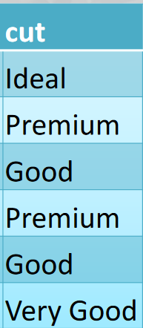
Ordinal Data
An ordinal scale is one where the order matters but not the difference between values.
Can tell if one attribute is smaller or larger than another
E.g. small < medium
To transform between mappings, order must be preserved

Slide 19
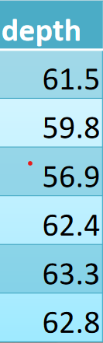
Interval Data
increases in set steps
the difference between two values is meaningful.
the difference between 90°C and 100°C
interval data can be added or subtracted

Slide 20
Ratio Data
has all the properties of an interval variable,
+
has a clear definition of 0.0.
Examples: scores of randomly selected students
30, 50, 70, and 90.
Order in this data?
Meaningful difference?
Can calculate ratio?

Slide 21
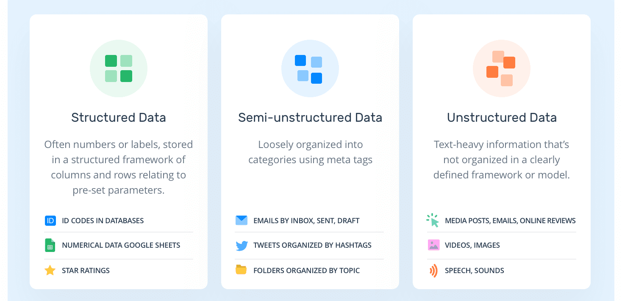
Source of Data
Image source Monkey Learn

Slide 22
Structured Data
Structured data is data that adheres to a pre-defined data model
Structured data conforms to a tabular format with relationship between the different rows and columns.
Examples include:
Excel files, Relational Databases, Graph data
Properties of structured data are
Data has Dimensionality, Sparsity and Resolution

Slide 23
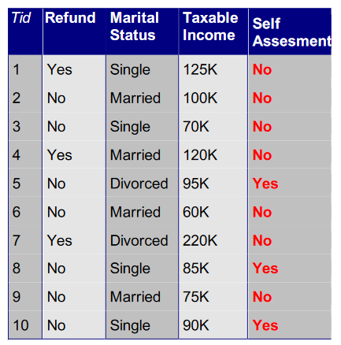
Structured Data Examples: Record data
Data that consists of a collection of records, each of which consists of a fixed set of attributes

Slide 24
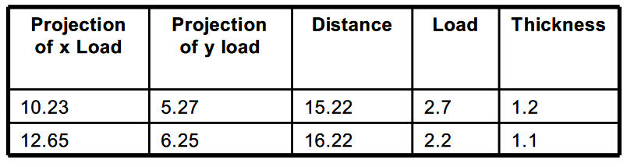
Structured Data Examples: Data Matrix
If every record has same attribute type the data can be represented as a data matrix
m by n matrix
m rows; one per object
n columns; one per attribute
Matrix operations can then be performed
multiplication, inverse, eigenvalues, etc

Slide 25
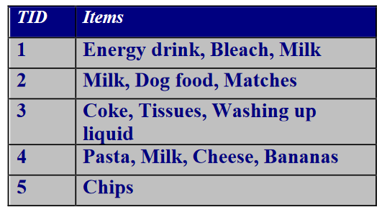
Structured Data Examples: Transaction Data
A special type of record data where
Each record is observed as a transaction involving a set of items.
Example; transactions at a supermarket

Slide 26
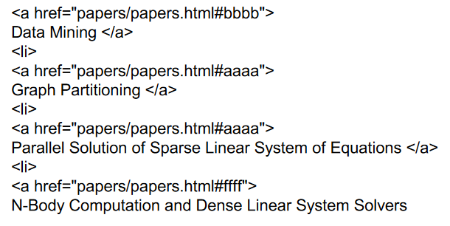
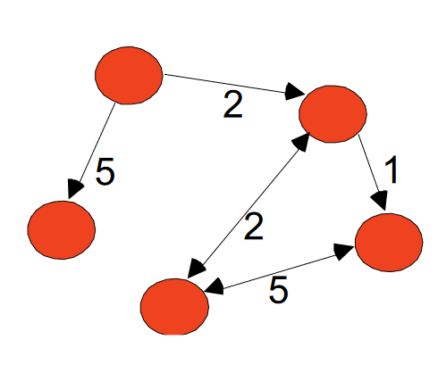
Structured Data Examples: Graph Data
A graph database uses graph structures for semantic queries
The graph relates the data items in the store to a collection of nodes and edges
The edges then represent the relationships between the nodes
Explicitly lays out any dependencies between nodes of data
Examples: Generic graph and HTML Links

Slide 27
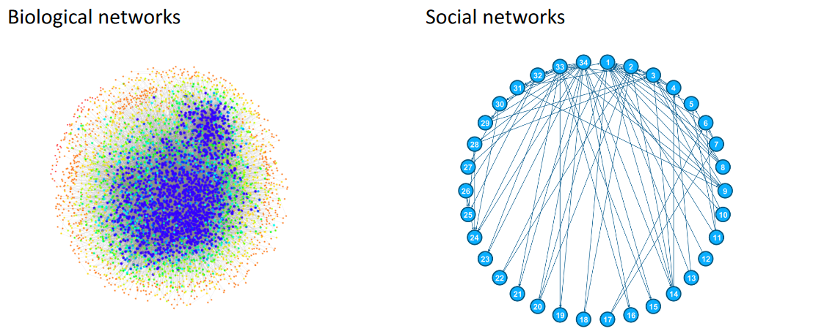
Uses of Graph Data
In a graph database:
Nodes can have attributes
Edges can also have attribute
These characteristics allow statistics to be calculated in the context to the rest of the network, this is known as network analysis

Slide 28
Unstructured Data
unstructured data does not adhere to a pre-defined data model
more difficult to understand using traditional data mining algorithms.
Examples of "unstructured data"
books, journals, documents, metadata, health records, audio, video, images,
Properties of unstructured data
Data has Dimensionality, Sparsity and Resolution

Slide 29
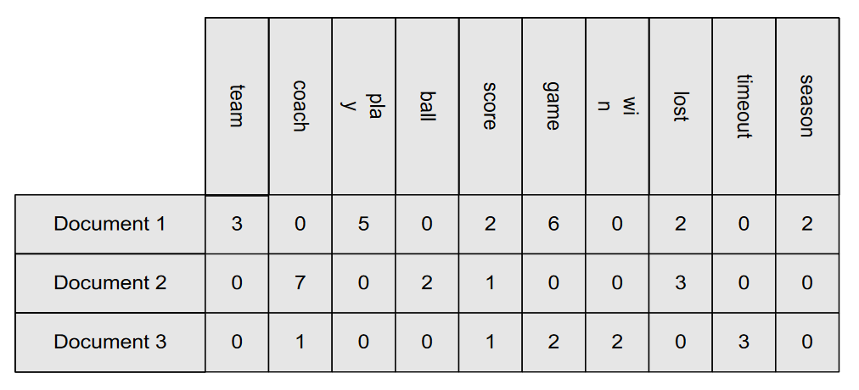
Unstructured Data Examples: Document Data
Text data is often unstructured e.g. emails, academic papers.
Natural Language processing (NLP) methods are used to convert text into ordered data structures
Often the text is converted to numeric data
Each document becomes a ‘term’ vector,
Each term is a component (attribute) of the vector,

Slide 30





Image Data
Image: Gary scale
$$I= \left[\begin{matrix}p_{11} & ⋯ & p_{1,W} \\ ⋮ & ⋱ & ⋮ \\ p_{H, 1} & ⋯ & p_{H},p_{W}\end{matrix}\right]$$
$$I= \left[\begin{matrix}p_{11} & ⋯ & p_{1,256} \\ ⋮ & ⋱ & ⋮ \\ p_{256, 1} & ⋯ & p_{256},p_{256}\end{matrix}\right]$$
$$Hight (H)$$
$$For Hight=256, Width=256$$
$$Width (W)$$

Slide 31
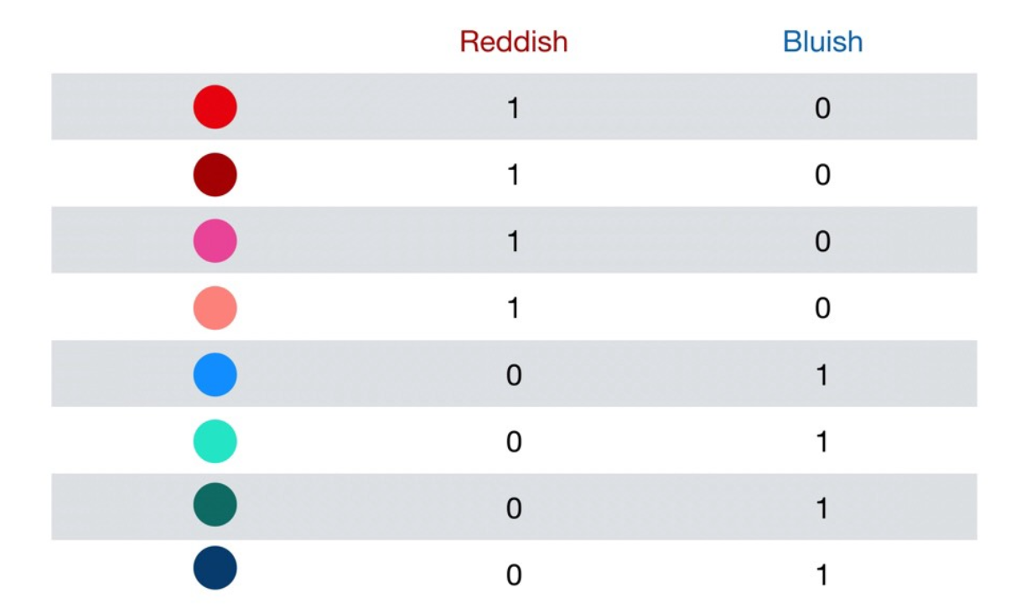
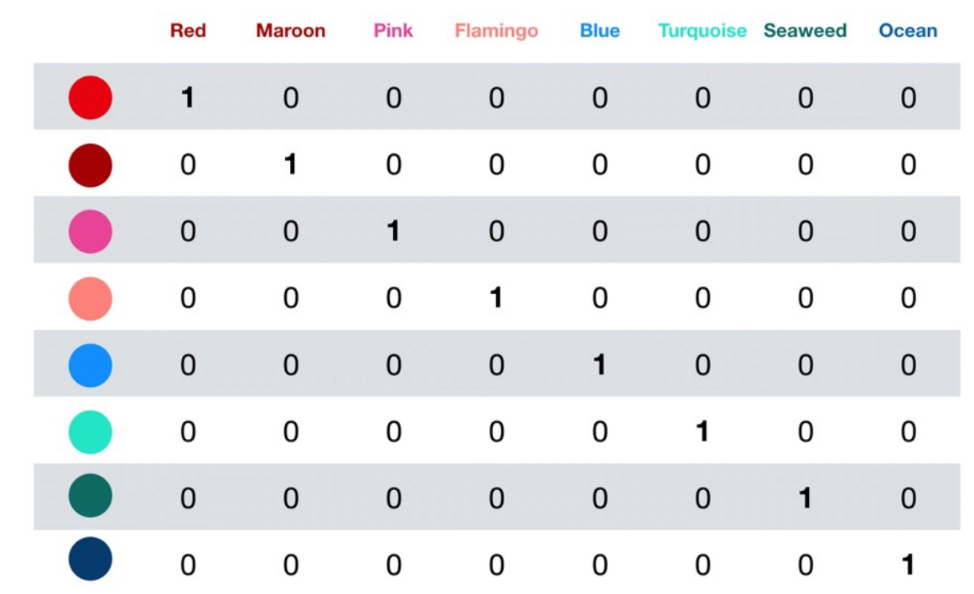
Data Properties: Data Dimensionality
Data Dimensionality -> how many attributes a dataset has
For Example: Every point in a cube has an x, y, z value
High dimensionality data is usually bad.
The more dimensions -> more difficulty.
Known as the ‘Curse of Dimensionality’
Where each added attribute results in an exponential decrease in predictive power.

Slide 32
Data Properties: Data Sparsity
Data sparsity -> not observing enough data in a dataset.
Data sparsity is usually bad
it means that we are missing information that might be important.
Essentially, how much of the data is non-zero?
If the data is sparse, how do we deal with missing data?

Slide 33
Data Properties: Data Resolution
Data resolution can have 2 meanings:
It is the ratio between the maximum signal value to the minimum
It is the degree to which a change can be theoretically detected
Therefore, for any application a resolution has to be chosen
Too large and you may lose important features
Too small and there will be too much data to process

Slide 34

Data Quality
What kinds of data-quality problems?
How can we detect problems with the data?
What can we do about these problems?
Examples of data quality problems:
Noise
Outliers
Missing values
Duplicate values

Slide 35
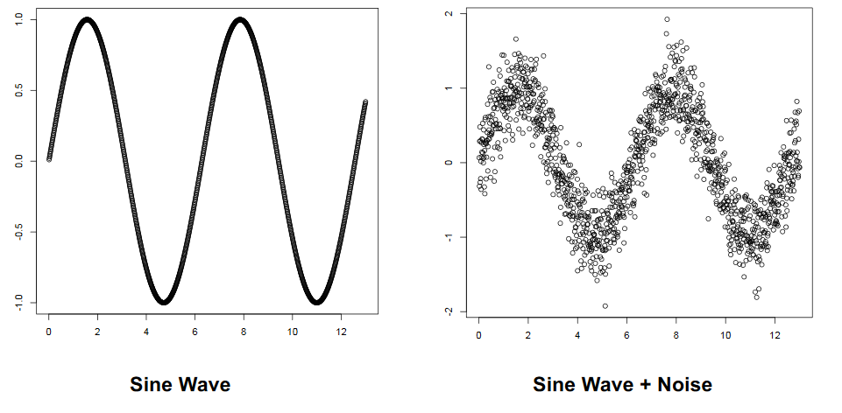
Data Quality: Noise
Noise is a general term for unwanted signals when capturing data.
Noise reduction; the recovery of the original signal from the noise.

Slide 36
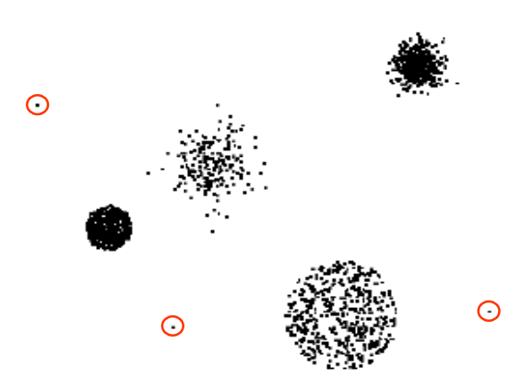
Data Quality: Outliers
Data objects with unusual or extreme characteristics outside of the normal distribution
Why do they occur?
Are they significant or should they be removed?

Slide 37
Data Quality: Missing Values
Reasons for missing values:
Information is not collected (e.g., people decline to give their age and weight)
Attributes may not be relevant in every case (e.g. a student who has no grade)
Data may have been discarded as an outlier
Handling missing values:
Remove all objects that have missing data
Estimate Missing Values
Ignore the Missing Value During Analysis.

Slide 38
Summary
Various data value types: Discrete and continuous, nominal, ordinal, interval, ratio
Structured (records, relational, graph) and Unstructured data (text and images)
Properties of data: Dimensionality, sparsity and resolution
Data Quality Issues: Noise, Outliers, Missing values, Duplicate values
Exercises – KNIME

