Slide 1

Data Preprocessing
Lecture CS1AC16
Dr Varun Ojha
University of Reading
02/03/2022

Slide 2
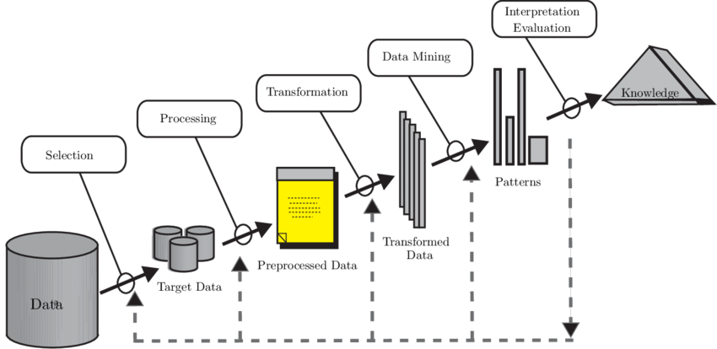
Module Outline

Slide 3
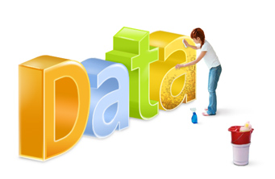
Data Preprocessing
Approx. 80% of effort in data science is data preprocessing
Dirty to clean data
Clean Data -> proper representation
Clean Data -> high quality of data
Steps to clean data
Dealing with Missing values
Attribute Transformation (Binarization and Discretization)
Sampling
Feature Selection
Dimensionality Reduction (Feature Engineering)

Slide 4

Missing Values
Reasons for missing values
Information is not collected
Attributes may not be relevant
Data discarded as an outlier
Methods to handle missing values
Remove all objects that have missing data
Estimate Missing Values (Data Imputation)

Slide 5
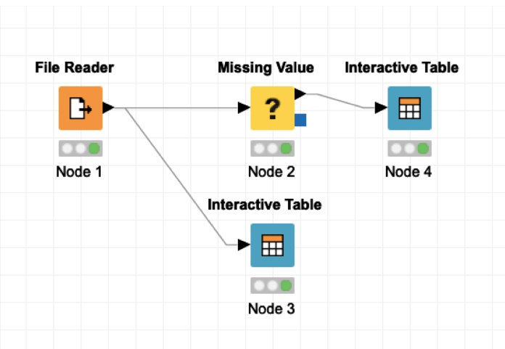
Workflow for Missing Values in KNIME

Slide 6
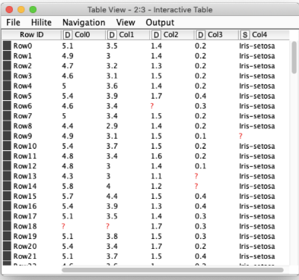
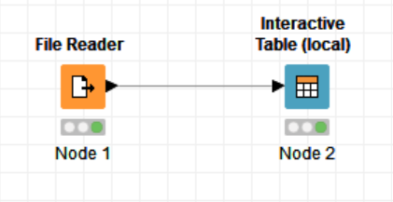
Iris Data (Multivariate and Unorder Data)
Missing data is shown as “?” in an interactive table in KNIME workflow

Slide 7
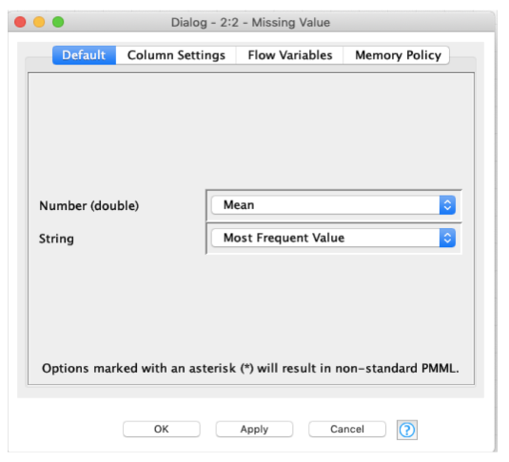
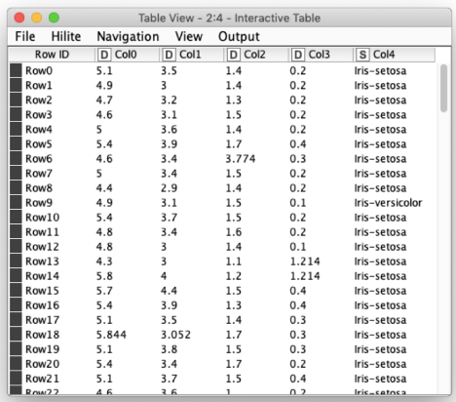
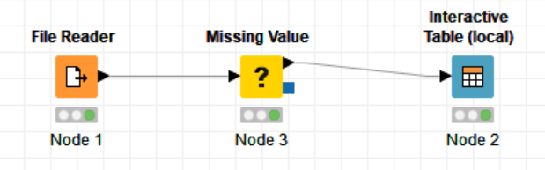
Configure Missing Value Node
Unorder data:
Use mean and mode (Most Frequent Value)

Slide 8
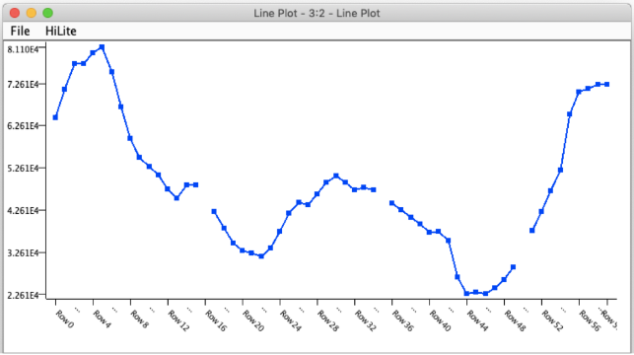
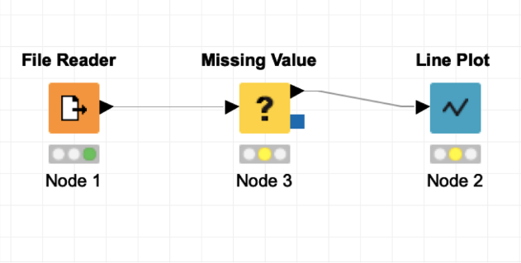
Internet traffic Data (Time Series Data)
Order data:
internet traffic volumes in the UK academic network backbone collected hourly.

Slide 9
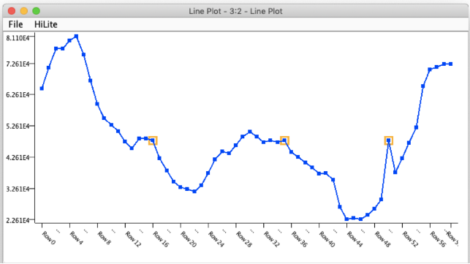
Mean value
missing data
mean to impute data

Slide 10
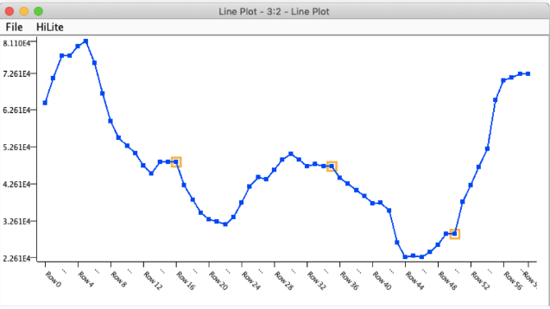
Carry over value
(only makes sense for such ordered data)
missing data
(carry over) the previous value to impute

Slide 11
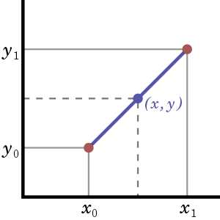
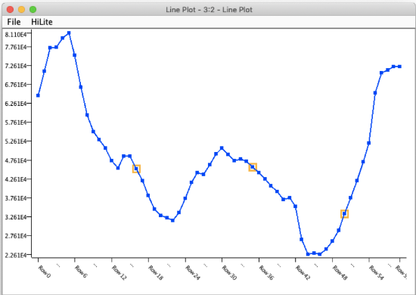

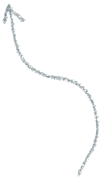
Interpolated value
missing data
linear interpolation to impute

Slide 12
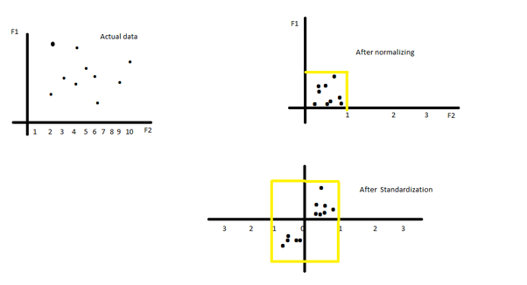
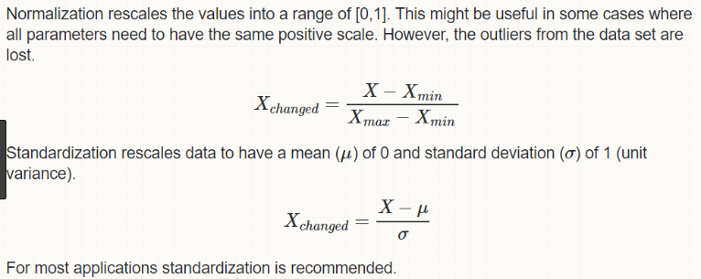
Attribute Transformation
Original data
Normalization
Standardization

Slide 13
Discretization and Binarization
Attribute (e.g., age) | Discretization (age group) | Binarization (can vote?)
10 | Kid | 0
12 | Kid | 0
15 | Young | 0
20 | Young | 1
55 | Old | 1
60 | Old | 1

Slide 14
Sampling
Sampling is used for data selection
Statisticians sample because obtaining the entire set of data of interest is too expensive or time-consuming
Sampling is used in data mining because processing the entire set of data of interest is too expensive or time-consuming

Slide 15
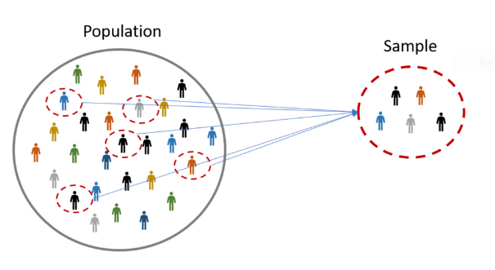
Sampling: Principles
Sampling assumes that using a sample will work almost as well as using the entire data sets if the sample is representative
A sample is representative if it has approximately the same property (of interest) as the original set

Slide 16
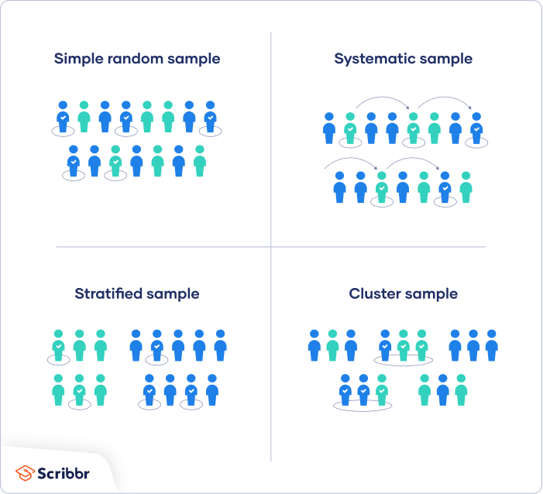
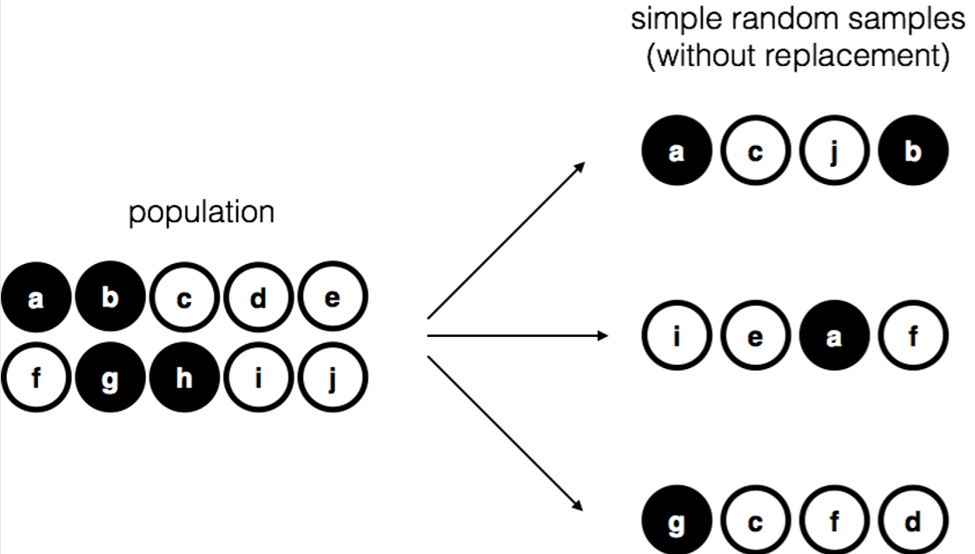
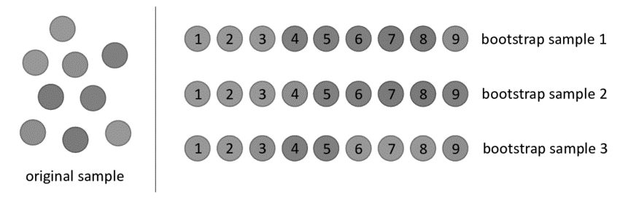
Types of Sampling
Simple Random Sampling
Sampling without replacement
Sampling with replacement
Stratified sampling

Slide 17
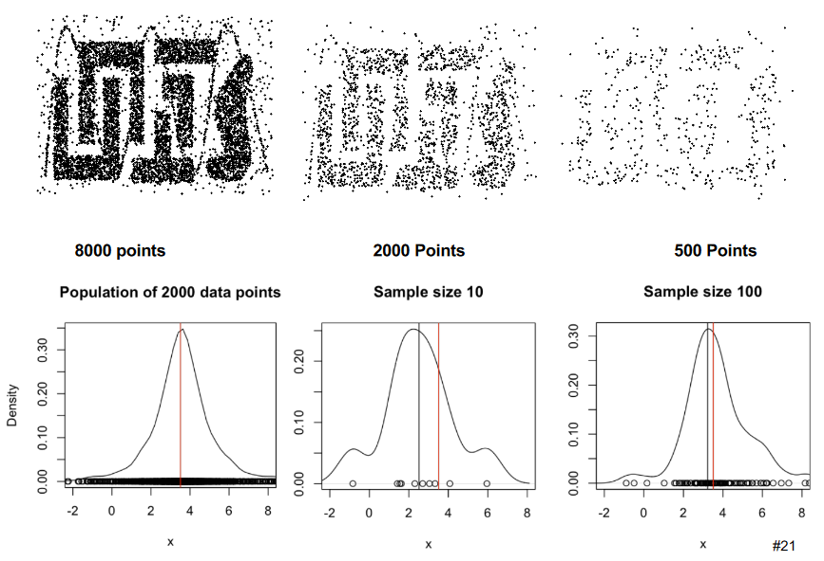
The Effect of Sample Size

Slide 18
Feature Subset Selection (Benefits)
Discard Redundant and irrelevant features
Speed up Training time
Improve model interpretability
Improve model generalisation (by reducing overfitting)
Notes:
Redundant features
duplicate much or all of the information contained in one or more other attributes
Example: purchase price of a product and the amount of sales tax paid
Irrelevant features
contain no information that is useful for the data mining task at hand
Example: students ID is often irrelevant to the task of predicting students' Grade Point Average

Slide 19










Feature Subset Selection (Techniques)
Brute-force approach:
Try all possible feature subsets
Filter approaches:
Features are selected before the run
Wrapper approaches:
Use the data mining algorithm as a black box to find the best subset

Slide 20
Aggregation (Feature Engineering)
Combining two or more attributes into a single attribute
Combining two or more objects (examples) into a single object
The purpose of aggregation:
Data reduction
Reduce the number of attributes or objects
Change of scale
Cities aggregated into regions, states, countries, etc
More “stable” data
Aggregated data tends to have less variability

Slide 21
Dimensionality Reduction Principles
Purpose:
Reduce the amount of time and memory required by data mining algorithms
Allow data to be more easily visualized
May help to eliminate irrelevant features or reduce noise
Techniques
Principle Component Analysis
Singular Value Decomposition
Others: supervised and non-linear techniques

Slide 22
Dimensionality Reduction with PCA
Principle Component Analysis (PCA):
Goal is to find a projection that captures the largest amount of variation in data
Source: https://www.r-bloggers.com/2017/01/principal-component-analysis-in-r/

Slide 23
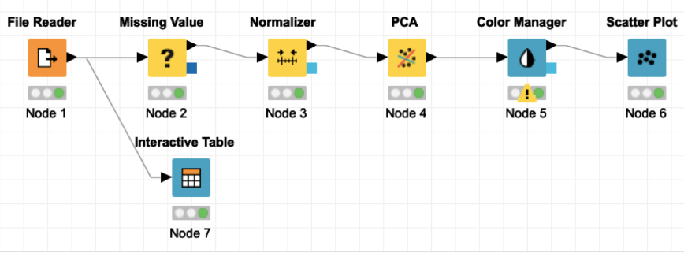
Dimensionality Reduction in KNIME

Slide 24
Modelling

Slide 25
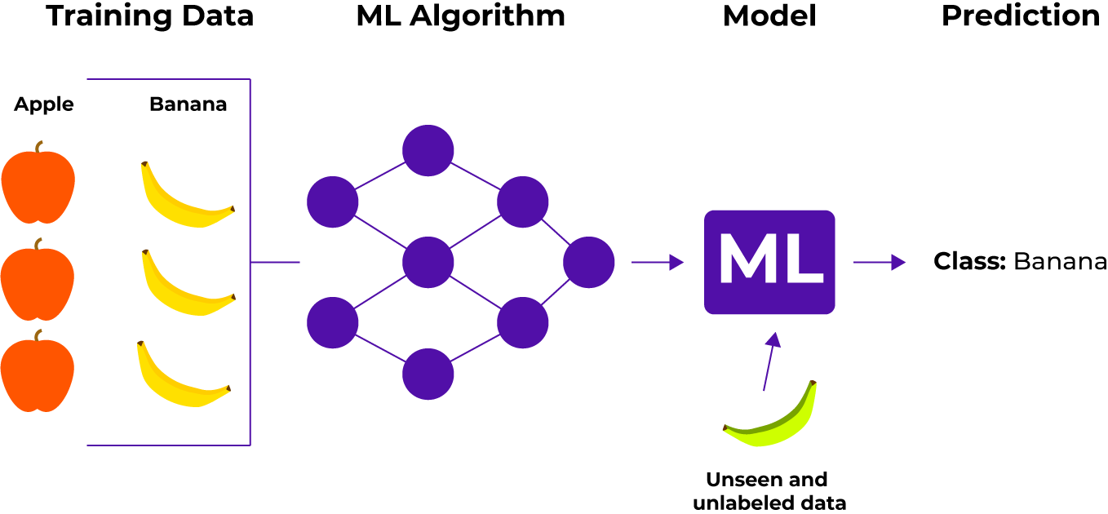
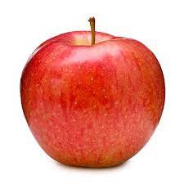
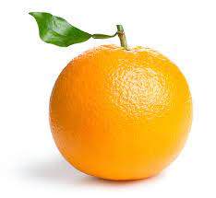
Supervised Learning (Classification)
Apple Orange
Apple

Slide 26
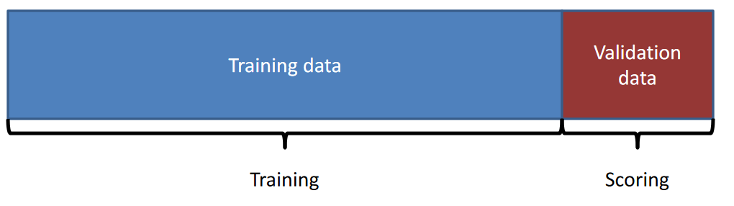
Holdout Validation
Train on a subset of the data
Validate on ‘unseen’ data
Calculate score of the model

Slide 27
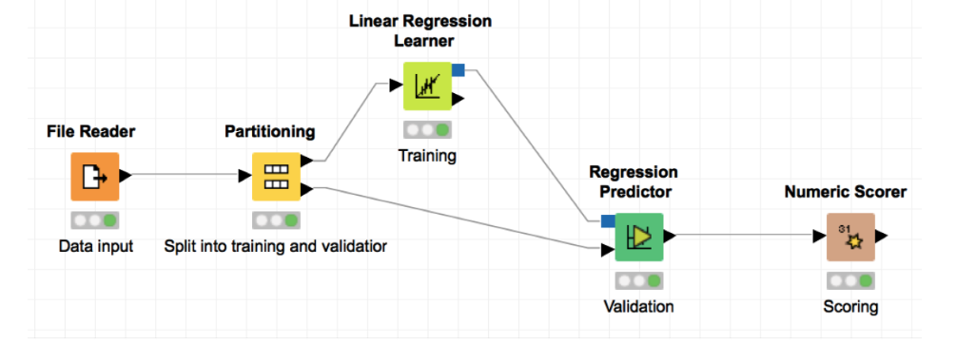

Partitioning data in KNIME

Slide 28
Scoring: Evaluating a Classification Model
Classification models are evaluated depending on the correct number of predictions
There are 2 basic categories of classification problems
Binary classification problem
– A classification model with only 2 classes
Multiclass classification problem
– A classification model with more than 2 classes

Slide 29
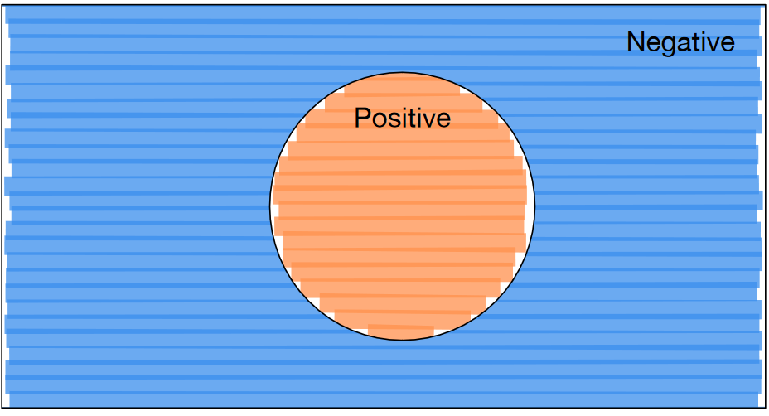
A Binary Classification Problem

Slide 30
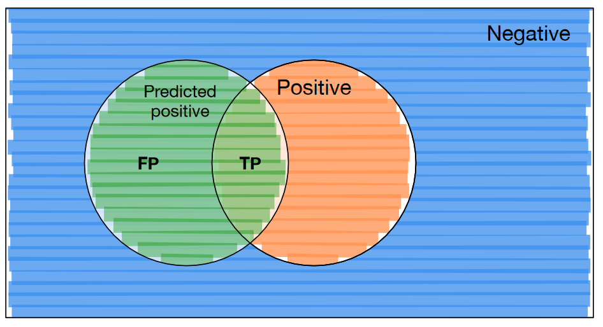



False Positives and True Positives

Slide 31
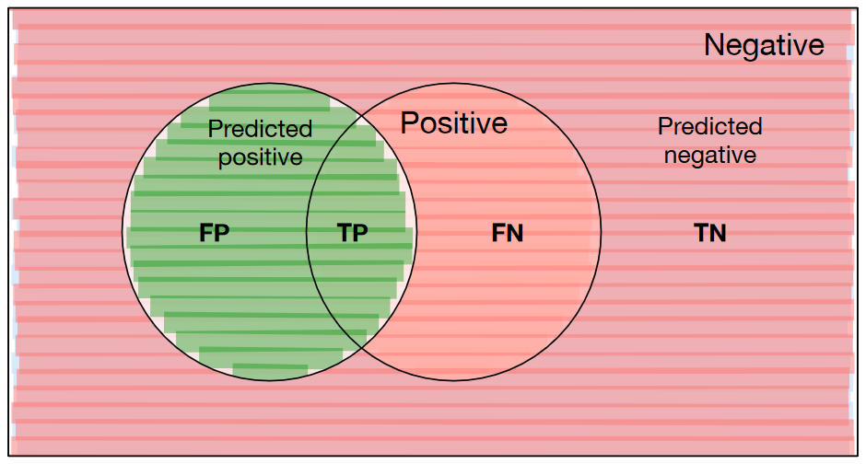




False Negatives and True Negatives

Slide 32
Scoring (Classification)
How many correct predictions were made on the test dataset
The higher percentage is better
A better way to display results of predictions is as a confusion matrix
A confusion matrix of actual data vs predicted data
Different metrics can be generated according to values in the confusion matrix

Slide 33

The Confusion Matrix (A matrix of actual data vs predicted data)
 | Predicted Class 0 | Predicted Class 1
Actual Class 0 | True Positive | False negative
Actual Class 1 | False Positive | True Negative
From the confusion matrix the total accuracy of the model can be generated:
The accuracy states how many predictions were correct

Slide 34


Evaluation Metrics: Precision
Precision is the fraction of positive predictions for the respective class that are correct: How well you guess
$= \frac{\text{Total} \text{apples} \text{correctly} \text{p}\text{redicted} \text{as} \text{apples}}{\text{T}\text{otal} \text{number} \text{of} \text{postive} \text{prediction} \text{in} \text{the} \text{data}}$
Notes:
Precision expresses the ability to find all of the relevant instances within the dataset
The proportion of data points the model correctly predicted the correct label with respect to all predictions of the all

Slide 35



Evaluation Metrics: Recall
Recall is the fraction of positive values in the data that we correctly predict: How complete is the prediction?
$= \frac{\text{Total} \text{apples} \text{correctly} \text{p}\text{redicted} \text{as} \text{apples}}{\text{T}\text{otal} \text{apples} \text{in} \text{the} \text{data}}$
Notes:
Recall expresses the ability to find all of the relevant instances within the dataset
The proportion of data points the model correctly predicted the correct label relative to the total number of instances with that label
Also known as sensitivity or the true positive rate

Slide 36

Trade off between Precision and Recall
When dealing with real world data you will never see 100% precision and recall at the same time
For example: if all the samples are predicted as a positive class in a dataset you will get 100 % recall but a low precision statistic
Instead, the F1 score is used to generate a single metric that balances the precision and recall:

Slide 37
Summary
Data Imputation (Data Cleaning)
Sampling
Feature Engineering (Feature Selection)
Dimensionality Reduction
Feature Transformation
Modelling
Validation and Scoring

