Slide 1
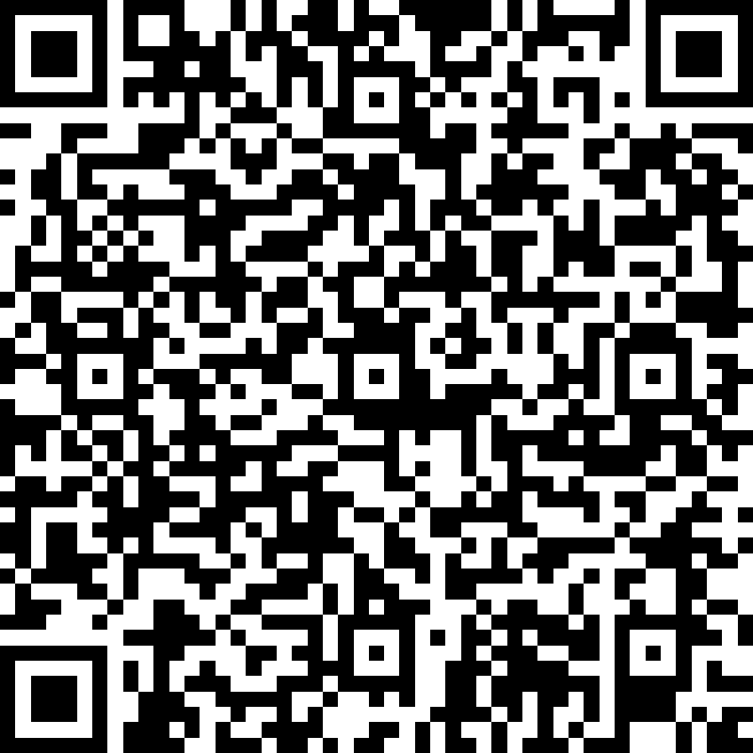
Modelling
Lecture CS1AC16
Dr Varun Ojha
University of Reading
09/03/2022

Slide 2
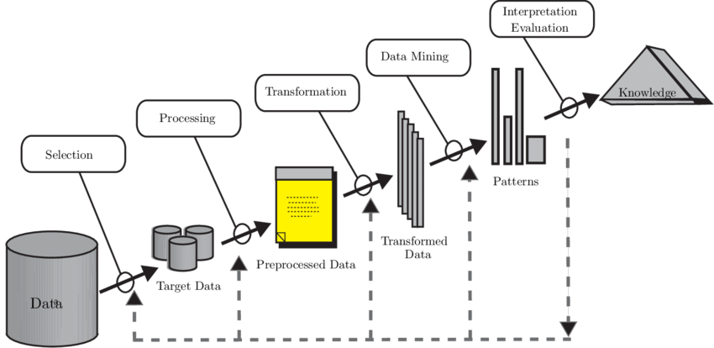
Module Outline

Slide 3
Modelling
Regression Model
Classification Model
Model Evaluation

Slide 4
Why data modelling?
We build mathematical models to help understand data
Models can be used in two ways:
Descriptive (inference):
how feature X influences outcome Y
how changes in X result in changes in Y
Predictive:
to learn the relationship between X and Y
to predict a value of Y for some values of X

Slide 5
Regression and Classification
Knowing your target attribute type
Continuous (Numerical) labeled data
Regression
 | # | Inputs Attributes (Independent) |  |  | Target/Class/Output Attributes (Dependent)
 |  | A1 | A2 |  | A3
Records | Ex. 0 | A1₀ | A2₀ |  | A3₀
 | Ex. 1 | A1₁ | A2₁ |  | A3₁
 | Ex. 2 | A1₂ | A2₂ |  | A3₂
 | Ex. 3 | A1₃ | A2₃ |  | A3₃
 | Ex. 4 | A1₄ | A2₄ |  | A3₄
 | Ex. 5 | A1₅ | A2₅ |  | A3₅
 | Ex. 6 | A1₆ | A2₆ |  | A3₆
 | Ex. 7 | A1₇ | A2₇ |  | A3₇
 | Ex. 8 | A1₈ | A2₈ |  | A3₈
 | Ex. 9 | A1₉ | A2₉ |  | A3₉
Discrete (Categorical) labeled data
Classification

Slide 6
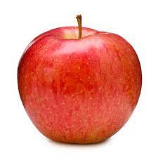
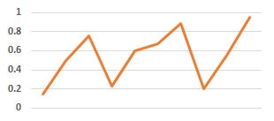

Regression and Classification
Data preparation
Continuous labeled data
Discrete labeled data
# | Inputs (Descriptor of Price) (X) |  | Target (Y)
 | Area (m²) | Distance(mile) | Price (£Bn)
Ex. 0 | 76.85 | 17.27 | 0.15
Ex. 1 | 76.97 | 19.54 | 0.5
Ex. 2 | 77.10 | 18.51 | 0.76
Ex. 3 | 85.28 | 46.09 | 0.23
Ex. 4 | 85.42 | 35.83 | 0.6
Ex. 5 | 88.02 | 2.59 | 0.67
Ex. 6 | 77.25 | 6.34 | 0.89
Ex. 7 | 77.49 | 6.98 | 0.2
Ex. 8 | 85.81 | 12.18 | 0.55
Ex. 9 | 98.81 | 2.18 | 9.45
# | Inputs (Descriptor of Fruits) (X) |  | Class (Y)
 | Length (mm) | Weight (gm) | Fruit
Ex. 0 | 23.2 | 3.2 | Apple
Ex. 1 | 70.9 | 19.5 | Orange
Ex. 2 | 60.5 | 18.51 | Orange
Ex. 3 | 24.5 | 4.6 | Apple
Ex. 4 | 110.0 | 35.83 | Orange
Ex. 5 | 23.8 | 3.7 | Apple
Ex. 6 | 25.8 | 4.5 | Apple
Ex. 7 | 24.7 | 4.9 | Apple
Ex. 8 | 85.8 | 25.6 | Orange
Ex. 9 | 78.8 | 20.33 | Orange

Slide 7
Regression and Classification
The goal of Regression and Classification is to produce a model
Test Score
 | # | X Inputs Attributes (Independent) |  |  | Y Target/Class Attributes Dependent
 |  | A1 | A2 |  | A3
Training Records (Set) | Ex. 0 | A1₀ | A2₀ |  | A3₀
 | Ex. 1 | A1₁ | A2₁ |  | A3₁
 | Ex. 2 | A1₂ | A2₂ |  | A3₂
 | Ex. 3 | A1₃ | A2₃ |  | A3₃
 | Ex. 4 | A1₄ | A2₄ |  | A3₄
 | Ex. 5 | A1₅ | A2₅ |  | A3₅
Test Records (Set) | Ex. 6 | A1₆ | A2₆ |  | A3₆
 | Ex. 7 | A1₇ | A2₇ |  | A3₇
 | Ex. 8 | A1₈ | A2₈ |  | A3₈
 | Ex. 9 | A1₉ | A2₉ |  | A3₉
Training Score
Train
MODEL
Evaluate

Slide 8
Regression Models
Table of paired data values (x, y)
X (Revenue) | Y (Stock price)
3.4 | 0.7
4.7 | 9.5
5.2 | 1.1
… | …
MODEL
♦
Create: a model
to describe the data and
to predict the outcome value y given a new instance x
Stock
Price
(Y)
♦
♦
♦
♦
♦
♦
♦
Revenue (X)

Slide 9
Regression Models
Regression Model Construction
MODEL
♦
Stock
Price
(Y)
♦
♦
y = f(x) = aX + b
♦
♦
♦
Slope
a = dy/dX
Intercept
b
dy
b
dX
Revenue (X)

Slide 10
Regression Models
Prediction from the model (for new point X’)
y’ = f(X) = aX’ + b
MODEL
Stock
Price
(Y)
y’
X’
Revenue (X)

Slide 11
Regression: Which is the best line?
y’ = f(x) = aX’ + b
Line 1
Line 2
Line 3
Stock
Price
(Y)
y’
Line 4
X’
Revenue (X)

Slide 12
Regression: Finding the “best fit” line?
y’ = f(x) = aX + b
Stock
Price
(y)
Line 2
observed value
y’
error
predicted value
e
y
e = y – y’
= y – (ax + b)
e = y – y’
x
Revenue (X)

Slide 13
Regression: Least Square
Minimisation of Squared Error
Best Fit
Find the line (parameters a and b of a line equation) that minimize the norm of the y errors
(sum of the squares)
Stock
Price
(y)
e₈
e₆
e₇
e₃
e₅
e₄
e₂
Error
e_{i} = y_{i} – y_{i}’
e₁
Revenue (X)

Slide 14
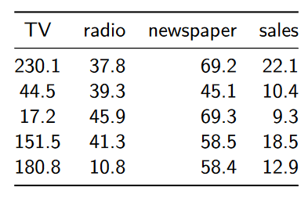
Linear Regression Example
We are interested in
learning how the different advertising budgets affect sales.
predicting how changing advertising budgets will affect sales
Dataset of an advertising company sales

Slide 15
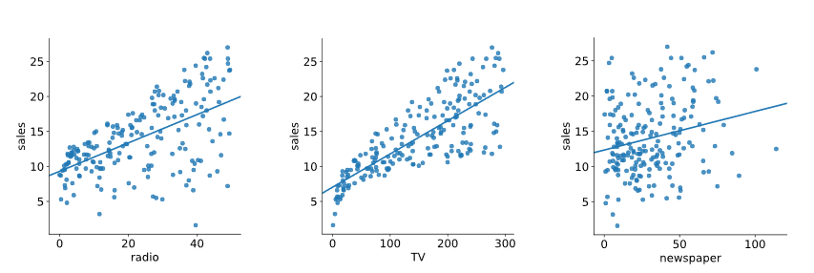
Linear Regression Example
Three Linear regression models
Multivariate data
relationship between each of the three different budgets and sales

Slide 16
Multivariate Linear Regression Models
Taking all variables into account
Hyperplane
4-dimensional data points
MODEL
Sales
(Y)
y = f(x) = w₀ + w₁X₁ + w₂X₂ + w₃X₃
radio (X₁)
Slope
w₁ = dy/dX
w₂ = dy/dZ
Intercept
w₀
TV (X₂ )
newspaper (X₃)

Slide 17
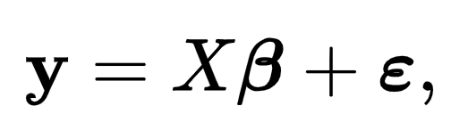
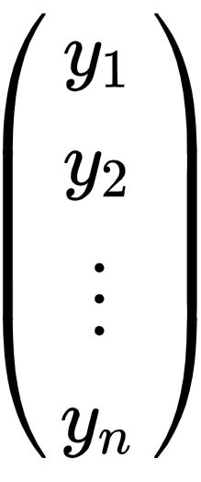
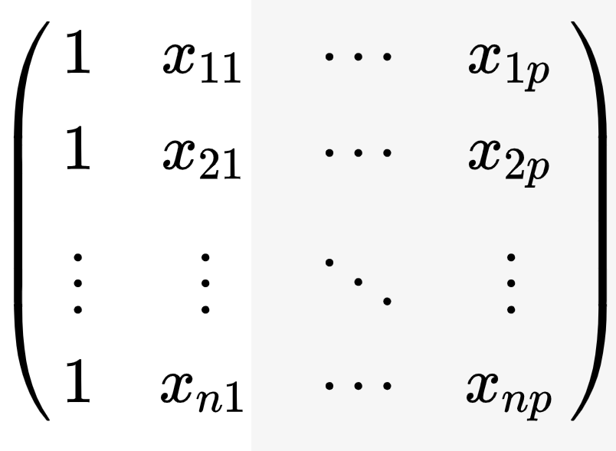
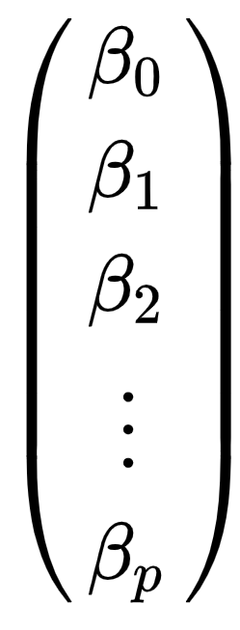
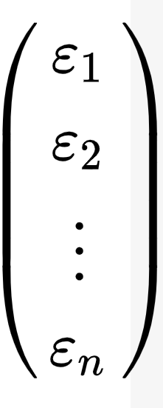











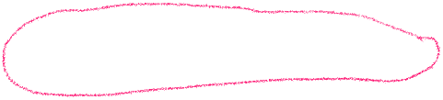





Least Square Estimation
We can sum up multivariate linear regression as

Slide 18
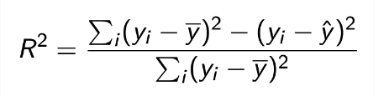


Using R2 to score a regression model
Mean Squared Error (MSE) minimisation is a measure to find the best fit
R2 instead is a measure of the sensitivity of the predictions
It describes the fraction of the variance explained by the regression model
Where ӯ is the mean, predicted value of y
R2 = 0.61 for TV advertising data means
61% of the variation in the sales figure can be explained by the TV marketing budget.

Slide 19
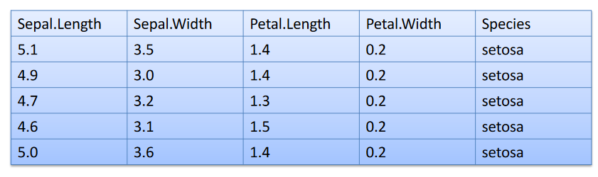
KNIME example – Iris data
Measurements of flowers of different species of iris plant.
Target Column

Slide 20
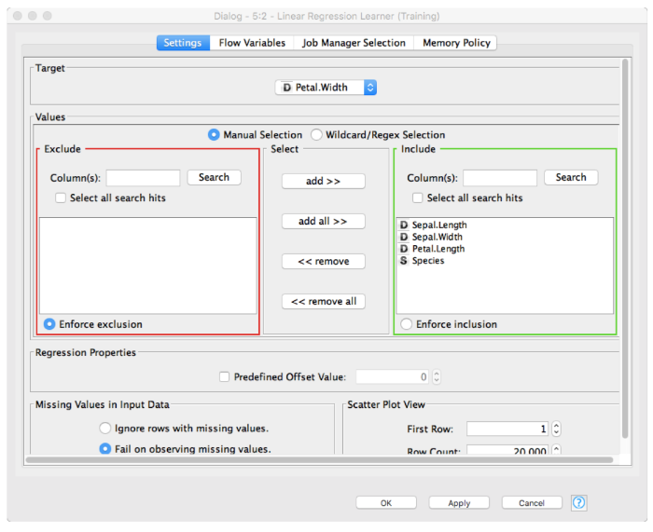
Regression with Iris Data
Using linear regression to predict Petal Width using the remaining variables

Slide 21
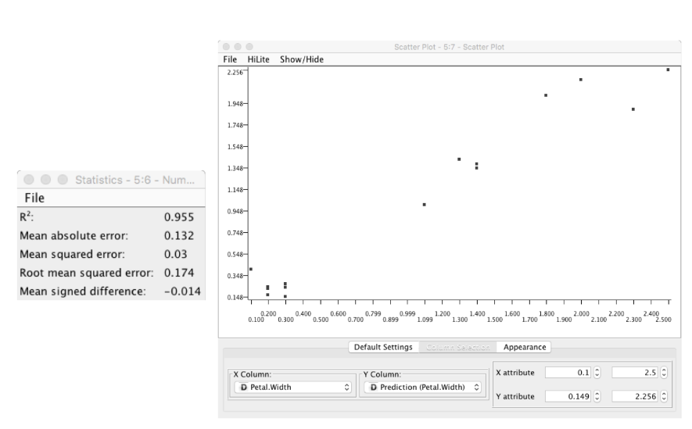
Iris Data Regression: Results

Slide 22
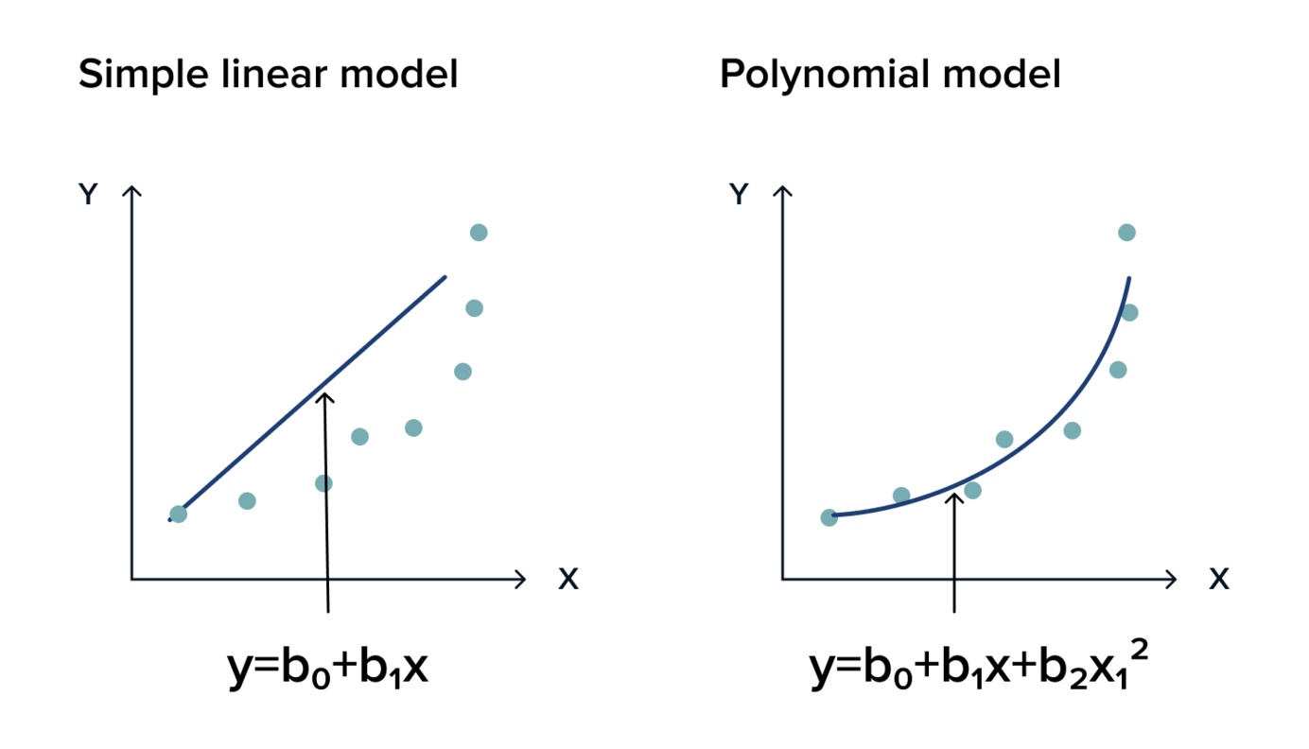
Model Problems: Overfitting
complex a model makes predictions perfectly on training data, i.e., it overfits the data.
this is not a good model as it does not generalise well and performs poorly when new data

Slide 23
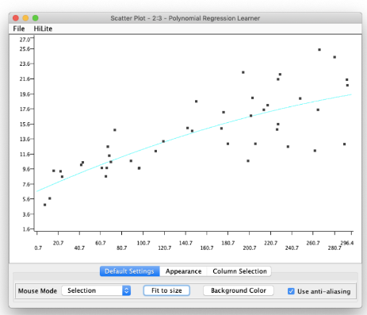
Simple Linear Model (underfit)
Fit a simple linear equation to the data
Mean Squared Error (MSE) of the simplest linear model on training data is 12.8
MSE on validation data is 9.51

Slide 24

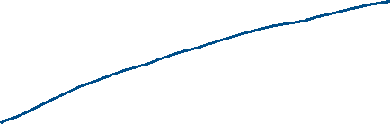
Polynomial fitting (good fit)
The quadratic polynomial equation improves the regression fit over the linear regression model
Mean Squared Error (MSE) of a simple model on training data is 9.21.
MSE on validation data is 8.326

Slide 25
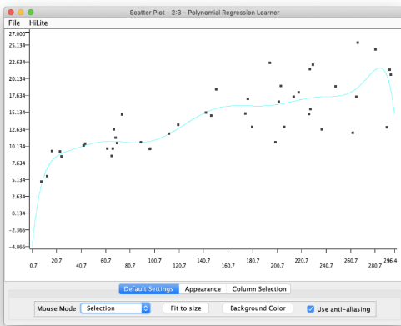




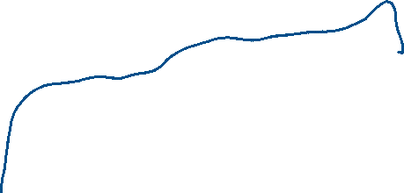
Extreme Polynomial fitting (overfit)
Mean Squared Error (MSE) of a complex model on training data is 5.34.
When used to make predictions on the validation data, MSE is 11.9

Slide 26
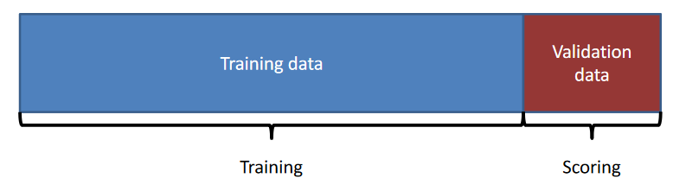
Sampling Bias (avoiding Holdout)
Holdout partitioning splits the data only once into
training and
validation data
If the split has been a lucky split, then your model will perform well
Sampling bias is common in imbalanced classification problems

Slide 27
Cross Validation
MODEL
Total number of data records
k-fold cross-validation
At each fold:
Training set
k-1 folds are used to train a model
Test set
1-fold is used to score a trained model
1
Test set
Training set
2
3
...
k
Aggregate test results of k iterations

Slide 28
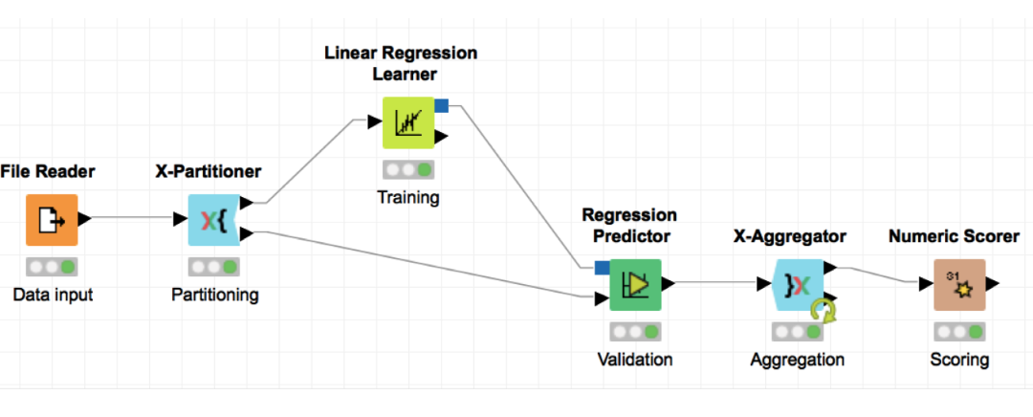
Cross validation in KNIME
Use X-Partitioner split the data
Use X-Aggregator to collect the predictions from each split

Slide 29
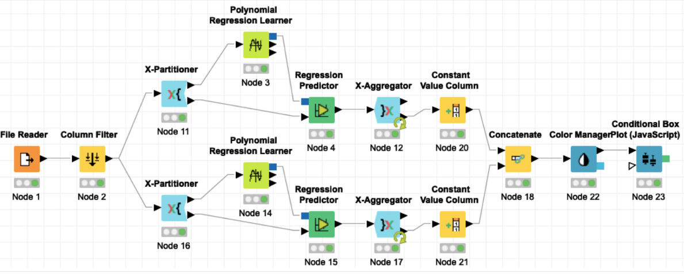
Comparing Models in KNIME
We can create two or more models with cross-validation
We can help us compare models to find the least overfitting model

Slide 30
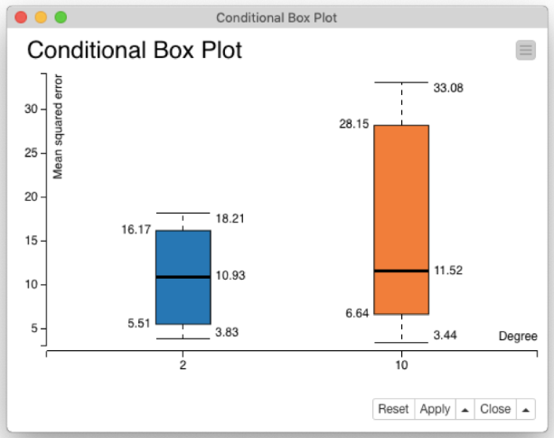
Model Comparison Output
A single partition (holdout) of the data
A simple model may give a high error
A complex model may give a small error
A 10-fold cross-validation
models produce 10 different scores
A model that has a lower variance of scores is the least overfitting model

Slide 31
Conclusions
Modelling is used for prediction and inference
Classification models assign data points to a discrete class
Regression models predict the value of a dependent variable for each data point.
Data is partitioned into training and validation data.
Model scores depend on how the data is divided into training and validation subsets
The best way to avoid overfitting is by using cross-validation

Slide 32
Next Two Weeks
Practice Sessions in G56 (Polly Vacher Building)
Try KNIME exercises before coming to the lecture
Last week you have a MCQ Blackboard Test

