Slide 1
Content
Install ROS
Install Gazebo
navigate the mobile robot in simulation (make copied files to work)
Learn Gazebo
Understand the robot description
Make your own mobile robot and replace the robot in the navigation
Add Sensors
Make your own manipulator.
Moveit！
Homework: Make your own mobile manipulator

Slide 2
Beginning
Learn how to use terminal
Ctrl + Alt + t
Multiple terminals in same window
Ctrl + Shift + t
Install a text editor (sublime)
Screen capture (Kazam)

Slide 3
Install ROS
Follow the ROS Kinetic http://wiki.ros.org/kinetic/Installation/Ubuntu
- ROS Kinetic -> Ubuntu 16.04
- ROS Melodic -> Ubuntu 18.04
- ROS Noetic -> Ubuntu 20.04
2. - catkin_make with no errors
- run roscore in the terminal

Slide 4
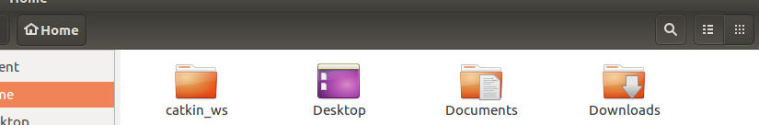
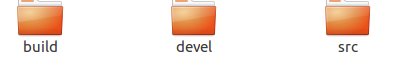
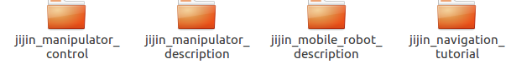

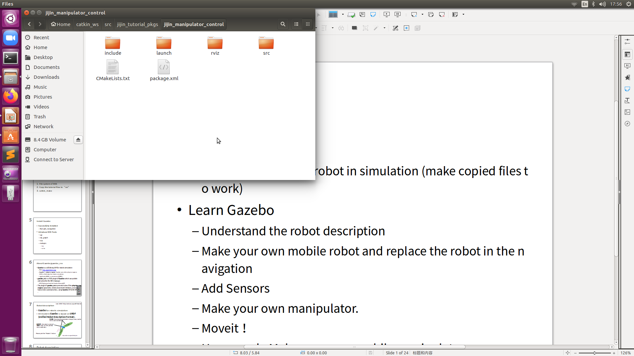
Install ROS
File system of ROS
Copy the tutorial files to “src”
catkin_make
Source codes of ros pkgs
Built program
& runtime program
Ros program searching lists
A key file to determine the ros workspase
Two key files to determine a ros pkg
Two key files to determine a ros pkg

Slide 5
Install Gazebo
Successfully installed
Run jijin_navigation
Introduce ROS Tools
rqt
rqt_graph
rviz
rostopic
list
echo

Slide 6
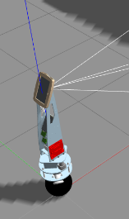
About Gazebo/gazebo_ros
Gazebo is a soft/library/API for robotic simulation
Web: http://gazebosim.org/
Gazebo != physics engine. Gazebo uses other physics engines(ODE or Simbody) for robotic simulation
rigid body(剛体), no elasticity(非弾性)
gazebo_ros is a ROS plugin of Gazebo which can publish and subscribe the ROS massage.
A ROS pkg involved the Gazebo library/API
The plugin of gazebo_ros is personal rules of the physics engine (parameter, robots movement limitation, or new physical rules (aerodynamic)) , using Gazebo API (ODE API).

Slide 7
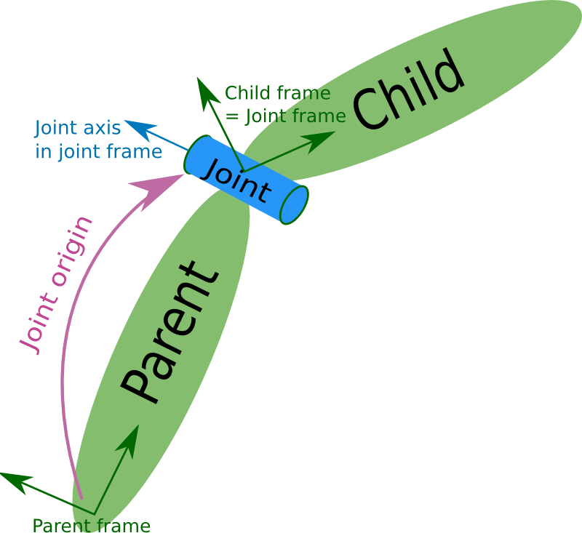
Lean URDF: http://wiki.ros.org/urdf/Tutorials
Robot description
Gazebo for robotic simulation
All model in Gazebo is based on URDF (Unified Robot Description Format).
Link: the physical parameters: shape, mass, inertial
On its own coordinates
Joint: the rules to connect TWO Links. On the parents link coordinates
Please joint the “Robotic” lecture
http://wiki.ros.org/urdf/XML/joint

Slide 8
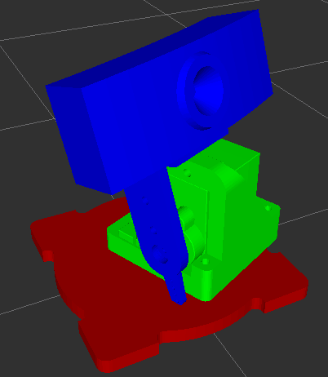
Robot description
Link
1. Visual
Geometry: the shape of object
Material: Color (useless)
2. Collision
Geometry: the shape of object
3. Inertial
mass
Inertia
4. Contact Coefficients
Important for wheels and gripper

Slide 9

Robot description
Type of Joints (Apply forces)
rigid body
1000
fixed
revolute/continuous
prismatic
planar
floating
6-DOF. Simulate the FORCE of Jedi
Actually, the earth and human can be seen as a single robot, the joint between them is

Slide 10

Robot description
How to describe spherical pair? (quiz)

Slide 11
Robot description
How to describe spherical pair? (quiz)
Two revolute joints
The geometry of the middle link is
Super small
No physical collision

Slide 12
Robot description
How to write a robot description
.urdf file
.xarco file

Slide 13
Robot description
Show your personal-made robot description
Before your add your own robot model in Gazebo, you’d better to check whether your model is correct.
Rviz
TF (transform)
You must give/fake a value to all joints, which is TF in ROS. Otherwise, Rviz will not show the robot.
Remove the fake values of joints when simulation because the TF can be given by Gazebo.

Slide 14
Robot description
gazebo_ros plugins
For your convince, some gazebo_ros plugins are developed
Mobile robot
Car (input: wheel angle, linear speed)
Two wheel robots (input: rotation speed, linear speed)
Manipulator
Joint Force control (input: force)
Joint Angle control (input: angle with PID force control)
Sensors
Laser
Camera
Depth camera
IMU/GPS

Slide 15
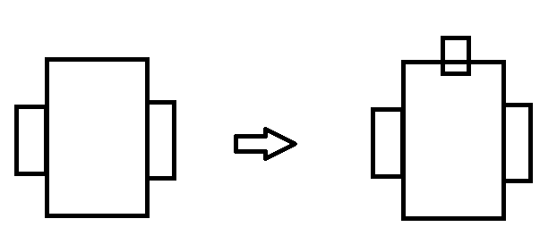
Robot description
https://www.youtube.com/watch?v=8ckSl4MbZLg
Mobile Robot
= body + two wheels + gazebo_ros plugins (Two wheel robots)
= body + two wheel-like arms + gazebo_ros plugins (joint force control)
Sensor
A laser scanner on the top of the robot

Slide 16
Robot description
How to write gazebo_ros plugins in to the robot description
.xarco file

Slide 17
Robot description
Assignment
Make your personal ROS pkg for your personal mobile robot. Learn ros
Change the gravity center and give a front wheel to your personal mobile robot to keep its balance. Base on my robot. Learn urdf file
Add a camera sensor on your personal mobile robot. Search on the internet to find the plugin. Learn how to use plugin

Slide 18
Tea Time of mine

Slide 19
Manipulator
Make a urdf file for 3DoF manipulator
4 links + 3 joints
Show the 3Dof manipulator in Rviz
Add gazebo_ros plugine to each joints
Effort (force/torque) interface
Position input

Slide 20
Manipulator
Test the gazebo_ros plugin
Run the gazebo_ros
Type “rqt” in the terminal
Find the $ROBOT/$JOINT/controller/command topic
Send a command by the topic

Slide 21
Manipulator
Write a ros node (a program using ros) to command the links (gazebo_ros plugine) by send commands to topics.
Joints’ angle generator
Robot
/Sim Robot
Joints’ angle/vel/force
A tiny node
Joints’ angles
(trajectory)

Slide 22
Manipulator
Tips:
Robot model
Test robot model in Rviz
Add gazebo_ros plugins
Test the robt model in gazebo
Check the controller using rqt
Write your own ros node
Assignment
Make a 6 DoF manipulator.
7 links + 6 joints. Base on my robot
Add a 2 DoF gripper.
6 DoF manipulator + 2 links + 2 joints. Your innovation
Make your personal ros node to control the manipulator. Base on my cpp file. Your first ros cpp code

Slide 23
Tea Time of mine

Slide 24
Manipulator (Moveit!)
Moveit! can not work for nonholomic mobile robot!!!!
Inverse Kinectics
Trajectory planning
Joints’ angle generator
Robot
/Sim Robot
Joints’ angle/vel/force
A tiny node
Joints’ angles
(trajectory)

