Slide 1
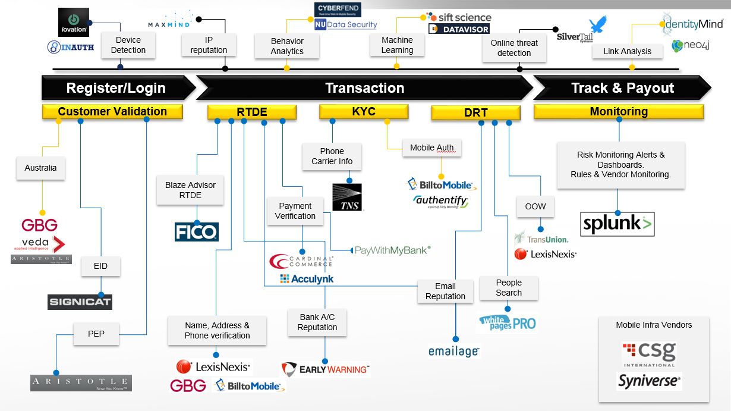

WU Digital Risk -- Vendor

Slide 2
Vendors A - Z
Vendor | Status | Description
Accertify | Sunsetting | Serves as Vendor pass-through, Sunsetting
Aristotle | Active | Provides the capability to perform NAP in US & international countries, PEP check in Nordics and Compliance check in Australia.
Boku (Danal) | Active | Authenticates mobile device ownership and validates the mobile owner’s carrier information
Cardinal Commerce | Active | Provides us the capability to do payment verification – 3DS, Zero Dollar Auth.
Data Visor | Active | Machine Learning / Cluster Analysis
Emailage | Active | Provides email attribute information and history with a risk score. Used in real time decisioning and DRT for all new customers.
Equifax | Active | Consumer credit reporting agency – collects and aggregates information on over 800 million consumers and 88 million businesses world wide

Slide 3
Vendors A - Z
Vendor | Status | Description
EWS | Active | Provides bank account verification and bank account status for ACH transaction for US customers
FICO (BLAZE) | Active | FICO’s Blaze Advisor is used as our Risk Platform, providing real- time decision engine capability. RTDE.
GB Group | Active | NAP and Compliance Vendor (replaced Veda for AU compliance) and NAP in UK and Canada
Giact | Active | Account Owner Authentication
iOvation | Active | Tracks physical device profiles and allows us to identify fraudulent devices by leveraging information reported by other merchants in the iOvation network
Key Lines (Caimbridge Intelligence) | Active | Graph display for Neo4j graph database
Lexis Nexis | Active | NAP verification vendor. Provides name, address, phone, ssn and DOB verification. More comprehensive than Neustar. Used for high principle transactions.

Slide 4
Vendors A - Z
Vendor | Status | Description
Lexis Nexis KBA | Active | OOW offered to US customers only. Presents questions to challenge customers based on their credit profile.
MaxMind | Active | Provides IP Address services that score an IP based on its reputation as well as providing the Geolocation that it originates from
Neo4j – Graph DB | Active | Graph DB for Link Analysis
Paramount Commerce | Active | Consumer and bank account authentication
PWMB | Active | Provides customer verification through the customers bank account through Easy Online Verification (Instant)
Sift Science | Active | Uses machine learning to identify fraud patterns automatically. It works with heavy lumps of data to analyze and predict fraud patterns based on the data.
Signicat | Active | Provides Electronic ID (EID) solutions for Nordic Banks

Slide 5
Vendors A - Z
Vendor | Status | Description
TNS | Active | Provides carrier phone information for US customers – phone type, sms capable, carrier type, phone validity, phone subscription info, phone activity, etc.
TransUnion | Active | OOW offered to Canadian customers only. Presents question challenge to customer passed on their credit profile
Vix Verify | Active | AU Customer Electronic Identification
Whitepages PRO | Active | Allows the manual review agents to search for a person online and validate contact information about a customer such as phone, email, address, age, social contacts, etc.
Zumigo | Active | Mobile identity and location services

Slide 6

Accertify
Vendor Description | Leading provider of solutions that help merchants combat fraudulent online and other card-not-present transactions. Fraud prevention, chargeback management, and payment gateway solutions, helping companies increase revenue by driving down fraudulent losses.
Services we use | NAP check, OOW verification, Australia compliance. Previously all transactions were sent to Accertify
How those services are used (in rules or models / etc.) | We are undergoing a 4 phase plan to sunset Accertify from WU systems. This includes: Ramp down unnecessary traffic, move NAP check over to VG, Move OOW verifications to an internal platform or external vendor link, and finally to move Australia compliance.

Slide 7
Aristotle
Vendor Description | Aristotle Integrity is a suite of widely accepted identity and age verification solutions. A division of Aristotle, Integrity provides tailored solutions to both commercial and government sectors. Business over the internet is global, and they provide an identity solution that exceeds clients’ requirements, regardless of location. Simply integrate once and identify the world.
Services we use | Aristotle Integrity product is used by us to verify customer identity data globally. Aristotle has data sources for customer identity verification in various countries and custom site ids can be created to verify customer identity as per requirements specified by us in those countries.
How those services are used (in rules or models / etc.) | We use Aristotle in the following way – Currently Aristotle is only being used in Australia for customer identity verification. Although the verification rates are quite low, Aristotle cost is very low as compared to other data providers in Australia. We use Aristotle as a first step in the waterfall, if it doesn’t match on Aristotle we use other data vendors like GBG and Veda to verify the customer.

Slide 8
Boku (Danal)
Vendor Description | Mobile Authentication gives us the opportunity to authenticate mobile device ownership and validate the mobile owner's CRM information to allow the approval of a broader range of WU customers. First, this will restore the functionality of Additional Verification that Pin via SMS provided using carrier authentication. Further, it enables that enhanced customer verification to occur for both transactions originating in the mobile channel as well as the web channel on Smartphones. Mobile identification is the process of mobile number detection and is achieved in one of the following ways. Header enrichment Mobile originated SMS (MO SMS) Consumer entered mobile number confirmation using one time passcode (OTP) In addition to identifying the mobile number, Danal performs the following validations in the background. Validate that the mobile number is active (not reported lost or stolen) Validate that the user has possession of the mobile device
Services we use | StartPhoneId API : This API is used to start the phone identification process. GetPhoneId API : This API is used to check the consumer’s phone identification status, get the user token, account token and mobile number token. GetMatchScore API: This API is used to request an attribute level match score rating for the information the merchant has collected from the consumer.
How those services are used (in rules or models / etc.) | Multiple rules in production to approve/decline/send to DRT for US transactions with the tokens received from Danal.

Slide 9
Boku (Danal) GetMatchScore API response
Method | Name of the API – GetMatchScoreRes
Version | 1.0.0
Error code | If 0, the command was successful, If not then error code indicates the reason the call failed – Eg. Error code = -1001
Error description | Additional information regarding the error condition – Eg. Authentication failed
Correlation id | Merchant’s transaction identifier that uniquely identifies this transaction. Eg. 1310881973286793
Reference id | Danal’s unique transaction identifier. Eg. 568887569756956
FirstNameScore | Level of match for the first name attribute assigned to the submitted MDN from low to high – higher the match score, more accurate is the match. Eg. FirstNameScore = 10
LastNameScore | Level of match for the last name attribute assigned to the submitted MDN from low to high – higher the match score, more accurate is the match. Eg. LastNameScore = 10
StreetAddressScore | Level of match for the street address attribute assigned to the submitted MDN from low to high – higher the match score, more accurate is the match. Eg. StreetAddressScore= 10
CityScore | Level of match for the city attribute assigned to the submitted MDN from low to high – higher the match score, more accurate is the match. Eg. CityScore= 10
StateScore | Level of match for the State attribute assigned to the submitted MDN from low to high – higher the match score, more accurate is the match. Eg. StateScore= 10
ZipcodeScore | Level of match for the Zip code attribute assigned to the submitted MDN from low to high – higher the match score, more accurate is the match. Eg. ZipcodeScore= 10
EmailaddressScore | Level of match for the email address attribute assigned to the submitted MDN from low to high – higher the match score, more accurate is the match. Eg. EmailaddressScore= 10
DataSource | Returns the data source that the merchant data was compared against. Eg. DataSource = Carrier

Slide 10
Boku (Danal) GetPhoneId API response
Method | Name of the API – GetPhoneIDRes
Version | 1.0.0
Error code | If 0, the command was successful, If not then error code indicates the reason the call failed – Eg. Error code = -1001
Error description | Additional information regarding the error condition – Eg. Authentication failed
Correlation id | Merchant’s transaction identifier that uniquely identifies this transaction. Eg. 1310881973286793
AuthenticationKey | AuthenticationKey is echoed back from the request. Eg. AuthenticationKey = abc0123456789
MobileNumberToken | A unique hashed value for the MDN.
AccountToken | A unique hashed value for the user’s carrier account.
UserToken | A unique identifier for the mobile phone.
Carrier | Three character carrier code to indicate the carrier for the consumer’s mobile number. Eg. Carrier = VZW

Slide 11
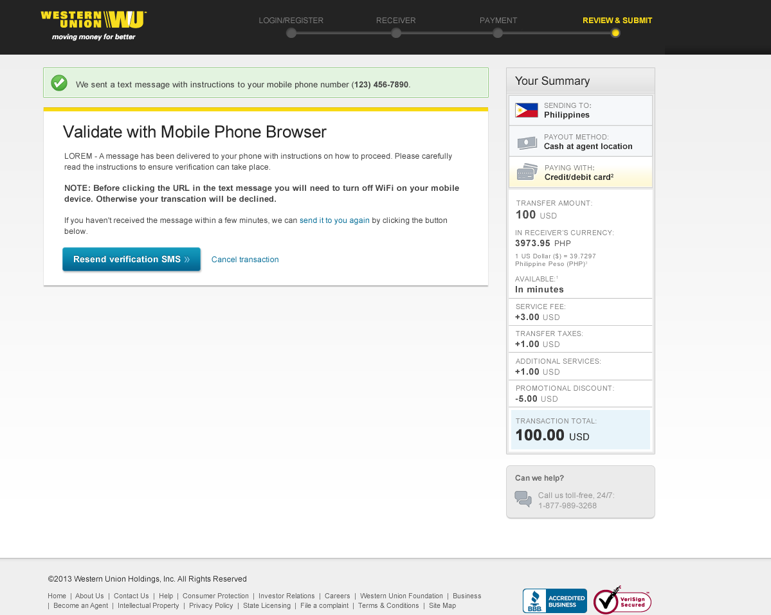
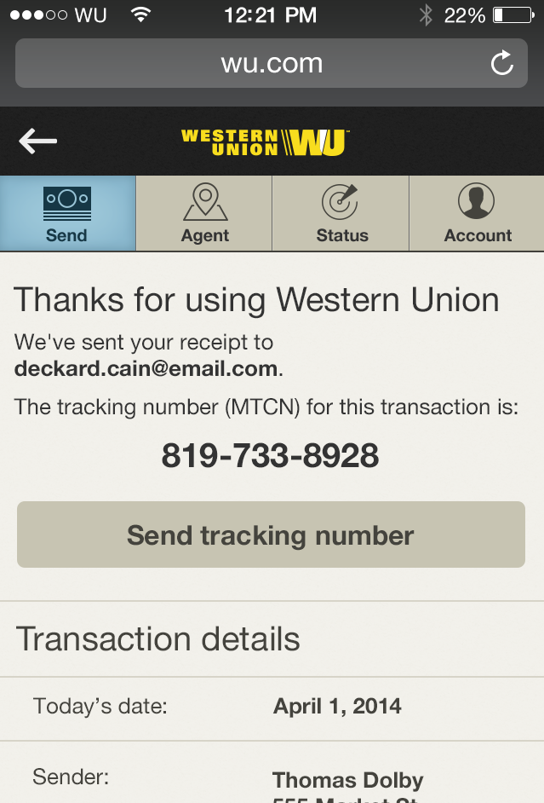
Boku (Danal) Validate with smartphone (Sample screen – not the actual)

Slide 12
Cardinal Commerce
Vendor Description | Cardinal Commerce provides 3D-Secure (3DS) Cardinal Commerce’s New Platform (CCNP) keeps us on guidelines to do business in various geographies and provide the following: 3DS Authentication Coverage. Usage of Cardinal Commerce APIs. Integrate to CCNP utilizing Cardinal Commerce specifications what would establish better transparency and control. Verify service for 3DS detection Offers service to determine the enrollment status of a payment card in the 3D Secure program Authentication services available for both web and mobile transactions.
Services we use | Provides Secondary Authentication – 3D Secure service
How those services are used (in rules or models / etc.) | Blaze will consume following cardinal commerce response at TRD for Risk decisioning *The Vendor results are currently not being used in Models as the vendor integration is in progress
Key | Description
ThreeDSResponseCode | Cardinal Commerce Response code
ThreeDSECIIndicator | ECI
ThreeDSExternalProcessor | External Processor
ThreeDSSignatureStatus | Signature Status
ThreeDSCardinalPAResStatus | Payer Authentication Responses

Slide 13
DataVisor
Vendor Description | Western Unions will send various pieces of information to DataVisor as the consumer interacts with the WU website or mobile app. Information will be sent when events such as profile creation, profile update, log in and send money occur. DataVisor will use the information provided by Western Union to conduct semi-supervised machine learning and create mathematical models to identify fraud based on the idea of cluster analysis. The cluster analysis focus is unique to this vendor. When Western Union makes a transaction risk decision we will contact this vendor via an API call and DataVisor will provide a score indicating the likelihood the given transaction is fraudulent.
Services we use | DataVisor Real-Time User Analytics Service: Provides a score from 0-1 indicating the likelyhood a transaction is fraudulent.
How those services are used (in rules or models / etc.) | This vendor is not yet integrated so no data is being sent and no services are being used at this time. We expect to have multiple rules and models that will leverage their score to identify fraudulent behavior.

Slide 14

EmailAge
Vendor Description | Emal reputation vendor. Provides email attribute information and history with a risk score.
Services we use | EmailRisk
How those services are used (in rules or models / etc.) | Used in real time decisioning and DRT for all new customers. Emailage data is also provided in MRT.

Slide 15
Equifax
Vendor Description | Financial transactions and reports analysis center of Canada
Services we use | Designed to align with FINTRAC’s intent and expectations, AML Assist empowers reporting entities in the following areas: Compliance Implement your compliance strategies and address requirements with ease and greater flexibility for identity verification. Actionable results Gain insight to identify risks to take the needed action for compliance. Reliable source Get the separate and reliable sources you need to fulfill your identity verification obligations. Reporting Obtain a unique ID to assist you with record-keeping requirements for audit purposes. With AML Assist, you have the option to subscribe to a Single Source verification solution, Dual Source verification solution or an automated cascade from Single to Dual Source. Smart markers match logic results on the search criteria as well as other critical indicators. Comprehensive and actionable, AML Assist helps you identify risks and fulfil your verification and reporting obligations.
How those services are used (in rules or models / etc.) | Used in Canada

Slide 16
Early Warning Systems (EWS)
Vendor Description | Early Warning provides innovative risk management solutions to a diverse network of 2,300 financial institutions, government entities and payment companies, enabling businesses and consumers to transact with security and convenience. Owned and governed by seven of the largest banks in the United States; Bank of America, BB&T, Capital One, JPMorgan Chase, PNC, U.S. Bank and Wells Fargo. Each day hundreds of Financial Service Organizations (FSOs) contribute timely, accurate and relevant transactional data. Early Warning serves as custodian to this immense database, which reflects the activity of approximately 50 percent of the country’s eligible banking population.
Services we use | Real-time Payment Chek Service with Account Owner Authentication Inquiry: Identity-to-account matching is performed using the Account Owner Authentication capability within the Payment Chek Service. Account Owner Authentication enables payment processors and check acceptance companies to confirm an account owner or authorized user by inquiring against account owner data contributed to the National Shared Database.
How those services are used (in rules or models / etc.) | Multiple rules in production to approve/decline/refer to DRT for ACH transactions based on various scores and account information.

Slide 17
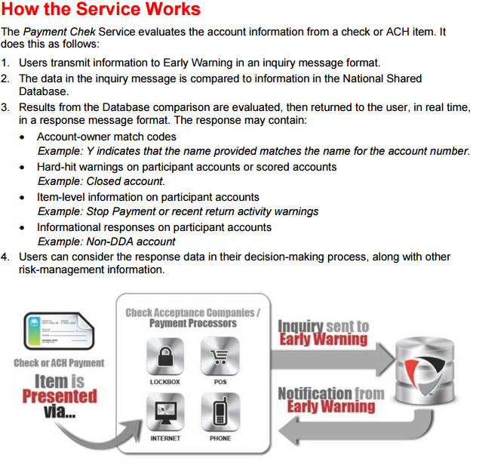
Early Warning Systems (EWS)

Slide 18
EWS Response
ClientRecID | Client-assigned record ID
ClientAPI | Client API
SysRecID | Unique Transaction ID
ErrorCd | Error Code
PrimID | Primary Client ID
SecID | Secondary Client ID
AddID | Additional Client ID
UserID | User ID
RTN | Routing/Transit Number
AcctNo | Account Number
FeeAttrib | Fee Attribute
PCTranCode | Process Control Transaction Code
Amount | Amount
SerialNo | Serial Number
DataSource1 | Name of the contributing bank
AccountType2 | Type of account
CondCd | Condition Code
NameMtch | First, Last and Middle Name
FNameMtch | First Name
LNameMtch | Last Name
MNameMtch | Middle Name or Initial
NamePfxMtch | Name Prefix
NameSfxMtch | Name Suffix
BusNameMtch | Business Name
FullAddressMtch1 | Address1+Address2+City+State+first five characters of ZIP
ClientDt | Client Date
ClientTime | Client Time
UserDef | User-defined
AddressMtch | Combined address 1 & 2
CityMtch | City
StateMtch | State
ZipMtch | ZIP Code
HmPhoneMtch | Home Phone Number
WkPhoneMtch | Work Phone Number
SSNMtch | SSN/TIN or last 4 of SSN
DOBMtch | Date of Birth
IDTypeMtch | ID Type
IDNoMtch | ID Number
IDStateMtch | State or place of Issuance
OverallMtchScore | Measure of how closely the inquiry attributes match the information in the Account Owner Elements database. Derived by examining all information sent; incorporates name variations (for name fields), edit distance, abbreviations, phonetic encoding and other matching algorithms.
PrimStatusCd | Primary Status Code
SecStatusCd | Secondary Status Code
AddStatusCd | Additional Status Code
NumRet | Number of Returns
LstRetDt | Last Return Date
LstRetReason | Last Return Reason
LastUpdate | Last Update
AddClosedDt | Add Closed Date
PrevStatus | Previous Status
FCRADispute | FCRA Dispute
SAReason1 | Scored Accounts Reason 1
SAReason2 | Scored Accounts Reason 2
SAReason3 | Scored Accounts Reason 3
SAReason4 | Scored Accounts Reason 4
SAReason5 | Scored Accounts Reason 5

Slide 19


FICO (Blaze)
Vendor Description | Decision rules management system, maximizes control over high-volume operational decisions. Provides companies with a scalable solution that delivers agility and actionability for smarter business decisions.
Services we use | FICO Blaze Advisor Decision Rules Management System
How those services are used (in rules or models / etc.) | Blaze is our digital rules management system All digital transactions flow through Blaze

Slide 20
GB Group
Vendor Description | GB Group provides services to do customer data verification in international countries like Australia, UK, Canada, Germany, Spain, etc. This will help us improve customer verification rates and also reduce the cost of performing these verifications. We will be using this service at various geographies at different scenarios like during Customer/Sender registration and transaction. We will send GB Group specified NAP data to them during above mentioned scenarios real-time. GB Group will consume these information and verifies identity against various data sources like postal address, utility data, credit information etc. They in response return with scores and match/no match info against NAP data. We plan to use these information for our risk decisioning. Business Justification Helps in detecting fraudulent transactions/customers Reduces fraud rate and thereby lowers financial losses Lower vendor request call rates and better NAP match rates justifies this vendor
Services we use | NAP Data Verification service and Regulatory Compliance check
How those services are used (in rules or models / etc.) | GB Group API Call will be made during registration under CIV (for AU) and during transaction part of PRD/TRD for various countries like Australia, UK, Canada, Germany, Spain, etc. Blaze will send following data to GBG and in response blaze receives match result Name Address Phone / Telephone Number National ID *The Vendor results are currently not being used in Models as the vendor integration is in progress

Slide 21

Giact
Vendor Description | Early warning services reseller. Account owner authentication. Real-time account verification and check verification for consumers and businesses
Services we use | gVerify, CustomerId
How those services are used (in rules or models / etc.) | Real time decisioning for ACH transactions

Slide 22
Iovation
Vendor Description | Iovation provides a real-time service that exposes online fraudsters, and more specifically, the computers they are using to damage online businesses. Their SaaS solution exposes the reputation of devices (computer, tablet or mobile phone) connecting to online businesses. Iovation manages the reputations of billions of devices that have touched their customers from all over the world, which helps Western Union understand how devices in their network and outside of their network are related. Iovation provides a shared platform that enables businesses to benefit from the collective experience of others. Every single day, iovation screens 12 million transactions and stops 250,000 fraudulent and risky transactions within a variety of online industries including financial services, retail, travel, gaming and online communities.
Services we use | Reputation 360: Establishes fraud risk and the need for further transaction review based on suspicious behavior and inconsistent data elements. Device anomalies help us accurately separate the fraudsters from the good customers.
How those services are used (in rules or models / etc.) | Rules Models Age Variable/Velocity Variables Iovation Web Portal- Monitoring team

Slide 23
Iovation API response
POST_DECISIONING_IND | false
NO_BLACKBOX_DATA_IND | false
RESULT | A
TRACKINGNUMBER | 231194980610533492
device.alias | 543075518572821726
device.browser.configuredlang | EN-US,EN;Q=0.5
device.browser.lang | EN-US
device.browser.type | FIREFOX
device.browser.version | 45.0
device.cookie.enabled | true
device.firstseen | 2016-04-06T10:20:44.102Z
device.flash.enabled | false
device.flash.installed | false
device.js.enabled | true
device.new | true
device.os | WINDOWS NT 6.1; WOW64
device.screen | 768X1364
device.type | WINDOWS
device.tz | 300
ipaddress | 199114223019
ipaddress.isp | MADEIT
ipaddress.proxy | PROXY
ipaddress.org | MADEIT
realipaddress | 199114223019
realipaddress.isp | MADEIT
realipaddress.org | MADEIT
realipaddress.source | subscriber
realipaddress.proxy | PROXY

Slide 24
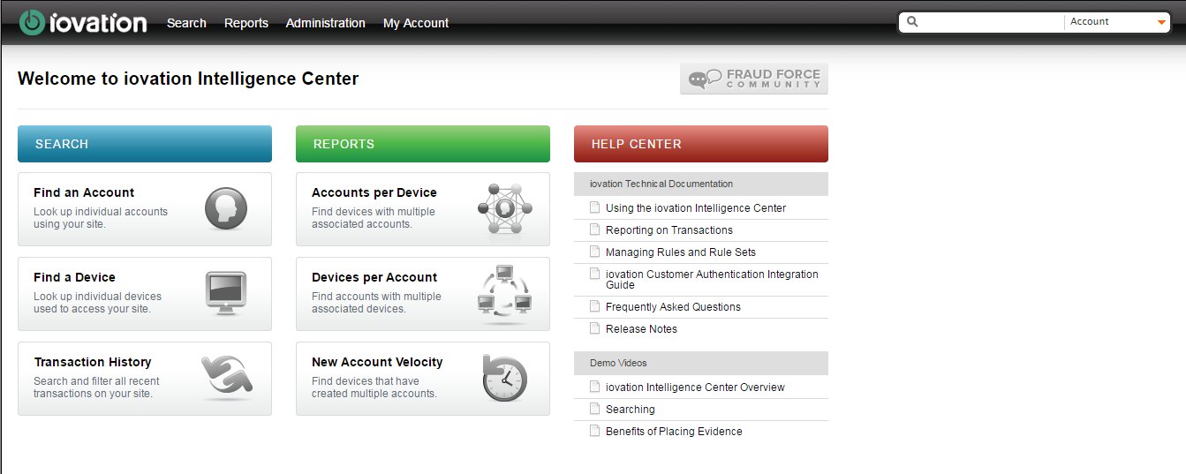
Iovation Dashboard

Slide 25
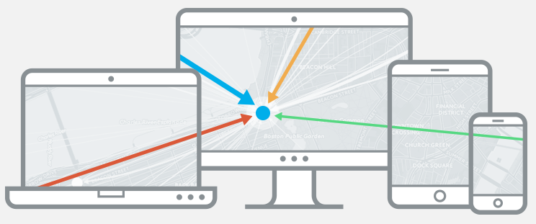
Key Lines (Cambridge Intelligence Limited)
Vendor Description | Interactive visualization that turns data into insight. Used to build powerful customer network visualization applications.
Services we use | KeyLines Toolkit
How these services are used (in rules or models, etc) | KeyLines is used with Neo4j graph display feature in DRT and used also used by MRT, Fraud Investigations, and Collections teams to name a few

Slide 26
Lexis Nexis
Vendor Description | Lexis Nexis offers a fast, convenient and effective solution to verify the identity of individuals and businesses and to assist with USA PATRIOT Act compliance. This powerful tool simultaneously searches multiple independent databases — containing 4 billion consumer and 300 million business records — for information that can verify and validate a person's identity. Lexis Nexis InstantID is the only identity verification solution endorsed by the American Bankers Association. Access to Lexis Nexis is provided by a system-to-system interface, commonly known as “Web Services.” These services can be accessed using the industry-standard Simple Object Access Protocol (SOAP).
Services we use | We use Lexis Nexis Flex ID product to validate and verify a consumer’s identity information (name, address, phone, SSN, State ID and date-of-birth) across multiple databases using a powerful proprietary search and comparison process. It also identifies potentially high-risk data elements, such as prison addresses, campground addresses, disconnected phone numbers, Social Security Numbers of deceased persons, etc
How those services are used (in rules or models / etc.) | We use Lexis Nexis in the following way – Lexis Nexis Flex ID is used for performing Compliance Verification for High Principal Transactions (>$2,999) in US, where we verify the Name, Address, DOB, SSN or State ID of the customer. Lexis Nexis Flex ID is used for Risk based Name, Address, Phone (NAP) verification, used in real time decisioning. Lexis Nexis results are used by DRT/Monitoring Analysts to understand the level of customer information verification.
Response Field Details

Slide 27
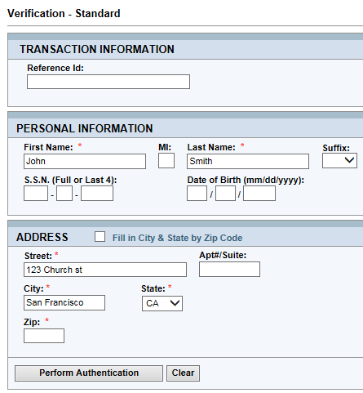
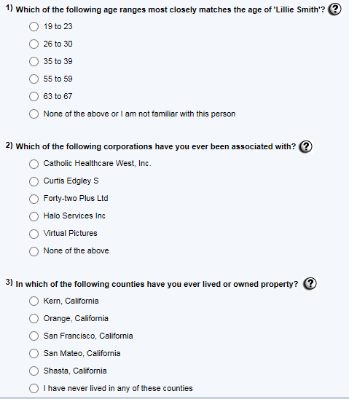
Lexis Nexis OOW
Vendor Description | LexisNexis it’s a vendor that provides identity checks through APIs and Web checks, amongst other services.
Services we use | Within Lexis Nexis products we can find a KBA solution that enables users with questionnaires to interview customers, these questions can be potentially answered by the true owners of the information.

Slide 28
Maxmind
Vendor Description | MaxMind provides IP intelligence through the GeoIP brand. Over 5,000 companies use GeoIP data to locate their Internet visitors and show them relevant content and ads, perform analytics, enforce digital rights, and efficiently route Internet traffic. Businesses can obtain additional insights into their customers' connection speeds, ISPs, and more using GeoIP data. WU uses Maxmind for intelligence and reputation on an IP address.
Services we use | Minfraud: The minFraud service determines the likelihood that a transaction is fraudulent based on many factors, including whether an online transaction comes from a high risk IP address, high risk email, high risk device, or anonymizing proxy. One of the key features of the minFraud service is the minFraud Network, which allows MaxMind to establish the reputations of IP addresses, emails, and other parameters.
How those services are used (in rules or models / etc.) | Multiple rules in production to decline/refer to DRT for global ACH/Credit card transactions with various risk and proxy score thresholds.

Slide 29
Maxmind
Response
riskScore | decimal | This field contains the risk score, from 0.01 to 100. A higher score indicates a higher risk of fraud. For example, a score of 20 indicates a 20% chance that a transaction is fraudulent. We never return a risk score of 0, since all transactions have the possibility of being fraudulent.
score | decimal | This field has been deprecated, is not supported, and is no longer present in API version 1.3.
explanation | string | This field has been deprecated, is not supported, and is no longer present in API version 1.3. This is a brief explanation of the score (not the riskScore).
countryMatch | enum | This field can be either Yes or No. It indicates whether the country of the IP address matched the billing address country. A mismatch indicates a higher risk of fraud.
highRiskCountry | enum | This field can be either Yes or No. It indicates whether the country is one that MaxMind considers to be especially risky, such as Ghana, Nigeria, or Vietnam.
distance | integer | The distance from the IP address location to the billing location, in kilometers. A higher distance indicates a higher risk of fraud.
ip_accuracyRadius | integer | The radius in kilometers around the specified location where the IP address is likely to be.
ip_city | string | The city or town name associated with the IP address. See our list of cities to see all the possible return values. This list is updated on a regular basis.
ip_region | string (2) | A two character ISO-3166-2 or FIPS 10-4 code for the state/region associated with the IP address.
ip_regionName | string | The region name associated with the IP address.
ip_postalCode | string | The postal code associated with the IP address. These are available for some IP addresses in Australia, Canada, France, Germany, Italy, Spain, Switzerland, United Kingdom, and the US. We return the first 3 characters for Canadian postal codes. We return the the first 2-4 characters (outward code) for postal codes in the United Kingdom.
ip_metroCode | integer | The metro code associated with the IP address. These are only available for IP addresses in the US. MaxMind returns the same metro codes as the Google AdWords API.
ip_areaCode | string | The telephone area code associated with the IP address. These are only available for IP addresses in the US. This output is deprecated, and may not reflect newer area codes.
countryCode | string (2) | A two-character ISO 3166-1 country code for the country associated with the IP address. In addition to the standard codes, we may also return one of the following:
ip_countryName | string | The country name associated with the IP address.
ip_continentCode | string (2) | A two-character code for the continent associated with the IP address. The possible codes are:
ip_latitude | decimal | The latitude associated with the IP address. The latitude and longitude are near the center of the most granular location value returned: postal code, city, region, or country.
ip_longitude | decimal | The longitude associated with the IP address.

Slide 30
Maxmind
Response cont’d
ip_timeZone | string | The time zone associated with the IP address. Time zone names are taken from the IANA time zone database. See the list of possible values.
ip_asnum | string | The autonomous system number associated with the IP address.
ip_userType | enum | The user type associated with the IP address. This will be one of the following values.
ip_netSpeedCell | enum | The network speed associated with the IP address. This can be one of the following values:
ip_domain | string | The second level domain associated with the IP address. This will be something like “example.com” or “example.co.uk”, not “foo.example.com”.
ip_isp | string | The name of the ISP associated with the IP address.
ip_org | string | The name of the organization associated with the IP address.
ip_cityConf | decimal | A value from 0-100 representing our confidence that the city is correct.
ip_regionConf | decimal | A value from 0-100 representing our confidence that the region is correct.
ip_postalConf | decimal | A value from 0-100 representing our confidence that the postal code is correct.
ip_countryConf | decimal | A value from 0-100 representing our confidence that the country is correct.
anonymousProxy | enum | This field can be either Yes or No. It indicates whether the user’s IP address is an anonymous proxy. An anonymous proxy indicates a high risk of fraud.
proxyScore | decimal | A score from 0.00-4.00 indicating the likelihood that the user’s IP address is an open proxy.
isTransProxy | enum | This field can be either Yes or No. It indicates whether the user’s IP address is in our database of known transparent proxy servers. This is only returned if the forwardedIP field was set in the input.
ip_corporateProxy | enum | This field can be either Yes or No. It indicates whether the user’s IP address is a known corporate proxy.
freeMail | enum | This field can be either Yes or No. It indicates whether the user’s email address is from a free email provider. Note that this will be set to “No” if no domain is passed in the input.
carderEmail | enum | This field can be either Yes or No. It indicates whether the user’s email address is in a database of known high risk emails.
highRiskUsername |  | This field does not return useful data. It will be removed in a future release.
highRiskPassword |  | This field does not return useful data. It will be removed in a future release.
binMatch | enum | This field can be either Yes, No, NotFound, or NA It indicates whether the credit card’s bank is in the same country as the user’s billing address.
binCountry | string (2) | The two letter ISO 3166 country code for the bank. This is available for approximately 99% of all BIN numbers. This field is returned for premium service level queries. For standard service level queries the field is only returned if the binMatch is Yes.
binNameMatch | enum | This field can be either Yes, No, NotFound, or NA It indicates whether the credit card’s bank name matches the binName input field.

Slide 31
Maxmind
Response cont’d
binName | string | The name of the bank which issued the credit card. This is available for approximately 96% of all BIN numbers. This field is only returned for premium service level queries.
binPhoneMatch | enum | This field can be either Yes, No, NotFound, or NA It indicates whether the credit card’s bank name matches the binPhone input field.
binPhone | string | The phone number of the bank which issued the credit card. This is available for approximately 75% of all BIN numbers. In some cases the phone number we return may be out of date. This field is only returned for premium service level queries.
prepaid | enum | This field can be either Yes or No. This indicates whether the card is a prepaid or gift card. If no bin input was provided, this field will be left blank.
custPhoneInBillingLoc | enum | This field can be either Yes, No, or NotFound. This indicates whether the customer’s phone number is in the billing address’s postal code.
shipForward | enum | This field can be either Yes, No, or NA. This indicates whether the customer’s shipping address is in a database of known high risk shipping addresses. The NA response indicates that we could not parse the shipping address.
cityPostalMatch | enum | This field can be either Yes or No. This indicates whether the customer’s billing city and state match their postal code. This is currently only available for US addresses. For addresses outside the US, this field is empty.
shipCityPostalMatch | enum | This field can be either Yes or No. This indicates whether the customer’s shipping city and state match their postal code. This is currently only available for US addresses. For addresses outside the US, this field is empty.
queriesRemaining | integer | This is the number of minFraud queries remaining in your account.
maxmindID | string (8) | This is a unique eight character string identifying this minFraud request. Please use this ID in bug reports or support requests to MaxMind so that we can easily identify a particular request.
minfraud_version | string | This returns the API version that was used for this request.
service_level | enum | This returns the service level that was used for this request. This can be either standard or premium.
err | enum | If there was an error or warning with this request, this field contains an error code string.

Slide 32
Neo4j for Link Analysis (Graph DB)
Vendor Description | Neo4j is a graph database management system developed by Neo Technology, Inc. Described by its developers as an ACID-compliant transactional database with native graph storage and processing, Neo4j is the most popular graph database according to db-engines.com. Neo4j is implemented in Java and accessible from software written in other languages using the Cypher Query Language through a transactional HTTP endpoint.
Services we use | We have stood up Neo4j graph database in the production environment and are publishing events in real time - Registration, Login, Transaction, Payout, Track a Transfer and Adverse events like Chargebacks, Blacklist, etc. Neo4j ingests the data attributes from these events stores them in the graph database. We can use the Cypher Query language to query the database in real time and pull all the related transactions/clusters as needed. We have also developed a visualization layer for showcasing the linked graph using Keylines technology.
How those services are used (in rules or models / etc.) | We use Neo4j graph db in the following way – DRT/Monitoring Analysts will use it to visualize transactions and associated attributes/clusters in a graphical manner on a custom portal developed using Keylines Neo4j can be used for Real time decisioning, to check if a given transaction is part of a bad cluster Since all the different customer touchpoint events are published in real time to Neo4j, if a new event results in forming a bad cluster then those transactions can be re-decisioned. Redecisioned transactions can be published to MRT in real time, where Monitoring Analysts will be able to review and decision the transactions accordingly.

Slide 33











Neo4j for Link Analysis
Register/Login
Transaction
Track
Payout
CB/ACH Return
A
Keylines based Visualization - DRT
B
Real Time Risk Decision
Neo4j Graph DB
C
Risk
Re-decision
D
MRT

Slide 34
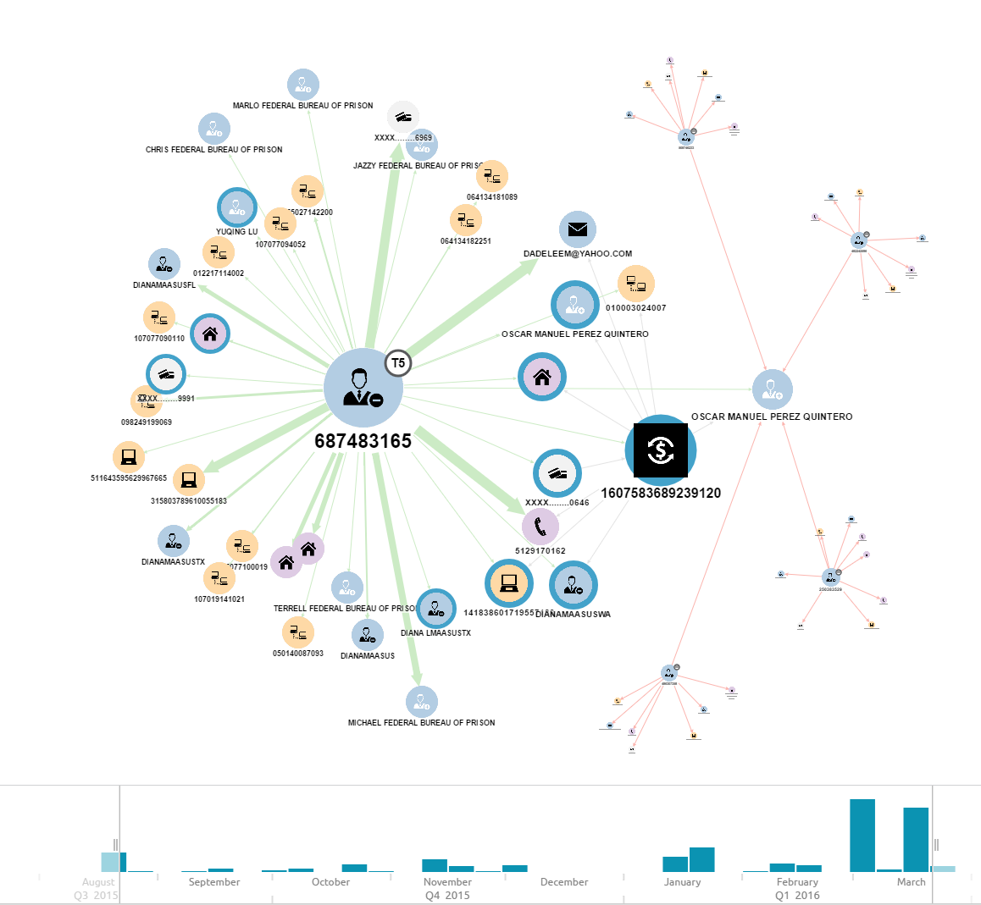
Neo4j Case of Account Take Over (ATO)
Case - 1607583689239120
Symptoms
Long established history of a T5 customer - has sent several transactions using the same Device and Credit Card (CC). Has generally sent transactions to Prison in the past. Current transaction uses new device, new CC, new address, new phone and sends to a new receiver in a new country (blue halos = new) 4 other Senders (clusters) linked to parent cluster, have recently tried to send money to the same receiver.
Diagnosis – Account Take Over (ATO)

Slide 35
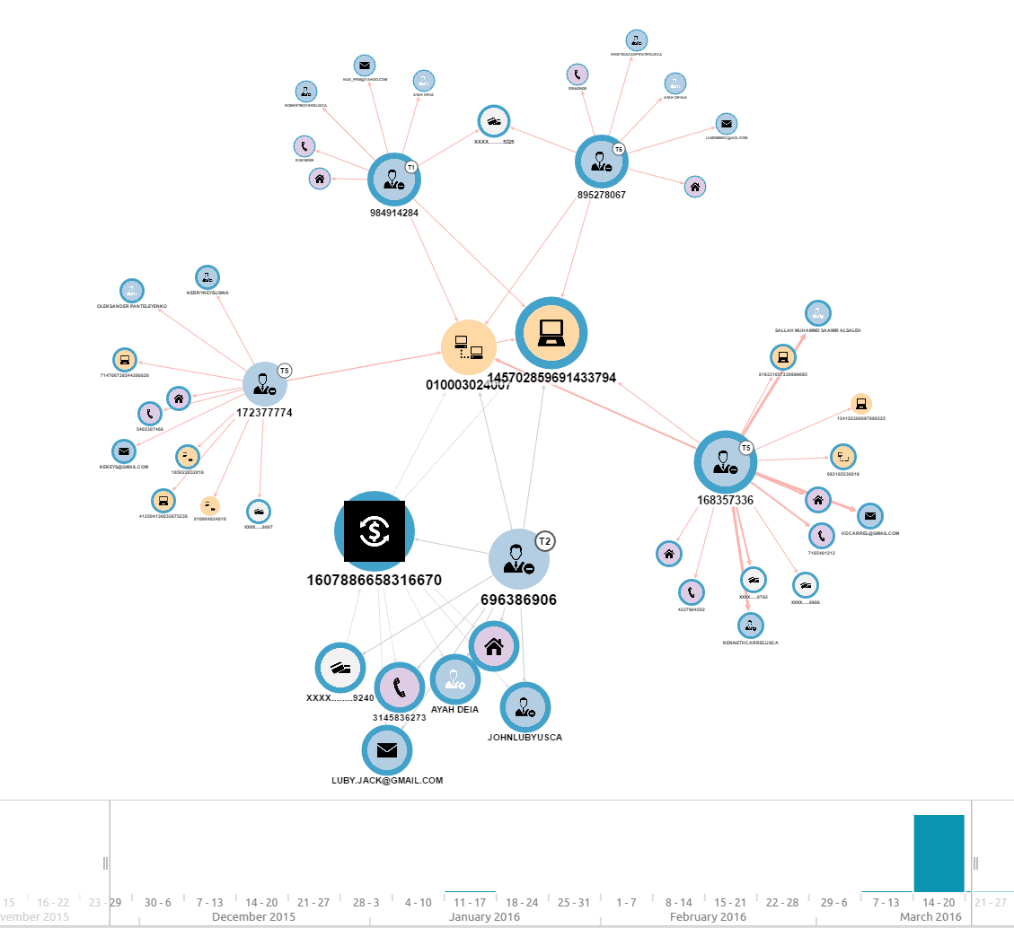
Neo4j Case of Stolen Financial (SF)
Case - 1607886658316670
Symptoms
Root transaction (Black Square) is linked to a T2 (New) customer. Recently 4 other Senders (clusters) are linked to the parent cluster, sharing Device & IP. Top two clusters also share a CC. Several declined transactions (red lines) in all the linked clusters showing low confidence Further analysis shows that all the Senders have very different names and located in different states. Receiver names in multiple clusters are very similar.
Diagnosis – Stolen Financial (SF)

Slide 36
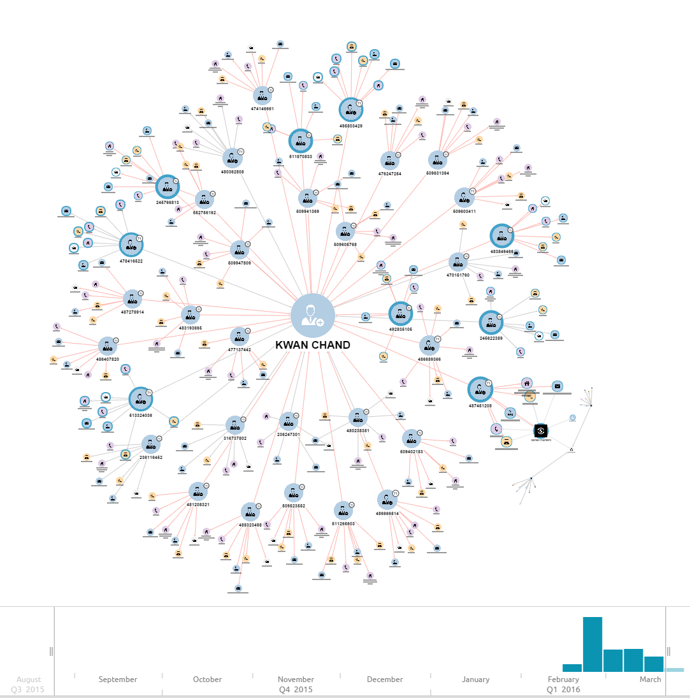
Neo4j Case of Scam
Case - 1607681174278973
Symptoms
Link Analysis at 4 degrees of separation shows a large graph – centered on the Receiver. Several new Senders sending to the same Receiver over the last couple of weeks. Further analysis shows that elderly US customers with western names sending to same receiver in India.
Diagnosis – Scam * Confirm by calling a few customers/senders.

Slide 37
Paramount Commerce
Vendor Description | Consumer and bank account authentication.
Services we use | SAV utilizes Paramount’s patented risk management software for consumer and bank account authentication
How those services are used (in rules or models / etc.) | Used in Canada

Slide 38
PayWithMyBank
Vendor Description | PayWithMyBank allows US customers to send money by connecting to their online banking account without leaving the Western Unions site or app. They enable real time instant verification (Easy Online Verification) for customers using most of WU’s top banks.
Services we use | Easy Online Verification (EOV - instant bank account verification): User verifies their account by entering their online banking credentials (not all banks are supported)
How those services are used (in rules or models / etc.) | The Risk System (e.g. Blaze) drives an offering of Easy online Verification for users on: R3 US web iOS App Android App The Risk System (e.g. Blaze) drives an offering of KYC options including new additions: Instant Bank Account Verification (Easy Online Verification) Deposit Verification (Manual Challenge Deposit Verification)

Slide 39
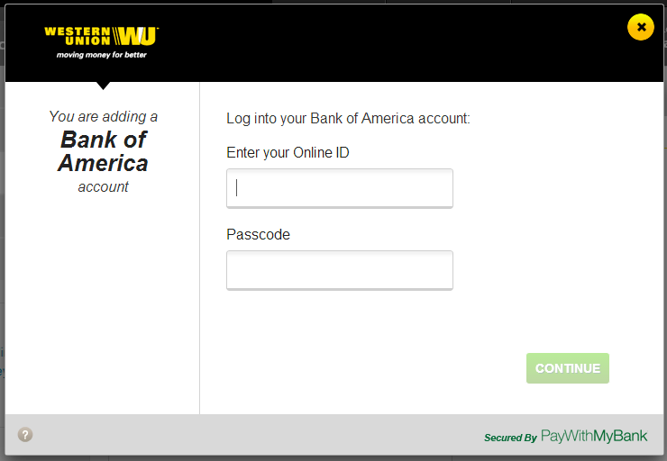
Pay With My Bank / Payment
After selecting ACH Payment:
Provide banking credentials to validate with Easy Online Verification (EOV) or walk-away/skip
EOV will verify their ownership, NAP, and sufficient funds in real-time
Walk Away/Skip will be considered in Transaction Risk Decision for Blaze decision

Slide 40
Sift Science
Vendor Description | Sift Science Service collects and stores the raw data pertaining to Users using various methods such as Client-Provided Information, Automatically Collected Information(using Javascript code on the website), Identification Technology and Cookies including any individual identifiers and personally identifiable information (the “Raw Data”). Sift Science's large-scale machine learning technology analyzes data instantly, connecting thousands of seemingly unconnected clues left behind by fraudsters. Based on this analysis, they provide us with an assessment of the relative risk that a particular User transaction or other User activity may be unauthorized or fraudulent ("Risk Assessment"). Pursuant to providing the Service, they combine and analyze data related to a User from multiple sources, including the data obtained across all or most of their Clients in order to compute a more comprehensive Risk Assessment.
Services we use | Getscore API: Provides a Sift Score for each user, which is a calculated probability between 0 and 100, that predicts how likely a user is to commit fraud. The Sift Science Console: The Sift Science console is a powerful tool that helps the monitoring team analyze the users and money transfers.
How those services are used (in rules or models / etc.) | Multiple rules in production to decline/refer to DRT for US card transactions with various sift score thresholds.

Slide 41
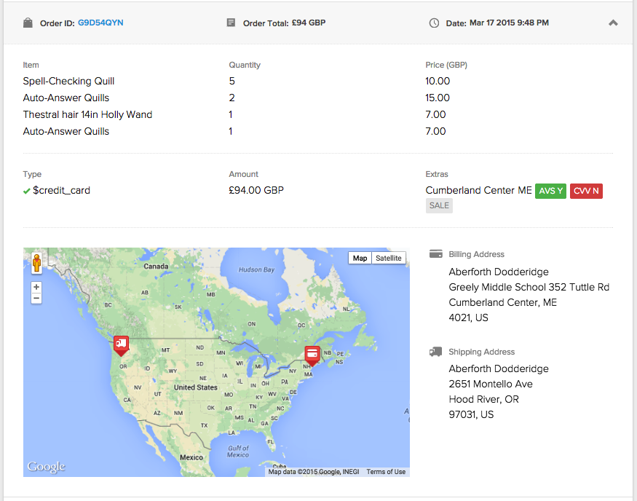
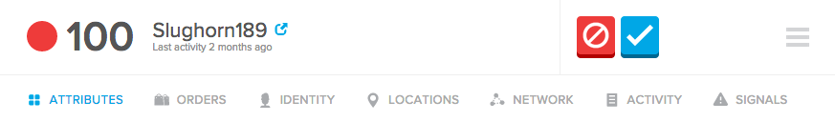
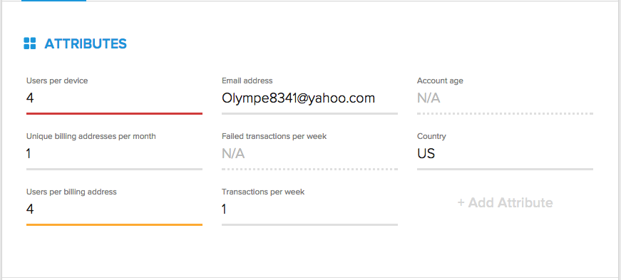
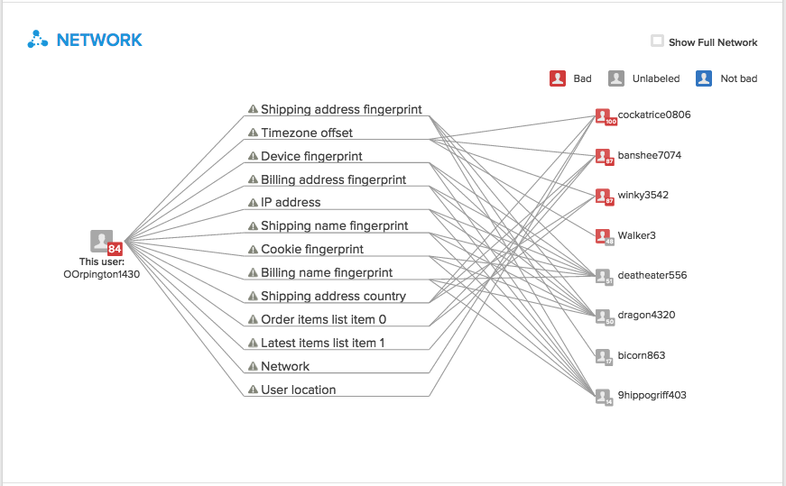
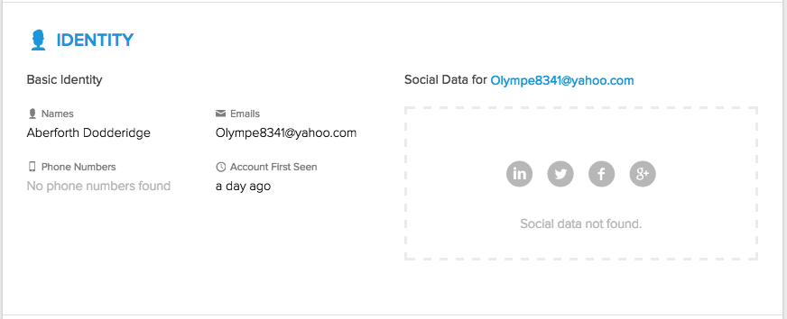
Sift Science Console
User Details contains all of the information about a given user that is available
Attributes allows us to easily customize and view user information, which will appear in both Lists and User Details pages
Displays all of the orders and transactions associated with a particular user.
Consolidated data of user’s identity information that Sift found in a single location.
Network Visualization tool to look for connections between Western Union
users and see how they are connected.

Slide 42
Sift Science getScore API response
ProviderName | SiftScience
USER_ID | 241275293
SCORE | 0.5488893
STATUS | 0
ERROR_MESSAGE | OK
REASONS | 2
Transactions_in_the_last_week | 2
Event_sequence | /us, $update_account, /us, $create_order, /us
Email_domain | xtra.co.nz
Billing/credit_card_country_codes_pair | NZ_NZ
Credit_card_country | New Zealand
Latest_billing_address_name_casing | capitalized

Slide 43
Signicat
Vendor Description | Signicat is one of the leading providers of electronic identity and electronic signature solutions in Europe. Its solutions fulfill operational capabilities in line with international standards and requirements, such as Privacy, Anti-Money Laundering (AML) and Anti-Terrorist legislation and regulations, as well as Know Your Customer (KYC) requirements for onboarding of new users. The goal is to enable customers to do business more effectively by delivering great user experiences for the end users and at the same time reduce the risk by using advanced security technology.
Services we use | The ID infrastructures services used through Signicats is the following BankID (NO), BankID on Mobile (NO), BankID as App (NO), Buypass ID, TUPAS, Elisa Mobiilivarmenne with TUPAS interface, Elisa Mobile ID, Nordea e-legitimation, Telia e-legitimation, BankID (SE), BankID on Mobile (SE), NemID.
How those services are used (in rules or models / etc.) | Signicat offers on-line identification services over the SAML protocol. The following is a high level description of the data flow between WU and Signicat. 1. The WU user is redirected to Signicat for identification, and he or she gives her credentials. 2. Signicat collects the identification data, typically SSN and name *), from the ID infrastructure. The ID infrastructure may for example be Norwegian BankID or a Finnish TUPAS Bank. The data may be retrieved from a certificate provided by the user or an on-line service, depending on the infrastructure in question. 3. Signicat returns the obtained identification data (SSN and name) to Western Union, in a SAML Assertion with a confirmation that Customer was able to successfully login with their Banking ID (EID). * For all ID infrastructures, with one exception for Danish NemID, the user ID information is not stored by Signicat.

Slide 44
TNS
Vendor Description | TNSVerify provides fraud prevention systems with a single point of access to telecom data for identity verification. The TNS service eliminates the need for fraud systems to access multiple data stores using multiple protocols, each with their own unique data format and affords access to datasets that privacy laws prohibit. TNSVerify allows fraud prevention application to invoke callouts to verify carrier, subscription, and subscriber information. No telco information is revealed or returned, only an underlying score indicating the likelihood of a data match.
Services we use | We use TNS Verify’s carrier and subscription information package, where based on the phone number we get to know which carrier, information about the phone subscription – line type, last port date, service duration, service status, text capability and subscription type
How those services are used (in rules or models / etc.) | We use the following services offered by TNS DRT analysts can view the graphical view of the transaction and its linked attributes by going to the ID Mind UI. TNS response is used in Real Time Decisions (Rules/Models) to evaluate the eligibility for KYC – text capable phone, service status TNS response is used in Real Time Decisions (Rules/Models) as a signal for riskiness – line type (VOIP is more risky), service duration, last port date TNS response is used by DRT Analysts on their portal to understand the phone service type of the customer.

Slide 45
TNS
Response Fields
Field Name | Description | Response Examples
Carrier Domain | The carrier’s Internet domain address or URL. | google.com, attwireless.com
Carrier Category | The carrier's category type. | MNO, MVNO, NUVO, MSO, other.
SPID OCN | Service Provider Identifier for the carrier. | ZA81, 7380, 6529
Service Status | Information about the telephone subscriber’s status. | unknown, active.
Service Duration | Information regarding the length of time a telephone subscriber’s account has been open | sixMonthsOrMore, lessThanSixMonths, unknown.
Line Type | Subscriber’s type of service | wireless, voip, wireline.
Subscription Type | Information about the subscriber’s subscription type. | noContract, unknown.
Txt Msg Capable | Whether the telephone number can receive text messages or not. | yes, no.
Ported Duration | Length of time since the telephone number was last ported (transferred service from one carrier to another) | 90To120Days, 3To6Years, 1To3Years. moreThan9Years
Calling Plan | Type of plan the network is associated with. | business, familyOther, unknown.
Country | Country of the phone number. | 2 digit country code

Slide 46
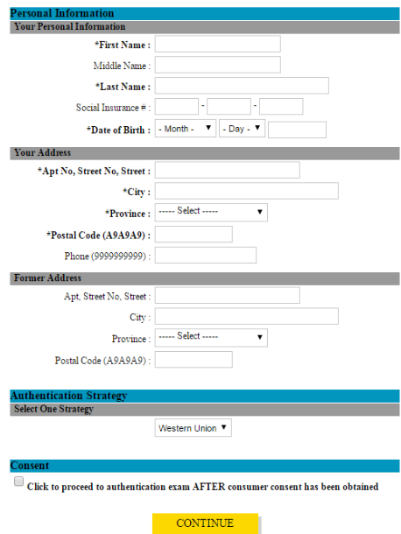
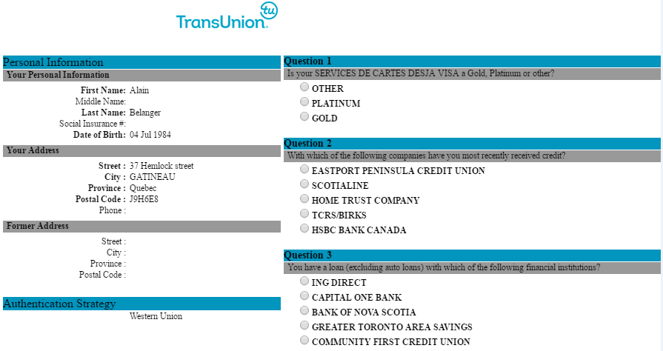
TransUnion OOW (Canada)
Vendor Description | Provides identity checks through APIs and Web checks, amongst other services.
Services we use | Provides a KBA solution that enables users with questionnaires to interview customers, these questions can be potentially answered by the true owners of the information.

Slide 47

VixVerify
Vendor Description | Australia (AU) electronic identity verification services. Comparing identifying information with a AU government issued record by having access to the Australian Federal Government Document Verification Service (DVS)
Services we use | greenID, Retail & Digital, Compliance
How those services are used (in rules or models / etc.)

Slide 48
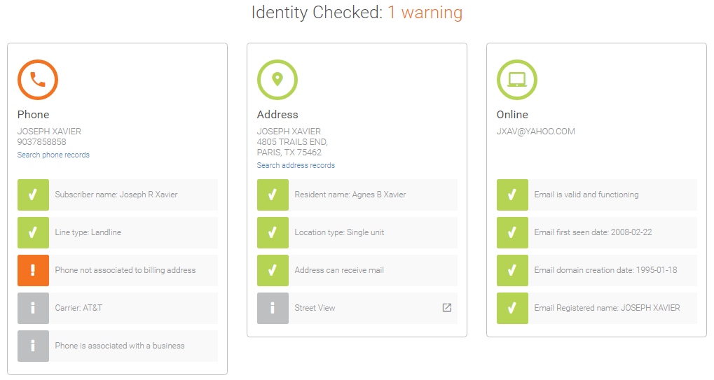
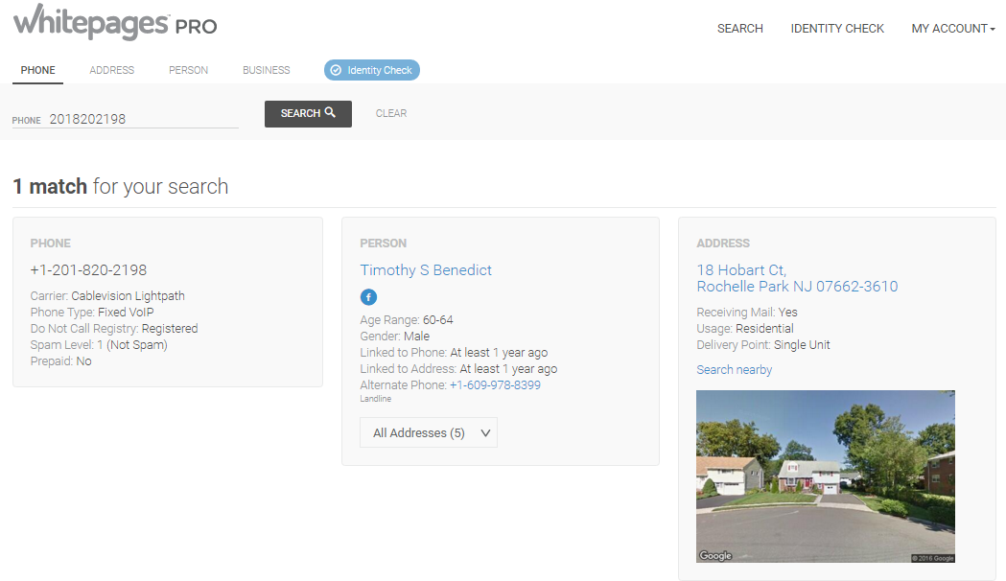
WhitePages PRO
Vendor Description | Provides identity checks, such as names, address, phone, email and IP information and determines if they match real time, this is done through their website
Services we use | Whitepages Pro: Identity check, Find by: Phone, Address, Person, Business and email.

Slide 49

Zumigo
Vendor Description | Mobile identify and location services around the globe. Zumigo provides real-time, authoritative billing and account information for major carriers around the world. They also provide real-time and near real-time solutions for mobile phone location throughout the world.
Services we use | POC in progress
How those services are used (in rules or models / etc.) | POC in progress - Exploring these services for Canada

