Slide 1
Risk Overview
August 19, 2013

Slide 2
Ways to Transact
Web
  www.westernunion.com
Smartphone App
  Download from your Android Market for iPhone apps
Mdot site
  m.westernunion.com

Slide 3
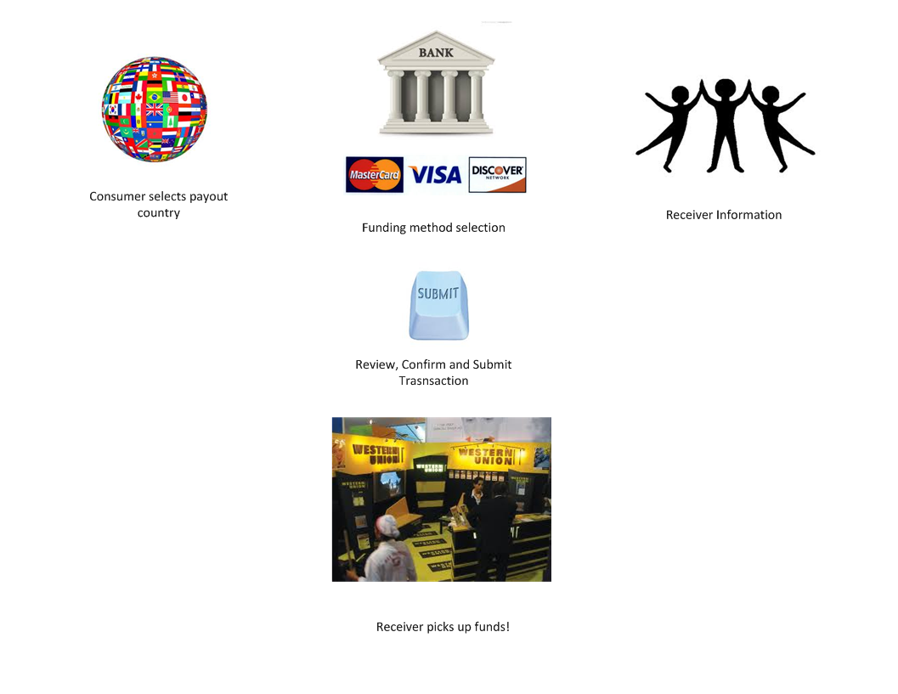
General Happy Path

Slide 4
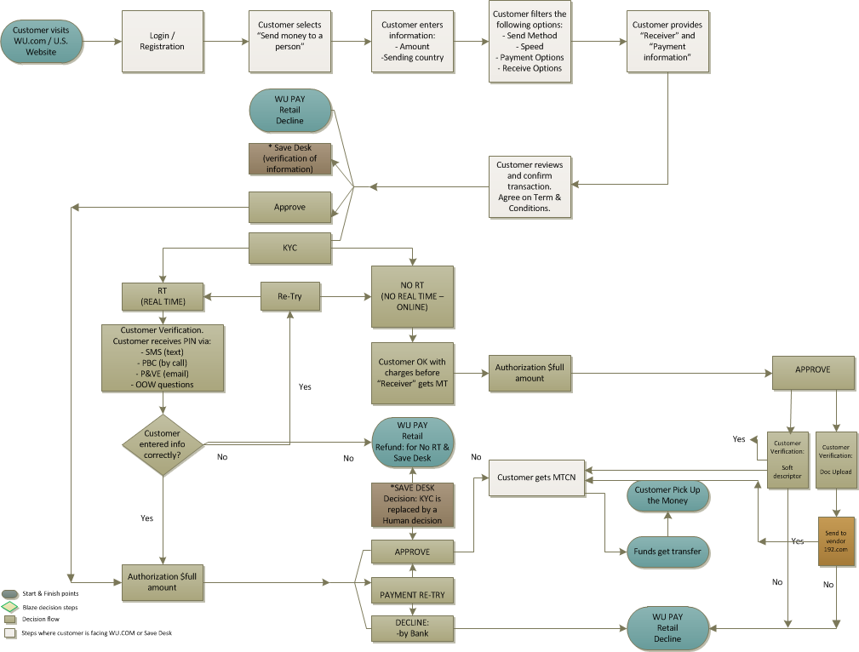
KYC path

Slide 5
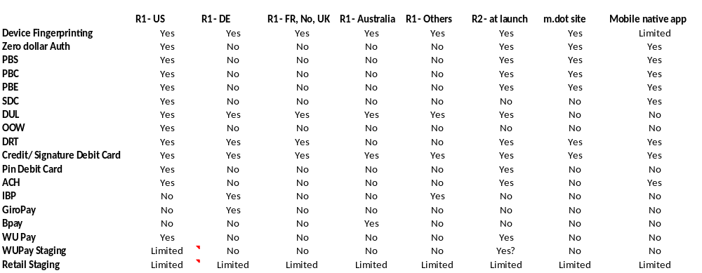
Feature Comparison Matrix

