Slide 1

RPA: Robotic Process Automation

Slide 2


Continuous Improvement - What is Robotics?
Robotics is software that can navigate across different IT systems to work the way a human does.
Robotics process automation (RPA) is the most commonly adopted type of robotics solution thus far.
RPA automates heavily rules-based processes with structured data; Think If, Then, Else…
Key Terms
Robot = “Bot”
Configuration
Vendor/Tool Examples
An individual agent or “virtual worker” capable of performing tasks assigned to it.
The action of creating an automation for a process or activity within a robotics software platform.
Automation Anywhere, Blue Prism, UiPath, Workfusion, IBM Watson, Amelia, NICE, Redwood, Pega, Kofax.
Alternatively with some tools, a bot can refer to the automated task itself.
Alternatively, some companies may use the terms “program,” “develop,” or “train.”
Source: CEB, now Gartner analysis

Slide 3
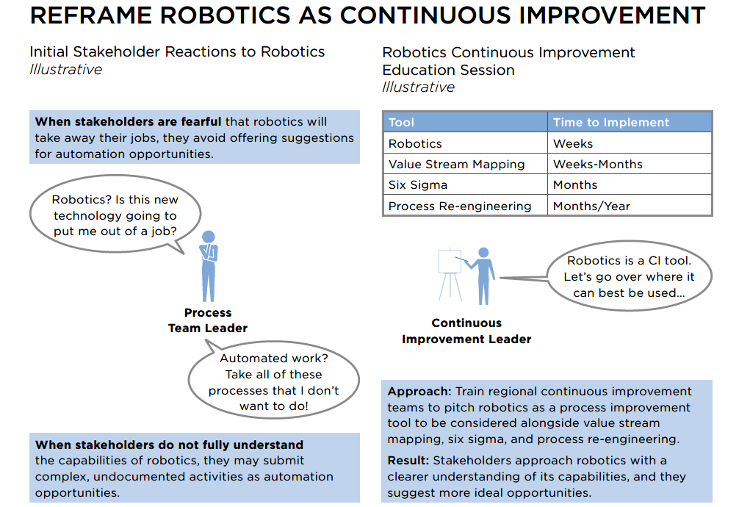
Continuous Improvement-What is Robotics? (Page 2)
Source: CEB, now Gartner analysis

Slide 4
Selection Criteria for RPA
Criteria | Description
No RPA Alternative | Processes should rely heavily on legacy systems or services that do not have supported APIs.
No Case for Modernization | Processes should have been evaluated and rejected from being reimplemented or modernized with supported APIs.
Stability | Processes should not change very frequently.
Iteration | Processes should repeat often enough to justify RPA investment, but not so often that it introduces risk or inefficiency.
Process Quality | Processes are well-architected, well-implemented, and well-documented.
Data Quality | Processes have data sources that are prepared for robotic consumption – that is, they are of good quality and are appropriate for the credentials used within the script.
Process Mechanics | Processes that include conditionality must have decisions that can be expressed and resolved through regular expression.

Slide 5
When to Use RPA
RPA is ideal for processes that:
Access web enterprise applications
Collect data from various applications
Copy and paste data
Extract structured data from documents
Follow if/then rules
Open email and attachments
Typical use cases for RPA:
Getting data into or between systems
Consolidating data into reports or standardized formats
Automating a structured, predetermined workflow or building a workflow
Send exceptions or cases with more subjective decisions to the employee
RPA can complete repetitive/rules-based processes faster and with less errors than a human employee
Using RPA in a highly repetitive process will free up employees to complete higher value work

Slide 6
Use Cases for RPA (Finance)
Category | Subprocess | Use Case
Financial Reporting | Cash Flow Statement Preparation | Extract bank statement information into prepared template to accelerate the preparation of the cash flow statement.
Financial Reporting | Fixed Asset Accounting | Create a new asset record in the accounting system, open invoice, copy acquisition date, placed-in-service date, description, type and cost basis, then paste into the new record to reduce manual processing time.
Financial Reporting | Goods-in-Transit Accounting | Open supplier portal, navigate to goods status page, copy current status, open Excel spreadsheet, paste status into local tracking database to ensure accuracy of goods in transit reporting.
Financial Reporting | Variance Report Accounting | Open vendor invoice database, organize by date, match line items by date, mark items with no invoice match, take note of invoice IDs, tabulate variances, notify accounting personnel to reconcile variances in vendor invoices.
Financial Close and Consolidation | Bank Reconciliation | Log into bank account, download statement, extract statement information, match transactions against ledger, flag exceptions to ensure accuracy and compliance during the close.
Financial Close and Consolidation | General Ledger Reconciliations | Open the general ledger (GL), match the beginning balance to the ending reconciliation detail from the prior period for each account, send notification to accounting personnel when accounts do not match to ensure complete accuracy of reconciliations.

Slide 7
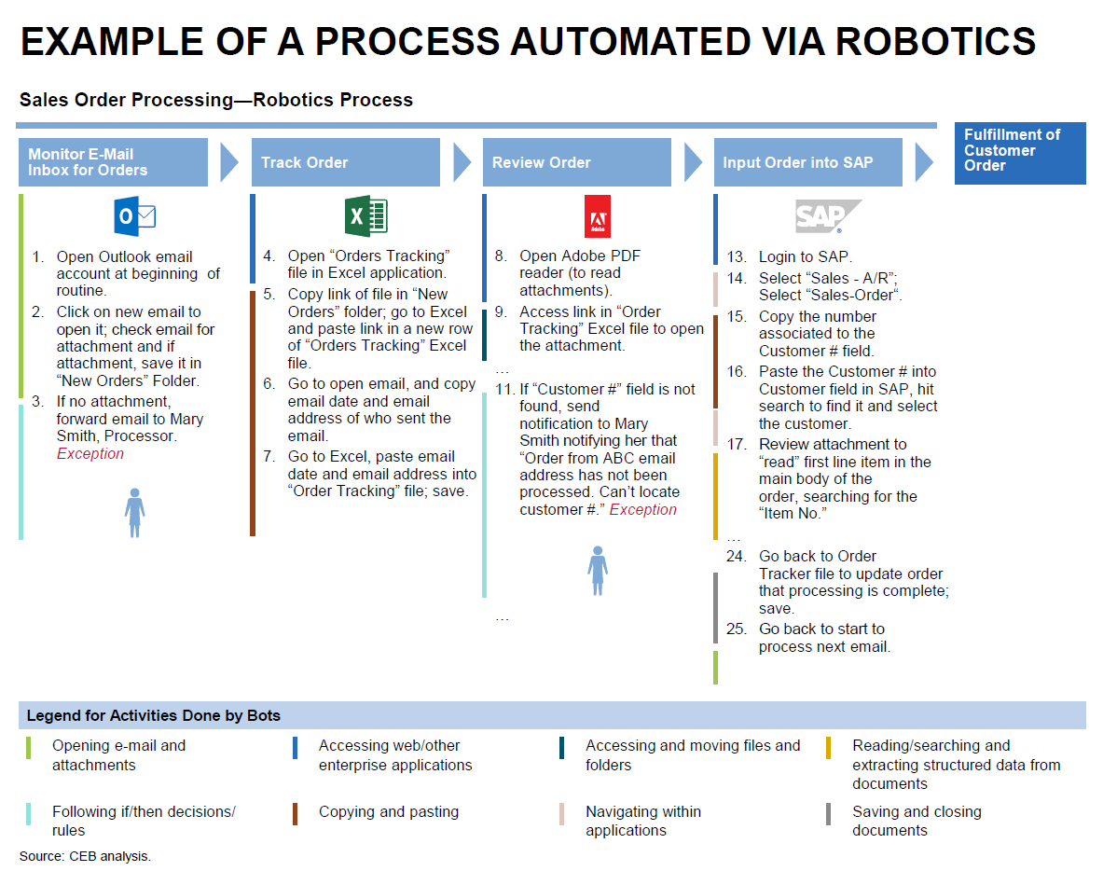
Example of a Process Automated via Robotics

