Slide 1
Prediction of soccer player performance
Ou Jin
September, 2019

Slide 2
Outline:
Project goal and dataset
Data wrangling
Exploratory data analysis
Machine learning
Decision Tree regression
Random Forest regression

Slide 3
Project goal and dataset:
To establish a predictive model to predict players’ value based on their physical attributes and skill scores.
May help soccer clubs in recruiting players.
FIFA19 soccer player data available on www.Kaggle.com has many player attributes (skill score of many kinds, and physical attributes like height, weight, etc.) and player overall score and potential.
https://www.kaggle.com/karangadiya/fifa19
The dataset is rich in attributes with 18.2k rows by 89 columns

Slide 4
Data wrangling:
Drop columns that are apparently not part of physical attributes or skill scores, and columns that don’t have much useful or clear meaning.
'Unnamed: 0', 'ID', 'Photo', 'Flag', 'Club', 'Club Logo', 'Jersey Number', 'Joined', 'Loaned From', 'Contract Valid Until', 'Release Clause', 'Real Face', 'Special', 'Work Rate', 'Body Type', and 26 other columns corresponding to player positions
Divide column Work Rate into two columns, Attack Work Rate and Defence Work Rate. Work Rate has attack and defence work rate combined.
Remove ‘lbs’ from string values in column Weight and change the column data type to float.
Convert Height column from like 5’9’’ to numerical values in inches.
Remove ‘€’ sign from Value and Wage columns, and convert values into numerical. Calculate differently according to different unit (in million or kilo).
Drop 60 lines that have missing values.
Combine 27 player positions in Position column into 6 simplified positions. E.g. combine all RB, CB, LCB, etc. positions into one position.
Before combining, some position only has 15 samples/players
Apply one-hot-coding to Attack Work Rate, Defence Work Rate, and Simple Position.

Slide 5
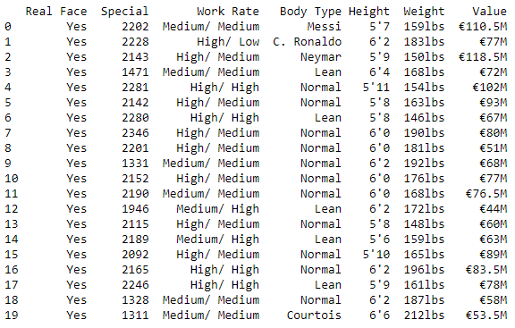

Above showing data columns that need transformation

Slide 6
Exploratory data analysis
Questions of interest:
Which variable is best as Predicted--Value, Wage, Overall, Potential?
Are certain player positions under- or over-valued in the dataset?
Does player value decrease when player becomes older?
Does monetary value follow the perceived player value or potential?
How is value and potential related?
How does players’ international reputation impact their perceived value?
Is preferred foot a strong factor in average?
Are players’ physical attributes larger factors?
Are individual skill scores good predictors for players’ value?

Slide 7
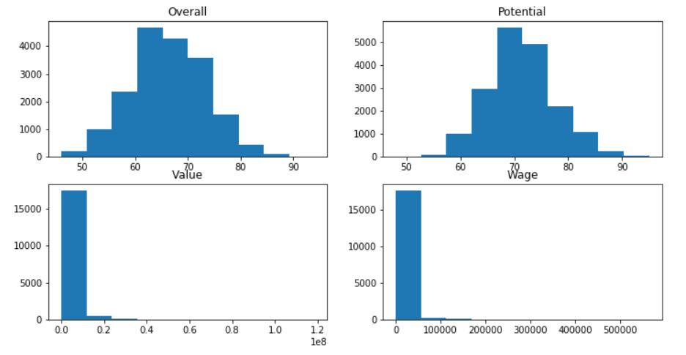
EDA: histogram of possible Predicted variables
Overall and Potential are close to normal distribution.
Value and Wage (both in monetary term) are very right skewed, with even some 0 values.

Slide 8
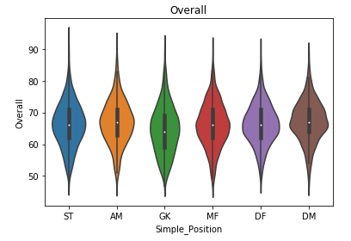
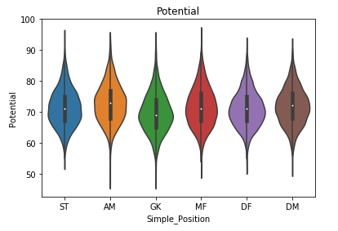
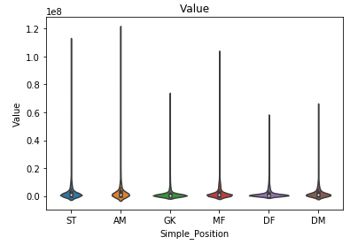
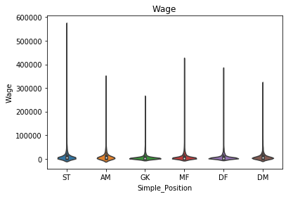
EDA: possible Predicted vs. player positions
GK has lowest mean Overall and Potential. AM has the highest mean.

Slide 9
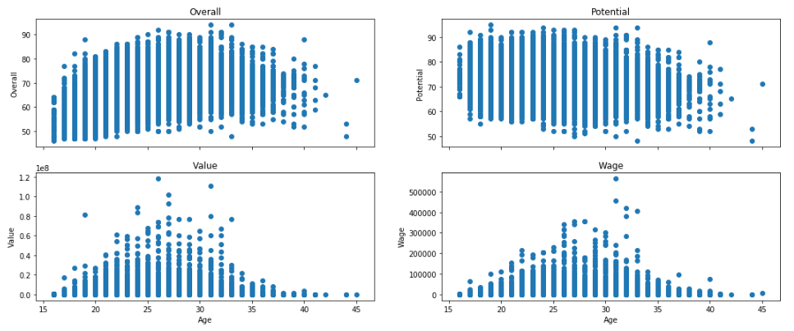
EDA: possible Predicted variable vs. Age
Overall tends to go up with the increase of Age to a little above 30 years old, and then starts to go down
Potential has a general trend to go down with the increase of Age.
Value and Wage peaks around 27 years old, with some exceptions due to several super stars.

Slide 10
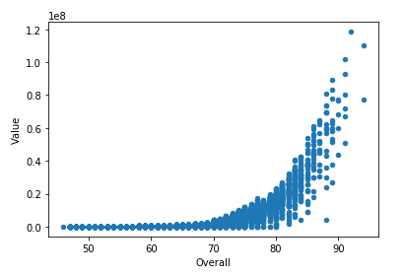
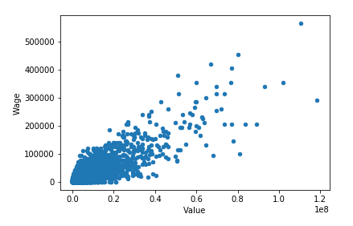
EDA: relationship among possible Predicted variables
Monetary value stays low with Overall below ~70, then it starts to increase exponentially.
Wage and Value (both in monetary term) appear to have a positive linear relationship. There is still a lot of variation in Wage at the same Value level due to many other factors (contract, club, age, etc.).

Slide 11
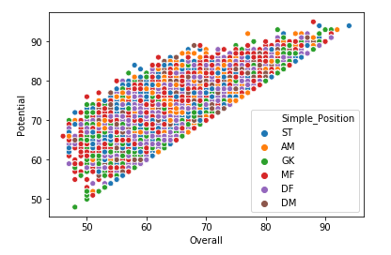
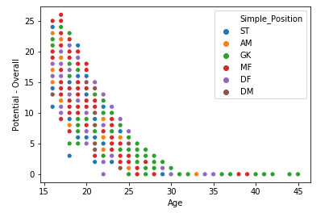
EDA: Overall vs. Potential, and Age
Potential vs. Overall scatter plot shows a clear linear boundary.
The calculation of (Potential - Overall) shows that Potential is lower-bounded by Overall, i.e. Potential equals Overall plus some positive value.
(Potential - Overall) vs. Age scatter plot (shown above) shows that the positive difference decreases with Age, and goes down to 0 at 31 years old and beyond.

Slide 12
Overall is the best Predicted variable to use

Slide 13
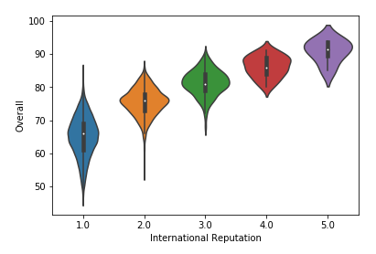
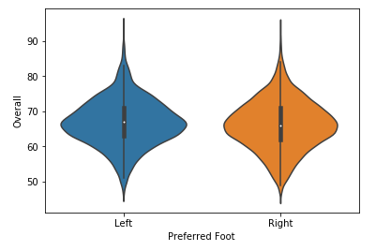
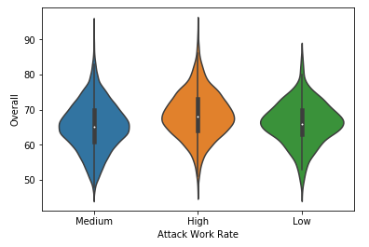
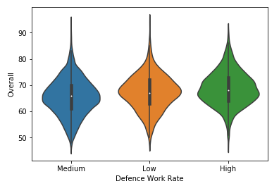
EDA: Overall vs. International Reputation, Preferred Foot, and Work Rate
Not surprisingly, the higher the International Reputation, the higher the Overall.
Left or Right foot does not show significant difference in impact of Overall.
The higher the Attack Work Rate, the higher the Overall. Mean difference is not very large.
Defence Work Rate does not show clear impact on Overall.

Slide 14
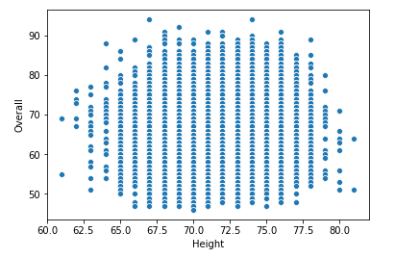
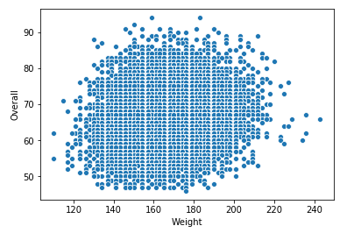
EDA: Overall vs. Height and Weight
Height does not show significant correlation to Overall, while Weight appears to show a small positive correlation to Overall.

Slide 15
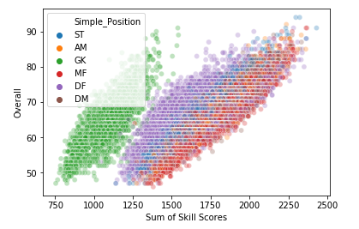
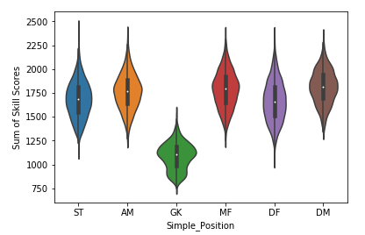
EDA: Sum of all skill scores vs. Overall and Position
Sum of all 34 skill scores like Crossing, Dribbling, Agility, GKReflexes, etc. is calculated.
Scatter and violin plots above clearly shows that GK (Goal Keeper) stands out with lower sum of scores, which is not surprising.

Slide 16
Machine Learning:
Applied Decision Tree regression and Random Forest regression
Flexible in handling non-linear relationship
Some technical details:
Set aside 20% of data (~3600 players) as testing data for model comparison
Used 5-fold cross-validation on rest (80%) as training data
Used randomized search to tune hyper-parameters
Decision Tree: tree depth, minimum samples to split
Random Forest: tree depth, minimum samples to split, maximum features, number of trees

Slide 17
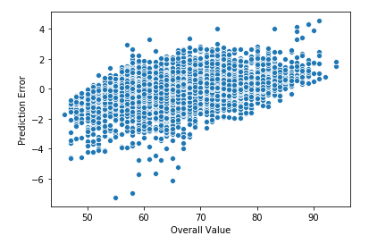
Modeling Results:
Random Forest performs better than Decision Tree regressor.
Decision Tree generated mse of 4.24 on held-out test data (make sure it is root mean squared error)
Random Forest generated mse of 1.40 on held-out test data
Random Forest generated Mean Absolute Percent Error of 0.70%.
Random Forest error plot below shows that the model under-fits a little at high Overall Value end, and overfits a little at low end. Some investigation is needed.

Slide 18
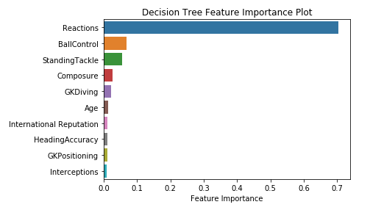
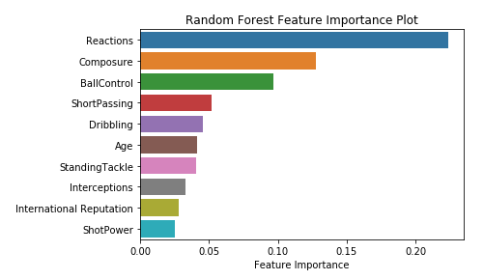
Modeling Insights:
Both regressors have 7 out 10 most important predictors overlapping, which are scores for Reactions, Composure, Ball Control, Standing Tackle, Interceptions, plus Age and International Reputation.

Slide 19
Conclusion:
A random forest regression model was developed to predict overall value of soccer players based on their scores on many aspects of their individual skill sets, physical attributes and reputation.
The model can predict on unseen data with Mean Absolute Percent Error of about 0.70%.
The model indicates that Reaction, Composure, Ball Control, Short Passing, and Dribbling as the top five skills.

