Slide 1
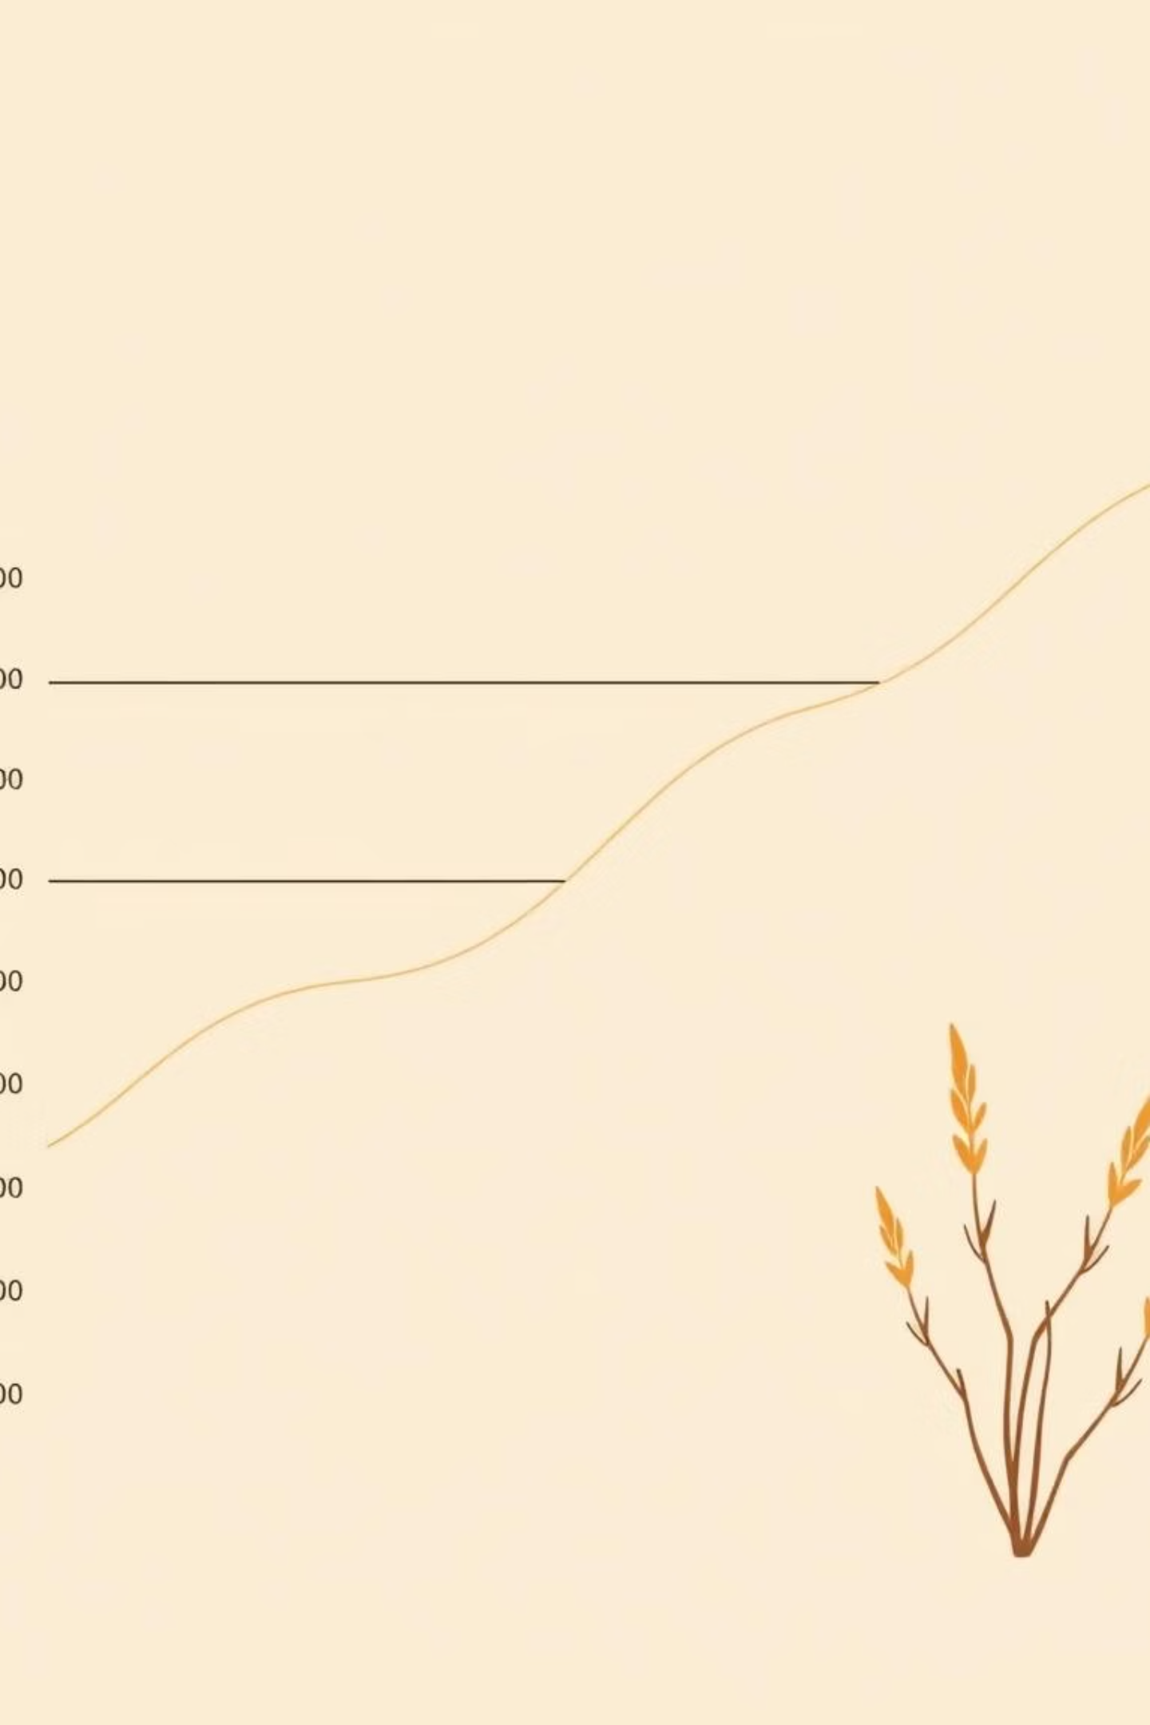
Why MSE/RMSE Penalize Large Errors More Heavily
Understanding Error Metrics in Machine Learning

Slide 2
Navigating Predictive Accuracy
Why Do MSE/RMSE Amplify Large Errors?
This presentation will explore the critical role of Mean Squared Error (MSE) and Root Mean Squared Error (RMSE) in regression analysis, focusing on their inherent tendency to penalize larger prediction inaccuracies.
What are MSE & RMSE?
Where are they used?
Why do they penalize large errors?
Examples & Applications

Slide 3
Defining MSE and RMSE
Mean Squared Error (MSE)
Root Mean Squared Error (RMSE)
Square root of the MSE.
Average of the squared differences between predicted and actual values.
Returns the error to the original units of the target variable.
Squaring errors ensures all values are positive and emphasizes larger errors.
Easier to interpret and compare directly with the data.
Unit is the square of the target variable's unit.
Both metrics quantify the average magnitude of errors, but RMSE provides a more interpretable value in the context of the original data.

Slide 4
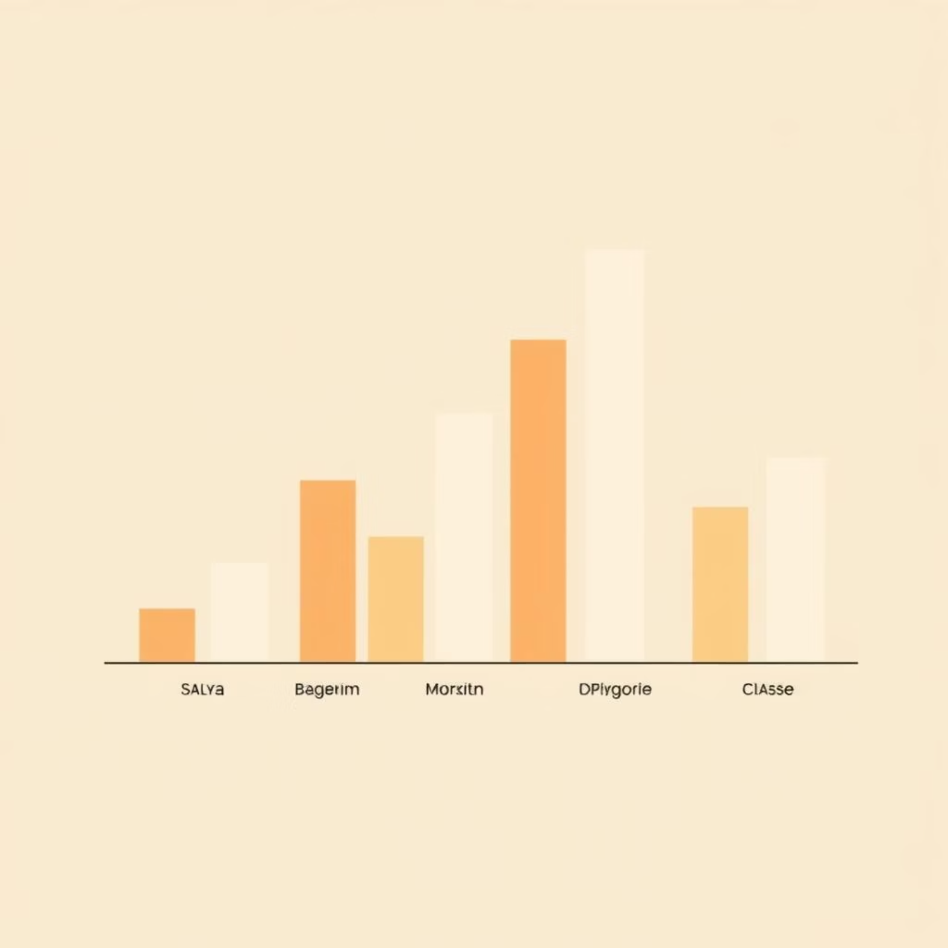
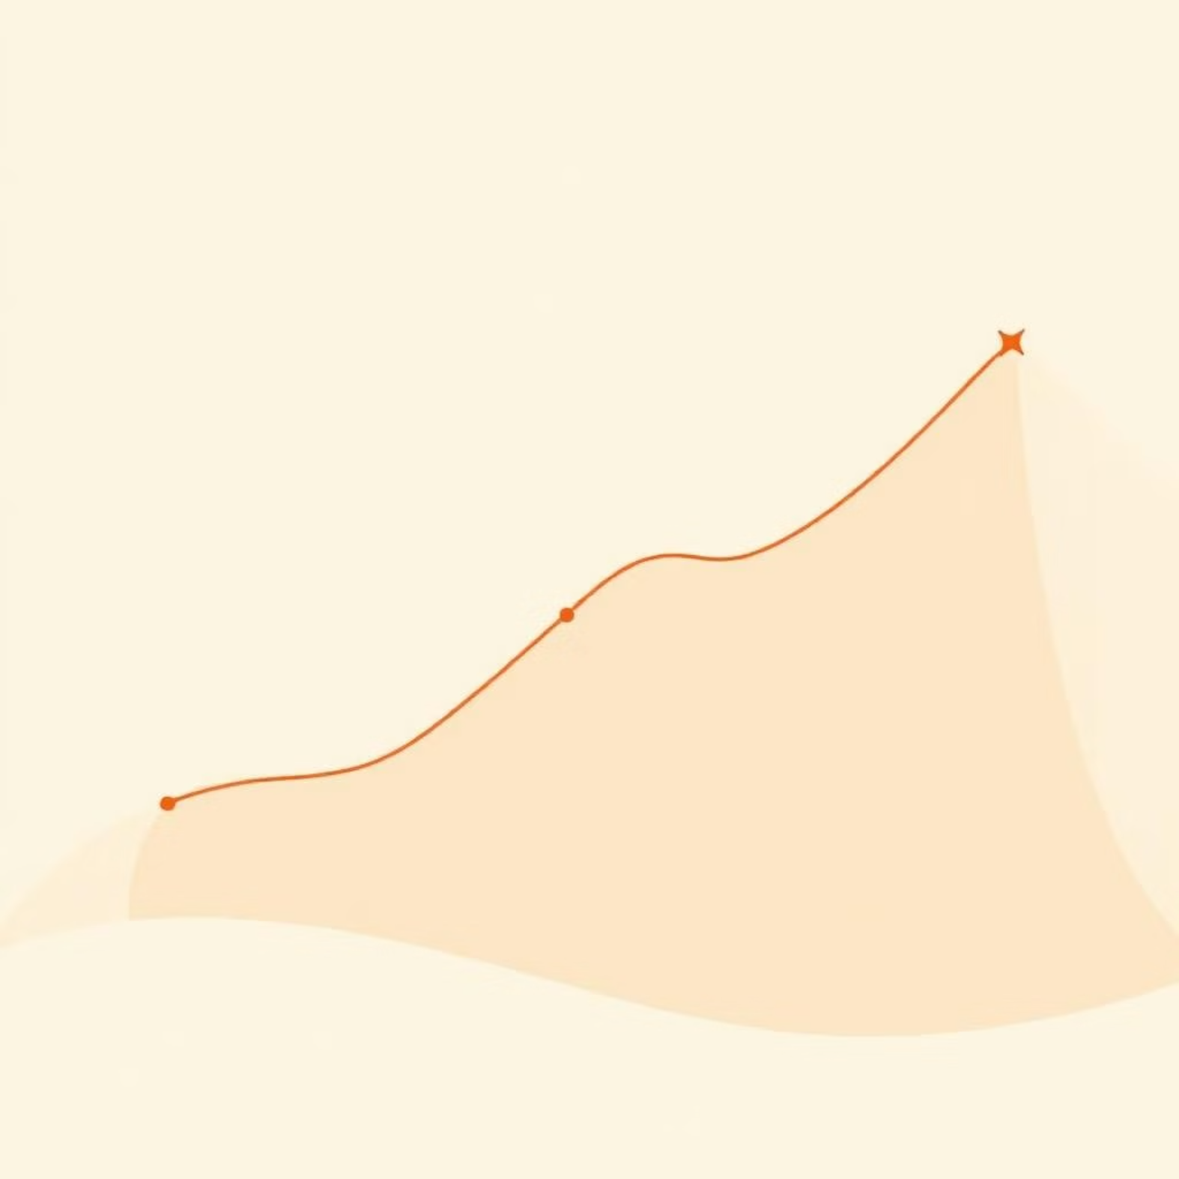
Application Scope: Regression Problems Only
Used in Regression ✅
Not for Classification ❌
MSE and RMSE are exclusively used for regression tasks, where the goal is to predict continuous numerical values.
These metrics are inappropriate for classification problems, which involve predicting discrete categories or labels.
Predicting house prices
Categorical labels (e.g., spam/not spam, disease/no disease)
Estimating delivery times
Metrics like accuracy, precision, and recall are used instead.
Forecasting temperatures
Predicting product demand

Slide 5



The Power of Squaring: Why Large Errors are Penalized
"Penalizing large errors" means bigger mistakes incur a disproportionately higher cost than smaller ones.
Small Error
Moderate Error
Large Error
If the error is 2 units,
If the error is 5 units,
If the error is 10 units,
Squared Error = 4
Squared Error = 25
Squared Error = 100
The squaring function causes errors to grow exponentially. This characteristic is highly desirable in scenarios where significant mistakes carry severe consequences, such as inaccurate medical dosages or critical financial predictions.

Slide 6
Example 1: Consistent Small Errors
Consider a model predicting delivery times, where all predictions are consistently off by just 1 minute.
Actual
Predicted
Error
Error²
10
11
-1
1
20
21
-1
1
30
31
-1
1
40
41
-1
1
50
51
-1
1
In this scenario, the model exhibits high consistency. The MSE and RMSE remain low, indicating that the small, uniform errors do not significantly impact the overall error metric.

Slide 7
Example 2: One Large Error Dominates
Now, observe the effect when just one prediction is significantly off, while others remain small.
Actual
Predicted
Error
Error²
10
11
-1
1
20
21
-1
1
30
31
-1
1
40
41
-1
1
50
70
+20
400
The impact of the single large error is dramatically amplified due to the squaring term. The MSE jumps from 1 to 80.8, and RMSE increases from 1 to approximately 8.98, demonstrating how MSE/RMSE heavily penalize significant deviations.

Slide 8
Why This Penalty Matters
The inherent penalty for large errors in MSE and RMSE serves a critical purpose in model evaluation and development.
Prevents Costly Mistakes
1
Ensures models don't just perform well on average but actively avoid catastrophic individual errors.
Encourages Accuracy
2
Drives models to be more precise, as even a few large errors will significantly impact the overall score.
Critical in High-Stakes Fields
Essential when large prediction errors can lead to:
3
Financial Loss: Inaccurate stock market predictions.
Safety Issues: Misjudging critical engineering parameters.
Poor User Experience: Highly delayed delivery estimates.
By heavily weighting larger discrepancies, MSE and RMSE guide models toward minimizing the most impactful errors.

Slide 9



Limitations of MSE and RMSE
While powerful, MSE and RMSE have certain drawbacks that data scientists must consider.
Sensitive to Outliers
MSE Unit Problem
No Error Direction
A single extreme prediction can drastically inflate MSE/RMSE, potentially misrepresenting overall model performance.
MSE is in "squared units" (e.g., "dollars squared"), making it less intuitive to interpret compared to the original data units.
Neither metric indicates whether the model consistently over-predicts or under-predicts the actual values.
Understanding these limitations is crucial for choosing the right evaluation metric and interpreting model results accurately.

Slide 10



Real-World Impact: Food Delivery App
Consider a food delivery application where accurate delivery time prediction is crucial for customer satisfaction.
Actual Delivery Time: 30 minutes
Model Prediction 1: 32 min
Error: +2 minError²: 4 (tolerable)
Model Prediction 2: 60 min
Error: +30 minError²: 900 (highly penalized)
A 2-minute error might be acceptable, but a 30-minute overestimation leads to customer frustration and potential order cancellations.
RMSE ensures that models are trained to avoid the 30-minute overestimation much more than the 2-minute deviation.

