Slide 1
AndroMDA Boot Camp
"From scratch to your own cartridge in four days"
Part 2: Implementing your own cartridge
Copyright © 2014: andromda.org (BSD License)
all rights reserved
Notes:
AndroMDA Boot Camp Course Material
February 4, 2007
© 2007 Matthias Bohlen, mbohlen@andromda.com, http://www.andromda.com

Slide 2
MDSD with MagicDraw and AndroMDA
Part 2: Implementing your own cartridge
Copyright © 2014: andromda.org (BSD License)
all rights reserved
Notes:
AndroMDA Boot Camp Course Material
February 4, 2007
© 2007 Matthias Bohlen, mbohlen@andromda.com, http://www.andromda.com

Slide 3
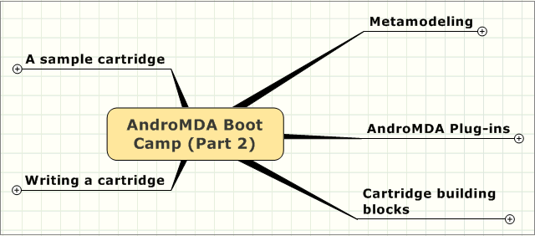
AndroMDA Boot Camp (Part 2)
Notes:
AndroMDA Boot Camp Course Material
February 4, 2007
© 2007 Matthias Bohlen, mbohlen@andromda.com, http://www.andromda.com

Slide 4
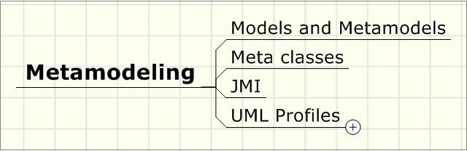
Metamodeling
Notes:
AndroMDA Boot Camp Course Material
February 4, 2007
© 2007 Matthias Bohlen, mbohlen@andromda.com, http://www.andromda.com

Slide 5
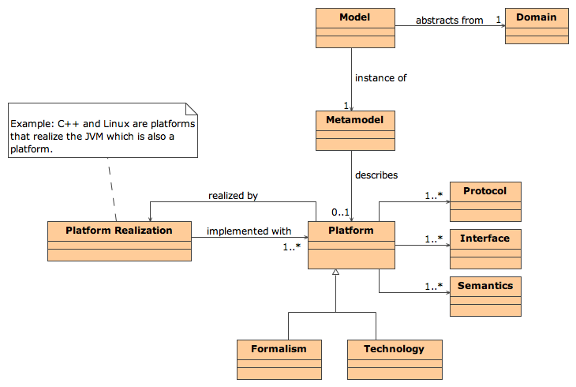
MDA: Basic Concepts
Notes:
AndroMDA Boot Camp Course Material
February 4, 2007
© 2007 Matthias Bohlen, mbohlen@andromda.com, http://www.andromda.com

Slide 6
Definition of "Model"
Model
  A model is the abstraction of an application domain (shop, bank, etc.)
  Example 1:
  A model of a shop contains notions like Order and Price
  Example 2:
  A model of a bank contains notions like Account und Transfer
Notes:
AndroMDA Boot Camp Course Material
February 4, 2007
© 2007 Matthias Bohlen, mbohlen@andromda.com, http://www.andromda.com

Slide 7
Definition of "Metamodel"
Metamodel
  A metamodel is a model for the domain of modeling
  Example 1:
  The XML metamodel contains notions like Node, Element and Attribute
  Example 2:
  The UML metamodel contains notions like Class, Property, Operation, Association
Notes:
AndroMDA Boot Camp Course Material
February 4, 2007
© 2007 Matthias Bohlen, mbohlen@andromda.com, http://www.andromda.com

Slide 8
Models on metalevels M0-M2
Metamodel (M2)
Class
Property
-name : String
-name : String
instanceOf
instanceOf
instanceOf
UML model (M1)
-fromAccount
Account
-toAccount
Transfer
-accountNumber : String
-amount : Number
instanceOf
instanceOf
instanceOf
Application data (M0)
a1 : Account
a2 : Account
t : Transfer
123-456-789
456-789-123
1500
Notes:
AndroMDA Boot Camp Course Material
February 4, 2007
© 2007 Matthias Bohlen, mbohlen@andromda.com, http://www.andromda.com

Slide 9
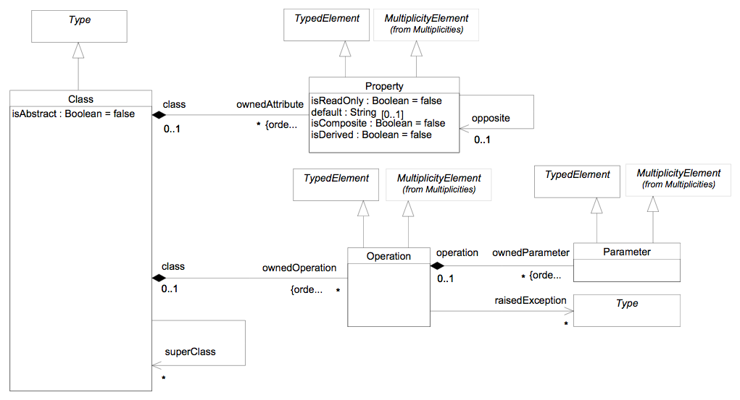
UML Metamodel (1)
These are
so-called metaclasses
Notes:
AndroMDA Boot Camp Course Material
February 4, 2007
© 2007 Matthias Bohlen, mbohlen@andromda.com, http://www.andromda.com

Slide 10
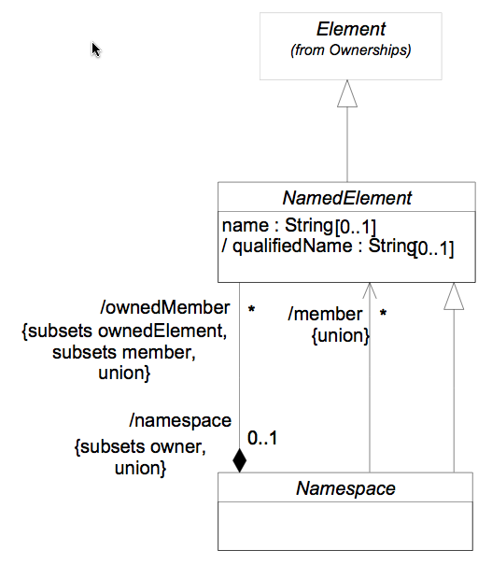
UML Metamodel (2)
When loading a model, metaclasses are
instantiated as metaobjects.
Metaobjects can be accessed via JMI or
EMF interfaces.
Notes:
AndroMDA Boot Camp Course Material
February 4, 2007
© 2007 Matthias Bohlen, mbohlen@andromda.com, http://www.andromda.com

Slide 11
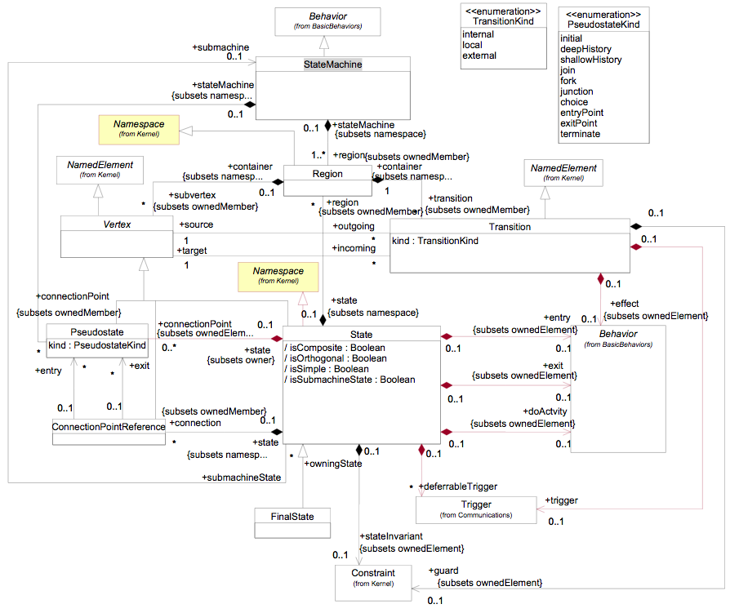
UML Metamodel (3)
The JMI or EMF interfaces
contain getter methods
for the attributes you see
here in the metaclasses.
Notes:
AndroMDA Boot Camp Course Material
February 4, 2007
© 2007 Matthias Bohlen, mbohlen@andromda.com, http://www.andromda.com

Slide 12
UML profile: What is it?
Standard mechanism to extend the language UML
Language elements used
  Stereotype
  Tagged Value (UML2 Stereotype Attribute)
  OCL Constraint
Notes:
AndroMDA Boot Camp Course Material
February 4, 2007
© 2007 Matthias Bohlen, mbohlen@andromda.com, http://www.andromda.com

Slide 13
Stereotypes
Stereotypes
  classify other model elements
  almost create new "metaclasses"
  can be attached to any model element
    Class, Property, Operation, Parameter
    State, Transition, Activity, etc.
Stereotypes mark model elements in an application specific way
  Most UML tools even allow to associate an icon with a stereotype
Notes:
AndroMDA Boot Camp Course Material
February 4, 2007
© 2007 Matthias Bohlen, mbohlen@andromda.com, http://www.andromda.com

Slide 14
Tagged Values
Tagged Values
  extend the attribute set of a metaclass
  can be associated with a metaclass or with a stereotype
Using stereotypes and tagged values, you create your own vocabulary for modeling
Limitation:
  Below all this is the UML metamodel
  So you can only model what is valid in UML!
Notes:
AndroMDA Boot Camp Course Material
February 4, 2007
© 2007 Matthias Bohlen, mbohlen@andromda.com, http://www.andromda.com

Slide 15
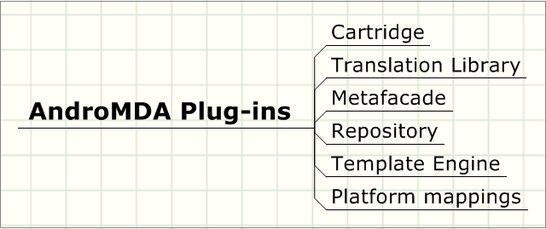
AndroMDA Plug-ins
Notes:
AndroMDA Boot Camp Course Material
February 4, 2007
© 2007 Matthias Bohlen, mbohlen@andromda.com, http://www.andromda.com

Slide 16
AndroMDA Plug-ins (1)
Repository
  loads models and metamodels
Metafacade
  adds code generation behavior to a metaclass
Cartridge
  container for metafacades and templates
  orchestrates the translation from
  model to model and model to code
Notes:
AndroMDA Boot Camp Course Material
February 4, 2007
© 2007 Matthias Bohlen, mbohlen@andromda.com, http://www.andromda.com

Slide 17
AndroMDA Plug-ins (2)
Translation Library
  translate OCL to Java (or other languages)
Template Engine
  translates objects to text (e.g. source code)
Platform mapping
  simple XML file, maps platform-independent stuff to platform-specific stuff
  best example:
  mapping of PIM data types to Java
  or SQL data types
Notes:
AndroMDA Boot Camp Course Material
February 4, 2007
© 2007 Matthias Bohlen, mbohlen@andromda.com, http://www.andromda.com

Slide 18
Cartridge invocation and control
Maven
calls
andromda.xml
AndroMDA Maven Plugin
reads
calls
AndroMDA core
cartridge.xml
reads
calls
cartridge
namespace.xml
profile.xml
metafacades.xml
Notes:
AndroMDA Boot Camp Course Material
February 4, 2007
© 2007 Matthias Bohlen, mbohlen@andromda.com, http://www.andromda.com

Slide 19
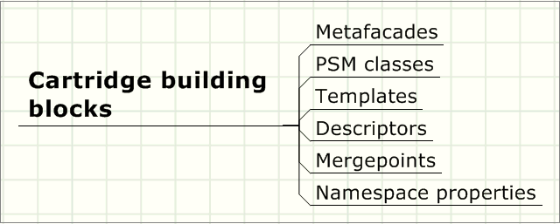
Cartridge building blocks
Notes:
AndroMDA Boot Camp Course Material
February 4, 2007
© 2007 Matthias Bohlen, mbohlen@andromda.com, http://www.andromda.com

Slide 20
What is a cartridge?
Cartridge is a jar file (or directory) on the classpath
It is a plug-in for AndroMDA that generates code for a given target platform or technology
Packages all the items needed for code generation (templates, metafacades, etc.)
Describes itself via a cartridge descriptors
Notes:
AndroMDA Boot Camp Course Material
February 4, 2007
© 2007 Matthias Bohlen, mbohlen@andromda.com, http://www.andromda.com

Slide 21
How a cartridge generates code
abstract syntax tree
<xmi>
</xmi>
metafacade returns
PSM metaobjects
retrieves objects
or values
Code
Template engine
= PIM metaobject
= metafacade
templates
= PSM metaobject
Notes:
AndroMDA Boot Camp Course Material
February 4, 2007
© 2007 Matthias Bohlen, mbohlen@andromda.com, http://www.andromda.com

Slide 22
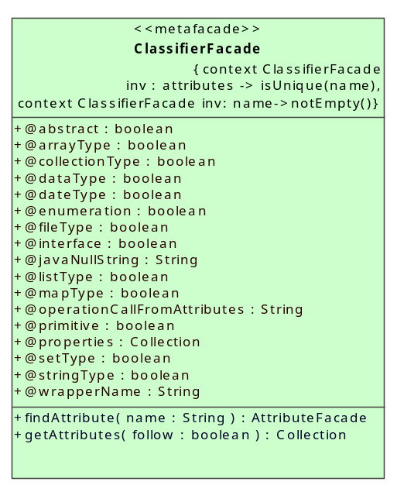
Metafacade
short for "metaclass facade"
Class that adds code generation behavior to an ordinary metaclass
Example:
  ClassifierFacade delivers
  all kinds of useful info
  about a UML Classifier
  metaobject and its children:
Notes:
AndroMDA Boot Camp Course Material
February 4, 2007
© 2007 Matthias Bohlen, mbohlen@andromda.com, http://www.andromda.com

Slide 23
Metafacade instantiation
Metafacade objects are instantiated by an XML-configurable factory
  metafacades.xml contains the mapping rules
  Mapping rules trigger on:
    metaclass name
    stereotype name
    metafacade property value
<metafacade class="org.andromda.metafacades.emf.uml2.ClassifierFacadeLogicImpl">
<mapping class="org.eclipse.uml2.impl.ClassifierImpl"/>
</metafacade>
Notes:
AndroMDA Boot Camp Course Material
February 4, 2007
© 2007 Matthias Bohlen, mbohlen@andromda.com, http://www.andromda.com

Slide 24
PSM metaobjects
instances of PSM metaclasses
represent the concepts of the target platform
Typical scenario:
  metafacade returns PSM metaobject
  template engine converts PSM metaobject to text (e.g. source code) format
  this is easier than to generate text directly from the PIM
Notes:
AndroMDA Boot Camp Course Material
February 4, 2007
© 2007 Matthias Bohlen, mbohlen@andromda.com, http://www.andromda.com

Slide 25
Coupling to template engine
Template engine works on a so-called "context" which is a HashMap of Java objects
Template text contains placeholders that references those context objects
In AndroMDA, the context objects are either metafacades or helper objects
Notes:
AndroMDA Boot Camp Course Material
February 4, 2007
© 2007 Matthias Bohlen, mbohlen@andromda.com, http://www.andromda.com

Slide 26
Template expansion example
Velocity
"hello world" template:
Template expands to this:
Velocity context contains an object which is registered under the hash key "person"
Object has a method getName() which returns "Bill"
hello, $person.name !
hello, Bill !
So, $person.name is interpreted as context.get("person").getName()
Notes:
AndroMDA Boot Camp Course Material
February 4, 2007
© 2007 Matthias Bohlen, mbohlen@andromda.com, http://www.andromda.com

Slide 27
Velocity Template Language
VTL is quite easy to learn
Eclipse plugins available
Documented at
http://velocity.apache.org/engine/devel/user-guide.html
Hello $customer.Name!
<table>
#foreach( $mud in $mudsOnSpecial )
#if ( $customer.hasPurchased($mud) )
<tr>
<td>
$flogger.getPromo( $mud )
</td>
</tr>
#end
#end
</table>
Notes:
AndroMDA Boot Camp Course Material
February 4, 2007
© 2007 Matthias Bohlen, mbohlen@andromda.com, http://www.andromda.com

Slide 28
What is a namespace?
A namespace consists of
  a set of components
    templates (mandatory)
    metafacades (optional)
    profile for modeling (optional)
  a map of (name, value) pairs (mandatory)
Each cartridge has a namespace
When AndroMDA starts, it configures all the namespaces
  fills them with properties and values
Notes:
AndroMDA Boot Camp Course Material
February 4, 2007
© 2007 Matthias Bohlen, mbohlen@andromda.com, http://www.andromda.com

Slide 29
Namespace described as 4 files
namespace.xml: overview
cartridge.xml: the templates
profile.xml: stereotypes and tagged values
metafacades.xml: how to wrap metamodel elements into facades
Each cartridge must have namespace.xml and cartridge.xml but may optionally have the others
Notes:
AndroMDA Boot Camp Course Material
February 4, 2007
© 2007 Matthias Bohlen, mbohlen@andromda.com, http://www.andromda.com

Slide 30
Cartridge descriptor
cartridge.xml file that describes the cartridge components
  templates to be expanded
  properties to be evaluated
  libraries with template macros
  helper objects with utility code
  resources to be copied literally
Documented in
/docs/andromda-cartridges/index.html
Later, we'll see a sample in action!
Notes:
AndroMDA Boot Camp Course Material
February 4, 2007
© 2007 Matthias Bohlen, mbohlen@andromda.com, http://www.andromda.com

Slide 31
Namespace properties (1)
Settings to control internal operation of cartridge
  declared and documented in namespace.xml
  defined in andromda.xml
  referenced in cartridge.xml and metafacades.xml
  used in metafacades or templates
cartridge.xml
<cartridge>
<property reference="driver"/>
<property reference="username“/>
<property reference="password“/>
<property reference="connectionUrl"/>
<property reference="dataSource"/>
....
</cartridge>
namespace.xml
<namespace name="spring">
....
<property name ="dataSource">
<default>java:/DefaultDS</default>
<documentation>
Some documentation...
</documentation>
</property>
...
</namespace>
andromda.xml
<namespace name="spring">
<properties>
<property name="dataSource">
${dataSource}
</property>
</properties>
</namespace>
Notes:
AndroMDA Boot Camp Course Material
February 4, 2007
© 2007 Matthias Bohlen, mbohlen@andromda.com, http://www.andromda.com

Slide 32
Namespace properties (2)
Using namespace properties in metafacade and template code
MyMetafacadeLogicImpl.java
Object configuredProperty
= this.getConfiguredProperty(MyCartridgeGlobals.SOME_PROPERTY);
double configuredDoubleProperty
= Double.valueOf(String.valueOf(configuredProperty)).doubleValue();
applicationContext-dataSource.xml.vsl
<bean id="dataSource" class="org.spring...JndiObjectFactoryBean">
<property name="jndiName"><value>$dataSource</value></property>
</bean>
Notes:
AndroMDA Boot Camp Course Material
February 4, 2007
© 2007 Matthias Bohlen, mbohlen@andromda.com, http://www.andromda.com

Slide 33
Let's wait a minute…
Now you have had an overview of what's in a cartridge
We'll now look at a sample cartridge
Notes:
AndroMDA Boot Camp Course Material
February 4, 2007
© 2007 Matthias Bohlen, mbohlen@andromda.com, http://www.andromda.com

Slide 34
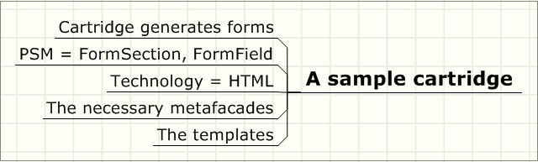
A sample cartridge
Notes:
AndroMDA Boot Camp Course Material
February 4, 2007
© 2007 Matthias Bohlen, mbohlen@andromda.com, http://www.andromda.com

Slide 35
Sample: HTML Forms Cartridge
Very simple cartridge
Demonstrates the basic components of a cartridge
Generates HTML input forms from UML classes
Notes:
AndroMDA Boot Camp Course Material
February 4, 2007
© 2007 Matthias Bohlen, mbohlen@andromda.com, http://www.andromda.com

Slide 36
Metamodels for forms
PIM metamodel
  class
  property
  dependency
PSM metamodel
  Form section
  Form field
A form is composed of several sections
Each section contains fields
let's go and transform this!
Notes:
AndroMDA Boot Camp Course Material
February 4, 2007
© 2007 Matthias Bohlen, mbohlen@andromda.com, http://www.andromda.com

Slide 37
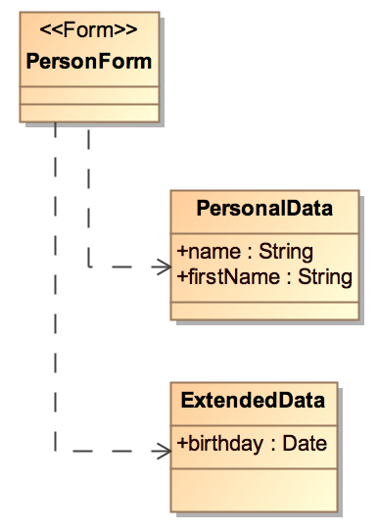
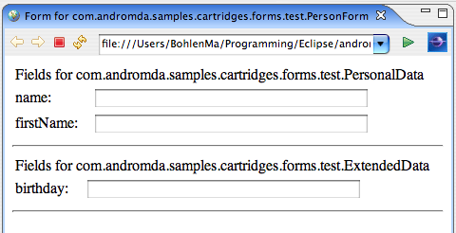
From model to form
The model
The resulting form
Notes:
AndroMDA Boot Camp Course Material
February 4, 2007
© 2007 Matthias Bohlen, mbohlen@andromda.com, http://www.andromda.com

Slide 38
Model transformations
Two transformations take place:
PIM
UML model
PSM
Form sections and
fields as transient
Java objects
model to model
Code
Form in HTML
model to text
Notes:
AndroMDA Boot Camp Course Material
February 4, 2007
© 2007 Matthias Bohlen, mbohlen@andromda.com, http://www.andromda.com

Slide 39
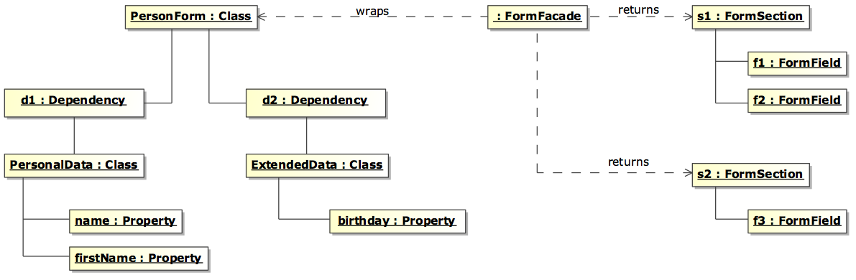
Step 1: Model to model
PIM
Metafacades
PSM
Notes:
AndroMDA Boot Camp Course Material
February 4, 2007
© 2007 Matthias Bohlen, mbohlen@andromda.com, http://www.andromda.com

Slide 40
Step 1: Model to model in Java
protected java.util.Collection handleGetFormSections()
{
ArrayList sections = new ArrayList();
Collection sourceDependencies = this.getSourceDependencies();
for (Iterator iter = sourceDependencies.iterator(); iter.hasNext();)
{
DependencyFacade element = (DependencyFacade) iter.next();
ModelElementFacade targetElement = element.getTargetElement();
if (targetElement instanceof ClassifierFacade)
{
ClassifierFacade otherClass = (ClassifierFacade) targetElement;
FormSection section = transformClassifierToFormSection(otherClass);
sections.add(section);
}
}
return sections;
}
private FormSection transformClassifierToFormSection(ClassifierFacade theClass)
{
FormSection section = new FormSection("Fields for " + theClass.getFullyQualifiedName(),
new ArrayList());
for (Iterator iter = theClass.getAttributes().iterator(); iter.hasNext();)
{
AttributeFacade element = (AttributeFacade) iter.next();
section.getFormfields().add(new FormField(element.getName(), 40));
}
return section;
}
Notes:
AndroMDA Boot Camp Course Material
February 4, 2007
© 2007 Matthias Bohlen, mbohlen@andromda.com, http://www.andromda.com

Slide 41
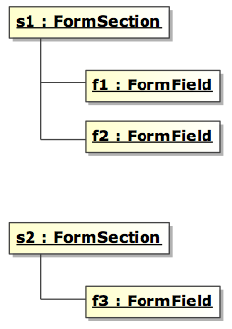
Step 2: Model to text
PSM
Code
<html>
<head>
<title>Form for com.andromda.samples.cartridges.forms.test.PersonForm</title>
</head>
<body>
<form action="post">
<table>
<tr>
<td colspan="2">Fields for com.andromda.samples...PersonalData</td>
</tr>
<tr>
<td>name:</td>
<td><input size="40" /></td>
</tr>
<tr>
<td>firstName:</td>
<td><input size="40" /></td>
</tr>
</table>
<hr/>
<table>
<tr>
<td colspan="2">Fields for com.andromda.samples...ExtendedData</td>
</tr>
<tr>
<td>birthday:</td>
<td><input size="40" /></td>
</tr>
</table>
<hr/>
</form>
</body>
</html>
Notes:
AndroMDA Boot Camp Course Material
February 4, 2007
© 2007 Matthias Bohlen, mbohlen@andromda.com, http://www.andromda.com

Slide 42
Step 2: Model to text in VTL
<html>
<head>
<title>Form for ${formFacade.fullyQualifiedName}</title>
</head>
<body>
<form action="post">
#foreach ($section in $formFacade.formSections)
<table>
<tr>
<td colspan="2">${section.name}</td>
</tr>
#foreach ($formfield in $section.formfields)
<tr>
<td>${formfield.label}:</td>
<td><input size="${formfield.inputLength}" /></td>
</tr>
#end
</table>
<hr/>
#end
</form>
</body>
</html>
Notes:
AndroMDA Boot Camp Course Material
February 4, 2007
© 2007 Matthias Bohlen, mbohlen@andromda.com, http://www.andromda.com

Slide 43
Let's wait a minute…
Now you have seen a sample cartridge
We'll now go into the details – there are many details…
Make sure you keep the big picture!
Notes:
AndroMDA Boot Camp Course Material
February 4, 2007
© 2007 Matthias Bohlen, mbohlen@andromda.com, http://www.andromda.com

Slide 44
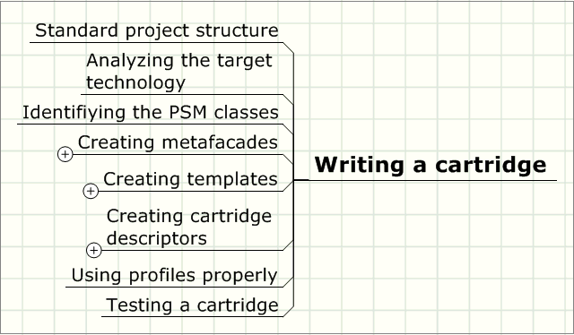
Writing a cartridge
Notes:
AndroMDA Boot Camp Course Material
February 4, 2007
© 2007 Matthias Bohlen, mbohlen@andromda.com, http://www.andromda.com

Slide 45
Cartridge development process
The following steps are recommended:
Analyze target
technology
Identify PSM
metaclasses
Identify
transformation
rules
Write
metafacades
Write PSM
metaclasses
Write
templates
Write
deployment
descriptors
Design
test model
Test cartridge
Deploy cartridge
Prepare to iterate.
Notes:
AndroMDA Boot Camp Course Material
February 4, 2007
© 2007 Matthias Bohlen, mbohlen@andromda.com, http://www.andromda.com

Slide 46
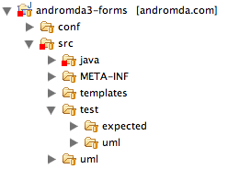
Standard project structure
src/main/java: Metafacades and helper classes
META-INF/andromda: cartridge descriptors
templates: template scripts
test/uml: a test model to run the cartridge
test/expected: the expected output from the test model
uml: the metafacade model
src: handwritten sources, resources, tests
target: generated sources and compiled classes and test output
Notes:
AndroMDA Boot Camp Course Material
February 4, 2007
© 2007 Matthias Bohlen, mbohlen@andromda.com, http://www.andromda.com

Slide 47
Analyzing target technology (1)
Ask yourself some questions
  What are the core concepts in my target technology?
    Java: classes, interfaces, methods, …
    MS Excel: sheets, cells and their contents
    Database: tables, rows, columns, keys, …
  What are the formats in which the target technology expresses itself?
    Java: source code
    MS Excel: proprietary binary or readable XML
    Database: DDL scripts, SQL scripts w/ test data
    currently, it's not possible to generate binaries!
Notes:
AndroMDA Boot Camp Course Material
February 4, 2007
© 2007 Matthias Bohlen, mbohlen@andromda.com, http://www.andromda.com

Slide 48
Analyzing target technology (2)
Results of target technology analysis
PSM core
concepts
PSM
metaclasses
Analysis
File formats
Template
formats
Notes:
AndroMDA Boot Camp Course Material
February 4, 2007
© 2007 Matthias Bohlen, mbohlen@andromda.com, http://www.andromda.com

Slide 49
Designing PSM metaclasses
Inside a PSM metaclass…
  attributes capture target contents
  associations define logical target structure
Later on, templates will transform PSM metaobjects to text format
  PSM metaclass will need methods to return values which fill the placeholders in template scripts
  Design those methods a little later when you know more about your PSM metaclass
Notes:
AndroMDA Boot Camp Course Material
February 4, 2007
© 2007 Matthias Bohlen, mbohlen@andromda.com, http://www.andromda.com

Slide 50
Identifying transformation rules
Ask yourself
  Which PIM elements will be translated to which PSM elements?
  How is the relationship? 1:1, 1:n, n:m?
  How can I formalize a rule that translates PIM metaobjects into PSM metaobjects?
And now the final question:
  What would a PIM metaobject need to transform itself into PSM metaobjects?
  The answer will tell you which metafacades you need in your cartridge!
Notes:
AndroMDA Boot Camp Course Material
February 4, 2007
© 2007 Matthias Bohlen, mbohlen@andromda.com, http://www.andromda.com

Slide 51
Recording transformation rules
Take a piece of paper and write down:
Source element in PIM | Target elements in PSM | Transformation
Class with stereotype «Form» | None | Class acts only as a trigger to instantiate the metafacade
Dependency and Class on other end | FormSection | One FormSection per Class
Property | FormField | One FormField per Property
etc. | … | …
Notes:
AndroMDA Boot Camp Course Material
February 4, 2007
© 2007 Matthias Bohlen, mbohlen@andromda.com, http://www.andromda.com

Slide 52
Designing transformation rules
Think of a transformation rule as an operation inside a PIM metafacade
Let those operations return PSM metaobjects
The algorithm inside the operation implements the PIM-to-PSM transformation
Notes:
AndroMDA Boot Camp Course Material
February 4, 2007
© 2007 Matthias Bohlen, mbohlen@andromda.com, http://www.andromda.com

Slide 53
Creating metafacades (1)
Design the transformation rules you have found as methods of one or more metafacade classes
Then apply the three-step process:
  Model metafacades using UML
  Generate code for them using AndroMDA's cartridge andromda-meta
  Implement them in Java
Notes:
AndroMDA Boot Camp Course Material
February 4, 2007
© 2007 Matthias Bohlen, mbohlen@andromda.com, http://www.andromda.com

Slide 54
Creating metafacades (2)
Metafacade wraps a metaclass from the original PIM metamodel
  Example:
    ClassifierFacade wraps Classifier
Identify or create new metafacade
  Find an existing metafacade that wraps your PIM source element (from your transformation table)
  specialize that existing metafacade class
  if there is none, create a new one and model a wrapping dependency on the desired metaclass
Add your transformation operations to your own metafacade class
Notes:
AndroMDA Boot Camp Course Material
February 4, 2007
© 2007 Matthias Bohlen, mbohlen@andromda.com, http://www.andromda.com

Slide 55
Modeling metafacades
Create MagicDraw model in src/uml
Add pathmap variable for M2_REPO
Use the existing metafacade modules
  andromda-metafacades-uml-*.xml.zip
  you'll find it in your Maven repository in the folder
  org/andromda/metafacades/andromda-metafacades-uml/*
Go ahead
  Create a package
  Create a class diagram
  Create <<metafacade>> classes
  Add attributes, associations, operations
Notes:
AndroMDA Boot Camp Course Material
February 4, 2007
© 2007 Matthias Bohlen, mbohlen@andromda.com, http://www.andromda.com

Slide 56
Modeling PSM metaclasses
Put them in a separate *.psm package
Use them as return types of metafacade operations
Generate code for them
Unit-test them
Let's see the
Form* classes
in Eclipse!
Notes:
AndroMDA Boot Camp Course Material
February 4, 2007
© 2007 Matthias Bohlen, mbohlen@andromda.com, http://www.andromda.com

Slide 57
Implementing metafacades
Add andromda-meta cartridge as a dependency to pom.xml
Run AndroMDA to get source code for your metafacades
Compile
Implement handleXXX() methods in *LogicImpl classes
compile again
Notes:
AndroMDA Boot Camp Course Material
February 4, 2007
© 2007 Matthias Bohlen, mbohlen@andromda.com, http://www.andromda.com

Slide 58
OCL in metafacades
OCL constraints are very useful to make sure that your models are valid before they are translated to code
Use these steps:
  add OCL constraints to a metafacade
  constraints will be translated to Java
  when the metafacade is instantiated, the OCL constraints will be checked
  when a constraint is violated, an error message is given at the end of the AndroMDA run
Notes:
AndroMDA Boot Camp Course Material
February 4, 2007
© 2007 Matthias Bohlen, mbohlen@andromda.com, http://www.andromda.com

Slide 59
Let's wait a minute…
OK, until now you know the following:
  a model is parsed into an AST
  AST is made of metaobjects
  (instances of metaclasses)
  metaobjects are wrapped with metafacades
  metafacades return PSM metaobjects which are ready to fill a template
Where we go now…
  you'll learn how to write templates that transform PSM objects to text
Notes:
AndroMDA Boot Camp Course Material
February 4, 2007
© 2007 Matthias Bohlen, mbohlen@andromda.com, http://www.andromda.com

Slide 60
Velocity test case in Java
To understand Velocity, you can write this test case:
Context variables
StringWriter writer = new StringWriter();
VelocityEngine ve = new VelocityEngine();
ve.init();
VelocityContext velocityContext = new VelocityContext();
velocityContext.put("foo", "@test1@");
velocityContext.put("bar", "@test2@");
assertTrue(ve.evaluate(velocityContext, writer, "mylogtag", "$foo$bar"));
assertEquals("@test1@@test2@", writer.getBuffer().toString());
Template
Result after expansion
Notes:
AndroMDA Boot Camp Course Material
February 4, 2007
© 2007 Matthias Bohlen, mbohlen@andromda.com, http://www.andromda.com

Slide 61
Creating templates
Take an existing target artifact
Copy it to create a template for that type of artifact you want to generate
Replace the concrete names in the text by placeholders using Velocity's ${} syntax
Write the placeholders such that they access the PSM metaobjects you designed, implemented and unit-tested
Name the template file *.vsl and put it into the src/templates directory of your cartridge project
Notes:
AndroMDA Boot Camp Course Material
February 4, 2007
© 2007 Matthias Bohlen, mbohlen@andromda.com, http://www.andromda.com

Slide 62
Creating macro libraries
If you find yourself writing the same template script code over and over again…
  extract it into macros
  add macros to a macro library file
  name the file *.vm and put it into the src/templates directory of your cartridge project
  declare the macro library in your cartridge descriptor cartridge.xml
  call the macros from your usual template scripts and pass arguments into them
Notes:
AndroMDA Boot Camp Course Material
February 4, 2007
© 2007 Matthias Bohlen, mbohlen@andromda.com, http://www.andromda.com

Slide 63
Creating cartridge descriptors (1)
cartridge.xml
  documented in
  /docs/andromda-cartridges/index.html
  describes the contents of your cartridge
  macro libraries
  property references
    if you write a property reference here, the value is taken from the namespace properties in andromda.xml and copied to the template context so that you have it available in a template script
  templates
  resources
  template objects for the template context
    nice if you want to have utility functions globally available in the template scripts
Notes:
AndroMDA Boot Camp Course Material
February 4, 2007
© 2007 Matthias Bohlen, mbohlen@andromda.com, http://www.andromda.com

Slide 64
Creating cartridge descriptors (2)
metafacades.xml
  documented in
  /docs/andromda-metafacades/configuring.html
  map metaclasses to your own metafacades
  narrow mappings with metafacade properties and/or stereotypes.
Notes:
AndroMDA Boot Camp Course Material
February 4, 2007
© 2007 Matthias Bohlen, mbohlen@andromda.com, http://www.andromda.com

Slide 65
Merge point: what is it?
Is a replacable piece of text in a file
Valid for the following files
  template scripts
  namespace.xml
  cartridge.xml
  metafacades.xml
  profile.xml
Used to override/extend files which are in a cartridge without touching the JAR
Notes:
AndroMDA Boot Camp Course Material
February 4, 2007
© 2007 Matthias Bohlen, mbohlen@andromda.com, http://www.andromda.com

Slide 66
Merge point declaration
Put (or look for) a merge point declaration (comment string) in a template, cartridge descriptor or metafacade mapping file
  e.g. template for bpm4struts web.xml:
  Comment syntax is specific for the file format (e.g. XML)
<welcome-file-list>
<!-- welcome-file-list merge-point -->
<welcome-file>$welcomeFileName</welcome-file>
</welcome-file-list>
Notes:
AndroMDA Boot Camp Course Material
February 4, 2007
© 2007 Matthias Bohlen, mbohlen@andromda.com, http://www.andromda.com

Slide 67
Merge point mappings
Map the merge point to something you want in your project
  e.g. WebMergeMappings.xml in yourproject/mda/src/main/config/mappings:
<mapping>
<from>
<![CDATA[<!-- welcome-file-list merge-point -->]]>
</from>
<to>
<![CDATA[
]]>
</to>
</mapping>
Notes:
AndroMDA Boot Camp Course Material
February 4, 2007
© 2007 Matthias Bohlen, mbohlen@andromda.com, http://www.andromda.com

Slide 68
Merge point config in andromda.xml
Reference the merge point mapping file inside andromda.xml:
<namespace name=“bpm4struts”>
...
<properties>
...
<property name=“mergeMappingsUri”>
file:${conf.dir}/mappings/WebMergeMappings.xml
</property>
...
</properties>
...
</namespace>
Notes:
AndroMDA Boot Camp Course Material
February 4, 2007
© 2007 Matthias Bohlen, mbohlen@andromda.com, http://www.andromda.com

Slide 69
Using UML profiles properly
Profile as a separate UML module
String constants in a separate class
Name mapping for stereotypes and tagged values
Access to Tagged Values from Java code
Notes:
AndroMDA Boot Camp Course Material
February 4, 2007
© 2007 Matthias Bohlen, mbohlen@andromda.com, http://www.andromda.com

Slide 70
Profile as a separate UML module
A UML profile is a set of
  data types
    for attribute types, parameter types or return value types
  stereotypes
    to express that a class belongs to a certain kind
  tag definitions
    as prototypes for tagged values (UML2 Stereotype attributes)
  enumeration types
    to define the set of valid values that a tagged value can have
Notes:
AndroMDA Boot Camp Course Material
February 4, 2007
© 2007 Matthias Bohlen, mbohlen@andromda.com, http://www.andromda.com

Slide 71
Profile Names in a separate class
To access stereotypes and tagged values from Java metafacades
  to make sure that you use names consistently
  to allow your users to use their own stereotype and tagged value names
You need two files
  YourCartridgeProfile.java
  profile.xml
Notes:
AndroMDA Boot Camp Course Material
February 4, 2007
© 2007 Matthias Bohlen, mbohlen@andromda.com, http://www.andromda.com

Slide 72
YourCartridgeProfile.java
public class Bpm4StrutsProfile
{
private static final Profile profile = Profile.instance();
/* ----------------- Stereotypes -------------------- */
public static final String STEREOTYPE_VIEW
= profile.get("FRONT_END_VIEW");
public static final String STEREOTYPE_EVENT
= profile.get("FRONT_END_EVENT");
...
/* ----------------- Tagged Values -------------------- */
public static final String TAGGEDVALUE_ACTION_TYPE
= profile.get("ACTION_TYPE");
public static final String TAGGEDVALUE_ACTION_RESETTABLE
= profile.get("ACTION_RESETTABLE");
public static final String TAGGEDVALUE_ACTION_SUCCESS_MESSAGE
= profile.get("ACTION_SUCCESS_MESSAGE");
...
Notes:
AndroMDA Boot Camp Course Material
February 4, 2007
© 2007 Matthias Bohlen, mbohlen@andromda.com, http://www.andromda.com

Slide 73
profile.xml
Important: register profile.xml in namespace.xml!
<?xml version="1.0" encoding="ISO-8859-1" ?>
<profile>
<elements>
<elementGroup name=“Stereotypes”>
<element name=“FRONT_END_VIEW”>
<value>FrontEndView</value>
</element>
<element name=“FRONT_END_USE_CASE”>
<value>FrontEndUseCase</value>
</element>
...
</elementGroup>
<elementGroup name=“Tagged Values”>
<element name=“ACTION_TYPE”>
<value>@andromda.presentation.action.type</value>
</element>
<element name=“ACTION_RESETTABLE”>
<value>@andromda.presentation.action.resettable</value>
</element>
</elementGroup>
...
maps internal identifiers to real names used in the model
Notes:
AndroMDA Boot Camp Course Material
February 4, 2007
© 2007 Matthias Bohlen, mbohlen@andromda.com, http://www.andromda.com

Slide 74
Access to tagged values in Java
Access the tagged value names via YourCartridgeProfile.java
Use them in metafacade methods:
protected boolean handleIsHyperlink()
{
Object value = findTaggedValue
(Bpm4StrutsProfile.TAGGEDVALUE_ACTION_TYPE);
return Bpm4StrutsProfile
.TAGGEDVALUE_ACTION_TYPE_HYPERLINK
.equalsIgnoreCase(value == null ? null
: value.toString()
);
}
the findTaggedValue() method is in class ModelElementFacade which is a "superclass" of your metafacade
Notes:
AndroMDA Boot Camp Course Material
February 4, 2007
© 2007 Matthias Bohlen, mbohlen@andromda.com, http://www.andromda.com

Slide 75
Testing a cartridge (1)
Creating a test model
  create a new model
  use the profile module to have access to data types, stereotypes and tagged values
  create some model elements to be transformed
  Cover all the model variations and Use Cases used by your cartridge
  store the model in src/test/uml
  make the model file name known as a property in pom.xml
Run the test via mvn test
Notes:
AndroMDA Boot Camp Course Material
February 4, 2007
© 2007 Matthias Bohlen, mbohlen@andromda.com, http://www.andromda.com

Slide 76
Testing a cartridge (2)
Test will fail the first time
Create a ZIP file that contains the expected AndroMDA output
Put cartridge-output.zip in src/test/expected
Rerun the test
Each time you change something
  Verify the changes are what you wanted, using a directory compare utility
  ZIP the contents of the directory
  target/cartridge-test/actual into a new file cartridge-output.zip
  Put it again into src/test/expected
  Check that file into your version control system
Notes:
AndroMDA Boot Camp Course Material
February 4, 2007
© 2007 Matthias Bohlen, mbohlen@andromda.com, http://www.andromda.com

Slide 77
PIM->PSM data type mapping
Data types are modeled in the UML profile
They are platform-independent
An XML file maps them to platform-specific types
    Java example: datatype::String → java.lang.String
    SQL example: datatype::String → VARCHAR
Mappings are documented in /docs/mappings.html
To see how they work in existing cartridges, look for references to the method Mappings.getTo()
Notes:
AndroMDA Boot Camp Course Material
February 4, 2007
© 2007 Matthias Bohlen, mbohlen@andromda.com, http://www.andromda.com

Slide 78
Tasks for you to do
Size of input fields is fixed (40) – make it configurable via namespace property and tagged value
Make UML operations on the form class translate to buttons on the form
Check multiplicity of properties: if > 0, add an asterisk to the form field‘s label to mark it as a mandatory field
run cost calculator cartridge on one of your own application projects
Notes:
AndroMDA Boot Camp Course Material
February 4, 2007
© 2007 Matthias Bohlen, mbohlen@andromda.com, http://www.andromda.com

Slide 79

Questions?
Our thanks to
Matthias Bohlen <mbohlen@andromda.com>
Phone: +49 (170) 772 8545
Notes:
AndroMDA Boot Camp Course Material
February 4, 2007
© 2007 Matthias Bohlen, mbohlen@andromda.com, http://www.andromda.com

