Slide 1
AndroMDA Boot Camp
"From scratch to your own cartridge in four days"
Part 1: Modeling and Code Generation
using the existing Cartridges
Copyright © 2007: Matthias Bohlen,
<mbohlen@andromda.com>
all rights reserved

Slide 2
MDSD with MagicDraw and AndroMDA
Part 1: Modeling and Code Generation
using the existing Cartridges
Copyright © 2007: Matthias Bohlen,
<mbohlen@andromda.com>
all rights reserved

Slide 3
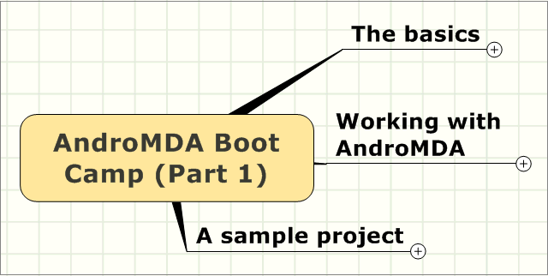
AndroMDA Boot Camp (Part 1)

Slide 4
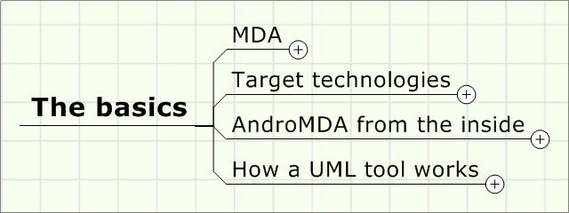
The basics

Slide 5
MDA
Model and metamodel
Platform defined
PIM and PSM
UML profile
  Stereotypes
  Tagged Values
Roles, tasks and skills
Collaborating in a project

Slide 6
MDA by definition
MDA is a collection of specifications
The key idea is…
"…to build a comprehensive, formally correct model for the construction of a software system, from which the executable software components can be generated by automated transformations."

Slide 7
What is MDA?
Generating software...
  by transformation of a model
  into software artifacts
  by means of templates
But we had this already years ago?!
Abstraction level and standards make the difference:
  Modeling: UML
  Storage for models: MOF
  Exchange of models: XMI

Slide 8
Why MDA?
Complexity
  Software becomes more and more complex
  Technological change accelerates
  Abstraction must help to conquer complexity
Quality is a critical aspect of software
Frameworks cause repeated code
  Coding becomes repetitive and "boring"

Slide 9
History and future
(next big wave)
MDA
Abstraction level
Frameworks (OOP)
Object oriented
Procedural
Assembly language
1950 1960 1970 1980 1990 2000 2010 2020 Time

Slide 10
Core concepts of MDA
Software is generated from models
Abstraction from technical Platform
  PIM (Platform Independent Model)
Mapping to arbitrary platforms
  PSM (Platform Specific Model)

Slide 11
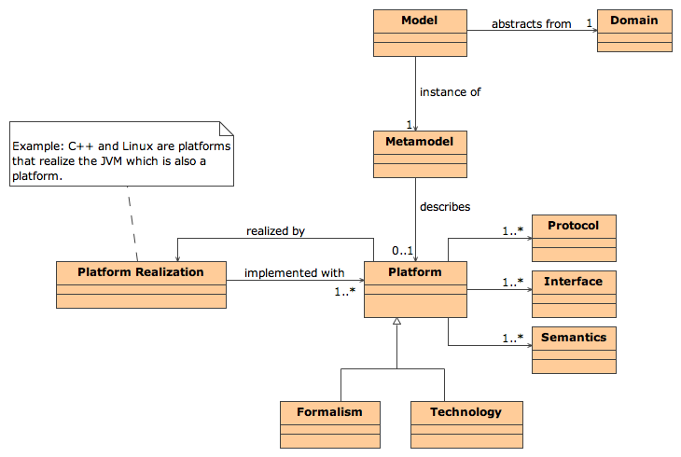
Overview of core concepts

Slide 12
From requirements to code
Legend
existing
Requirements
new in MDA
PIM
PSM (J2EE)
PSM (.NET)
PSM (CORBA)
PSM (...)
Code (J2EE)
Code (.NET)
Code (CORBA)
Code (...)

Slide 13
Definition of model
Model
  A model is the abstraction of an application domain (shop, bank, etc.)
  Example 1:
  A model for a shop contains notions like order and price
  Example 2:
  A model for a bank contains notions like account and transfer

Slide 14
Definition of metamodel
Metamodel
  A metamodel is a model for the application domain called modeling
  Example 1:
  The metamodel of XML contains notions like node, element and attribute
  Example 2:
  The metamodel for UML contains notions like class, property, operation, association

Slide 15
Models on metalevels M0-M2
Metamodel (M2)
Class
Property
-name : String
-name : String
instanceOf
instanceOf
instanceOf
UML model (M1)
-fromAccount
Account
-toAccount
Transfer
-accountNumber : String
-amount : Number
instanceOf
instanceOf
instanceOf
Application data (M0)
a1 : Account
a2 : Account
t : Transfer
123-456-789
456-789-123
1500

Slide 16
UML profile: What is it?
Standard mechanism to extend the scope of UML
Language elements used
  Stereotypes
  Tagged Values
  OCL Constraints

Slide 17
Stereotypes
Stereotypes
  classify model elements
  almost create new "metaclasses"
  can be attached to any normal model element
    Class, Property, Operation, Parameter
    State, Transition, etc.
Stereotypes provide application specific annotations for model elements
  Some UML tools allow to associate an icon to a stereotype

Slide 18
Tagged Values
Tagged Values
  extend the attribute set of a metaclass
  can be associated to a metaclass and (optionally) a stereotype
Using Stereotypes and Tagged Values, you create your own "modeling vocabulary"
Restriction:
  The UML metamodel is still the limit
  You can only model what conforms to the UML metamodel

Slide 19
Collaboration using MDA
Architectural and quality goals
Feedback from daily work
Template
1: Design
4: Generate
templates
Code
Architect
Generator
2: Create model
XM I
Code
6: Compile
and package
Business analyst
Build script
UML
Components, DB scripts, etc.
3: Annotate
5: Write
7: Deploy
model
business logic
and test
Developer

Slide 20
Roles and skills for MDA
Role | Tasks | Skills
Business analyst | Creates a business model of the application domain | Insight, domain knowledge, talent for abstraction, modeling language (UML or DSL)
Architect | Defines application architecture, creates templates and transformation rules to map business to technology | (Meta-)Modeling, deep knowledge of architecture, frameworks and target platform in general
Developer | Lets the generator create the "boring" part of the application and adds the business logic by hand | Understanding of the model, business requirements, programming

Slide 21
Target technologies (examples)
Spring
  a framework to structure J2EE applications
Hibernate
  a persistence mapping framework
Struts
  a Model-View-Controller framework for web applications

Slide 22
Introduction to Spring
Framework simplifies development of J2EE applications
Lightweight IoC container
Instantiates and links JavaBeans
Wraps JavaBeans with aspects for transaction handling and other useful stuff

Slide 23
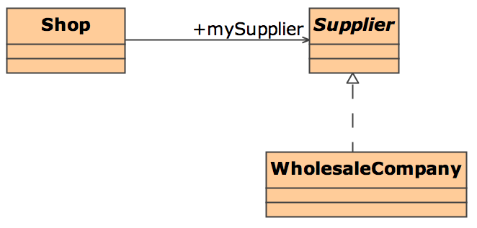
Inversion of Control
Hollywood principle
  Don't call me, I'll call you!
Example:

Slide 24
Hollywood principle in "Shop"
Not like this…
but like this:
public void refillStock() {
Supplier mySupplier = (Supplier)Factory.find("WholesaleCompany");
mySupplier.placeOrder(100, "apple", "sweet");
}
public void setMySupplier(Supplier s) {
this.mySupplier = s;
}
public void setAppleRefillCount(int count) {
this.appleRefillCount = count;
}
public void refillStock() {
mySupplier.placeOrder(this.appleRefillCount, "apple", "sweet");
}

Slide 25
And then in Spring…
applicationContext.xml
<bean id="wholesaleSupplier"
class="example.WholesaleCompany">
</bean>
<bean id="shop"
class="example.Shop">
<property name="mySupplier">
<ref bean="wholesaleSupplier"/>
</property>
<property name="appleRefillCount"><value>100</value></property>
</bean>

Slide 26
Advantages of Spring
Spring classes are ordinary JavaBeans
  no dependency to a Spring API
  testable with JUnit without a container
  strong typing, no generic factories like JNDI
Spring integrates a lot of ready made stuff
  Data sources, transactions, persistence, security, remoting, etc.
Business classes stay untouched
Later, we'll see more in practice!

Slide 27
AndroMDA 3.x component architecture
<<Metafacade>>
UML (1.4), 2.0
<<Cartridge>>
hibernate, ejb
bpm4struts, meta, java
<<Mapping>>
java
hypersonic, mysql
<<Component bus>>
container
<<Repository>>
MDR, EMF
Core
<<Translation Library>>
OCL
<<Template Engine>>
Velocity, others
Dependency inversion principle:
Components know each other only as interfaces!

Slide 28
AndroMDA components
Core
  orchestrates all other components
Repository
  loads models and metamodels
Metafacades
  add code generation functionality to metaclasses
Cartridges
  translate from model to code
  contain technology-specific metafacades and templates
Translation Libraries
  translate OCL constraints and OCL queries to Java
Template Engines
  translate objects to text (e.g. source code)
Control
  using Maven or Ant

Slide 29
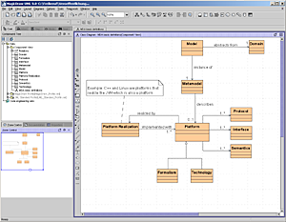
How a CASE tool works
Model as a tree (AST = "abstract syntax tree")
  the model itself consists of the nodes in the tree on the left
Diagrams
  are only views on the model
  a node in the tree can be seen on different diagrams but exists only once!
Model exchange via XMI
  the tree is serialized to XML
<xmi/>

Slide 30
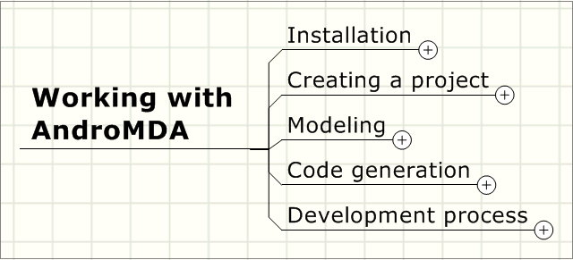
Working with AndroMDA

Slide 31
Installation for today
Ant
Maven
MagicDraw
JBoss
AndroMDA
You‘ll find all this on the training DVD!

Slide 32
Installation of the tools (1)
Ant
  unpack, set ANT_HOME
Maven
  unpack, set MAVEN_HOME
  set MAVEN_OPTS (in the machine's environment) to
  -XX:MaxPermSize=128m -Xmx512m
  copy settings.xml.sample to %USERPROFILE%\.m2 (in Unix: $HOME/.m2) and rename to settings.xml
  adjust settings.xml if you're behind an HTTP proxy
  add %MAVEN_HOME%\bin ($MAVEN_HOME/bin) to the PATH
  Start a command shell and look if the variables
  are set correctly

Slide 33
Installation of the tools (2)
MagicDraw
  Run the installer, start MagicDraw
  Copy the license key from the text file on the CD and paste it into the license dialog
JBoss
  Run jems-installer-*.jar and set JBOSS_HOME to the directory where you installed JBoss

Slide 34
Installation of the tools (3)
AndroMDA need not be installed
Maven downloads all necessary artifacts to your local repository
To tell Maven what to download, you need a scratch pom.xml that you throw away after use:
  copy andromdapp-loader/pom.xml from the training DVD to a temporary directory
  open a command prompt (a.k.a. shell)
  change to the temporary directory
  try to generate an empty AndroMDA project:
    mvn andromdapp:generate
  watch Maven download the necessary plugins
  cancel the generation when it displays:
    Please choose the type of application to generate
  remove the temporary directory from disk

Slide 35
Installation of the tools (4)
Maven downloads all necessary artifacts to your local repository
This works best if you have these lines in your settings.xml:
<pluginGroups>
<pluginGroup>org.andromda.maven.plugins</pluginGroup>
</pluginGroups>

Slide 36
Creating an empty project (1)
Open a command prompt (a.k.a. shell)
Choose a base directory for programming (examples):
  C:\AndroMDA\Tutorial
  ~/andromda/tutorial
Change to that directory and invoke this command line
  mvn andromdapp:generate
Type in the following information
(see next slide)

Slide 37
Creating an empty project (2)
Please choose the type of application to generate | j2ee
Please enter location in which your new application will be created | samples
Please enter your first and last name | Your Name
Which kind of modeling tool will you use? | uml2
Please enter the name of your J2EE project | Online Auction
Please enter an id for your J2EE project | onlineauction
Please enter a version for your project | 1.0-SNAPSHOT
Please enter the root package name for your J2EE project: com.andromda.bootcamp.samples
Would you like an EAR or standalone WAR? | war
Please enter the database backend for the persistence layer | hypersonic
Will your project need workflow engine capabilities? | no
Please enter the hibernate version number | 3
Will your project have a web user interface? | yes
Would you like your web user interface to use JSF or Struts? | jsf
Would you like to use Facelets or JSP as your view type for JSF? | jsp
Would you like to be able to expose web services? | no

Slide 38
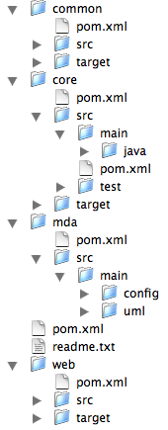
Standard project structure
app: J2EE application
common: exception classes, etc.
core: business objects, services
mda: UML model
web: web application
src: handwritten code
target: generated source and binaries (*.class)

Slide 39
Run Maven the first time
Open a command prompt (a.k.a. shell)
Change to your tutorial directory
Type mvn install
Maven will download all necessary plugins and start AndroMDA
AndroMDA will fail because we have not yet exported the model
However, plugins and profiles will be already in your local Maven repository

Slide 40
Maven: an overview
Maven plugins
Project object model
(pom.xml)
Maven build system
Project artifacts
Repository
(local or remote)
Custom plugins

Slide 41
Maven background
Automates repetitive build tasks
    Setting the classpath
    Invoking the Java compiler
    Run tests (e.g. JUnit)
    Pack JAR, WAR, EAR
    Deploy to the server
    and much more that you would have to write at a lower level using Ant
Maven is designed for projects with lots of components and versions
Manages component dependencies automatically

Slide 42
Learning to use Maven
There is a good tutorial for Maven 1
  http://www.theserverside.com/articles/
  article.tss?l=MavenMagic
Describes step by step how to create a J2EE project and why!
With AndroMDA, the andromdapp-Plugin does those steps automatically
In this course, we are going to use Maven 2!

Slide 43
Maven basics
group | Group of artifacts, e.g. several jars that make up a component or an application
artifact | Single file, e.g. a *.jar, *.ear, etc.
version | Version identifier of an artifact
plug-in | Re-usable Java component that can be invoked from a Maven build
Goal | Name for a piece of build procedure within a plug-in
Example of an artifact
  groupId = andromda
  artifactId = andromda-spring-cartridge
  versionId = 3.2
  file name = andromda-spring-cartridge-3.2.jar

Slide 44
Invoking Maven
Command line:
mvn [options] [<goal(s)>] [<phase(s)>]
Important command line options
  mvn –o builds off-line without fetching artifacts from the remote repository
Important plug-ins and their goals
  andromdapp:generate
  andromda:run
Important phases
  generate-sources
  compile
  test
  install

Slide 45
pom.xml
Control file for Maven
  describes the project
  including dependencies on other components
  used in AndroMDA to indicate which cartridges are available during the build

Slide 46
Using cartridges
Cartridges are plug-ins for AndroMDA
They are JAR-Files
Insert them into pom.xml as a dependency
Configure them by namespace properties (in andromda.xml)
pom.xml
<dependencies>
...
<dependency>
<groupId>org.andromda.cartridges</groupId>
<artifactId>andromda-spring-cartridge</artifactId>
</dependency>
<dependency>
<groupId>org.andromda.cartridges</groupId>
<artifactId>andromda-hibernate-cartridge</artifactId>
</dependency>
</dependencies>
...

Slide 47
Using the Spring cartridge
Excerpt from mda/src/main/config/andromda.xml
<namespace name="spring">
<properties>
<property name="dataSource">${dataSource}</property>
<property name="username">${jdbc.username}</property>
<property name="password">${jdbc.password}</property>
<property name="driver">${jdbc.driver}</property>
<property name="connectionUrl">${jdbc.url}</property>
<property name="hibernateDialect">${hibernate.dialect}</property>
<property name="transactionManager">
org.springframework.jdbc.datasource.DataSourceTransactionManager</property>
<property name="hibernateInheritanceStrategy">
${hibernate.inheritance.strategy}</property>
<property name="springTypesPackage">${application.package}</property>
<property name="daos">${core.generated.dir}</property>
<property name="dao-impls">${core.manual.dir}</property>
<property name="spring-configuration">${core.generated.dir}</property>
<property name="services">${core.generated.dir}</property>
<property name="service-impls">${core.manual.dir}</property>
<property name="service-interfaces">${core.generated.dir}</property>
<property name="criteria">${common.generated.dir}</property>
<property name="value-objects">${common.generated.dir}</property>
</properties>
</namespace>

Slide 48
Properties in mda/src/main/config/andromda.xml
Two files – when to use which one?
    If a value is used only once, write it into andromda.xml directly
    If you need a value more than once, make it a property in pom.xml and reference it in andromda.xml using the "$"-syntax
pom.xml
<properties>
<core.generated.dir>
${pom.basedir}/../core/target/src</core.generated.dir>
<core.manual.dir>${pom.basedir}/../core/src/main/java</core.manual.dir>
</properties>
andromda.xml
<namespace name="spring">
<properties>
<property name="daos">${core.generated.dir}</property>
<property name="dao-impls">${core.manual.dir}</property>
</properties>
</namespace

Slide 49
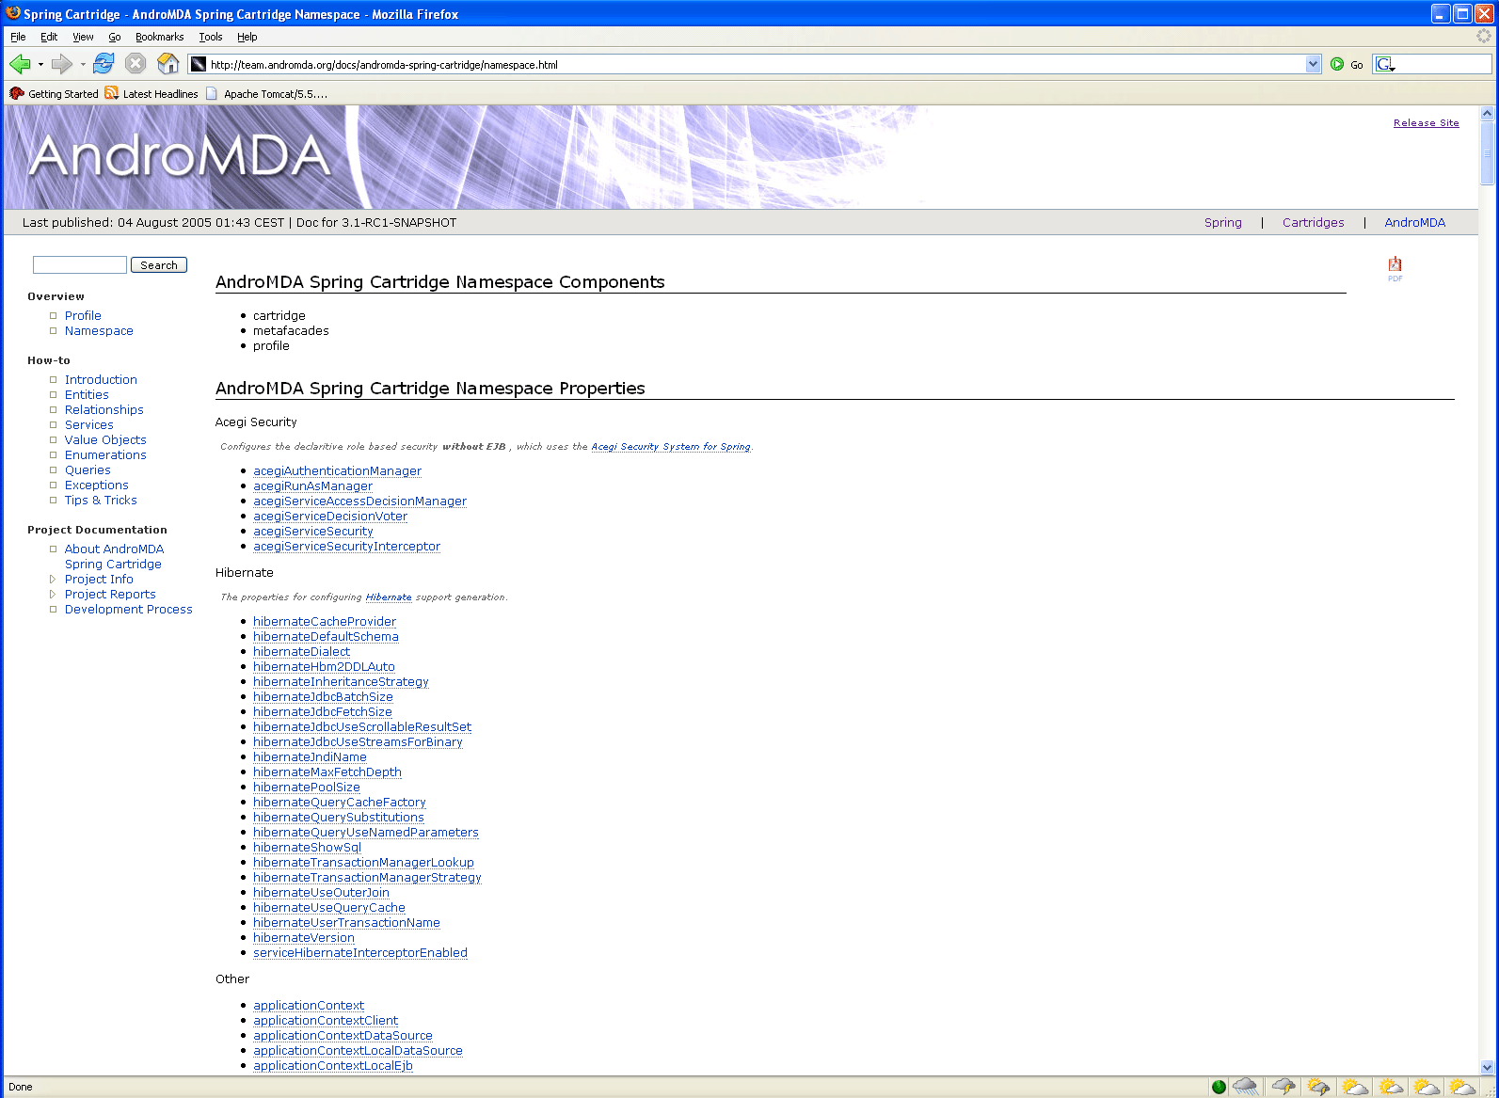
Properties are documented
docs/andromda-spring-cartridge/namespace.html

Slide 50
Typical Maven commands
Directory | Command | Effect
. | mvn install | Build all
. | mvn –o install | Build all, off line
core | mvn compile | Compile only
core | mvn test | Run unit tests only
mda | mvn andromda:run | Generate code
. | mvn install -Ddeploy | Deploy in app server
. | mvn -o -f core/pom.xml andromdapp:schema -Dtasks=create -DexecuteScripts=false | Create database schema
For more typical commands, see readme.txt in your project.

Slide 51
List of Maven Plug-ins
http://maven.apache.org/plugins/index.html

Slide 52
Modeling for Spring
Entities
  Attributes
  Business methods
    instance scope
    classifier scope
    nullable parameters
  Finder methods
Services
  Operations
  Dependencies
Associations
Value objects
Persistent Enums
Exception Handling
OCL Queries
Everything is documented in the How-To:
/docs/andromda-spring-cartridge/howto.html

Slide 53
Modeling for Struts
Use Cases
Activity Graphs
  Initial States
  Action States
  Transitions
  Event Parameters
  Decision Points
  Final States
Controller Classes
Decision points
Session objects
Security
Service calls
Table handling
Everything is documented in the How-To:
/docs/andromda-bpm4struts-cartridge/howto.html

Slide 54
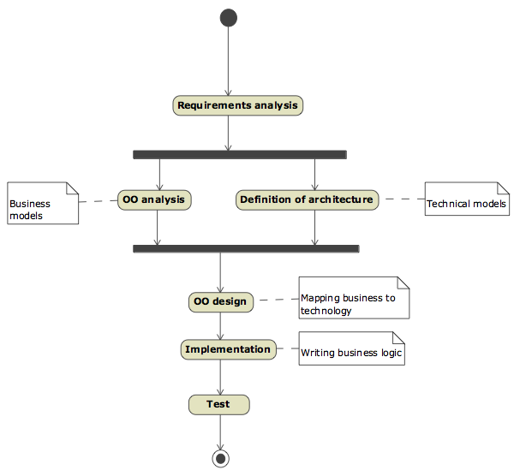
Steps in a software project
If we still applied the waterfall approach, a project would look like this:
We don't do that any more today,
do we? ☺

Slide 55
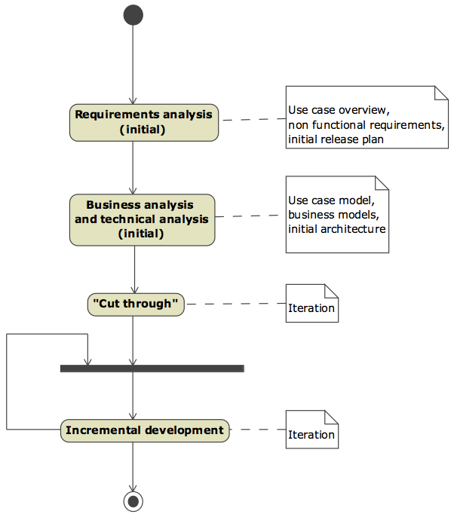
Transition towards iterations
"Cut through":
Minimal version of the system across all architectural layers → minimizes risk
After that, incremental growth in future iterations

Slide 56
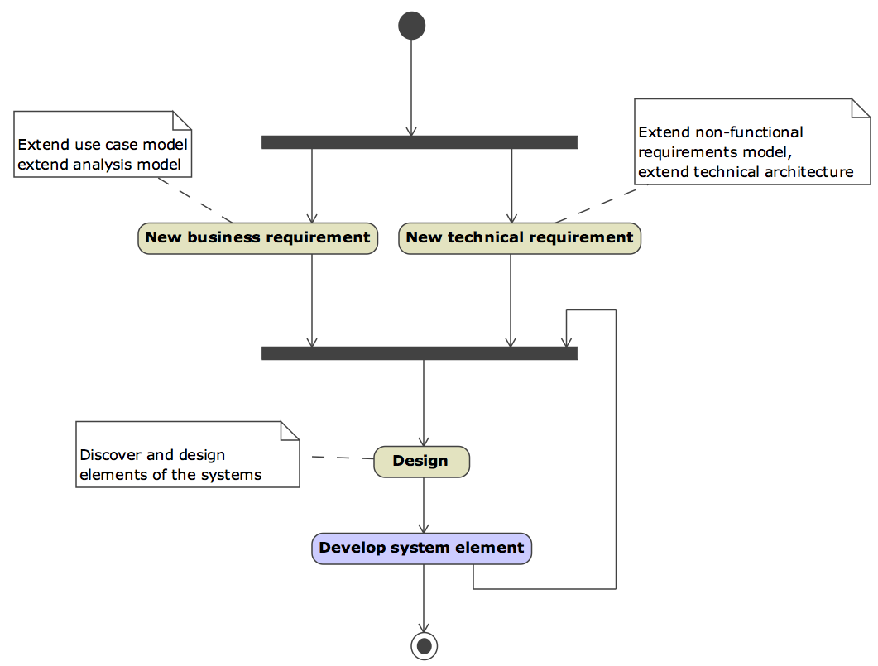
Within one iteration

Slide 57
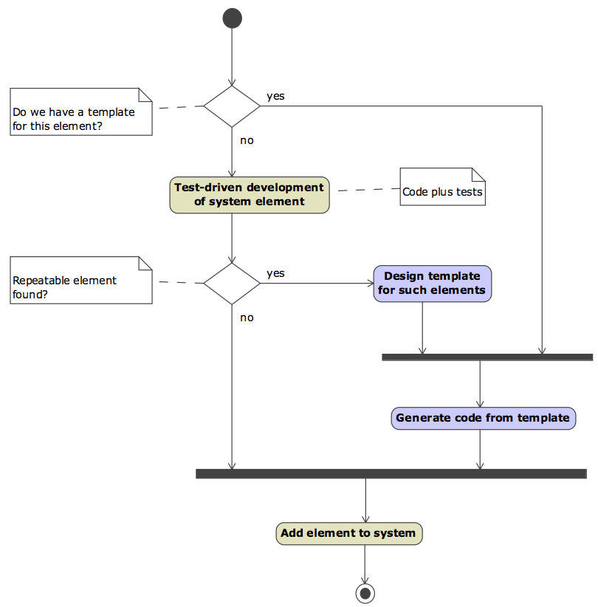
Developing a system element with MDA

Slide 58
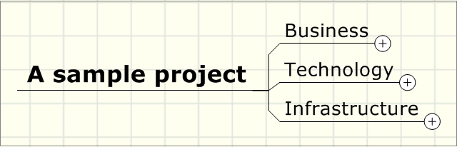
A sample project

Slide 59
The subject
The project is called "OnlineAuction"
It's about online auctions à la Ebay
Use Cases
  Register User
  Login User
  List Item
  Bid for Item
  Notify bidder

Slide 60
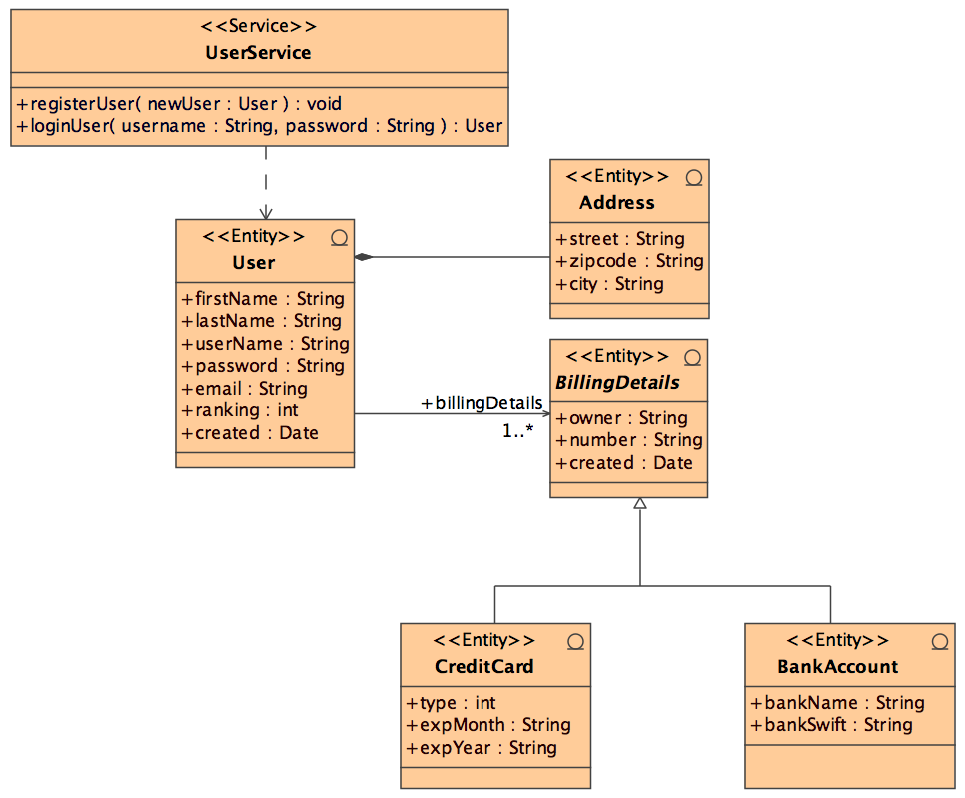
User management (draft)

Slide 61
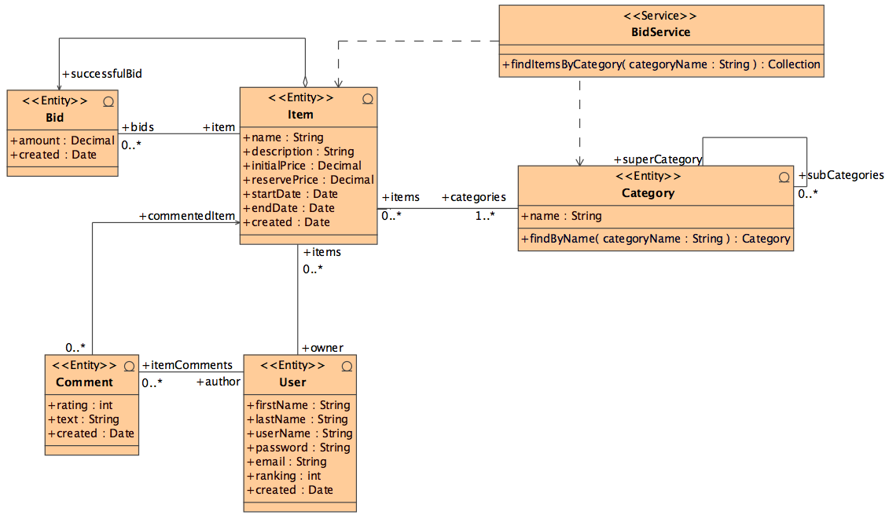
Auction items (draft)

Slide 62
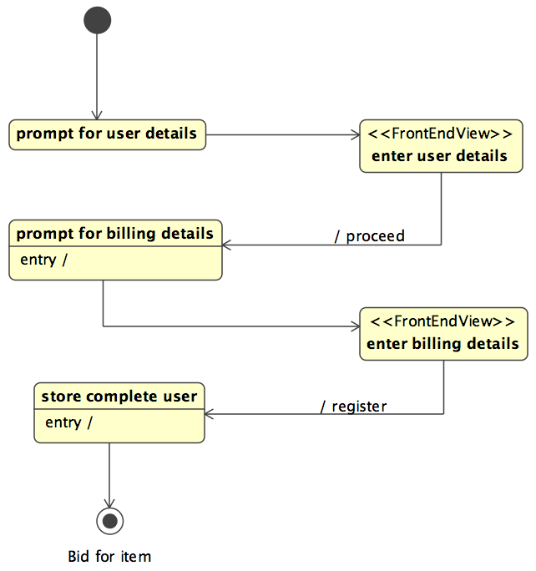
Register user (draft)

Slide 63
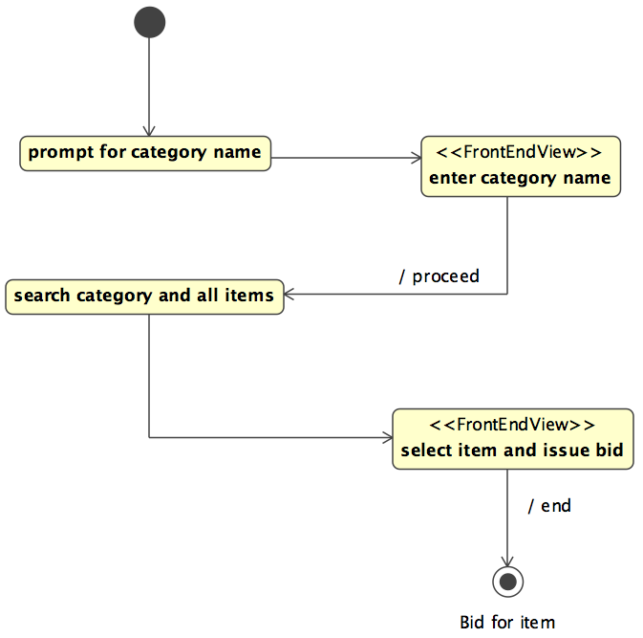
Bid for item (draft)

Slide 64
Technology
We build a J2EE application
  using the Spring and Struts frameworks
  Entities
  Services
  Forms
  Controller classes

Slide 65
Copy the UML profiles
You will need the Andromda UML profiles for modeling
Open an window on your local Maven repository directory
Navigate to org/andromda/profiles/uml2
Search for all *-3.2.xml.zip files
Copy them into one new directory, without subdirectory structure, e.g.
Windows: C:\AndroMDA\Tutorial\profiles
Unix: ~/andromda/tutorial/profiles

Slide 66
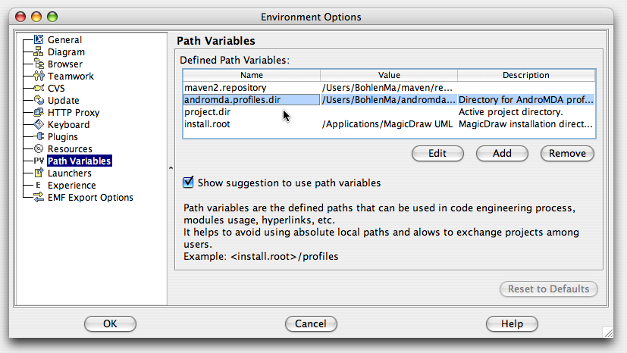
Prepare to open the model
andromdapp:generate has created an empty model in mda/src/main/uml
Start MagicDraw
Add a path variable andromda.profiles.dir to your environment options and make it point to the directory where you copied the profiles:

Slide 67
Steps for modeling (1)
Model the business entities
  Associate with stereotype <<Entity>>
Model the business services
  Associate with the stereotype <<Service>>
  Draw dependencies from the service to the entities used by the service

Slide 68
Steps for modeling (2)
Model the use cases
  "Figures and bubbles"
  Create a state diagram for each use case
  Model the necessary states, transitions and activities
Controller classes
  Create one controller class for each state diagram
  Make the state machine the owner of the controller class
  Invoke controller methods via activities
    from a state or a transition inside the state machine

Slide 69
Steps for modeling (3)
Result
  Business Tier
    Entities and services
  Web Tier
    State machines and controller classes
  Now, connect both tiers!
  Draw a dependency from the controller class to one or more service classes
    this creates a getter in the controller class that returns a reference to the service interface

Slide 70
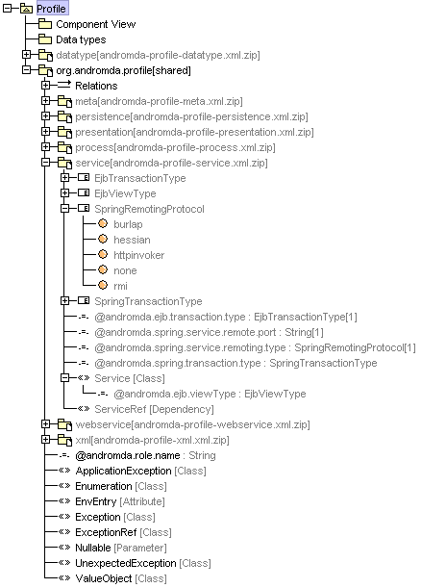
Contents of the UML profile
predefined UML library
  data types
  (language independent)
  Tagged Values
  and their types
  Stereotypes
  Tagged Values associated with the correct stereotypes
Comfortable modeling made possible by using OMG standards

Slide 71
MagicDraw module management
A profile is a special case of a module
  you can save any package in your model as a separate file, this is called a module
  link it into the active model
  modules can use each other hierarchically
  create module: File, Export, Module
  use module: File, Use Module
Organize your project
  define modules
  check them into the
  version control system
  use them in your team
model
module
module
module
module
module

Slide 72
Infrastructure
Application server JBoss
  two important folders on disk after installation
    bin
      contains run and shutdown
    server/default/deploy
      deploy the components (*.ear) of your application there (mvn install -Ddeploy)
      configure the database connection (e.g. hsqldb-ds.xml)
Database
  JBoss uses an in-memory database HSQLDB
  edit hsqldb-ds.xml, so that the database is accessible via TCP on port 1701
  makes it easier to see the database contents from within Eclipse

Slide 73
OK, let's go!
Assign tasks to the team members
Let's develop and test OnlineAuctions together!
Have fun!
To be continued: Boot camp part 2!

Slide 74

Questions?
Go ahead!
Matthias Bohlen <mbohlen@andromda.com>
Phone: +49 (170) 772 8545

