Slide 1
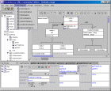

CASE tool
(Poseidon, Rose, Together)
AndroMDA
Software components
<xmi>
</xmi>
UML Model
Templates

