Slide 1
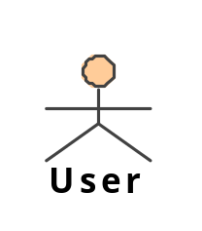
starts one of these
Ant
Maven
IDE
models
(as files or by API)
invokes
error messages
(by API)
modeling tool
AndroMDA
refactoring commands
(by API)
code (as files)
can run inside or
outside the IDE
refactoring engine

