Slide 1
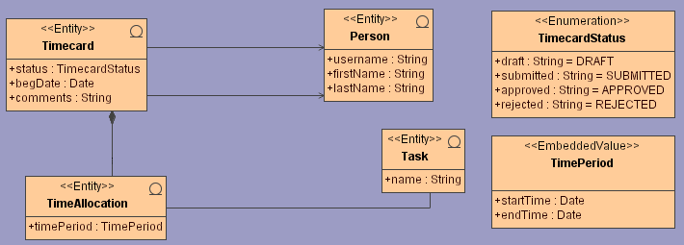

UML Model
AndroMDA
Model Parser
Other Cartridges…
Java Cartridge
Hibernate Cartridge
Other Cartridges…

