Slide 1
Extending the XML and JSP editors _x000b_from the WTP Project
David Williams
IBM Rational Software
david_williams@us.ibm.com
Nitin Dahyabhai
IBM Rational Software
nitind@us.ibm.com
Amy Wu
IBM Rational Software
amywu@us.ibm.com

Slide 2
Agenda and Topics to Cover
Introductions
Improving the Editing Experience
Architecture of Structured Source Editing (SSE) Models
Tools, JUnit tests, and Debugging Tips
Examples and Exercises
Questions and your code

Slide 3
Other WTP Events
Long Talks
Consuming and Producing Web Services with WST and JST
(Tues. 10:45)
Developing Data Tools with the DTP SQL Models and Parsers
(Tues. 10:45)
EJB 3.0 Persistence and the Dali EJB ORM Project (Tues. 2:15)
What’s New in Web Tools 1.0 and 1.5 (Thurs. 9:45)
Using and Extending the Eclipse Web Tools Platform (WTP)
(Thurs. 10:45)
Build JavaServer™ Faces Applications with the JSF Tools Project
(Thurs. 2:15)
Short Talks
Managing APIs with the Eclipse API Scanner (Wed. 4:33)
The AJAX Toolkit Framework (Wed. 4:51)
Authoring in Eclipse (Thurs. 1:27)
Eclipse and Apache Derby (Thurs. 1:36)
What’s new in WTP? Find out at the WTP project sprint!
Mon. 6:30-8:30pm, room 203

Slide 4

Project Antoine
Help improve the Eclipse WTP user experience!
What is this study about?
  UBC and IBM are conducting a usage study to improve the organization of commands and functions in Eclipse based projects.
How can you take part?
  Simply install the study plug-in and use Eclipse WTP for your daily work.
For more information, or to sign up, please visit:
http://www.cs.ubc.ca/~lkf/antoine

Slide 5
Introductions
Our Components and their extensive documentation
  General Introduction to SSE Editors
  SSE
  XML
  JSP
  HTML
  CSS
  JavaScript
  DTD

Slide 6
Architecture – high level
Purpose of SSE is intended to be a thin layer on top of Eclipse text infrastructure
  Aides some things
  Some things just different (or better?!)
  Especially for “mark up” type languages
  Especially for “mixed content”
WTP Components
Editing (with Models) Related Components

Slide 7
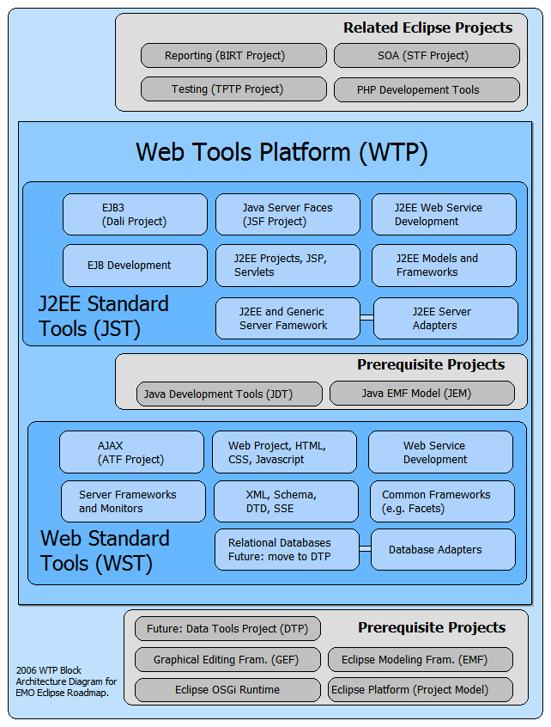
WTP Components

Slide 8
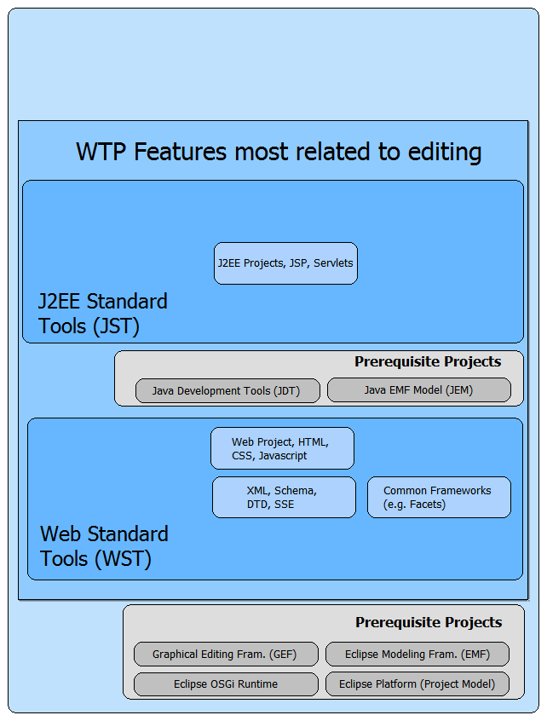
Editing (with Models)

Slide 9
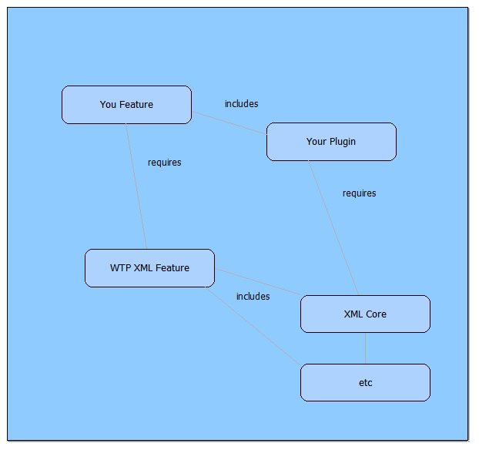
How to Extend – use feature dependencies

Slide 10
The Data and Architecture of Structured Source Editing (SSE) Models
Content Types
Partition Types
Structured Documents
  Structured Document Events
  Structured Document Regions
Structured Models (mostly DOM models)
  Model Manager
  Adapters and notifications

Slide 11
Eclipse Content Types
Eclipse base documentation: A central content type catalog for Eclipse
Beyond (above) file type via file extensions
  User settable “family” of file types
  Can be influenced by actual contents of file
Determines “encoding rules”
Can associate editors, validators, etc.
Its common to define your own contentType, say for a specialized form of XML, based on some specific DTD, and then that can be associated with your editor
See TestContentDescription in JUnit tests for examples of determining contentType of a resource

Slide 12
Structured Models
See TestModelManager JUnit test for some “getting started” examples.
StructuredModelManager.getModelManager();
The model is “shared” : getModel… may create a new one, may return one someone else is also using
“for Read” vs. “for Edit” – ‘edit’ means you are interested in saving results.
Always use try { get } finally {release}
Model.getDocument() gives DOM
For thread control, use model.aboutToChange() and model.changed(); to bracket more than one modifiication

Slide 13
Changing the Document by Changing the DOM
Use Standard DOM APIs (if and when possible)
Some differences:
  We maintain existing EOL (XML Spec says to convert all, even CRLF, to LF)
  We preserve whitespace, So, many ask “why so many Nodes?”
  We “mis-use” PI for XMLDecl
  Exercise: how many Nodes can you find in this code:
<?xml version="1.0" encoding="UTF-8"?>
<site>
<description url="index.html">
This Callisto Update Site contains the M5a level of feature and
plug-in for a number of Eclipse based projects.
</description>
</site>

Slide 14
Improving the Editing Experience
Without extending the editor!
  ContentModels: DOCTYPE, DTDs, Schema, Custom Tag Libraries
  XML Catalog
Custom editors are no substitute for well designed documents (and languages) – with their legal content well defined
In general, “extending” SSE Editors means using extension points, not subclassing – this is done to allow future growth and changes without breakage

Slide 15
Improving the Editing Experience – transition slide
Using standard Eclipse APIs
  Selections
  Actions, menus,
Using WTP Editing APIs
  Source Viewer Configurations
  multiple pages
  Outlines
  Snippets View
  Validation
Tools and Debugging hints
Hands On Exercises and Problems

Slide 16
General Selection in Text Editors
Workbench ISelectionService tracks selection in parts and forwards events to its listeners (like views)
ISelectionService tracks selection in Text editors by listening their ISelectionProvider
All text editors have ISelectionProvider
ISelectionProvider
  getSelection
  setSelection
  add/removeSelectionChangedListener
Notes:
All text editors have an ISelectionProvider which is in charge of handling selection events and such.

Slide 17
Selection in Structured Text Editors
StructuredTextEditor's ISelectionProvider returns an ISelection combination of:
  ITextSelection
  IStructuredSelection
(ITextSelection)ISelection - current text selection (used in ITextEditors)
(IStructuredSelection)ISelection - selected IndexedRegions for the current text selection.
Notes:
Casting ISelection to ITextSelection gives you the current text selection (used in ITextEditor)
Casting ISelection to IStructuredSelection gives you the selected IndexedNodes for the current text selection.

Slide 18
Handling Selection in Structured Text Editors
Make sure elements in IStructuredSelection are of type you want!!
If you can handle both types of selection, make sure you check both types
Don’t:
  if (selection instanceof IStructuredSelection)
    do this to get info i need
  else if (selection instanceof ITextSelection)
    do that to get info i need
Do:
  if (selection instanceof IStructuredSelection)
    do this to get info i need
  if (i don’t have info yet && selection instanceof ITextSelection)
    do that to get info i need
Notes:
Currently any selection within Structured Text editors will give you an ITextSelection & IStructuredSelection that contains selected IndexedNodes. Nothing more! Some platform actions expect IStructuredSelection to contain IResources, which it doesn’t. So make sure you are getting the selection elements you want before giving up.

Slide 19
Synchronizing Selection from Editor to View
Register as listener of ISelectionService
Pages in a PageBookView
  Check visibility before handling selection changed notification
  PageBook will ensure that the page is only visible when the correct workbench part is active.
Notes:
View should register itself as a listener of the ISelectionService Then view will automatically receive notification about selection changes and the workbench part that originated them.
Pages in a PageBookView should check their visibility before handling any selection change notifications as they'll receive notification from every workbench part.

Slide 20
Synchronizing Selection Within a Multi-Page Editor
Main multi-page editor class must synchronize the selection between its pages by itself.
Example:
  XML Source page & XML Design page both have selection provider and sends out selection notification. XMLMultiPageEditorPart synchronizes them and relies on the source viewer to notify the selection service.

Slide 21
Avoiding Selection Notification Loops
Setting selection into a viewer causes it to also fire selection notifications
If 2 viewers are synchronizing selection, they might end up looping endlessly notifying each other when selection is applied to their Controls
The selection objects themselves will be different as each viewer will be generating a fresh selection event and selection from the underlying Control
Recommended solution: make sure that a part never updates its selection from outside notification when it is the active part, nor when it is sending selection (or post selection) notification itself.

Slide 22
Additional Information on Selection in StructuredTextEditor
Design Document:
  http://www.eclipse.org/webtools/wst/components/sse/designs/EditorSelection.html

Slide 23
Contributing Actions to Editors in General
Eclipse platform framework already provides extension points to contribute actions
  org.eclipse.ui.editorActions - contribute actions to editor menu bar and toolbar
  org.eclipse.ui.popupMenus - contribute actions to context menu

Slide 24
editorActions
Need to specify "targetID" where your action will be placed
targetID is the editor id of the editor you are contributing your action to.
Structured Text editors' editor ids are generated in the following format:
  [content type].[editor type keyword]

Slide 25
Possible Content Types/Editor Types
Possible content types:
  org.eclipse.core.runtime.xml
  org.eclipse.wst.html.core.htmlsource
  org.eclipse.jst.jsp.core.jspsource
  org.eclipse.wst.css.core.csssource
  org.eclipse.wst.dtd.core.dtdsource
  org.eclipse.wst.javascript.core.javascriptsource
Possible editor types:
  source - source page editor

Slide 26
editorActions Examples and Exceptions
Exception:
  targetID="org.eclipse.wst.xml.ui.internal.tabletree.XMLMultiPageEditorPart" - contributes an action to the XML editor (this id may change in the future)
Examples:
  targetID="org.eclipse.jst.jsp.core.jspsource.source" - contributes an action to the JSP editor
  targetID="org.eclipse.wst.css.core.csssource.source" - contributes an action to the CSS editor

Slide 27
popupMenus
Need to specify a "targetID" where your action will be placed
targetID is the context menu id of the editor you are contributing your action to
Structured Text editors have some targetID's already set up in various popup menus for clients to use
Structured Text editors' popup menu ids are generated in the following format:
  [content type].[editor type keyword].[place to contribute keyword]

Slide 28
Possible Content Types/Editor Types
Possible content types:
  org.eclipse.core.runtime.xml
  org.eclipse.wst.html.core.htmlsource
  org.eclipse.jst.jsp.core.jspsource
  org.eclipse.wst.css.core.csssource
  org.eclipse.wst.dtd.core.dtdsource
  org.eclipse.wst.javascript.core.javascriptsource
Possible editor types:
  source - source page editor

Slide 29
Possible Places to Contribute
Possible places to contribute:
  EditorContext - editor popup menu
  RulerContext - editor vertical ruler popup menu
  OutlineContext - outline view popup menu

Slide 30
popupMenus Examples
Contribute action to the editor context menu of the XML editor
  targetID="org.eclipse.core.runtime.xml.source.EditorContext“
Contribute action to the outline view's context menu for the XML editor
  targetID="org.eclipse.core.runtime.xml.source.OutlineContext“
Contribute action to the editor context menu of the JSP editor
  targetID="org.eclipse.jst.jsp.core.jspsource.source.EditorContext“
Contribute action to the vertical ruler context menu of the JSP editor
  targetID="org.eclipse.jst.jsp.core.jspsource.source.RulerContext“

Slide 31
Additional Information on Actions in Editors
Eclipse Article:
  http://www.eclipse.org/articles/Article-action-contribution/Contributing%20Actions%20to%20the%20Eclipse%20Workbench.html
Help Documentation:
  org.eclipse.ui.editorActions extension point schema
  org.eclipse.ui.popupMenus extension point schema

Slide 32
Structured Text Viewer Configuration
Customizes various aspects of the Structured text editor including:
  content assist
  hyperlink navigation
  autoedit
  syntax highlighting
  many more!
Check out org.eclipse.wst.sse.ui.StructuredTextViewerConfiguration & other classes in its hierarchy for more information on what you can customize

Slide 33
Creating a Structured Text Viewer Configuration
Must subclass org.eclipse.wst.sse.ui.StructuredTextViewerConfiguration
You can utilize existing configurations:
  subclass existing configuration to build on top of it
  create new instance of existing configuration and call methods within it

Slide 34
Examples of Utilizing Existing Configurations
StructuredTextViewerConfigurationWSDL subclasses StructuredTextViewerConfigurationXML to add its own WSDLHyperlinkDetector
StructuredTextViewerConfigurationJSP creates new instances of:
  StructuredTextViewerConfigurationHTML
  StructuredTextViewerConfigurationXML
  JavaSourceViewerConfiguration
And retrieves their processors to be reused in JSP content.

Slide 35
Existing Structured Text Viewer Configurations
org.eclipse.wst.xml.ui.StructuredTextViewerConfigurationXML
org.eclipse.wst.html.ui.StructuredTextViewerConfigurationHTML
org.eclipse.jst.jsp.ui.StructuredTextViewerConfigurationJSP
org.eclipse.wst.css.ui.StructuredTextViewerConfigurationCSS
org.eclipse.wst.dtd.ui.StructuredTextViewerConfigurationDTD

Slide 36
EditorConfiguration
Provide your own source viewer configuration via extension point: org.eclipse.wst.sse.ui.editorConfiguration
Just need to specify:
  Your implementation of StructuredTextViewerConfiguration
  Content type associated with your configuration

Slide 37
EditorConfiguration Configuration Markup
<!ELEMENT extension (sourceViewerConfiguration* , contentOutlineConfiguration* , propertySheetConfiguration* , provisionalConfiguration* , provisionalDefinition*)>
  <!ATTLIST extension
    point CDATA #REQUIRED
    id CDATA #IMPLIED
    name CDATA #IMPLIED>
<!ELEMENT sourceViewerConfiguration EMPTY>
  <!ATTLIST sourceViewerConfiguration
    target CDATA #REQUIRED
    class CDATA #REQUIRED>
Defines the source viewer configuration, affecting syntax highlighting, content assist, hover help, and more in the current editor.
target - A string defining when to use this extension, either an editor or content type id. Multiple targets may be given as a comma delimited value.
class - Must subclass org.eclipse.wst.sse.ui.StructuredTextViewerConfiguration

Slide 38
Example of EditorConfiguration
<extension point="org.eclipse.wst.sse.ui.editorConfiguration">
  <sourceViewerConfiguration
    class="org.eclipse.wst.html.ui.StructuredTextViewerConfigurationHTML“
    target="org.eclipse.wst.html.core.htmlsource"/>
</extension>

Slide 39
Additional Information on Source Viewer Configuration
Design Document:
  http://www.eclipse.org/webtools/wst/components/sse/designs/EditorConfiguration.html
Help Documentation:
  org.eclipse.wst.sse.ui.editorConfiguration extension point schema
JavaDoc:
  org.eclipse.jface.text.source.SourceViewerConfiguration
    All its subclasses
  org.eclipse.wst.sse.ui.StructuredTextViewerConfiguration
    All its subclasses

Slide 40
Improving the Editing Experience – transition slide
Using standard Eclipse APIs
  Selections
  Actions, menus,
Using WTP Editing APIs
  Source Viewer Configurations
  multiple pages
  Outlines
  Snippets View
  Validation
Tools and Debugging hints
Hands On Exercises and Problems

Slide 41
Support for JSP Custom Tag Libraries
  Near-transparent discovery of tag library descriptors (TLDs)
    org.eclipse.jst.jsp.core.taglib API package
  Follows JSP 1.2 specification as closely as possible
    Loose .tld file support
    Loose .jar support
    Automatically discovered URI values inside of JARs (when on Build Path)
    web.xml mappings
    Server-specific “well-known” tag libraries*
  *New for WTP 1.5

Slide 42
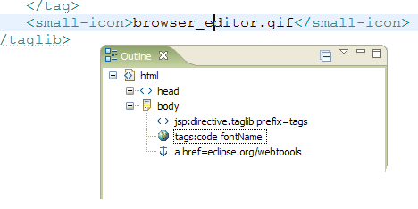
Support for JSP Custom Tag Libraries
  Elements, attributes, and Java variables and functions are validated and offered through Content Assist and in the Property Sheet
  TLD documentation is shown within editor
  Tag library icons are used throughout UI

Slide 43
Support for JSP Custom Tag Libraries
  .tag/.tagx file support to be added when time permits (contributions welcomed)
  Provisional support for extended function according to partition types based on custom tags with tagdependent body content

Slide 44
Improving the Editing Experience using standard Eclipse APIs
“Buy-in” with as little or as much as you need
Start out simple – StructuredTextEditor is a text editor after all
  Regular editor input types are supported
  External files supported
  Syntax coloring often Just Works

Slide 45
Improving the Editing Experience using WTP APIs
But wait, there’s more!
  Built-in Drag and Drop
  Content Outlines
  Property Sheets
  As-you-type validation
  Designed to work well in multi-page editors

Slide 46
Improving the Editing Experience using WTP APIs
Outline view customizable using editor configuration
  Extension point: org.eclipse.wst.sse.ui.editorConfiguration
Must subclass org.eclipse.wst.sse.ui.views.contentoutline.ContentOutlineConfiguration
  Custom tree items and labels
  New pull-down menu contributions and context menus
  New toolbar contributions
  Key handling

Slide 47
Improving the Editing Experience using WTP APIs
Property Sheet customizable using editor configuration
  Extension point: org.eclipse.wst.sse.ui.editorConfiguration
Must subclass org.eclipse.wst.sse.ui.views.properties.PropertySheetConfiguration
  New toolbar contributions
  Custom IPropertySource
Tabbed Property Pages
  Currently requires subclassing StructuredTextEditor

Slide 48
Improving the Editing Experience using WTP APIs
In-editor validation (org.eclipse.wst.sse.ui.sourcevalidation)
  Validates as-you-type, in the background
  Reuses Validation APIs
  Implement IValidator to validate entire contents of file, associating the validator to specific content-types and partition types
  Implement ISourceValidator from org.eclipse.wst.sse.ui to (re)validate specific IRegions as the content is edited
See http://www.eclipse.org/webtools/wst/components/sse/tutorials/source-validation.html for more information.

Slide 49
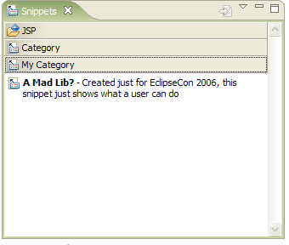
Improving the Editing Experience using WTP APIs
The Snippets View
The Snippets view shows a palette of reusable text snippets that can be dragged and dropped into SSE editors.

Slide 50
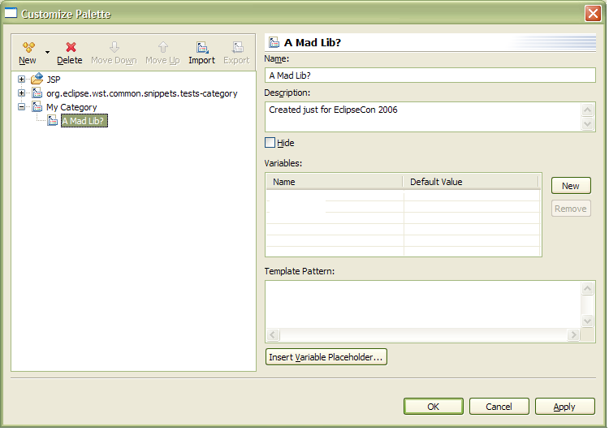
Improving the Editing Experience using WTP APIs
The Snippets View
Users can create and organize their own snippets using the Customize dialog, or just copying and pasting text into the view
Variables can be created in the snippet for the user to fill in when the snippet is dropped into an editor

Slide 51
Improving the Editing Experience using WTP APIs
The Snippets View
Drawers and snippets can be automatically shown and hidden based on the active editor’s content type
Plug-in developers can do all of this and more:
  Tailored dialog when dropped
  Custom behavior when double-clicked

Slide 52
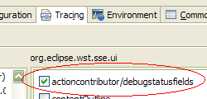

Tools and Debugging Tips – Editor Information Dialog
Presents read-only information about the editor and its contents.
Enable org.eclipse.wst.sse.ui/actioncontributor/debugstatusfields trace option in Eclipse Application Launch configuration.
Double-click on bracketed selection range in status bar while editor is open.

Slide 53
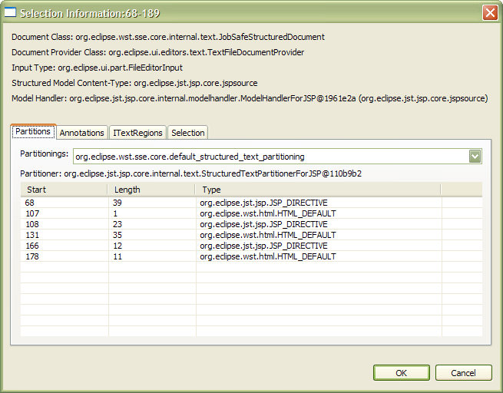
Tools and Debugging Tips – Editor Information Dialog
Text Selection information
IDocument and IDocumentProvider implementations in use
IEditorInput class
Content-Type reported by IStructuredModel
Partitions according to each partitioning
Annotations and their properties
IStructuredDocumentRegions and ITextRegions structure
Structured Selection contents
Adapters for INodeNotifiers

Slide 54
Exercises
Theme: Improve the users’ experience for editing TLDs
How to proceed: Start with each problem description and “try to do it” before reading/copying the code
Overview
  Add content type
  Add action
  Add hyperlink support
  Provide a custom outline view
If we have time left over, feel free to ask about or show your “real world” examples

Slide 55
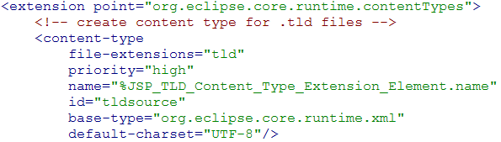
Exercise: Improve Outline view display for TLDs
  Create a new TLD content type extending the XML content type

Slide 56
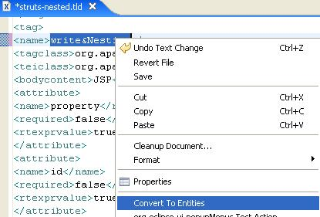
Exercise: Add Convert to Entities Action (problem)
Add an action to TLD editor’s context menu that converts special characters in selected text to their entities
  Only convert selected text if selected text is between tags (selected text is in a text node)

Slide 57
Exercise: Add Convert to Entities Action (solution)
Create new action delegate (IEditorActionDelegate)
In run() get selection from text editor’s ISelectionProvider
Check if selection includes an IStructuredSelection that contains 1 IDOMText node. If so, and if selection also includes ITextSelection, convert the ITextSelection region text.
Associate action delegate to TLD editor’s context menu

Slide 58
Exercise: Add Convert to Entities Action (solution)
Checking selection:
ISelection selection = textEditor.getSelectionProvider().getSelection();
// try to go through structured selection and find indexed nodes
if (selection instanceof IStructuredSelection) {
IStructuredSelection structSelection = (IStructuredSelection) selection;
List nodes = new ArrayList();
Iterator iter = structSelection.iterator();
while (iter.hasNext()) {
Object o = iter.next();
if (o instanceof IndexedRegion) {
nodes.add(o);
}
}
// if only 1 node was selected, check if it was a text node
if ((nodes.size() == 1) && (nodes.get(0) instanceof IDOMText)) {
if (selection instanceof ITextSelection) {
convertTextSelection((ITextSelection) selection);
}
}
}

Slide 59
Exercise: Add Convert to Entities Action (solution)
Associate action delegate to TLD editor’s context menu:
<extension point="org.eclipse.ui.popupMenus">
  <viewerContribution
    targetID="org.eclipse.jst.jsp.core.tldsource.source.EditorContext"
    id="org.eclipse.jst.jsp.examples.tld.context.actions">
    <action
      label="Convert To Entities"
class="org.eclipse.jst.jsp.examples.tld.ui.internal.ConvertToEntitiesActionDelegate"
      menubarPath="additions"
id="org.eclipse.jst.jsp.examples.tld.ui.internal.ConvertToEntitiesActionDelegate">
    </action>
  </viewerContribution>
</extension>

Slide 60
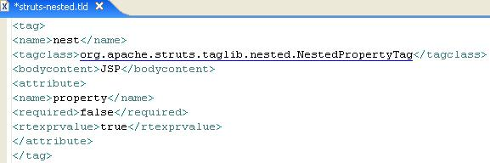
Exercise: Adding Class Hyperlinking in TLD Editor (problem)
Include existing features in XML Editor but add hyperlinking for class references in TLD

Slide 61
Exercise: Adding Class Hyperlinking in TLD Editor
Solution:
  Create your own hyperlinkDetector
  Subclass StructuredTextViewerConfigurationXML
  Override getHyperlinkDetectors and add your hyperlinkDetector
  Use editorConfiguration extension point to associate your viewer configuration to TLD content type

Slide 62
Exercise: Adding Class Hyperlinking in TLD Editor (solution)
Subclass StructuredTextViewerConfigurationXML & Override getHyperlinkDetectors to add your hyperlinkDetector
public IHyperlinkDetector[] getHyperlinkDetectors(ISourceViewer sourceViewer) {
  if (sourceViewer == null || !fPreferenceStore.getBoolean(AbstractDecoratedTextEditorPreferenceConstants.EDITOR_HYPERLINKS_ENABLED))
    return null;
  List allDetectors = new ArrayList(0);
  allDetectors.add(new TLDHyperlinkDetector()); // add own hyperlink detector
  IHyperlinkDetector[] superDetectors = super.getHyperlinkDetectors(sourceViewer);
  for (int m = 0; m < superDetectors.length; m++) {
    IHyperlinkDetector detector = superDetectors[m];
    if (!allDetectors.contains(detector)) {
      allDetectors.add(detector);
    }
  }
  return (IHyperlinkDetector[]) allDetectors.toArray(new IHyperlinkDetector[0]);
}

Slide 63
Exercise: Adding Class Hyperlinking in TLD Editor (solution)
Use editorConfiguration extension point to associate your viewer configuration to TLD content type
<extension point="org.eclipse.wst.sse.ui.editorConfiguration">
<sourceViewerConfiguration
target = "org.eclipse.jst.jsp.core.tldsource"
class = "org.eclipse.jst.jsp.examples.tld.ui.internal.StructuredTextViewerConfigurationTLD"/>
</extension>

Slide 64
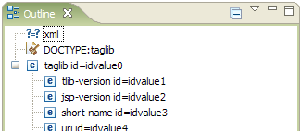
Exercise: Improve Outline view display for TLDs
Problem: Outline view isn’t very useful with a .tld file
  Default XML Outline shows element names and optionally a single attribute and value.
  Tags in a .tld file don’t make use of attributes. The interesting values are located as text in between the start and end tags. No Text nodes are ever shown in the default XML Outline.

Slide 65
Exercise: Improve Outline view display for TLDs
Solution:
  Create a TLD Outline Configuration displaying element values with tag names.

Slide 66
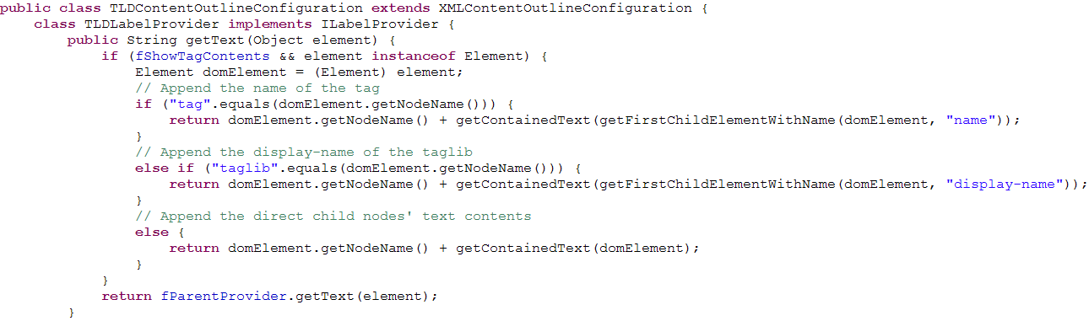
Exercise: Improve Outline view display for TLDs
Solution: Create a TLD Outline Configuration
  Extend the XMLContentOutlineConfiguration class from the org.eclipse.wst.xml.ui plug-in.
  Return a different ILabelProvider, wrapping the original, with a new getText(Object) method

Slide 67
Exercise: Improve Outline view display for TLDs
Solution: Create a TLD Outline Configuration
  Create a new TLD content type extending the XML content type

Slide 68

Exercise: Improve Outline view display for TLDs
Solution: Create a TLD Outline Configuration
  Associate the new configuration class to the TLD content type

Slide 69
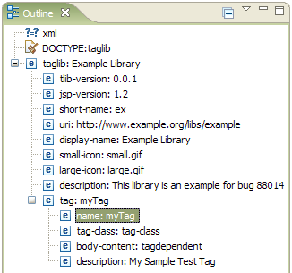
Exercise: Improve Outline view display for TLDs
Solution: Create a TLD Outline Configuration
  New Outline is displayed when users open a .tld file

