Slide 1
Telco Customer Churn Analysis
ABC Communications Ltd – Week 1 Business Case Study
Prepared by: Precious Mojolaoluwa OJO
Data Analytics Intern, AnalystLab Africa.

Slide 2
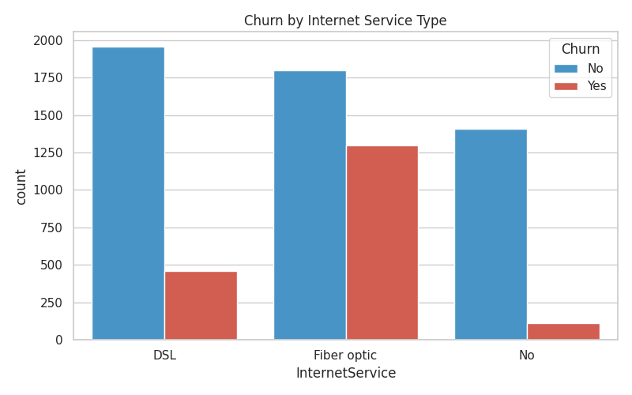
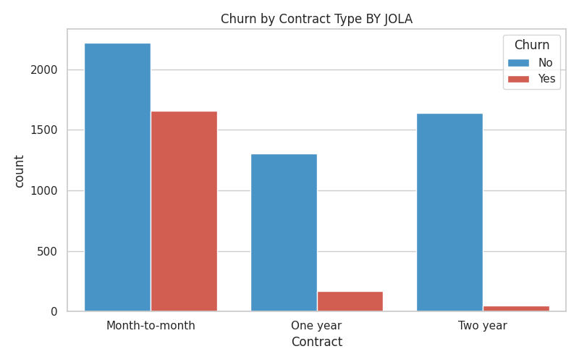
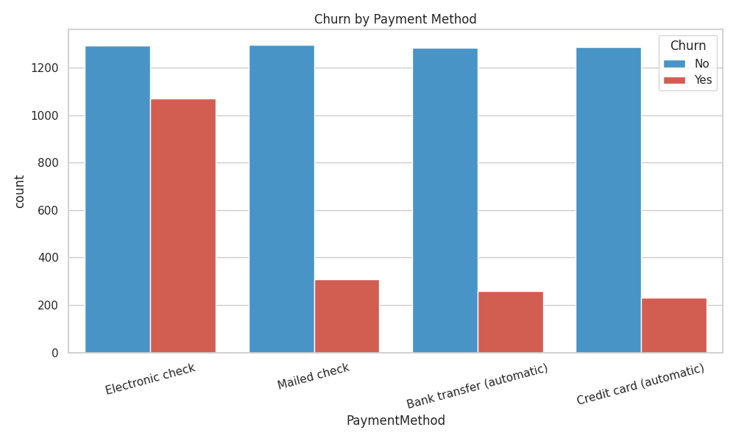
Customer Base Overview
Month-to-month contracts have the highest churn
Fiber optic customers churn more than DSL customers
Electronic check users leave more often than other payment methods

Slide 3
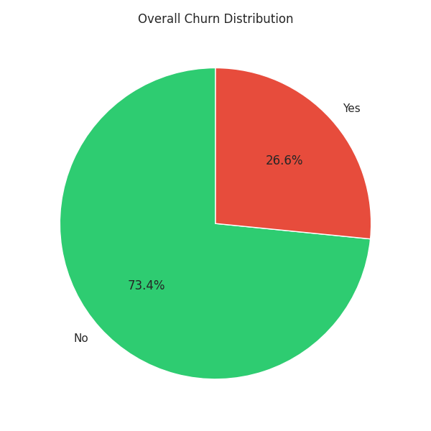
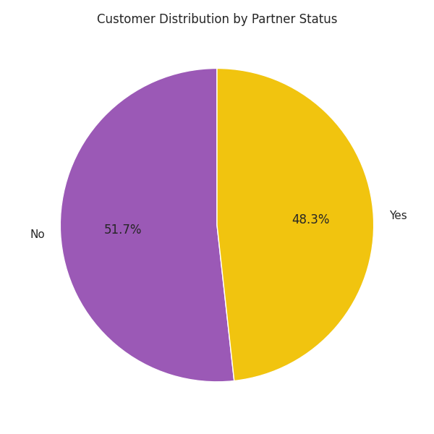
Customer Base Overview
About 26.5% of customers churned (1 in 4)
Gender split is almost 50/50
Churn is driven by service & contract type, not demographics

Slide 4
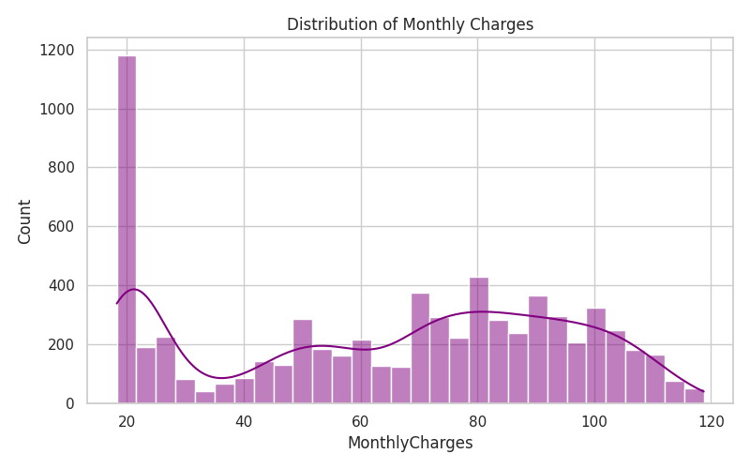
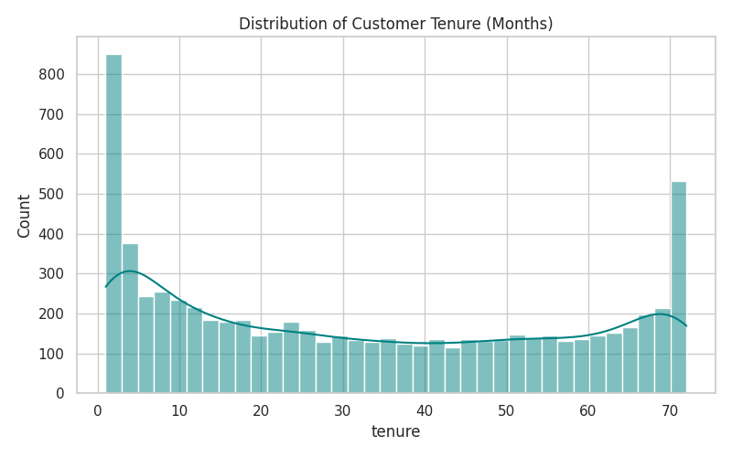
Tenure & Monthly Charges Distribution
Many customers leave within the first 0–10 months
Charges cluster at ~$20 (low) and ~$70–100 (high)
New, high-paying customers are the highest-risk group

Slide 5
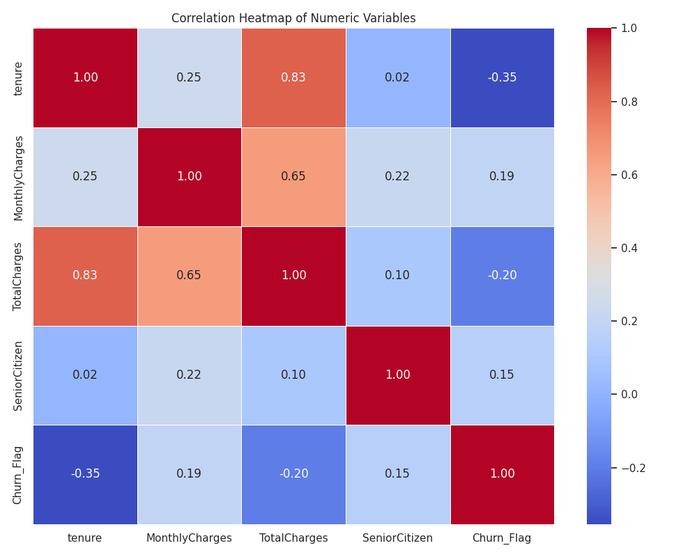
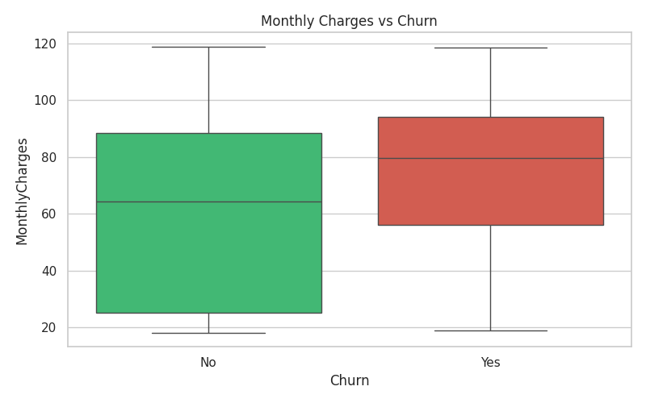
Correlations & Charges vs Churn
Tenure and Total Charges are strongly positively correlated
Churned customers pay higher monthly charges (box plot)
Longer tenure = lower churn risk

Slide 6
Recommendations for Management
Offer discounts to upgrade month-to-month users to 1–2 year contracts
Improve fiber optic service quality & pricing
Encourage automatic payment instead of electronic checks
Add a "first 6 months" onboarding/support program for new customers

